Slide 1
Budget Setup
Budget Setup is where we setup yearly budget per project, branch and department.

Slide 2
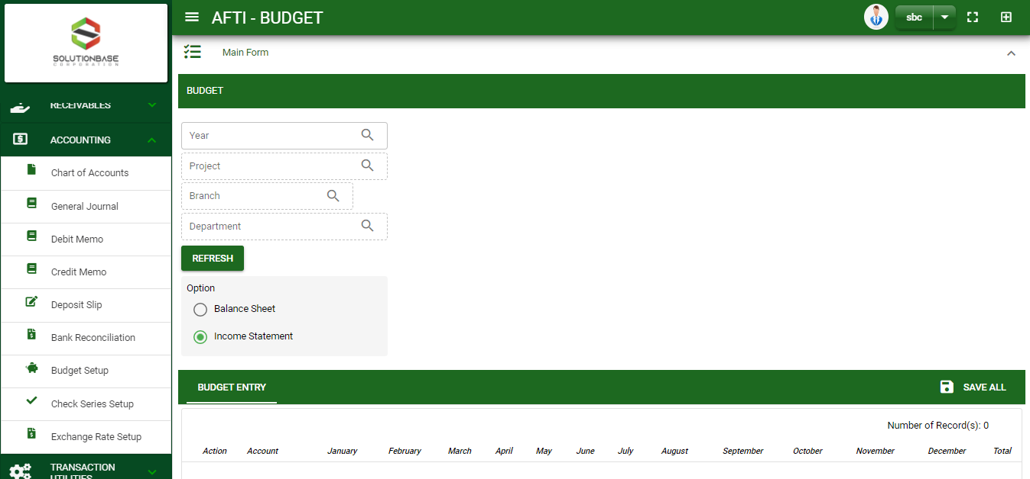

Accounting /Budget Setup- Module
Main Window
When you click the Budget Setup module under Accounting, Budget Setup main form will display
Budget Setup – Main Window
2

Slide 3
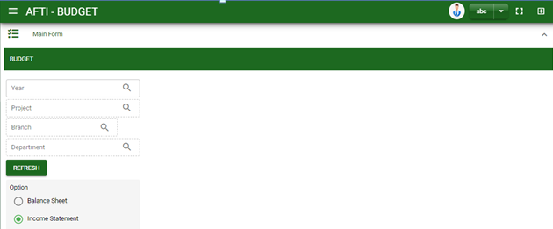
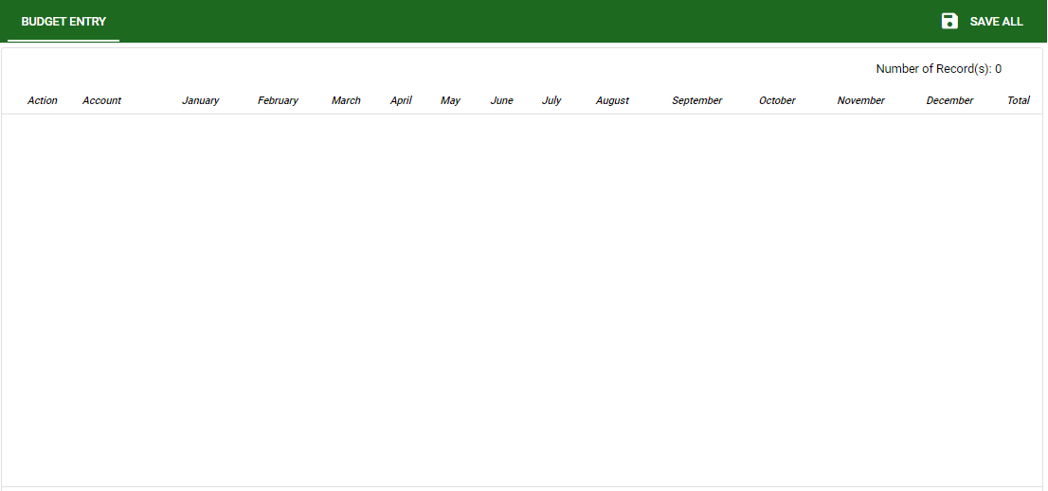
Accounting /Budget Setup- Module
How To Setup a Yearly Budget?
1. In Budget setup – main form fill in the necessary fields.
2. Select from the option.
3. Click refresh button to display the accounts.
4. Select from the option.
5. Click refresh button to display the accounts.
1
2
3
3

