Slide 1
Credit Memo
Credit memo is a module where adjustments to decrease receivables is recorded.

Slide 2
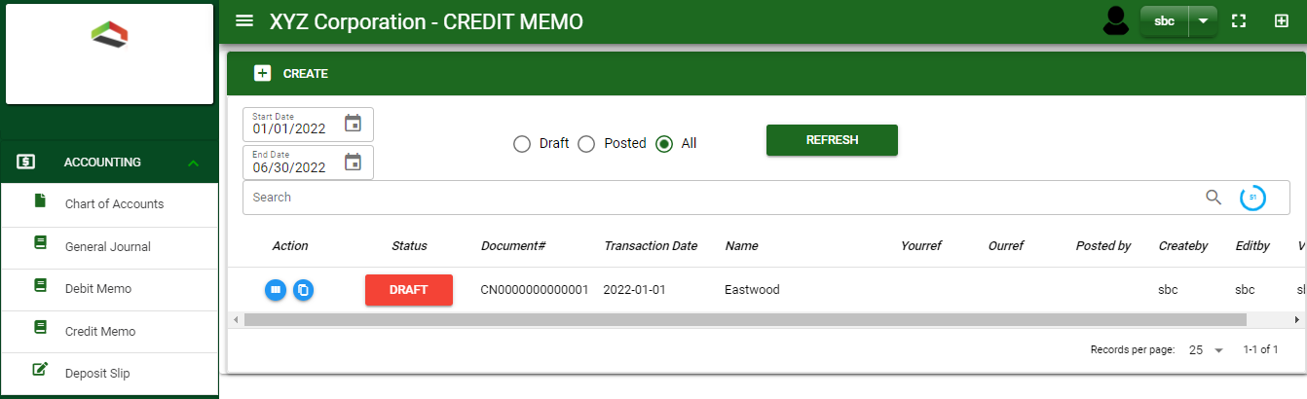

Accounting / Credit Memo- Module
Main Window
When you click the Credit Memo module under Accounting, Credit Memo transactions list will display based on filtered date and status in the credit memo - main window.
Credit Memo – Main Window
2

Slide 3
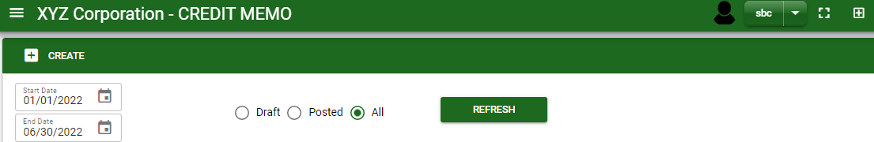
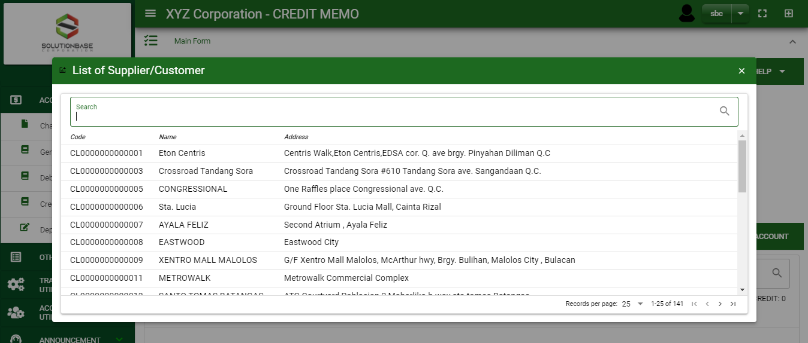
Accounting / Credit Memo- Module
How To Create Credit Notes?
1
1. In Credit Memo – Main Window, you will notice a create button in the upper left of the window. Click the create button and you will be redirect in credit memo – main form.
2. After you click the create button a dialog box will pop out with a list of customer. Search and select a customer.
2
3. After you select a customer, you will be redirect in credit memo – main form where you will encode other necessary information of the transaction and record the adjustment entry
How to search customer?
Type the customer name in the search bar.
And it will automatically sort out.
Then click the selected customer.
3

Slide 4
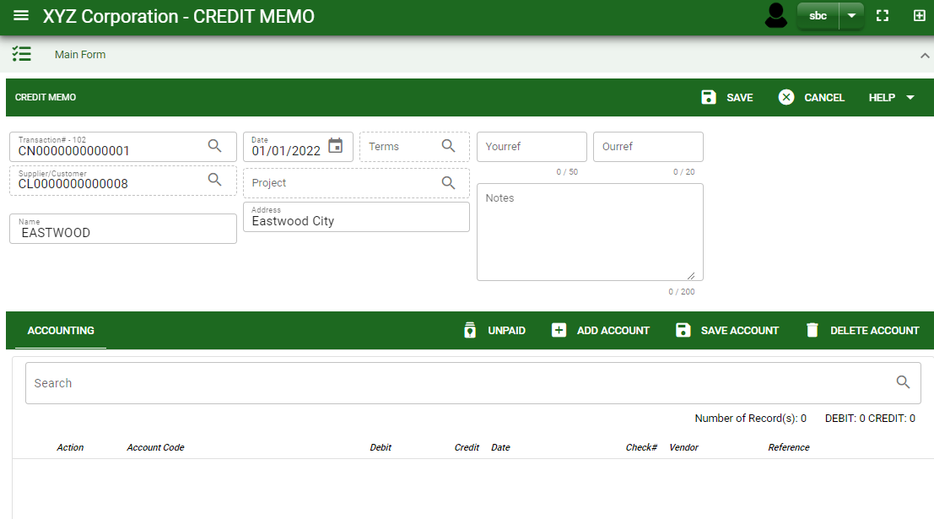
Accounting / Credit Memo- Module
How To Create Credit Notes?
4.1 After you select the customer, current date is plotted automatically but if you wish to change the date – click the date picker and select its respective date.
4.2 In header, add the necessary information if there’s any.
4.3 If done in header, click save button.
Header
4.3
4.1 to 4.2
Detail
5. After saving the header, you may now record the adjusting entry.
6.1 Unpaid : This is where unpaid receivables are floated.
6.1.
5.5
5.6
4

Slide 5
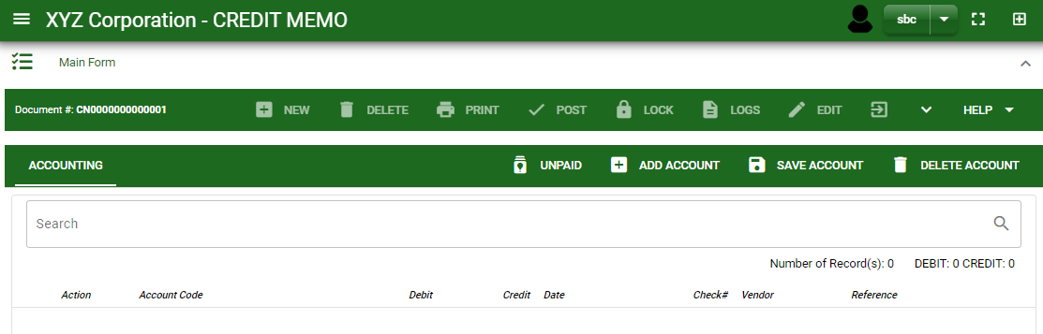
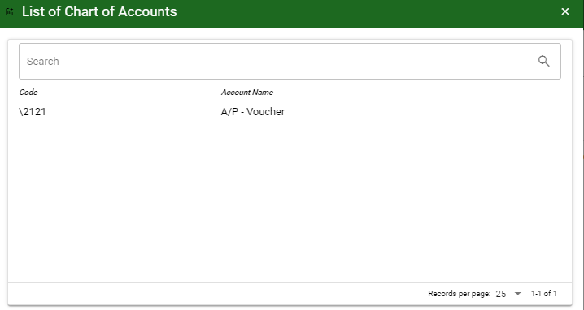
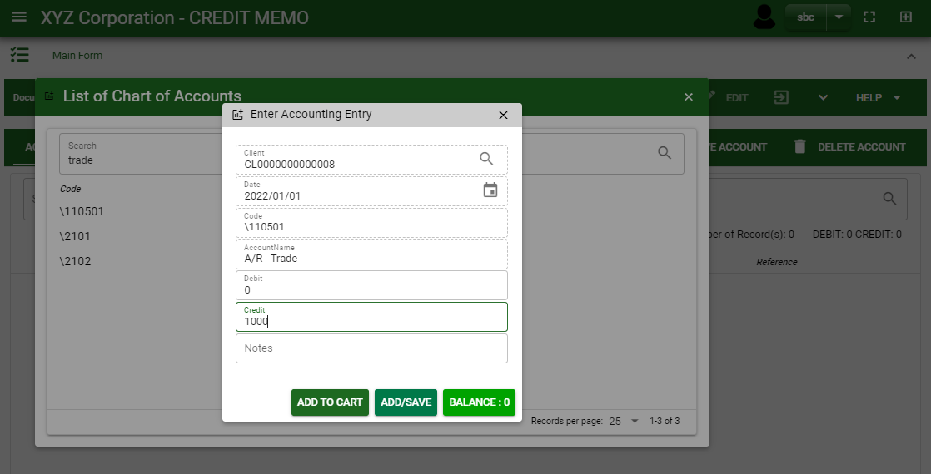
Accounting / Credit Memo- Module
How To Create Credit Notes?
6.2.
How to search an account?
Type the account name in the search bar.
And it will automatically sort out.
Then click the selected account.
6.2 Add Account : Click this to select other account. By clicking add new account, add the necessary details by following the instructions below.
After you select an account, a dialog box will prompt. Enter the details of the account.
1
2.1
3
4
4
2.2

Slide 6
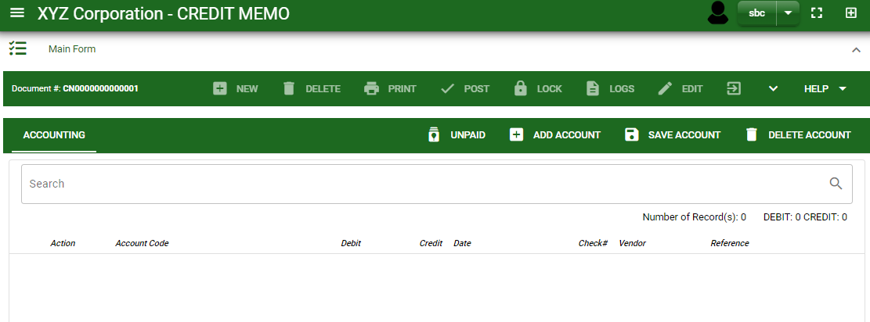
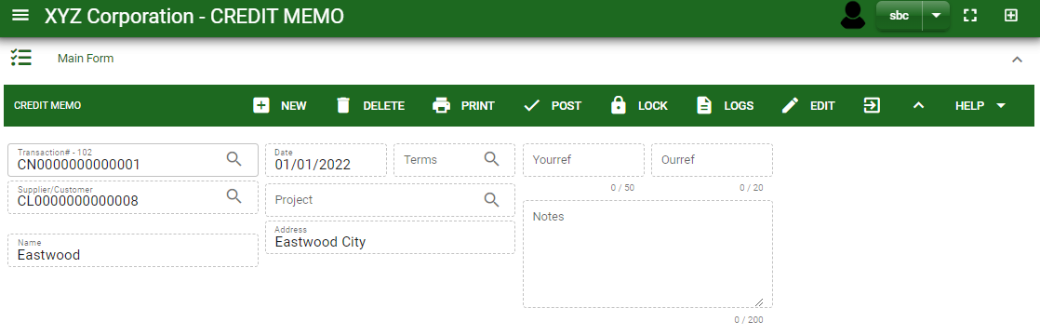
Accounting / Credit Memo- Module
How To Create Credit Notes?
7. If done, click save account button.
8. Click the arrow maximize the header.
9. To finalize, click post button.
8
9

Slide 7
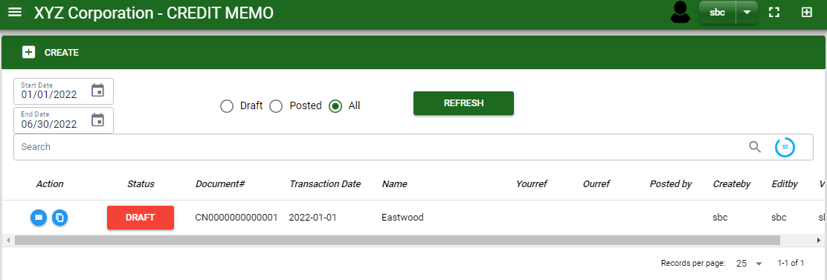
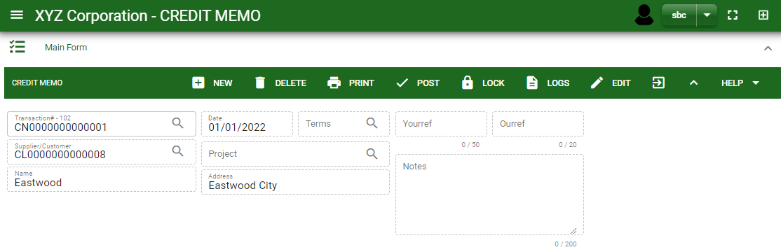
Accounting / Credit Memo- Module
How To Edit Credit Notes?
1.1.
1.1 In the credit memo – main window, search the credit memo you wish to edit its information in the search bar. Or,
1.2 In credit memo – main form, click the lookup button and select the transaction you wish to edit its information by typing its transaction number in the search bar.
Credit Memo – Main Window
2. After you select the credit memo transaction, click edit button and change the information you want to alter.
3. If you are done editing the credit memo header, click save button in the upper side of the header.
HEADER
2.
1.2.
How to search credit memo transaction?
Type the transaction number in the search bar.
Click ‘enter’ in the keyboard to search.
Click to select the transaction you want to edit
Credit Memo – Main Form
7

Slide 8
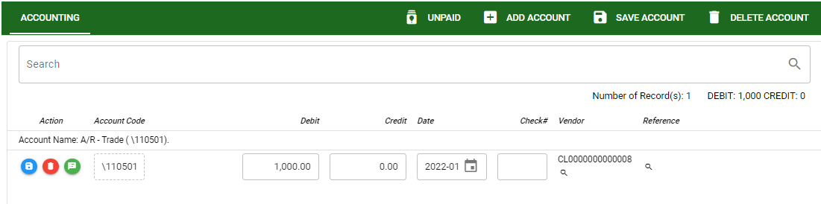

Accounting / Credit Memo- Module
How To Edit Credit Notes?
DETAIL
4. If you want to edit the entry in the detail, edit right away the details you want to change and you will notice that after you change the details, the account you edited will be highlighted into blue.
5. If you’re done editing, click save account button to save the changes you made in the entry.
5
8

Slide 9
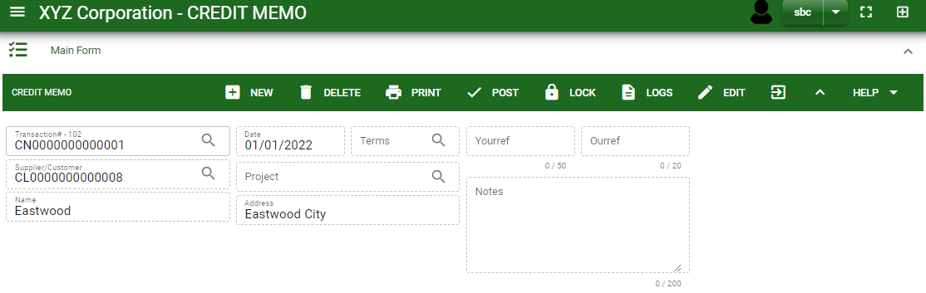
Accounting / Credit Memo- Module
How To Delete Credit Notes?
1.1 In the credit memo – main window, search the entry you wish to edit its information in the search bar. Or,
1.2 In credit memo – main form, click the lookup button and select the transaction you wish to edit its information by typing its transaction number in the search bar.
1.1.
Credit Memo – Main Window
HEADER
2. If done, click delete button.
2.
1.2.
Credit Memo – Main Form
9

Slide 10
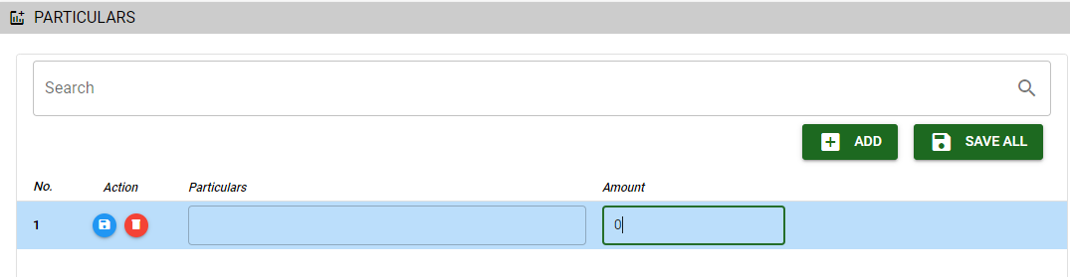

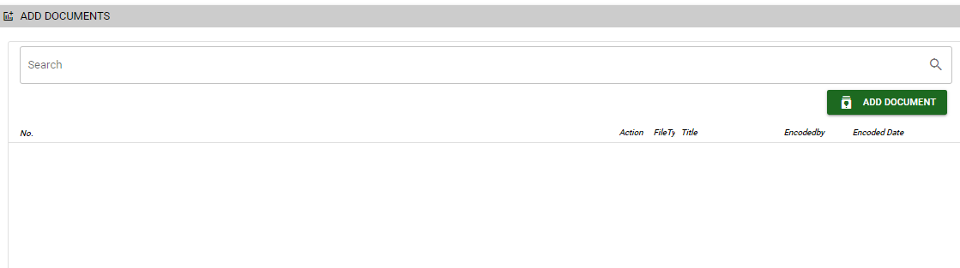
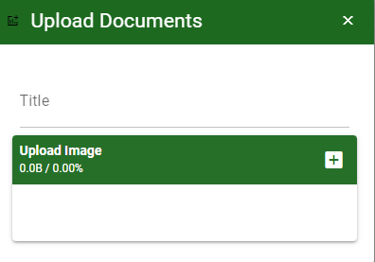
Accounting / Credit Memo- Module
Other Information
Particular Tab
When you click the arrow icon parallel in the main form on the upper right, the credit memo – main form will be minimize and the other tabs will be visible.
Particular tab
Click maximize arrow to view the Particular tab
Provide the necessary details in their fields
2.1. Click Add button to add new row
2.2. Type particular and amount if there’s any
2.3. If done, click save all button
Click save button once done
Attachment tab
1. Click maximize arrow to view the attachment tab
2. Click add document button
3. Once you click the add document button, a dialog box of upload documents will pop out.
4. To upload files, follow ‘how to upload document”
2.1
Attachment Tab
2
How to upload document?
Type the title of the document.
Click add button to add the chosen document to upload
Then click upload button.
If you want to add more document, click add document button and repeat steps 1 to #3
10

Slide 11
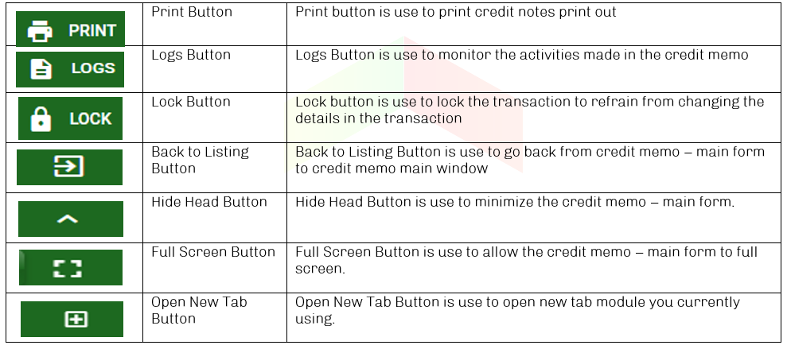
Accounting / Credit Memo- Module
Other Buttons

