Slide 1
Debit Memo
Debit memo is a module where adjustments to increase receivables is recorded.

Slide 2
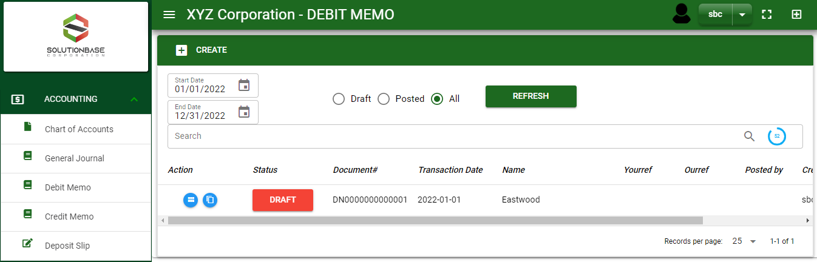

Accounting / Debit Memo- Module
Main Window
When you click the Debit Memo module under Accounting, Debit Memo transactions list will display based on filtered date and status in the debit memo - main window.
Debit Memo – Main Window
2

Slide 3
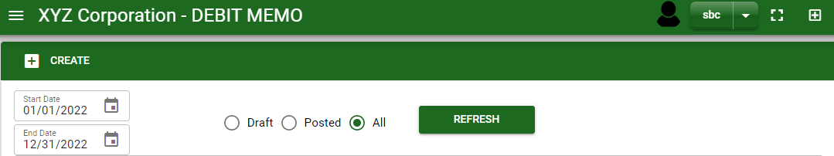
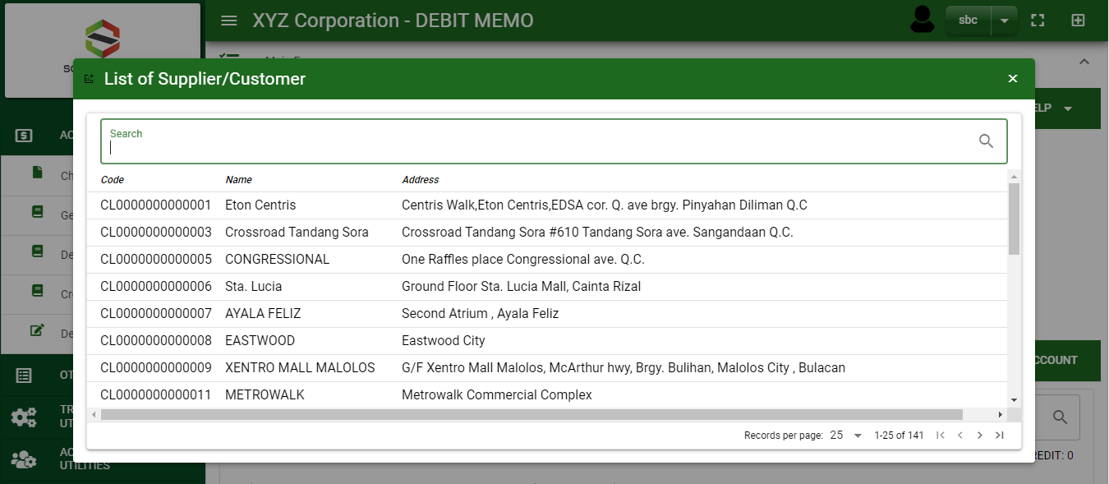
Accounting / Debit Memo- Module
How To Create Debit Notes?
1
1. In Debit Memo – Main Window, you will notice a create button in the upper left of the window. Click the create button and you will be redirect in debit memo – main form.
2. After you click the create button a dialog box will pop out with a list of customer. Search and select a customer.
2
How to search customer?
Type the customer name in the search bar.
And it will automatically sort out.
Then click the selected customer.
3. After you select a customer, you will be redirect in debit memo – main form where you will encode other necessary information of the transaction and record the adjustment entry
3

Slide 4
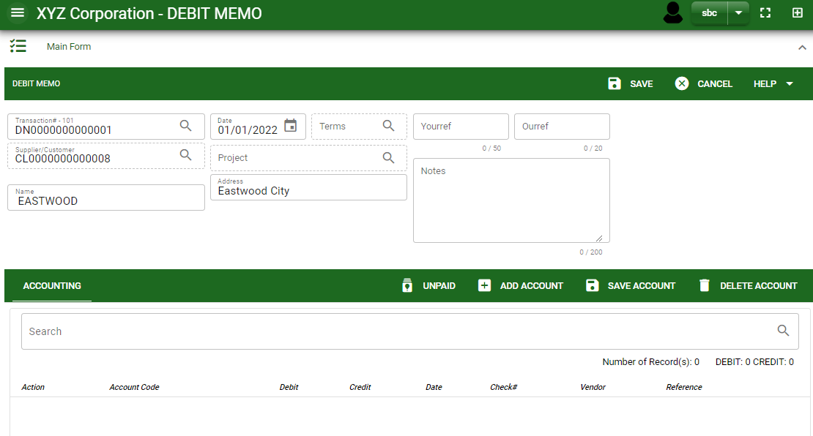
Accounting / Debit Memo- Module
How To Create Debit Notes?
4.1 After you select the customer, current date is plotted automatically but if you wish to change the date – click the date picker and select its respective date.
4.2 In header, add the necessary information if there’s any.
4.3 If done in header, click save button.
Header
4.3
4.1 to 4.2
5. After saving the header, you may now record the adjusting entry.
6.1 Unpaid : This is where unpaid receivables are floated.
Detail
6.1
6.2
5.5
5.6
Debit Memo – Main Form
4

Slide 5
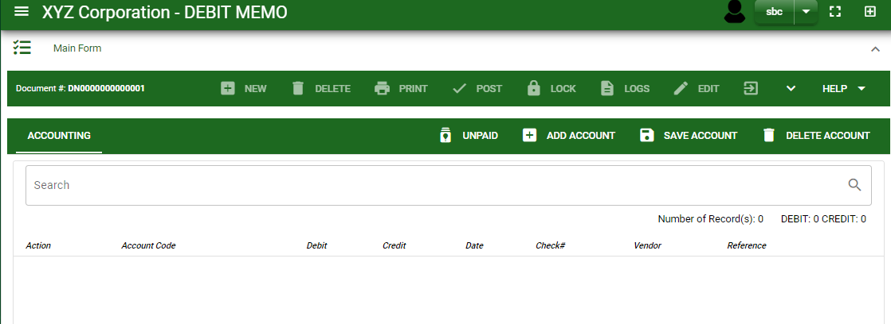
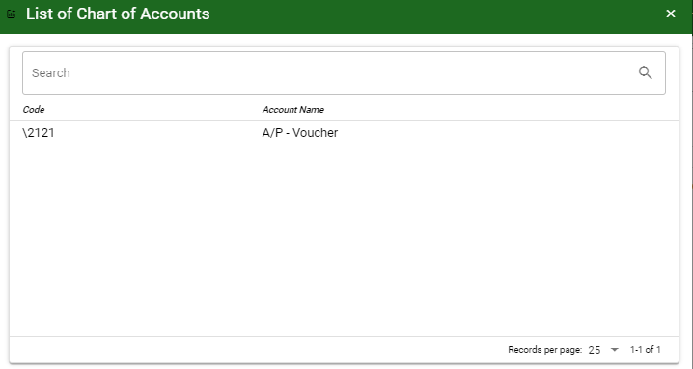
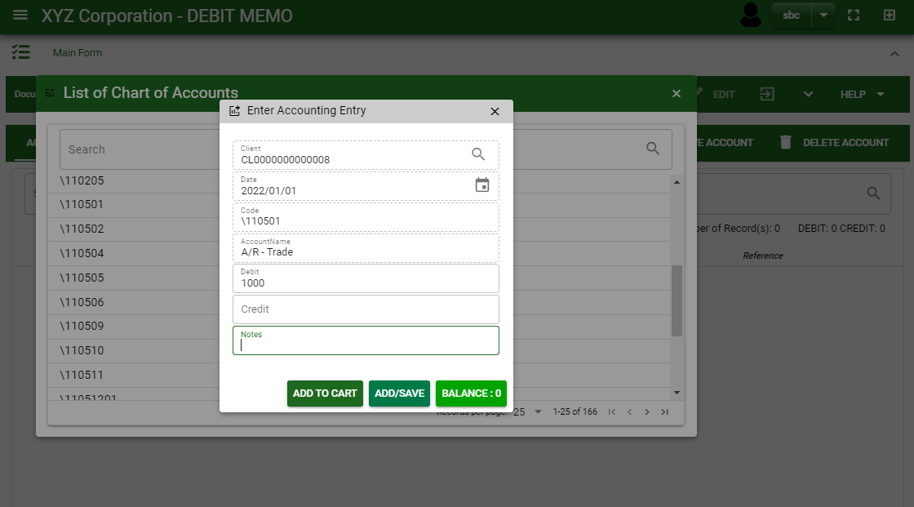
Accounting / Debit Memo- Module
How To Create Debit Notes?
How to search an account?
Type the account name in the search bar.
And it will automatically sort out.
Then click the selected account.
6.2 Add Account : Click this to select other account. By clicking add new account, add the necessary details by following the instructions below.
After you select an account, a dialog box will prompt. Enter the details of the account.
How to add details per account?
Click the date picker if you want to change the date.
Add amount in debit or credit field or
If you want to automatically copy the total amount of accounts plotted in the main form, click balance button.
Add notes, if there’s any
Once done, click add to cart or add/save button.
1
2
4
5
5
3
5

Slide 6
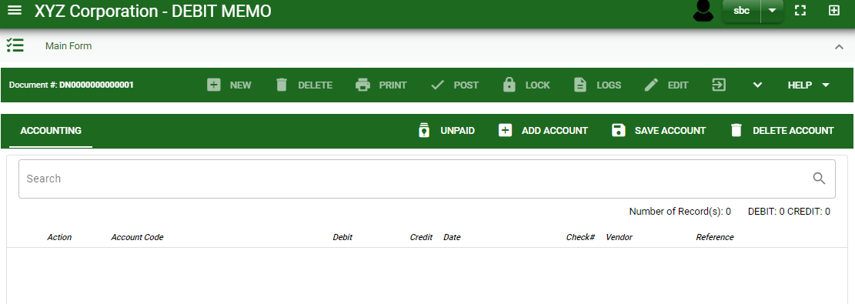
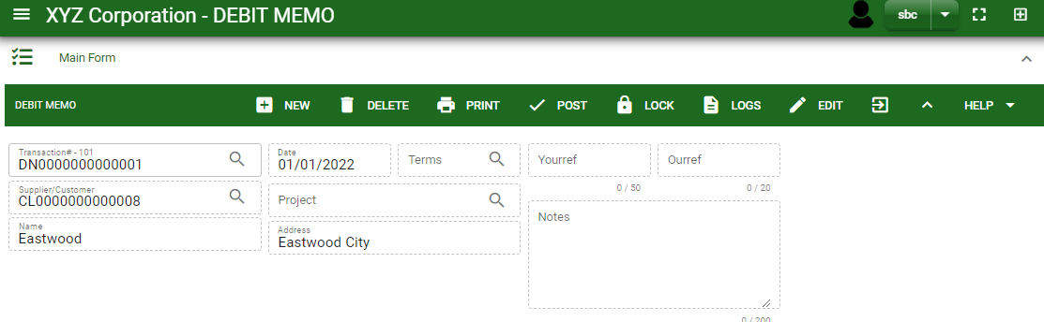
Accounting / Debit Memo- Module
How To Create Debit Notes?
7. If done, click save account button.
8. Click the arrow maximize the header.
9. To finalize, click post button.
8
9
6

Slide 7
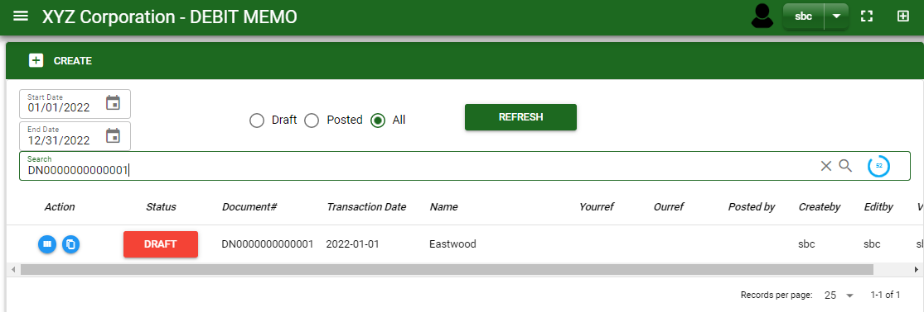
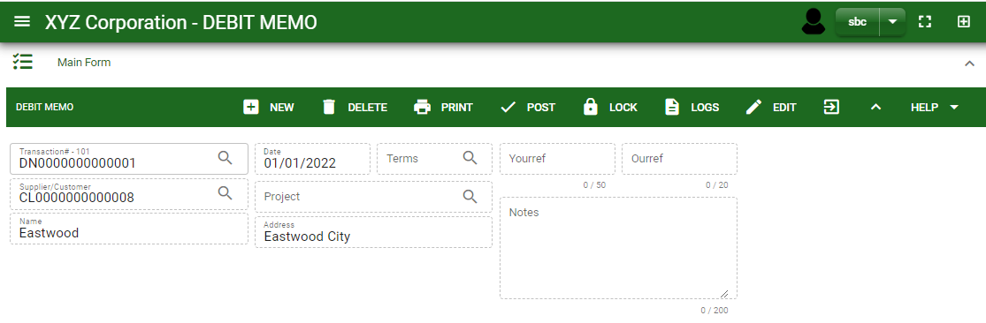
Accounting / Debit Memo- Module
How To Edit Debit Notes?
1. In the debit memo – main window, search the debit memo you wish to edit its information in the search bar. Or,
2. In debit memo – main form, click the lookup button and select the transaction you wish to edit its information by typing its transaction number in the search bar.
1
Debit Memo – Main Window
3. After you select the debit memo transaction, click edit button and change the information you want to alter.
4. If you are done editing the debit memo header, click save button in the upper side of the header.
HEADER
3
2
How to search debit memo transaction?
Type the transaction number in the search bar.
Click ‘enter’ in the keyboard to search.
Click to select the transaction you want to edit
Debit Memo – Main Form
7

Slide 8
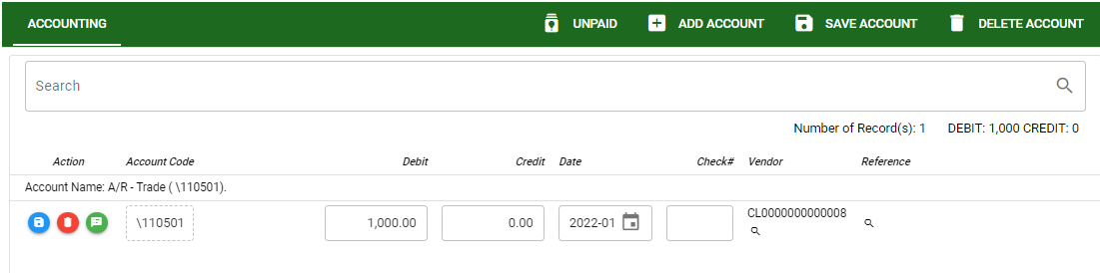

Accounting / Debit Memo- Module
How To Edit Debit Notes?
DETAIL
5. If you want to edit the entry in the detail, edit right away the details you want to change and you will notice that after you change the details, the account you edited will be highlighted into blue.
6. If you’re done editing, click save account button to save the changes you made in the entry.
6
8

Slide 9

Accounting / Debit Memo- Module
How To Delete Debit Notes?
1.1 In the debit memo – main window, search the entry you wish to edit its information in the search bar. Or,
1.2 In debit memo – main form, click the lookup button and select the transaction you wish to edit its information by typing its transaction number in the search bar.
1
Debit Memo – Main Window
2. If done, click delete button.
HEADER
2.
1.2.
How to search debit notes?
Type the transaction number in the search bar.
Click ‘enter’ in the keyboard to search.
Click to select the transaction you want to edit
Debit Memo – Main Form
9

Slide 10
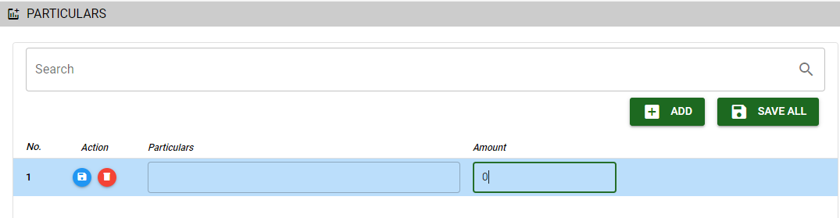

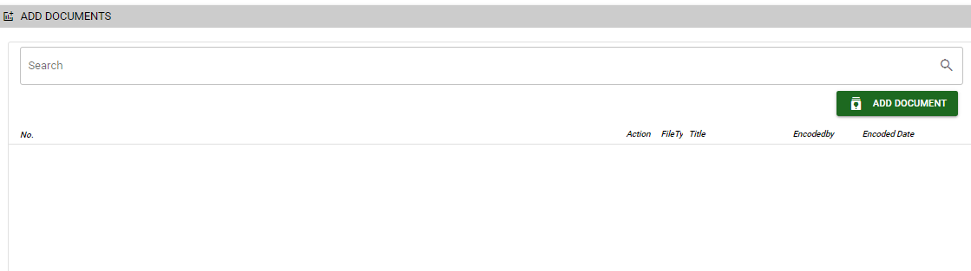
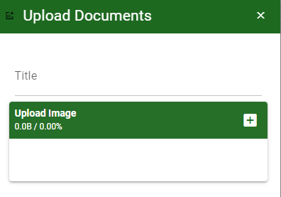
Accounting / Debit Memo- Module
Other Information
Particular Tab
When you click the arrow icon parallel in the main form on the upper right, the debit memo – main form will be minimize and the other tabs will be visible.
Particular tab
Click maximize arrow to view the Particular tab
Provide the necessary details in their fields
2.1. Click Add button to add new row
2.2. Type particular and amount if there’s any
2.3. If done, click save all button
Click save button once done
Attachment tab
1. Click maximize arrow to view the attachment tab
2. Click add document button
3. Once you click the add document button, a dialog box of upload documents will pop out.
4. To upload files, follow ‘how to upload document”
2.1
Attachment Tab
2
How to upload document?
Type the title of the document.
Click add button to add the chosen document to upload
Then click upload button.
If you want to add more document, click add document button and repeat steps 1 to #3
10

Slide 11
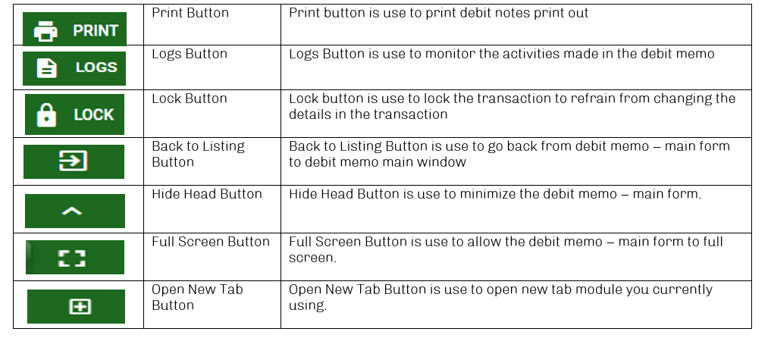
Accounting / Debit Memo- Module
Other Buttons

