Slide 1
General Journal
A module where accounting adjustments is recorded.

Slide 2
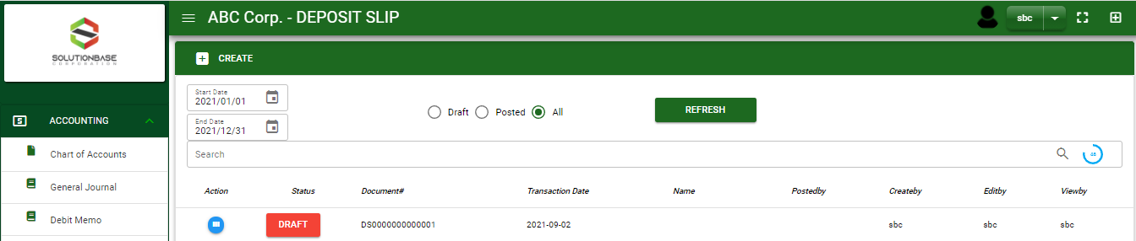
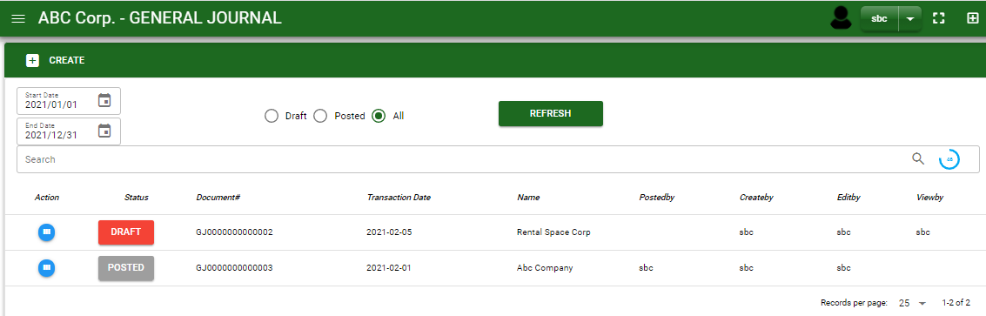


Accounting / General Journal - Module
Main Window
When you click the General Journal module under Accounting, general journal transactions list will display based on filtered date and status in the general journal - main window.
General Journal– Main Window
2

Slide 3
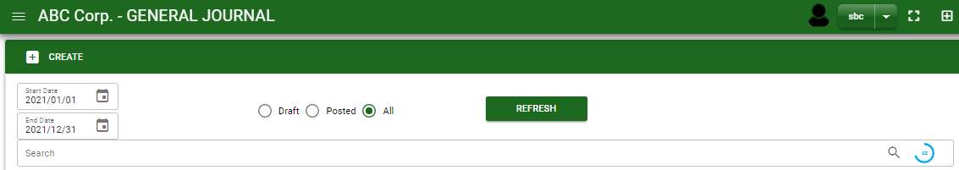
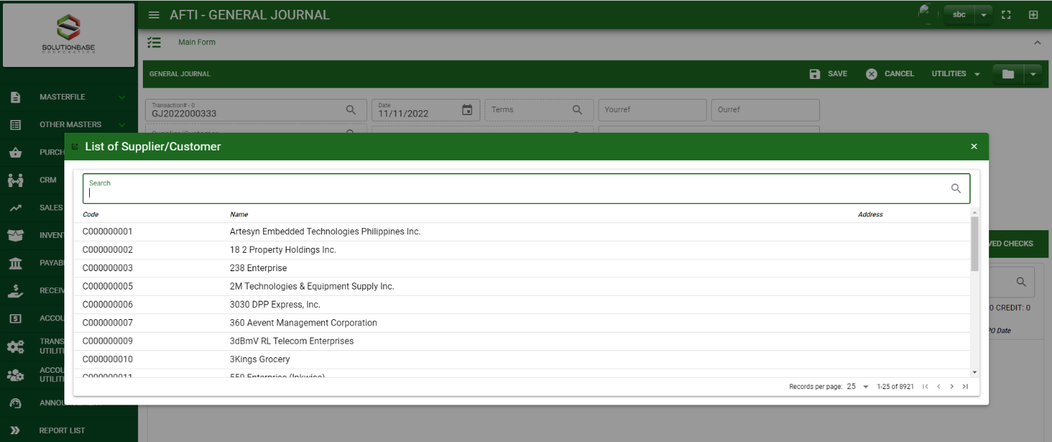
Accounting / General Journal - Module
How To Create General Journal Transaction?
1
1. In General Journal – Main Window, you will notice a create button in the upper left of the window. Click the create button and you will be redirect general journal – main form.
2. After you click the create button a dialog box will pop out with list of customer/ supplier. Search and select a customer/ supplier.
3. After you select a customer/ supplier, you will be redirect in general journal – main form where you will encode the other necessary information of the transaction and record the journal entry
2
How to search customer/supplier?
Type the customer/ supplier name in the search bar.
And it will automatically sort out.
Then click the selected customer/ supplier.
3

Slide 4
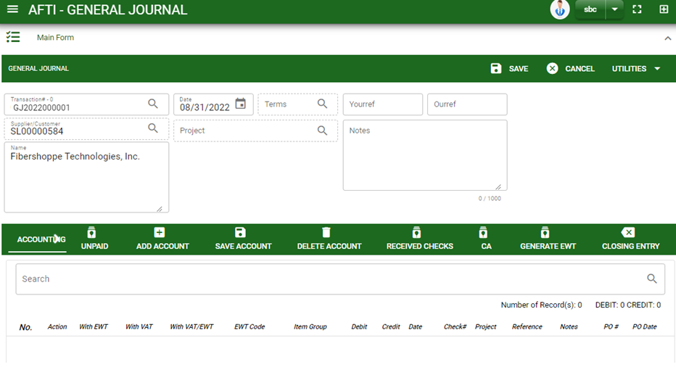
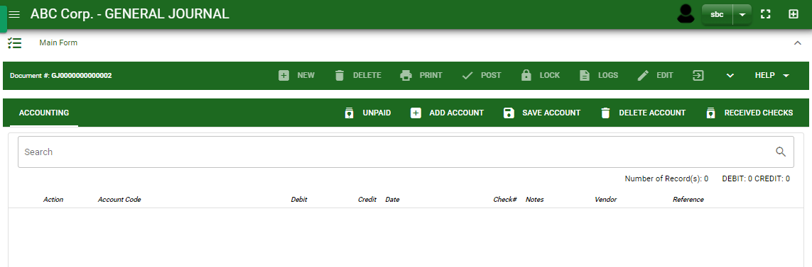
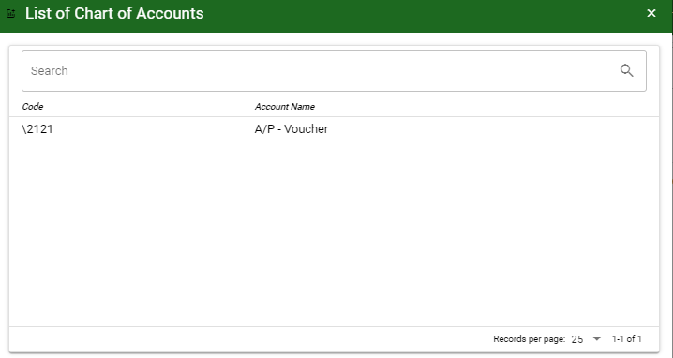
Accounting / General Journal - Module
How To Create General Journal Transaction?
4.3
Header
4.1 After you select the customer/ supplier, some details such as address, date are automatically plotted in their respective field.
4.2 In header, add the necessary information if necessary.
4.3 If done in header, click save button.
4.1 to 4.2
Detail
5.1
5.4
5.2
5.3
5.5
5.6
5.1 Unpaid: This is where unpaid receivables and payables are floated.
5.2 Received checks: This is where received checks are floated. If there are reversals such as bounced checks, this is where you will pick up the checks recorded in received payment module.
5.3 CA: This is where transactions of cash advances recorded in cash/check voucher module are floated.
5.4 Add Account : Click this to select other account. By clicking add new account, add the necessary details by following the instructions below.
How to search an account?
Type the account name in the search bar.
And it will automatically sort out.
Then click the selected account.
4

Slide 5
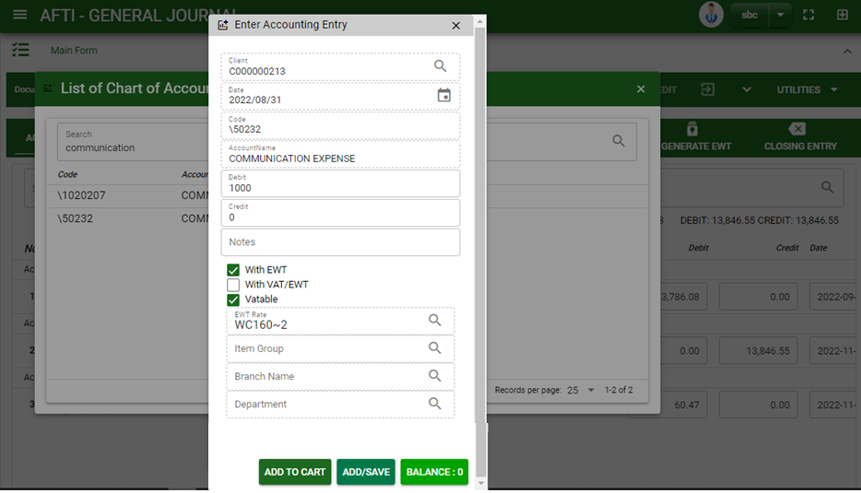
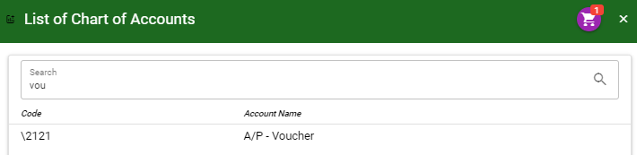
Accounting / General Journal - Module
How To Create General Journal Transaction?
1
How to add details per account?
Click the date picker if you want to change the date.
Add amount in debit or credit field or
If you want to automatically copy the total amount of accounts plotted in the main form, click balance button.
Add notes, if there’s any
For EWT and VAT, tick the check box if account should be computed with EWT and/or VAT.Click EWT lookup button, to select EWT rate.
Click lookup button in item group, branch and department if there’s any.
Once done, click add to cart or add/save button.
After you select an account, a dialog box will prompt. Enter the details of the account.
5.5.Generate EWT : After you tagged accounts with EWT and VAT. Click generate EWT to automatically compute EWT and VAT amount.
5.6.Closing Entry : Click closing entry to display all income and expense accounts with their respective amount.
6. If done, click save account button.
2
4
5
6
7
7
3
How to plot the selected accounts in the general journal – detail
Click the cart icon.
And a dialog box with list of selected accounts will pop out.
Then click the accept button.
5

Slide 6
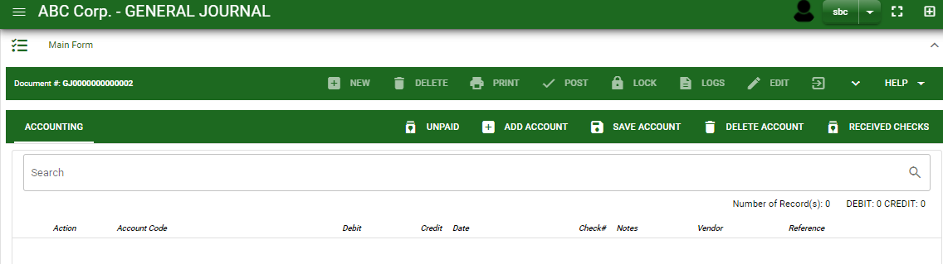
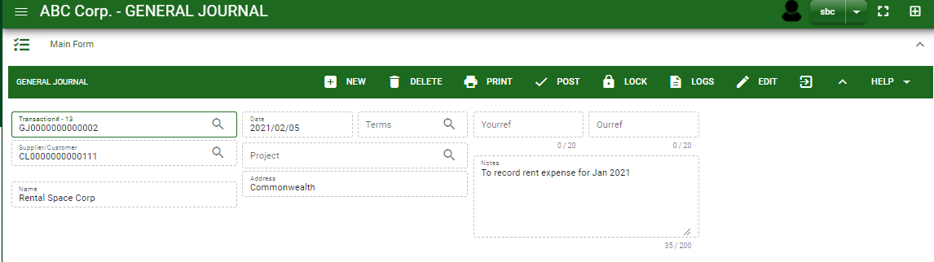
Accounting / General Journal - Module
How To Create General Journal Transaction?
7. If done click the arrow to enable the buttons in the header.
8. To finalize, click post button.
7
8
6

Slide 7
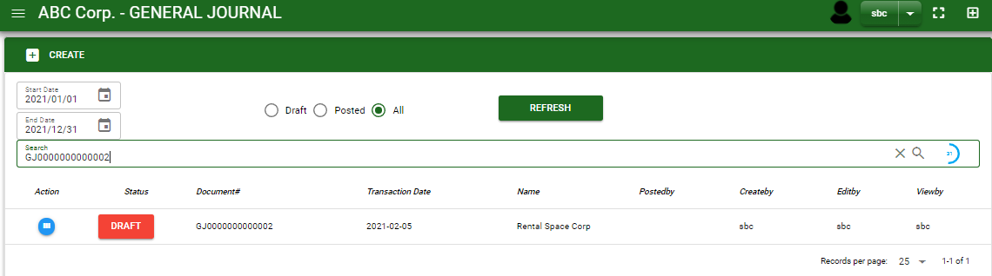
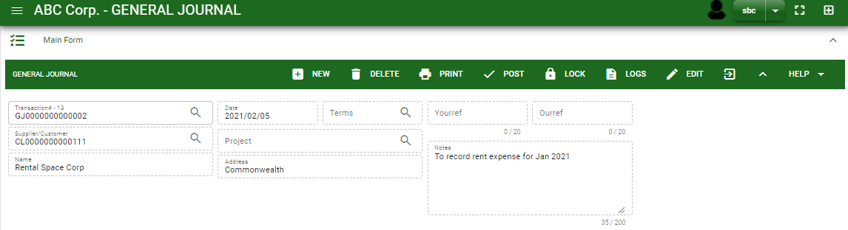

Accounting / General Journal - Module
How To Edit General Journal Transactions
1.1 In the general journal – main window, search the journal entry you wish to edit its information in the search bar. Or,
1.2 In general journal – main form, click the lookup button and select the transaction you wish to edit its information by typing its transaction number in the search bar.
1.1.
General Journal– Main Window
2. After you select the GJ transaction, if you wish to edit the header of the transaction click edit button.
3. If you are done editing the GJ header, click save button in the upper side of the header.
HEADER
2.
1.2.
How to search transaction?
Type the transaction number in the search bar.
Click ‘enter’ in the keyboard to search.
Click to select the transaction you want to edit
General Journal– Main Form
7

Slide 8
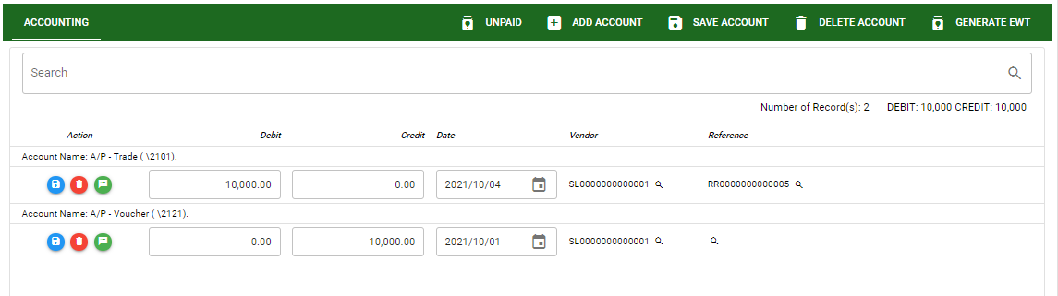
Accounting / General Journal - Module
How To Edit General Journal Transactions
DETAIL
4. If you want to edit the entry in the detail, edit right away the details you want to change and you will notice that after you change the details, the account you edited will be highlighted into blue.
5. If you’re done editing, click save account button to save the changes you made in the entry.
6. To delete all accounts in the entry, click delete account button.
7. To delete a specific line on the table, click the delete icon next to the account to delete it.
5
6
4
7
8

Slide 9
Accounting / General Journal - Module
How To Delete General Journal Transactions
1.3 In the general journal – main window, search the journal entry you wish to edit its information in the search bar. Or,
1.4 In general journal – main form, click the lookup button and select the transaction you wish to edit its information by typing its transaction number in the search bar.
General Journal– Main Window
HEADER
2.
2. If done, click delete button.
1.2.
How to search transaction?
Type the transaction number in the search bar.
Click ‘enter’ in the keyboard to search.
Click to select the transaction you want to edit
General Journal– Main Form
9

Slide 10
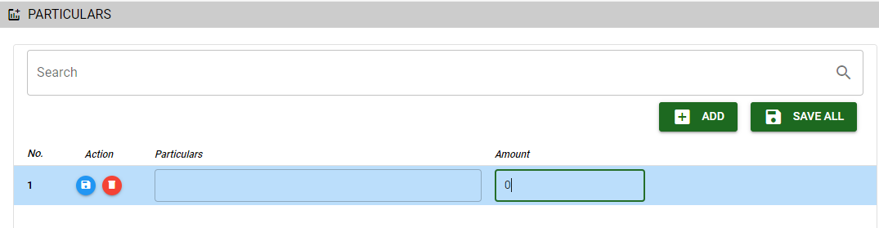

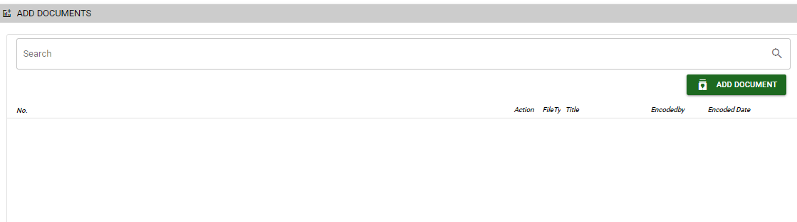
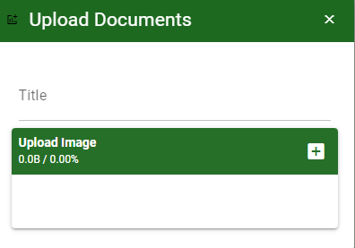
Accounting / General Journal - Module
Other Information
Particular Tab
When you click the arrow up icon parallel in the main form on the upper right, and the received payment – main form will be minimize and the other information will be displayed as shown in the photo.
Click the arrow parallel to what information you want to open and provide the necessary filter to generate the data you want to display.
Particular tab
Click maximize arrow to view the Particular tab
Provide the necessary details in their fields
2.1. Click Add button to add new row
2.2. Type particular and amount if there’s any
2.3. If done, click save all button
Click save button once done
Attachment tab
1. Click maximize arrow to view the attachment tab
2. Click add document button
3. Once you click the add document button, a dialog box of upload documents will pop out.
4. To upload files, follow ‘how to upload document”
2.1
Attachment Tab
2
How to upload document?
Type the title of the document.
Click add button to add the chosen document to upload
Then click upload button.
If you want to add more document, click add document button and repeat steps 1 to #3
10

Slide 11
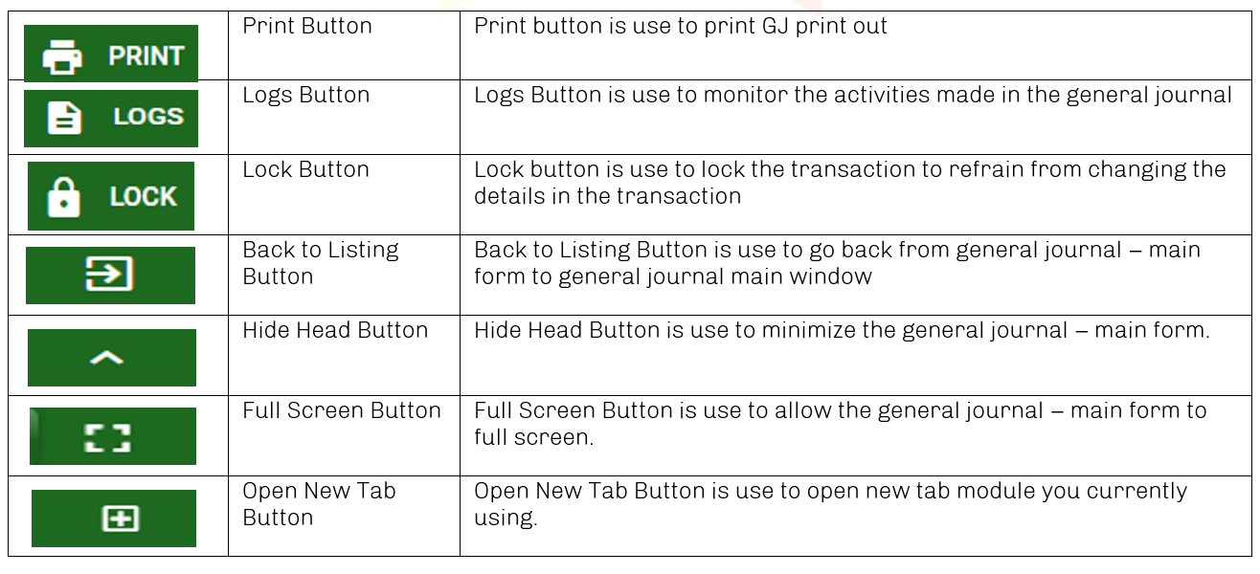
Accounting / General Journal - Module
Other Buttons
11

