Slide 1
Inventory Setup
This module is used to setup beginning Inventory Balance.

Slide 2
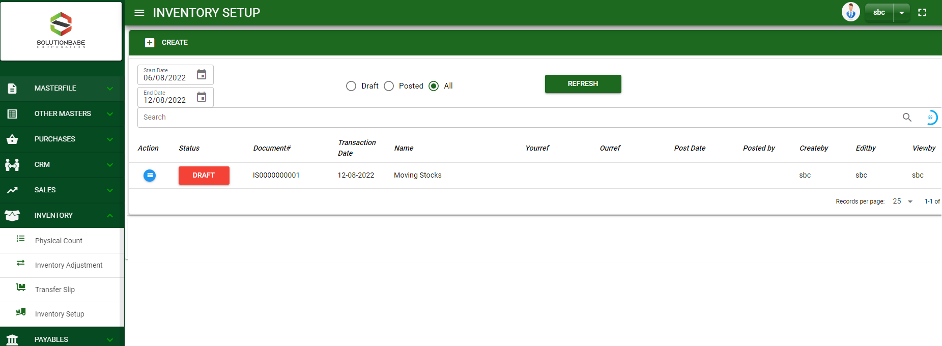

Inventory / Inventory Setup - Module
Main Window
When you click the Inventory Setup module under Inventory, it will display transactions from Inventory Setup based on filtered date and status in the main window.
Inventory Setup– Main Window

Slide 3
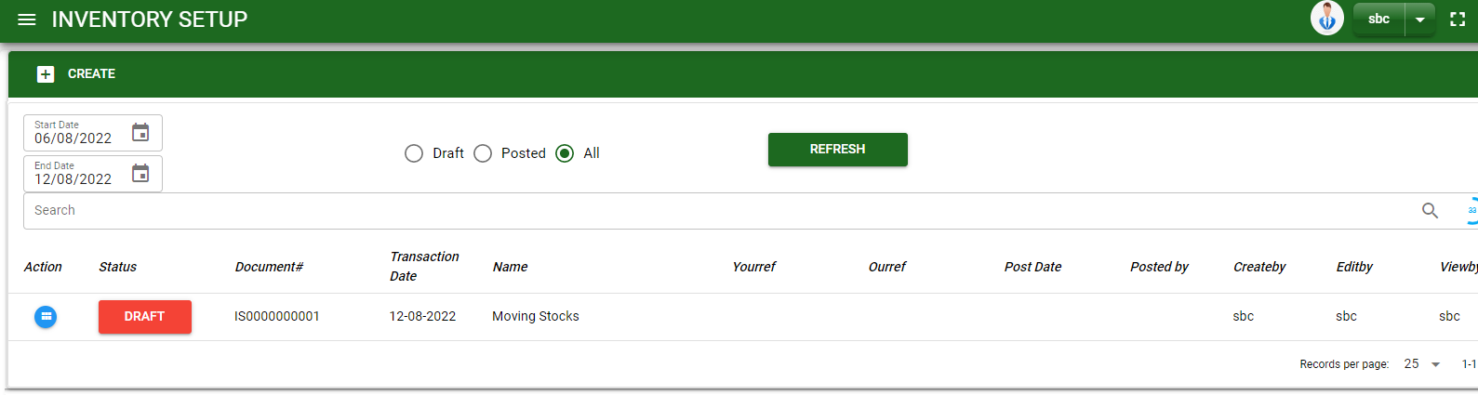
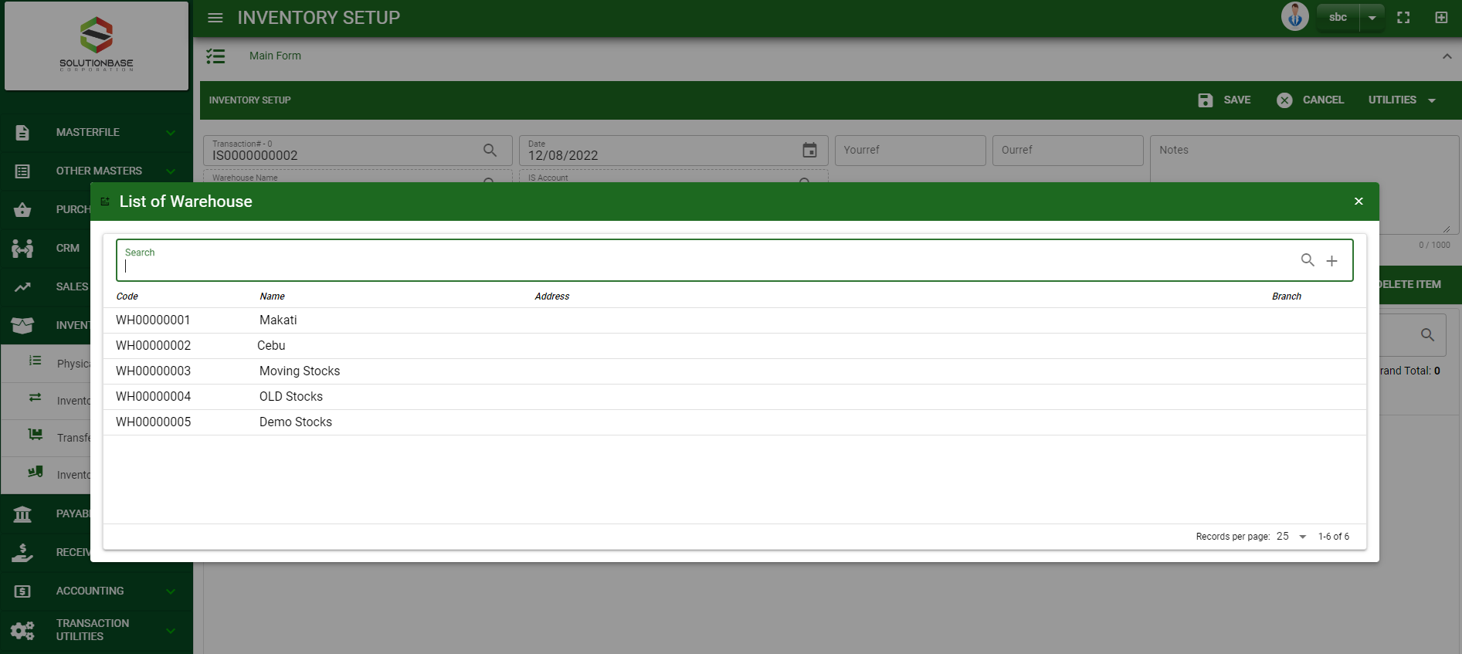
Inventory / Inventory Setup - Module
How To Create Inventory Setup Transaction?
1
1. In Inventory Setup – Main Window, you will notice a create button in the upper left of the window. Click the create button and you will be redirect in Inventory Setup – main form.
2. After you click the create button search and select a warehouse.
3. After you select a warehouse, you will be redirected in Inventory Setup – main form where you will encode the other necessary information of the transaction and record the items’ to setup.
2

Slide 4
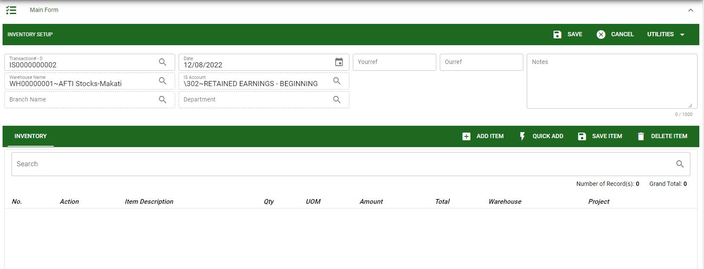
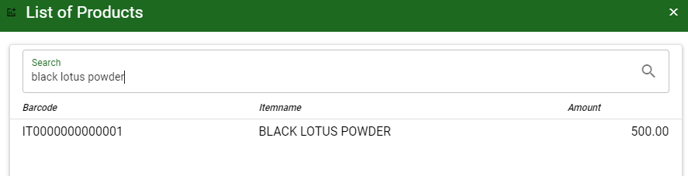
Inventory / Inventory Setup - Module
How To Create Inventory Setup Transaction?
4.1 After you select the warehouse, you may enter other necessary details needed for the transaction.
4.2 In header, current date and default warehouse is also plotted automatically but if you wish to change the date – click the date picker and select its respective cut off date. And if you want to change the warehouse, click the lookup button and select the warehouse.
4.3 In header, add the necessary information if necessary.
4.4 If done in header, click save button.
5.1. After saving the header, you may now add the item in the stock by clicking add button.
5.2. After you click the add button, a dialog box with item list pop out, search and select the item
4.4
4.1 to 4.3
5.1
Stock
Inventory Setup– Main Form
5.2
5.2

Slide 5
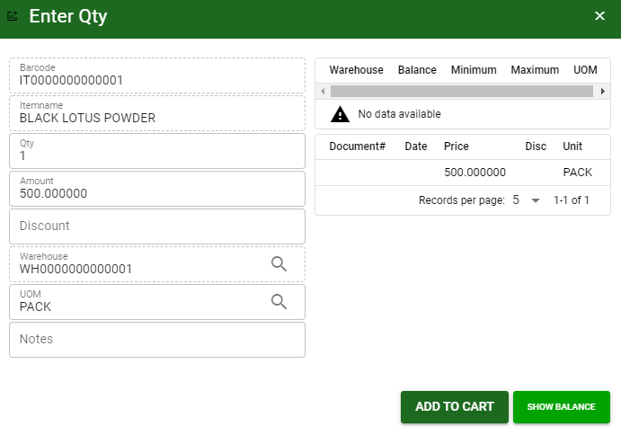
Inventory / Inventory Setup - Module
How To Create Inventory Setup Transaction?
5.3 After you select the item, a dialog box where item details will be encoded will pop out.
5.4 Enter the necessary quantity, change the amount, uom, warehouse.
5.5 If done, click add to cart button.
5.4.
5.5

Slide 6
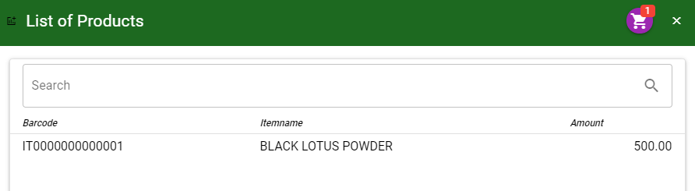
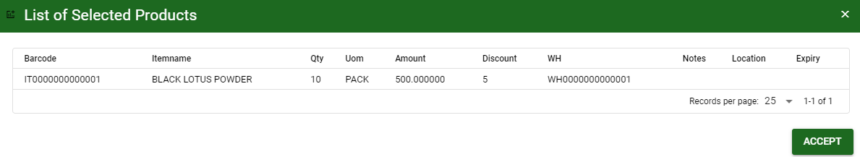
Inventory / Inventory Setup - Module
How To Create Inventory Setup Transaction?
5.6 After you click the add to cart button, you will notice in the upper right of item list an icon of add to cart. Click that, then click accept button to plot the items in the stock.
5.6
5.6

Slide 7
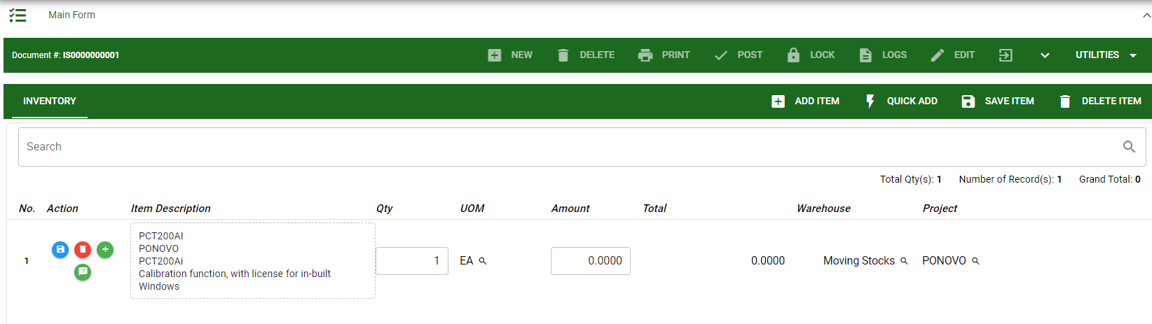
Inventory / Inventory Setup - Module
How To Create Inventory Setup Transaction?
5.7 To add more items, repeat 5.2 to 5.5 before doing 5.6
5.8 After you click the accept button in the dialog box of selected items in 5.6., the items select will be plotted in the stock as shown below.
5.9 You may still edit the details per item in the stock. Change directly the details needed to be change.
5.10 If done, click save item button
5.10

Slide 8
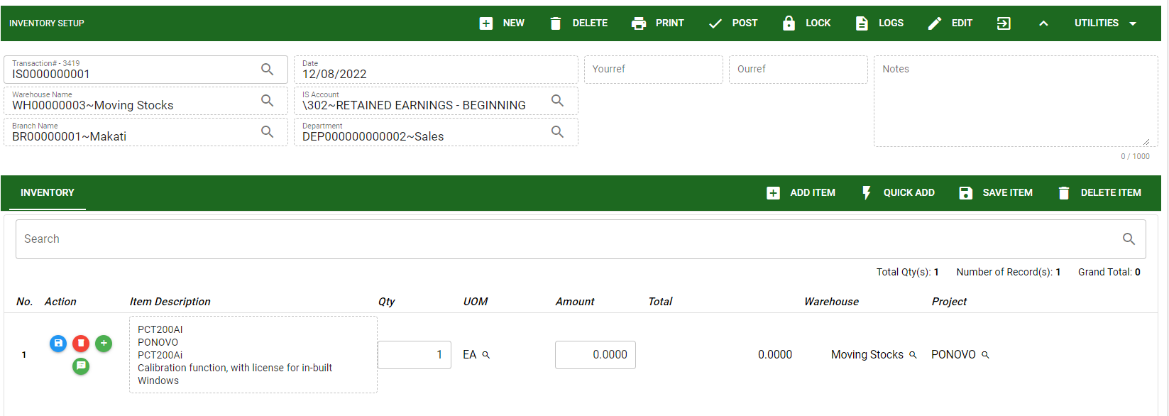
Inventory / Inventory Setup - Module
How To Create Inventory Setup Transaction?
5.11 Click the maximize arrow to enable the post button.
5.12 To finalize, the transaction, click post button located in the header.
5.11
5.12

Slide 9
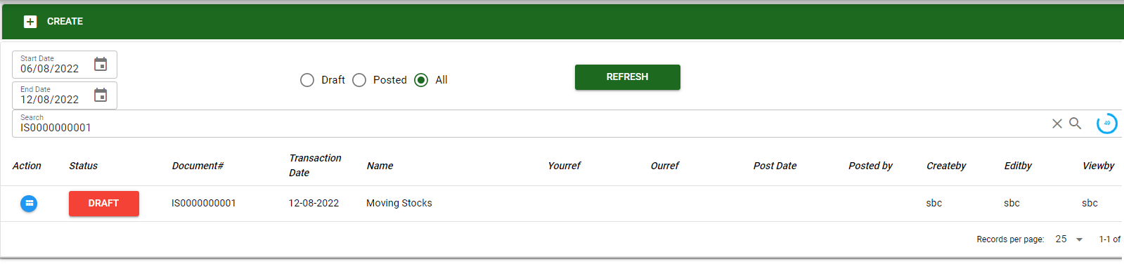
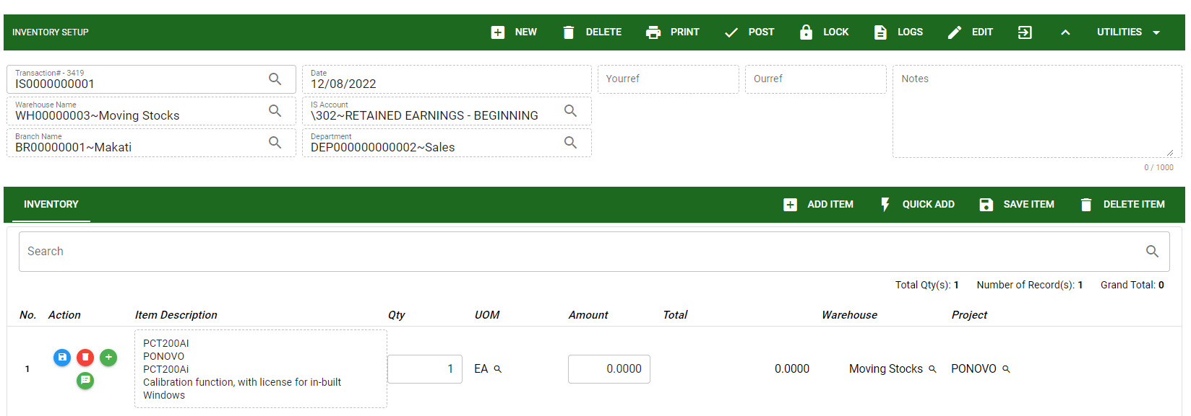
Inventory / Inventory Setup - Module
How To Edit Inventory Setup Transaction?
1.1. Search the transaction you wish to edit its information in the search bar. Or,
1.2. In Inventory Setup - main form, click the lookup button and select the transaction you wish to edit its information by typing its transaction number in the search bar.
2. After you select the transaction, if you wish to edit the header of the transaction click edit button.
3. If you are done editing, click save button in the upper side of the header.
1.1.
Inventory Setup– Main Window
HEADER
2.
1.2.
Inventory Setup – Main Form

Slide 10
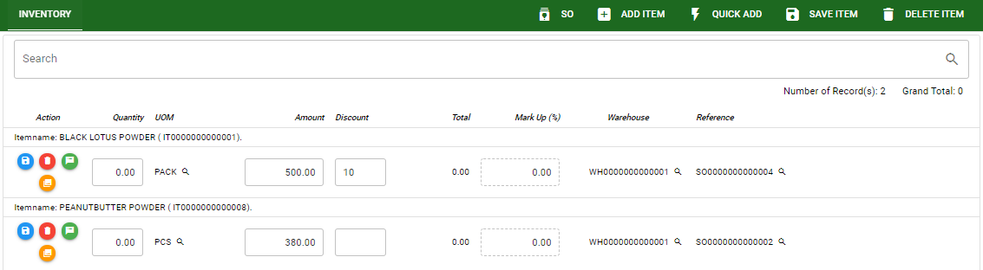
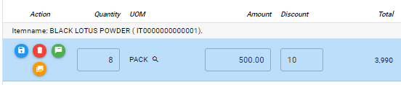
Inventory / Inventory Setup - Module
How To Edit Inventory Setup Transaction?
STOCK
4. If you want to edit the items in stock, edit right away the details you want to change and you will notice that after you change the details, the item you edited will be highlighted into blue.
5. If you’re done editing, click save item button to save the changes you made in the items.
6. To delete all items in the stock, click delete item button.
7. To delete a specific item on the table, click the delete icon next to the item to delete it.
5
6
7
4

Slide 11
Inventory / Inventory Setup - Module
How To Delete Inventory Setup Transaction?
1.1.
1.1. In the Inventory Setup – main window, search the transaction you want to delete.
1.2. In purchase order – main form, click the lookup button and select the transaction you want to delete.
2. After . If done, click delete button.
Inventory Setup– Main Window
HEADER
2.
1.2.
How to search transaction?
Type the transaction number in the search bar.
Click ‘enter’ in the keyboard to search.
Click to select the transaction you want to edit
Inventory Setup – Main Form

Slide 12




Inventory / Inventory Setup - Module
Other Information
When you click the arrow up icon parallel in the main form on the upper right, and the Inventory Setup – main form will be minimize and the other information will be displayed as shown in the photo below.
Click the arrow parallel to what information you want to open and provide the necessary filter to generate the data you want to display.
 | Print Button | Print button is use to print transaction.
 | Logs Button | Logs Button is use to monitor the activities made in the module.
 | Lock Button | Lock button is use to lock the transaction to refrain from changing the details in the transaction
 | Back to Listing Button | Back to Listing Button is use to go back from main form to main window
 | Hide Head Button | Hide Head Button is use to minimize the main form.
 | Full Screen Button | Full Screen Button is use to allow the main form to full screen.
 | Open New Tab Button | Open New Tab Button is use to open new tab module you currently using.
Other Buttons

