Slide 1
Job Order
is where we record job order from service receiving

Slide 2
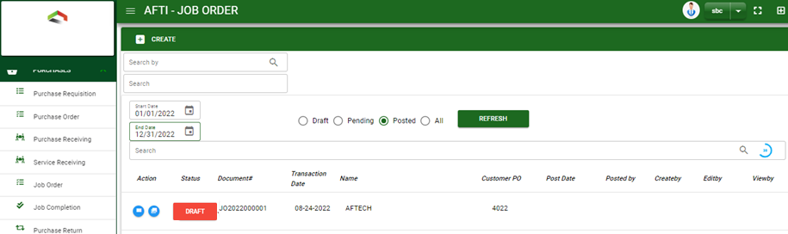

Purchase / Job Order - Module
Main Window
When you click the Job Order module under Purchases, Job Order transactions list will display based on filtered date and status in the job order main
Job Order – Main Window

Slide 3
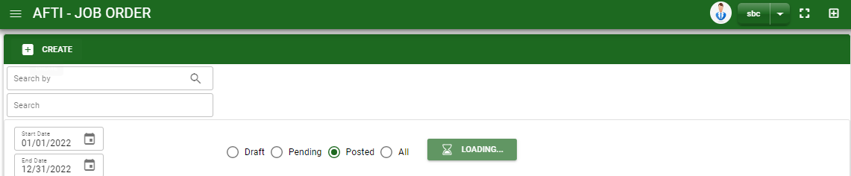
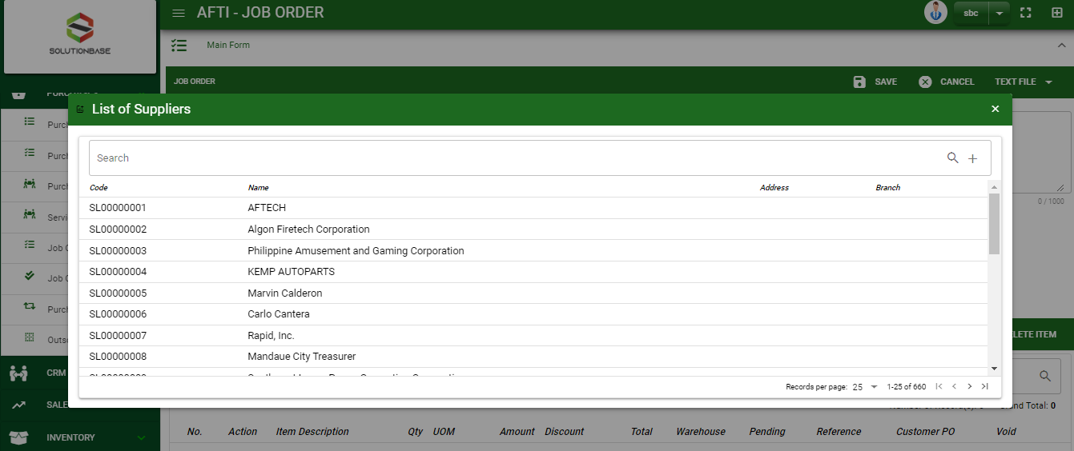
Purchase / Job Order - Module
How To Create Job Order Transaction?
1
1. In Job Order – Main Window, you will notice a create button in the upper left of the window. Click the create button and you will be redirect in job order – main form.
2. After you click the create button a dialog box will pop out with list of supplier. Search and select a supplier.
2
3. After you select a supplier, you will be redirected in job order – main form where you will encode the other necessary information of the transaction and record the job order.
How to search supplier?
Type the supplier name in the search bar.
And it will automatically sort out.
Then click the selected supplier.

Slide 4
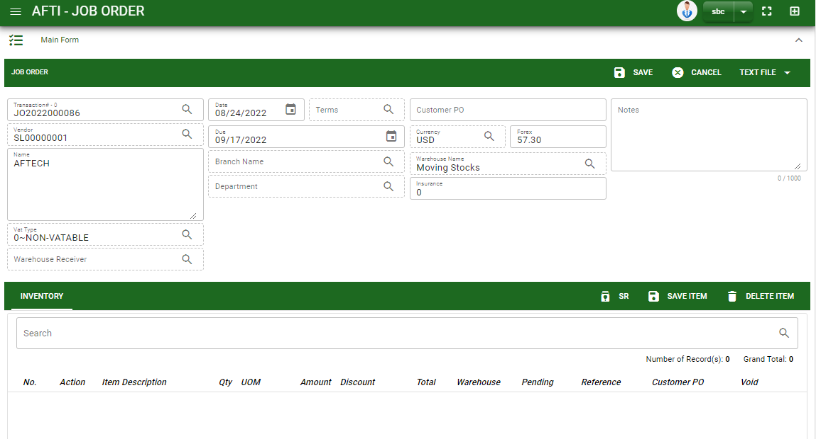
Purchase / Job Order - Module
How To Create Job Order Transaction?
4.2
4.1 In header, add the necessary information if necessary.
4.2 If done in header, click save button.
5. After saving the header, you may now add the ordered items.
SR: If services are from quotation, click Service Quotation to select transaction.
4.1
Stock
5

Slide 5
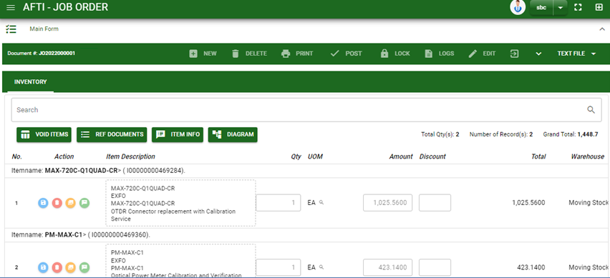
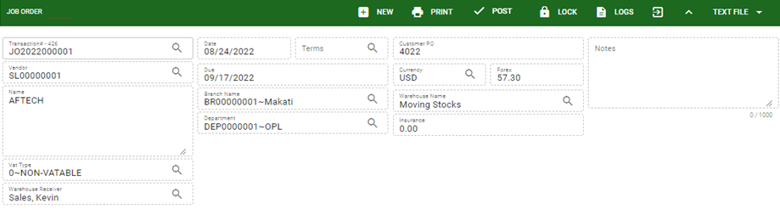
Purchase / Job Order - Module
How To Create Job Order Transaction?
6. If done, finalize the transaction by click the arrow button to maximize the main form header.
7. In header, click post button.
6
7

Slide 6
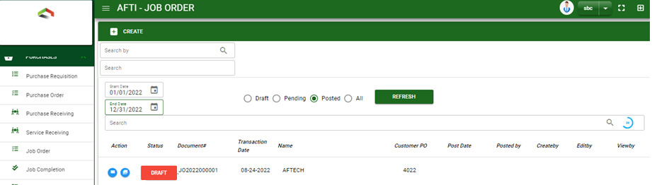
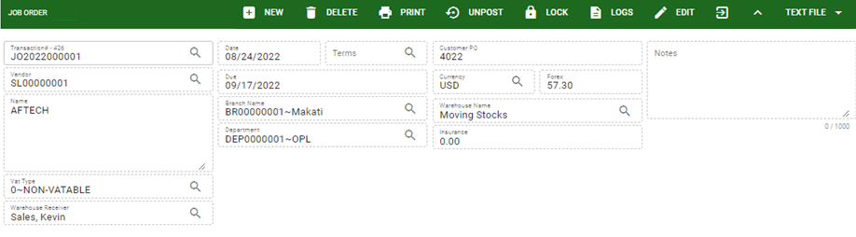
Purchase / Job Order - Module
How To Edit Job Order Transaction?
1.1. In the job order – main window, search the job order transaction you wish to edit its information in the search bar. Or,
1.2. In job order – main form, click the lookup button and select the transaction you wish to edit its information by typing its transaction number in the search bar.
2. After you select the JO transaction, if you wish to edit the header of the transaction click edit button.
3. If you are done editing the job order header, click save button in the upper side of the header.
1.1.
Job Order – Main Window
HEADER
2.
1.2.
Job Order – Main Form

Slide 7
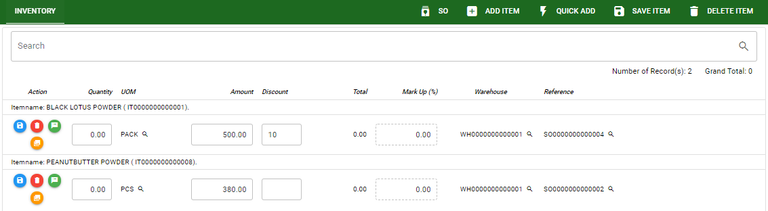
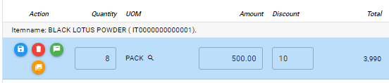
Purchase / Job Order - Module
How To Edit Job Order Transaction?
4. If you want to edit the items in job order stock, edit right away the details you want to change and you will notice that after you change the details, the item you edited will be highlighted into blue.
5. If you’re done editing, click save item button to save the changes you made in the items.
6. To delete all items in the stock, click delete item button.
7. To delete a specific item on the table, click the delete icon next to the item to delete it.
STOCK
5
6
7
4

Slide 8
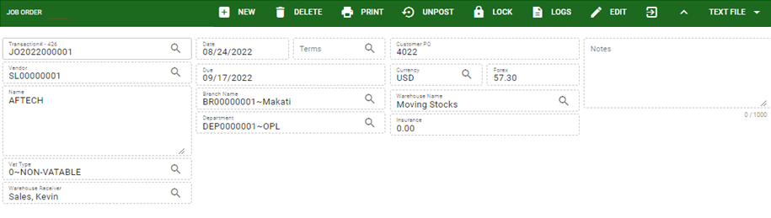
Purchase / Job Order - Module
How To Delete Job Order Transaction?
1.1. In the job order – main window, search the transaction you want to delete.
1.2. In job order – main form, click the lookup button and select the transaction you want to delete.
2. After . If done, click delete button.
1.1.
Job Order – Main Window
HEADER
2.
1.2.
How to search JO transaction?
Type the transaction number in the search bar.
Click ‘enter’ in the keyboard to search.
Click to select the transaction you want to edit
Job Order – Main Form

Slide 9
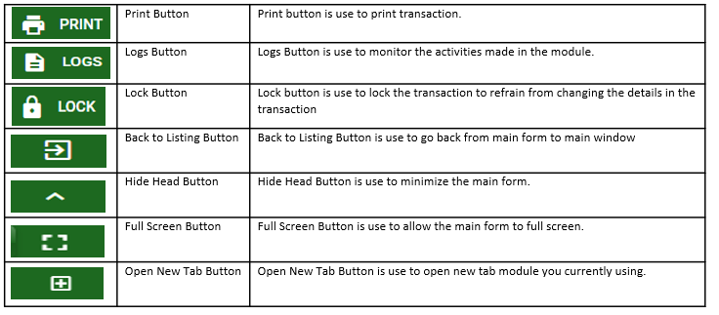
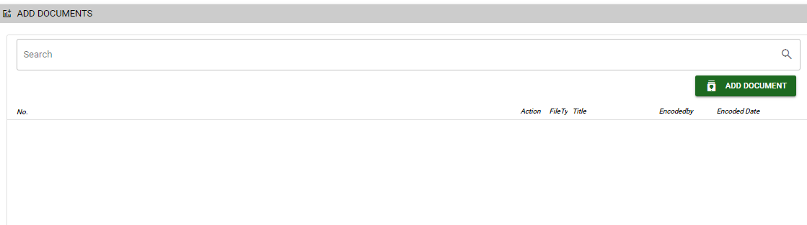
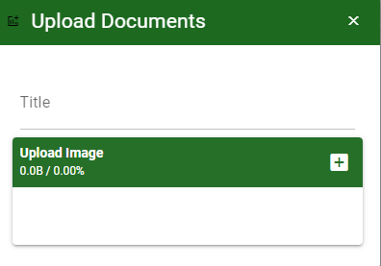
Purchase / Job Order - Module
Other Information
Other Buttons
When you click the arrow up icon parallel in the main form on the upper right, and the job order – main form will be minimize and the other tab will be visible.
Attachment tab
1. Click the arrow icon parallel to attachment tab
2. Click add document button
3. Once you click the add document button, a dialog box of upload documents will pop out.
4. To upload files, follow ‘how to upload document”
Shipping/Billing Tab
1. Click the arrow icon parallel to Shipping/ billing address
2. You may view or edit the Shipping and Billing Address for the JO transaction.
2
How to upload document?
Type the title of the document.
Click add button to add the document you want to upload.
Then click upload button.
If you want to add more document, click add document button and repeat steps 1 to #3

