Slide 1
Counter Receipt
Counter Receipt is where we generate the list of delivery receipts and invoices for collection.
This is for the customer to acknowledge their obligation in the copy list that is sent to them for confirmation/acknowledgement

Slide 2
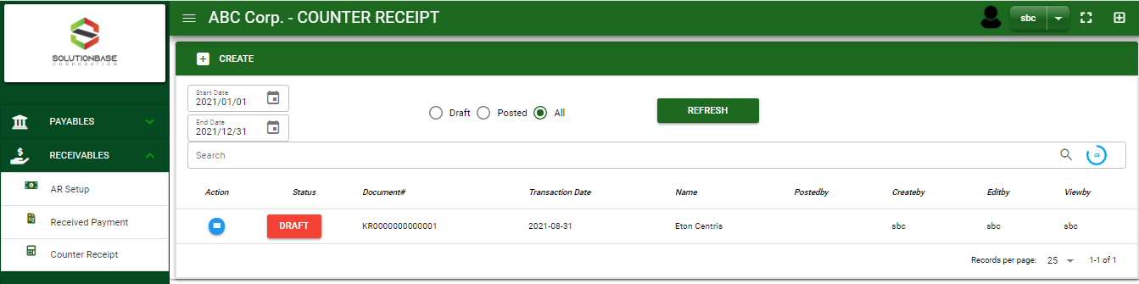

Receivables / Counter Receipt- Module
Main Window
When you click the Counter Receipt module under Receivables, Counter Receipt transactions list will display based on filtered date and status in the Counter Receipt - main window.
Counter Receipt – Main Window

Slide 3
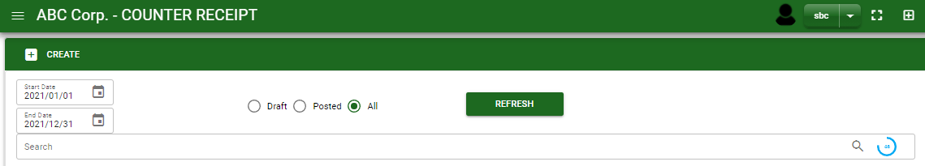
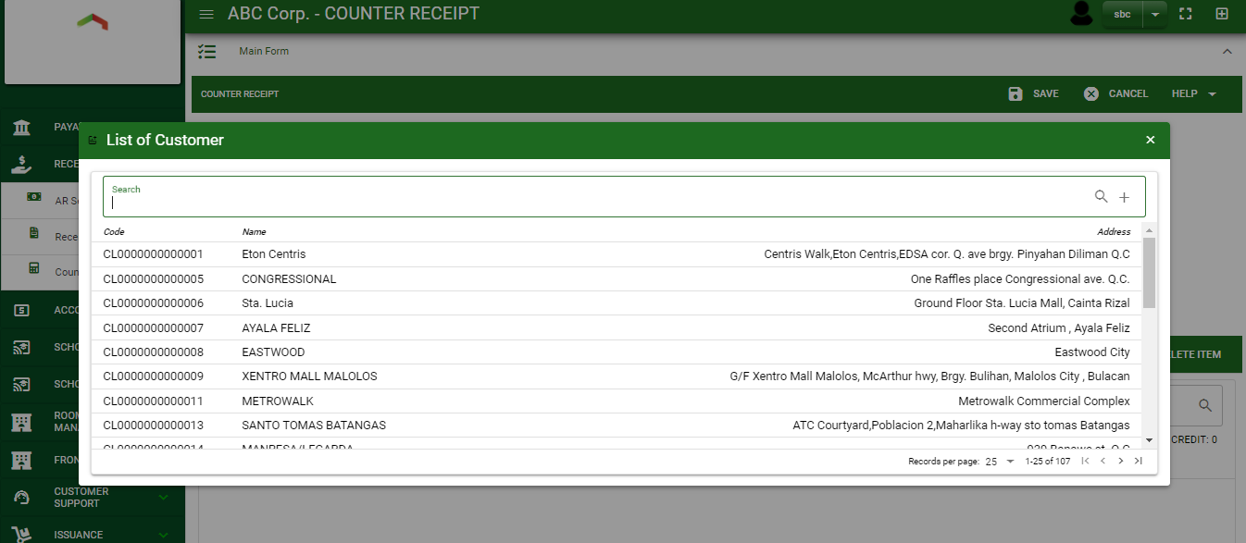
Receivables / Counter Receipt- Module
How To Create Counter Receipt Transaction?
1
1. In Counter Receipt – Main Window, you will notice a create button in the upper left of the window. Click the create button and you will be redirect in counter receipt – main form.
2. After you click the create button a dialog box will pop out with list of customer. Search and select a customer.
2
3. After you select a customer, you will be redirect in counter receipt – main form where you will encode the other necessary information of the transaction and record the KR transaction

Slide 4
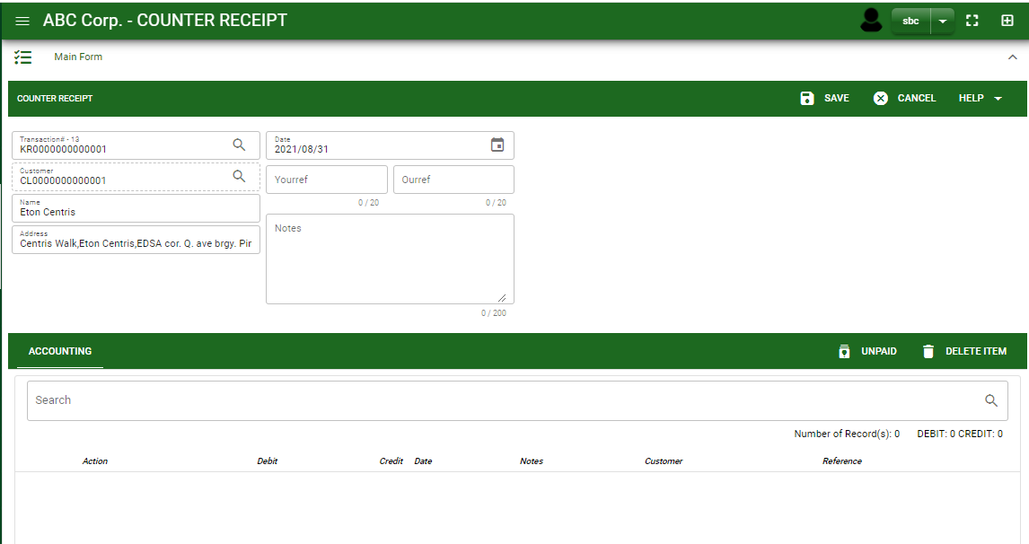
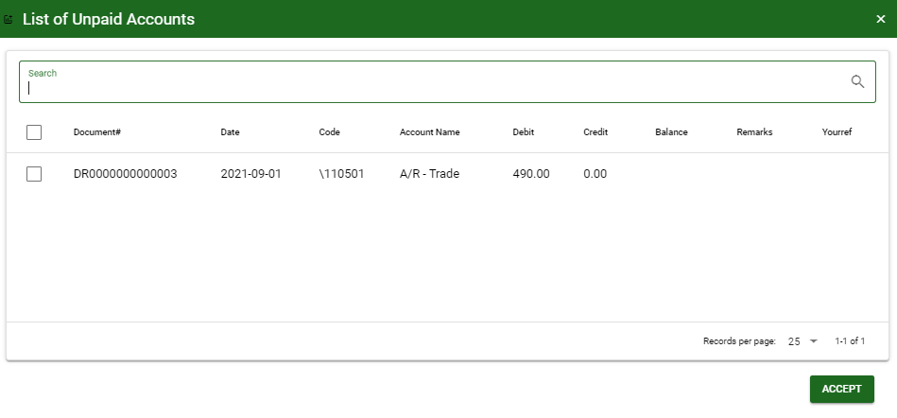
Receivables / Counter Receipt- Module
How To Create Counter Receipt Transaction?
4.4
Header
4.1 After you select the customer, some details such as address, date are automatically plotted in their respective field.
4.2 In header, current date is also plotted automatically but if you wish to change the date – click the date picker and select its respective date.
4.3. In header, add the necessary information if necessary.
4.4. If done in header, click save button.
5.1. After saving the header, you may now select the receivables from sales journal. Select it by ticking the check box.
5.2. Click accept, if done.
4.1 to 4.3
5.1
Detail
5.1.
5.2.

Slide 5
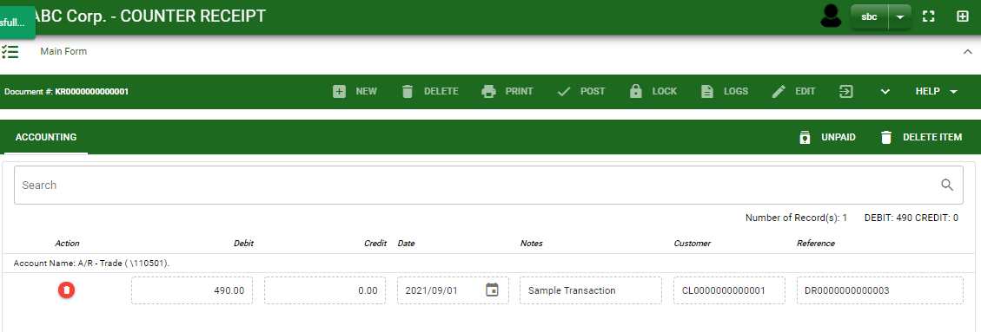
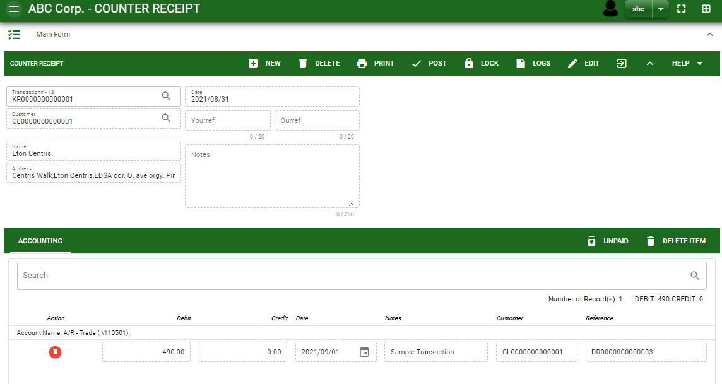
Receivables / Counter Receipt- Module
How To Create Counter Receipt Transaction?
6. After you select the receivables from sales journal, you will be redirect in counter receipt – main window and the selected receivables accounts will be displayed in counter receipt – detail.
7. If done click the arrow to enable the buttons in the header.
8. To finalize, click post button.
7
8

Slide 6
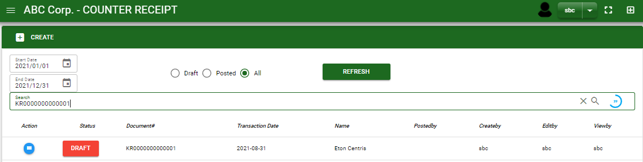
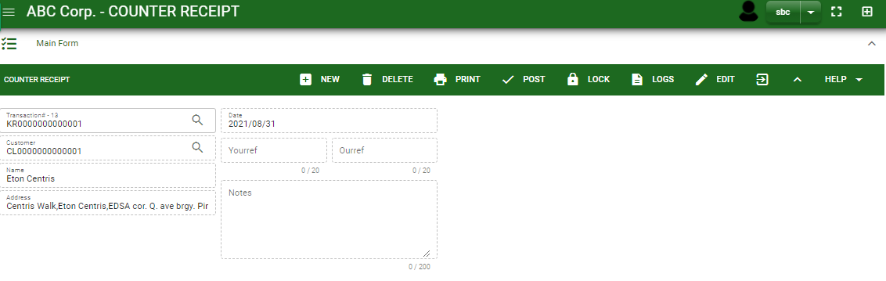

Receivables / Counter Receipt- Module
How To Edit Counter Receipt Transaction?
1.1. In the counter receipt – main window, search the counter receipt transaction you wish to edit its information in the search bar. Or,
1.2. In counter receipt – main form, click the lookup button and select the transaction you wish to edit the list by typing its transaction number in the search bar.
2. After you select the KR transaction, if you wish to edit the header of the transaction click edit button.
3. If you are done editing the KR header, click save button in the upper side of the header.
1.1.
Counter Receipt – Main Window
HEADER
2.
1.2.
How to search KR transaction?
Type the transaction number in the search bar.
Click ‘enter’ in the keyboard to search.
Click to select the transaction you want to edit
Counter Receipt – Main Form

Slide 7
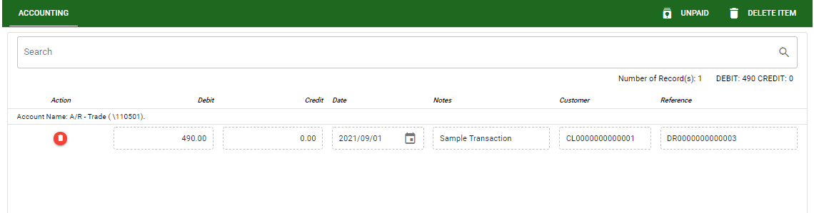
Receivables / Counter Receipt- Module
How To Edit Counter Receipt Transaction?
DETAIL
4. If you want to edit the list in the detail, click the button delete to remove it from the list.
5. If you’re done editing, click save account button to save the changes you made in the entry.
5

Slide 8
Receivables / Counter Receipt- Module
How To Delete Counter Receipt Transaction?
1.1 In the counter receipt – main window, search the counter receipt transaction you wish to edit its information in the search bar. Or,
1.2 In counter receipt – main form, click the lookup button and select the transaction you wish to edit the list by typing its transaction number in the search bar.
2. If done, click delete button.
1.1.
Counter Receipt – Main Window
HEADER
2.
1.2.
How to search KR transaction?
Type the transaction number in the search bar.
Click ‘enter’ in the keyboard to search.
Click to select the transaction you want to edit
Counter Receipt – Main Form

