Slide 1
Sales Activity
SSales Activity is where initial order of customer is encoded

Slide 2
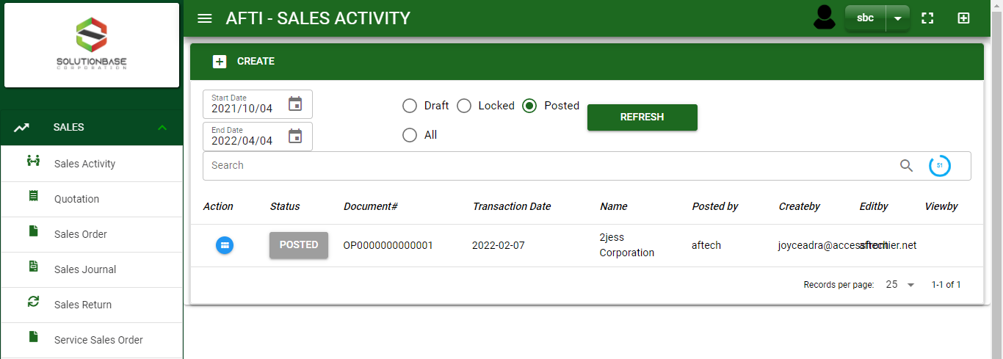

Sales/ Sales Activity - Module
Main Window
When you click the Sales Activity module under Sales, Sales Activity transactions .
Sales activity – Main Window

Slide 3
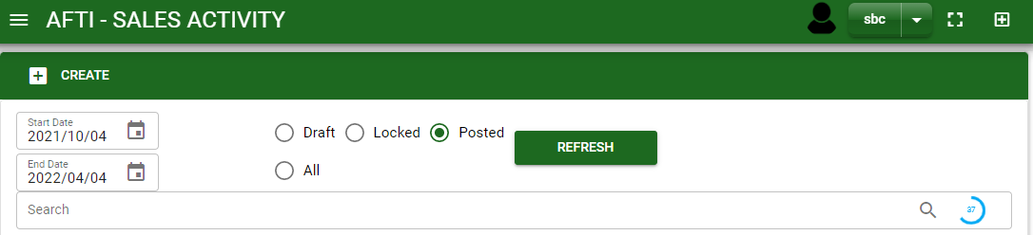
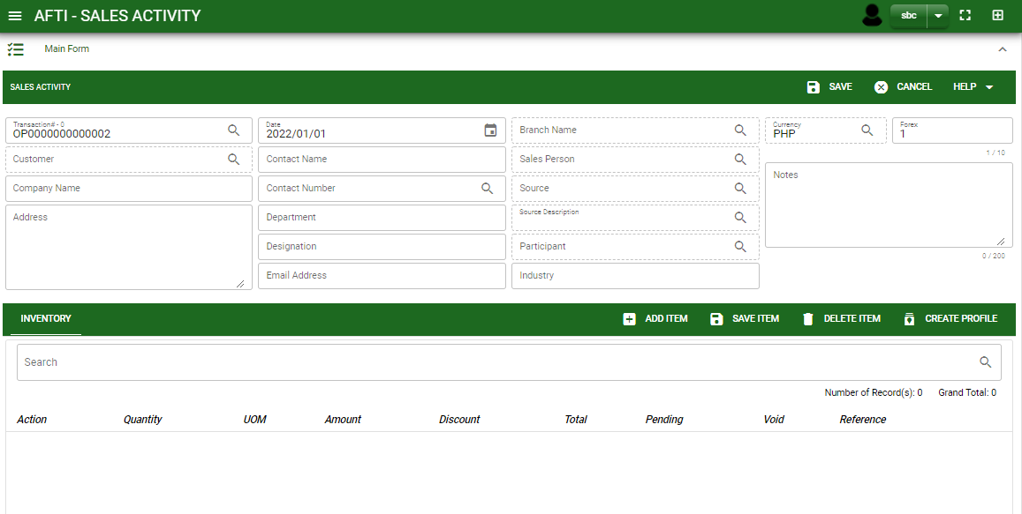
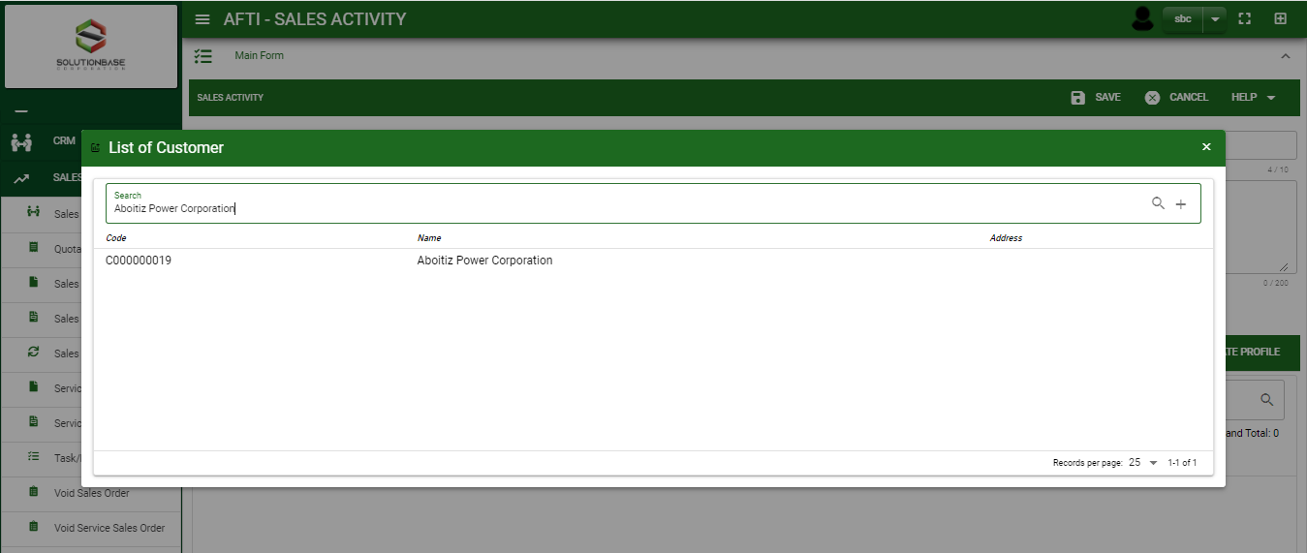
Sales/ Sales Activity - Module
1
How To Create Sales Activity Transaction?
1. In Sales Activity – Main Window, you will notice a create button in the upper left of the window. Click the create button and you will be redirect in sales activity – main form.
2.1. If customer is new and no record in customer ledger, fill in;
- Company Name
- Address
- Contact Name
- Contact Number
- Contact Person - Department
- Contact Person - Designation
- Contact Person - Email Address
Industry
2.1. But if customer has already record in customer ledger module, click lookup button in customer field and select customer name.
1
How to search customer?
Type the customer name in the search bar.
And it will automatically sort out.
Then click the selected customer.

Slide 4
Sales/ Sales Activity - Module
How To Create Sales Activity Transaction?
4
3. Fill in other necessary fields.
4. If done in header, click save button.
5. After saving the header, you may now add the ordered items in the stock by clicking add item button.
Header
5
Stock

Slide 5
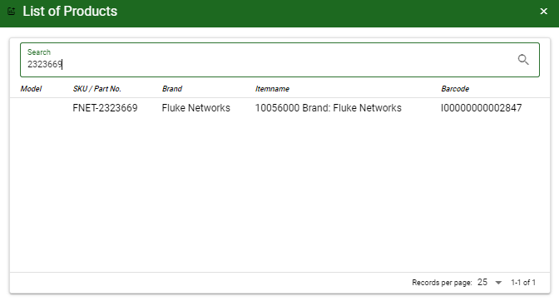
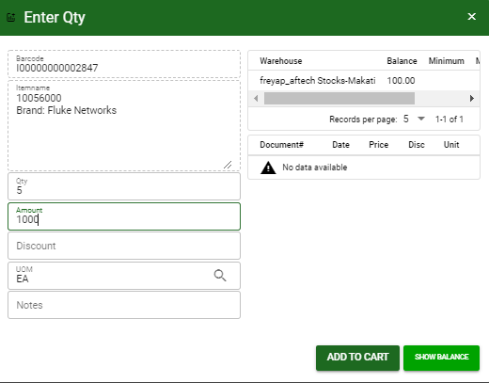
Sales/ Sales Activity - Module
How To Create Sales Activity Transaction?
6.1
6.1 Search and select the ordered item.
6.2. After you select the item, a dialog box where item details will be encoded will pop out.
6.3. If you want to check the balance per warehouse, click show balance button.
6.4. Enter the quantity, change the amount, uom, and add sales discount and notes if there’s any.
6.5. If done, click add to cart button.
How to search item?
Type the item in the search bar.
And it will automatically sort out.
Then click the selected item.
6.4
6.5
6.3.

Slide 6

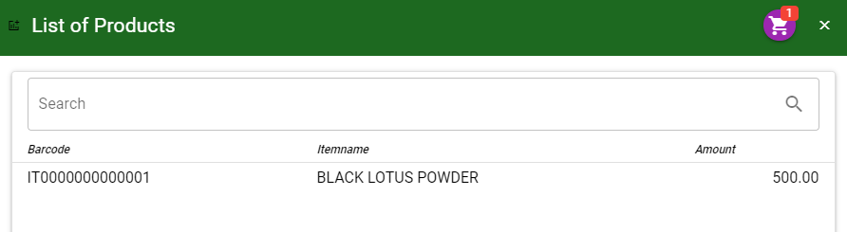
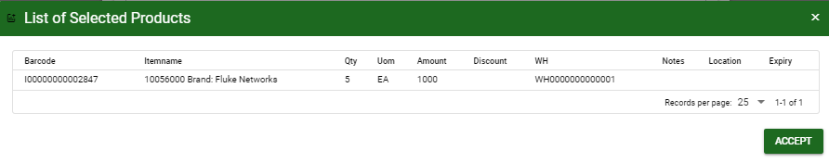
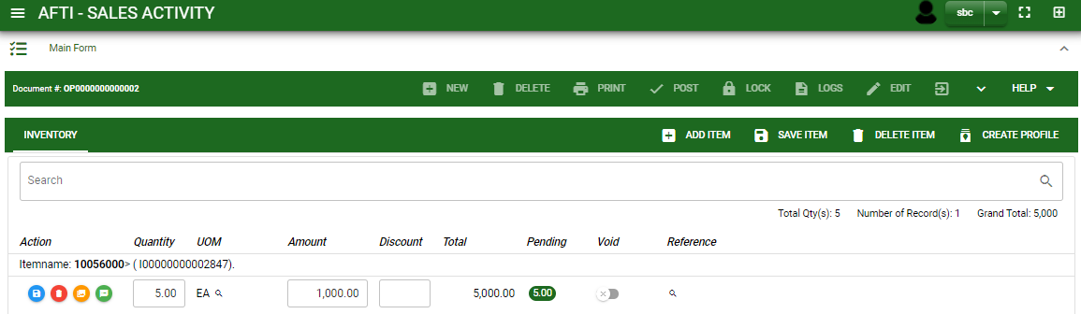
Sales/ Sales Activity - Module
How To Create Sales Activity Transaction?
7. After you click the add to cart button, you will notice in the upper right of the list of products an icon of cart. Click that, then click accept button to plot the order items in the stock.
8. To add more items, repeat steps 6.1 to 6.5 before doing step 7
9. After you click the accept button in the list of selected products, items from the cart will be plotted in the stock as shown below.
9.1. You may still edit the details per item in the stock. Change directly the details needed to be change.
9.2. If done, click save item button
9.2.
STOCK
9.1.

Slide 7
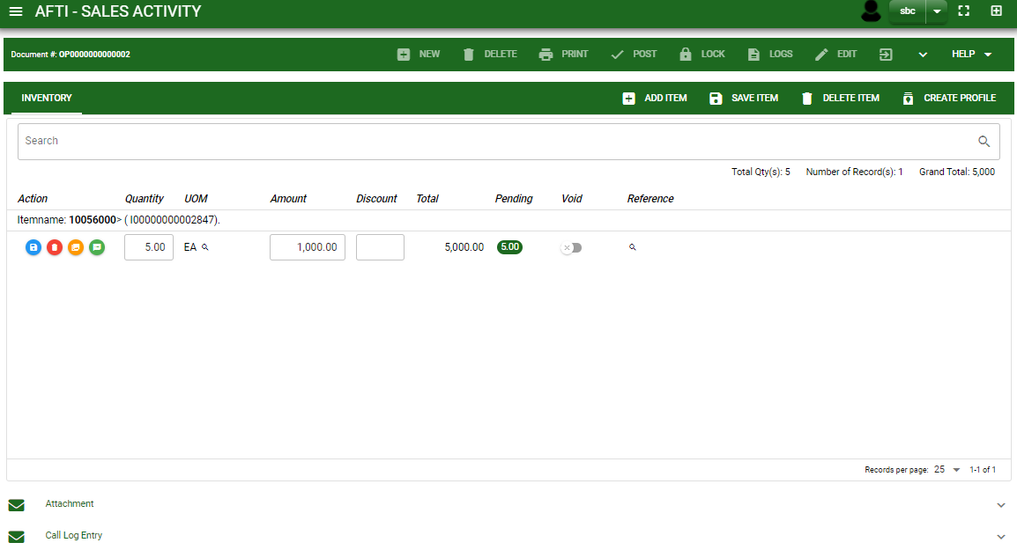
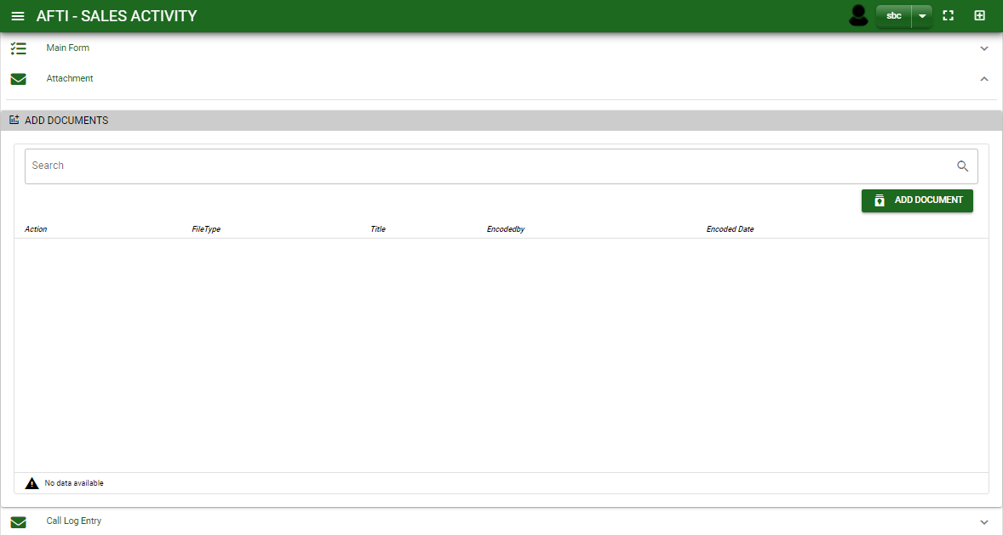
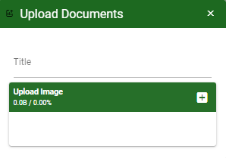
Sales/ Sales Activity - Module
How To Create Sales Activity Transaction?
10. Scroll down and you will notice, attachment tab.
11. Click maximize arrow to view the attachment tab
12. Attach document if there’s any.
12.1. Click add document button
12.2. Once you click the add document button, a dialog box of upload documents will pop out.
12.3. To upload files, follow ‘how to upload document”
13. Scroll down and you will notice, call log tab.
12.1.
How to upload document?
Type the title of the document.
Click add button to add the chosen document to upload
Then click upload button.
If you want to add more document, click add document button and repeat steps #12.4 to #12.6
12.4
12.5
11

Slide 8
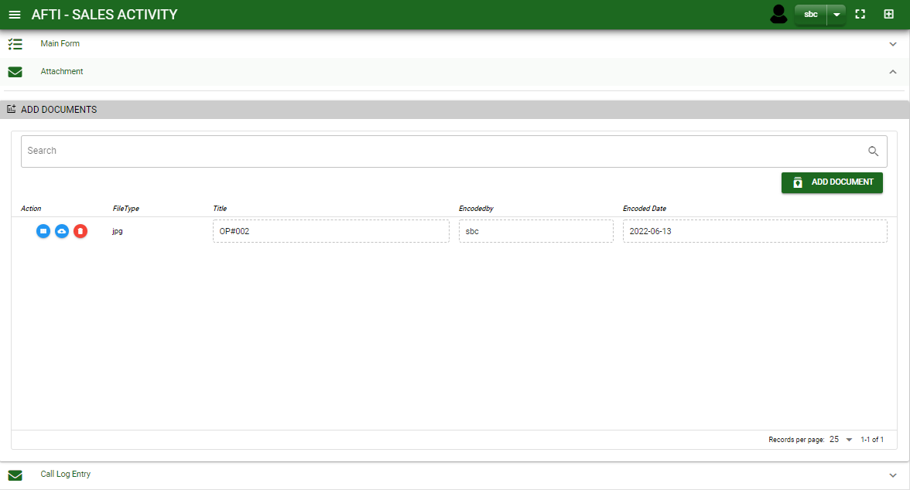
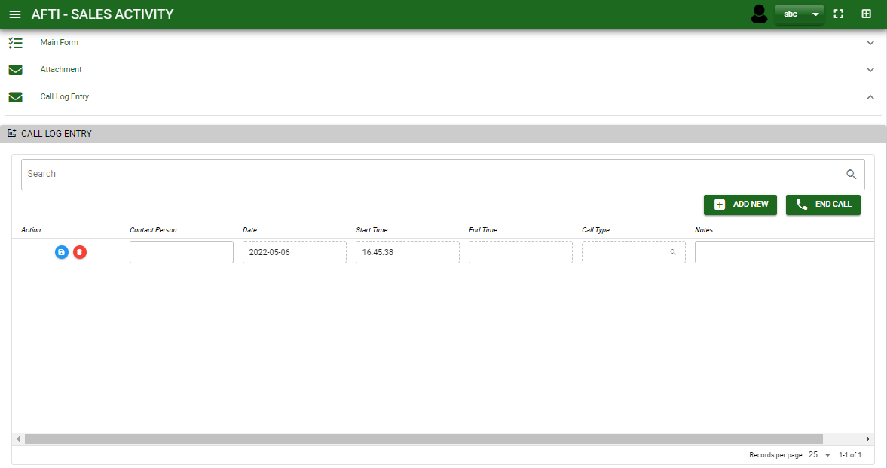
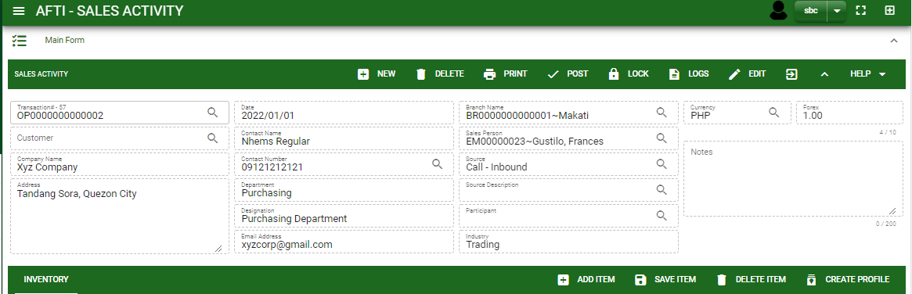
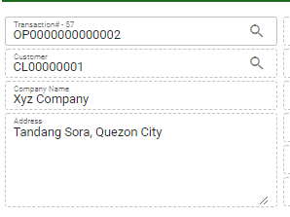
Sales/ Sales Activity - Module
How To Create Sales Activity Transaction?
14. Click maximize arrow to view the call log tab
14.1 Click Add New to add call logs, fill contact person, call type and notes.
14.2. Click save button to save the data encoded.
14.3. Click end call button to end the call log and the system will automatically fill in End time log.
14.4. Click add new button to add new call logs and repeat steps #14.1. to #14.3. (Note: you cannot add new call log when there is existing call logs not yet ended.
15. If done, you may now post the transaction.
But for customer that do not have profile in customer ledger it is require to click create profile button to generate customer code and then Post.
14.1.
14.2.
14.3.
14.1.
14
Once you click the create profile button, it will automatically be added in customer ledger module.
15

Slide 9
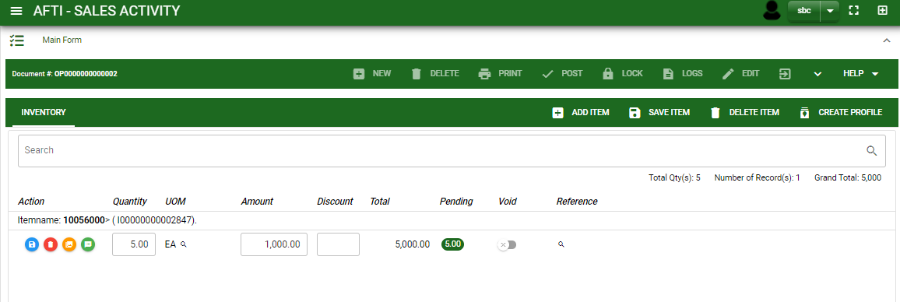

Sales/ Sales Activity - Module
How To Create Sales Activity Transaction?
16. To finalize the transaction. Click maximize button from the main form tab.
17. then click post button.
16
17

Slide 10
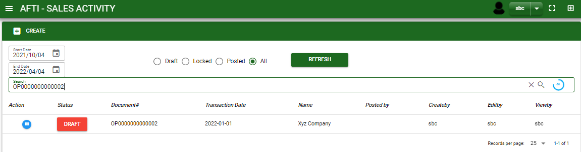
Sales/ Sales Activity - Module
How To Edit Sales Activity Transaction?
1.1 In the sales activity – main window, search the sales activity transaction you wish to edit its information in the search bar. Or,
1.2 In sales activity – main form, click the lookup button and select the transaction you wish to edit its information by typing its transaction number in the search bar.
2. To edit the header of the transaction click edit button.
3. If you are done, click save button in the upper side of the header.
1.1.
Sales activity – Main Window
HEADER
2.
1.2.
How to search Sales Activity transaction?
Type the transaction number in the search bar.
Click ‘enter’ in the keyboard to search.
Click to select the transaction you want to edit

Slide 11
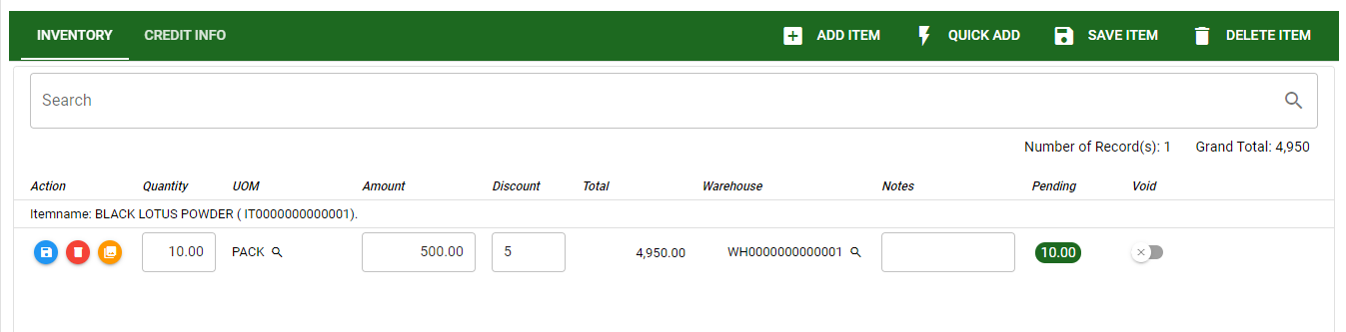
Sales/ Sales Activity - Module
How To Edit Sales Activity Transaction?
STOCK
5
4. To edit the items in stock, edit directly the details you want to change and you will notice that after you change the details, the item you edited will be highlighted into blue.
5. If you’re done editing, click save item button to save the changes you made in the items.
4

Slide 12
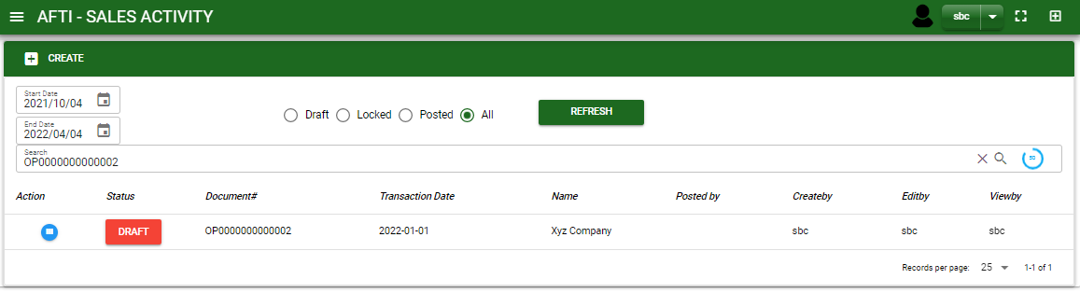
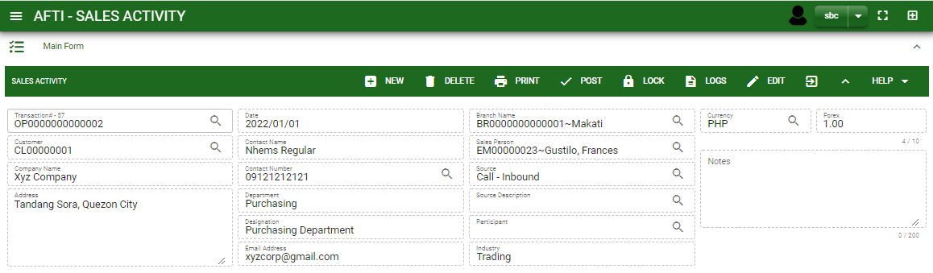
Sales/ Sales Activity - Module
How To Delete Sales Activity Transaction?
1.1 In the sales activity– main window, search the transaction you want to delete.
1.2 In sales activity – main form, click the lookup button and select the transaction you want to delete.
2. If done, click delete button.
1.1.
Sales activity – Main Window
HEADER
2.
1.2.
How to search Sales Activity transaction?
Type the transaction number in the search bar.
Click ‘enter’ in the keyboard to search.
Click to select the transaction you want to delete

Slide 13
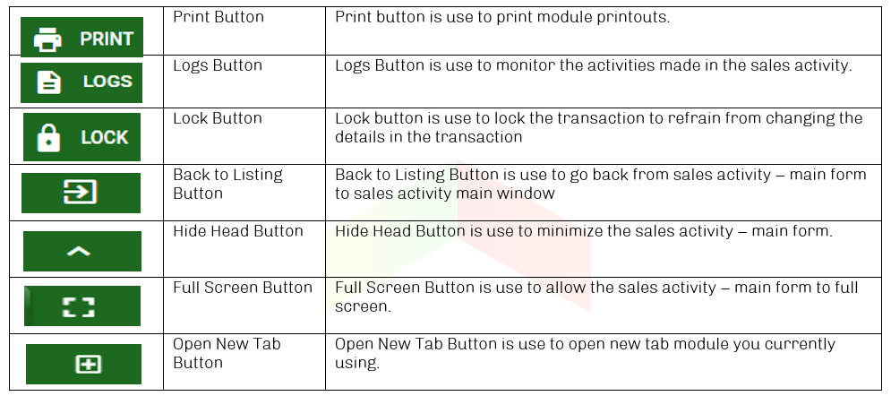
Sales/ Sales Activity - Module
Other Buttons

