Slide 1
Outsource
to record outsource items.

Slide 2
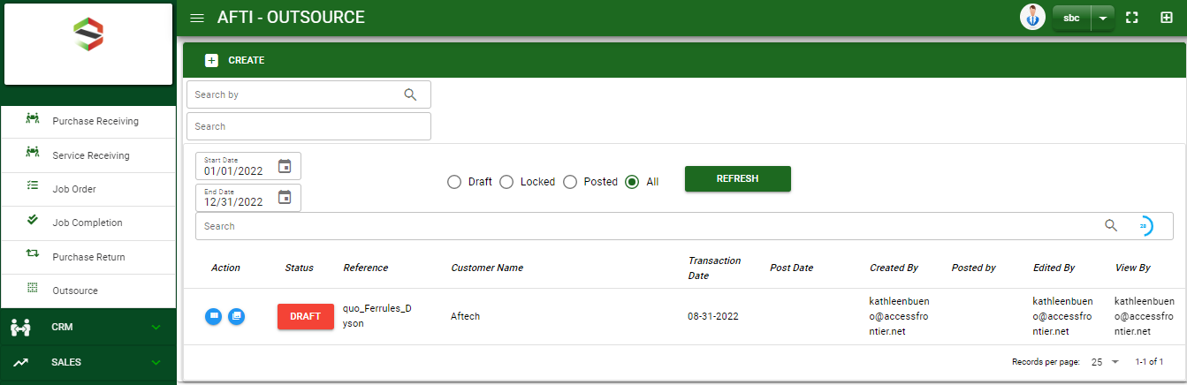

Purchase / Outsource - Module
Main Window
When you click the Outsource module under Purchases, Outsource transactions list will display based on filtered date and status in the purchases return main window.
Outsource – Main Window

Slide 3
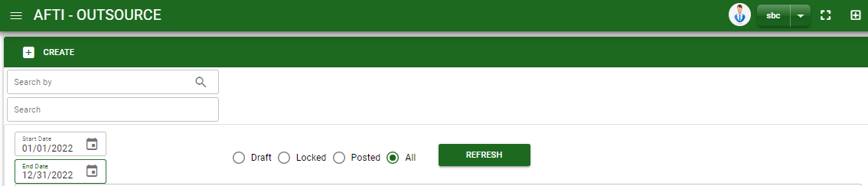
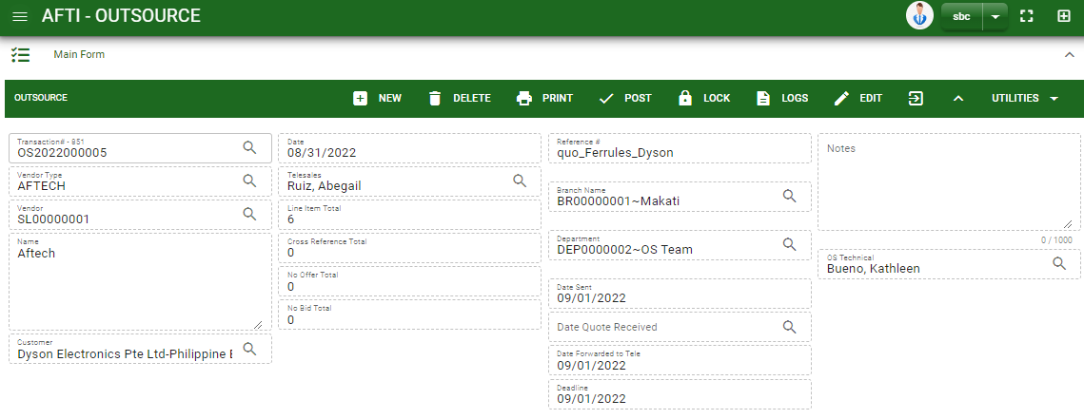
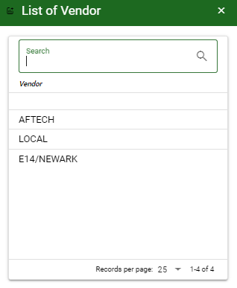
Purchase / Outsource - Module
How To Create Outsource Transaction?
1
1. In Outsource – Main Window, you will notice a create button in the upper left of the window. Click the create button and you will be redirect in outsource – main form.
2. After you click the create button a select a vendor
3. After you select a vendor, encode other necessary information of the transaction and record the item/s.
2
How to search vendor?
Type the vendor name in the search bar.
And it will automatically sort out.
Then click the selected vendor.

Slide 4
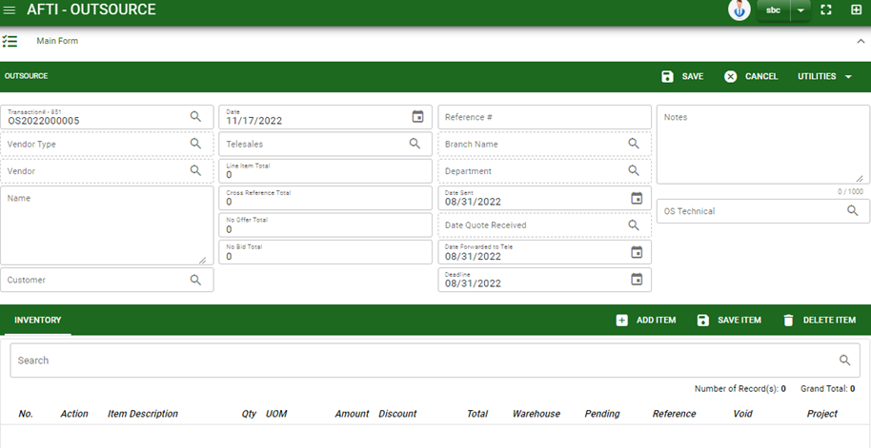
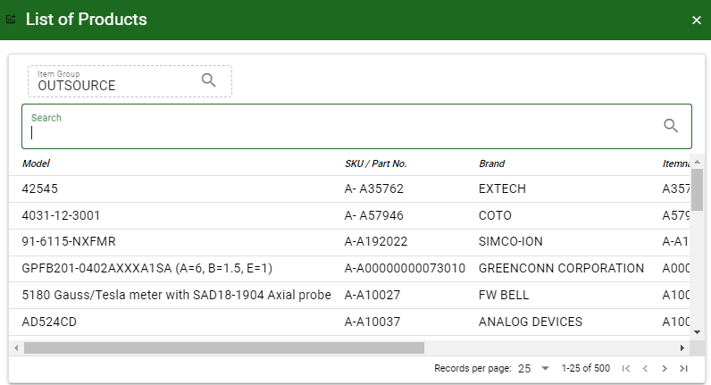
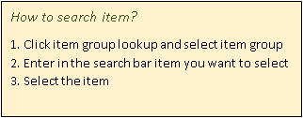
Purchase / Outsource - Module
How To Create Outsource Transaction?
Header
4.2
4.1. Fill in other necessary information.
4.2. If done in header, click save button.
5. After saving the header, you may now add the item/s.
6. Click add item button to select an items.
4.1
Stock
6
1
2

Slide 5
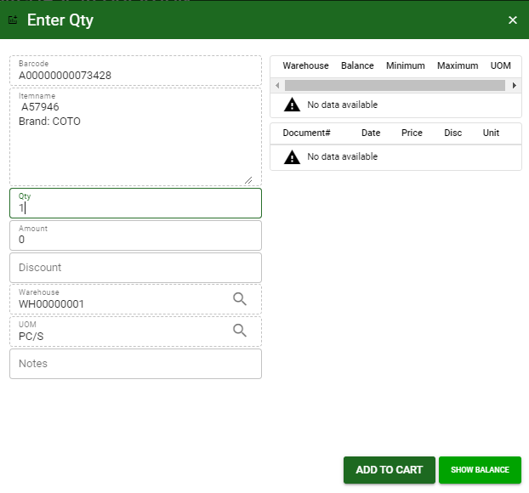
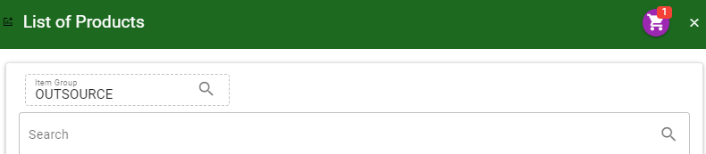
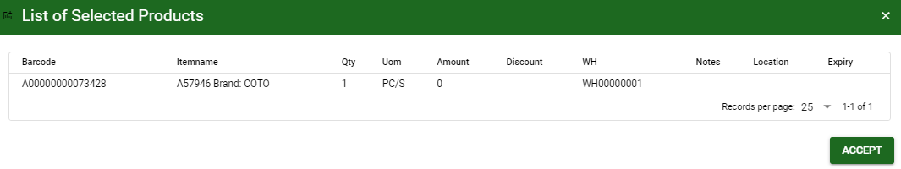
Purchase / Outsource - Module
How To Create Outsource Transaction?
After you select an item, a dialog box will pop out. Enter the details of the selected item.
After you click the add to cart button, item will be temporarily be added in the cart.
If you wish to add more items, repeat step #6.
7. To add the items in outsource – main window, click the cart button and click accept button.
How to add item details?
1. Fill in the quantity, amount, and discount if there’s any.
2. Change warehouse and uom if needed
3. Add notes if there’s any
4. Add to cart if done
4
7.
7.

Slide 6
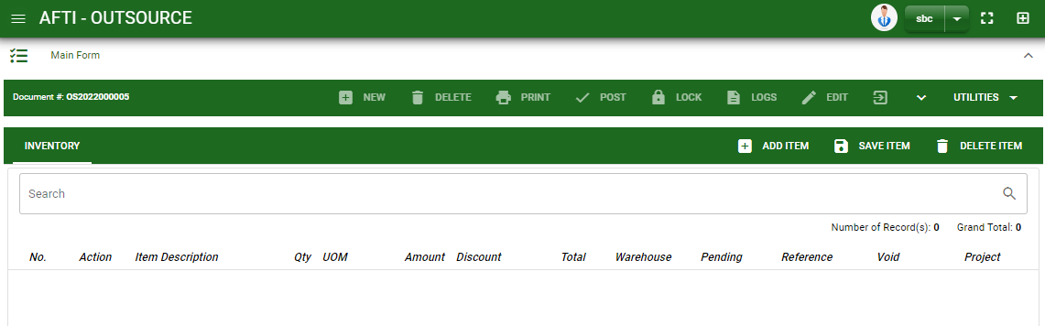
Purchase / Outsource - Module
How To Create Outsource Transaction?
8. If done, finalize the transaction by click the arrow button to maximize the main form header.
9. In header, click post button.
8.
9.

Slide 7
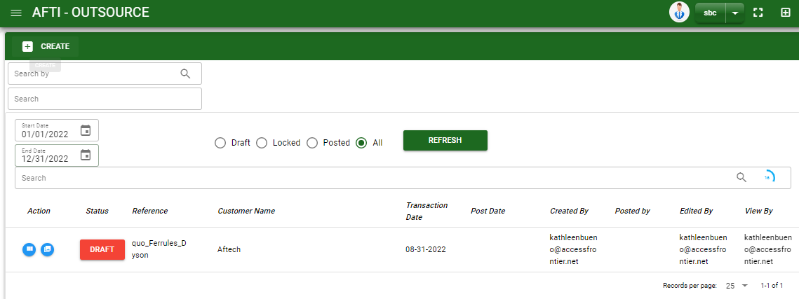
Purchase / Outsource - Module
How To Edit Outsource Transaction?
1.1. In the outsource – main window, search the outsource transaction you wish to edit its information in the search bar. Or,
1.2 In outsource – main form, click the lookup button and select the transaction you wish to edit its information by typing its transaction number in the search bar.
2. After you select the outsource transaction, if you wish to edit the header of the transaction click edit button.
3. If you are done editing the outsource header, click save button in the upper side of the header.
1.1.
Outsource – Main Window
HEADER
2.
1.2.
How to search outsource transaction?
Type the transaction number in the search bar.
Click ‘enter’ in the keyboard to search.
Click to select the transaction you want to edit
Outsource – Main Forms

Slide 8
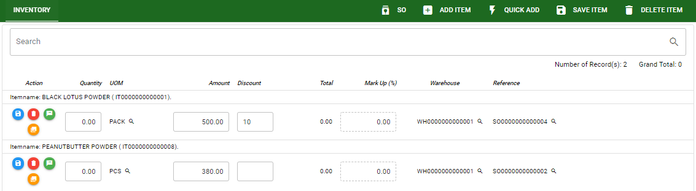
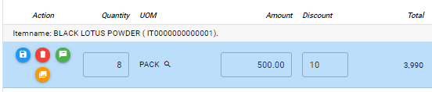
Purchase / Outsource - Module
How To Edit Outsource Transaction?
4. If you want to edit the items in outsource stock, edit right away the details you want to change and you will notice that after you change the details, the item you edited will be highlighted into blue.
5. If you’re done editing, click save item button to save the changes you made in the items.
6. To delete all items in the stock, click delete item button.
7. To delete a specific item on the table, click the delete icon next to the item to delete it.
STOCK
5
6
7
4

Slide 9
Purchase / Outsource - Module
How To Delete Outsource Transaction?
1.1.
1.1. In the outsource – main window, search the transaction you want to delete.
1.2. In outsource – main form, click the lookup button and select the transaction you want to delete.
2. If done, click delete button.
Outsource – Main Window
HEADER
2.
1.2.
How to search outsource transaction?
Type the transaction number in the search bar.
Click ‘enter’ in the keyboard to search.
Click to select the transaction you want to edit
Outsource – Main Form

Slide 10
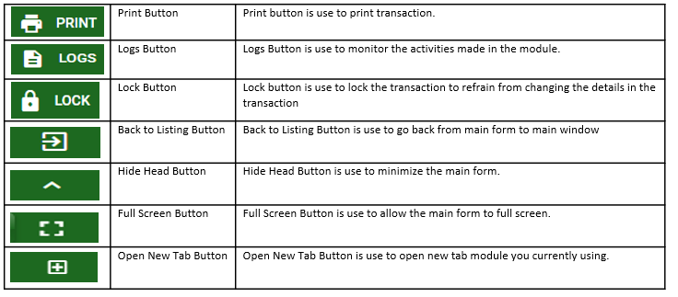
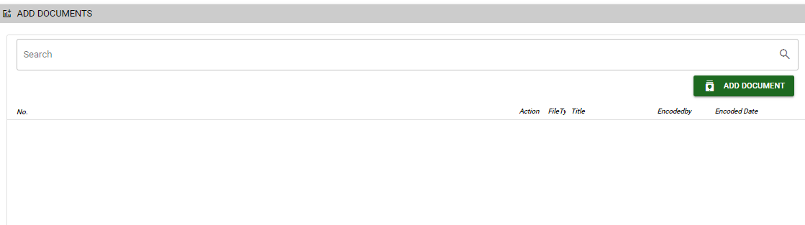
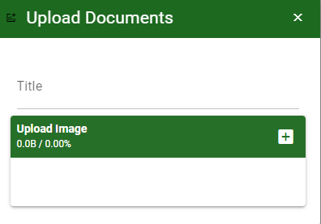
Purchase / Outsource- Module
Other Information
Other Buttons
When you click the arrow up icon parallel in the main form on the upper right, and the outsource– main form will be minimize and the other tab will be visible.
Attachment tab
1. Click the arrow icon parallel to attachment tab
2. Click add document button
3. Once you click the add document button, a dialog box of upload documents will pop out.
4. To upload files, follow ‘how to upload document”
Shipping tab
Click the arrow icon parallel to Shipping/ billing address
You may view or edit the Shipping and Billing Address for the return transaction.
2
How to upload document?
Type the title of the document.
Click add button to add the document you want to upload.
Then click upload button.
If you want to add more document, click add document button and repeat steps 1 to #3

