Slide 1
Physical Count
Is used to enter actual physical count of item as of given period.

Slide 2
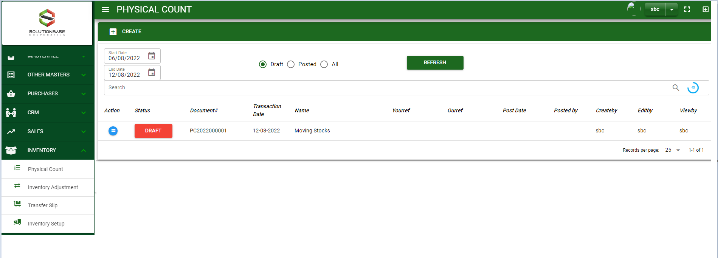

Inventory / Physical Count - Module
Main Window
When you click the Physical Count module under Inventory, it will display all the transactions based on filtered date and status in the physical count main window.
Physical Count– Main Window

Slide 3
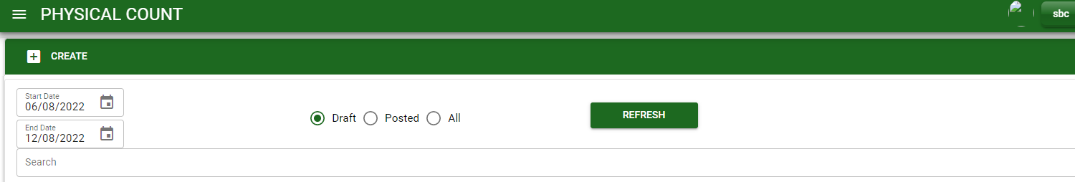
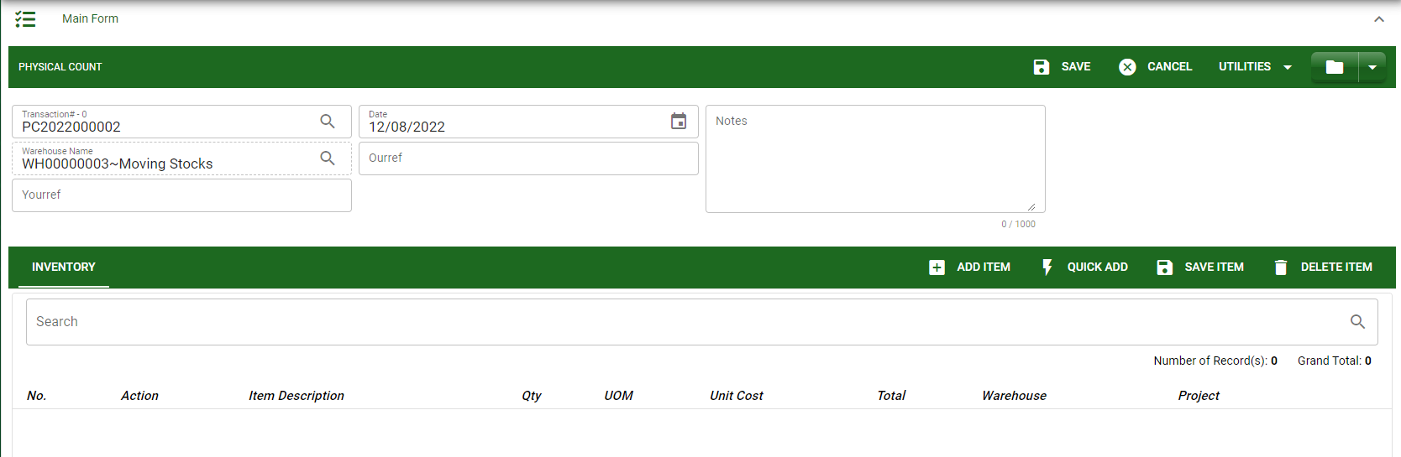
Inventory / Physical Count - Module
How To Create Physical Count Transaction?
1
In Physical Count – Main Window, you will notice a create button in the upper left of the window. Click the create button and you will be redirect in physical count – main form.
After you click the create button, the system will generate automatic document # and plot the default warehouse. You may encode other details needed for your transaction.
If done in header, click save button.
Header
3
2

Slide 4
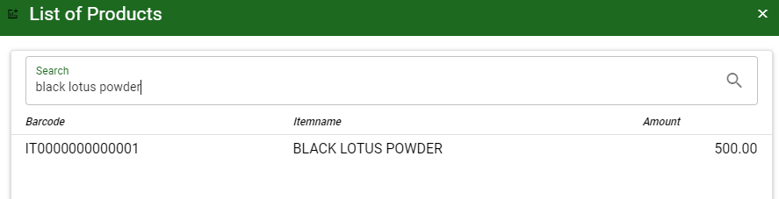
Inventory / Physical Count - Module
How To Create Physical Count Transaction?
After saving the header, you may now add the item in the stock by clicking add button.
After you click the add button, a dialog box with item list pop out, search and select the item
4
Stock
5
5

Slide 5
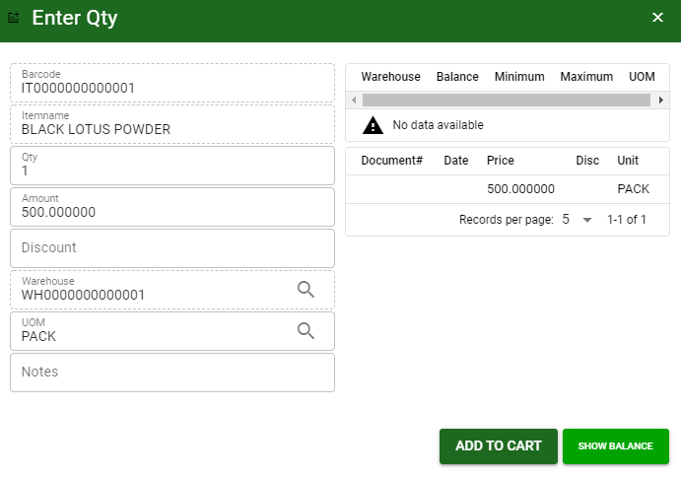
Inventory / Physical Count - Module
How To Create Physical Count Transaction?
5.1 After you select the item, a dialog box where item details will be encoded will pop out.
5.2 Enter the necessary quantity, change the amount, uom, warehouse.
5.3 If done, click add to cart button.
5.2.
5.3

Slide 6
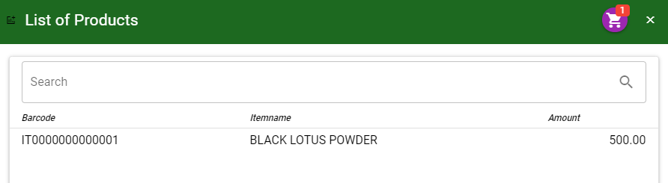
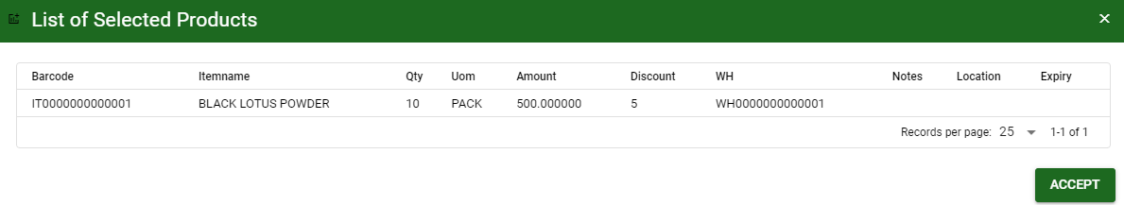
Inventory / Physical Count - Module
How To Create Physical Count Transaction?
5.4 After you click the add to cart button, you will notice in the upper right of item list an icon of add to cart. Click that, then click accept button to plot the items in the stock.
5.6
5.6

Slide 7
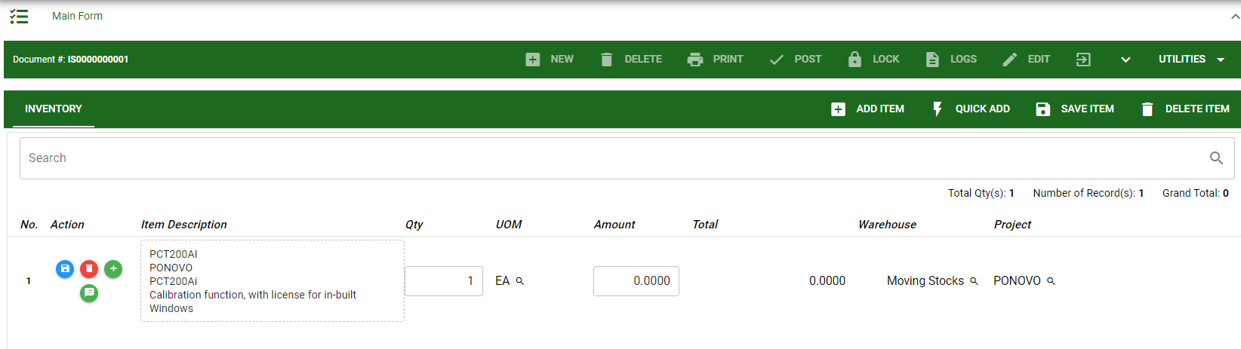
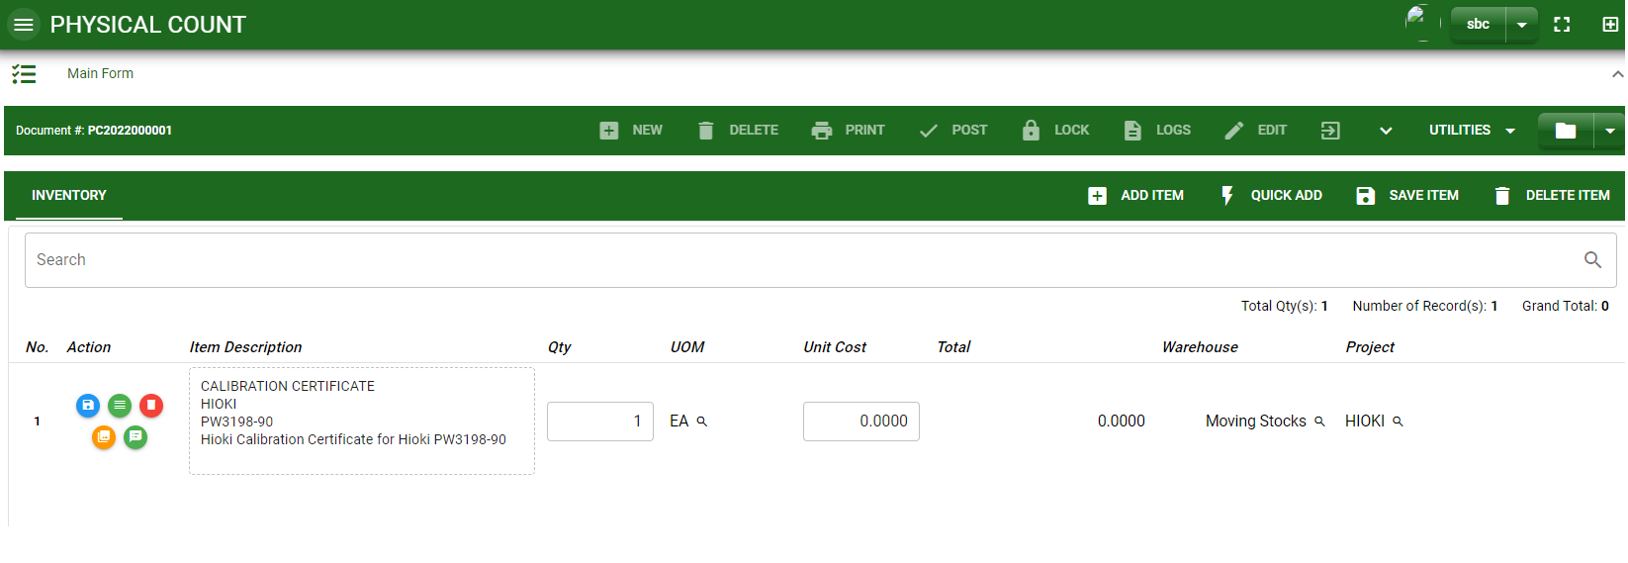
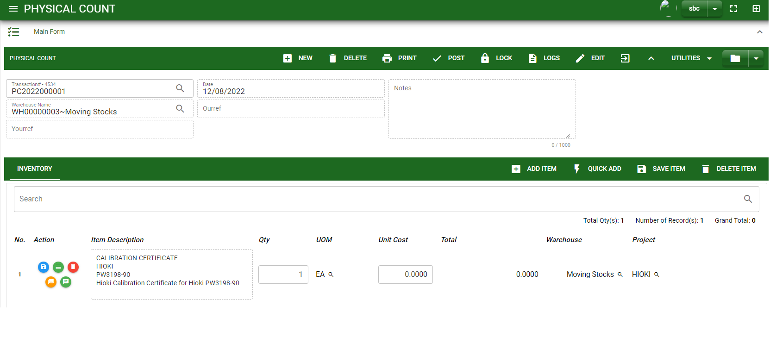
Inventory / Physical Count - Module
How To Create Physical Count Transaction?
5.5 To add more items, repeat 5 to 5.3 before doing 5.4
5.7 After you click the accept button in the dialog box of selected items in 5.5., the items selected will be plotted in the stock as shown below.
5.8 You may still edit the details per item in the stock. Change directly the details needed to be change.
5.9 If done, click save item button
5.10 Click the maximize arrow to enable the post button.
5.11 To finalize, the transaction, click post button located in the header.
5.9
5.10
5.11

Slide 8
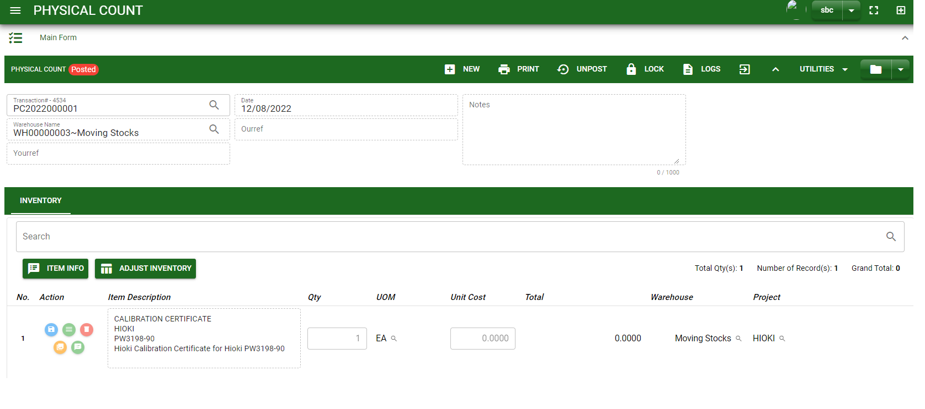
Inventory / Physical Count - Module
How To Create Physical Count Transaction?
5.12 After posting, you may click the Adjust Inventory Button to automatically create Inventory Adjustment between System count and Physical Count encoded.

Slide 9
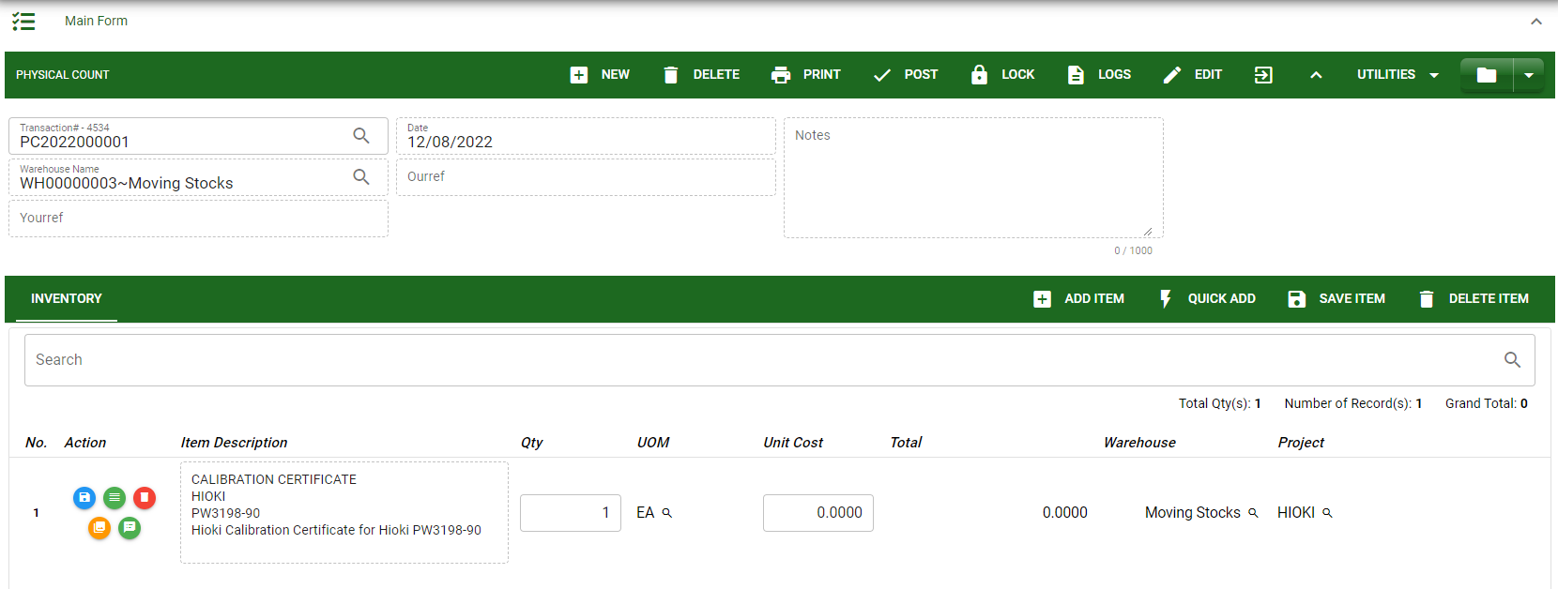
Inventory / Physical Count - Module
How To Edit Physical Count Transaction?
1.1. In the physical count – main window, search the transaction you wish to edit its information in the search bar. Or,
1.2. In physical count – main form, click the lookup button and select the transaction you wish to edit its information by typing its transaction number in the search bar.
2. After you select the transaction, if you wish to edit the header of the transaction click edit button.
3. If you are done editing, click save button in the upper side of the header.
1.1.
Physical Count– Main Window
HEADER
2.
1.2.
How to search transaction?
Type the transaction number in the search bar.
Click ‘enter’ in the keyboard to search.
Click to select the transaction you want to edit
Physical Count– Main Form

Slide 10
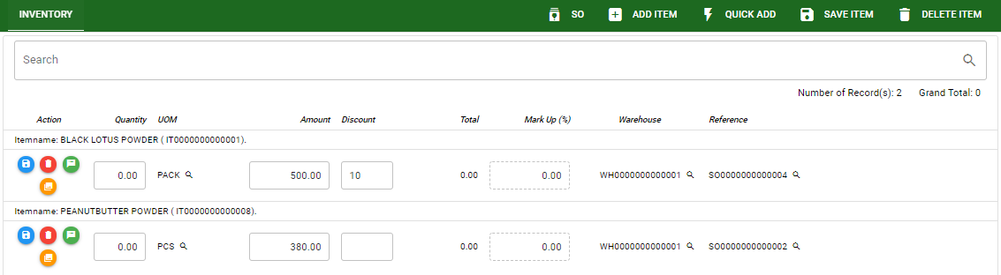
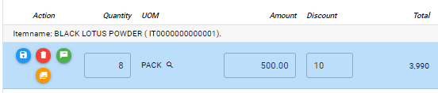
Inventory / Physical Count - Module
How To Edit Physical Count Transaction?
STOCK
4. If you want to edit the items in stock, edit right away the details you want to change and you will notice that after you change the details, the item you edited will be highlighted into blue.
5. If you’re done editing, click save item button to save the changes you made in the items.
6. To delete all items in the stock, click delete item button.
7. To delete a specific item on the table, click the delete icon next to the item to delete it.
5
6
7
4

Slide 11
Inventory / Physical Count - Module
How To Delete Physical Count Transaction?
1.1.
1.1. In the physical count – main window, search the transaction you want to delete.
1.2. In physical count - main form, click the lookup button and select the transaction you want to delete.
2. If done, click delete button.
Physical Count– Main Window
HEADER
2.
1.2.
How to search transaction?
Type the transaction number in the search bar.
Click ‘enter’ in the keyboard to search.
Click to select the transaction you want to edit
Physical Count– Main Form

Slide 12




Inventory / Physical Count - Module
Other Information
Other Buttons
When you click the arrow up icon parallel in the main form on the upper right, and the Physical Count – main form will be minimize and the other information will be displayed as shown in the photo below.
Click the arrow parallel to what information you want to open and provide the necessary filter to generate the data you want to display.
 | Print Button | Print button is use to print transaction.
 | Logs Button | Logs Button is use to monitor the activities made in the module.
 | Lock Button | Lock button is use to lock the transaction to refrain from changing the details in the transaction
 | Back to Listing Button | Back to Listing Button is use to go back from main form to main window
 | Hide Head Button | Hide Head Button is use to minimize the main form.
 | Full Screen Button | Full Screen Button is use to allow the main form to full screen.
 | Open New Tab Button | Open New Tab Button is use to open new tab module you currently using.

