Slide 1
Purchase Order
It is where orders to suppliers are encoded.

Slide 2
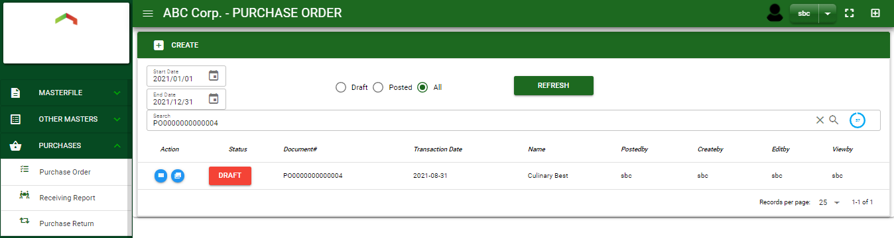

Purchase / Purchase Order - Module
Main Window
When you click the Purchase Order module under Purchases, Purchase Order transactions list will display based on filtered date and status in the purchase order main
Purchase Order – Main Window

Slide 3
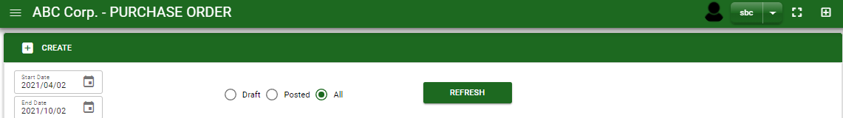
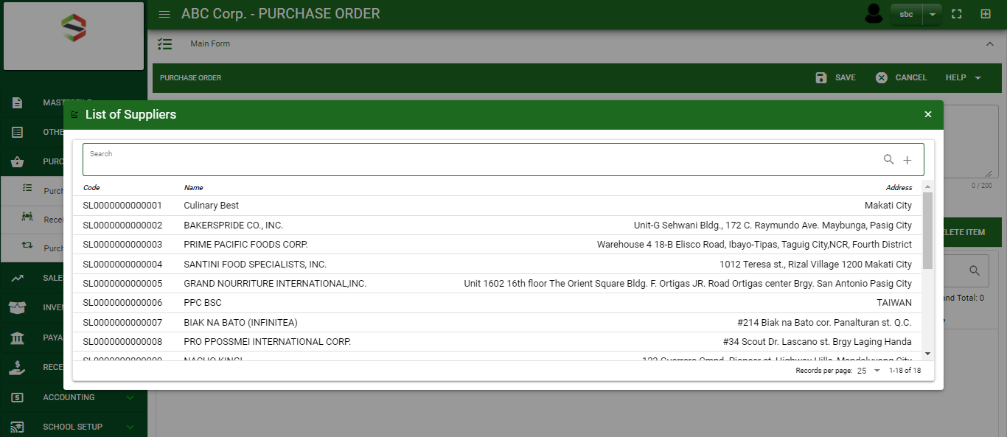
Purchase / Purchase Order - Module
How To Create Purchase Order Transaction?
1
1. In Purchase Order – Main Window, you will notice a create button in the upper left of the window. Click the create button and you will be redirect in purchase order – main form.
2. After you click the create button a dialog box will pop out with list of supplier. Search and select a supplier.
2
3. After you select a supplier, you will be redirected in purchase order – main form where you will encode the other necessary information of the transaction and record the items’ ordered.

Slide 4
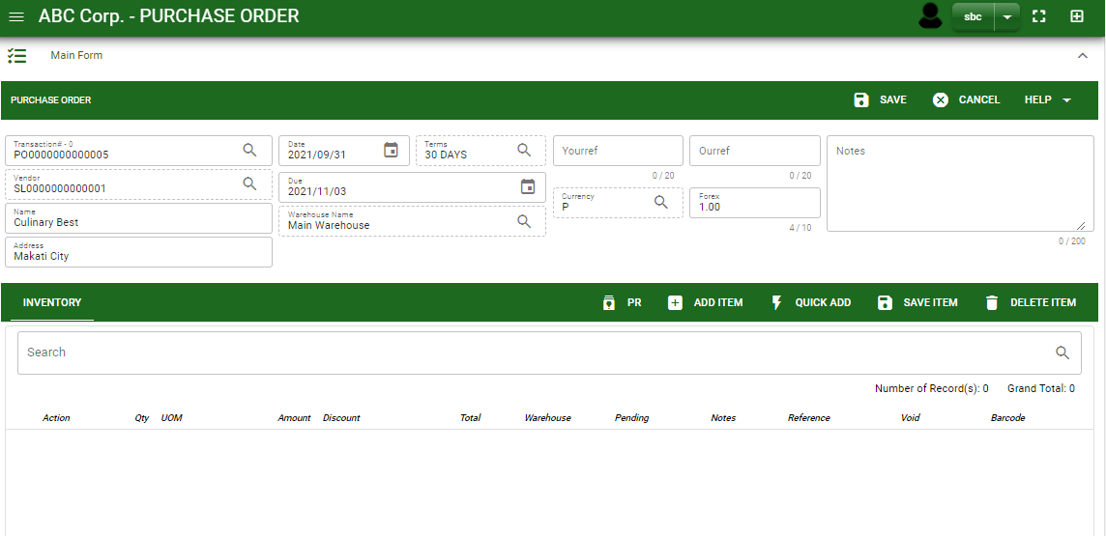
Purchase / Purchase Order - Module
How To Create Purchase Order Transaction?
4.1 In header, add the necessary information if necessary.
4.2 If done in header, click save button.
5. After saving the header, you may now add the ordered items.
OS items: If ordered items are from outsource items, click OS button to select items from outsource.
PR: If ordered items are from purchase requisition, click PR to select transactions made in purchase requisition module.
SO: If ordered items are from Sales Order, click SO button to select transaction from sales order module.
Add item: If ordered items don’t have any reference, manually add the item by clicking the add item button.
4.2
4.1
5
Stock

Slide 5
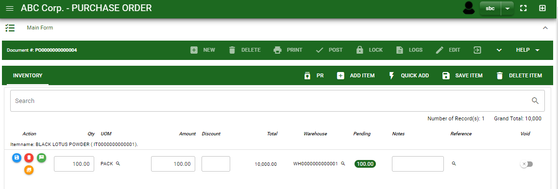
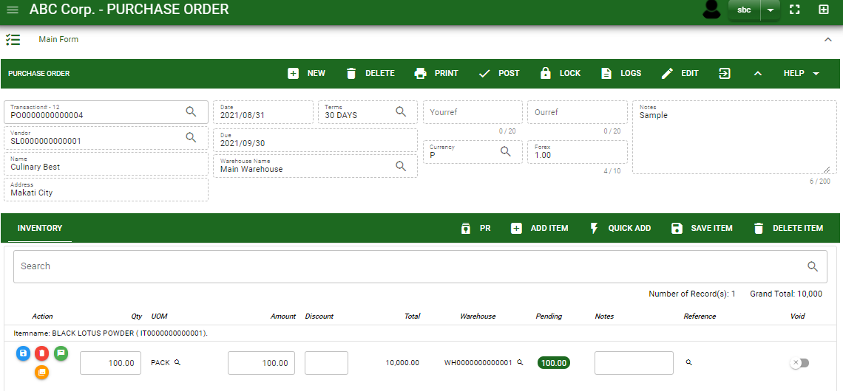
Purchase / Purchase Order - Module
How To Create Purchase Order Transaction?
6. If done, finalize the transaction by click the arrow button to maximize the main form header.
7. In header, click post button.
6
7

Slide 6
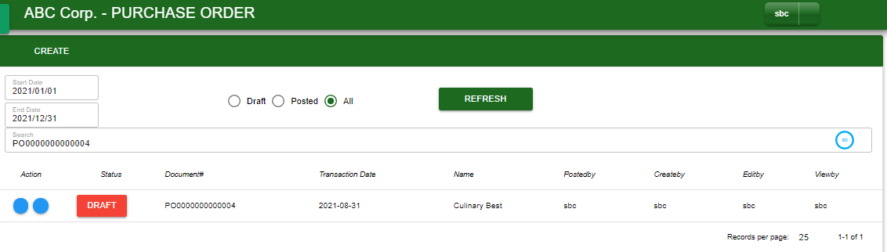
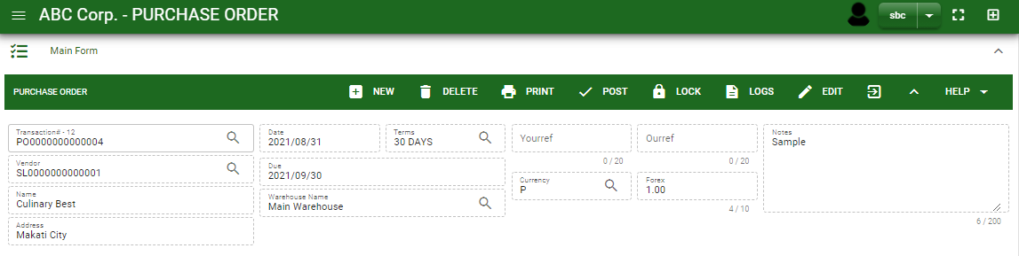
Purchase / Purchase Order - Module
How To Edit Purchase Order Transaction?
1.1. In the purchase order – main window, search the purchase order transaction you wish to edit its information in the search bar. Or,
1.2. In purchase order – main form, click the lookup button and select the transaction you wish to edit its information by typing its transaction number in the search bar.
2. After you select the PO transaction, if you wish to edit the header of the transaction click edit button.
3. If you are done editing the purchase order header, click save button in the upper side of the header.
1.1.
Purchase Order – Main Window
HEADER
2.
1.2.
Purchase Order – Main Form

Slide 7
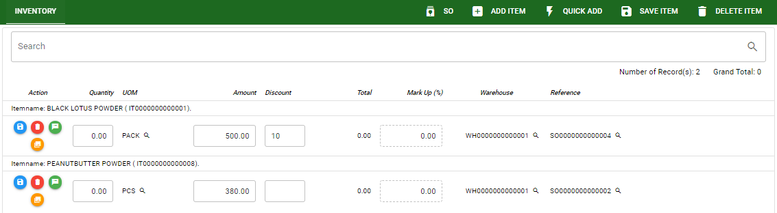
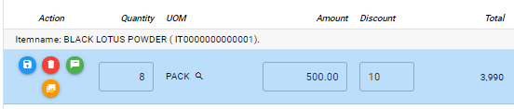
Purchase / Purchase Order - Module
How To Edit Purchase Order Transaction?
4. If you want to edit the items in purchase order stock, edit right away the details you want to change and you will notice that after you change the details, the item you edited will be highlighted into blue.
5. If you’re done editing, click save item button to save the changes you made in the items.
6. To delete all items in the stock, click delete item button.
7. To delete a specific item on the table, click the delete icon next to the item to delete it.
STOCK
5
6
7
4

Slide 8
Purchase / Purchase Order - Module
How To Delete Purchase Order Transaction?
1.1.
1.1. In the purchase order – main window, search the transaction you want to delete.
1.2. In purchase order – main form, click the lookup button and select the transaction you want to delete.
2. After . If done, click delete button.
Purchase Order – Main Window
HEADER
2.
1.2.
How to search PO transaction?
Type the transaction number in the search bar.
Click ‘enter’ in the keyboard to search.
Click to select the transaction you want to edit
Purchase Order – Main Form

Slide 9
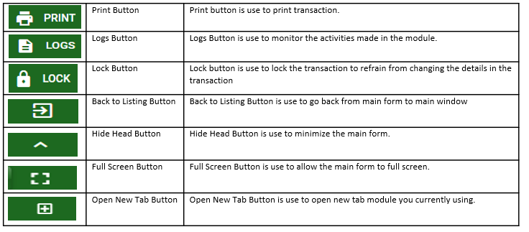
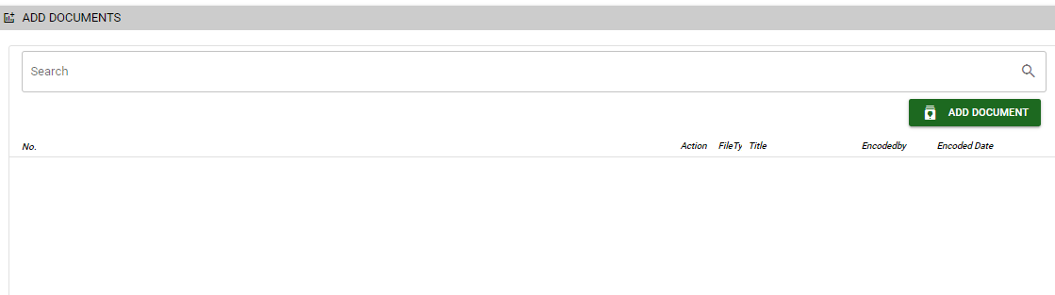
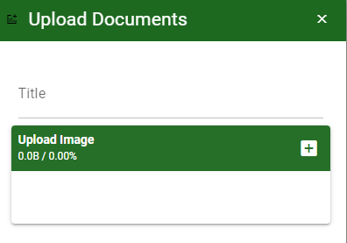
Purchase / Purchase Order - Module
Other Information
Other Buttons
When you click the arrow up icon parallel in the main form on the upper right, and the purchase order – main form will be minimize and the other tab will be visible.
Attachment tab
1. Click the arrow icon parallel to attachment tab
2. Click add document button
3. Once you click the add document button, a dialog box of upload documents will pop out.
4. To upload files, follow ‘how to upload document”
Instruction, Shipping and Comments tab
1. Click the arrow icon parallel to instruction or Shipping/ billing address, or comments tab
2. You may view the instructions copied from Sales Order
2
How to upload document?
Type the title of the document.
Click add button to add the document you want to upload.
Then click upload button.
If you want to add more document, click add document button and repeat steps 1 to #3

