Slide 1
Purchase Requisition
is module where purchase request per department is recorded

Slide 2
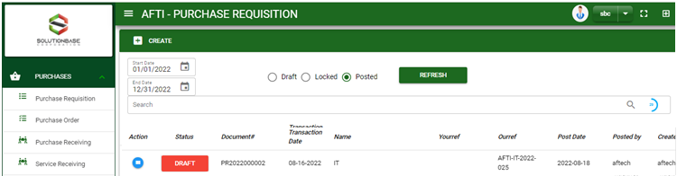

Purchase / Purchase Requisition - Module
Main Window
When you click the Purchase Requisition module under Purchases, Purchase Requisition transactions list will display based on filtered date and status in the purchase requisition main
Purchase Requisition – Main Window

Slide 3
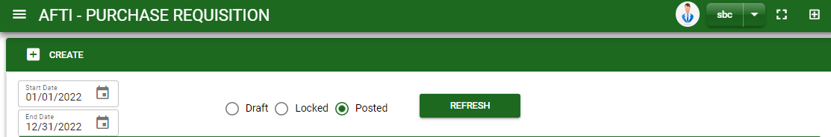
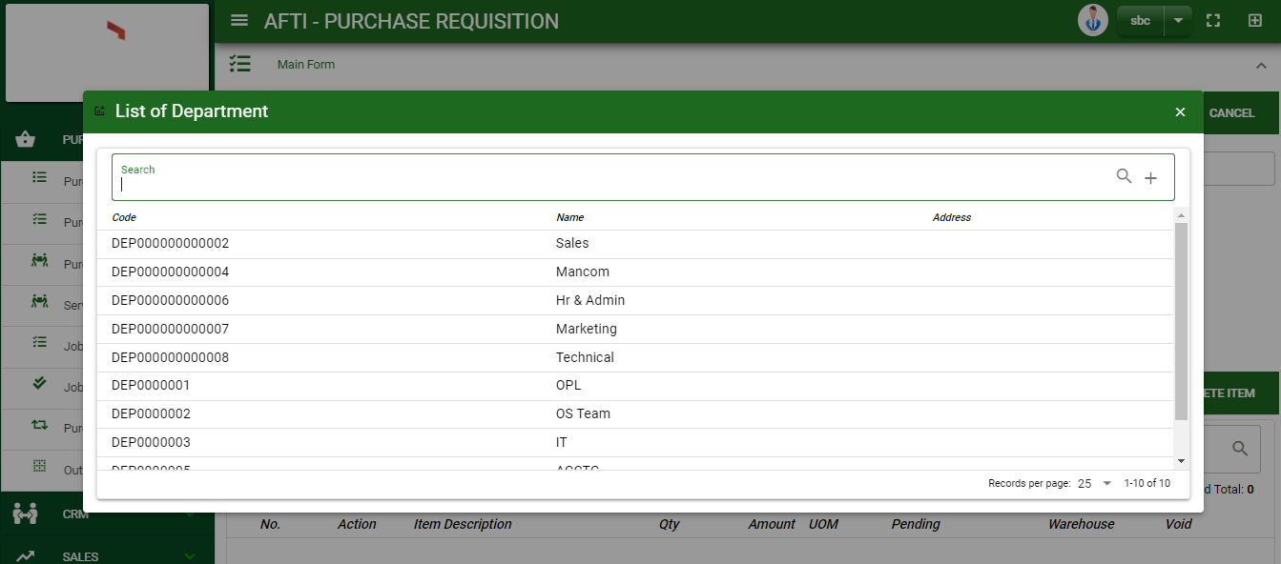
Purchase / Purchase Requisition - Module
How To Create Purchase Requisition Transaction?
1
1. In Purchase Requisition – Main Window, you will notice a create button in the upper left of the window. Click the create button and you will be redirect in purchase requisition – main form.
2. After you click the create button a dialog box will pop out with a list of departments. Search and select a department.
2
3. After you select a department, you will be redirect in purchase requisition – main form where you will encode other necessary information of the transaction and record the requested item/s.

Slide 4
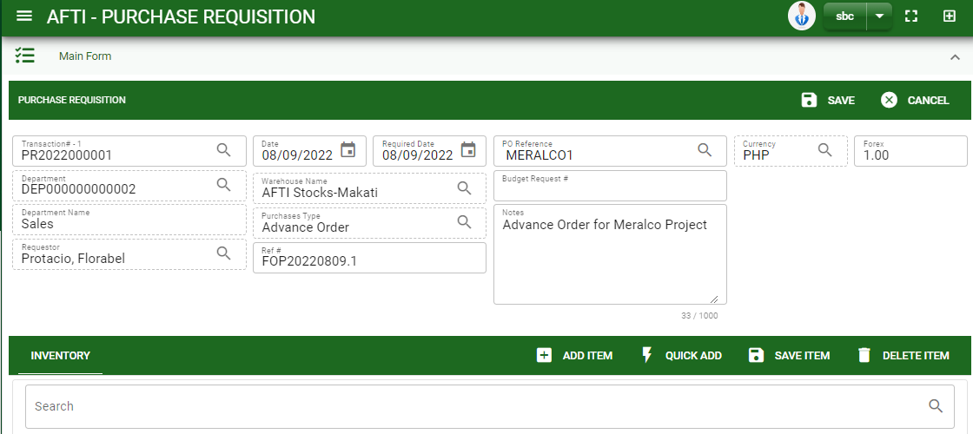

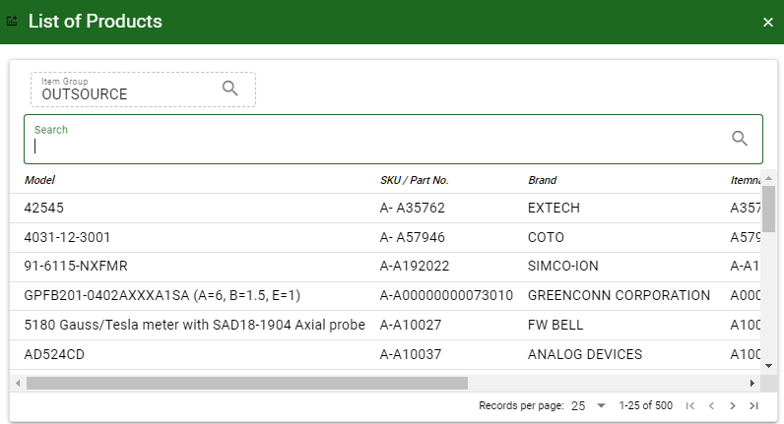
Purchase / Purchase Requisition - Module
How To Create Purchase Requisition Transaction?
4.1 Fill in the fields that are needed
4.2 Click warehouse lookup to change the default warehouse if needed.
4.3 Click purchase type lookup to tag what type of purchase is the transaction recorded.
4.4 Fill in other necessary information.
4.5 If done in header, click save button.
5. After saving the header, you may now add the request item/s.
6. Click add item button to select an items. If you know the barcode, click the quick add button instead.
Header
4.1 to 4.4
Stock
6
How to search item?
1. Click item group lookup and select item group
2. Enter in the search bar item you want to select
3. Select the item

Slide 5
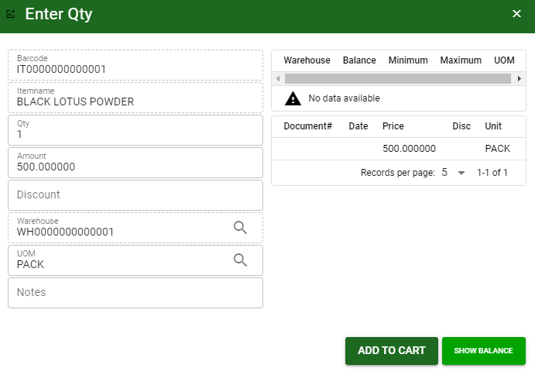
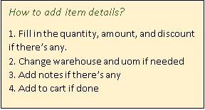
Purchase / Purchase Requisition - Module
How To Create Purchase Requisition Transaction?
After you select the item, a dialog box where item details will be encoded will pop out. Follow the steps on how to add item details.
After you click the add to cart button, item will be temporarily be added in the cart.
If you wish to add more items, search and select the item and follow the steps on how to add item details.
1
4

Slide 6
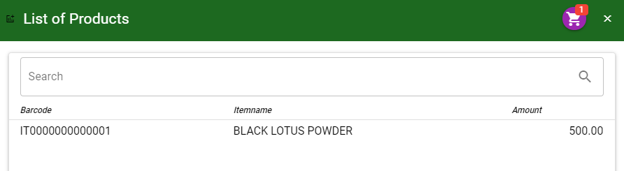
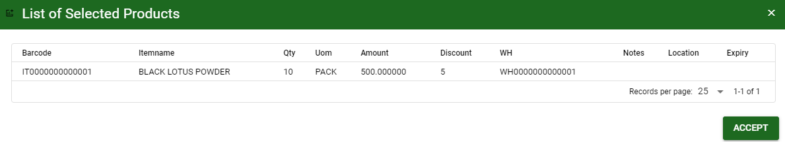
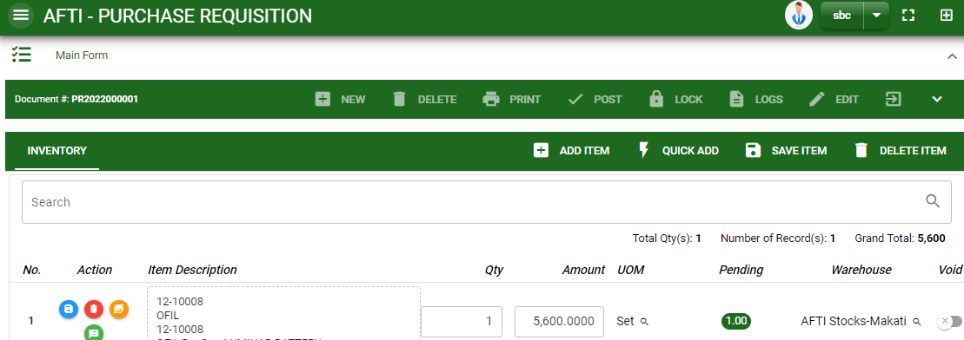
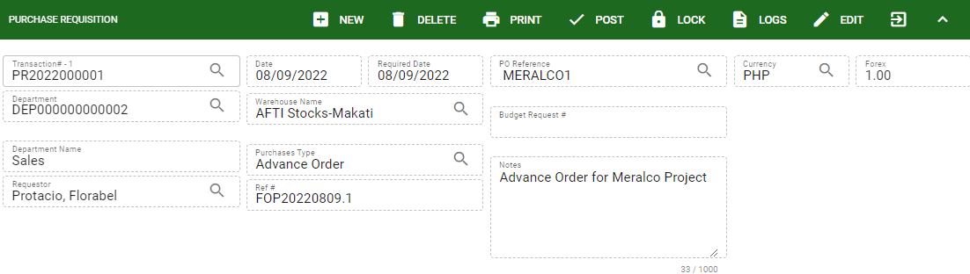
Purchase / Purchase Requisition - Module
How To Create Purchase Requisition Transaction?
7
7 To add the items in purchase requisition – main window, click the cart button and click accept button.
8 If done, finalize the transaction by click the arrow button to maximize the main form header.
9 In header, click post button
7
8
9

Slide 7
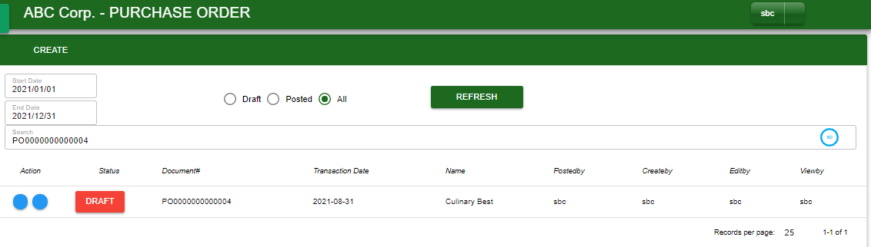
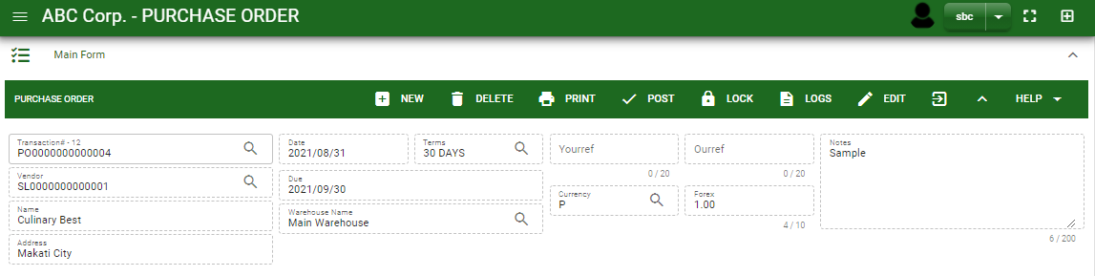
Purchase / Purchase Requisition - Module
How To Edit Purchase Requisition Transaction?
1.1. In the purchase requisition – main window, search the purchase requisition transaction you wish to edit its information in the search bar. Or,
1.2. In purchase requisition – main form, click the lookup button and select the transaction you wish to edit its information by typing its transaction number in the search bar.
2. After you select the PO transaction, if you wish to edit the header of the transaction click edit button.
3. If you are done editing the purchase requisition header, click save button in the upper side of the header.
1.1.
Purchase Requisition – Main Window
HEADER
2.
1.2.
Purchase Requisition – Main Form

Slide 8
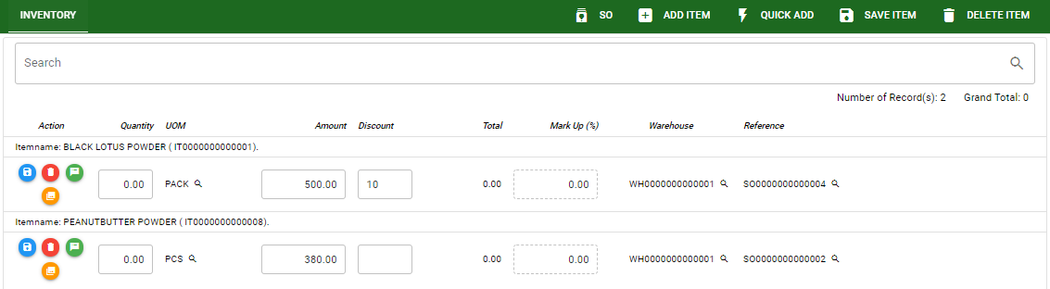
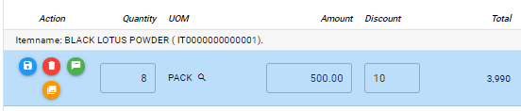
Purchase / Purchase Requisition - Module
How To Edit Purchase Requisition Transaction?
4. If you want to edit the items in purchase requisition stock, edit right away the details you want to change and you will notice that after you change the details, the item you edited will be highlighted into blue.
5. If you’re done editing, click save item button to save the changes you made in the items.
6. To delete all items in the stock, click delete item button.
7. To delete a specific item on the table, click the delete icon next to the item to delete it.
STOCK
5
6
7
4

Slide 9
Purchase / Purchase Requisition - Module
How To Delete Purchase Requisition Transaction?
1.1.
1.1. In the purchase requisition – main window, search the transaction you want to delete.
1.2. In purchase requisition – main form, click the lookup button and select the transaction you want to delete.
2. After . If done, click delete button.
Purchase Requisition – Main Window
HEADER
2.
1.2.
How to search PO transaction?
Type the transaction number in the search bar.
Click ‘enter’ in the keyboard to search.
Click to select the transaction you want to edit
Purchase Requisition – Main Form

Slide 10
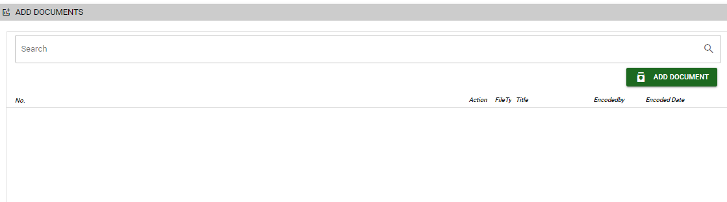

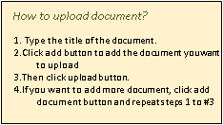
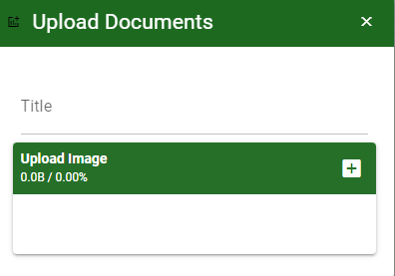
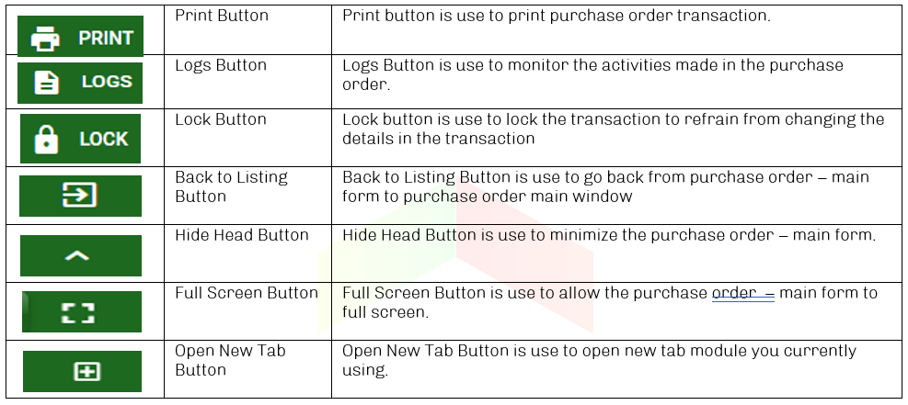
Purchase / Purchase Requisition - Module
Other Information
When you click the arrow icon parallel in the main form on the upper right side, the purchase requisition – main form will be minimize and the other tab will be visible.
Attachment tab
1. Click the arrow icon parallel to attachment tab
2. Click add document button
3. Once you click the add document button, a dialog box of upload documents will pop out.
4. To upload files, follow ‘how to upload document”
Other Buttons

