Slide 1
Accounts Payable Voucher
It is a module where we prepare the request for payment for expenses and payables.

Slide 2
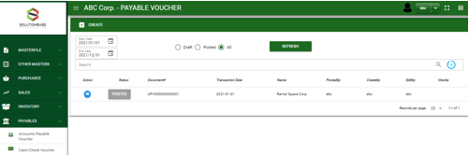

Payables / Accounts Payable Voucher- Module
Main Window
When you click the Accounts Payable Voucher module under Payables, Accounts Payable Voucher transactions list will display based on filtered date and status in the main window.
Accounts Payable Voucher – Main Window
2

Slide 3
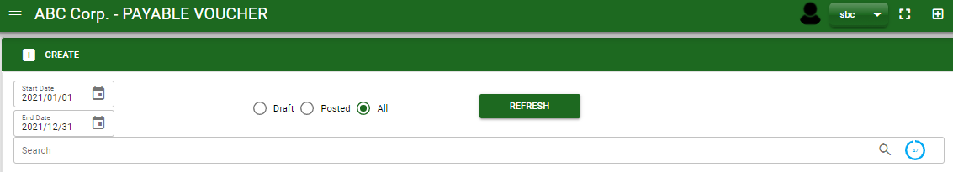
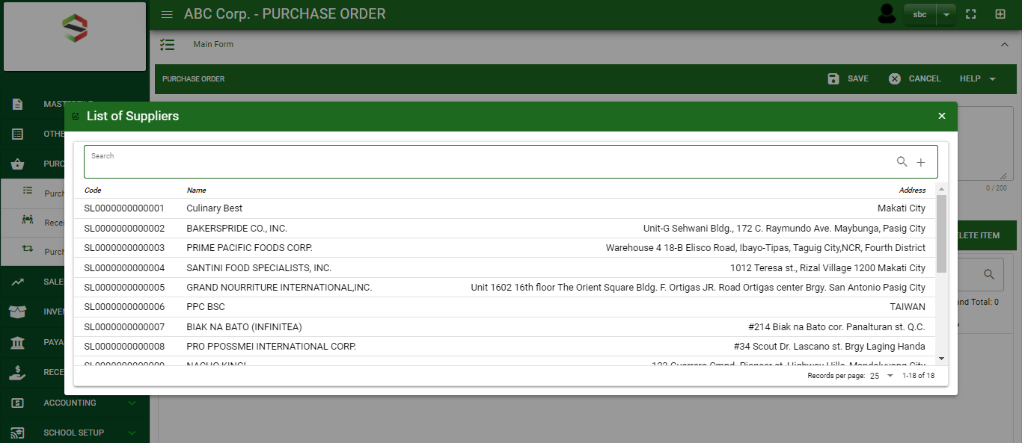
Payables / Accounts Payable Voucher- Module
How To Create APV Transaction?
1
1
1. In Accounts Payable – Main Window, you will notice a create button in the upper left of the window. Click the create button and you will be redirect in accounts payable voucher – main form.
2. After you click the create button a dialog box will pop out with list of supplier. Search and select a supplier.
2
3. After you select a supplier, you will be redirect in accounts payable voucher – main form where you will encode the other necessary information of the transaction and record the APV transaction
How to search supplier?
Type the supplier name in the search bar.
And it will automatically sort out.
Then click the selected supplier.
3

Slide 4
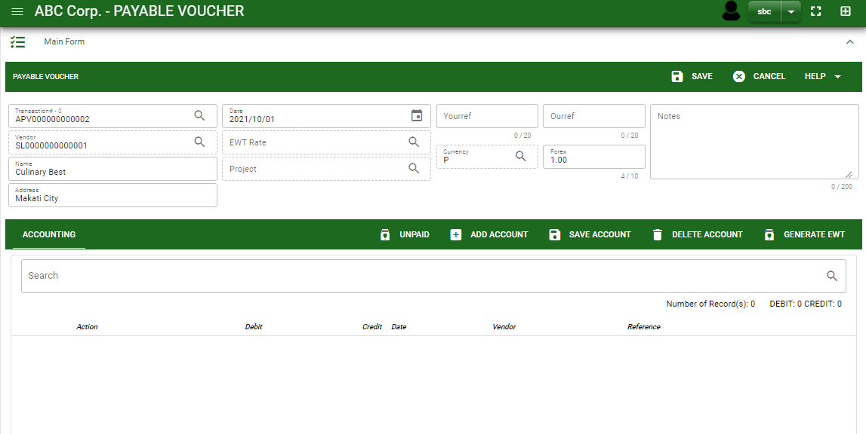
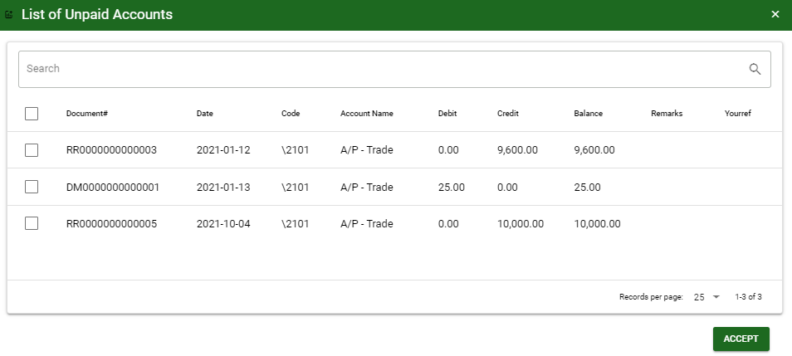
Payables / Accounts Payable Voucher- Module
How To Create APV Transaction?
4.4
Header
4.1 After you select the supplier, some details such as address, terms are automatically plotted in their respective field. If you wish to change the EWT rate if there’s any, click the lookup button and select its respective EWT rate.
4.2. In header, current date is also plotted automatically but if you wish to change the date – click the date picker and select its respective ordered date.
4.3. In header, add the necessary information if necessary.
5.1. After saving the header, you may now select the payable or expense account that you will record. If the payment is from receiving report transaction, click unpaid button to view all the unpaid payables of the supplier and select it by ticking the check box.
4.1 to 4.3
5.1
Detail
5.1.
4
5.2.

Slide 5
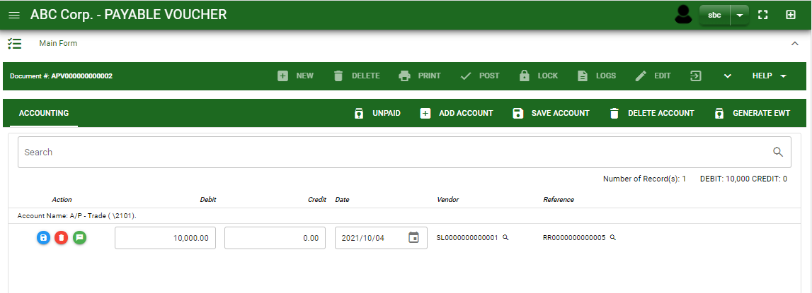
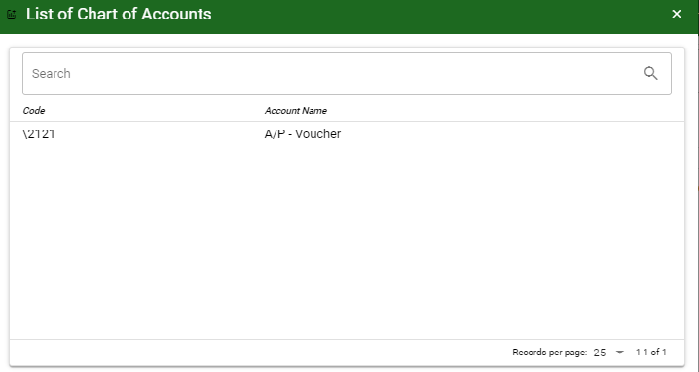
Payables / Accounts Payable Voucher- Module
How To Create APV Transaction?
6. After you select the unpaid account, you will be redirect in accounts payable voucher – main window and the selected unpaid accounts will be displayed in accounts payable voucher – detail.
7. If you want to add other payable and expense account that is not in the unpaid list, click add account and search the account you wish to add.
8. After you select an account, a dialog box will prompt. Enter the details of the account.
7
How to search an account?
Type the account name in the search bar.
And it will automatically sort out.
Then click the selected account.
5

Slide 6
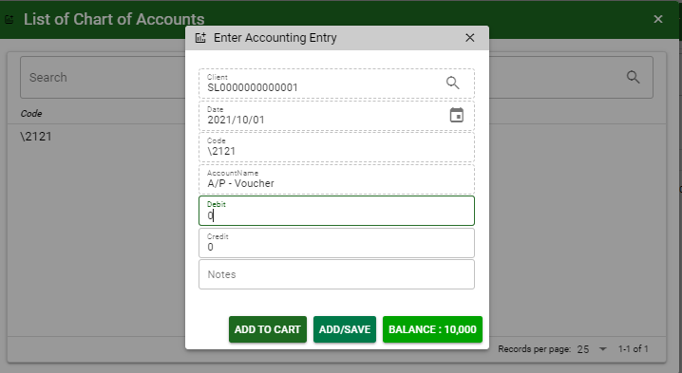
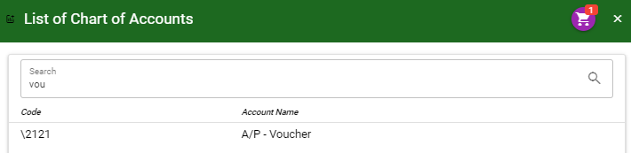
Payables / Accounts Payable Voucher- Module
How To Create APV Transaction?
9. Enter the details of the account. For the amount, enter the amount either in debit or credit field. But if you want to copy of amount in the balance, click the balance to autofill the credit field.
10. You may also add notes if necessary.
11.1 To save the account, if you want to add more other account, click add to cart button and select more accounts again. OR
11.2. OR If you want to plot the selected account already in accounts payable voucher – detail, you may click add/ save button.
9
10
11.1
11.2
9
11.1
How to plot the selected accounts in the accounts payable voucher – detail
Click the cart icon.
And a dialog box with list of selected accounts will pop out.
Then click the accept button.
6

Slide 7
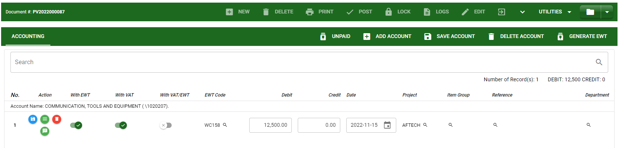
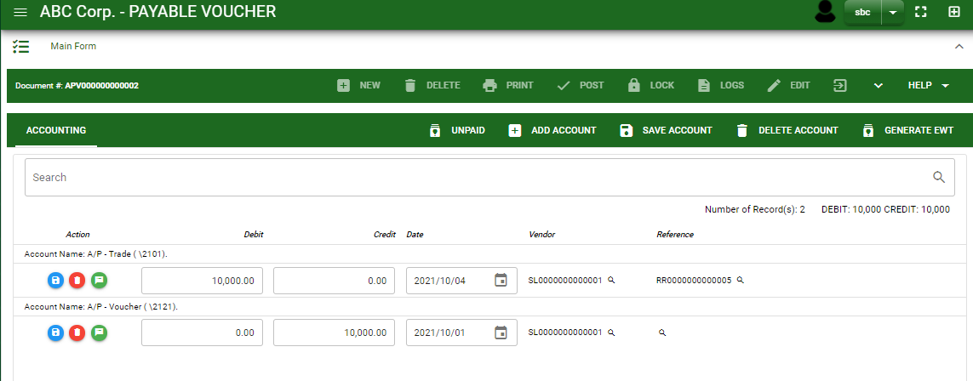
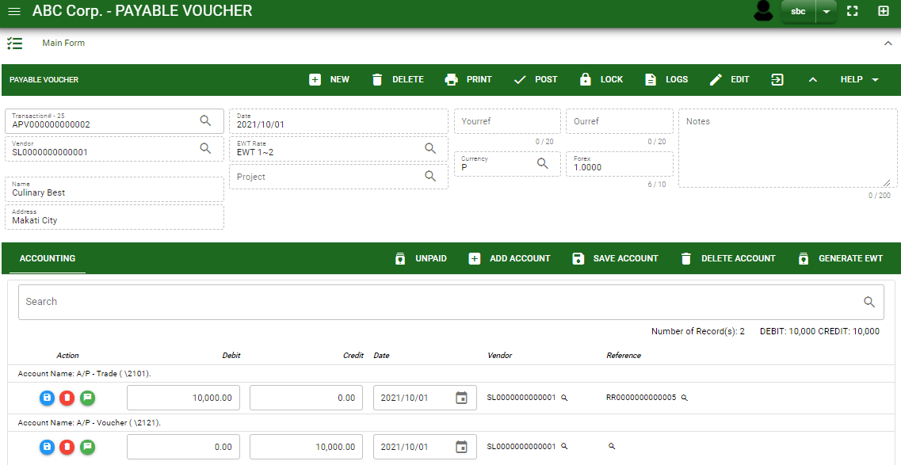
Payables / Accounts Payable Voucher- Module
How To Create APV Transaction?
12
12. In APV, you may also automatically generate entries for EWT. Just click the Generate EWT Button and it will automatically compute EWT and VAT entries base on the account tagging on the detail entry.
13. If done click the arrow to enable the buttons in the header.
14. To finalize, click post button.
13
14
7

Slide 8
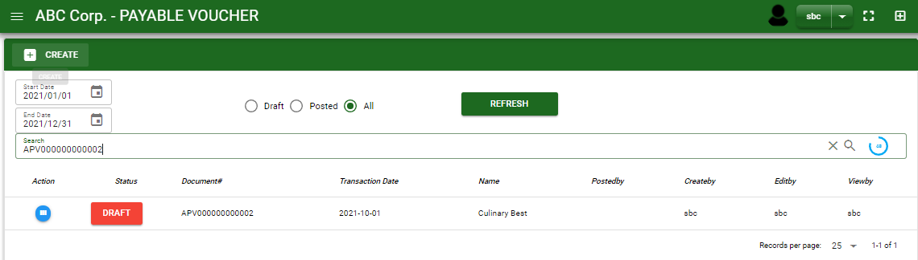
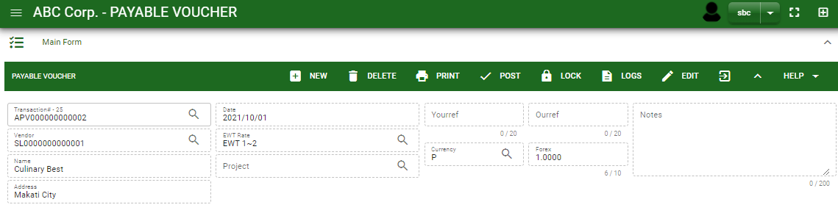

Payables / Accounts Payable Voucher- Module
How To Edit APV Transaction?
1.1 In the accounts payable voucher – main window, search the accounts payable voucher transaction you wish to edit its information in the search bar. Or,
1.2 In accounts payable voucher – main form, click the lookup button and select the transaction you wish to edit its information by typing the transaction number in the search bar.
1.1.
Accounts Payable Voucher – Main Window
HEADER
2. After you select the APV transaction, if you wish to edit the header of the transaction click edit button.
3. If you are done editing the APV header, click save button in the upper side of the header.
2.
1.2.
How to search APV transaction?
Type the transaction number in the search bar.
Click ‘enter’ in the keyboard to search.
Click to select the transaction you want to edit
Accounts Payable Voucher – Main Form
8

Slide 9
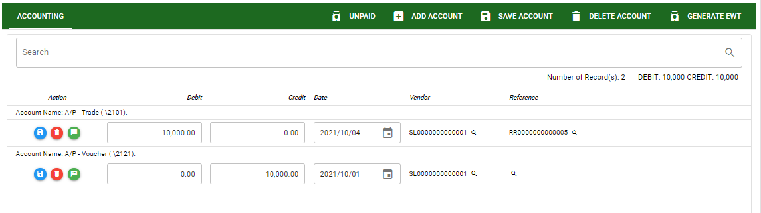
Payables / Accounts Payable Voucher- Module
How To Edit APV Transaction?
3. If you are done editing the APV header, click save button in the upper side of the header.
4. If you want to edit the entry in the detail, edit right away the details you want to change and you will notice that after you change the details, the account you edited will be highlighted into blue.
5. If you’re done editing, click save account button to save the changes you made in the entry.
6. To delete all accounts in the entry, click delete account button.
7. To delete a specific line on the table, click the delete icon next to the account to delete it.
DETAIL
5
6
4
7
9

Slide 10
Payables / Accounts Payable Voucher- Module
How To Delete APV Transaction?
1.1 In the accounts payable voucher – main window, search the accounts payable voucher transaction you wish to edit its information in the search bar. Or,
1.2 In accounts payable voucher – main form, click the lookup button and select the transaction you wish to edit its information by typing its transaction number in the search bar.
1.1.
Accounts Payable Voucher – Main Window
2. If done, click delete button.
HEADER
2.
1.2.
How to search APV transaction?
Type the transaction number in the search bar.
Click ‘enter’ in the keyboard to search.
Click to select the transaction you want to edit
Accounts Payable Voucher – Main form
10

Slide 11
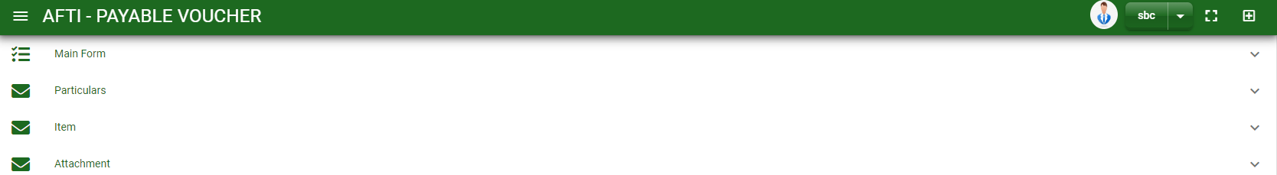
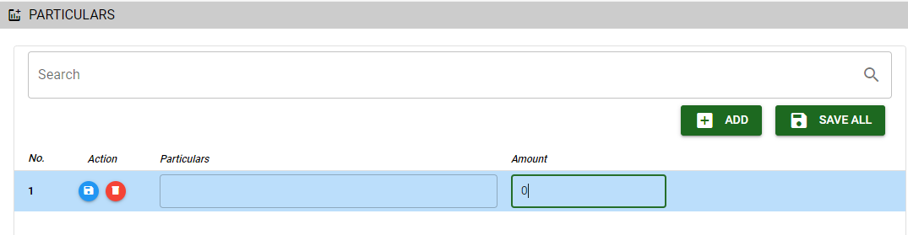

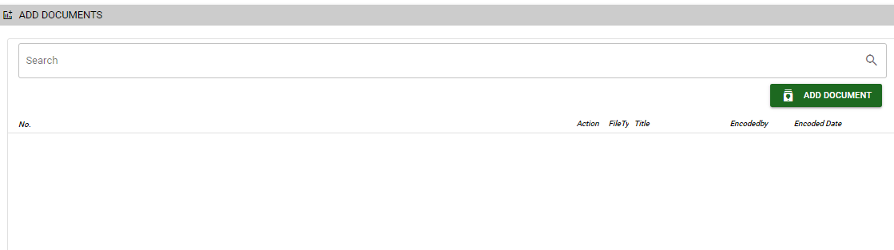
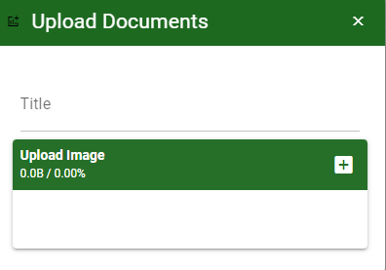
Payables / Accounts Payable Voucher- Module
Other Information
When you click the arrow up icon parallel in the main form on the upper right, and the accounts payable voucher – main form will be minimize and the other information will be displayed as shown in the photo.
Click the arrow parallel to what information you want to open and provide the necessary filter to generate the data you want to display.
Particular tab
Click maximize arrow to view the Particular tab
Provide the necessary details in their fields
2.1. Click Add button to add new row
2.2. Type particular and amount if there’s any
2.3. If done, click save all button
Click save button once done
Attachment tab
1. Click maximize arrow to view the attachment tab
2. Click add document button
3. Once you click the add document button, a dialog box of upload documents will pop out.
4. To upload files, follow ‘how to upload document”
2.1
2
How to upload document?
Type the title of the document.
Click add button to add the chosen document to upload
Then click upload button.
If you want to add more document, click add document button and repeat steps 1 to #3
11

Slide 12
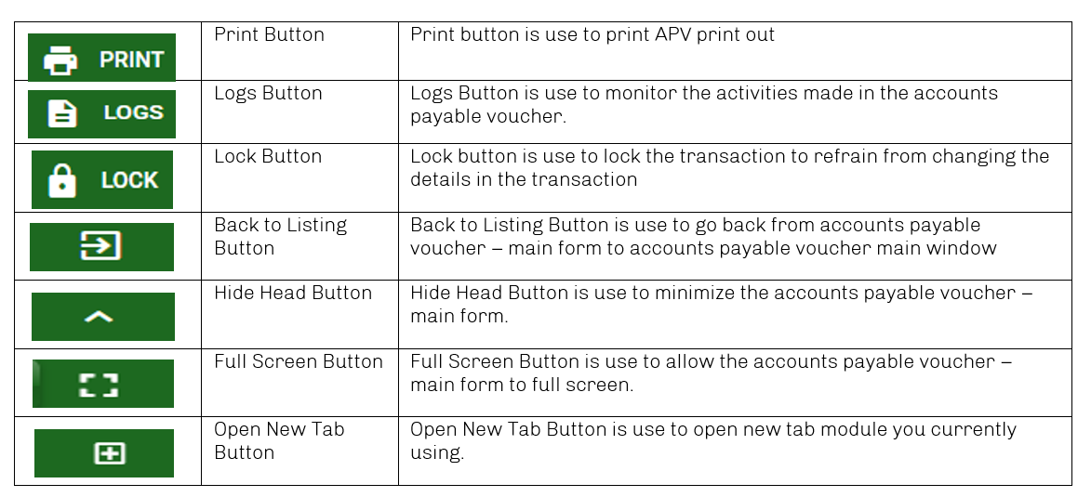
Payables / Accounts Payable Voucher- Module
Other Buttons
12

