Slide 1
Quotation
It is where quotations is made

Slide 2
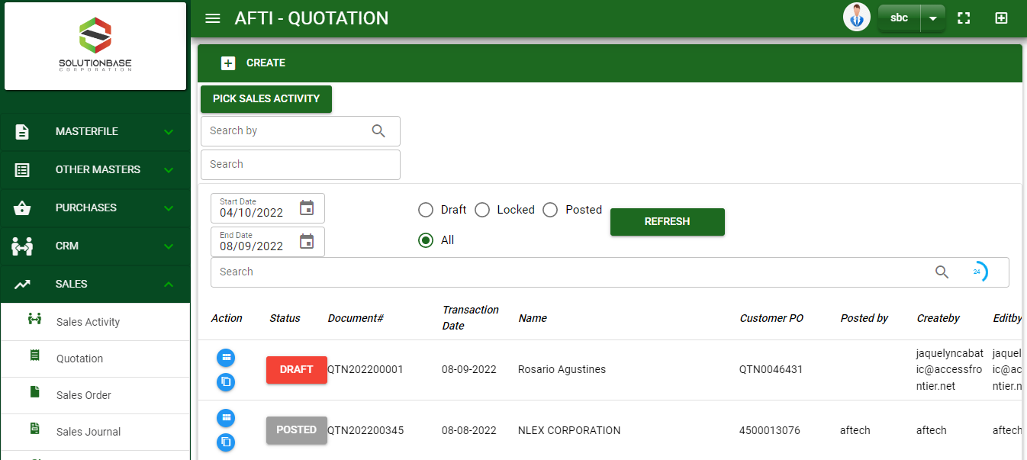

Sales/ Quotation- Module
Main Window
When you click the Quotation module under Sales, Quotation transactions list will display based on filtered date and status in the quotation main window.
Quotation – Main Window

Slide 3
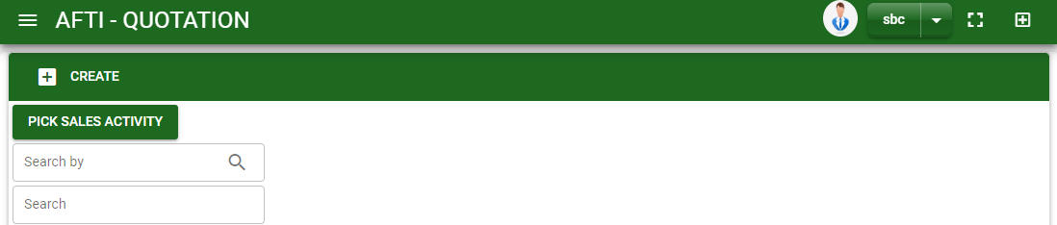

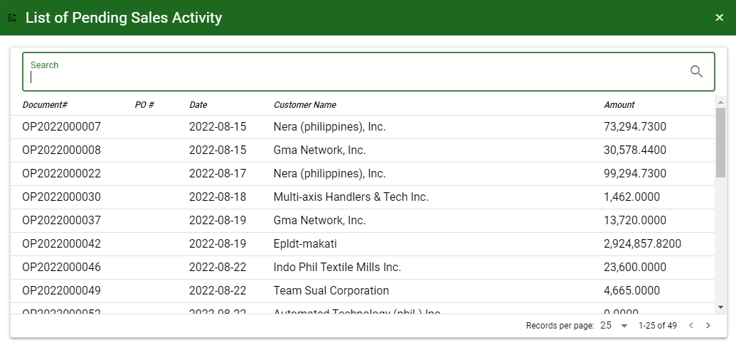
Sales/ Quotation- Module
How To Create Quotation Transaction?
1.a
CREATE USING PICK SALES ACTIVITY BUTTON
1. a In Quotation – Main Window, click pick sales activity button to select sales activity transaction that need to create a quotation.
2.a. A dialog box will pop out asking if you want to proceed to pick up sales activity, click Yes button and pending sales activity transaction will pop out.
2.a
How to search Sales Activity transaction?
Type the transaction number in the search bar.
Click ‘enter’ in the keyboard to search.
Click to select the transaction you want to select

Slide 4
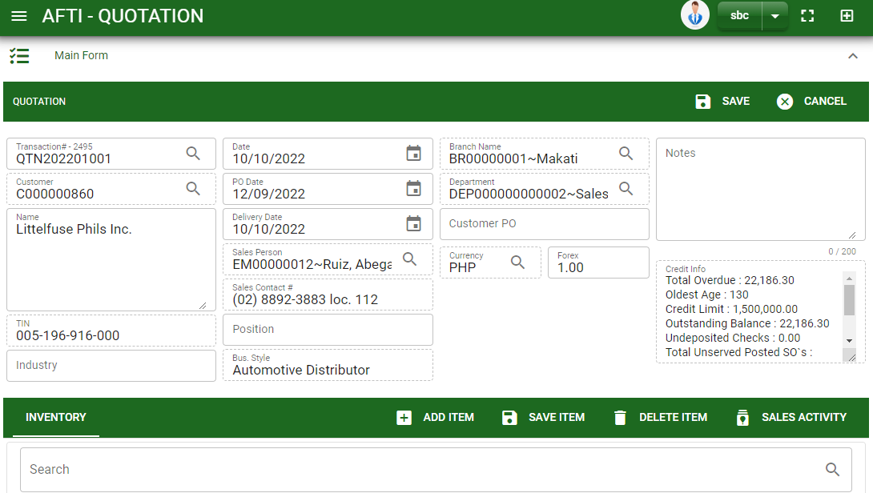
Sales/ Quotation- Module
How To Create Quotation Transaction?
3.a. After you select the sales activity transaction, details from selected sales activity transaction will be pull out to quotation – main form
4.a. Fill in other necessary information in main form.
5.a. Then click save button.
5.a

Slide 5
Sales/ Quotation- Module
How To Create Quotation Transaction?
CREATE USING CREATE BUTTON
1. Another way to create quotation is to click create button in quotation doc listing form.
2.a. After you click create button, you will be redirect in quotation – main form and document series will be automatically generated and customer list will pop out.
1

Slide 6
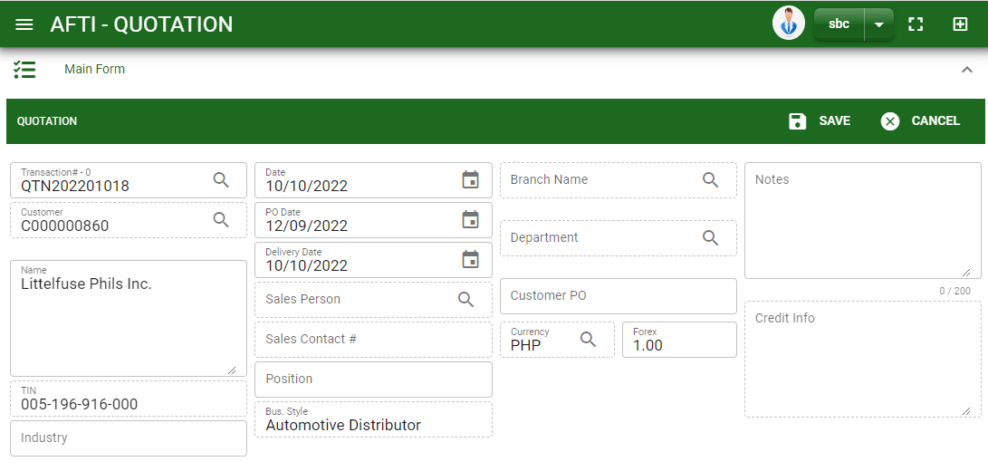
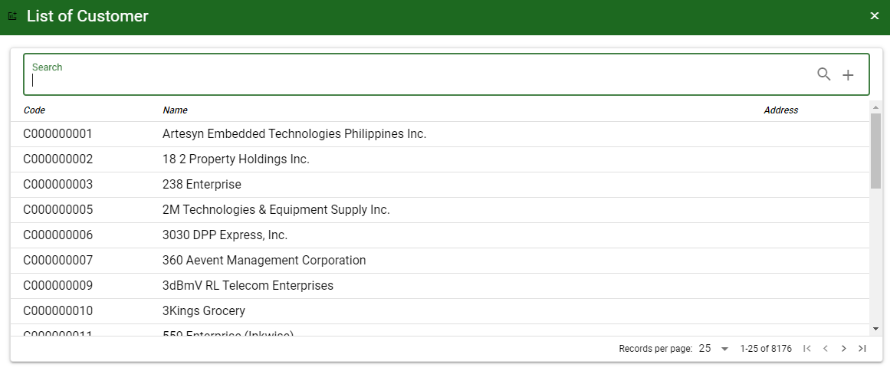
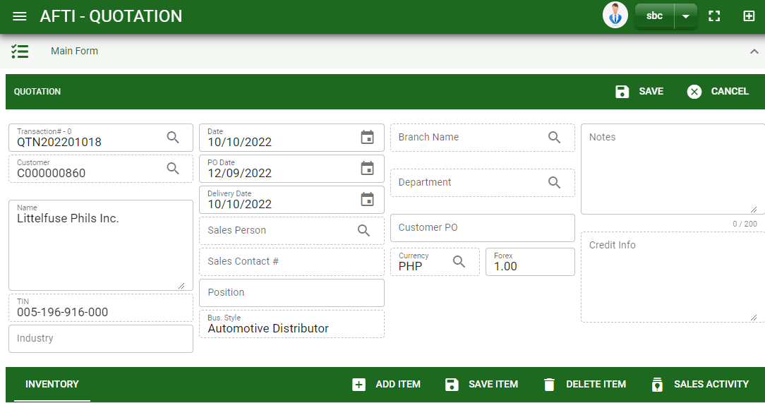

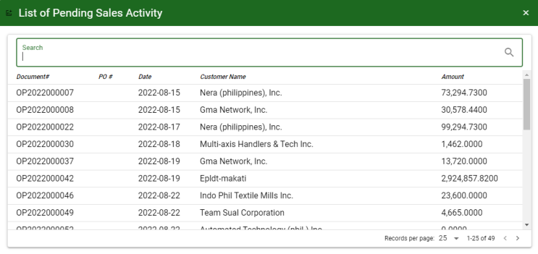
Sales/ Quotation- Module
How To Create Quotation Transaction?
CREATE USING CREATE BUTTON
2. b After you click create button, you will be redirect in quotation – main form and document series will be automatically generated and customer list will pop out.
2. c. Fill in other necessary information
2.d. Click save button if done.
2.e. After saving the header, click sales activity button to select sales activity transaction that need to create a quotation. And the details of items encoded from the selected sales activity transaction will be pull out to the quotation stock.
2.f. To add more items, click add item button to manually add items not from sales activity.
How to search customer?
Type the customer name in the search bar.
And it will automatically sort out.
Then click the selected customer.
2.d
How to search Sales Activity transaction?
Type the transaction number in the search bar.
Click ‘enter’ in the keyboard tosearch.
Click to select the transaction you want to select
2.f
2.g
2.e

Slide 7
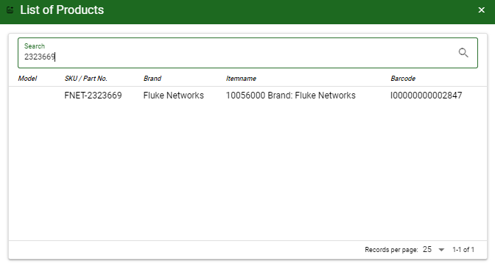
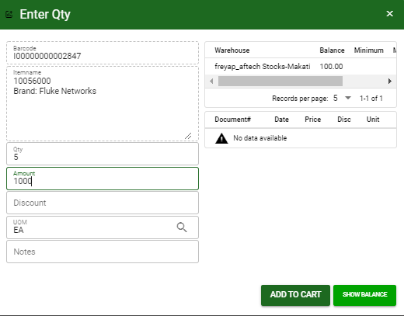
Sales/ Quotation- Module
How To Create Quotation Transaction?
CREATE USING CREATE BUTTON
1. Search and select the order item.
2. After you select the item, a dialog box where item details will be encoded will pop out.
3. If you want to check the balance per warehouse, click show balance button.
4. Enter the quantity, change the amount, UOM, and add sales discount and notes if there’s any.
5. If done, click add to cart button.
How to search item?
Type the item in the search bar.
And it will automatically sort out.
Then click the selected item.
4
5
3.

Slide 8
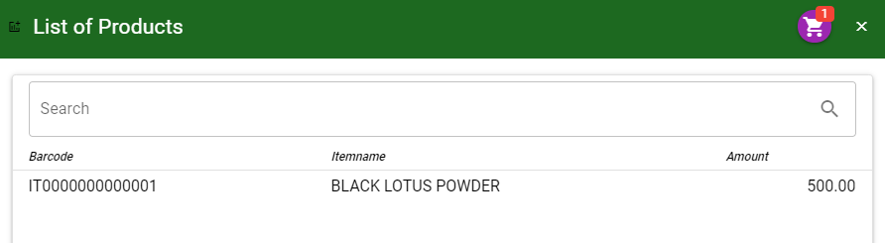
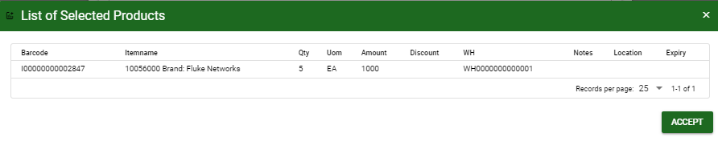
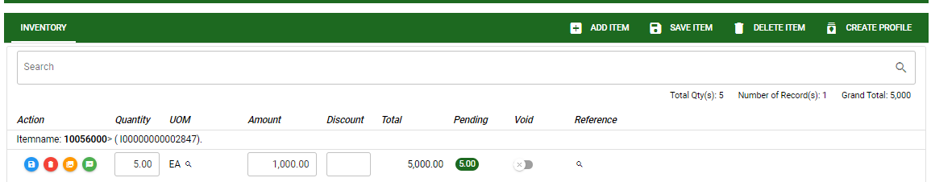
Sales/ Quotation- Module
How To Create Quotation Transaction?
CREATE USING CREATE BUTTON
6. After you click the add to cart button, you will notice in the upper right of list of products an icon of add to cart. Click that, then click accept button to plot the order items in the stock.
2.g. To add more items, repeat steps 1 to 5 before doing 6
2.h. After you click the accept button in the list of selected products, items from the cart will be plotted in the stock as shown below. You may still edit the details per item in the stock. Change directly the details needed to be change.
2.i. If done, click save item button
6
2.i.
STOCK
2.h.

Slide 9
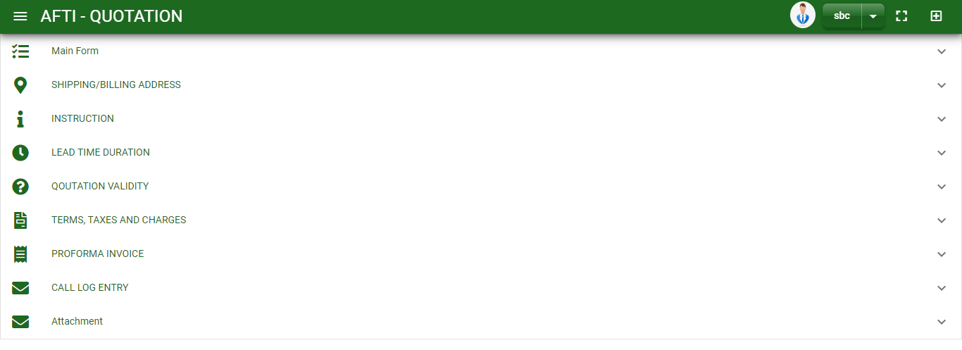
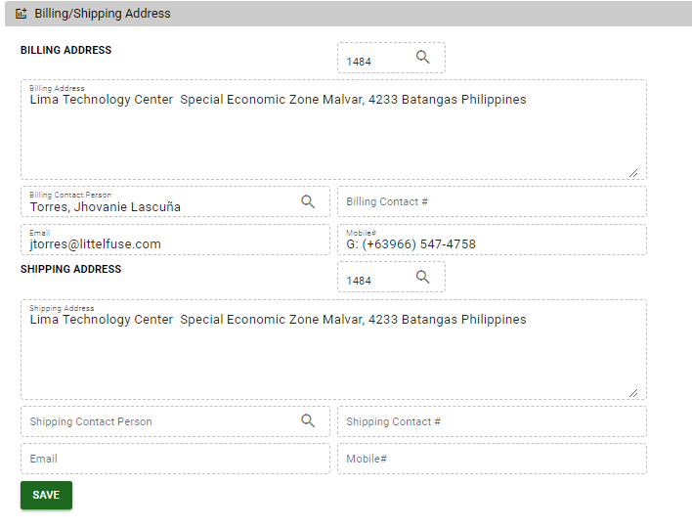
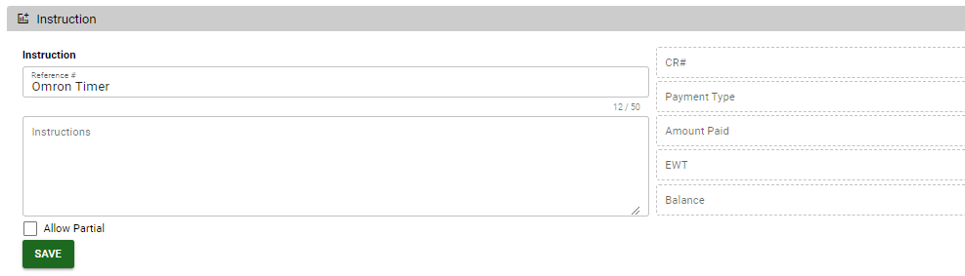
Sales/ Quotation- Module
How To Create Quotation Transaction?
Billing/Shipping Tab
1. Click maximize arrow to view the Billing/Shipping tab
2. Billing and shipping address displayed here are the default address of the customer. If you wish to edit, click the lookup button to select address.
3. Click save button once done
Instruction Tab
1. Click maximize arrow to view the Instruction tab
2. Fill in other necessary information.
3. Click save button once done
2
1
2
3
1
3
Details of down payment are automatically pulled out from received payment recorded by the accounting.

Slide 10
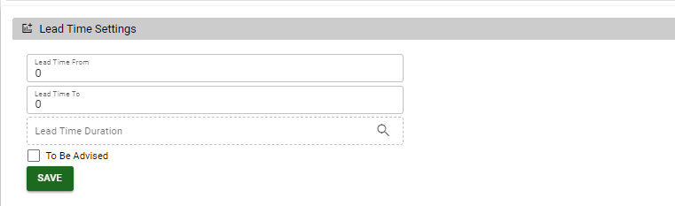
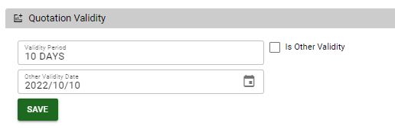
Sales/ Quotation- Module
How To Create Quotation Transaction?
Lead Time Duration Tab
1. Click maximize arrow to view the lead time duration tab
2. Fill in other necessary information.
3. Click save button once done
Quotation Validity Tab
1. Click maximize arrow to view the quotation validity tab
2. Fill in other necessary information.
3. Click save button once done
save button once done
1
3
1
3

Slide 11
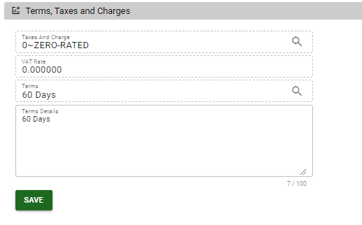
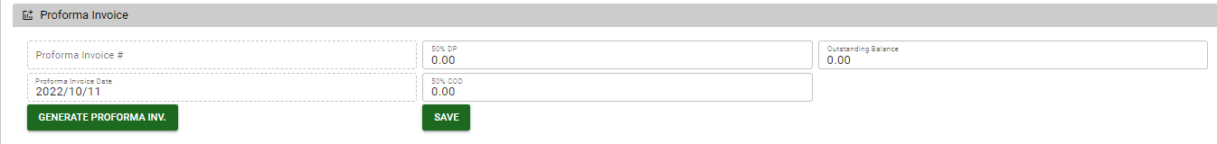
Sales/ Quotation- Module
How To Create Quotation Transaction?
Terms, Taxes and Charges Tab
1. Click maximize arrow to view the terms, taxes and charges tab
2. Fill in other necessary information.
3. Click save button once done
Proforma Invoice Tab
1. Click maximize arrow to view the proforma invoice tab
2. To generate proforma invoice, click generate proforma inv button
3. Fill in necessary information
4. Click save button once done
1
3
3
1
3

Slide 12
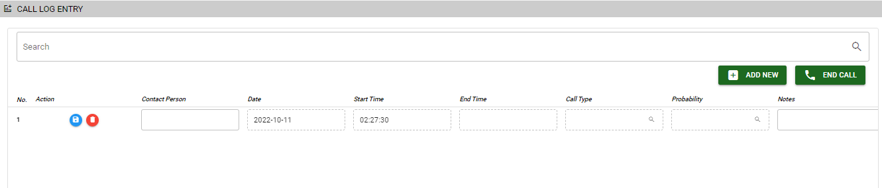
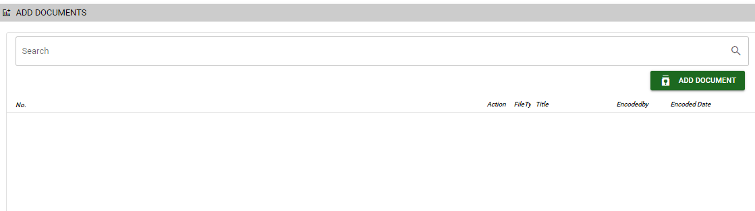
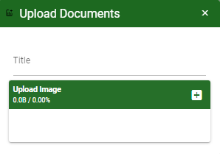
Sales/ Quotation- Module
How To Create Quotation Transaction?
Call Log Entry Tab
1. Click maximize arrow to view the call log invoice tab
2. Click add new button to add new logs
3. End call before adding new call log. To end call, fill contact person, call type and notes.
4. Click save button to save the data encoded.
5. Click end call button to fill end time.
Attachment Tab
1. Click maximize arrow to view the call log invoice tab
2. Click add document button
3. Once you click the add document button, a dialog box of upload documents will pop out.
4. To upload files, follow ‘how to upload document”
2
5
4
1
2
How to upload document?
Type the title of the document.
Click add button to add the chosen document to upload
Then click upload button.
If you want to add more document, click add document button and repeat steps 1 to #3
1

Slide 13
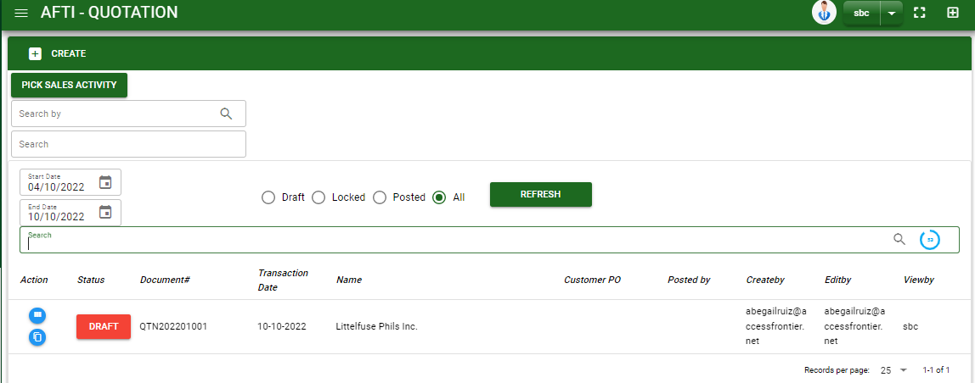
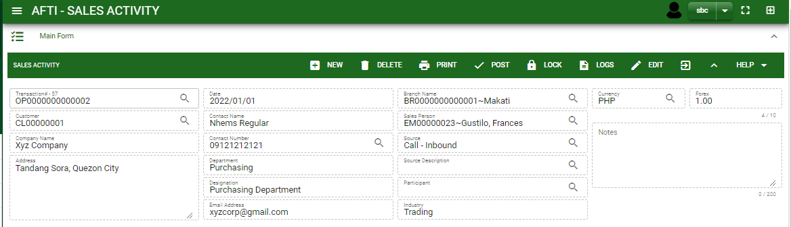
Sales/ Quotation- Module
How To Edit Quotation Transaction?
1. 1 In the quotation – main window, search the quotation transaction you wish to edit its information in the search bar. Or,
1.2 In quotation – main form, click the lookup button and select the transaction you wish to edit its information by typing its transaction number in the search bar.
2. After you select the quotation transaction, if you wish to edit the header of the transaction click edit button.
1.1.
Quotation – Main Window
HEADER
2
1.2.
How to search quotation transaction?
Type the transaction number in the search bar.
Click ‘enter’ in the keyboard tosearch.
Click to select the transaction you want to edit

Slide 14
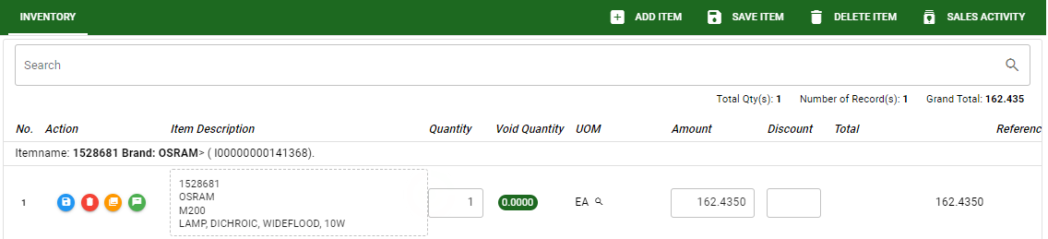
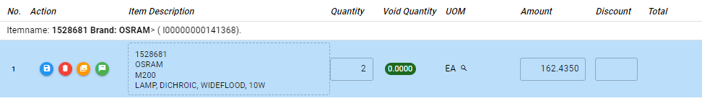
Sales/ Quotation- Module
How To Edit Quotation Transaction?
STOCK
5
3. If you are done, click save button in the upper side of the header.
4. If you want to edit the items in quotation stock, edit right away the details you want to change and you will notice that after you change the details, the item you edited will be highlighted into blue.
5. If you’re done editing, click save item button to save the changes you made in the items.
6. To edit other tab, open the tab and edit directly the information needed to be change
7. Then click save button
4

Slide 15
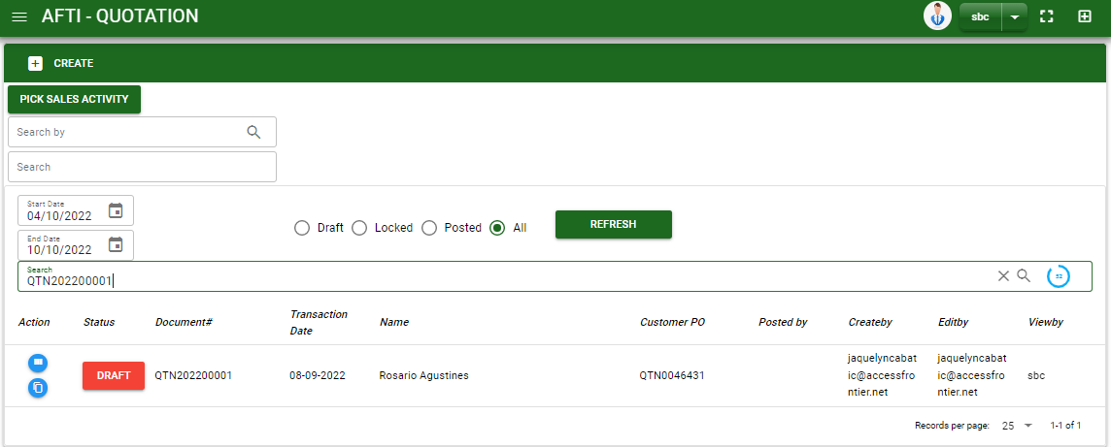
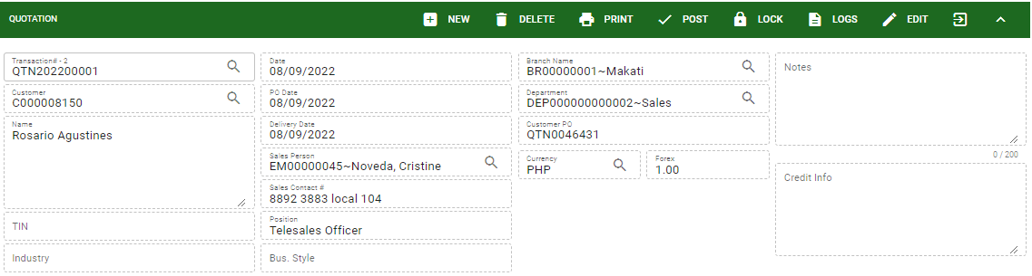
Sales/ Quotation- Module
How To Delete Quotation Transaction?
1. 1 In the quotation – main window, search the transaction you want to delete. Or
1.2. In quotation – main form, click the lookup button and select the transaction you want to delete.
2. If done, click delete button.
Quotation – Main Window
HEADER
2.
1.2.
How to search quotation transaction?
Type the transaction number in the search bar.
Click ‘enter’ in the keyboard to search.
Click to select the transaction you want to delete
Quotation – Main Form

Slide 16
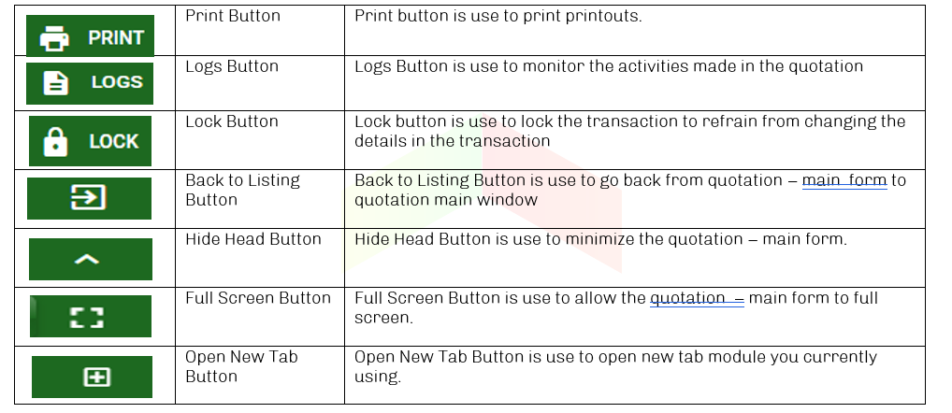
Sales/ Quotation- Module
Other Buttons

