Slide 1
Request For
Replacement/Return
Request for replacement/ return is request for replacement of items is recorded.

Slide 2
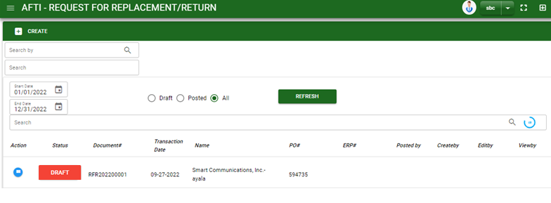

Sales/ Request for Replacement - Module
–
Main Window
When you click the Request for Replacement/ Return module under Sales, list of Request for Replacement/ Return transactions will display based on filtered date and status in the Request for Replacement/ Return main window.
Request for Replacement – Main Window

Slide 3
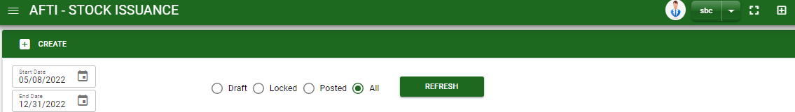
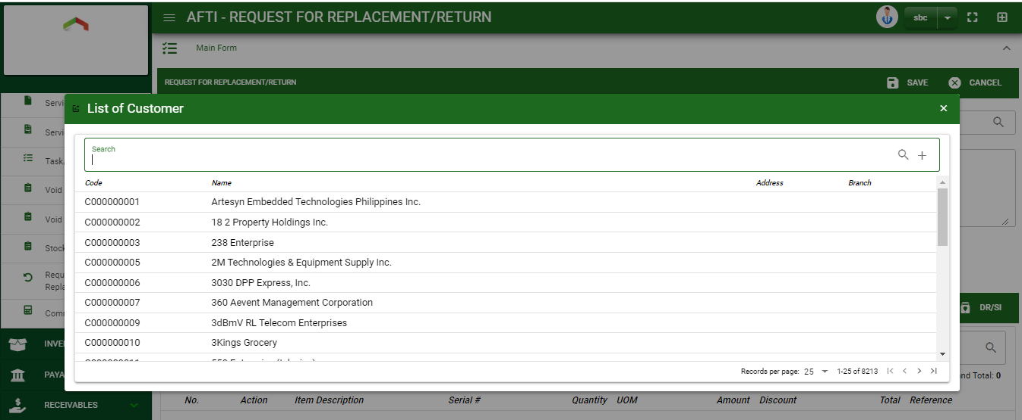
Sales/ Request for Replacement - Module
How To Create Request for
Replacement /Return Transaction?
1
2. In request for replacement / return – Main Window, you will notice a create button in the upper left of the window. Click the create button and you will be redirect in request for replacement/ return – main form.
3. After you click the create button a dialog box will pop out with list of customer. Search and select a customer.
How to search customer?
Type the customer name in the search bar.
And it will automatically sort out.
Then click the selected customer

Slide 4
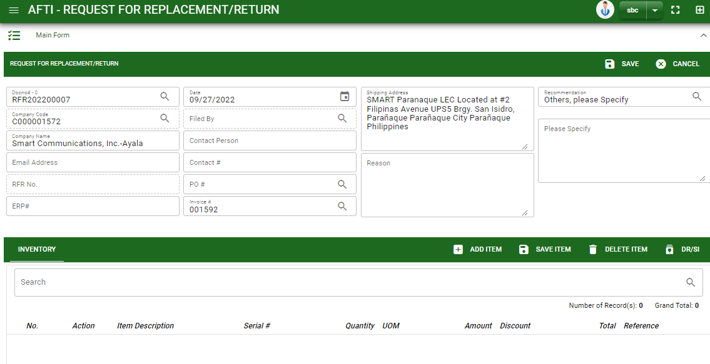
Sales/ Request for Replacement - Module
How To Create Request for
Replacement /Return Transaction?
4. After you select the customer, fill all necessary information in the header.
5. If done, click save button to save details from header
6. Click DR/SI button and a dialog box of list from sales journal will appear.
7. Select the DR/SI by ticking the check box.
8. After selecting, click accept button
9. If done in main form. Click the arrow parallel to main window to minimize the main form tab.
HEADER
5
4
6

Slide 5
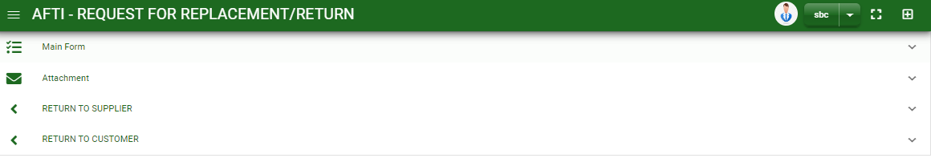
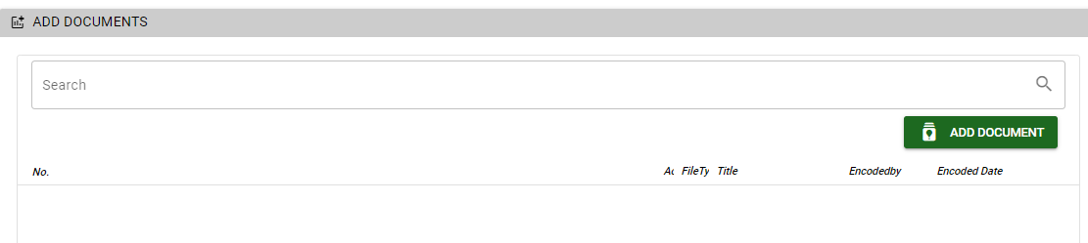
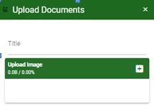
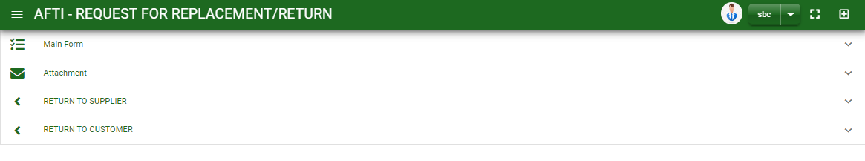
Sales/ Request for Replacement - Module
How To Create Request for
Replacement /Return Transaction?
10. If you want to upload file attachment, click the attachment and upload the file
11. If you want to add details in return to supplier or return to customer, click the arrow parallel to the tab you want add information and fill in the fields needed.
12. To finalized the transaction, click post button in main form
How to upload document?
Type the title of the document.
Click add button to add the chosen document to upload
Then click upload button.
If you want to add more document, click add document button and repeat steps #1 to 3.
1
2.

Slide 6
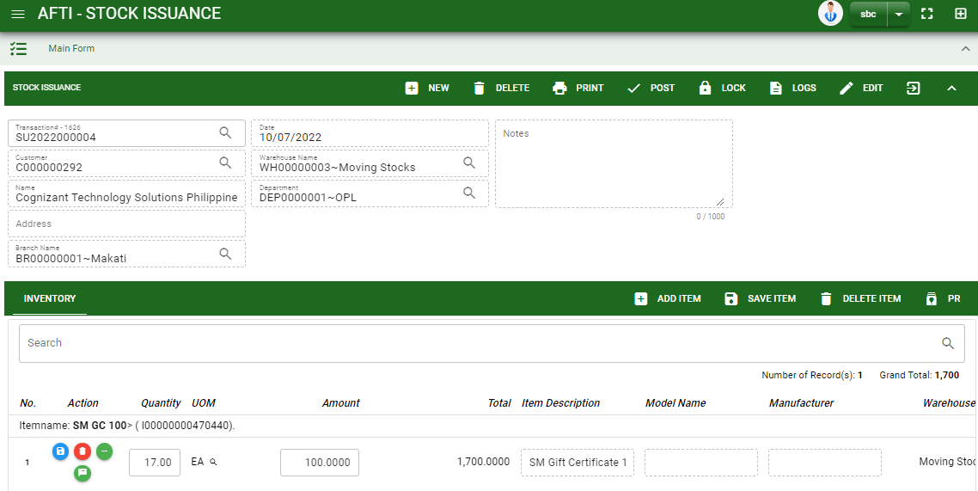
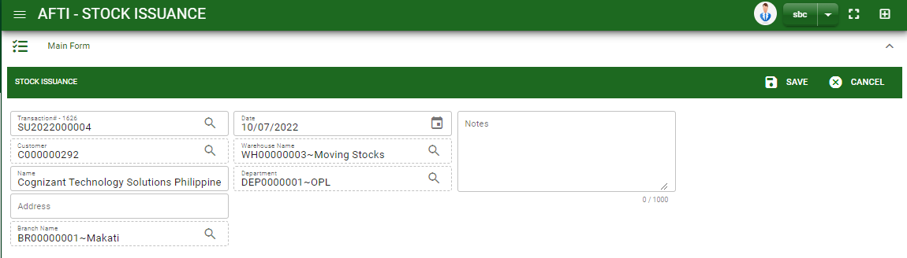
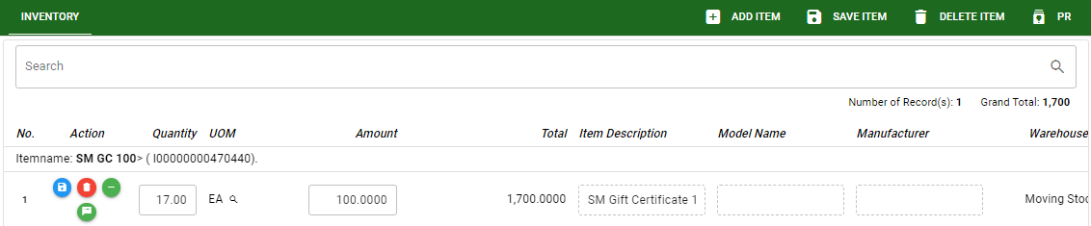
Sales/ Request for Replacement - Module
How To Edit Stock Request for
Replacement /Return Transaction?
1
2
1. To edit the header, click edit button then edit the information that you want to change.
2. If done, click save button.
3. To edit the item stock, edit directly the details you want to change.
4. If done, click save button.
4
3

Slide 7
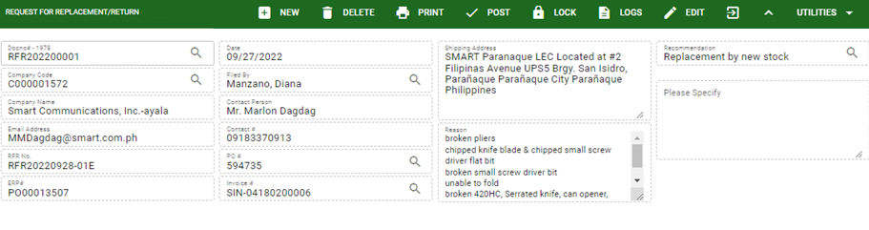
Sales/ Request for Replacement - Module
How To Delete Request for
Replacement /Return Transaction?
1.1 In the request for replacement/ return – main window, search the transaction you want to delete.
1.2. In request for replacement– main form, click the lookup button and select the transaction you want to delete.
2. If done, click delete button.
1.1.
Request for Replacement – Main Window
HEADER
2.
1.2.
How to search request for replacement/ return transaction?
Type the transaction number in the search bar.
Click ‘enter’ in the keyboard to search.
Click to select the transaction you want to delete
Request for Replacement – Main Form

Slide 8
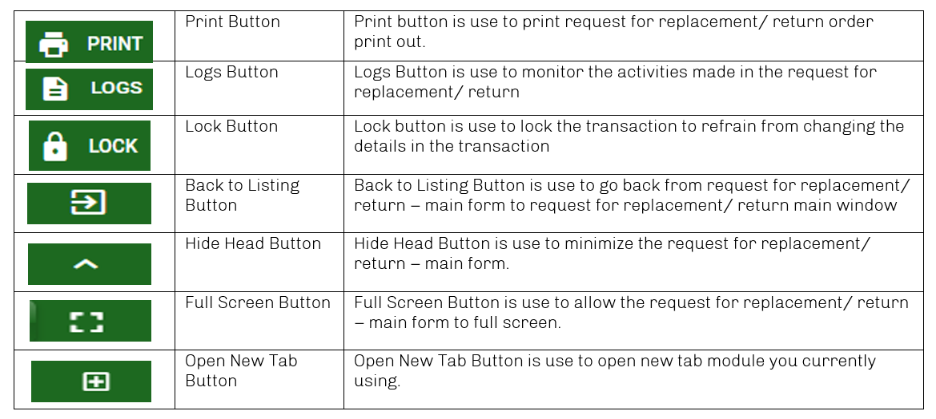
Sales/ Request for Replacement - Module
Other Buttons

