Slide 1
Purchase Receiving
Is where receiving of items from supplier are transacted.

Slide 2
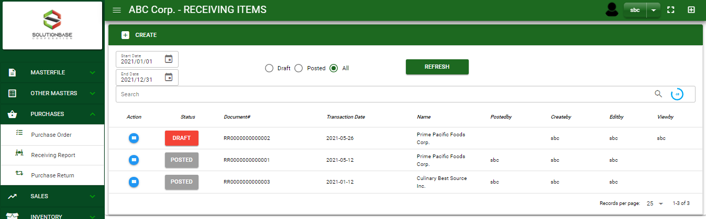

Purchase / Purchase Receiving- Module
Main Window
When you click the Purchase Receiving module under Purchases, Purchase Receiving transactions list will display based on filtered date and status in the purchase receiving main window.
Purchase Receiving – Main Window

Slide 3
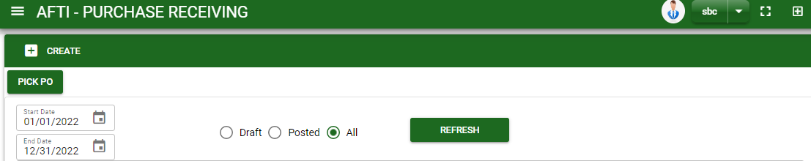
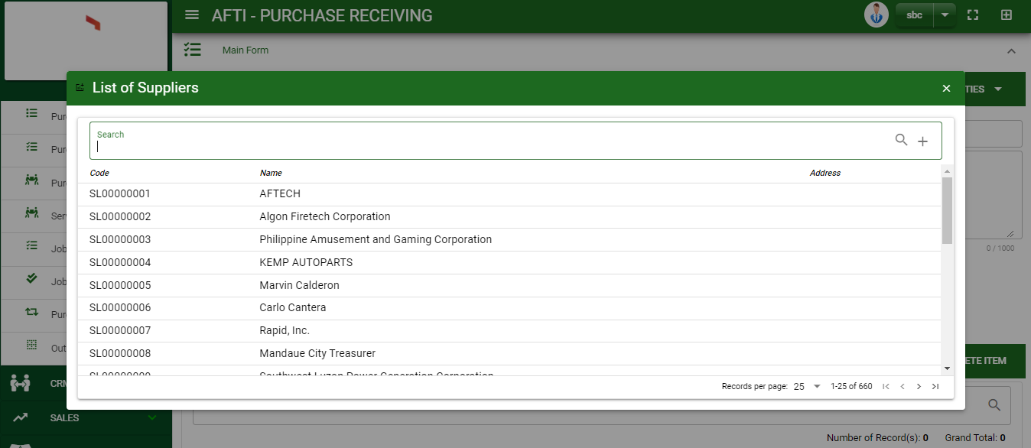
Purchase / Purchase Receiving- Module
How To Create Purchase Receiving Transaction?
1
CREATE USING CREATE BUTTON
1. In Purchase Receiving – Main Window, you will notice a create button in the upper left of the window. Click the create button and you will be redirect in purchase receiving – main form.
2. After you click the create button a dialog box will pop out with list of supplier. Search and select a supplier.
3. After you select a supplier, you will be redirected in purchase receiving– main form where you will encode the other necessary information of the transaction and record the items’ to be receive from the supplier
How to search supplier?
Type the supplier name in the search bar.
And it will automatically sort out.
Then click the selected supplier.

Slide 4
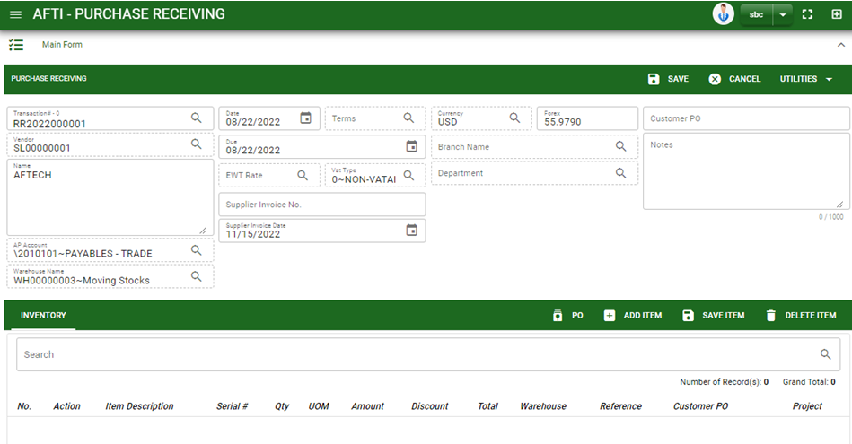



Purchase / Purchase Receiving- Module
How To Create Purchase Receiving Transaction?
4.1. Fill in other necessary information.
4.2. If done in header, click save button.
5. After saving the header, you may now add the ordered items.
PO: If ordered items are from purchase order, click PO to select transaction from purchase order module
Add item: If ordered items will have no reference, manually add the item by clicking the add item button.
4.1
Stock

Slide 5


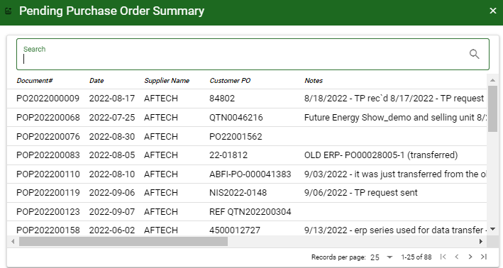
Purchase / Purchase Receiving- Module
How To Create Purchase Receiving Transaction?
CREATE USING PICK PO BUTTON
1. In Purchase Receiving– Main Window, you will notice a Pick PO button in the upper left of the window. Click the button and a confirmation message will pop out. Click OK to proceed.
2. After you proceed to pick PO, search and select the purchase order transaction you want to create a purchase receiving.
3. After you select the PO transaction, you will be redirect in purchase receiving – main form where details from selected PO transaction are copied from header to details of items.
2
How to search Purchase Order transaction?
Type the transaction number in the search bar.
And it will automatically sort out.
Then click the selected PO transaction.

Slide 6
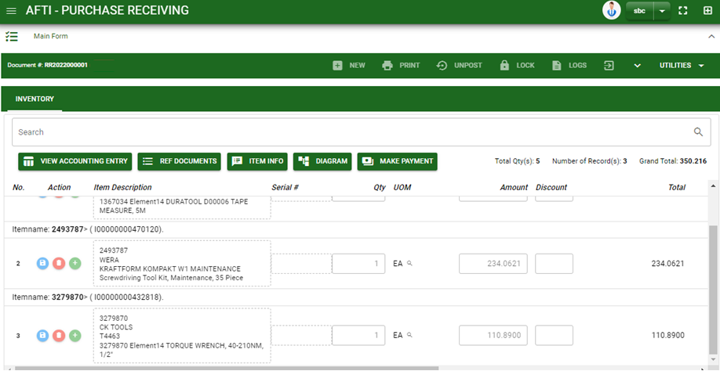

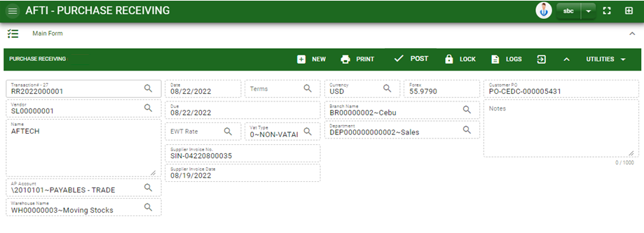
Purchase / Purchase Receiving- Module
How To Create Purchase Receiving Transaction?
If done, finalize the transaction by click the arrow button to maximize the main form header.
In header, click post button.
9

Slide 7
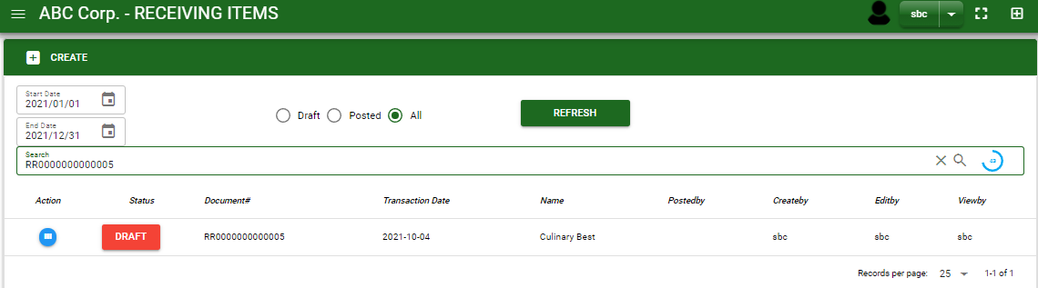
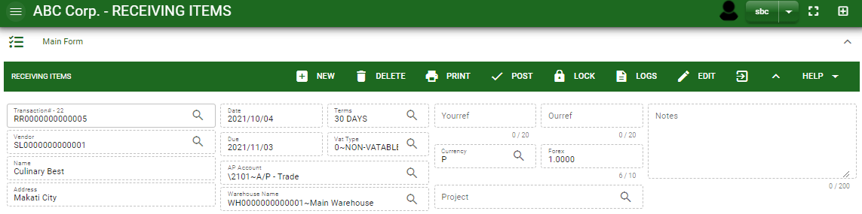
Purchase / Purchase Receiving- Module
How To Edit Purchase Receiving Transaction?
1.1. In the purchase receiving – main window, search the purchase receiving transaction you wish to edit its information in the search bar. Or,
1.2. In purchase receiving – main form, click the lookup button and select the transaction you wish to edit its information by typing its transaction number in the search bar.
2. After you select the RR transaction, if you wish to edit the header of the transaction click edit button.
3. If you are done editing the purchase receiving header, click save button in the upper side of the header.
1.1.
Purchase Receiving – Main Window
HEADER
2.
1.2.
How to search RR transaction?
Type the transaction number in the search bar.
Click ‘enter’ in the keyboard to search.
Click to select the transaction you want to edit
Purchase Receiving – Main Form

Slide 8
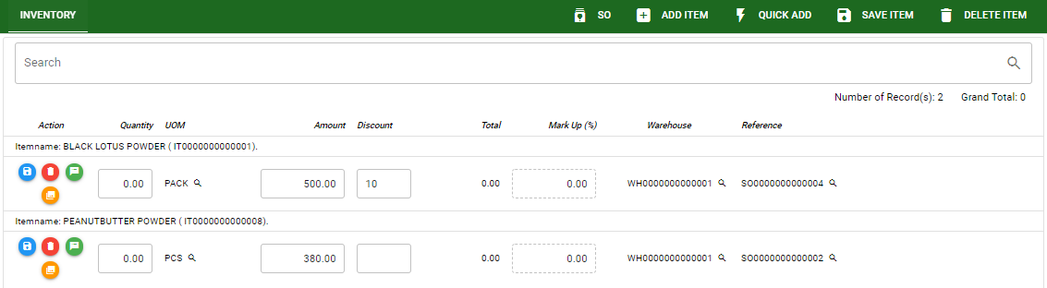
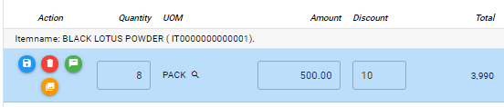
Purchase / Purchase Receiving- Module
How To Edit Purchase Receiving Transaction?
4. If you want to edit the items in purchase receiving stock, edit right away the details you want to change and you will notice that after you change the details, the item you edited will be highlighted into blue.
5. If you’re done editing, click save item button to save the changes you made in the items.
6. To delete all items in the stock, click delete item button.
7. To delete a specific item on the table, click the delete icon next to the item to delete it.
STOCK
5
6
7
4

Slide 9
Purchase / Purchase Receiving- Module
How To Delete Purchase Receiving Transaction?
1.1.
1.1. In the purchase receiving – main window, search the transaction you want to delete.
1.2. In purchase receiving - main form, click the lookup button and select the transaction you want to delete.
2. If done, click delete button.
Purchase Receiving – Main Window
HEADER
2.
1.2.
How to search RR transaction?
Type the transaction number in the search bar.
Click ‘enter’ in the keyboard to search.
Click to select the transaction you want to edit
Purchase Receiving – Main Form

Slide 10
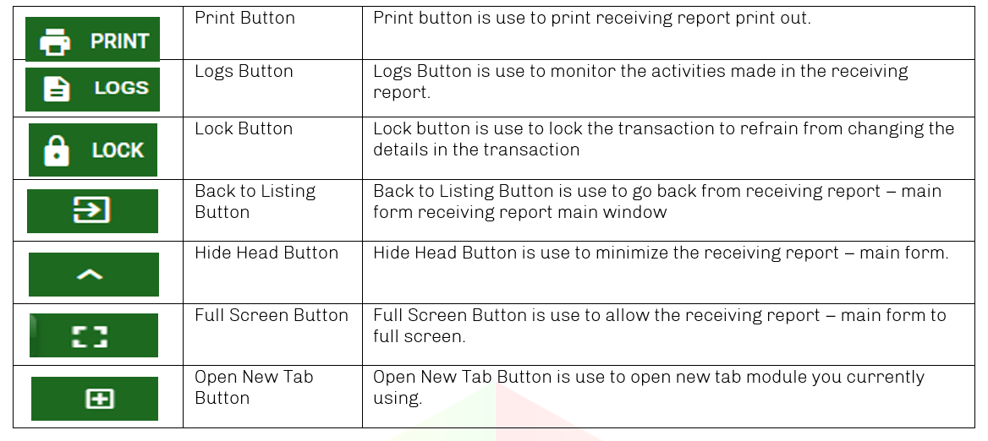
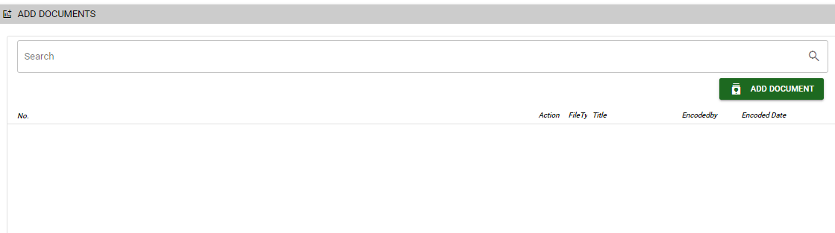
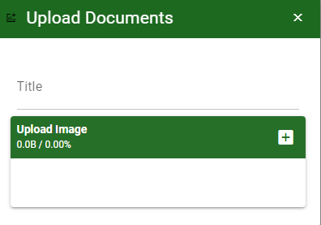
Purchase / Purchase Receiving- Module
Other Information
Other Buttons
When you click the arrow up icon parallel in the main form on the upper right, and the purchase receiving – main form will be minimize and the other tab will be visible.
Attachment tab
1. Click the arrow icon parallel to attachment tab
2. Click add document button
3. Once you click the add document button, a dialog box of upload documents will pop out.
4. To upload files, follow ‘how to upload document”
Shipping tab
Click the arrow icon parallel to Shipping/ billing address
You may view or edit the Shipping and Billing Address for the RR transaction.
2
How to upload document?
Type the title of the document.
Click add button to add the document you want to upload.
Then click upload button.
If you want to add more document, click add document button and repeat steps 1 to #3

