Slide 1
Sales Group
Sales Group is a module where we set up sales groups and tagged each group leader.

Slide 2
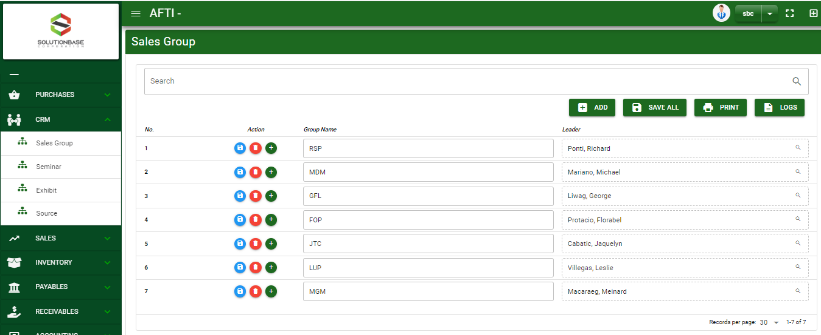

Accounting / Sales Group - Module
Main Window
When you click the Sales Group module under CRM, Sales Group main window will display
Sale Group – Main Window
2

Slide 3
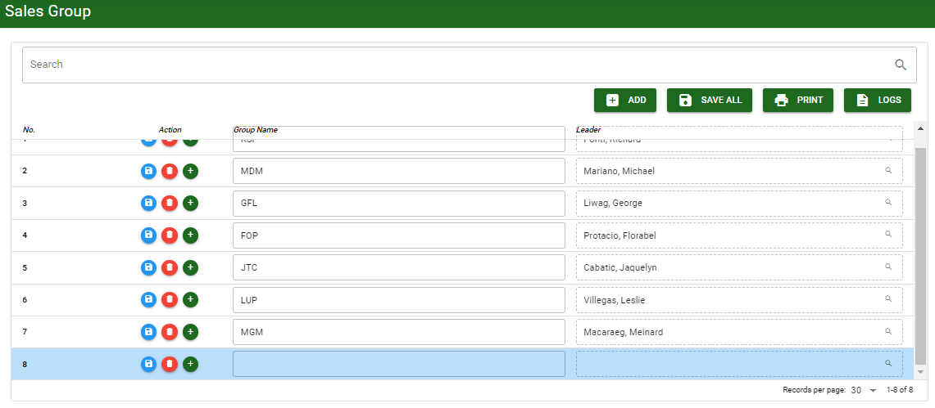
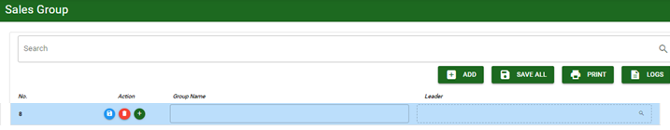
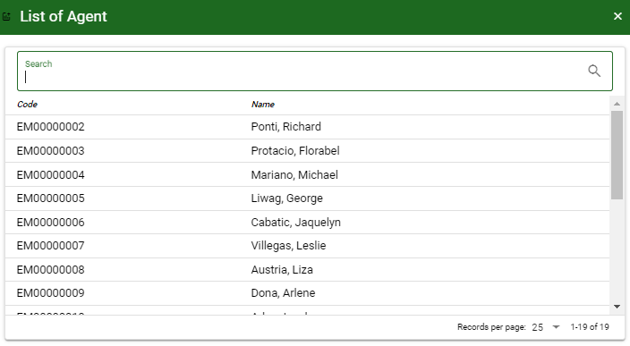
Accounting / Sales Group - Module
1
How To Setup Sales Group Masterfile?
1. In Sales Group– Main Window, you will notice an add button in the upper right parallel to other buttons. Click add button and you will be provided a field where you can add new group name and select leader.
2. You may now type the new sales group name in column provided and select the leader by click the lookup button.
3
3
2
2
3. If done, click save button under action column to save that specific sales group or you may click save all button parallel to other buttons in the upper side of the main window.
4. If you want to add more, repeat step 1 and 2 before doing step 3.
3

Slide 4
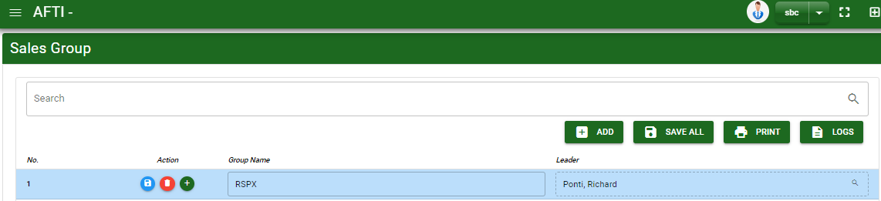
Accounting / Sales Group - Module
How To Edit Sales Group Masterfile?
1. If you wish to edit the group name, edit right away the details you want to change and you will notice that after you change the details, the line you edited will be highlighted into blue.
2. If you want to edit the detail under leader column, click the lookup button and reselect the agent.
3. If done, click save all button in the upper right side of the main window parallel to other buttons
3
2
4

Slide 5
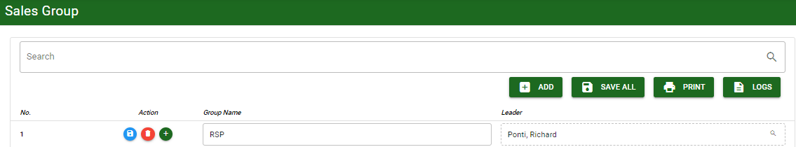

Accounting / Sales Group - Module
How To Delete Sales Group Masterfile?
1. You may select the group name in the search bar to filter the list.
2. Once it filtered out, click delete button parallel to sales group you want to
5

Slide 6
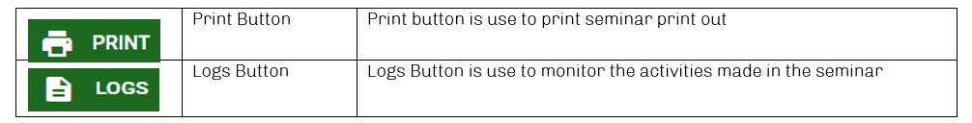
Accounting / Sales Group - Module
Other Buttons

