Slide 1
Sales Journal
Sales Journal is where delivery receipts and invoice are recorded.

Slide 2
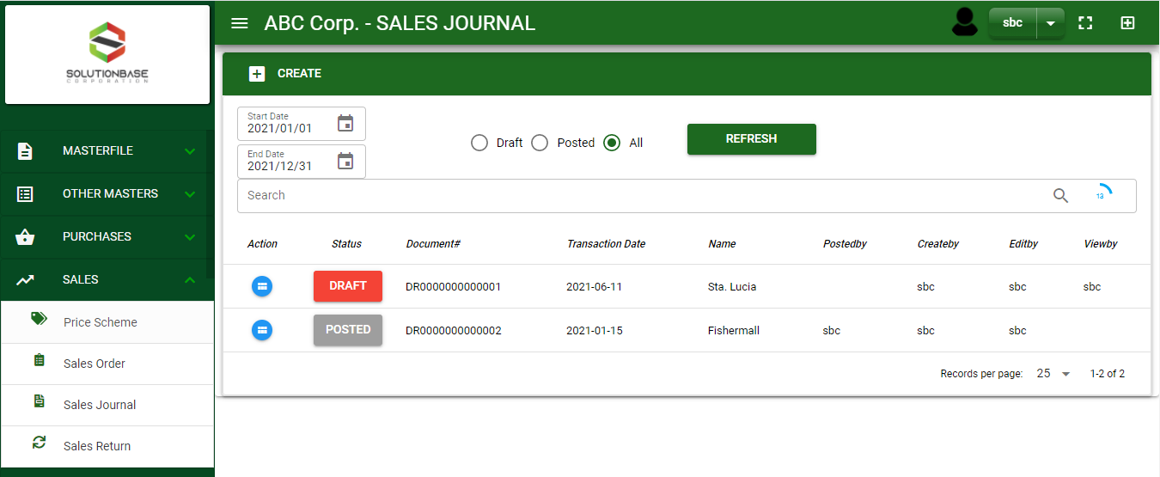

Sales/ Sales Journal - Module
Main Window
When you click the Sales Journal module under Sales, Sales Journal transactions list will display based on filtered date and status in the sales journal main window.
Sales Journal – Main Window

Slide 3
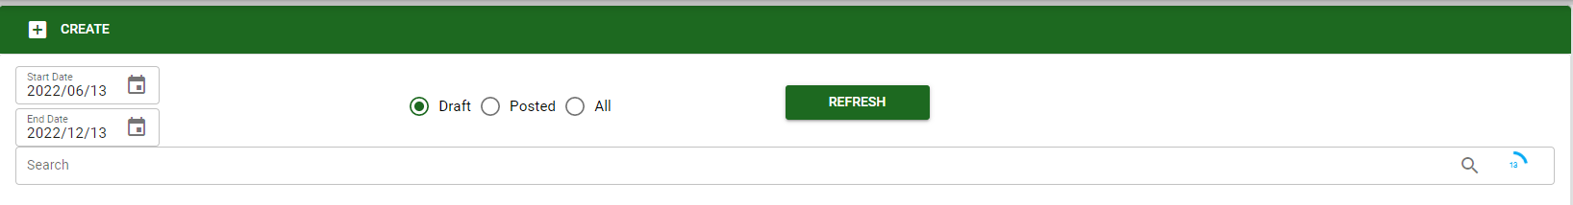
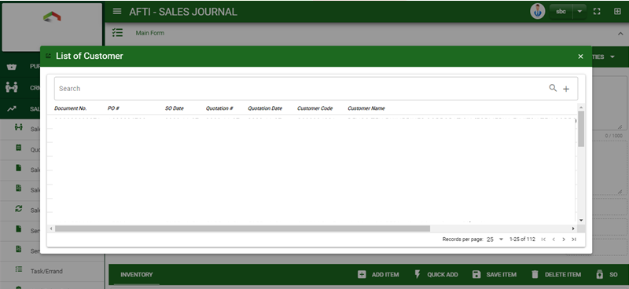
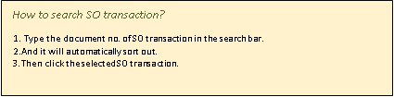
Sales/ Sales Journal - Module
How To Create Sales Journal Transaction?
1
1. In Sales Journal – Main Window, you will notice a create button in the upper left of the window. Click the create button and you will be redirect in sales journal – main form.
2. After you click the create button a dialog box will pop out with list of pending Sales Order transactions. Search and select a transaction.

Slide 4
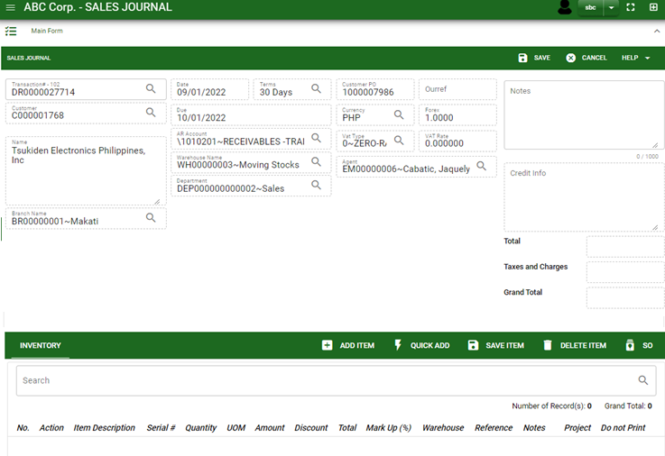
Sales/ Sales Journal - Module
How To Create Sales Journal Transaction?
3
3. After you select the SO transaction, you may now click Save and the details of the SO will be copied on Sales Journal.
4. Once saved, check the details in main form.

Slide 5
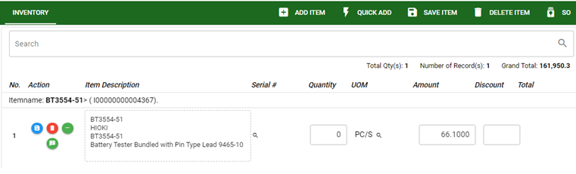
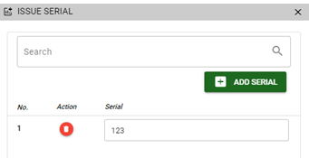
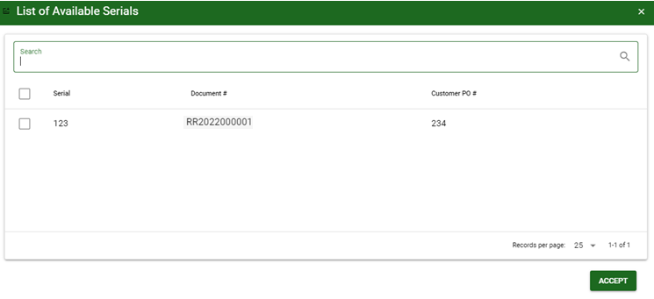
Sales/ Sales Journal - Module
How To Create Sales Journal Transaction?
How to add serial?
Click the add serial button
A dialog box will appear, enter the serial number,
Then click enter in keyboard.
5.1.
5. For items with serial/s, there are two ways to enter the serial.
5.1 If you know the serial number, click the – sign button.
5.2 If you want to select serial number from the available serial list, click look up button in serial column
5.2.
How to add serial from list of available serial?
Search the serial no./ document #/ customer PO
Tick the tickbox of selected serial
Then click accept button

Slide 6
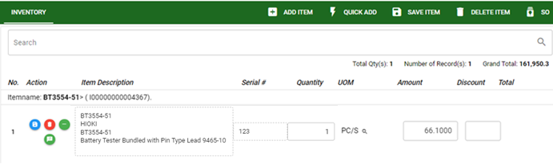
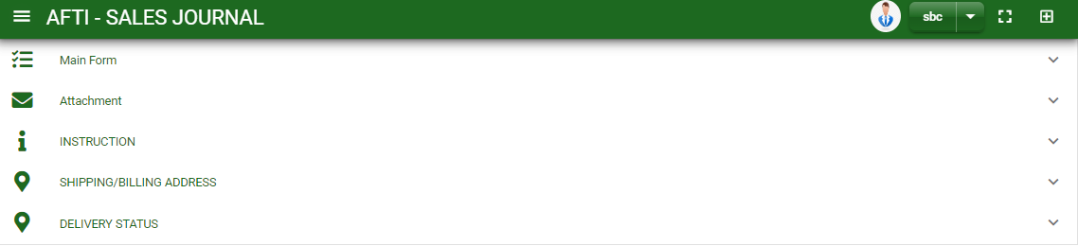
Sales/ Sales Journal - Module
How To Create Sales Journal Transaction?
6. If done you’ll notice that the selected serial no. will display in serial # column
7. If done in main form, click save item button
8. Details from main form, instruction and shipping/ billing address will be copied from the selected SO transaction.
7

Slide 7
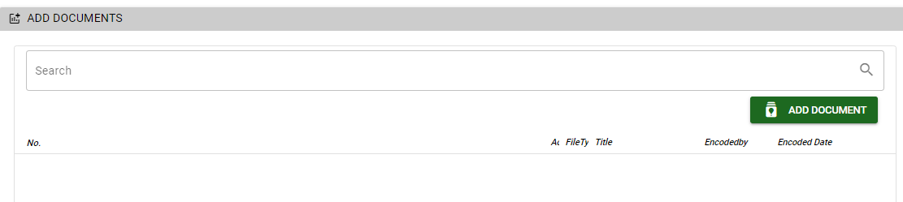
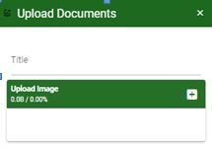
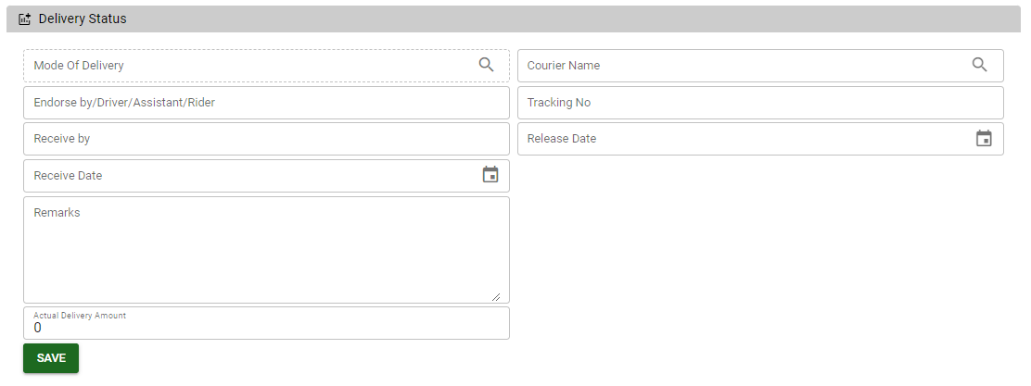
Sales/ Sales Journal - Module
How To Create Sales Journal Transaction?
9. If you want to upload file attachment in image form, click the attachment and upload the file.
10. To add details in delivery, scroll down and click the delivery status tab. Encode the necessary details and click save once done.
11. To finalized the transaction, go to main form and click post button
How to upload document?
Type the title of the document.
Click add button to add the chosen document to upload
Then click upload button.
If you want to add more document, click add document button and repeat steps #1 to 3.
1
2

Slide 8
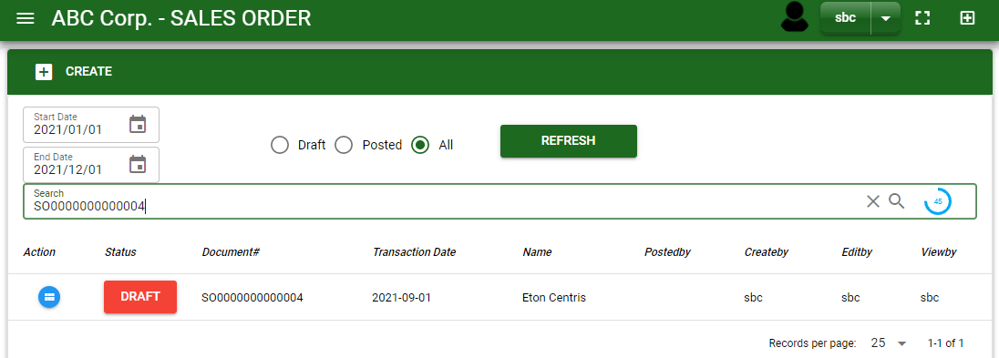
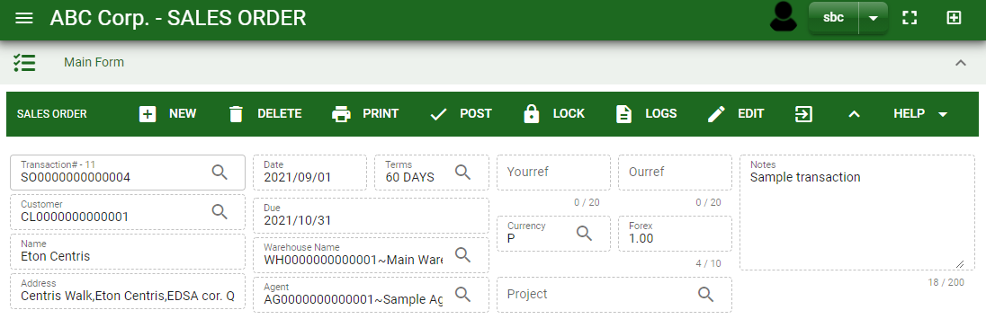
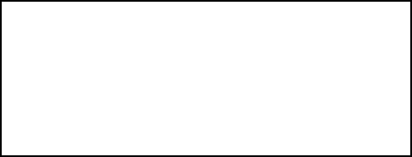
Sales/ Sales Journal - Module
How To Edit Sales Journal Transaction?
1.1. In the sales journal – main window, search the sales order transaction you wish to edit its information in the search bar. Or,
1.2. In sales journal – main form, click the lookup button and select the transaction you wish to edit its information by typing its transaction number in the search bar.
2.After you select the SJ transaction, if you wish to edit the header of the transaction click edit button.
3. If you are done editing the sales order header, click save button in the upper side of the header.
1.1.
Sales Journal – Main Window
HEADER
2.
1.2.
How to search SJ transaction?
Type the transaction number in the search bar.
Click ‘enter’ in the keyboard to search.
Click to select the transaction you want to edit
Sales Journal – Main Form

Slide 9
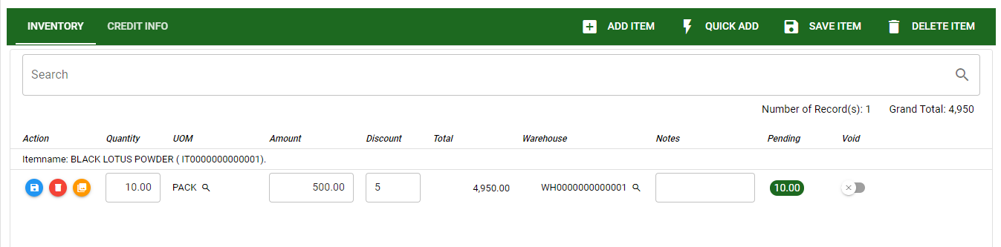
Sales/ Sales Journal - Module
How To Edit Sales Journal Transaction?
4. If you want to edit the items in sales journal stock, edit right away the details you want to change and you will notice that after you change the details, the item you edited will be highlighted into blue.
5. If you’re done editing, click save item button to save the changes you made in the items.
6. To delete all items in the stock, click delete item button.
7. To delete a specific item on the table, click the delete icon next to the item to delete it.
STOCK
5
6
4
7

Slide 10
Sales/ Sales Journal - Module
How To Delete Sales Journal Transaction?
1.1.
1.1 In the sales journal – main window, search the transaction you want to delete.
1.2. In sales journal – main form, click the lookup button and select the transaction you want to delete.
2. If done, click delete button.
Sales Journal – Main Window
HEADER
2.
1.2.
How to search SJ transaction?
Type the transaction number in the search bar.
Click ‘enter’ in the keyboard to search.
Click to select the transaction you want to delete
Sales Journal – Main Form

Slide 11




Sales/ Sales Journal - Module
Other Buttons
 | Print Button | Print button is use to print transaction.
 | Logs Button | Logs Button is use to monitor the activities made in the module.
 | Lock Button | Lock button is use to lock the transaction to refrain from changing the details in the transaction
 | Back to Listing Button | Back to Listing Button is use to go back from main form to main window
 | Hide Head Button | Hide Head Button is use to minimize the main form.
 | Full Screen Button | Full Screen Button is use to allow the main form to full screen.
 | Open New Tab Button | Open New Tab Button is use to open new tab module you currently using.

