Slide 1
Sales Order
Sales Order it is where product order of customers is recorded from quotation.

Slide 2
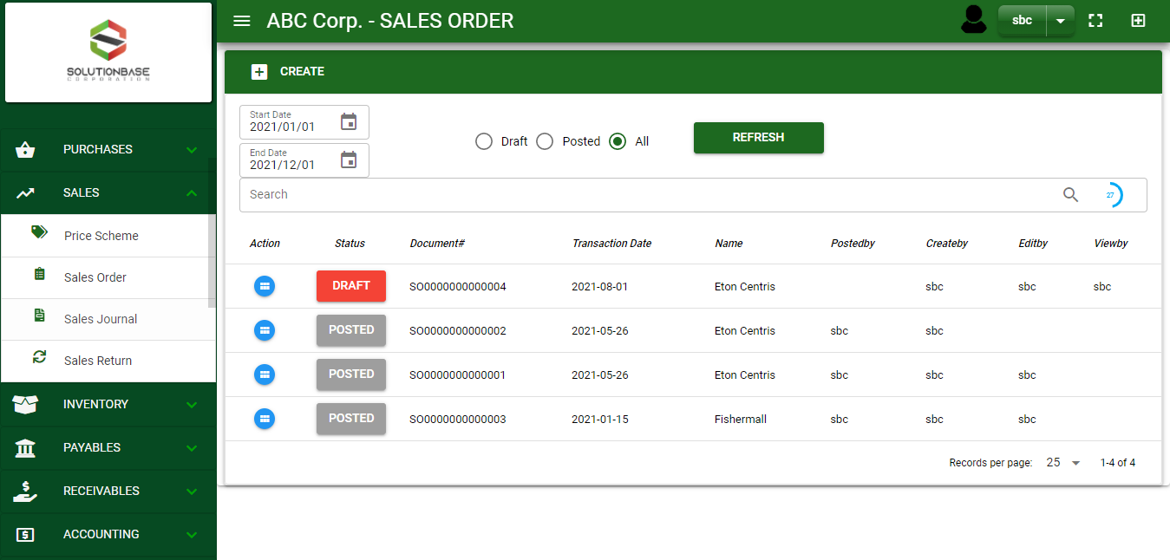

Sales/ Sales Order- Module
Main Window
When you click the Sales Order module under Sales, Sales Order transactions list will display based on filtered date and status in the sales order main window.
Sales Order – Main Window

Slide 3
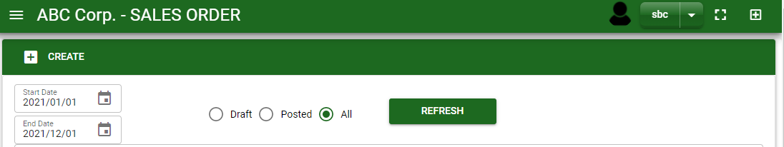
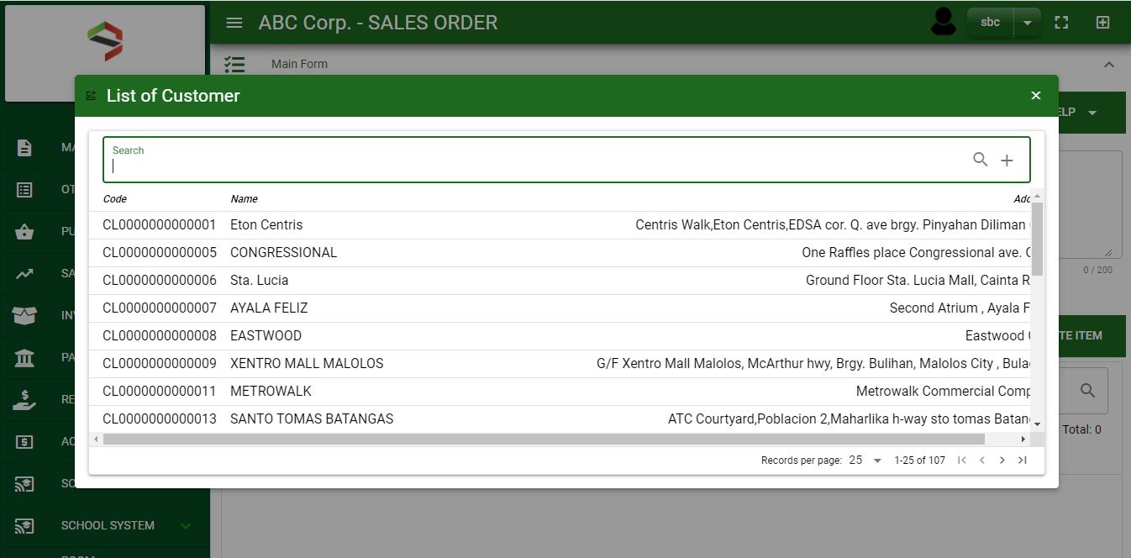
Sales/ Sales Order- Module
How To Create Sales Order Transaction?
1
1. In Sales Order – Main Window, you will notice a create button in the upper left of the window. Click the create button and you will be redirect in sales order – main form.
2. After you click the create button a dialog box will pop out with list of customer. Search and select a customer or the quotation transaction
2
How to search customer?
1. Type the transaction number of quotation in the search bar.
2. And it will automatically sort out.
3. Then click the selected transaction in quotation

Slide 4
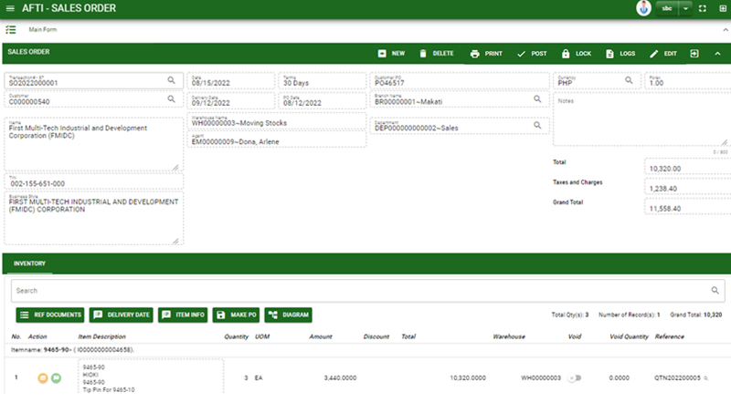
Sales/ Sales Order- Module
How To Create Sales Order Transaction?
5
3. After you select the quotation, you will be redirect in sales order – main form where you all information from quotation will be copied.
4. Check the transaction.
5. To finalize the transaction, click post button located in the header.
Sales Order – Main Form

Slide 5
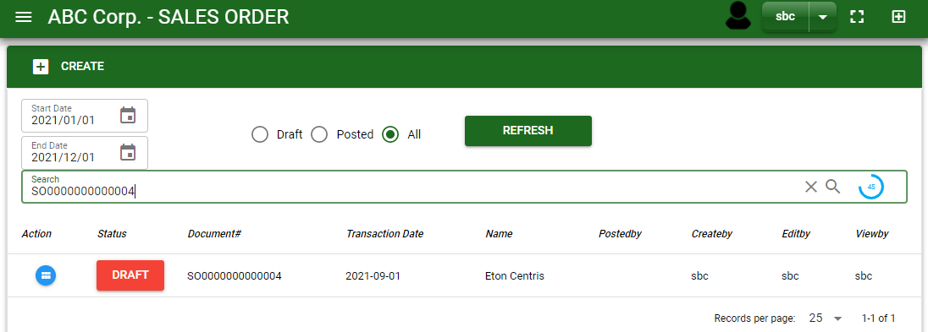
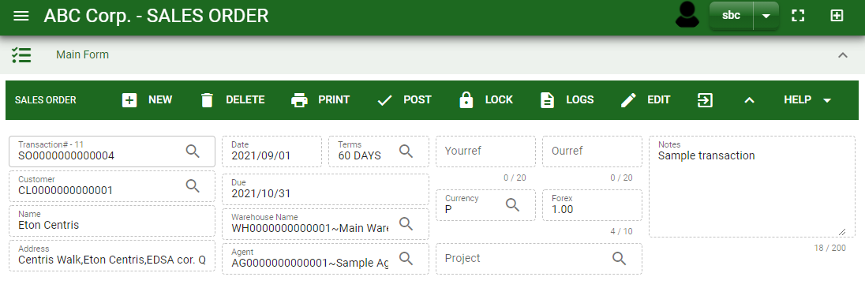

Sales/ Sales Order- Module
How To Delete Sales Order Transaction?
1.1. In the sales order – main window, search the transaction you want to delete.
1.2. In sales order – main form, click the lookup button and select the transaction you want to delete.
2. If done, click delete button.
1.1.
Sales Order – Main Window
HEADER
2.
1.2.
How to search SO transaction?
Type the transaction number in the search bar.
Click ‘enter’ in the keyboard to search.
Click to select the transaction you want to delete
Sales Order – Main Form

Slide 6
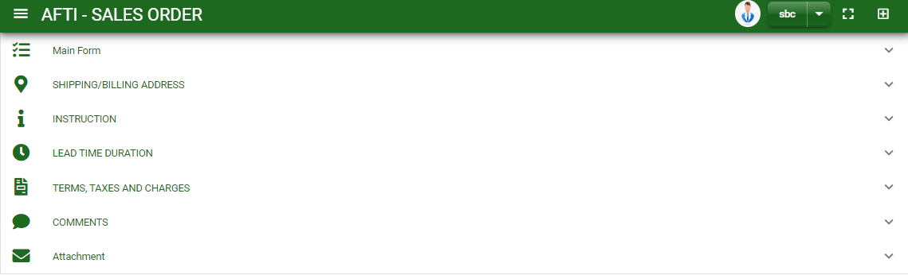
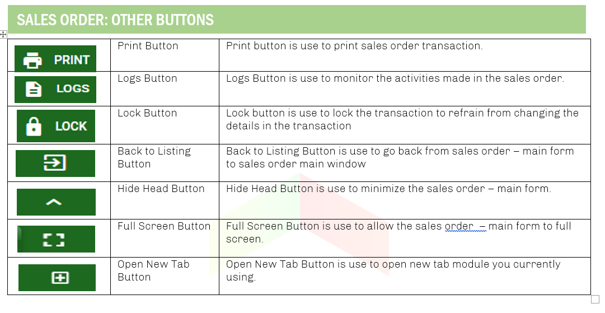
Sales/ Sales Order- Module
Other Information
When you click the arrow up icon parallel in the main form on the upper right, and the sales order – main form will be minimize and the other information will be displayed as shown in the photo.
Click the arrow parallel to the tab you want to open and the information copied from quotation module will be displayed.
Other Buttons

