Slide 1
Service Receiving
is where we record service receiving from quotation.

Slide 2
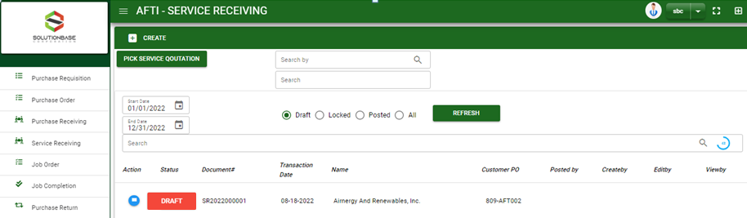

Purchase / Service Receiving- Module
Main Window
When you click the Service Receiving module under Purchases, Service Receiving transactions list will display based on filtered date and status in the service receiving main window.
Service Receiving – Main Window

Slide 3
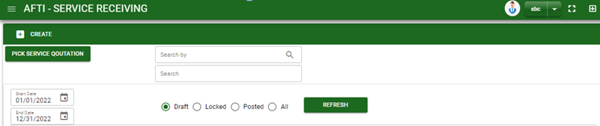
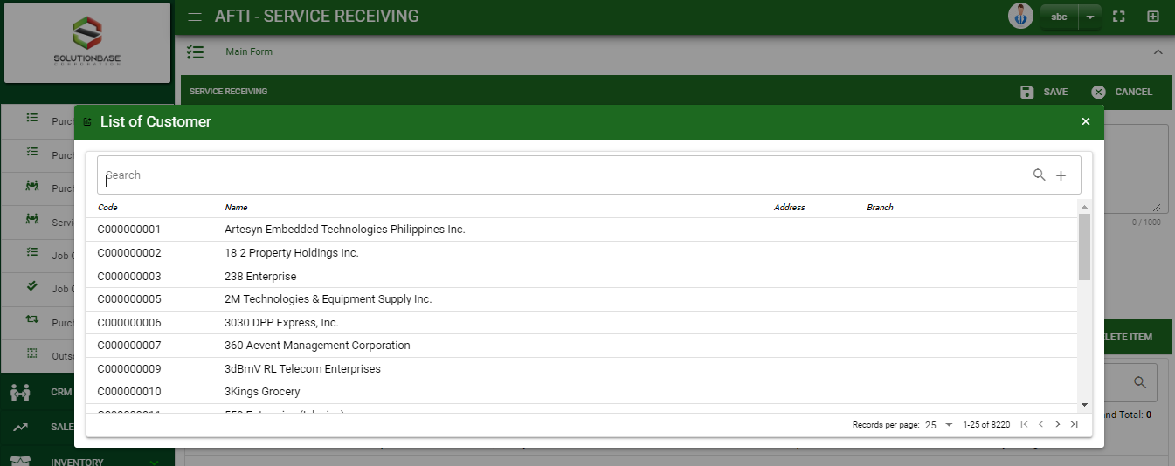
Purchase / Service Receiving- Module
How To Create Service Receiving Transaction?
1
CREATE USING CREATE BUTTON
1. In Service Receiving – Main Window, you will notice a create button in the upper left of the window. Click the create button and you will be redirect in service receiving – main form.
2. After you click the create button a dialog box will pop out with list of supplier. Search and select a supplier.
2
3. After you select a supplier, you will be redirected in service receiving– main form where you will encode the other necessary information of the transaction and record the services’ to be receive from the supplier
How to search supplier?
Type the supplier name in the search bar.
And it will automatically sort out.
Then click the selected supplier.

Slide 4
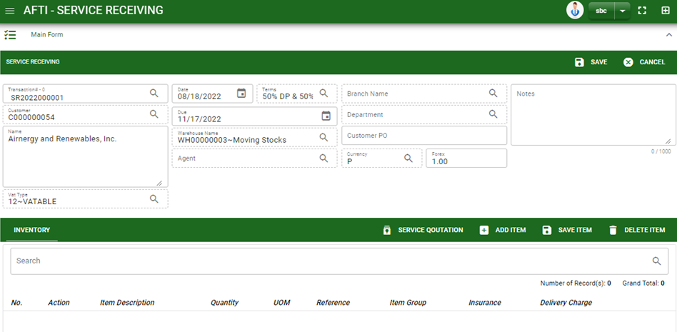



Purchase / Service Receiving- Module
How To Create Service Receiving Transaction?
4.1. Fill in other necessary information.
4.2. If done in header, click save button.
5. After saving the header, you may now add the ordered items.
Service Quotation: If services are from quotation, click Service Quotation to select transaction.
Add item: If ordered items will have no reference, manually add the item by clicking the add item button.
4.1
Stock

Slide 5
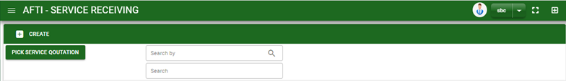


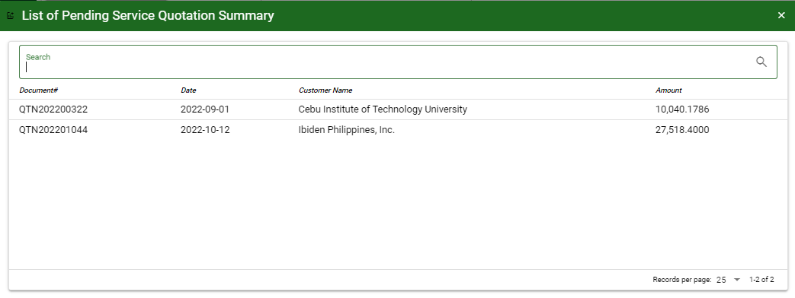
Purchase / Service Receiving- Module
How To Create Service Receiving Transaction?
CREATE USING PICK SERVICE QUOTATION BUTTON
1. In Service Receiving– Main Window, you will notice a Pick Service Quotation button in the upper left of the window. Click the button and a confirmation message will pop out. Click OK to proceed.
2. After you proceed to pick Service Quotation, search and select the quotation transaction you want to create a service receiving.
3. After you select the Quotation transaction, you will be redirected in service receiving – main form where details from selected Quotation transaction are copied from header to details of service items.
2
How to search Service Quotation transaction?
Type the transaction number in the search bar.
And it will automatically sort out.
Then click the selected transaction.

Slide 6
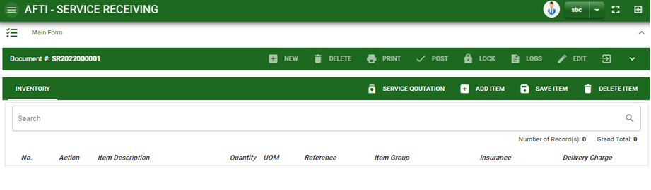

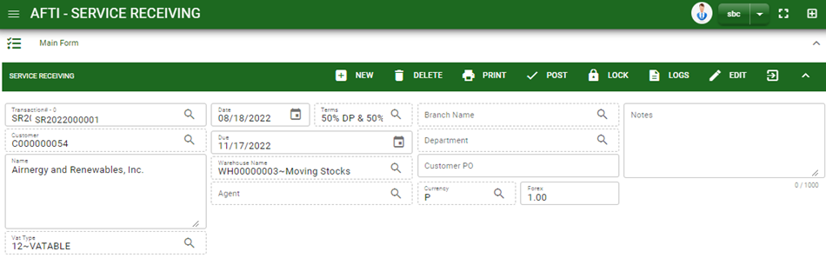
Purchase / Service Receiving- Module
How To Create Service Receiving Transaction?
If done, finalize the transaction by click the arrow button to maximize the main form header.
In header, click post button.
9

Slide 7
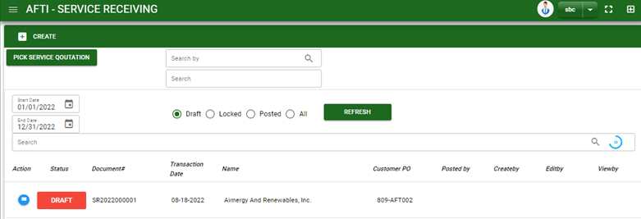

Purchase / Service Receiving- Module
How To Edit Service Receiving Transaction?
1.1. In the service receiving – main window, search the service receiving transaction you wish to edit its information in the search bar. Or,
1.2. In service receiving – main form, click the lookup button and select the transaction you wish to edit its information by typing its transaction number in the search bar.
2. After you select the SR transaction, if you wish to edit the header of the transaction click edit button.
3. If you are done editing the service receiving header, click save button in the upper side of the header.
1.1.
Service Receiving – Main Window
HEADER
2.
1.2.
How to search SR transaction?
Type the transaction number in the search bar.
Click ‘enter’ in the keyboard to search.
Click to select the transaction you want to edit
Service Receiving – Main Form

Slide 8
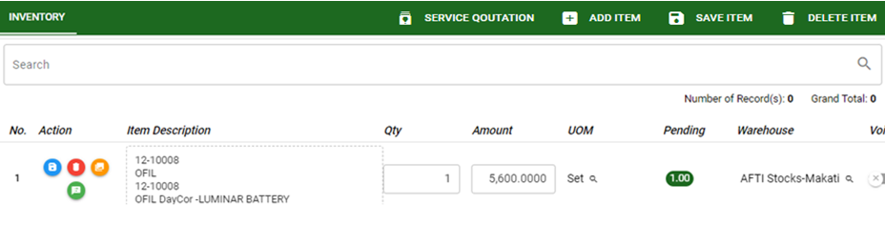

Purchase / Service Receiving- Module
How To Edit Service Receiving Transaction?
STOCK
4. If you want to edit the items in service receiving stock, edit right away the details you want to change and you will notice that after you change the details, the item you edited will be highlighted into blue.
5. If you’re done editing, click save item button to save the changes you made in the items.
6. To delete all items in the stock, click delete item button.
7. To delete a specific item on the table, click the delete icon next to the item to delete it.
5
6
7

Slide 9
Purchase / Service Receiving- Module
How To Delete Service Receiving Transaction?
1.1.
1.1. In the service receiving – main window, search the transaction you want to delete.
1.2. In service receiving - main form, click the lookup button and select the transaction you want to delete.
2. If done, click delete button.
Service Receiving – Main Window
HEADER
2.
1.2.
How to search SR transaction?
Type the transaction number in the search bar.
Click ‘enter’ in the keyboard to search.
Click to select the transaction you want to edit
Service Receiving – Main Form

Slide 10
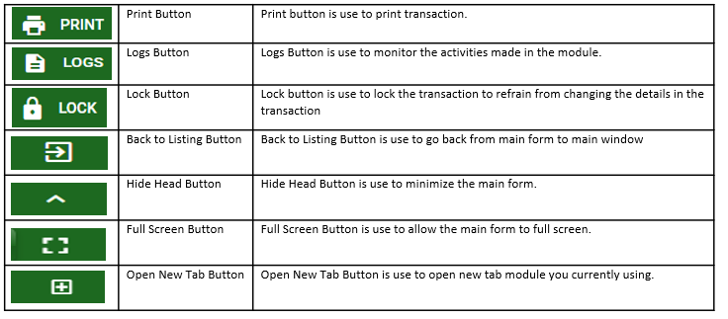
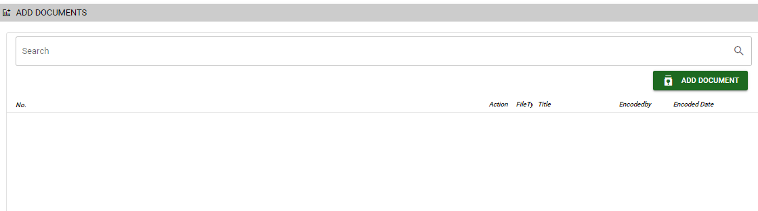
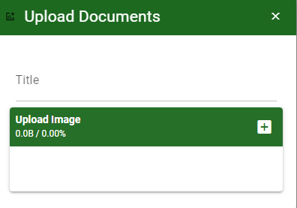
Purchase / Service Receiving- Module
Other Information
Other Buttons
When you click the arrow up icon parallel in the main form on the upper right, and the service receiving – main form will be minimize and the other tab will be visible.
Attachment tab
1. Click the arrow icon parallel to attachment tab
2. Click add document button
3. Once you click the add document button, a dialog box of upload documents will pop out.
4. To upload files, follow ‘how to upload document”
Shipping tab
Click the arrow icon parallel to Shipping/ billing address
You may view or edit the Shipping and Billing Address for the SR transaction.
2
How to upload document?
Type the title of the document.
Click add button to add the document you want to upload.
Then click upload button.
If you want to add more document, click add document button and repeat steps 1 to #3

