Slide 1
MAIN/OUTSOURCE ITEMS
Is the list of all items that a company offers in the market.
The stock movement of item can be viewed in this module as well as other details related to item.

Slide 2
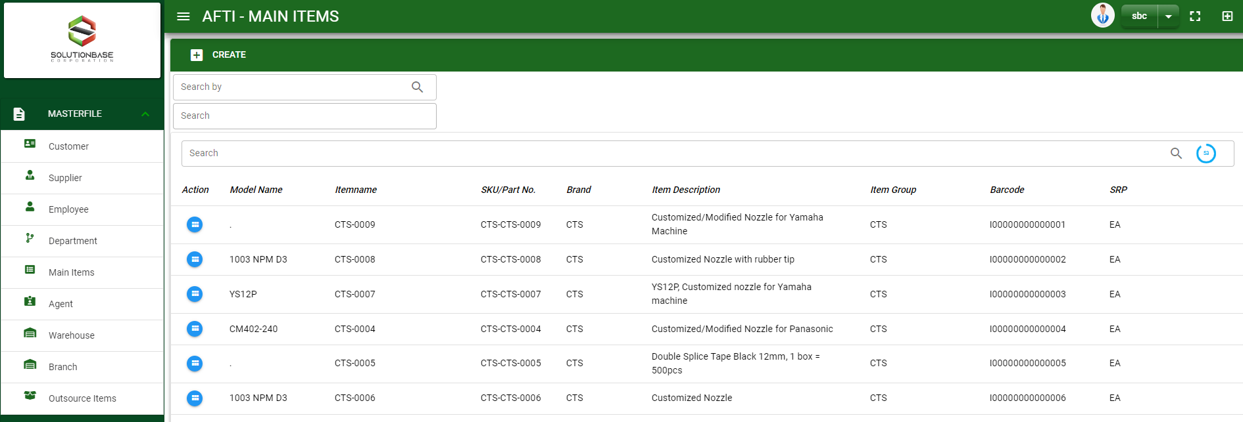

Masterfile / Main/Outsource Items - Module
Main Window
When you click the module under Masterfile, item list will display in the main window.
Main Window
2

Slide 3
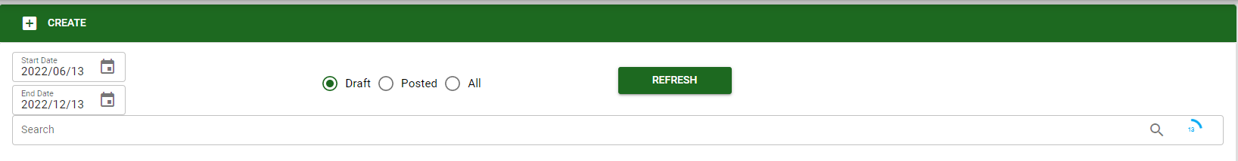
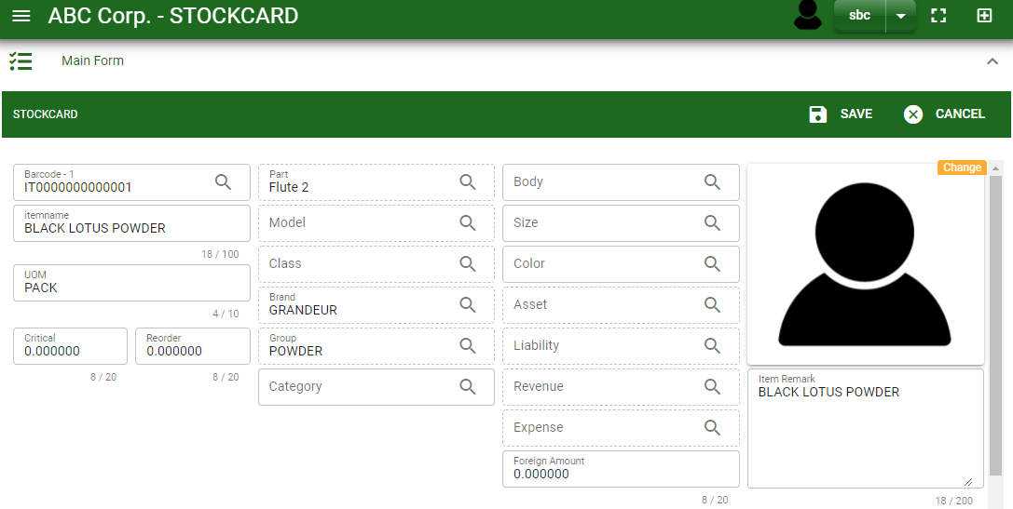
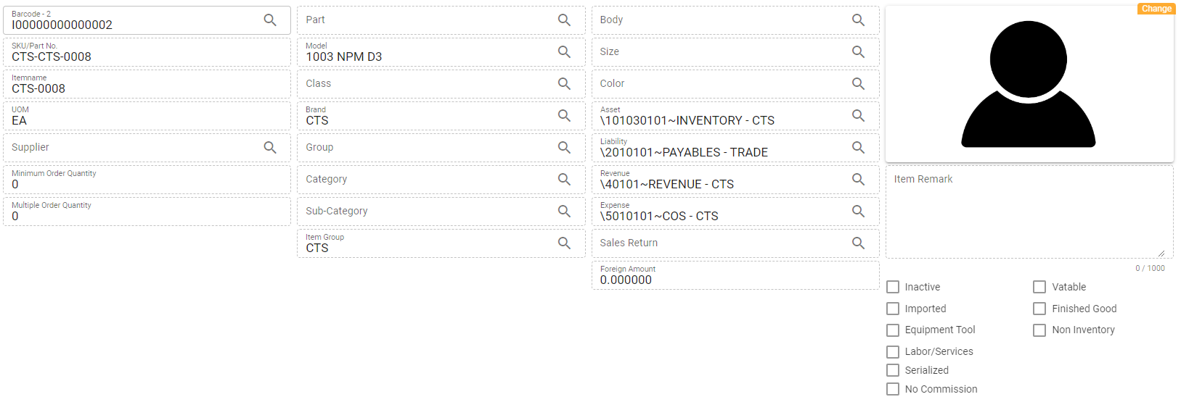
Masterfile / Main/Outsource Items - Module
1
How To Create New Item?
1. In Main Window, you will notice a create button in the upper left of the window. Click the create button and you will be redirect in Main form.
2. After you click the create button in the main window, you will be redirected in main form where you will encode the item other information.
3. In the above photo, fill in all the necessary details in the provided field.
4. If done, click save button.
Main Window
4
3
Main Form
3

Slide 4
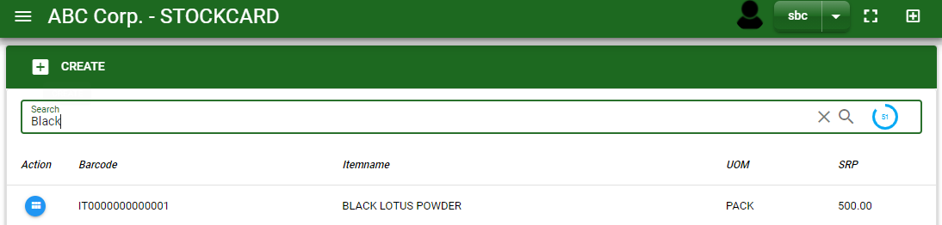
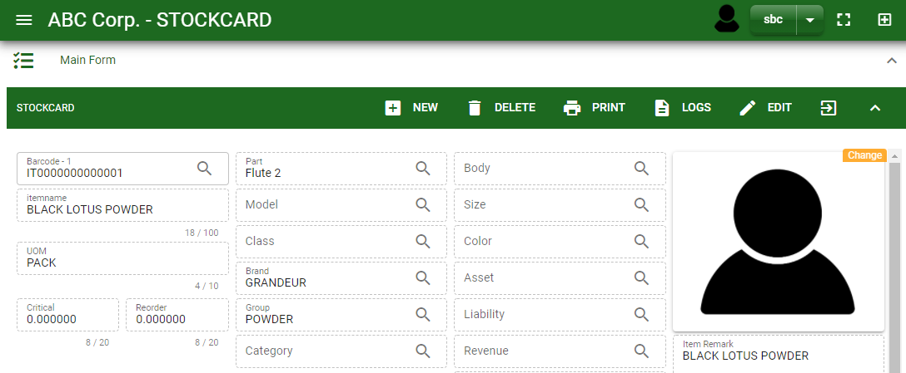
Masterfile / Main/Outsource Items - Module
How To Edit Item Details?
1.1. In the Main window, search the item you wish to edit its information in the search bar. Or,
1.2. In Main form, click the lookup button and select the item you wish to edit its information by typing its item name in the search bar.
1.1.
Main Window
2. After you select the item, click edit button in the upper right side of ain form.
2.
1.2.
How to search item?
Type the item name or code in the search bar.
Click ‘enter’ in the keyboard to search.
Click the button before the item code to select the item.
Main Form
4

Slide 5
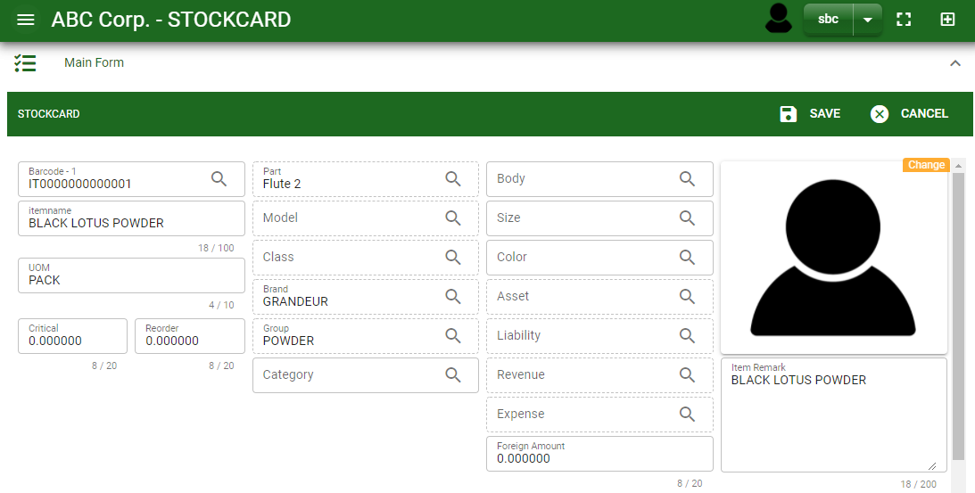
Masterfile / Main/Outsource Items - Module
How To Edit Item Details?
4
3
3. Edit the information you want to edit.
4. If done, click save button.
Main Form
5

Slide 6
Masterfile / Main/Outsource Items - Module
How To Delete an Item?
1.1 In Main window, search the customer you want to delete.
1.2 In Main form, click the lookup button and select the customer you want to delete.
1.1.
Main Window
2. Click delete button.
2.
1.2.
How to search item?
Type the item name or code in the search bar.
Click ‘enter’ in the keyboard to search.
Click the button before the item code to select the item.
Main Form
6

Slide 7
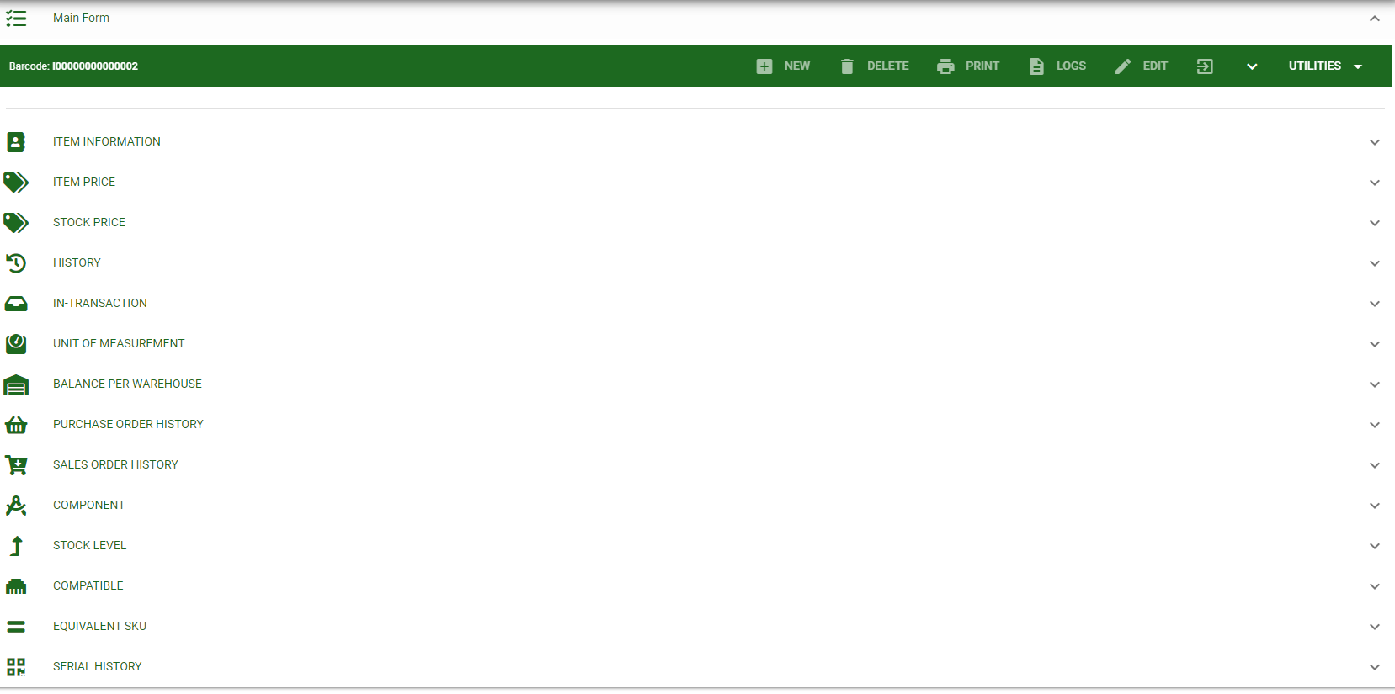
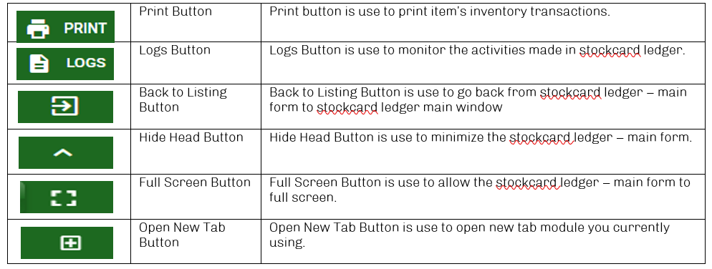
Masterfile / Main/Outsource Items - Module
Other Information
When you click the arrow parallel to the main form on the upper right, the Main form will minimize and the other information will be displayed as shown in the photo below.
Click the arrow parallel to what information you want to open and provide the necessary filter to generate the data you want to display.
Main form
Other Buttons
7

