Slide 1
Stock Issuance
Stock Issuance is where issuance of stock request is recorded.

Slide 2
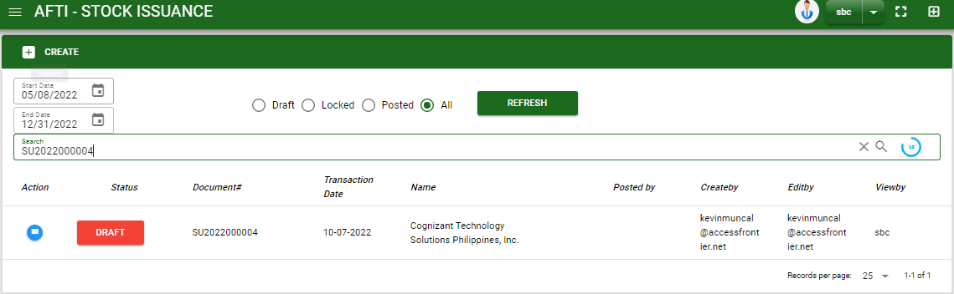

Sales/ Stock Issuance - Module
Main Window
–
When you click the Stock Issuance module under Sales, Stock Issuance transactions list will display based on filtered date and status in the Stock Issuance main window.
Stock Issuance – Main Window

Slide 3
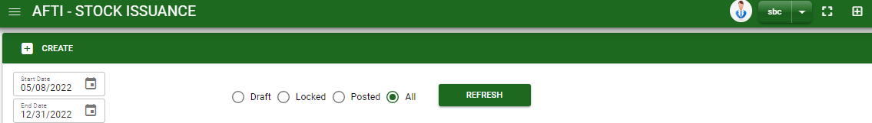
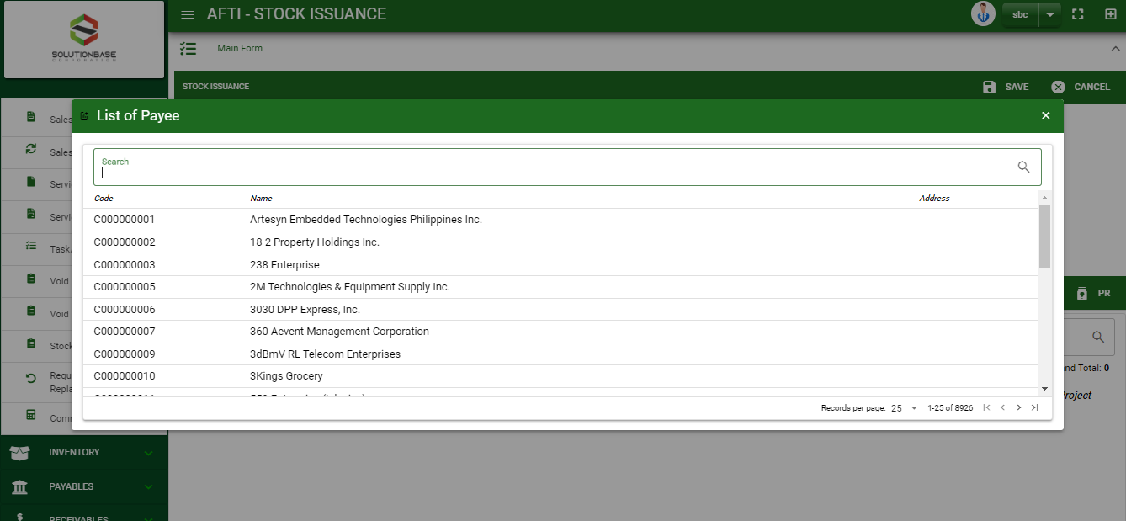
Sales/ Stock Issuance - Module
How To Create Stock Issuance Transaction?
1
1. In stock issuance – Main Window, you will notice a create button in the upper left of the window. Click the create button and you will be redirect in stock issuance – main form.
2. After you click the create button a dialog box will pop out with list of customer. Search and select a customer.
How to search customer?
Type the payee name in the search bar.
And it will automatically sort out.
Then click the selected payee

Slide 4
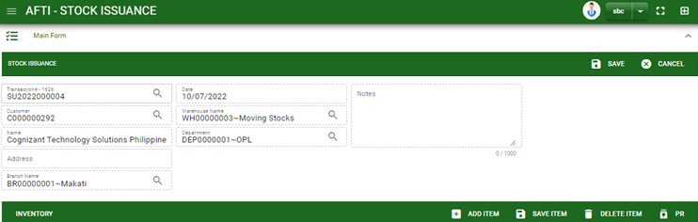
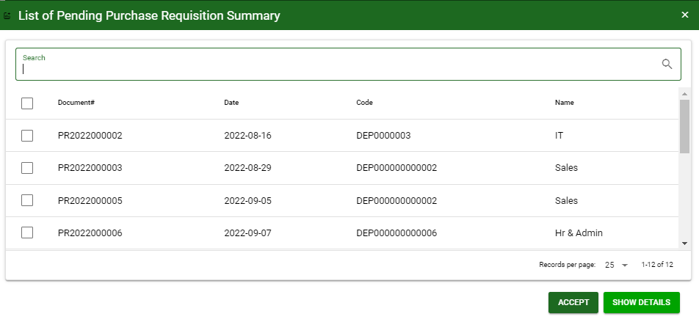
Sales/ Stock Issuance - Module
How To Create Stock Issuance Transaction?
HEADER
4
3. After you select the payee, fill all necessary information in the header.
4. If done, click save button to save details from header
5. Click PR button and a dialog box of list from purchase requisition will appear.
6. Select the purchase request by ticking the check box.
7. After selecting, click accept button
3
5
6
7

Slide 5
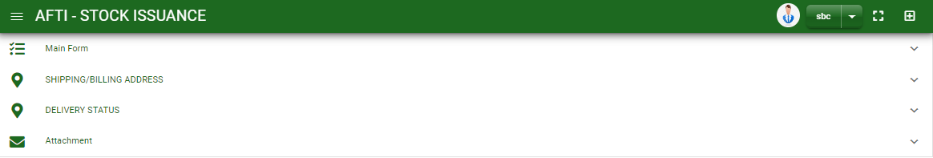
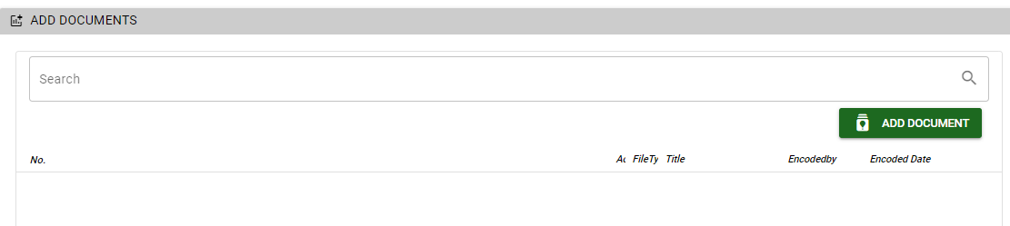
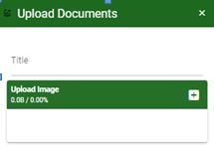
Sales/ Stock Issuance - Module
How To Create Stock Issuance Transaction?
8. If done in main form. Click the arrow parallel to main window to minimize the main form tab.
9. Add shipping/ billing address in shipping/ billing address tab
10. Add delivery details in delivery status tab
11. If you want to upload file attachment, click the attachment and upload the file
12. To finalized the transaction, click post button in main form
How to upload document?
Type the title of the document.
Click add button to add the chosen document to upload
Then click upload button.
If you want to add more document, click add document button and repeat steps #1 to 3.
1
2.

Slide 6
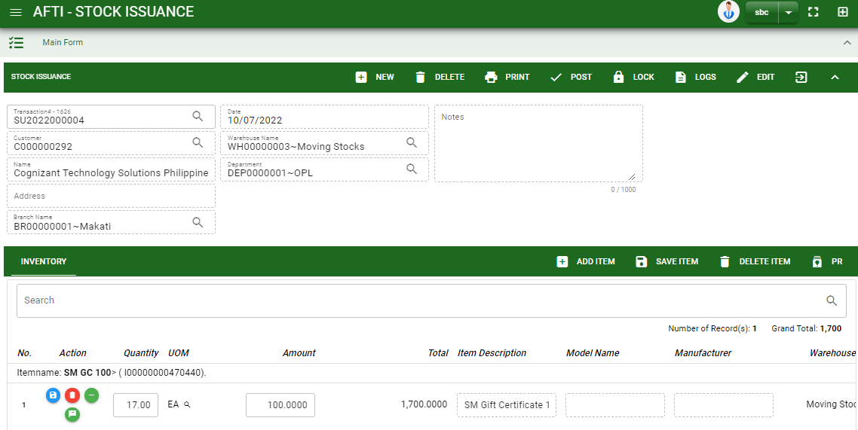
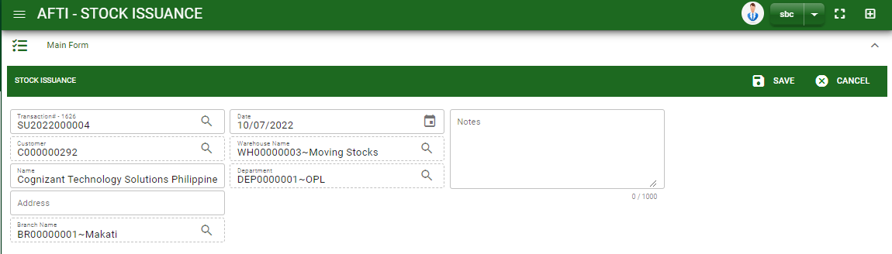
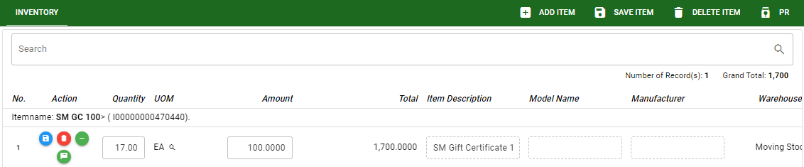
Sales/ Stock Issuance - Module
How To Edit Stock Issuance Transaction?
1
2
1. To edit the header, click edit button then edit the information that you want to change.
2. If done, click save button.
3. To edit the item stock, edit directly the details you want to change.
4. If done, click save item button.
4
3

Slide 7
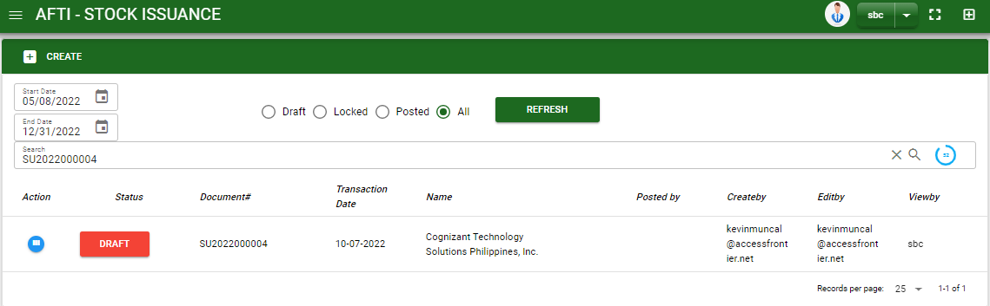
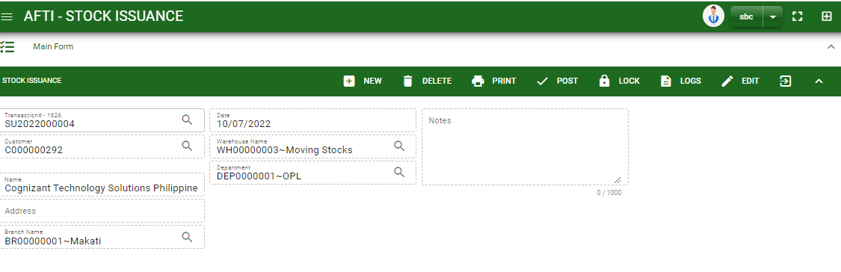
Sales/ Stock Issuance - Module
How To Delete Stock Issuance Transaction?
1.1 In the stock issuance – main window, search the transaction you want to delete.
1.2. In stock issuance– main form, click the lookup button and select the transaction you want to delete.
2. If done, click delete button.
1.1.
Stock Issuance – Main Window
HEADER
2.
1.2.
How to search stock issuance transaction?
Type the transaction number in the search bar.
Click ‘enter’ in the keyboard to search.
Click to select the transaction you want to delete
Stock Issuance – Main Form

Slide 8
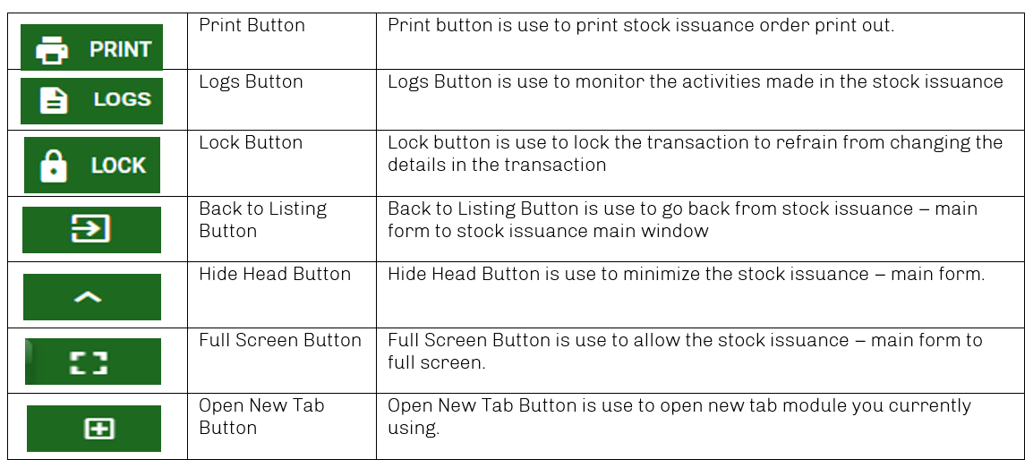
Sales/ Stock Issuance - Module
Other Buttons

