Slide 2
Supplier Ledger
Is a list of suppliers of the company.
It is where all transactions in inventory, payables and payments made by the supplier are all display.

Slide 3
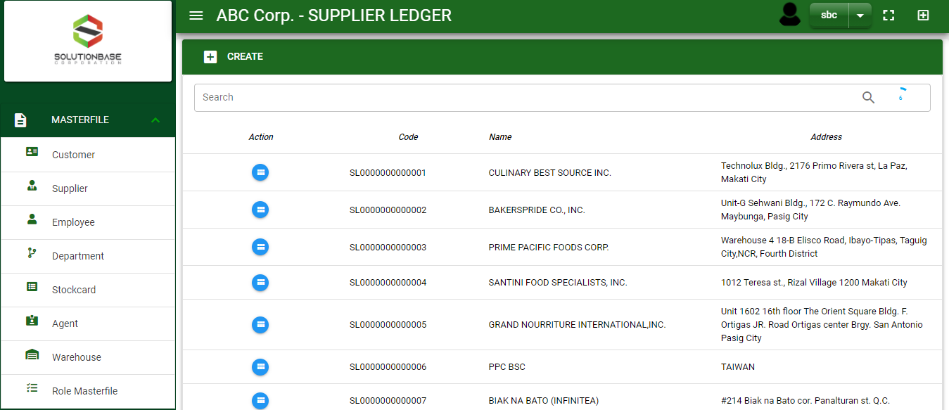

Masterfile / Supplier Ledger - Module
Main Window
When you click the Supplier module under Masterfile, supplier list will display in the supplier ledger main window.
Supplier Ledger – Main Window
3

Slide 4
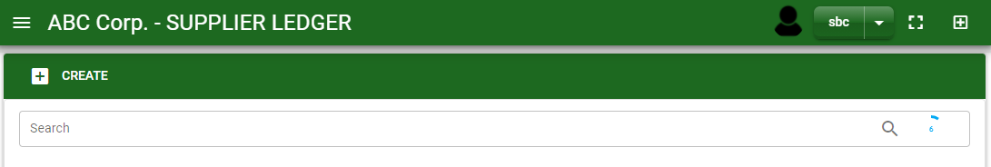
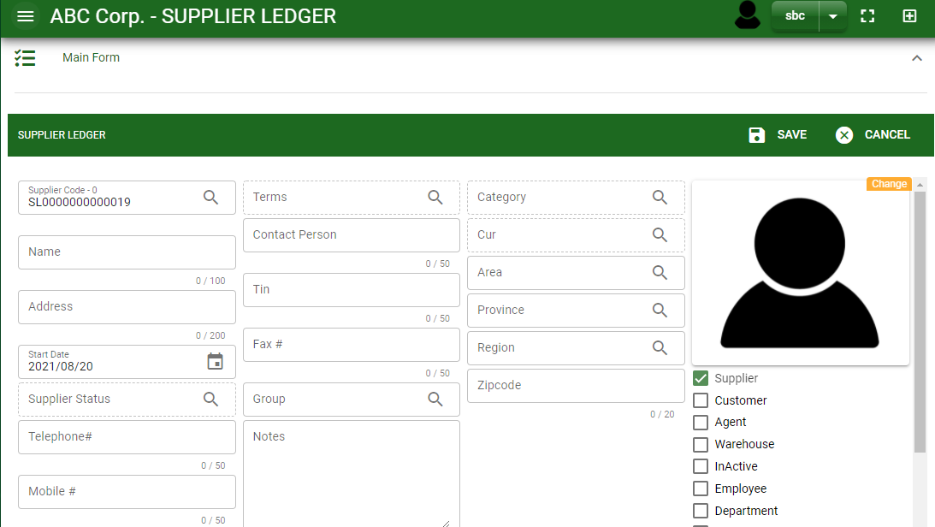
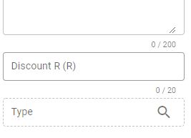

Masterfile / Supplier Ledger - Module
How To Create New Supplier?
1
1. In Supplier Ledger – Main Window, you will notice a create button in the upper left of the window. Click the create button and you will be redirect in supplier ledger – main form.
2. After you click the create button in the supplier ledger – main window, you will be redirected in supplier ledger – main form where you will encode the supplier other information.
3. In the above photo, fill in all the necessary details in the provided field.
4. If done, click save button.
4
3
Supplier Ledger – Main Form
4

Slide 5
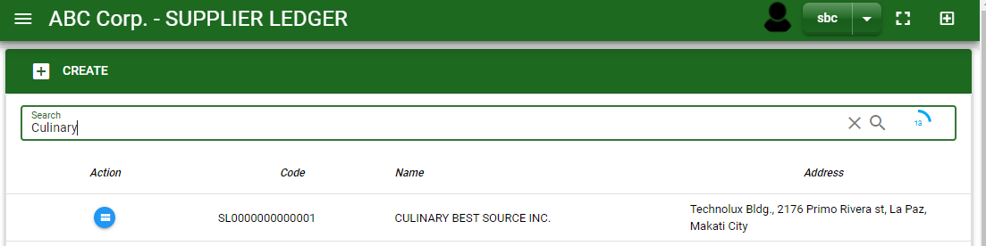
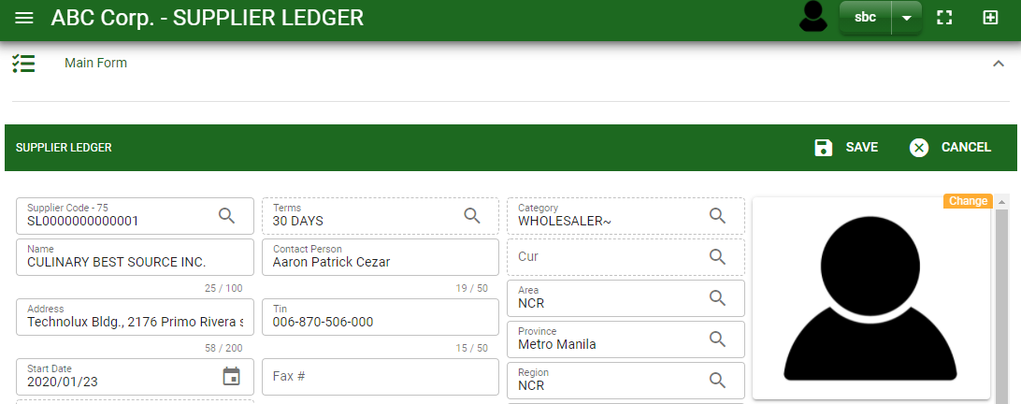

Masterfile / Supplier Ledger - Module
How To Edit Supplier Details?
1.1 In the supplier ledger – main window, search the supplier you wish to edit its information in the search bar. Or,
1.2 In supplier ledger – main form, click the lookup button and select the supplier you wish to edit its information by typing its supplier name in the search bar.
1.1.
Supplier Ledger – Main Window
2. After you select the supplier, click edit button in the upper right side of supplier ledger – main form.
2.
1.2.
How to search supplier?
Type the supplier name in the search bar.
Click ‘enter’ in the keyboard to search.
Click the button before the supplier code to select the supplier.
Supplier Ledger – Main Form
5

Slide 6
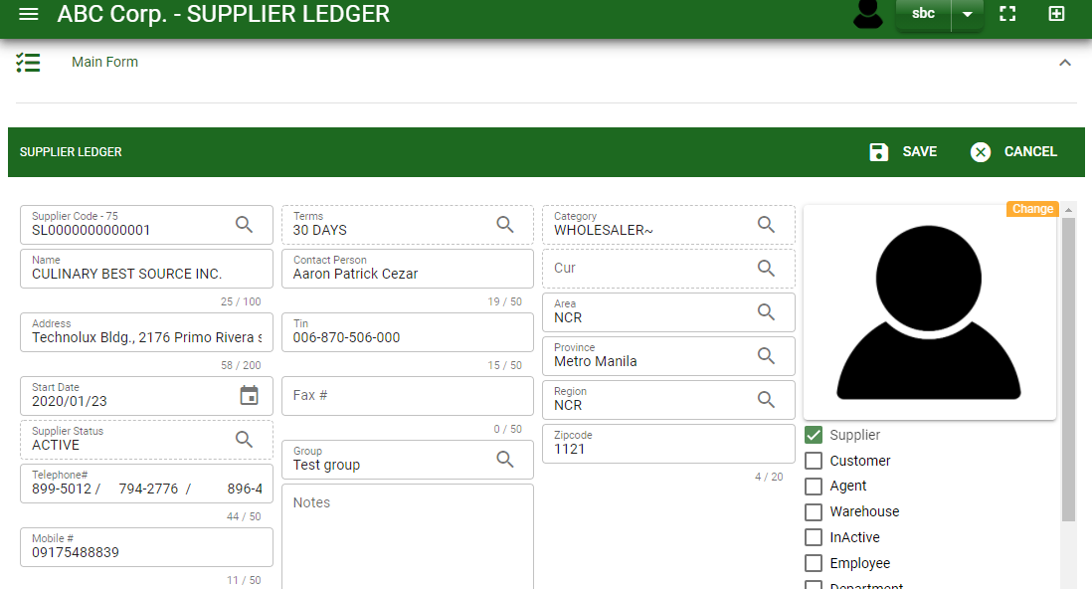
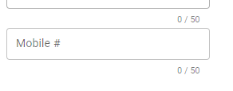
Masterfile / Supplier Ledger - Module
How To Edit Supplier Details?
4
3
3. Edit the information you want to edit.
4. If done, click save button.
Supplier Ledger – Main Form
6

Slide 7
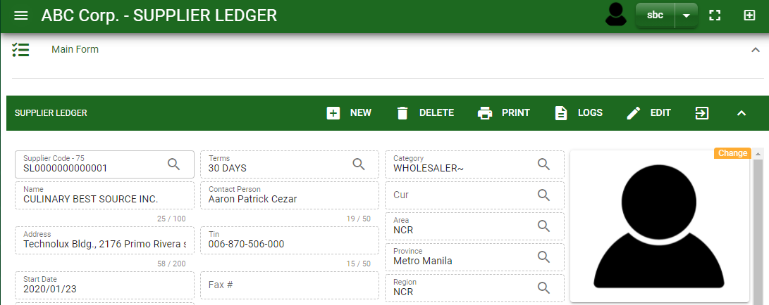
Masterfile / Supplier Ledger - Module
How To Delete a Supplier Ledger?
1.1 In the supplier ledger – main window, search the customer you want to delete.
1.2 In supplier ledger – main form, click the lookup button and select the customer you want to delete.
1.1.
Supplier Ledger – Main Window
3. Click delete button.
2.
1.2.
Supplier Ledger – Main Form
7

Slide 8
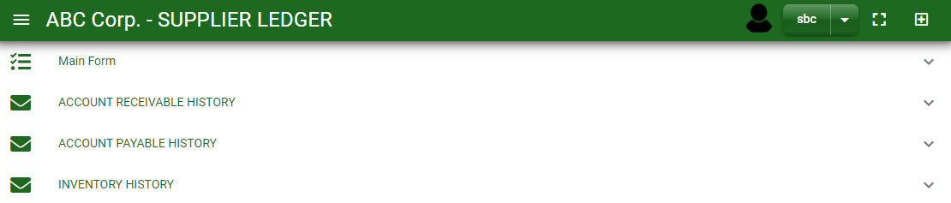
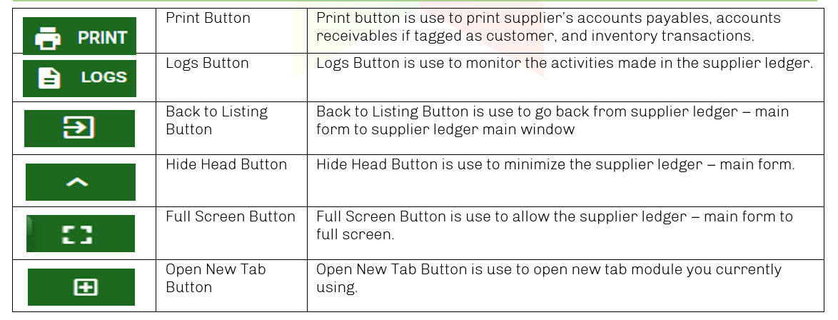
Masterfile / Supplier Ledger - Module
Other Information
When you click the arrow parallel to the main form on the upper right, the supplier ledger – main form will minimize and the other information will be displayed as shown in the photo below.
Click the arrow parallel to what information you want to open and provide the necessary filter to generate the data you want to display.
Supplier Ledger – Main form
Other Buttons
8

