Slide 1
Task/Errand Module
Task/ errand is where task/ errand is recorded.

Slide 2
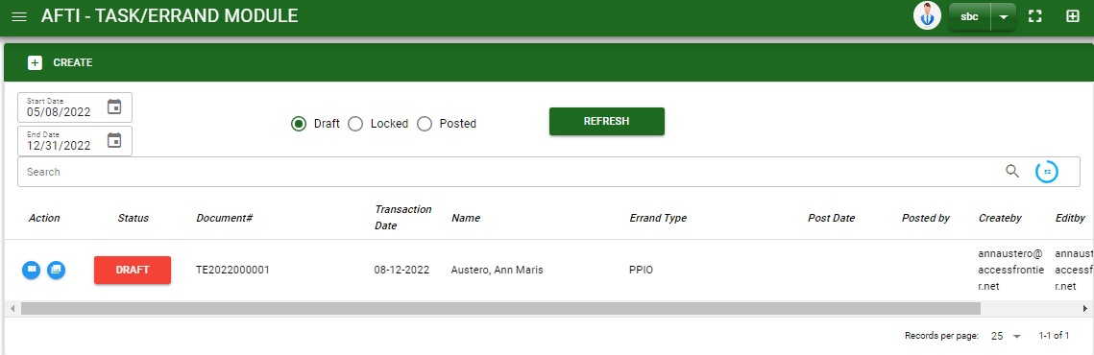

Sales/ Task/Errand - Module
–
Main Window
When you click the Task/ Errand module under Sales, Task/ Errand transactions list will display based on filtered date and status in the task/ errand main window.
Task/Errand Module – Main Window

Slide 3
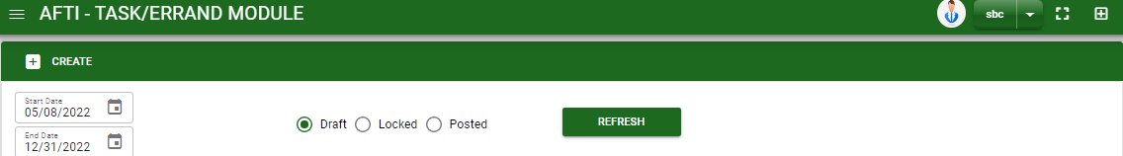
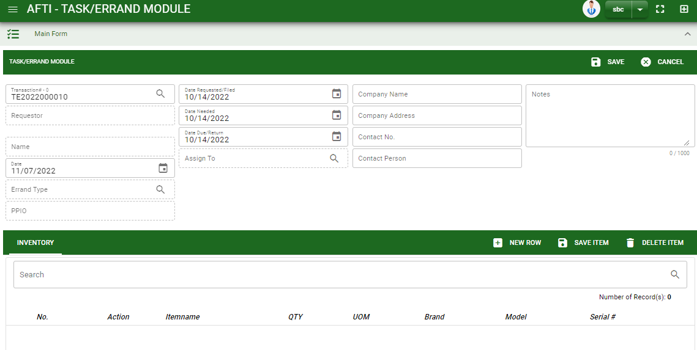
Sales/ Task/Errand - Module
How To Create Task Errand Transaction?
1
1. In Task/ Errand – Main Window, you will notice a create button in the upper left of the window. Click the create button and you will be redirect in task/ errand – main form.
2. After you click the create button, you will be redirect in task/ errand – main form. Fill in all necessary information.
3. Click save button to save header
4. Click new row button. Fill in all necessary information
5. If done, click save items button
6. To finalize, click post button.
HEADER
3
2
4
5

Slide 4
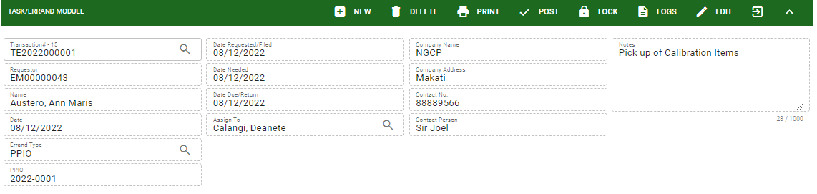
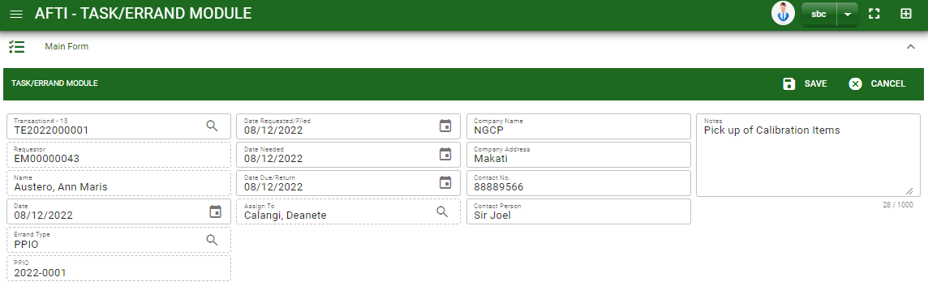
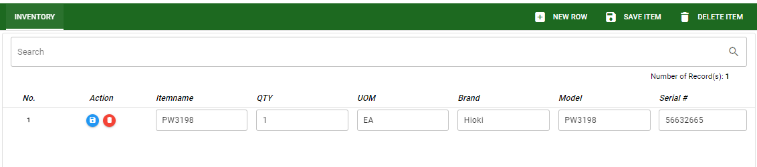
Sales/ Task/Errand - Module
How To Edit Task Errand Transaction?
1
2
1. To edit the header, click edit button then edit the information that you want to change.
2. If done, click save button.
3. To edit the item stock, edit directly the details you want to change.
4. If done, click save button.
4
3

Slide 5
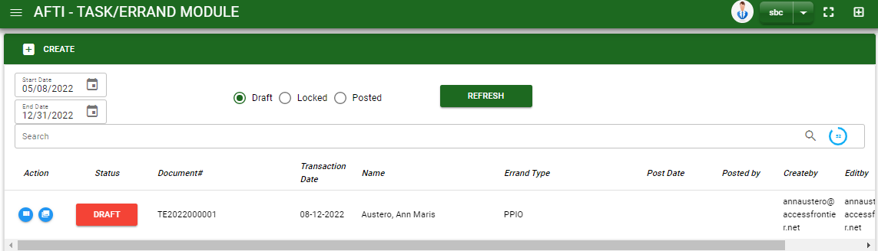
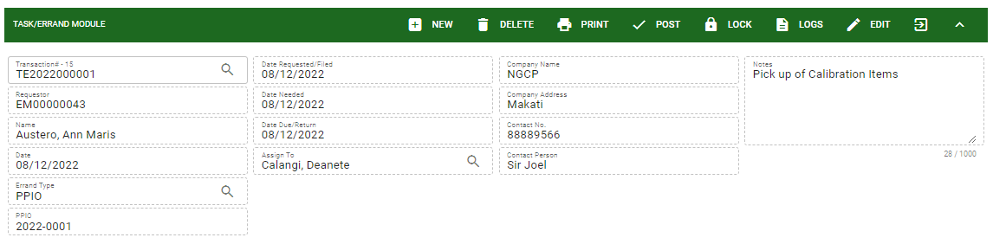
Sales/ Task/Errand - Module
How To Delete Task Errand Transaction?
1.1 In the task/ errand – main window, search the transaction you want to delete.
1.2. In task/ errand – main form, click the lookup button and select the transaction you want to delete.
2. If done, click delete button.
1.1.
Task/Errand Module – Main Window
HEADER
2.
1.2.
How to search task/errand transaction?
Type the transaction number in the search bar.
Click ‘enter’ in the keyboard to search.
Click to select the transaction you want to delete
Task/Errand Module – Main Form

Slide 6
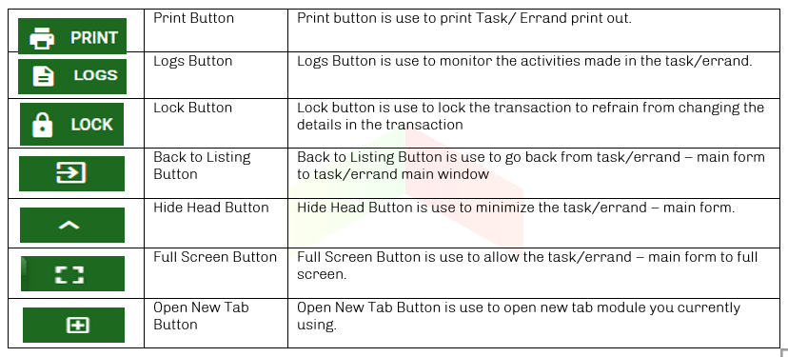
Sales/ Task/Errand - Module
Other Buttons

