Slide 1
Transfer Slip
Transfer slip is used to create transaction of transferring of stocks from one warehouse to another.

Slide 2
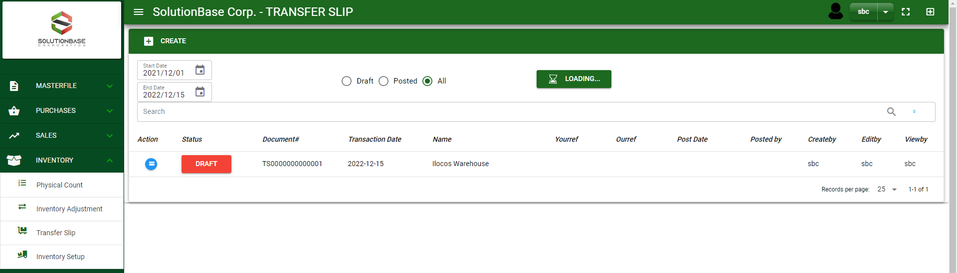

Inventory / Transfer Slip - Module
Main Window
When you click the Transfer Slip module under Inventory, it will display all the transactions based on filtered date and status in the Transfer Slip main window.
Transfer Slip – Main Window

Slide 3
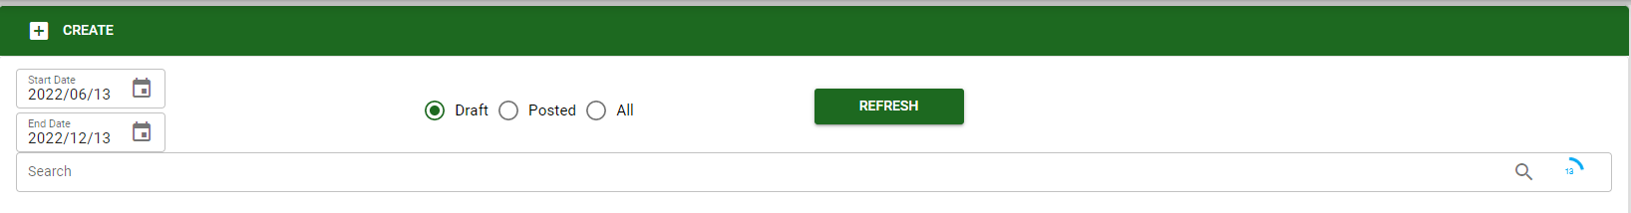
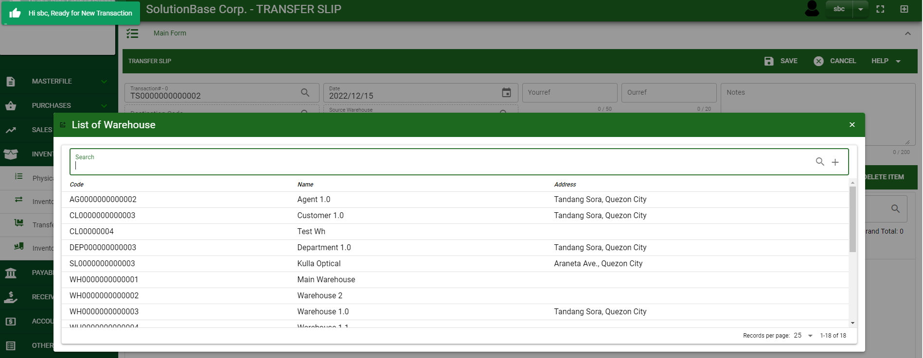
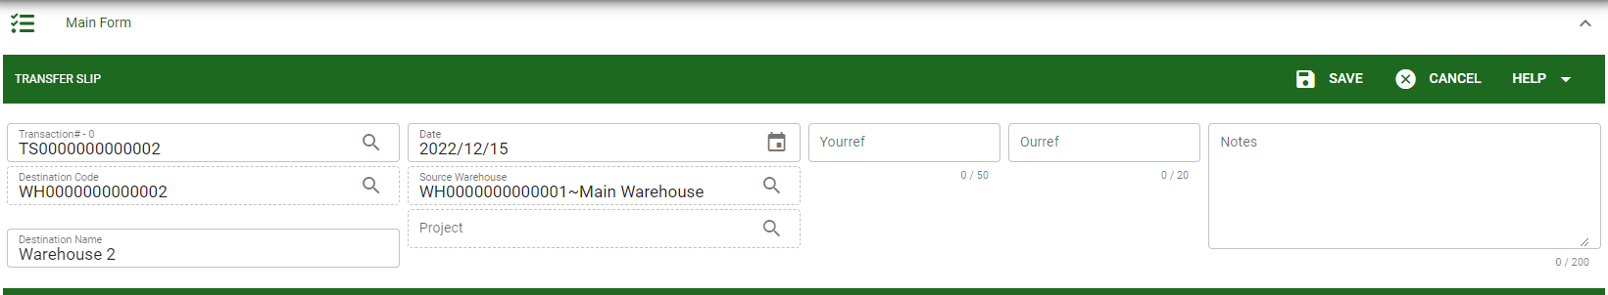
Inventory / Transfer Slip - Module
1
How To Create Transfer Slip Transaction?
In Transfer Slip– Main Window, you will notice a create button in the upper left of the window. Click the create button and you will be redirect in Transfer Slip – main form.
After you click the create button, the system will automatically create a document # and plot the default warehouse on the Source warehouse field and prompt the selection of warehouse, search and select a destination warehouse where you will be transferring the items.
If done in header, click save button.
2
2
3

Slide 4
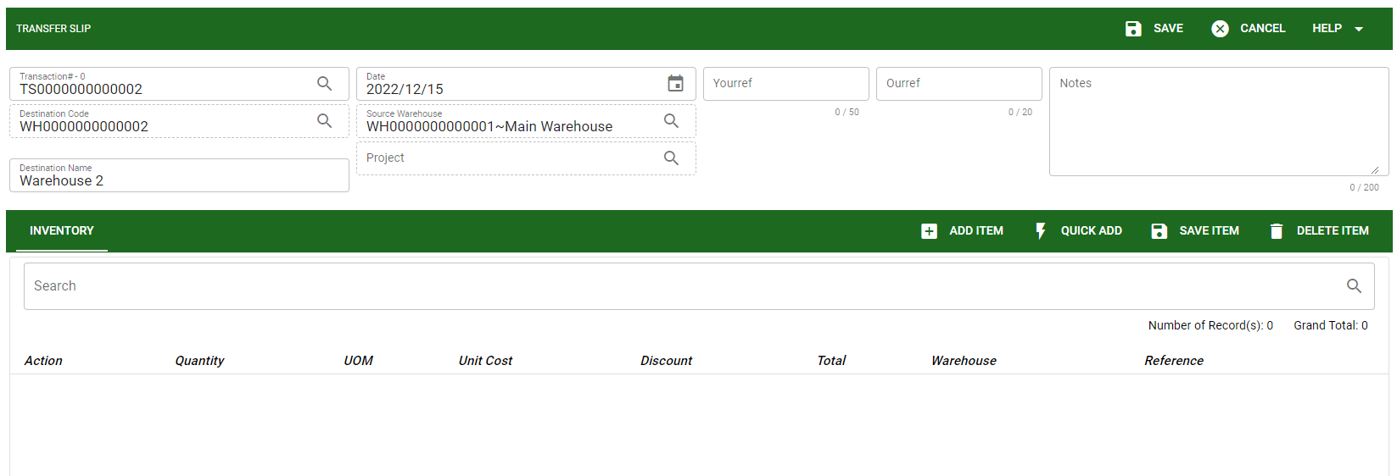
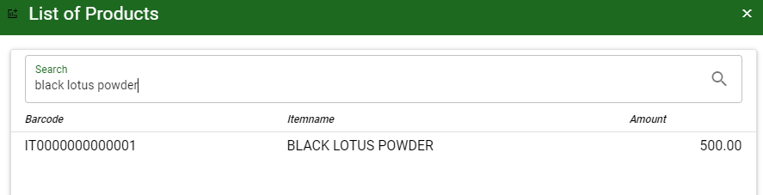
Inventory / Transfer Slip - Module
How To Create Transfer Slip Transaction?
After saving the header, you may now add the items you want to transfer the stocks in the Inventory tab by clicking add item button.
After you click the add item button, a dialog box with item list pop out, search and select the item
4
Stock
5
5

Slide 5
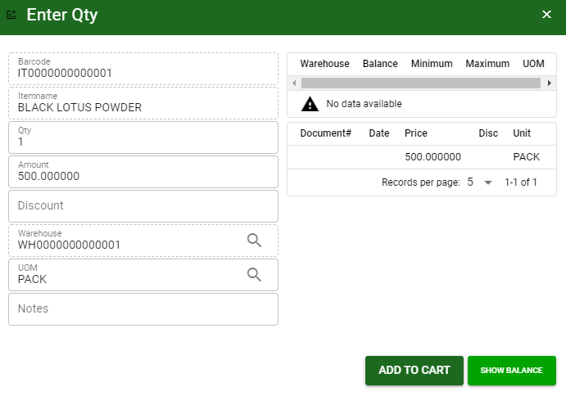
Inventory / Transfer Slip - Module
How To Create Transfer Slip Transaction?
5.1 After you select the item, a dialog box where item details will be encoded will pop out.
5.2 Enter the necessary quantity, change the amount, uom, warehouse.
5.3 If done, click add to cart button.
5.2.
5.3

Slide 6
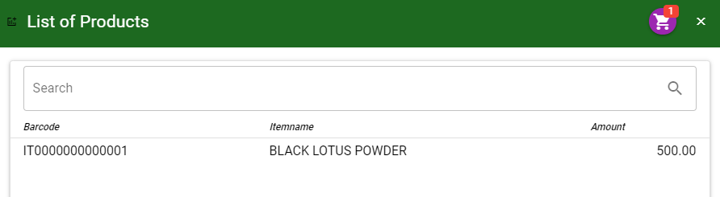
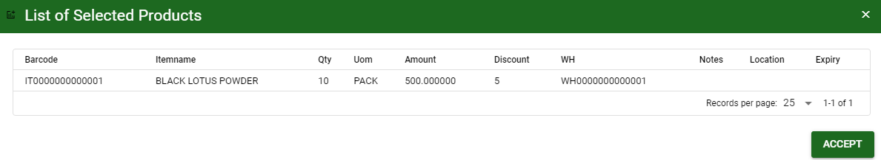
Inventory / Transfer Slip - Module
How To Create Transfer Slip Transaction?
5.4 After you click the add to cart button, you will notice in the upper right of item list an icon of add to cart. Click that, then click accept button to plot the items in the stock.
5.6
5.6

Slide 7
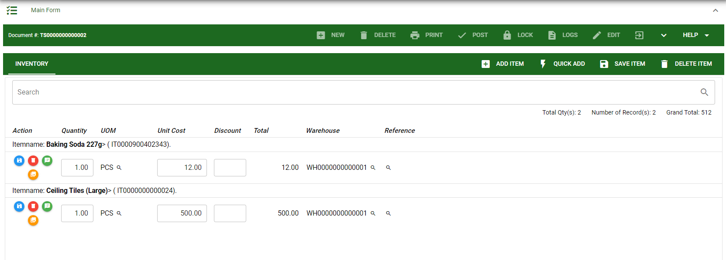
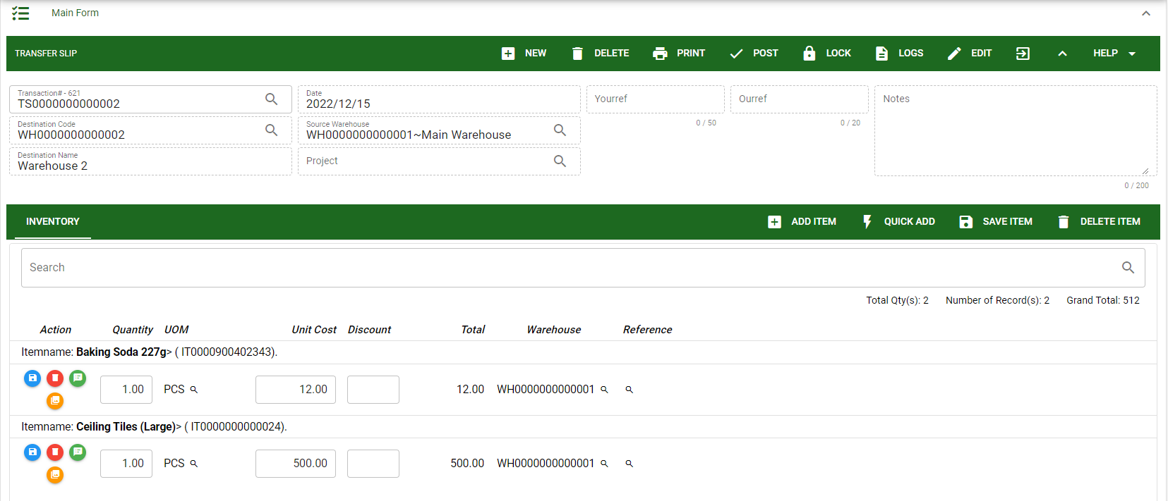
Inventory / Transfer Slip - Module
How To Create Transfer Slip Transaction?
5.5 To add more items, repeat 5 to 5.3 before doing 5.4
5.7 After you click the accept button in the dialog box of selected items in 5.5., the items selected will be plotted in the stock as shown below.
5.8 You may still edit the details per item in the stock. Change directly the details needed to be change.
5.9 If done, click save item button
5.10 Click the maximize arrow to enable the post button.
5.11 To finalize, the transaction, click post button located in the header.
5.9
5.10
5.11

Slide 8
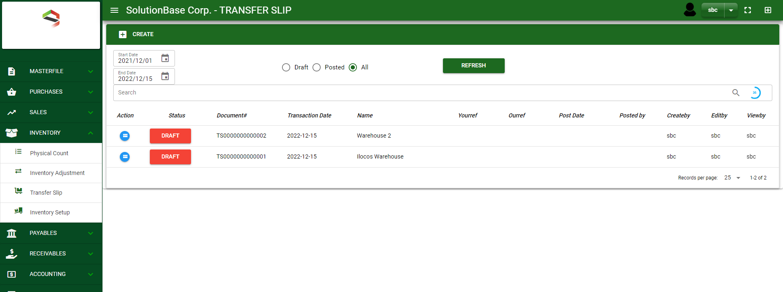
Inventory / Transfer Slip - Module
How To Edit Transfer Slip Transaction?
1.1. In the transfer slip– main window, search the transaction you wish to edit its information in the search bar. Or,
1.2. In Transfer Slip– main form, click the lookup button and select the transaction you wish to edit its information by typing its transaction number in the search bar.
2. After you select the transaction, if you wish to edit the header of the transaction click edit button.
3. If you are done editing, click save button in the upper side of the header.
1.1.
Transfer Slip – Main Window
HEADER
2.
1.2.
How to search transaction?
Type the transaction number in the search bar.
Click ‘enter’ in the keyboard to search.
Click to select the transaction you want to edit
Transfer Slip – Main Form

Slide 9
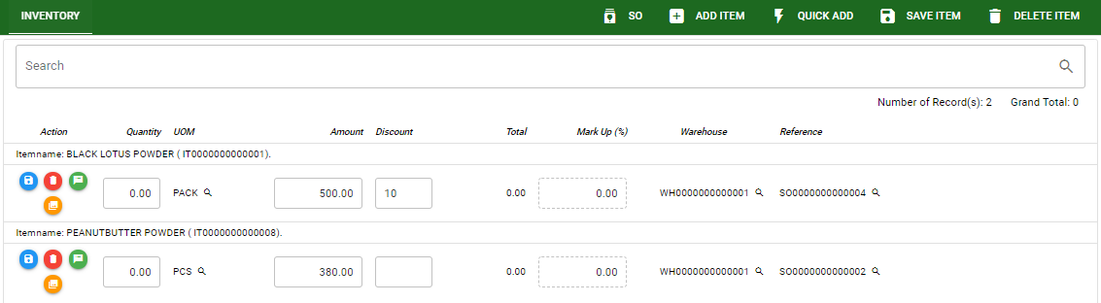
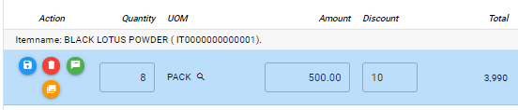
Inventory / Transfer Slip - Module
How To Edit Transfer Slip Transaction?
STOCK
4. If you want to edit the items in stock, edit right away the details you want to change and you will notice that after you change the details, the item you edited will be highlighted into blue.
5. If you’re done editing, click save item button to save the changes you made in the items.
6. To delete all items in the stock, click delete item button.
7. To delete a specific item on the table, click the delete icon next to the item to delete it.
5
6
7
4

Slide 10
Inventory / Transfer Slip - Module
How To Delete Transfer Slip Transaction?
1.1.
1.1. In the transfer slip – main window, search the transaction you want to delete.
1.2. In transfer slip - main form, click the lookup button and select the transaction you want to delete.
2. If done, click delete button.
Transfer Slip – Main Window
HEADER
2.
1.2.
How to search transaction?
Type the transaction number in the search bar.
Click ‘enter’ in the keyboard to search.
Click to select the transaction you want to edit
Transfer Slip – Main Form

Slide 11
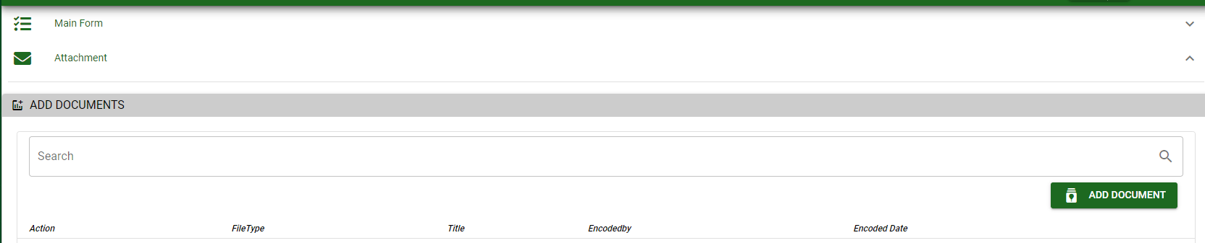




Inventory / Transfer Slip - Module
Other Information
When you click the arrow up icon parallel in the main form on the upper right, and the Transfer Slip – main form will be minimize and the other information will be displayed as shown in the photo below.
Click the arrow parallel to what information you want to open and provide the necessary filter to generate the data you want to display.
 | Print Button | Print button is use to print transaction.
 | Logs Button | Logs Button is use to monitor the activities made in the module.
 | Lock Button | Lock button is use to lock the transaction to refrain from changing the details in the transaction
 | Back to Listing Button | Back to Listing Button is use to go back from main form to main window
 | Hide Head Button | Hide Head Button is use to minimize the main form.
 | Full Screen Button | Full Screen Button is use to allow the main form to full screen.
 | Open New Tab Button | Open New Tab Button is use to open new tab module you currently using.
Other Buttons

