Slide 1
Void Service Sales Order
Void Service Sales Order is where voiding of Service Sales Order transaction is recorded.

Slide 2
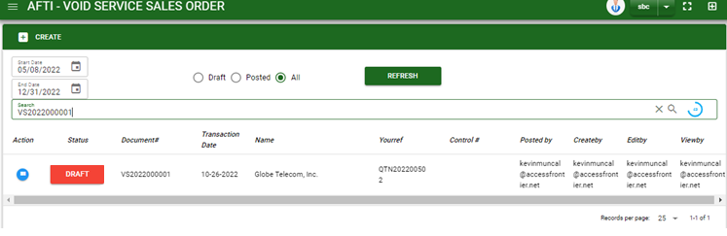

Sales/ Void Service Sales order - Module
Main Window
When you click the Void Service Sales Order module under Sales, Void Service SO transactions list will display based on filtered date and status in the Void Service SO main window.
Void Service Sales order – Main Window

Slide 3
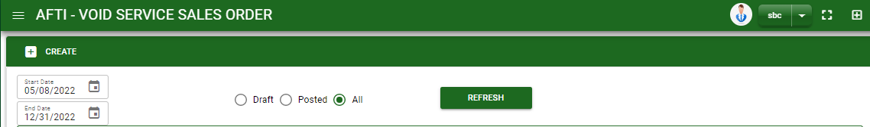
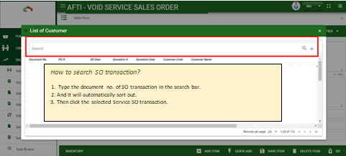
Sales/ Void Service Sales order - Module
How To Create Void Service SO Transaction?
1
1. In Void Service Sales Order – Main Window, you will notice a create button in the upper left of the window. Click the create button and you will be redirect in void service sales order – main form.
2. After you click the create button a dialog box will pop out with list of customer. Search and select a customer or Service SO transaction number.

Slide 4
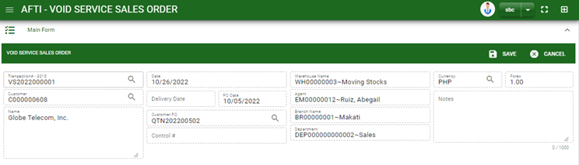
Sales/ Void Service Sales order - Module
How To Create Void Service SO Transaction?
3. After you select the customer, click customer PO lookup to select QTN transaction for reference
4.Fill in other necessary information
5. If done, click save button to save details from header
6. Click SO button and a dialog box of list of pending service sales order details will appear.
HEADER
5
3
6

Slide 5
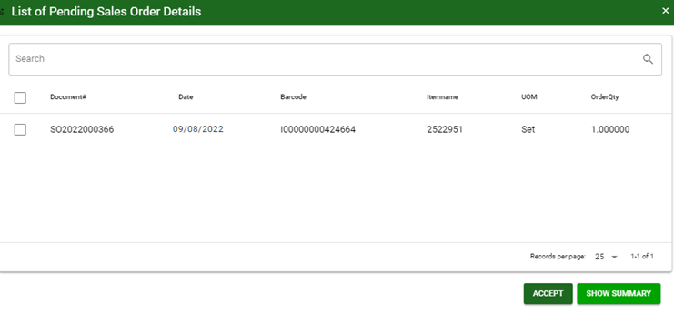
Sales/ Void Service Sales order - Module
How To Create Void Service SO Transaction?
7. Select the item you want to void by ticking the check box
8. After selecting, click accept button
7
8

Slide 6
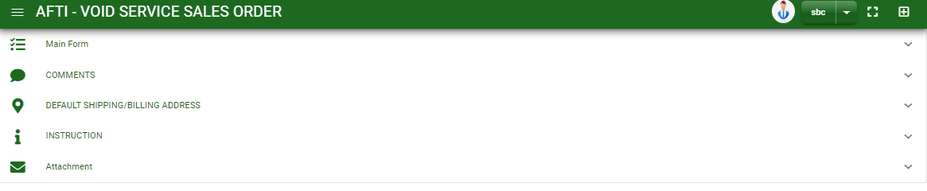
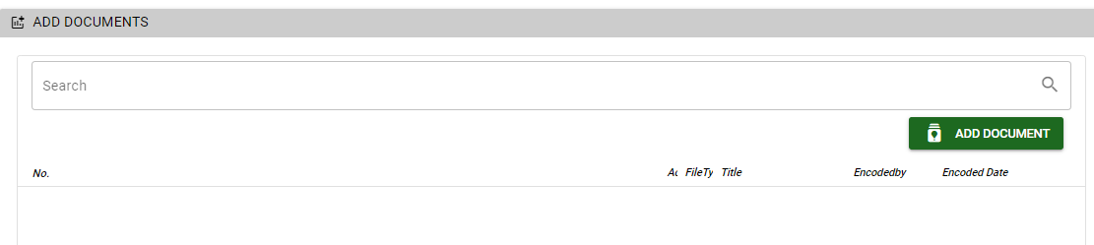
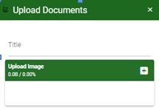
Sales/ Void Service Sales order - Module
How To Create Void Service SO Transaction?
9. If done in main form. Click the arrow parallel to main window to minimize the main form tab.
10. Add comments if there’s any by clicking the arrow parallel to comments tab
11. For viewing of shipping/ billing address and instruction tab, click also the arrow parallel to the tab
12. If you want to upload file attachment, click the attachment and upload the file
13. To finalized the transaction, click post button in main form
How to upload document?
Type the title of the document.
Click add button to add the chosen document to upload
Then click upload button.
If you want to add more document, click add document button and repeat steps #1 to 3.
1
2.

Slide 7
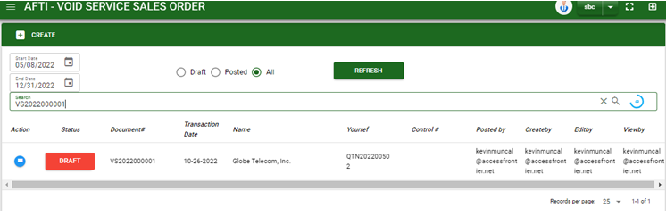
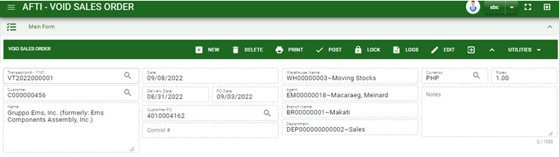
Sales/ Void Service Sales order - Module
How To Delete Void Service SO Transaction?
1 In the void Service Sales Order – main window, search the transaction you want to delete.
1.2. In void Service Sales Order– main form, click the lookup button and select the transaction you want to delete.
2. If done, click delete button.
1.1.
Void Sales order – Main Window
HEADER
2.
1.2.
How to search void service SO transaction?
Type the transaction number in the search bar.
Click ‘enter’ in the keyboard to search.
Click to select the transaction you want to delete
Void Sales order – Main Form

Slide 8
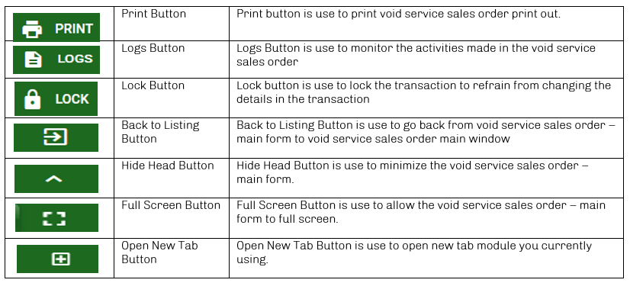
Sales/ Void Service Sales order - Module
Other Buttons

