Slide 1
Void Sales Order
Void Sales Order is where voiding of Sales Order transaction is recorded.

Slide 2
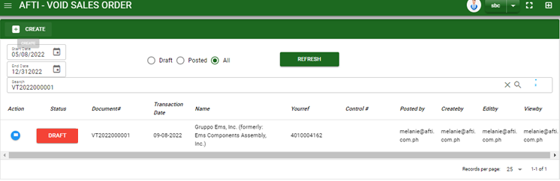

Sales/ Void Sales order - Module
Main Window
–
When you click the Void Sales Order module under Sales, Void Sales Order transactions list will display based on filtered date and status in the Void Sales Order main window.
Void Sales order – Main Window

Slide 3
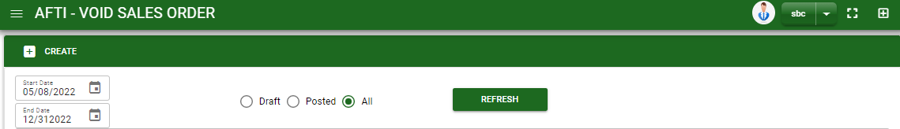

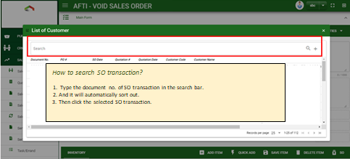
Sales/ Void Sales order - Module
How To Create Void Sales Transaction?
1
1. In Void Sales Order – Main Window, you will notice a create button in the upper left of the window. Click the create button and you will be redirect in void sales order – main form.
2. After you click the create button a dialog box will pop out with list of customer. Search and select a customer or SO transaction number.

Slide 4
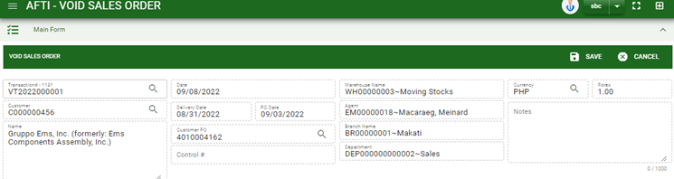
Sales/ Void Sales order - Module
How To Create Void Sales Transaction?
HEADER
3. After you select the customer, click customer PO lookup to select QTN transaction for reference
4. Fill in other necessary information
5. If done, click save button to save details from header
6. Click SO button and a dialog box of list of pending sales order details will appear.
5
3
6

Slide 5
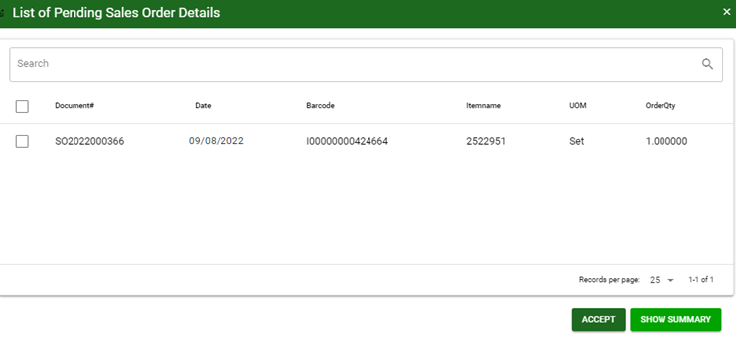
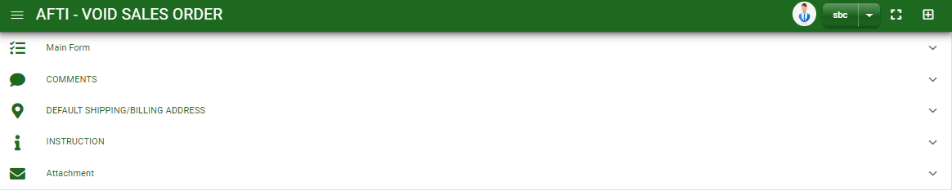
Sales/ Void Sales order - Module
How To Create Void Sales Transaction?
7
7. Select the item you want to void by ticking the check box of selected SO
8. After selecting, click accept button
9. If done in main form. Click the arrow parallel to main window to minimize the main form tab.
10. Add comments if there’s any by clicking the arrow parallel to comments tab
8
9

Slide 6
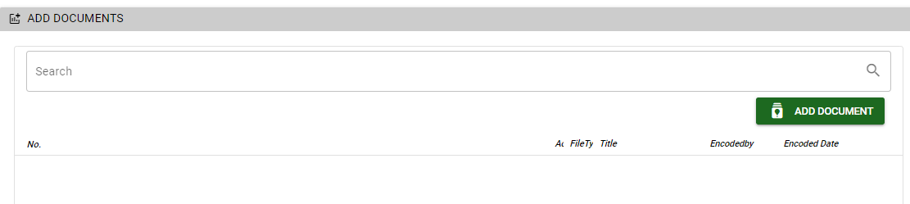
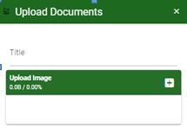
Sales/ Void Sales order - Module
How To Create Void Sales Transaction?
11. For viewing of shipping/ billing address and instruction tab, click also the arrow parallel to the tab
12. To finalized the transaction, go to main form and click post button
How to upload document?
Type the title of the document.
Click add button to add the chosen document to upload
Then click upload button.
If you want to add more document, click add document button and repeat steps #1 to 3.
1
2.

Slide 7
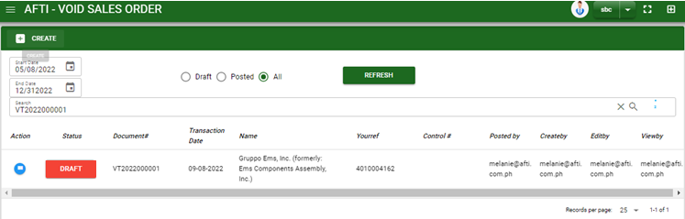
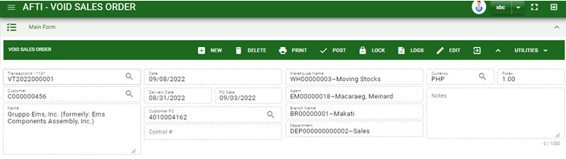
Sales/ Void Sales order - Module
How To Delete Void Sales Transaction?
1.1 In the void Sales Order – main window, search the transaction you want to delete.
1.2. In void Sales Order– main form, click the lookup button and select the transaction you want to delete.
2. If done, click delete button.
1.1.
Void Sales order – Main Window
HEADER
1.2.
How to search void sales order transaction?
Type the transaction number in the search bar.
Click ‘enter’ in the keyboard to search.
Click to select the transaction you want to delete

Slide 8
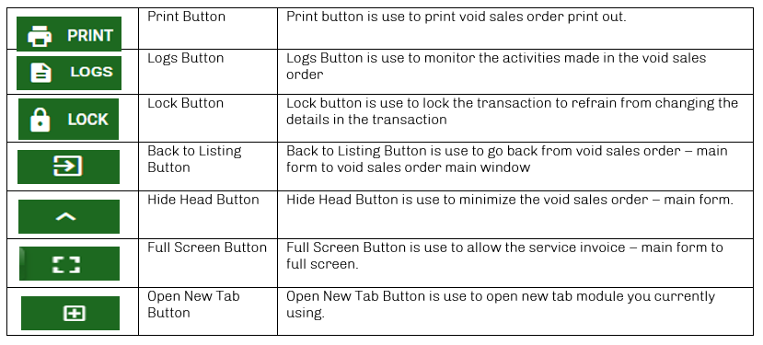
Sales/ Void Sales order - Module
Other Buttons

