Slide 1
Agent Ledger
Agent is a list of agent or salesman of a company.

Slide 2
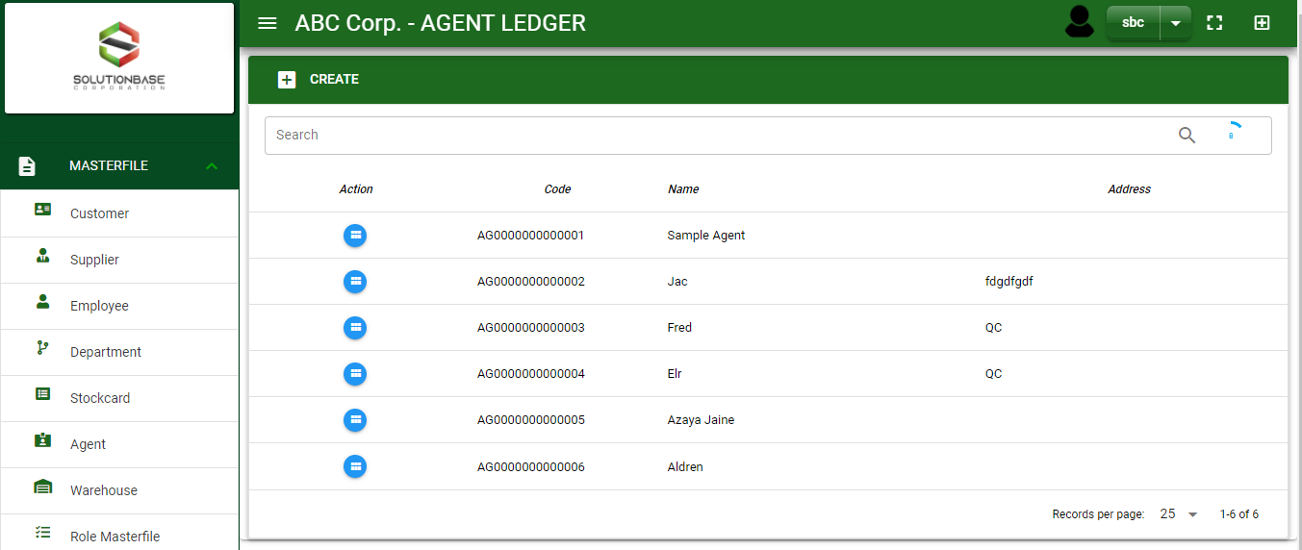

Masterfile / Agent Ledger - Module
Main Window
When you click the Agent module under Masterfile, agent list will display in the agent ledger main window.
Agent Ledger – Main Window
2

Slide 3
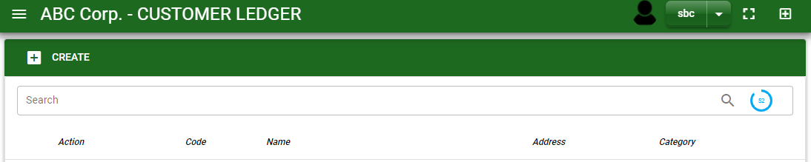

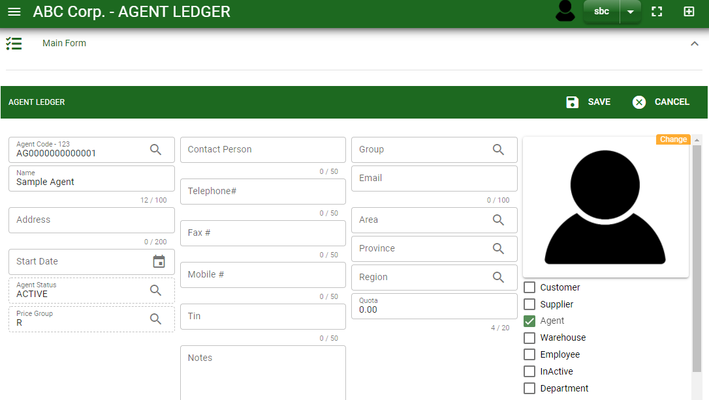
Masterfile / Agent Ledger - Module
1
How To Create New Agent?
1. In Agent Ledger – Main Window, you will notice a create button in the upper left of the window. Click the create button and you will be redirect in agent ledger – main form.
2. After you click the create button in the agent ledger – main window, you will be redirected in agent ledger – main form where you will encode the agent other information.
3. In the above photo, fill in all the necessary details in the provided field.
4. If done, click save button.
Agent Ledger – Main Window
4
3
Agent Ledger – Main Form
3

Slide 4
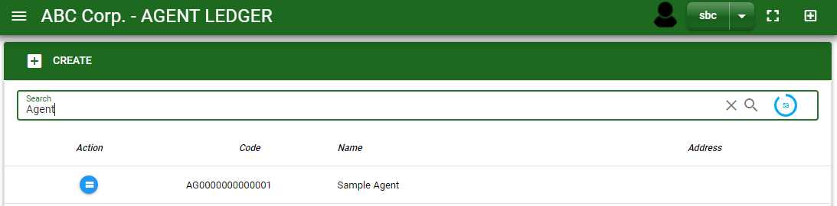
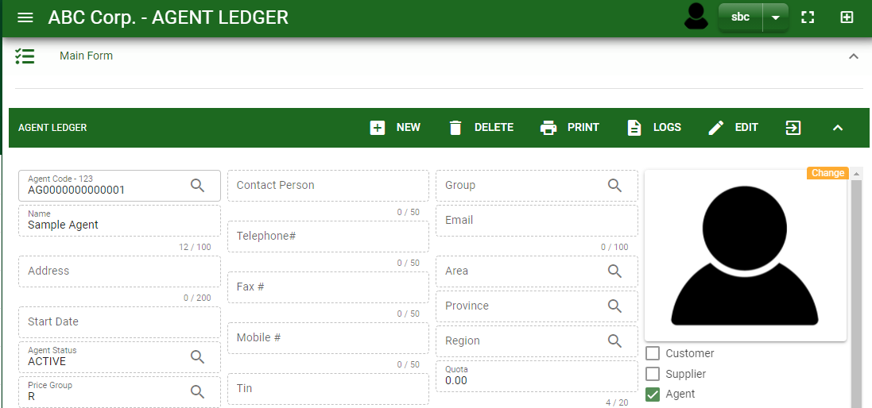
Masterfile / Agent Ledger - Module
How To Edit Agent Details?
1.1.
1.1. In the agent ledger – main window, search the agent name you wish to edit its information in the search bar. Or, edit its information in the search bar. Or,
1.2. In agent ledger – main form, click the lookup button and select the agent you wish to edit its information by typing its agent name in the search bar.
Agent Ledger – Main Window
2.
2. After you select the customer, click edit button in the upper right side of customer ledger – main form.
1.2.
How to search agent?
Type the agent name in the search bar.
Click ‘enter’ in the keyboard to search.
Click the button before the agent code to select the agent.
Agent Ledger – Main Form
4

Slide 5

Masterfile / Agent Ledger - Module
How To Edit Agent Details?
4
3
3. Edit the information you want to edit.
4. If done, click save button.
Agent Ledger – Main Form
5

Slide 6

Masterfile / Agent Ledger - Module
How To Delete a Agent Ledger?
1.1 In the agent ledger – main window, search the agent you want to delete.
1.2 In agent ledger – main form, click the lookup button and select the agent you want to delete.
1.1.
Agent Ledger – Main Window
2. Click delete button.
2.
1.2.
How to search agent?
Type the agent name in the search bar.
Click ‘enter’ in the keyboard to search.
Click the button before the agent code to select the agent.
Agent Ledger – Main Form
6

Slide 7
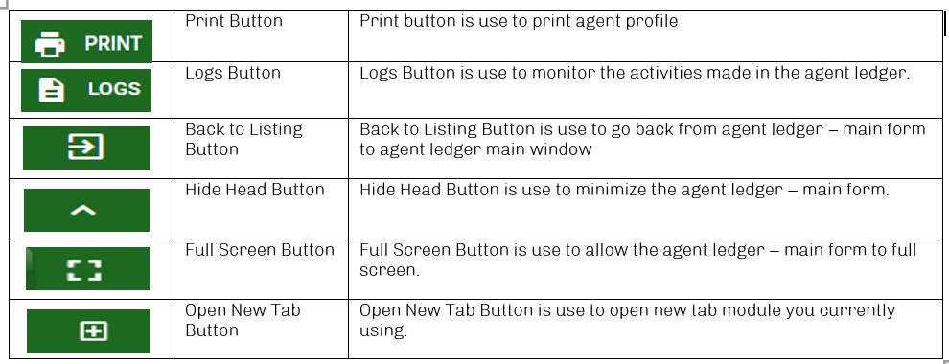
Masterfile / Agent Ledger - Module
Other Buttons
7

