Slide 1
Accounts Payable Setup
A module where outstanding accounts payable is setup per Supplier given the cut off date when starting to use the system.

Slide 2
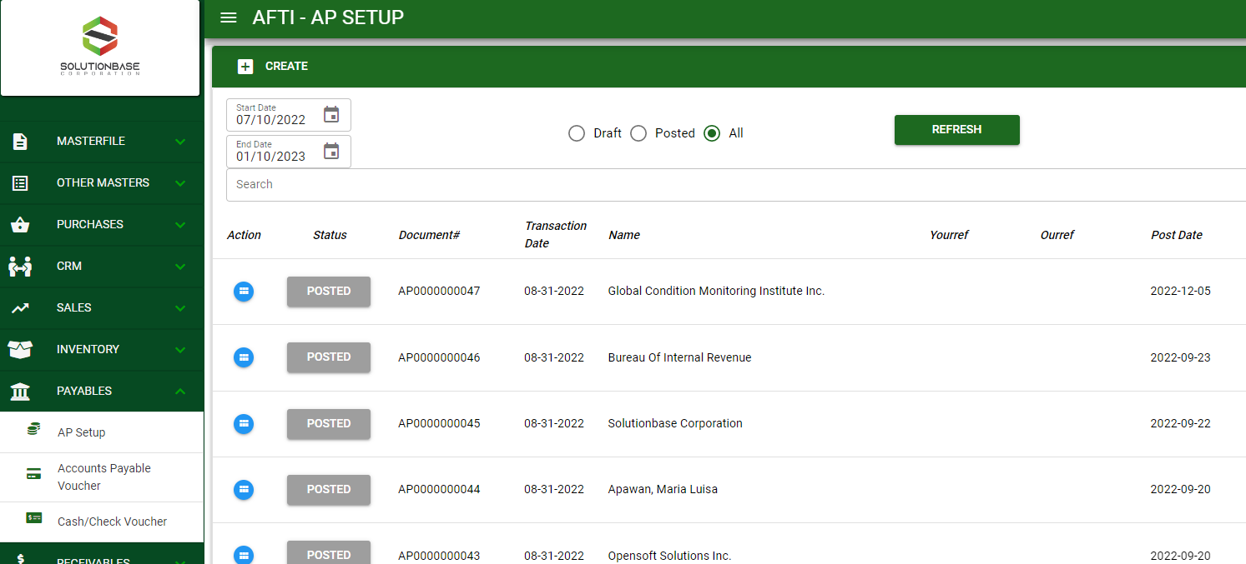

Accounting / Accounts Payable Setup - Module
Main Window
When you click the Accounts Payable Setup module under Payables, Accounts Payable Setup transactions list will display based on filtered date and status in the Accounts Payable Setup - main window.
Accounts Payable Setup– Main Window
2

Slide 3
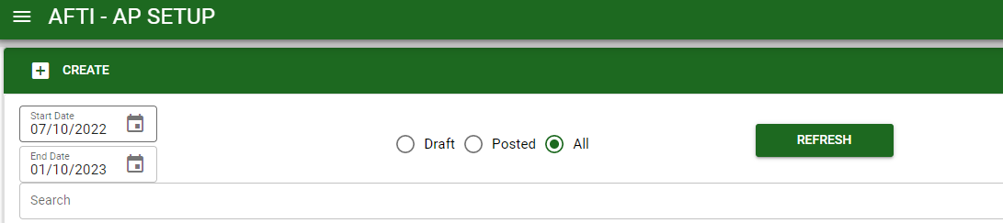
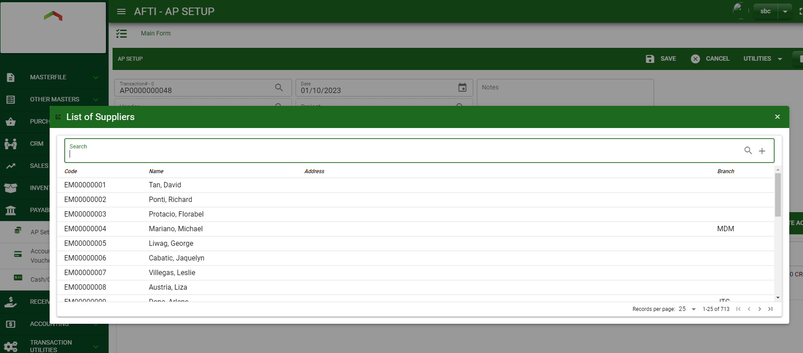
Accounting / Accounts Payable Setup - Module
How To Create Accounts Payable Setup Transaction?
1
1. In Accounts Payable Setup – Main Window, you will notice a create button in the upper left of the window. Click the create button and you will be redirect Accounts Payable Setup – main form.
2. After you click the create button a dialog box will pop out with list of customer/ supplier. Search and select a customer/ supplier.
3. After you select a customer/ supplier, you will be redirect in Accounts Payable Setup – main form where you will encode the other necessary information of the transaction and record the journal entry
2
How to search customer/supplier?
Type the customer/ supplier name in the search bar.
And it will automatically sort out.
Then click the selected customer/ supplier.
3

Slide 4
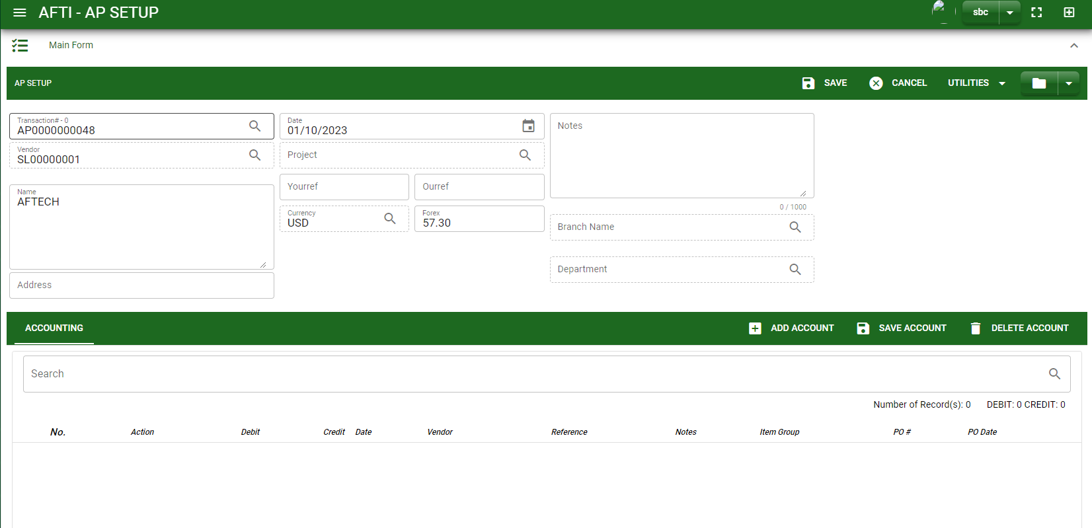
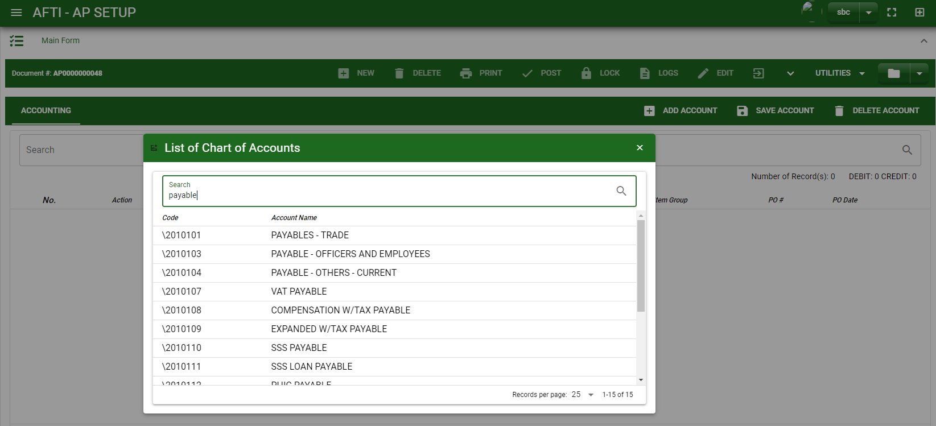
Accounting / Accounts Payable Setup - Module
How To Create Accounts Payable Setup Transaction?
4.4
Header
4.1 to 4.3
4.1 After you select the customer/ supplier, some details such as address, date are automatically plotted in their respective field.
4.2 In header, current date is also plotted automatically but if you wish to change the date – click the date picker and select its respective date.
4.3 In header, add the necessary information if necessary and fill out required fields.
4.4 If done in header, click save button.
Detail
6
5. After saving the header, you may now add accounts by clicking add new account, search an account to add.
How to search an account?
Type the account name in the search bar.
And it will automatically sort out.
Then click the selected account.
4

Slide 5
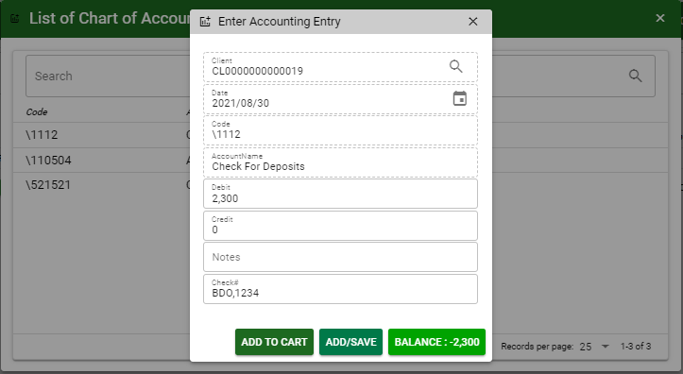
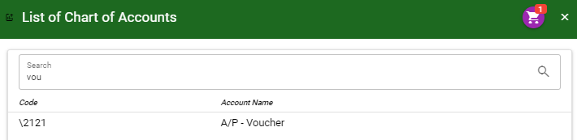
Accounting / Accounts Payable Setup - Module
How To Create Accounts Payable Setup Transaction?
6. After you select an account, a dialog box will prompt. Enter the details of the account.
7. Enter the details of the account. For the amount, enter the amount either in debit or credit field. But if you want to copy of amount in the balance, click the balance to autofill the credit field.
8. You may also add notes if necessary.
7
7
8
9.1
9.2
7
9.1 To save the account, if you want to add more other account, click add to cart button and select more accounts again. OR,
9.2 OR If you want to plot the selected account already in accounts payable setup– detail, you may click add/ save button.
How to plot the selected accounts in the Accounts Payable Setup – detail
Click the cart icon.
And a dialog box with list of selected accounts will pop out.
Then click the accept button.
5

Slide 6
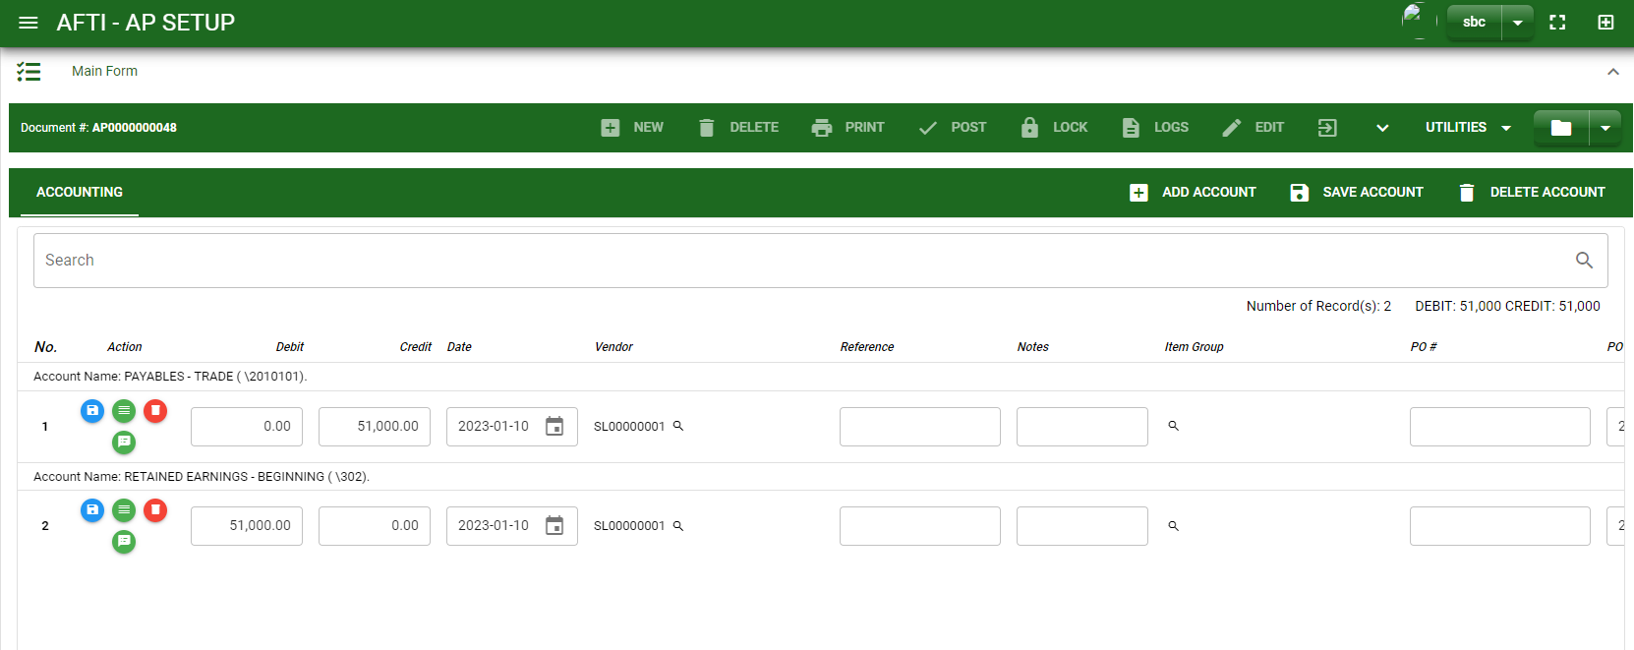
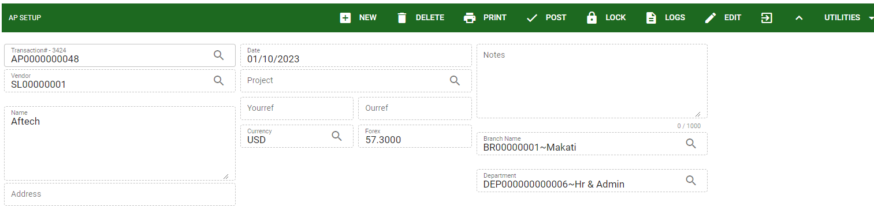
Accounting / Accounts Payable Setup - Module
How To Create Accounts Payable Setup Transaction?
10
10. If done click the arrow to enable the buttons in the header.
11. To finalize, click post button.
11
6

Slide 7
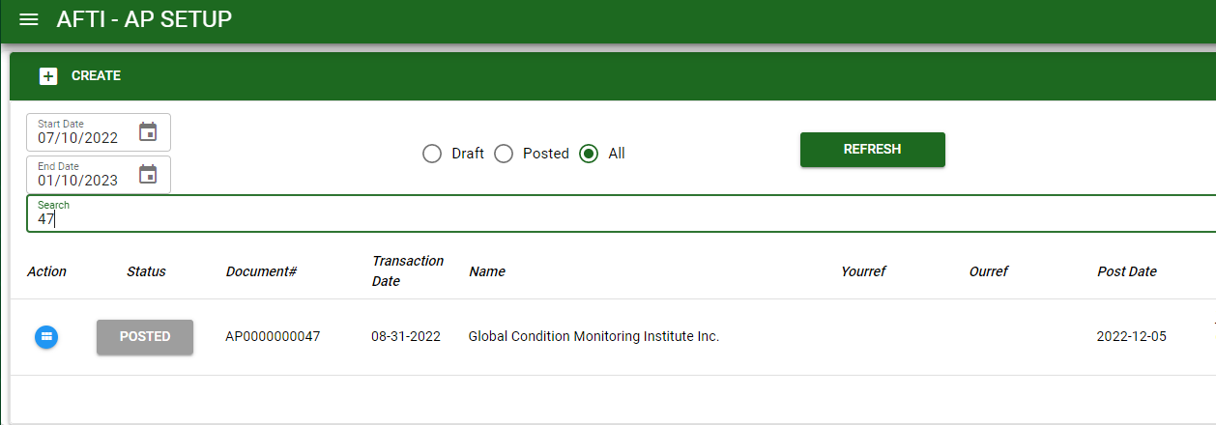
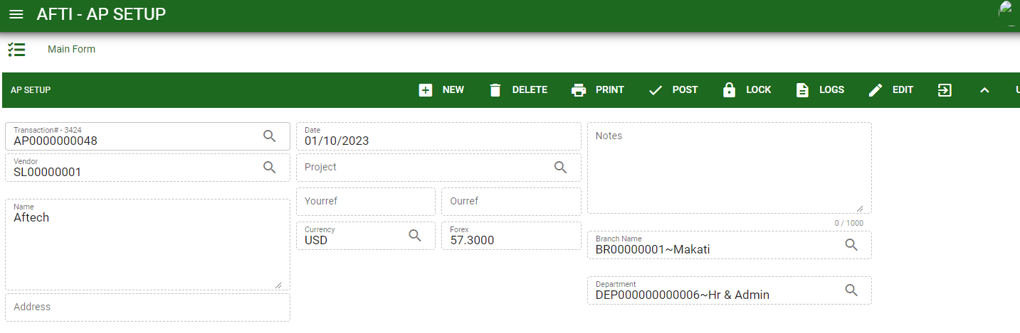

Accounting / Accounts Payable Setup - Module
How To Edit Accounts Payable Setup Transactions
1.1.
1.1 In the Accounts Payable Setup – main window, search the journal entry you wish to edit its information in the search bar. Or,
1.2 In Accounts Payable Setup – main form, click the lookup button and select the transaction you wish to edit its information by typing its transaction number in the search bar.
Accounts Payable Setup– Main Window
HEADER
2.
2. After you select the AP transaction, if you wish to edit the header of the transaction click edit button.
3. If you are done editing the AP header, click save button in the upper side of the header.
1.2.
How to search transaction?
Type the transaction number in the search bar.
Click ‘enter’ in the keyboard to search.
Click to select the transaction you want to edit
Accounts Payable Setup– Main Form
7

Slide 8
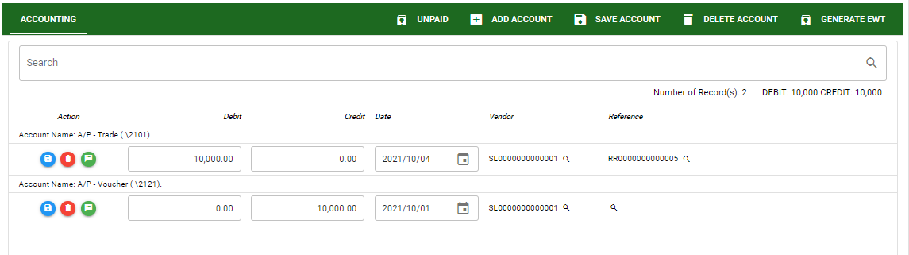
Accounting / Accounts Payable Setup - Module
How To Edit Accounts Payable Setup Transactions
DETAIL
4. If you want to edit the entry in the detail, edit right away the details you want to change and you will notice that after you change the details, the account you edited will be highlighted into blue.
5. If you’re done editing, click save account button to save the changes you made in the entry.
6. To delete all accounts in the entry, click delete account button.
7. To delete a specific line on the table, click the delete icon next to the account to delete it.
5
6
4
7
8

Slide 9
Accounting / Accounts Payable Setup - Module
How To Delete Accounts Payable Setup Transactions
1. In the Accounts Payable Setup – main window, search the journal entry you wish to edit its information in the search bar. Or,
1.2 In Accounts Payable Setup – main form, click the lookup button and select the transaction you wish to edit its information by typing its transaction number in the search bar.
1.1
Accounts Payable Setup– Main Window
HEADER
2. If done, click delete button.
2.
1.2.
How to search transaction?
Type the transaction number in the search bar.
Click ‘enter’ in the keyboard to search.
Click to select the transaction you want to edit
Accounts Payable Setup– Main Form
9

Slide 10
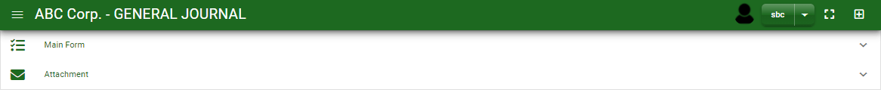

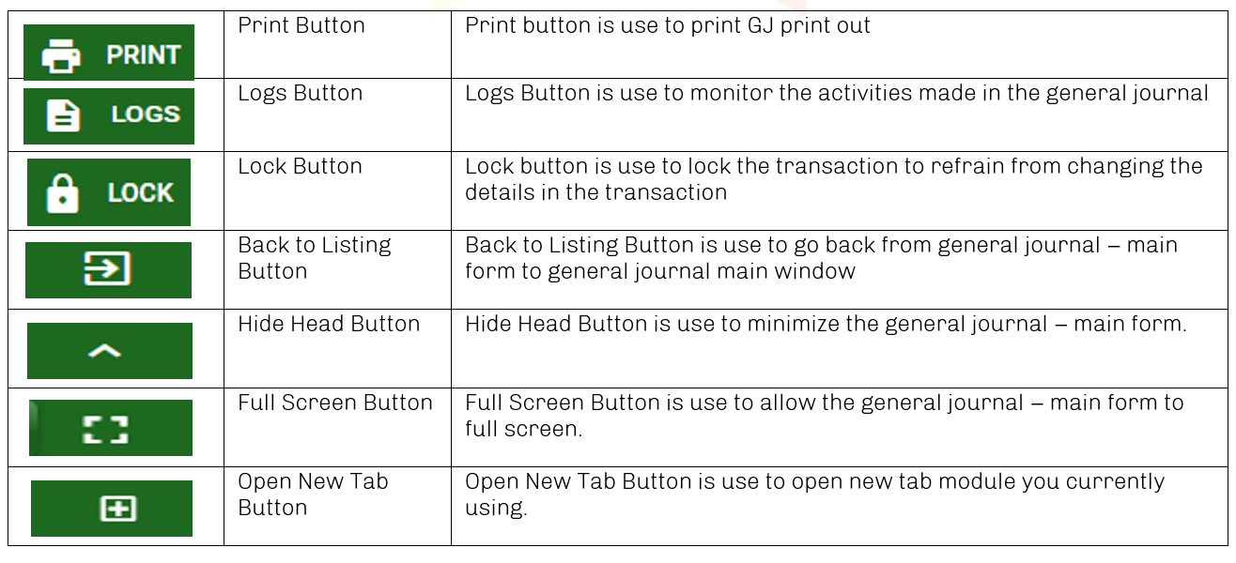
Accounting / Accounts Payable Setup - Module
Other Information
When you click the arrow up icon parallel in the main form on the upper right, and the Accounts Payable Setup – main form will be minimize and the other information will be displayed as shown in the photo below.
Click the arrow parallel to what information you want to open and provide the necessary filter to generate the data you want to display.
If you want to upload file attachment in image form, click the attachment and upload the file.
Other Buttons
10

