Slide 1
Sales Return
Sales Return is where item returned that has been previously purchased by the customer are recorded.

Slide 2
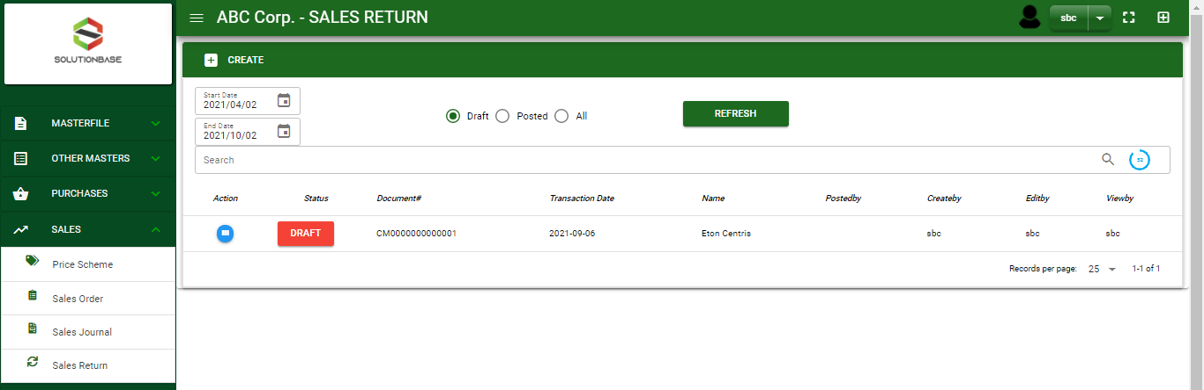

Sales/ Sales Return - Module
Main Window
When you click the Sales Return module under Sales, Sales Return transactions list will display based on filtered date and status in the sales return main window.
Sales Return – Main Window

Slide 3
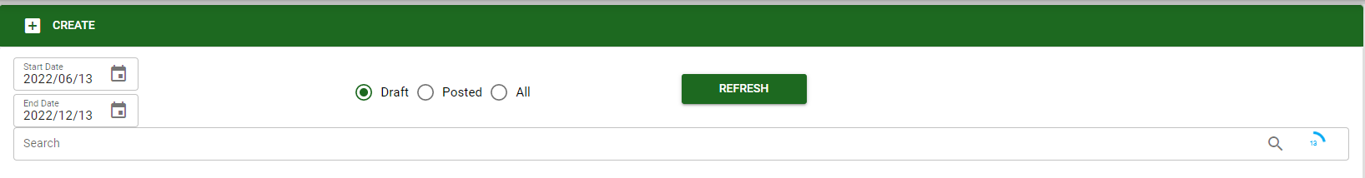
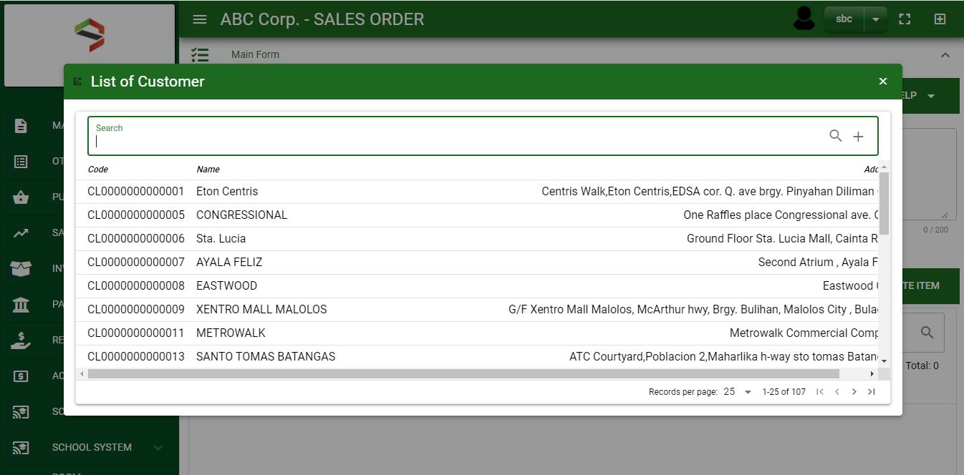
Sales/ Sales Return - Module
How To Create Sales Return Transaction?
1
1. In Sales Return – Main Window, you will notice a create button in the upper left of the window. Click the create button and you will be redirect in sales return – main form.
2. After you click the create button a dialog box will pop out with list of customer. Search and select a customer.
2
3. After you select a customer, you will be redirected in sales return – main form where you will encode the other necessary information of the transaction and record the items’ returned by the customer

Slide 4
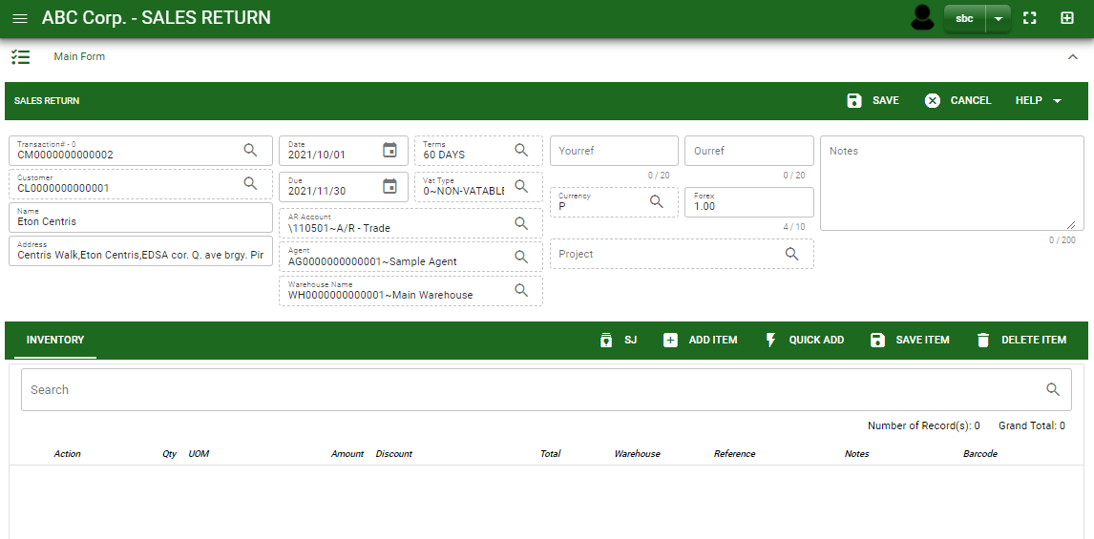
Sales/ Sales Return - Module
How To Create Sales Return Transaction?
4.1. After you select the customer, some details such as address, terms are automatically plotted in their respective field. If you wish to change the term, click the lookup button and select its respective term.
4.2. In header, current date and default warehouse is also plotted automatically but if you wish to change the date – click the date picker and select its respective return date. And if you want to change the warehouse, click the lookup button and select its respective warehouse.
4.3. In header, add the necessary information if necessary.
4.4. If done in header, click save button.
4.4
Header
4.1 to 4.3
5.1
Stock

Slide 5
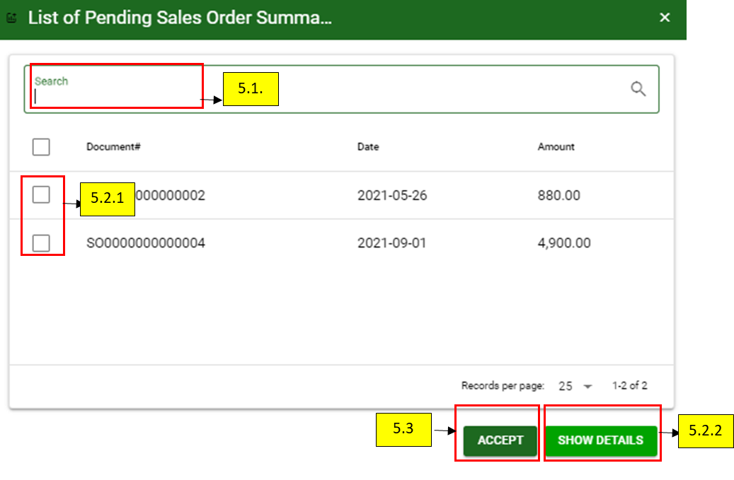
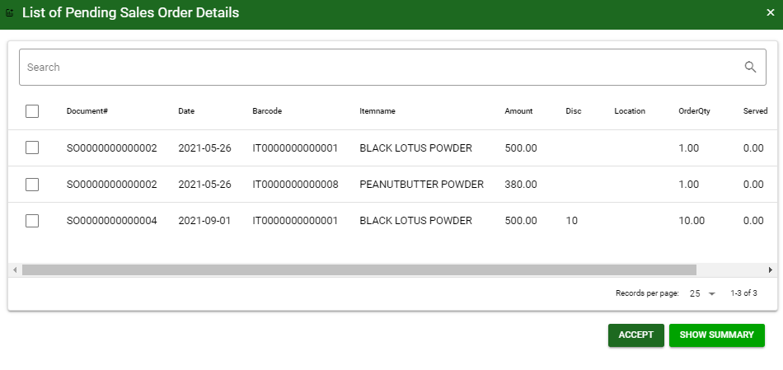
Sales/ Sales Return - Module
How To Create Sales Return Transaction?
5.1. After saving the header, you may now select the returned items of customer from Sales Journal and select the items returned by clicking SJ button
5.2.1. After you click the SJ button, a dialog box of all sales journal transactions of the customer will be displayed. Search the document number and select the delivered items, returned by customer by ticking the check box. You may select multiple sales journal transactions in one sales return transaction.
5.2.2. Click show details button, to itemize the sales journal transaction.
5.2.2. When you click the show detail button, SJ transactions will be detailed as shown below.
5.2.1

Slide 6
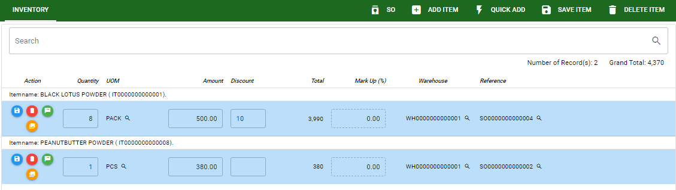
Sales/ Sales Return - Module
How To Create Sales Return Transaction?
6.1. After you click the accept button, selected returned items will be displayed in sales return stock. You may edit the details of item by directly changing it.
6.2. If you wish to add another item that is not from sales journal, click add item button. If you know the item code, click quick add button for faster adding of item.
6.3. After you edit, click save item button.
6.2.
6.2.
6.3.
6.1
5.2.1

Slide 7
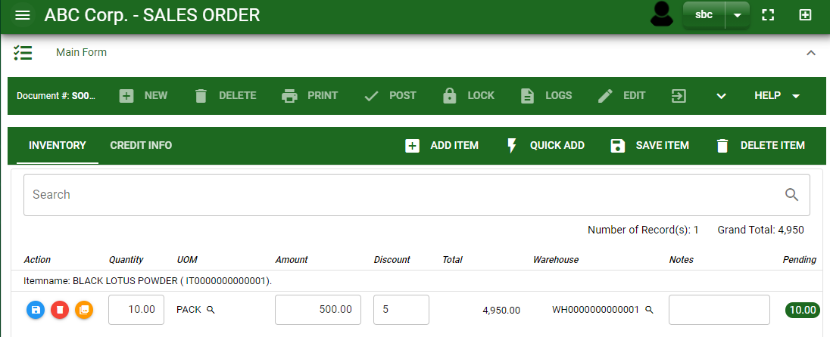
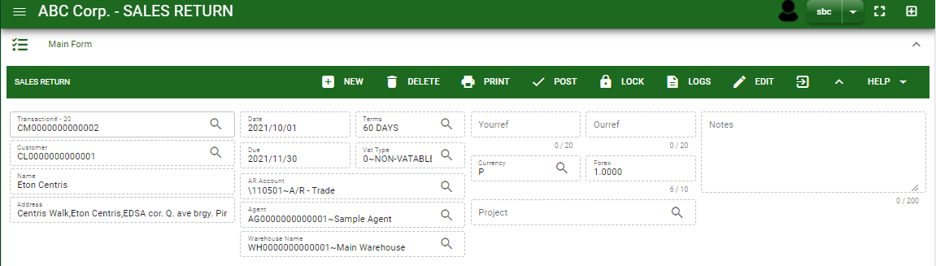
Sales/ Sales Return - Module
How To Create Sales Return Transaction?
7.1. Click the maximize arrow to enable the post button.
7.2. To finalize, the transaction, click post button located in the header.
7.1.
7.2

Slide 8
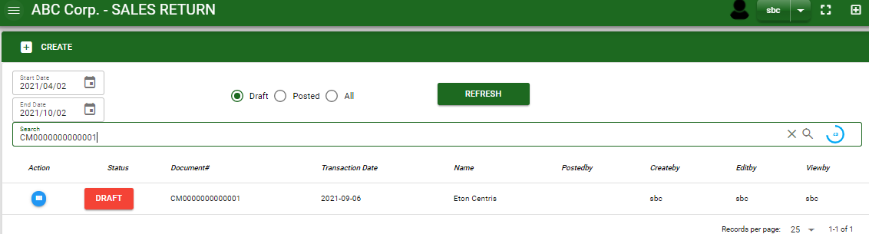
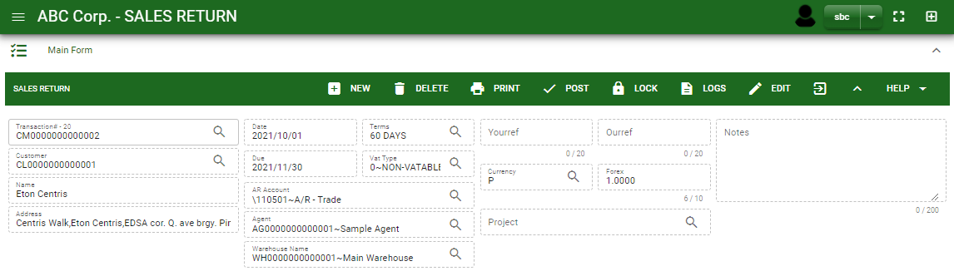
Sales/ Sales Return - Module
How To Edit Sales Return Transaction?
1.1. In the sales return – main window, search the transaction you wish to edit its information in the search bar. Or,
1.2 In sales return – main form, click the lookup button and select the transaction you wish to edit its information by typing its transaction number in the search bar.
2. After you select the sales return transaction, if you wish to edit the header of the transaction click edit button.
3. If you are done editing the header, click save button in the upper side of the header.
1.1.
Sales Return – Main Window
HEADER
2.
1.2.
How to search SR transaction?
Type the transaction number in the search bar.
Click ‘enter’ in the keyboard to search.
Click to select the transaction you want to edit
Sales Return – Main Form

Slide 9
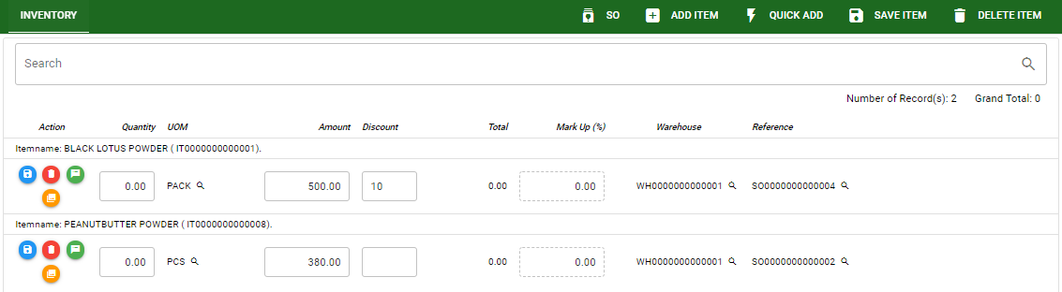
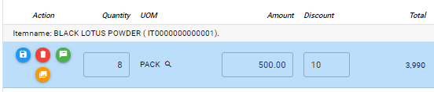
Sales/ Sales Return - Module
How To Edit Sales Return Transaction?
4. If you want to edit the items in sales return stock, edit right away the details you want to change and you will notice that after you change the details, the item you edited will be highlighted into blue.
5. If you’re done editing, click save item button to save the changes you made in the items.
6. To delete all items in the stock, click delete item button.
7. To delete a specific item on the table, click the delete icon next to the item to delete it.
STOCK
5
6
4
7
Sales Return – Main Window

Slide 10
Sales/ Sales Return - Module
How To Delete Sales Return Transaction?
1.1 In the sales return – main window, search the transaction you want to delete.
1.2. In sales return – main form, click the lookup button and select the transaction you want to delete.
2. If done, click delete button.
Sales Return – Main Window
HEADER
2.
1.2.
How to search SR transaction?
Type the transaction number in the search bar.
Click ‘enter’ in the keyboard to search.
Click to select the transaction you want to edit
Sales Return – Main Form

Slide 11
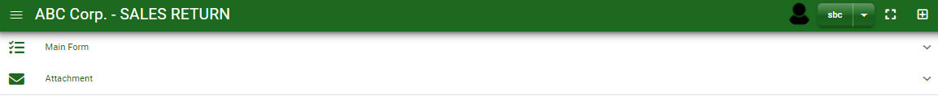
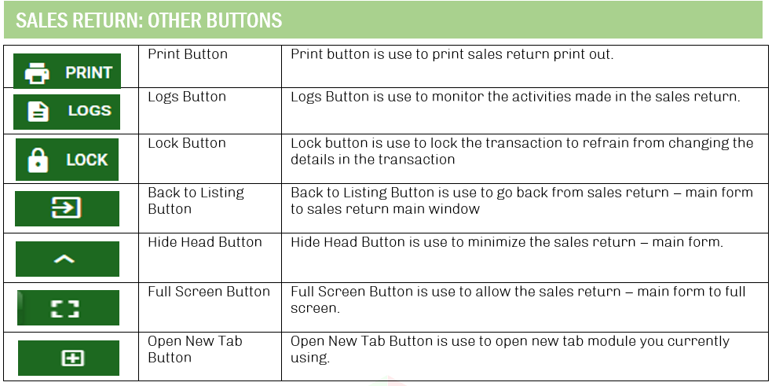
Sales/ Sales Return - Module
Other Information
When you click the arrow parallel in the main form on the upper right, the sales return – main form will be minimize and the other information will be displayed as shown in the photo below.
Click the arrow parallel to what information you want to open and provide the necessary filter to generate the data you want to display.
Other Buttons

