Slide 1
Purchase Return
Purchase Return is where item returned that has been previously purchased from the supplier are recorded.

Slide 2
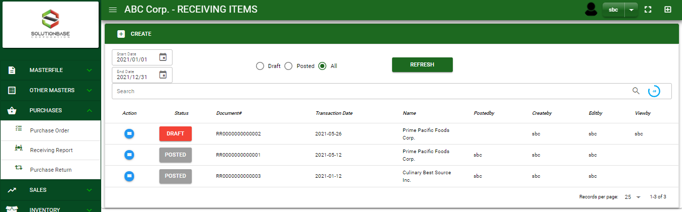

Purchase / Purchase Return - Module
Main Window
When you click the Purchase Return module under Purchases, Purchase Return transactions list will display based on filtered date and status in the purchases return main window.
Purchase Return – Main Window

Slide 3
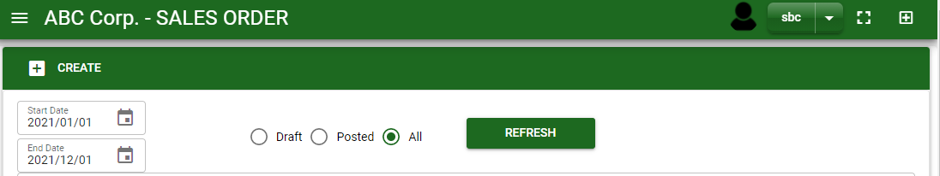
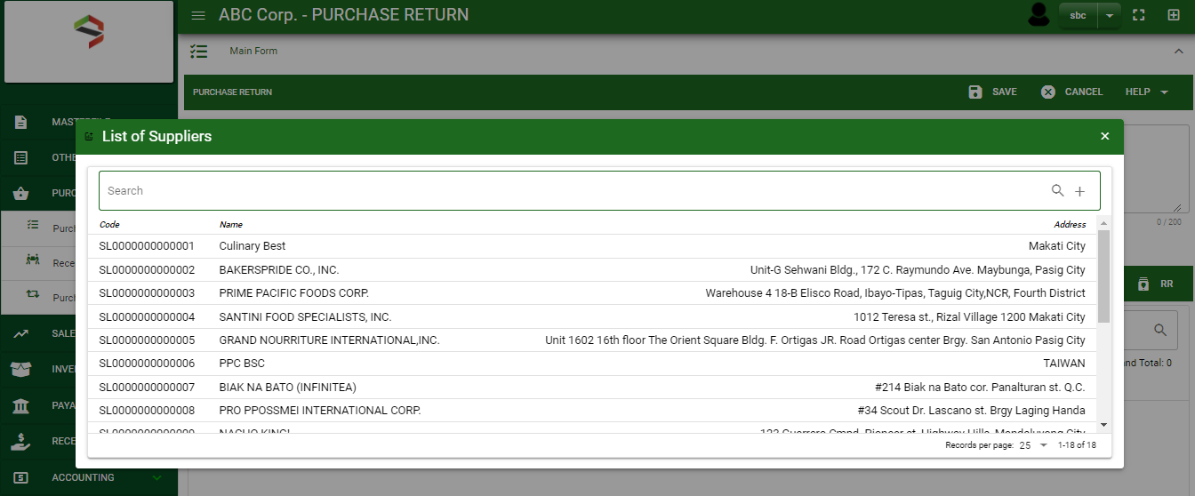
Purchase / Purchase Return - Module
How To Create Purchase Return Transaction?
1
1. In Purchase Return – Main Window, you will notice a create button in the upper left of the window. Click the create button and you will be redirect in purchase return – main form.
2. After you click the create button a dialog box will pop out with list of supplier. Search and select a customer.
3. After you select a supplier, you will be redirected in purchase return – main form where you will encode the other necessary information of the transaction and record the items’ returned by the customer
2

Slide 4
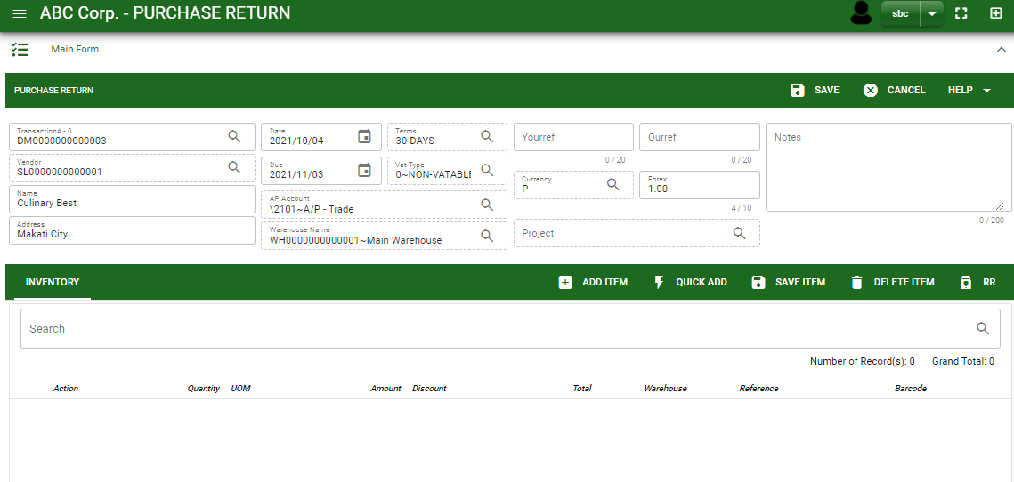
Purchase / Purchase Return - Module
How To Create Purchase Return Transaction?
4.1. After you select the supplier, some details such as address, terms are automatically plotted in their respective field. If you wish to change the term, click the lookup button and select its respective term.
4.2. In header, current date and default warehouse is also plotted automatically but if you wish to change the date – click the date picker and select its respective return date. And if you want to change the warehouse, click the lookup button and select its respective warehouse.
4.3. In header, add the necessary information if necessary.
4.4. If done in header, click save button.
5.1. After saving the header, you may now select the returned items to supplier from Receiving Report and select the items returned by clicking RR button
4.4
Header
4.1 to 4.3
5.1
Stock

Slide 5
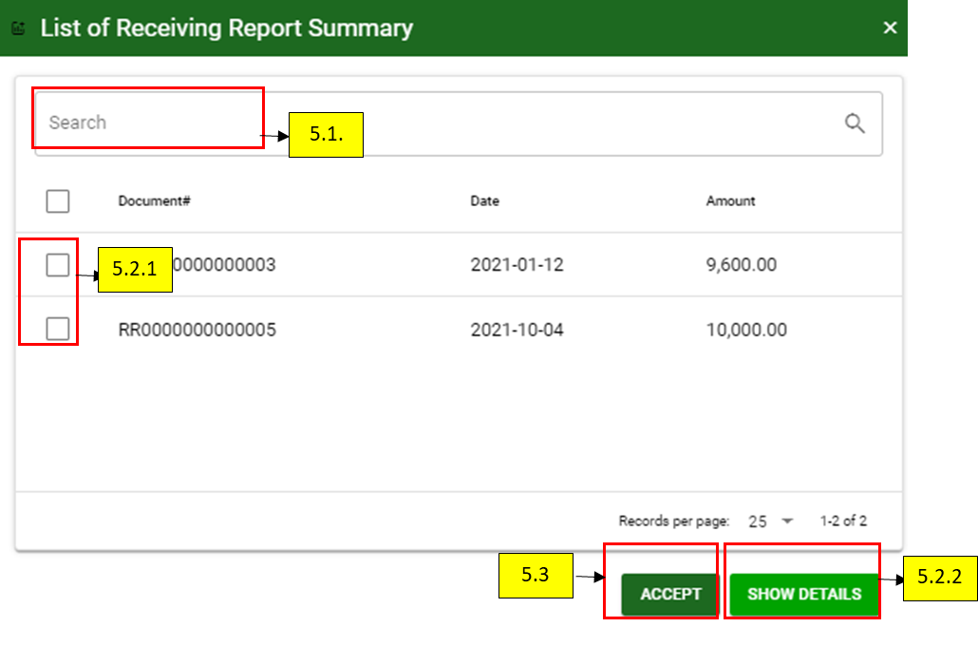
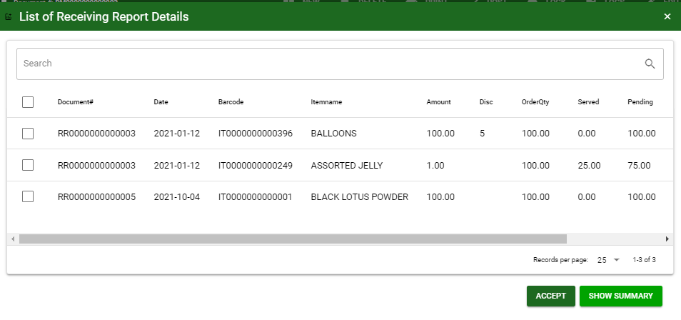
Purchase / Purchase Return - Module
How To Create Purchase Return Transaction?
5.1. After saving the header, you may now select the returned items to supplier from Receiving Report and select the items returned by clicking RR button
5.2.1. After you click the RR button, a dialog box of all receiving report transactions to the supplier will be displayed. Search the document number and select the received items, returned to supplier by ticking the check box. You may select multiple receiving report transactions in one purchase return transaction.
5.2.2. Click show details button, to itemize the receiving report transaction.
5.3. If done, click accept button.
5.2.1

Slide 6
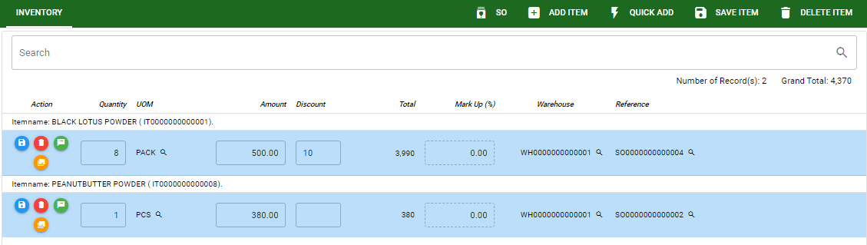
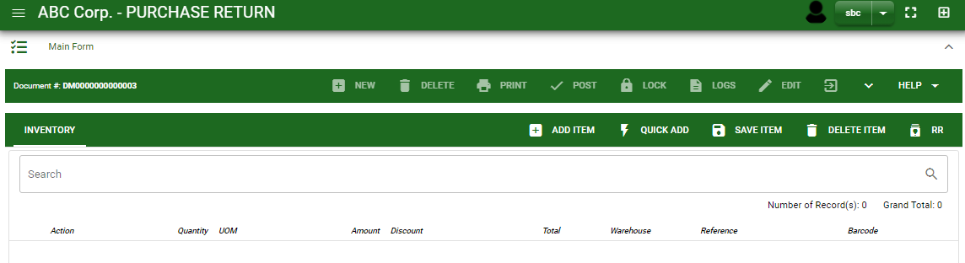
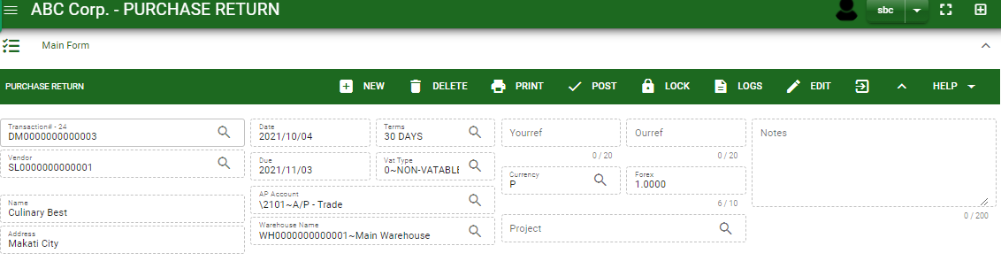
Purchase / Purchase Return - Module
How To Create Purchase Return Transaction?
6.1 After you click the accept button, selected returned items will be displayed in purchase return stock. You may edit the details of item by directly changing it.
6.2 If you wish to add another item that is not from receiving report, click add item button. If you know the item code, click quick add button for faster adding of item.
6.3 After you edit, click save item button.
7.1 Click the maximize arrow to enable the post button.
7.2 To finalize, the transaction, click post button located in the header.
6.2.
6.2.
6.3.
6.1
7.1.
7.2

Slide 7
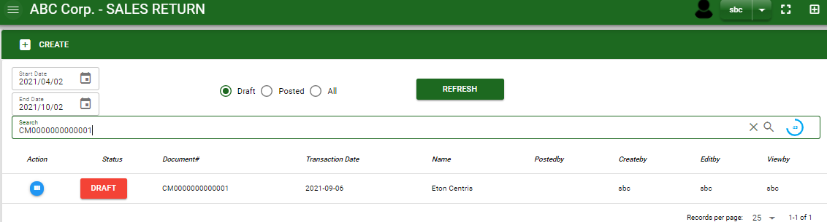
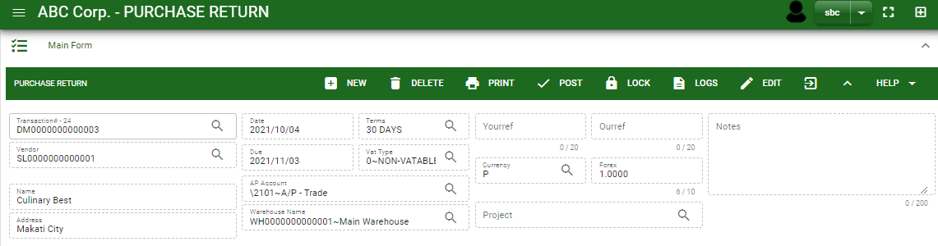
Purchase / Purchase Return - Module
How To Edit Purchase Return Transaction?
1.1. In the purchase return – main window, search the purchase return transaction you wish to edit its information in the search bar. Or,
1.2 In purchase return – main form, click the lookup button and select the transaction you wish to edit its information by typing its transaction number in the search bar.
2. After you select the purchase return transaction, if you wish to edit the header of the transaction click edit button.
3. If you are done editing the purchase return header, click save button in the upper side of the header.
1.1.
Purchase Return – Main Window
HEADER
2.
1.2.
How to search PR transaction?
Type the transaction number in the search bar.
Click ‘enter’ in the keyboard to search.
Click to select the transaction you want to edit
Purchase Return – Main Form

Slide 8
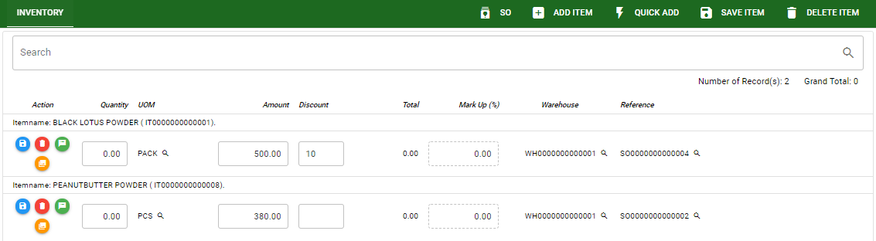
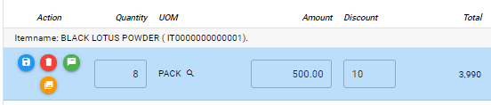
Purchase / Purchase Return - Module
How To Edit Purchase Return Transaction?
STOCK
4. If you want to edit the items in purchase return stock, edit right away the details you want to change and you will notice that after you change the details, the item you edited will be highlighted into blue.
5. If you’re done editing, click save item button to save the changes you made in the items.
6. To delete all items in the stock, click delete item button.
7. To delete a specific item on the table, click the delete icon next to the item to delete it.
5
6
7
4

Slide 9
Purchase / Purchase Return - Module
How To Delete Purchase Return Transaction?
1.1.
1.1. In the purchase return – main window, search the transaction you want to delete.
1.2. In purchase return – main form, click the lookup button and select the transaction you want to delete.
2. If done, click delete button.
Purchase Return – Main Window
HEADER
2.
1.2.
How to search PR transaction?
Type the transaction number in the search bar.
Click ‘enter’ in the keyboard to search.
Click to select the transaction you want to edit
Purchase Return – Main Form

Slide 10
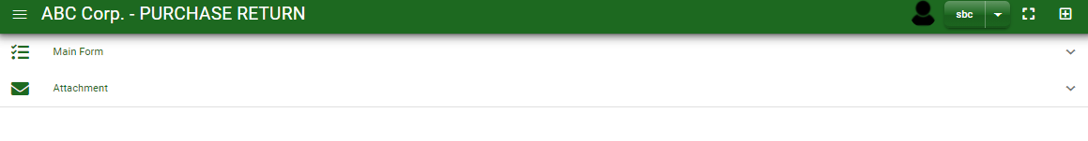
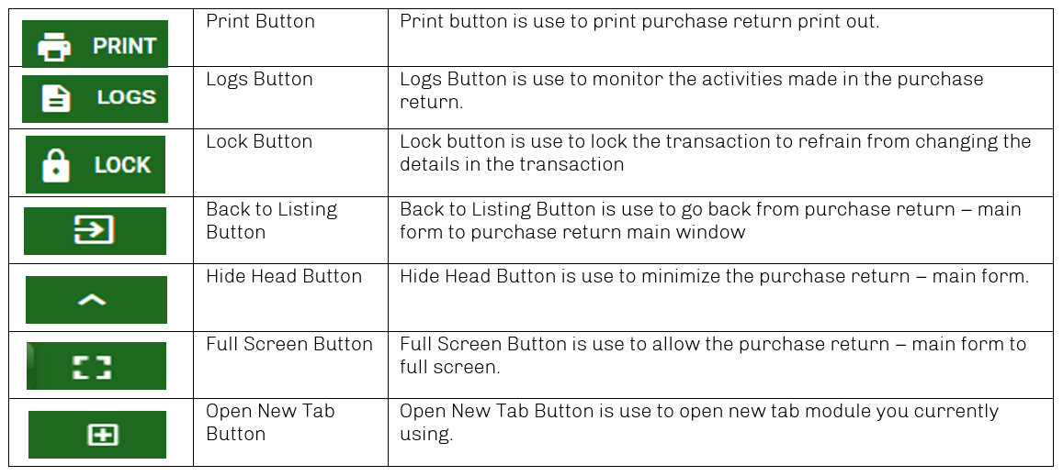
Purchase / Purchase Return - Module
Other Information
When you click the arrow parallel in the main form on the upper right, the purchase return – main form will be minimize and the other information will be displayed as shown in the photo below.
Click the arrow parallel to what information you want to open and provide the necessary filter to generate the data you want to display.
Other Buttons

