Slide 1
General Journal
A module where accounting adjustments is recorded.

Slide 2
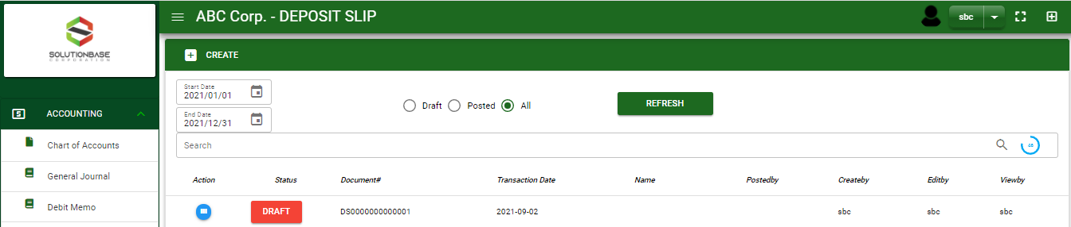
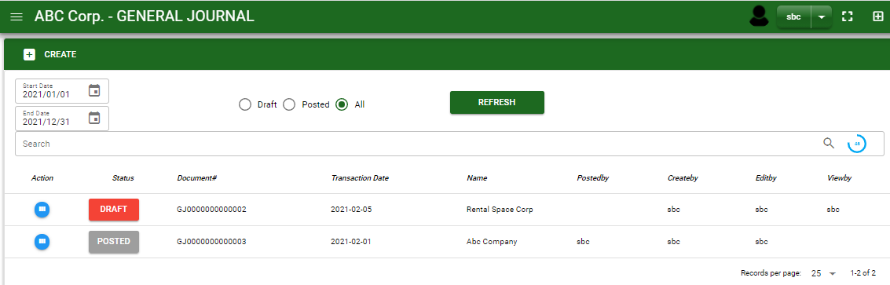


Accounting / General Journal - Module
Main Window
When you click the General Journal module under Accounting, general journal transactions list will display based on filtered date and status in the general journal - main window.
General Journal– Main Window
2

Slide 3
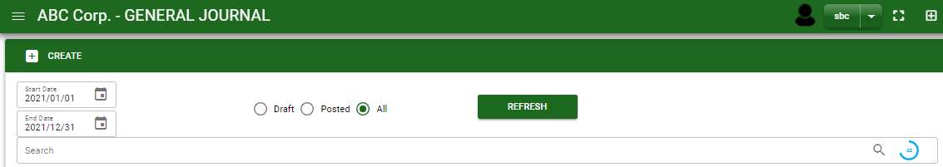
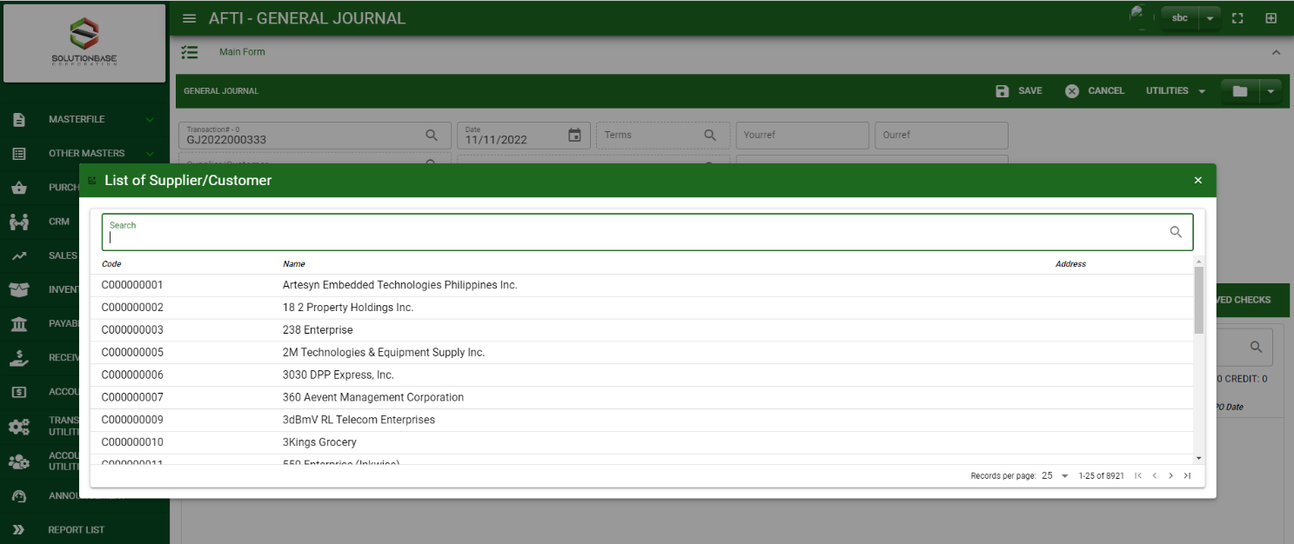
Accounting / General Journal - Module
How To Create General Journal Transaction?
1
1. In General Journal – Main Window, you will notice a create button in the upper left of the window. Click the create button and you will be redirect general journal – main form.
2. After you click the create button a dialog box will pop out with list of customer/ supplier. Search and select a customer/ supplier.
3. After you select a customer/ supplier, you will be redirect in general journal – main form where you will encode the other necessary information of the transaction and record the journal entry
2
How to search customer/supplier?
Type the customer/ supplier name in the search bar.
And it will automatically sort out.
Then click the selected customer/ supplier.
3

Slide 4
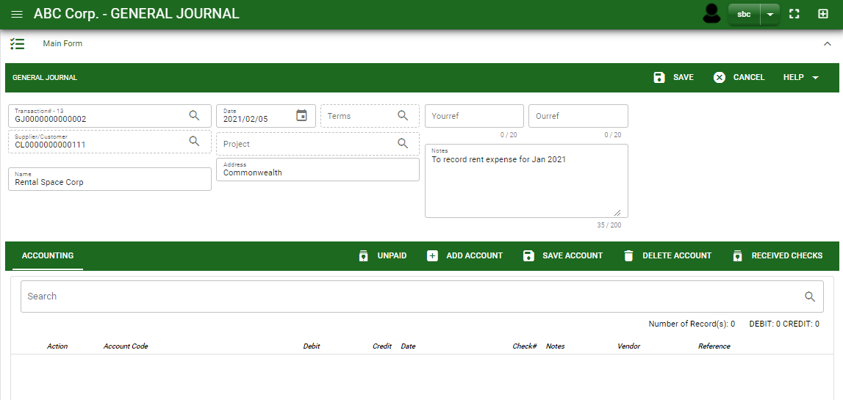
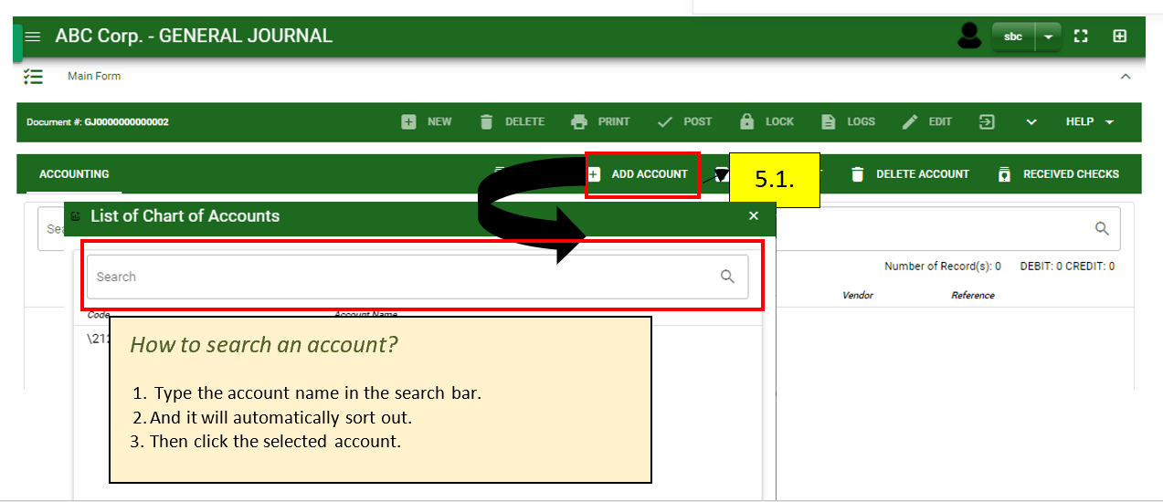
Accounting / General Journal - Module
How To Create General Journal Transaction?
4.4
4.1 After you select the customer/ supplier, some details such as address, date are automatically plotted in their respective field.
4.2 In header, current date is also plotted automatically but if you wish to change the date – click the date picker and select its respective date.
4.3 In header, add the necessary information if necessary.
4.4 If done in header, click save button.
Header
4.1 to 4.3
5.1
5.1
5.1
Detail
5.1 After saving the header, you may now select from received checks if the entry has to do with check for deposit adjustment. If the entry is AR or AP click unpaid button to select from the list and if the entry has no link from other modules, click add account to select an account. Search and select it by ticking the check box.
5.2 Click accept, if done.
6. By clicking add new account, add the necessary details by following the instruction below.
4

Slide 5
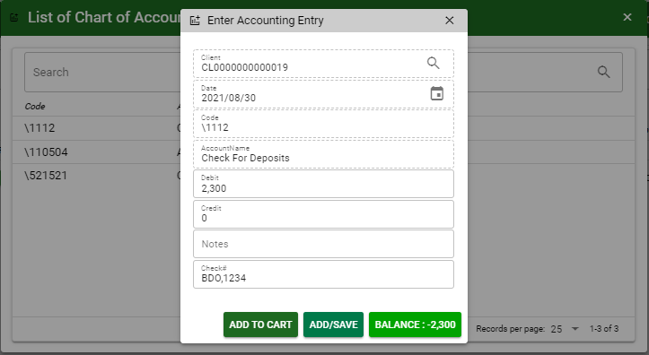
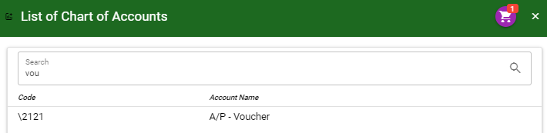
Accounting / General Journal - Module
How To Create General Journal Transaction?
7. After you select an account, a dialog box will prompt. Enter the details of the account.
8. Enter the details of the account. For the amount, enter the amount either in debit or credit field. But if you want to copy of amount in the balance, click the balance to autofill the credit field.
9. You may also add notes if necessary.
10. If the account is in Check, enter the check date a check number.
10
8
9
10
11.1
11.2
8
11.1 To save the account, if you want to add more other account, click add to cart button and select more accounts again. OR,
11.2 OR If you want to plot the selected account already in received payment– detail, you may click add/ save button.
How to plot the selected accounts in the general journal – detail
Click the cart icon.
And a dialog box with list of selected accounts will pop out.
Then click the accept button.
5

Slide 6
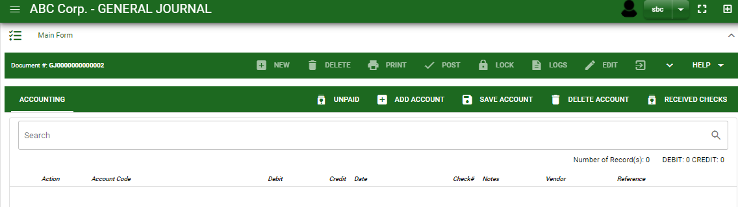
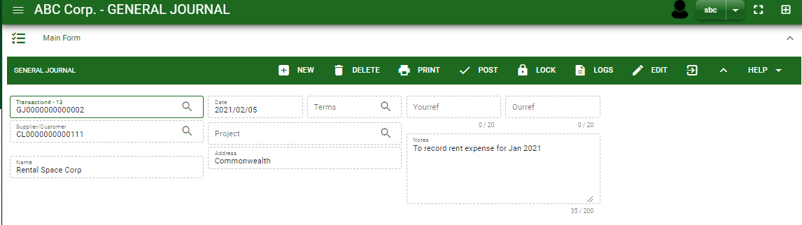
Accounting / General Journal - Module
How To Create General Journal Transaction?
12. If done click the arrow to enable the buttons in the header.
13. To finalize, click post button.
12
13
6

Slide 7
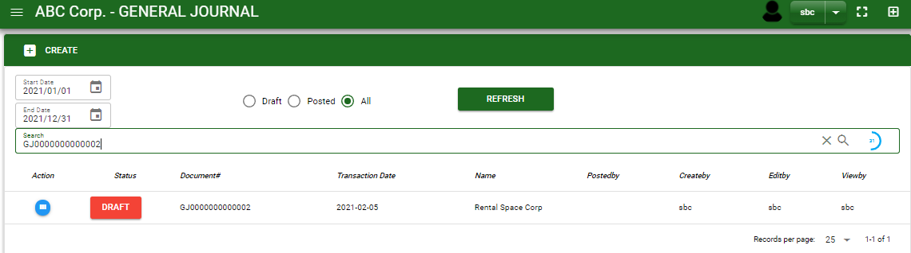
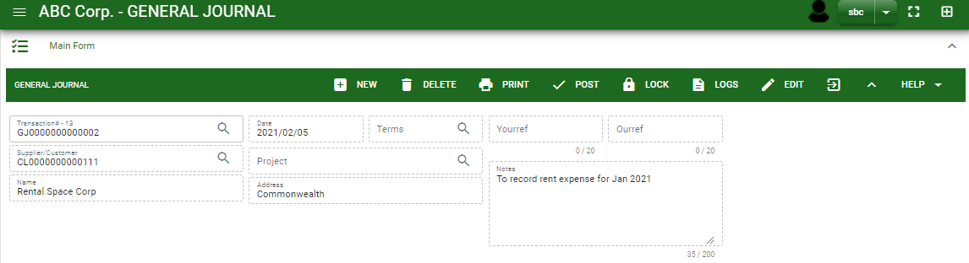

Accounting / General Journal - Module
How To Edit General Journal Transactions
1.1 In the general journal – main window, search the journal entry you wish to edit its information in the search bar. Or,
1.2 In general journal – main form, click the lookup button and select the transaction you wish to edit its information by typing its transaction number in the search bar.
1.1.
General Journal– Main Window
2. After you select the GJ transaction, if you wish to edit the header of the transaction click edit button.
3. If you are done editing the GJ header, click save button in the upper side of the header.
HEADER
2.
1.2.
How to search transaction?
Type the transaction number in the search bar.
Click ‘enter’ in the keyboard to search.
Click to select the transaction you want to edit
General Journal– Main Form
7

Slide 8
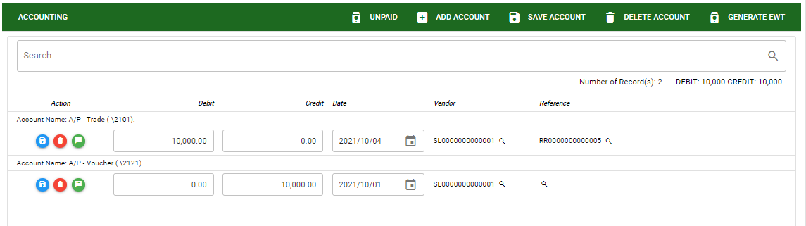
Accounting / General Journal - Module
How To Edit General Journal Transactions
DETAIL
4. If you want to edit the entry in the detail, edit right away the details you want to change and you will notice that after you change the details, the account you edited will be highlighted into blue.
5. If you’re done editing, click save account button to save the changes you made in the entry.
6. To delete all accounts in the entry, click delete account button.
7. To delete a specific line on the table, click the delete icon next to the account to delete it.
5
6
4
7
8

Slide 9
Accounting / General Journal - Module
How To Delete General Journal Transactions
1.3 In the general journal – main window, search the journal entry you wish to edit its information in the search bar. Or,
1.4 In general journal – main form, click the lookup button and select the transaction you wish to edit its information by typing its transaction number in the search bar.
General Journal– Main Window
HEADER
2.
2. If done, click delete button.
1.2.
How to search transaction?
Type the transaction number in the search bar.
Click ‘enter’ in the keyboard to search.
Click to select the transaction you want to edit
General Journal– Main Form
9

Slide 10
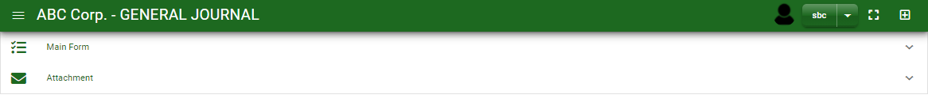
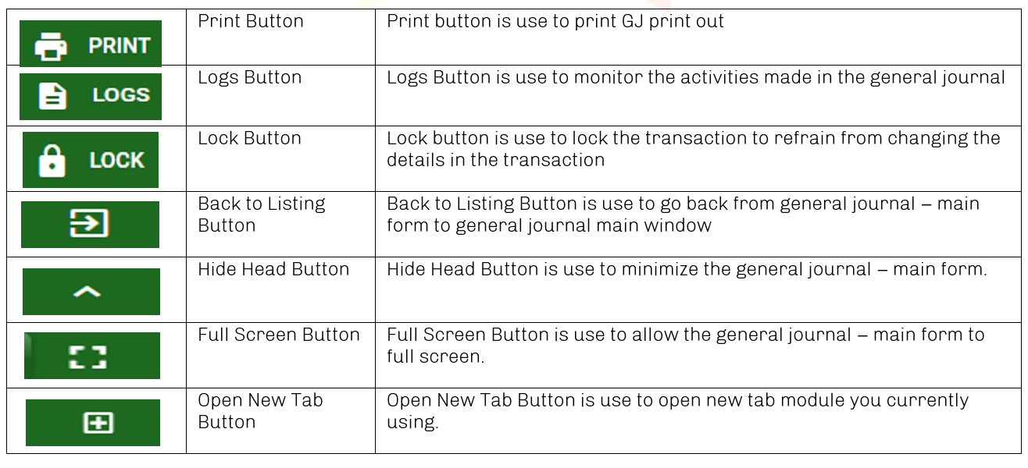
Accounting / General Journal - Module
Other Information
When you click the arrow up icon parallel in the main form on the upper right, and the general journal – main form will be minimize and the other information will be displayed as shown in the photo below.
Click the arrow parallel to what information you want to open and provide the necessary filter to generate the data you want to display.
If you want to upload file attachment in image form, click the attachment and upload the file.
Other Buttons
10

