Slide 1
Purchase Order
It is where orders to suppliers are encoded. It is also where ordered versus served quantity per purchase order transaction are viewed.

Slide 2
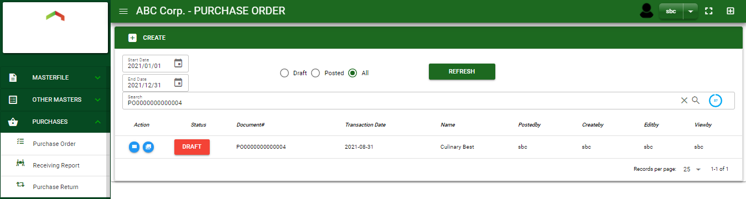

Purchase / Purchase Order - Module
Main Window
When you click the Purchase Order module under Purchases, Purchase Order transactions list will display based on filtered date and status in the purchase order main
Purchase Order – Main Window

Slide 3
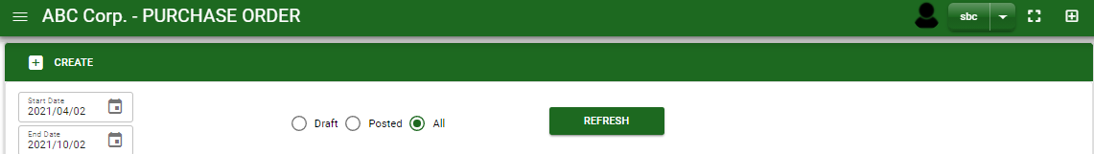
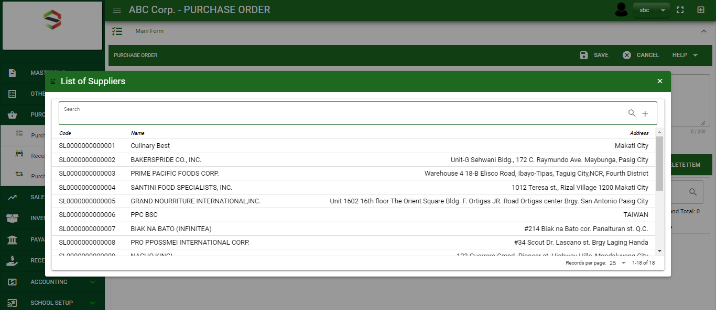
Purchase / Purchase Order - Module
How To Create Purchase Order Transaction?
1
1. In Purchase Order – Main Window, you will notice a create button in the upper left of the window. Click the create button and you will be redirect in purchase order – main form.
2. After you click the create button a dialog box will pop out with list of supplier. Search and select a supplier.
2
3. After you select a supplier, you will be redirected in purchase order – main form where you will encode the other necessary information of the transaction and record the items’ ordered.

Slide 4
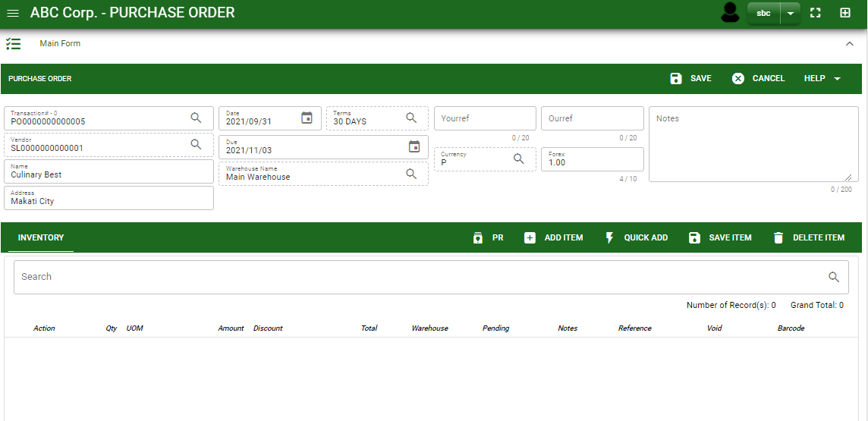
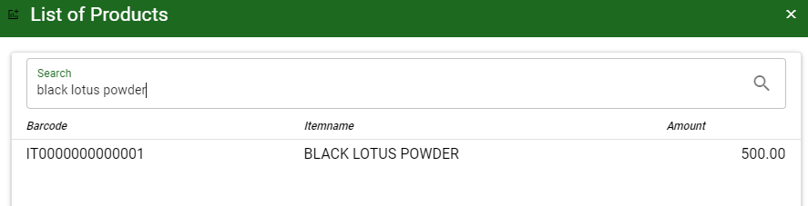
Purchase / Purchase Order - Module
How To Create Purchase Order Transaction?
4.1 After you select the supplier, some details such as address, terms are automatically plotted in their respective field. If you wish to change the term, click the lookup button and select its respective term.
4.2 In header, current date and default warehouse is also plotted automatically but if you wish to change the date – click the date picker and select its respective ordered date. And if you want to change the warehouse, click the lookup button and select the warehouse.
4.3 In header, add the necessary information if necessary.
4.4 If done in header, click save button.
5.1. After saving the header, you may now add the ordered item in the stock by clicking add button.
5.2. After you click the add button, a dialog box with item list pop out, search and select the order item
4.4
4.1 to 4.3
5.1
Stock
5.2
5.2

Slide 5
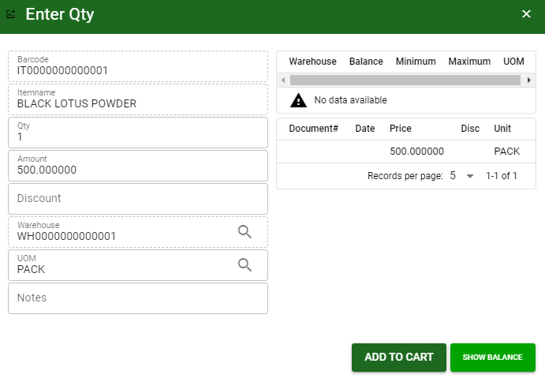
Purchase / Purchase Order - Module
How To Create Purchase Order Transaction?
5.3 After you select the item, a dialog box where item details will be encoded will pop out.
5.4 Enter the necessary quantity, change the amount, uom, warehouse and add purchase discount if there’s any.
5.5 If done, click add to cart button.
5.4.
5.5

Slide 6
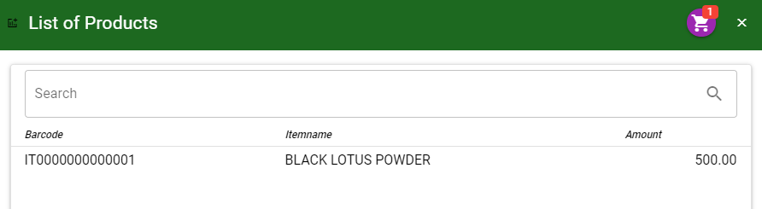
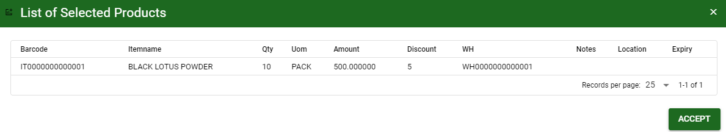
Purchase / Purchase Order - Module
How To Create Purchase Order Transaction?
5.6 After you click the add to cart button, you will notice in the upper right of item list an icon of add to cart. Click that, then click accept button to plot the order items in the stock.
5.6
5.6

Slide 7
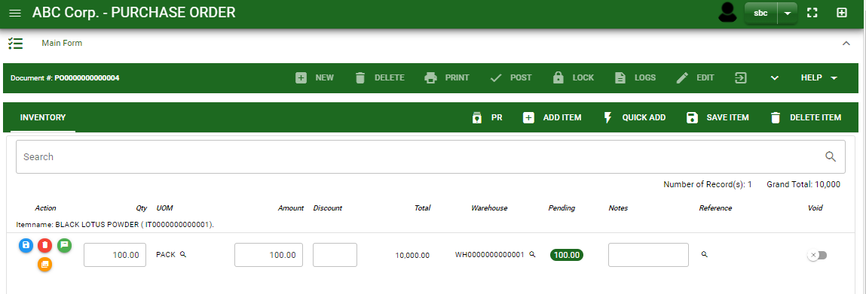
Purchase / Purchase Order - Module
How To Create Purchase Order Transaction?
5.7 To add more items, repeat 5.2 to 5.5 before doing
5.8 After you click the accept button in the dialog box of selected items in 5.6., the items select will be plotted in the stock as shown below.
5.9 You may still edit the details per item in the stock. Change directly the details needed to be change.
5.10 If done, click save item button
5.10

Slide 8
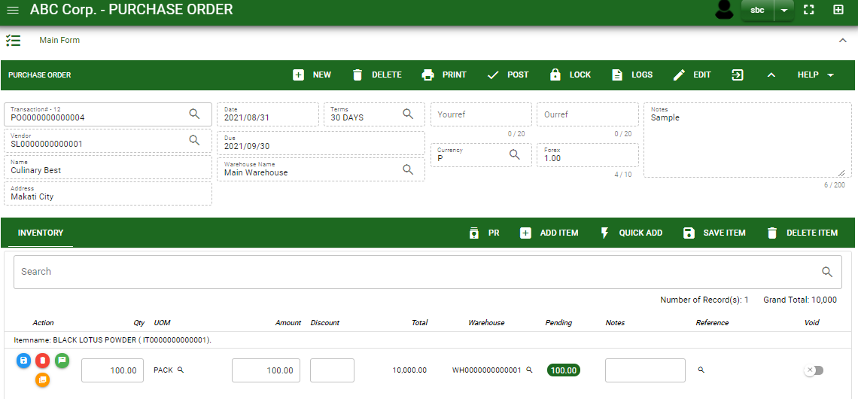
Purchase / Purchase Order - Module
How To Create Purchase Order Transaction?
5.11 Click the maximize arrow to enable the post button.
5.12 To finalize, the transaction, click post button located in the header.
5.11
5.12

Slide 9
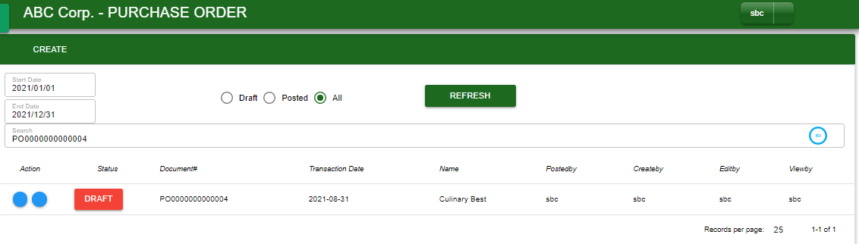
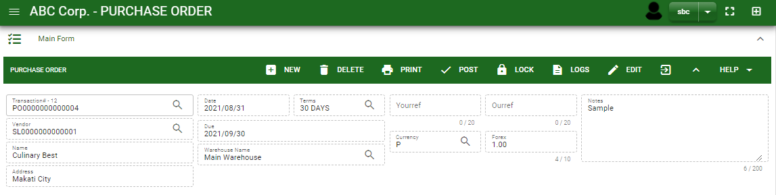
Purchase / Purchase Order - Module
How To Edit Purchase Order Transaction?
1.1. In the purchase order – main window, search the purchase order transaction you wish to edit its information in the search bar. Or,
1.2. In purchase order – main form, click the lookup button and select the transaction you wish to edit its information by typing its transaction number in the search bar.
2. After you select the PO transaction, if you wish to edit the header of the transaction click edit button.
3. If you are done editing the purchase order header, click save button in the upper side of the header.
1.1.
Purchase Order – Main Window
HEADER
2.
1.2.
Purchase Order – Main Form

Slide 10
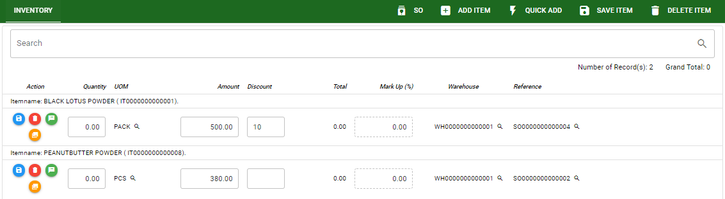
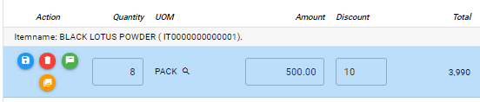
Purchase / Purchase Order - Module
How To Edit Purchase Order Transaction?
4. If you want to edit the items in purchase order stock, edit right away the details you want to change and you will notice that after you change the details, the item you edited will be highlighted into blue.
5. If you’re done editing, click save item button to save the changes you made in the items.
6. To delete all items in the stock, click delete item button.
7. To delete a specific item on the table, click the delete icon next to the item to delete it.
STOCK
5
6
7
4

Slide 11
Purchase / Purchase Order - Module
How To Delete Purchase Order Transaction?
1.1.
1.1. In the purchase order – main window, search the transaction you want to delete.
1.2. In purchase order – main form, click the lookup button and select the transaction you want to delete.
2. After . If done, click delete button.
Purchase Order – Main Window
HEADER
2.
1.2.
How to search PO transaction?
Type the transaction number in the search bar.
Click ‘enter’ in the keyboard to search.
Click to select the transaction you want to edit
Purchase Order – Main Form

Slide 12
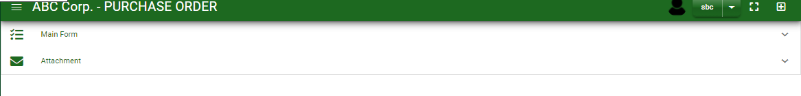
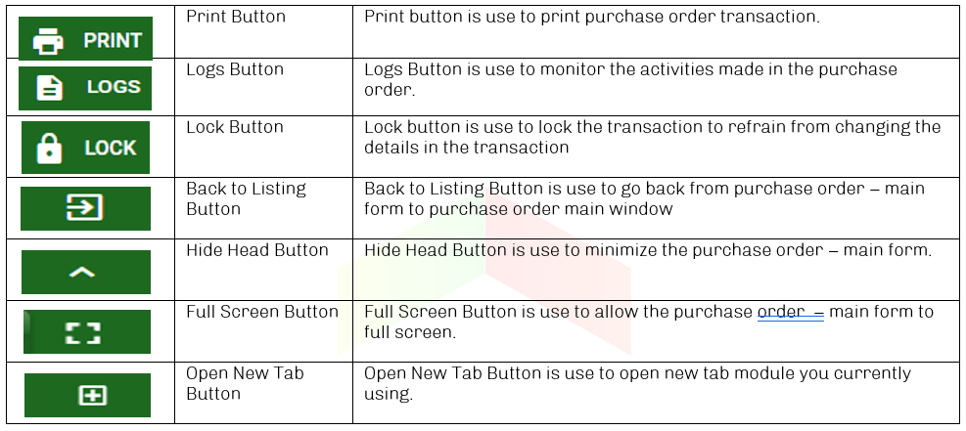
Purchase / Purchase Order - Module
Other Information
When you click the arrow up icon parallel in the main form on the upper right, and the purchase order – main form will be minimize and the other information will be displayed as shown in the photo below.
Click the arrow parallel to what information you want to open and provide the necessary filter to generate the data you want to display.
Other Buttons

