Slide 1
Receiving Report
Is where receiving of items from supplier are transacted.

Slide 2
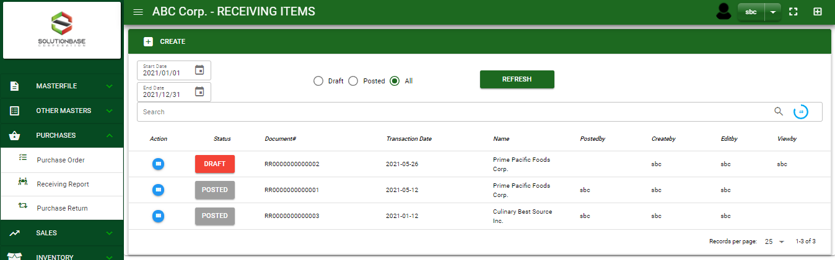

Purchase / Receiving Report- Module
Main Window
When you click the Receiving Report module under Purchases, Receiving Report transactions list will display based on filtered date and status in the receiving report main window.
Receiving Report – Main Window

Slide 3
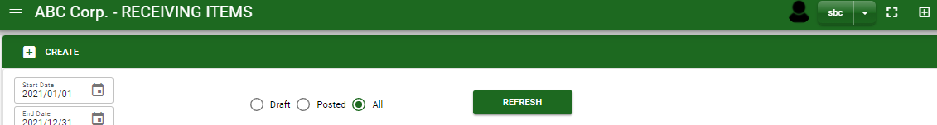
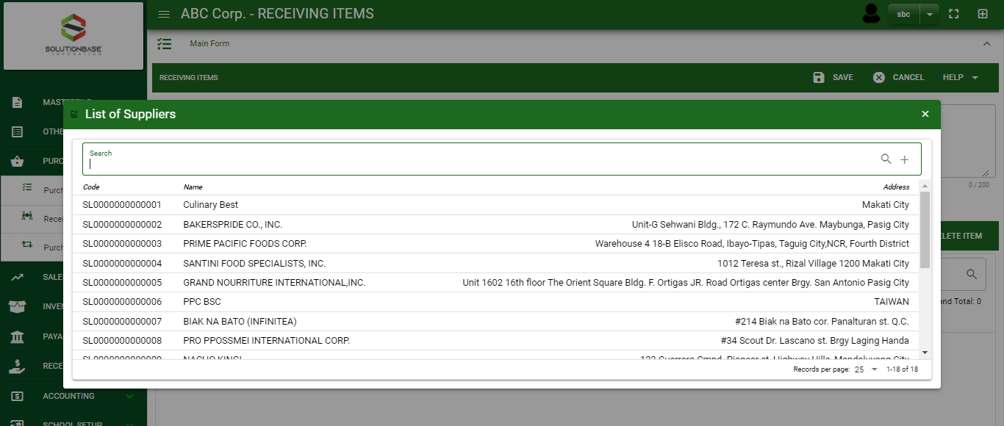
Purchase / Receiving Report- Module
How To Create Receiving Report Transaction?
1
1. In Receiving Report – Main Window, you will notice a create button in the upper left of the window. Click the create button and you will be redirect in receiving report – main form.
2. After you click the create button a dialog box will pop out with list of supplier. Search and select a supplier.
2
3. After you select a supplier, you will be redirected in receiving report– main form where you will encode the other necessary information of the transaction and record the items’ to be receive from the supplier

Slide 4
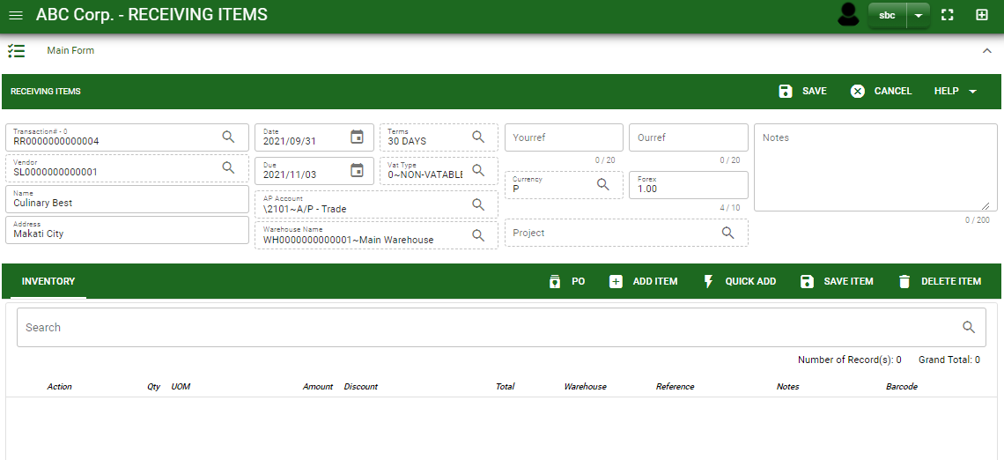
Purchase / Receiving Report- Module
How To Create Receiving Report Transaction?
4.1 After you select the supplier, some details such as address, terms are automatically plotted in their respective field. If you wish to change the term, click the lookup button and select its respective term.
4.2. In header, current date and default warehouse is also plotted automatically but if you wish to change the date – click the date picker and select its respective delivery date. And if you want to change the warehouse, click the lookup button and select the its respective warehouse.
4.3. In header, add the necessary information if necessary.
4.4. If done in header, click save button.
4.4
Header
4.1 to 4.3
5.1

Slide 5
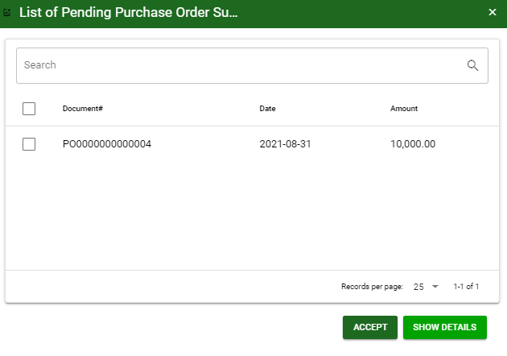
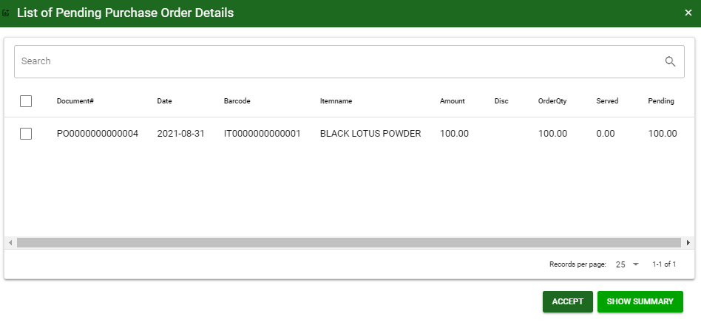
Purchase / Receiving Report- Module
How To Create Receiving Report Transaction?
5.1.
5.1. After saving the header, you may now select the ordered items from Purchase Order to the supplier and select the items to be received by clicking PO button
5.2.1 After you click the PO button, a dialog box of all pending orders to the supplier will be displayed. Select the ordered items to be receive by ticking the check box. You may select multiple purchase order transaction in one receiving report transaction.
5.2.2 When you click the show detail button, PO transactions will be detailed as shown below.
5.2.1
5.3
5.2.2
5.2.1

Slide 6
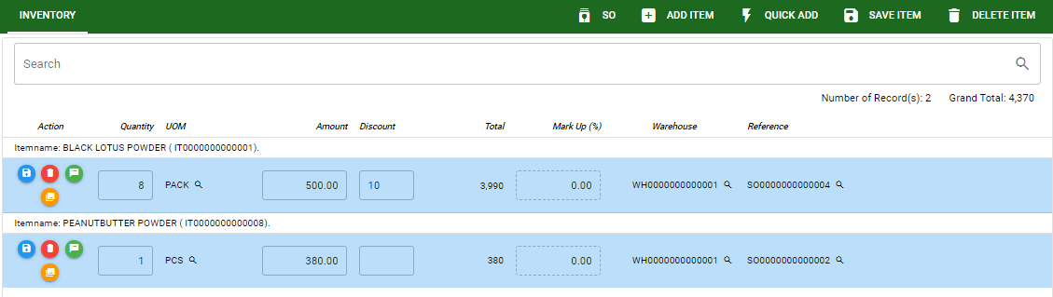
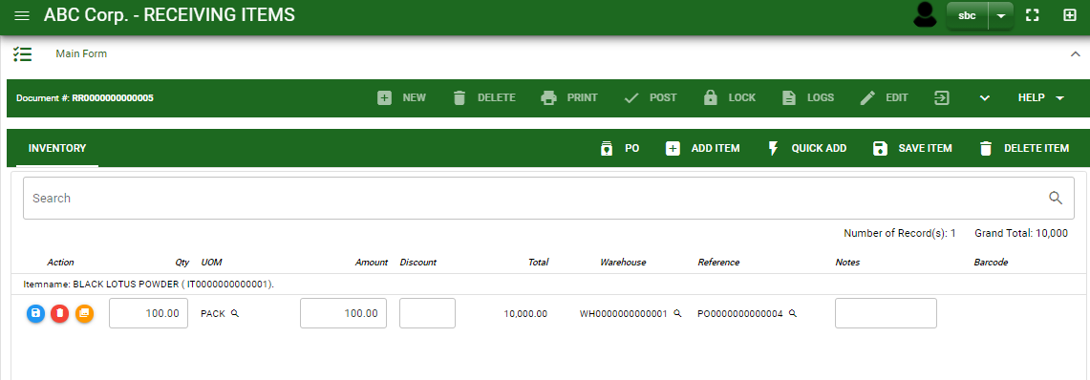
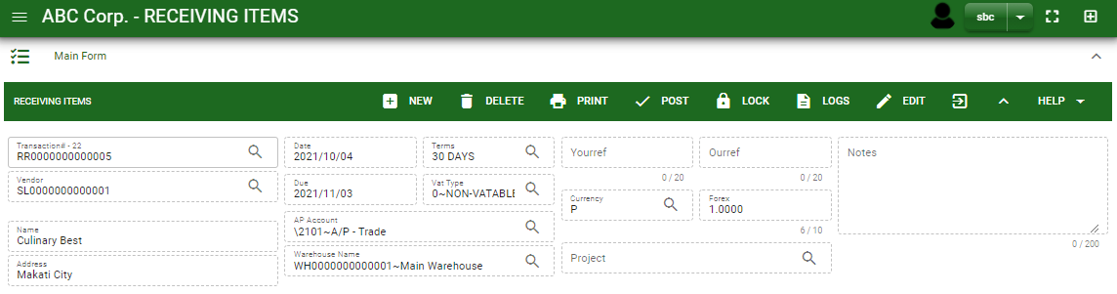
Purchase / Receiving Report- Module
How To Create Receiving Report Transaction?
6.2.
6.2.
6.3.
6.1. After 6.1. After you click the accept button, selected ordered items will be displayed in receiving report stock. You may edit the details of item by directly changing it.
6.2. If you wish to add another item that is not from purchase order, click add item button. If you know the item code, click quick add button for faster adding of item.
6.3. After you edit, click save item button.
6.1
7.1.
7.1. Click the maximize arrow to enable the post button.
7.2 To finalize, the transaction, click post button located in the header.
7.2

Slide 7
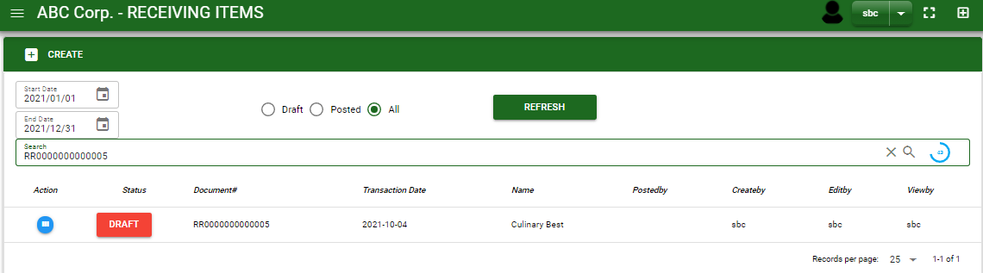
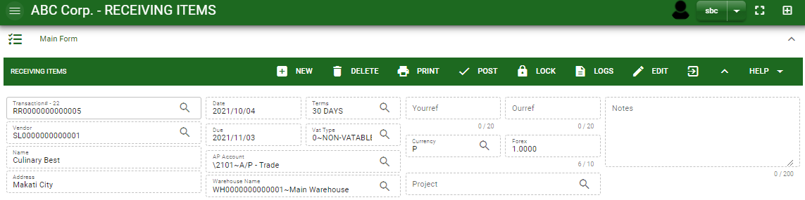
Purchase / Receiving Report- Module
How To Edit Receiving Report Transaction?
1.1. In the receiving report – main window, search the receiving report transaction you wish to edit its information in the search bar. Or,
1.2. In receiving report – main form, click the lookup button and select the transaction you wish to edit its information by typing its transaction number in the search bar.
2. After you select the RR transaction, if you wish to edit the header of the transaction click edit button.
3. If you are done editing the receiving report header, click save button in the upper side of the header.
1.1.
Receiving Report – Main Window
HEADER
2.
1.2.
How to search RR transaction?
Type the transaction number in the search bar.
Click ‘enter’ in the keyboard to search.
Click to select the transaction you want to edit
Receiving Report – Main Form

Slide 8
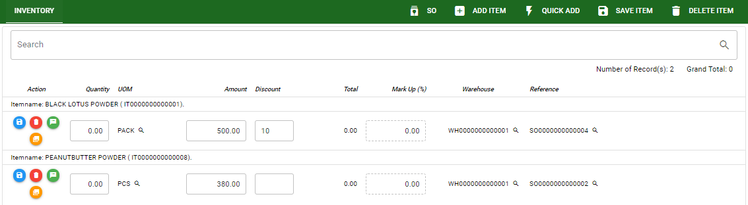
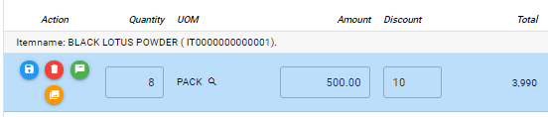
Purchase / Receiving Report- Module
How To Edit Receiving Report Transaction?
STOCK
4. If you want to edit the items in receiving report stock, edit right away the details you want to change and you will notice that after you change the details, the item you edited will be highlighted into blue.
5. If you’re done editing, click save item button to save the changes you made in the items.
6. To delete all items in the stock, click delete item button.
7. To delete a specific item on the table, click the delete icon next to the item to delete it.
5
6
7
4

Slide 9
Purchase / Receiving Report- Module
How To Delete Receiving Report Transaction?
1.1.
1.1. In the receiving report – main window, search the transaction you want to delete.
1.2. In receiving report - main form, click the lookup button and select the transaction you want to delete.
2. If done, click delete button.
Receiving Report – Main Window
HEADER
2.
1.2.
How to search RR transaction?
Type the transaction number in the search bar.
Click ‘enter’ in the keyboard to search.
Click to select the transaction you want to edit
Receiving Report – Main Form

Slide 10
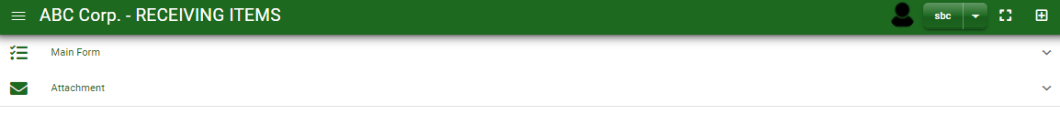
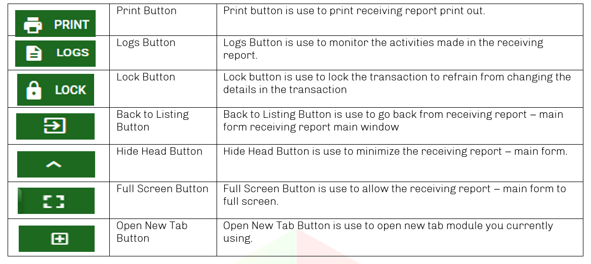
Purchase / Receiving Report- Module
Other Information
When you click the arrow parallel in the main form on the upper right, the receiving report – main form will be minimize and the other information will be displayed as shown in the photo below.
Click the arrow parallel to what information you want to open and provide the necessary filter to generate the data you want to display.
Other Buttons

