Slide 1
Sales Order
Sales Order it is where order of customers are recorded. It is also where ordered versus served quantity per sales order transaction are viewed.

Slide 2
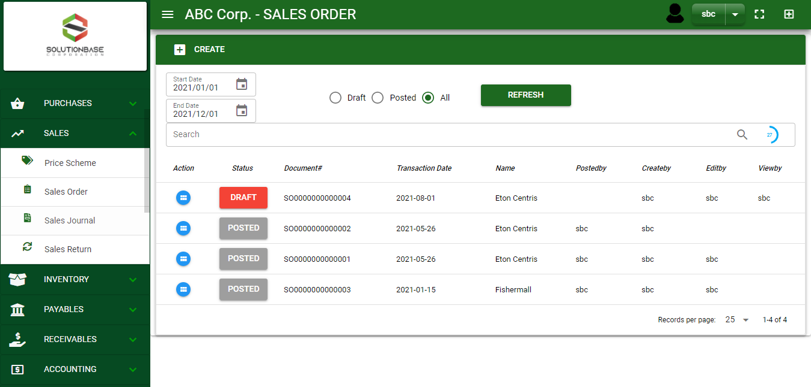

Sales/ Sales Order- Module
Main Window
When you click the Sales Order module under Sales, Sales Order transactions list will display based on filtered date and status in the sales order main window.
Sales Order – Main Window

Slide 3
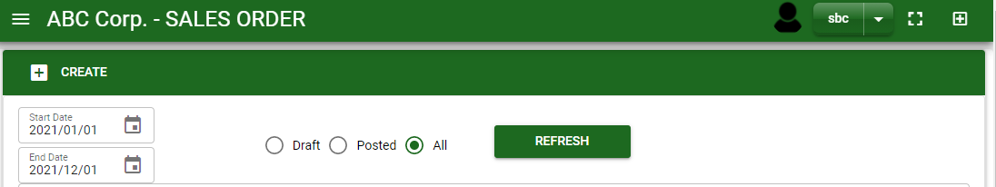
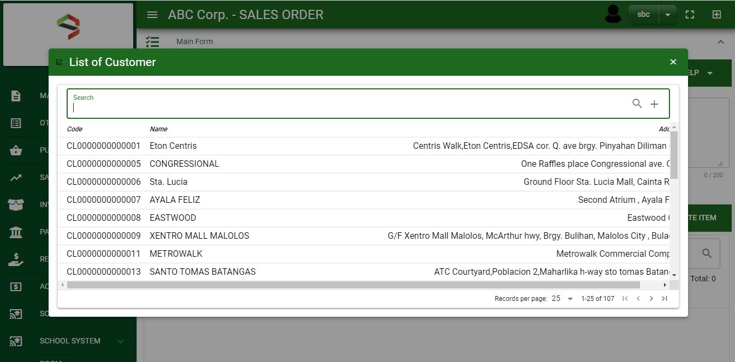
Sales/ Sales Order- Module
How To Create Sales Order Transaction?
1
1. In Sales Order – Main Window, you will notice a create button in the upper left of the window. Click the create button and you will be redirect in sales order – main form.
2. After you click the create button a dialog box will pop out with list of customer. Search and select a customer.
2
How to search customer?
Type the customer name in the search bar.
And it will automatically sort out.
Then click the selected customer.
3. After you select a customer, you will be redirected in sales order – main form where you will encode the other necessary information of the transaction and record the items’ ordered.

Slide 4
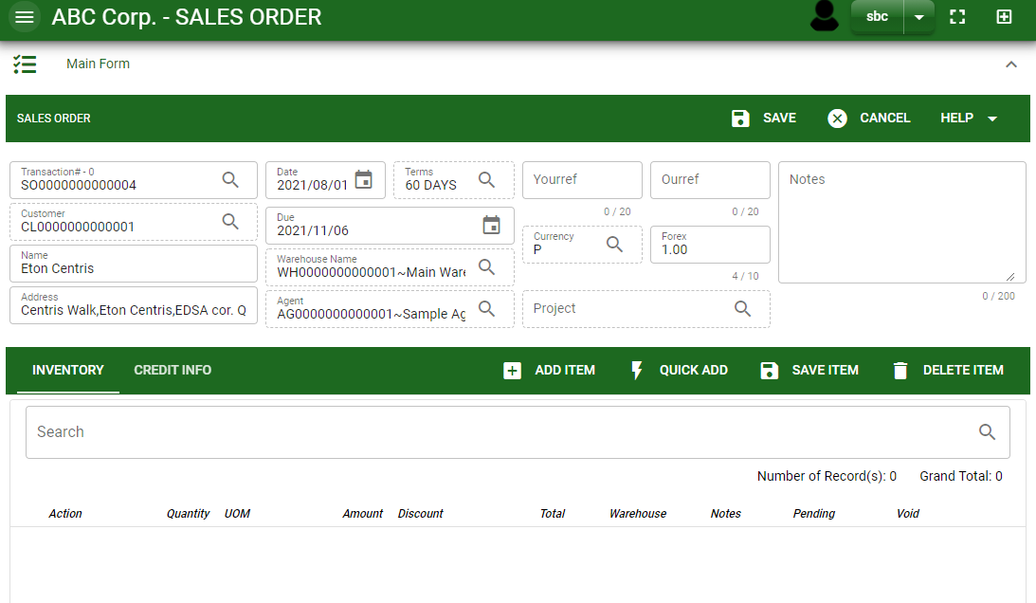
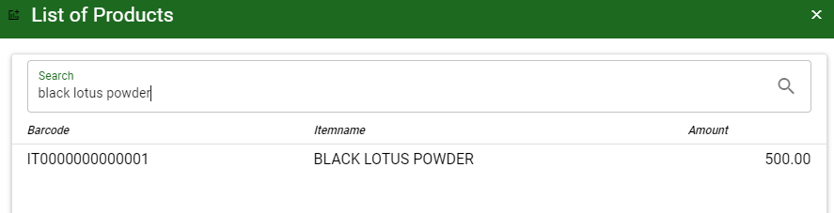
Sales/ Sales Order- Module
How To Create Sales Order Transaction?
4.4
Header
4.1 After you select the customer, some details such as address, terms are automatically plotted in their respective field. If you wish to change the term, click the lookup button and select its respective term.
4.2. In header, current date and default warehouse is also plotted automatically but if you wish to change the date – click the date picker and select its respective ordered date. And if you want to change the warehouse, click the lookup button and select the warehouse.
4.3. In header, add the necessary information if necessary.
4.4. If done in header, click save button.
5.1. After saving the header, you may now add the ordered item in the stock by clicking add button.
5.2 After you click the add button, a dialog box with item list pop out, search and select the order item
4.1 to 4.3
5.1
Stock
5.2
5.2

Slide 5
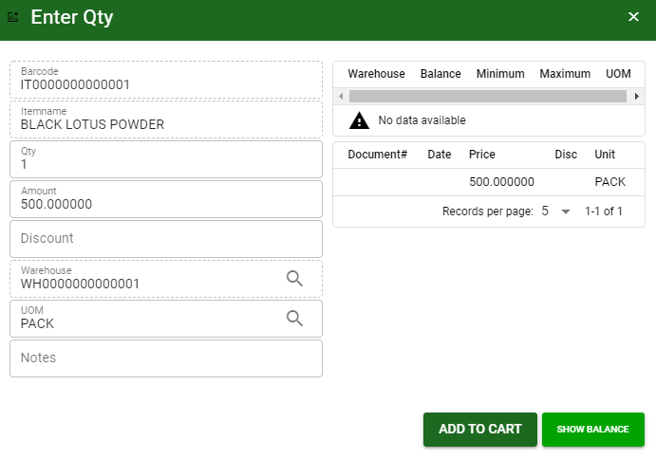
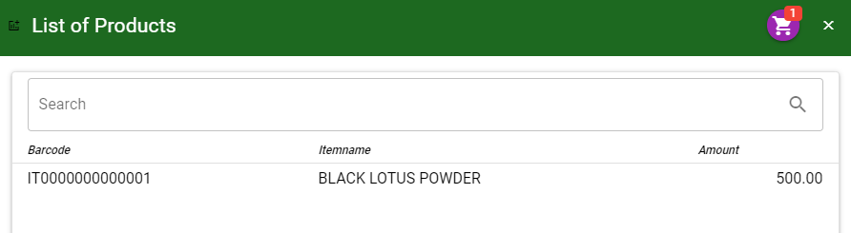
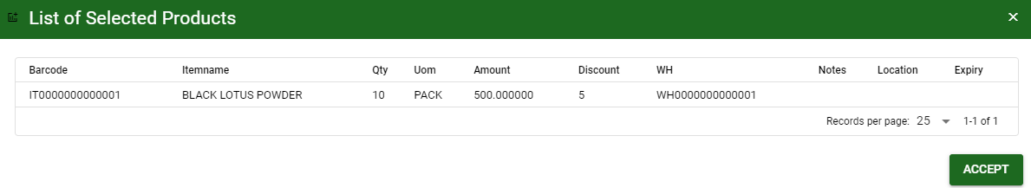
Sales/ Sales Order- Module
How To Create Sales Order Transaction?
5.4 After you select the item, a dialog box where item details will be encoded will pop out.
5.5 Enter the necessary quantity, change the amount, uom, warehouse and add sales discount if there’s any.
5.6 If done, click add to cart button.
5.7 After you click the add to cart button, you will notice in the upper right of item list an icon of add to cart. Click that, then click accept button to plot the order items in the stock.
5.4.
5.5
5.6
5.6

Slide 6
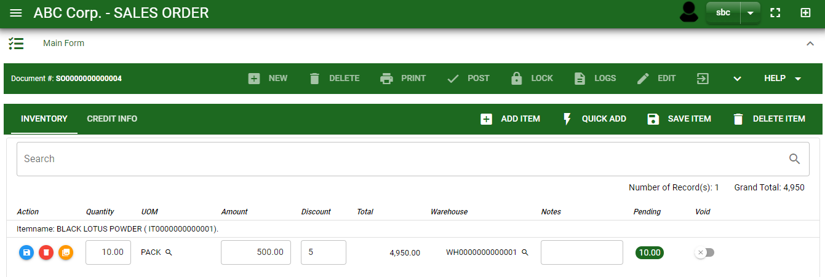
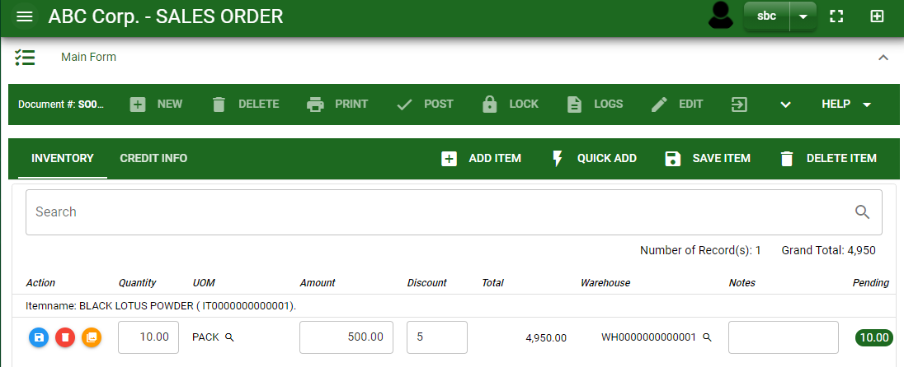
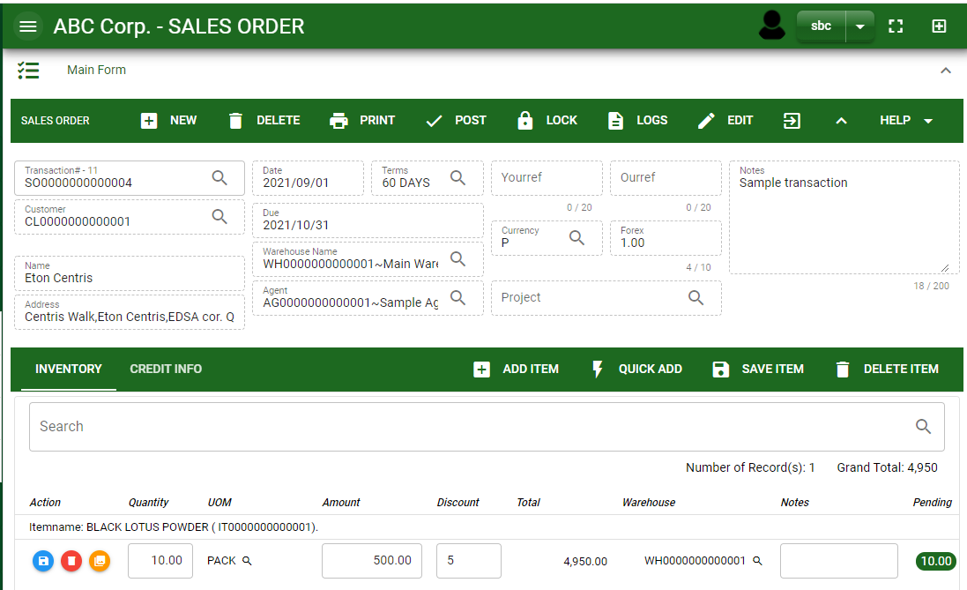
Sales/ Sales Order- Module
How To Create Sales Order Transaction?
5.10
5.8 To add more items, repeat 5.2 to 5.5 before doing 5.6.
5.9 After you click the accept button in the dialog box of selected items in 5.6., the items select will be plotted in the stock as shown below.
5.10 You may still edit the details per item in the stock. Change directly the details needed to be change.
5.11 If done, click save item button
5.12 Click the maximize arrow to enable the post button.
5.13 To finalize, the transaction, click post button located in the header
5.11
5.12

Slide 7
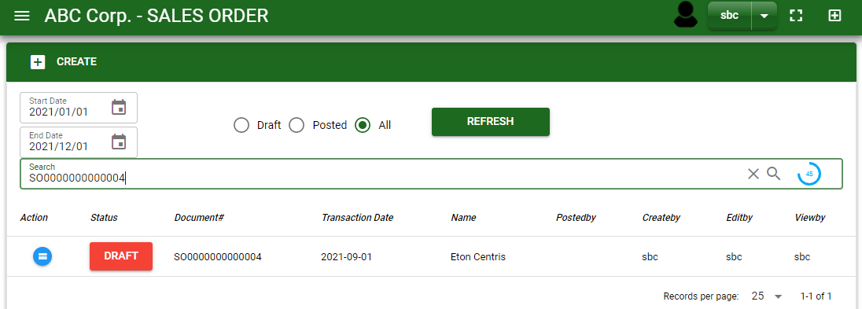
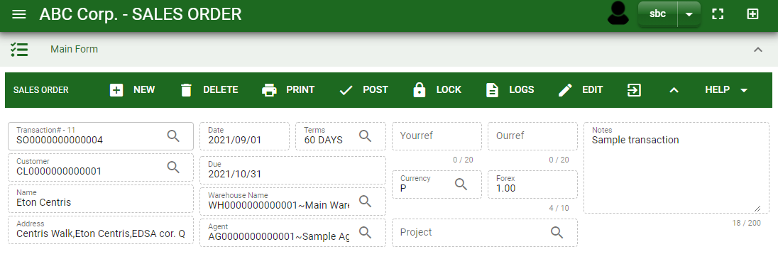
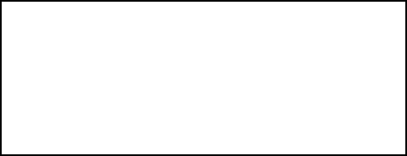
Sales/ Sales Order- Module
How To Edit Sales Order Transaction?
1.1 In the sales order – main window, search the sales order transaction you wish to edit its information in the search bar. Or,
1.2. In sales order – main form, click the lookup button and select the transaction you wish to edit its information by typing its transaction number in the search bar.
2. After you select the SO transaction, if you wish to edit the header of the transaction click edit button.
3. If you are done editing the sales order header, click save button in the upper side of the header.
1.1.
Sales Order – Main Window
HEADER
2.
1.2.
How to search SO transaction?
Type the transaction number in the search bar.
Click ‘enter’ in the keyboard to search.
Click to select the transaction you want to edit
Sales Order – Main Form

Slide 8
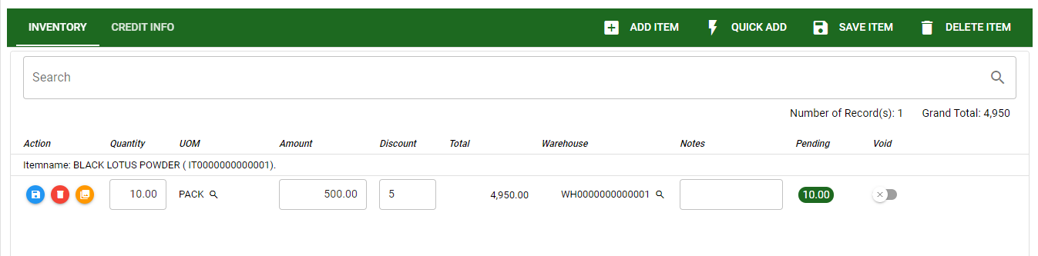
Sales/ Sales Order- Module
How To Edit Sales Order Transaction?
4. If you want to edit the items in sales order stock, edit right away the details you want to change and you will notice that after you change the details, the item you edited will be highlighted into blue.
5. If you’re done editing, click save item button to save the changes you made in the items.
6. To delete all items in the stock, click delete item button.
7. To delete a specific item on the table, click the delete icon next to the item to delete it.
STOCK
5
6
7
4

Slide 9
Sales/ Sales Order- Module
How To Delete Sales Order Transaction?
1.1. In the sales order – main window, search the transaction you want to delete.
1.2. In sales order – main form, click the lookup button and select the transaction you want to delete.
2. If done, click delete button.
1.1.
Sales Order – Main Window
HEADER
2.
1.2.
How to search SO transaction?
Type the transaction number in the search bar.
Click ‘enter’ in the keyboard to search.
Click to select the transaction you want to delete
Sales Order – Main Form

Slide 10
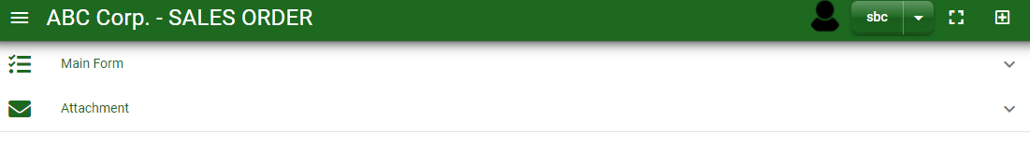
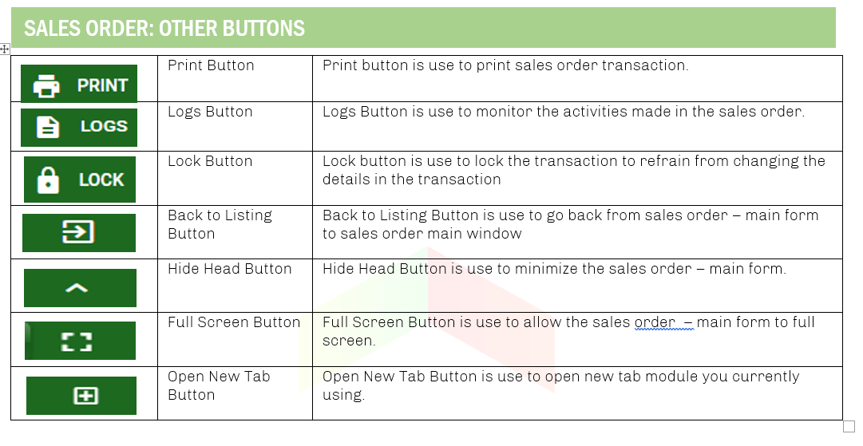
Sales/ Sales Order- Module
Other Information
When you click the arrow up icon parallel in the main form on the upper right, and the sales order – main form will be minimize and the other information will be displayed as shown in the photo below.
Click the arrow parallel to what information you want to open and provide the necessary filter to generate the data you want to display.
Other Buttons

