Slide 1
Stockcard Ledger
Is the list of all items that a company offers in the market.
The monitoring of stocks (in and out) is simplified in this module.

Slide 2
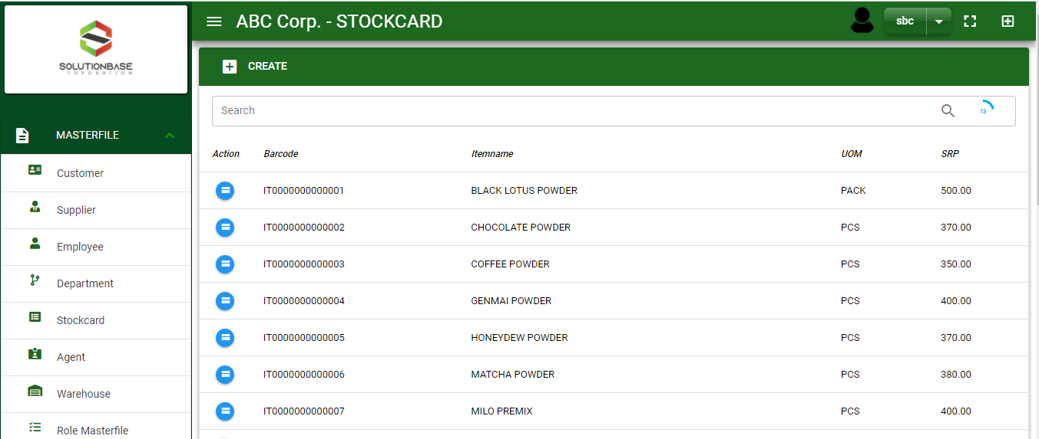

Masterfile / Stockcard Ledger - Module
Main Window
When you click the Stockcard module under Masterfile, item list will display in the stockcard ledger main window.
Stockcard Ledger – Main Window
2

Slide 3
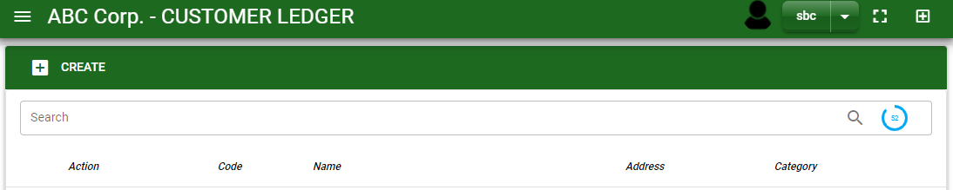

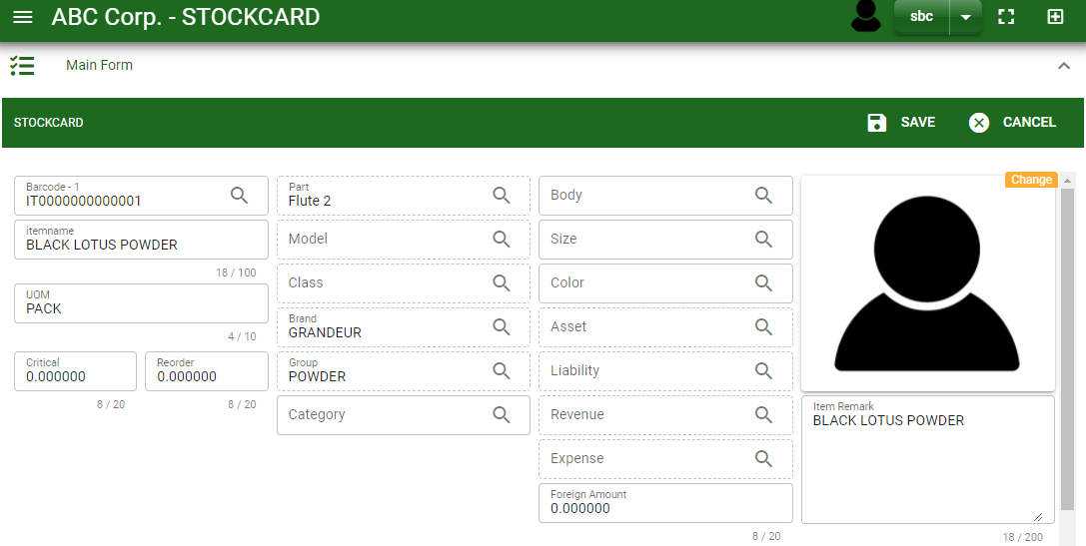
Masterfile / Stockcard Ledger - Module
1
1
How To Create New Item?
1. In Stockcard Ledger – Main Window, you will notice a create button in the upper left of the window. Click the create button and you will be redirect in stockcard ledger – main form.
2. After you click the create button in the stockcard ledger – main window, you will be redirected in stockcard ledger – main form where you will encode the item other information.
3. In the above photo, fill in all the necessary details in the provided field.
4. If done, click save button.
Stockcard Ledger – Main Window
4
3
Stockcard Ledger – Main Form
3

Slide 4
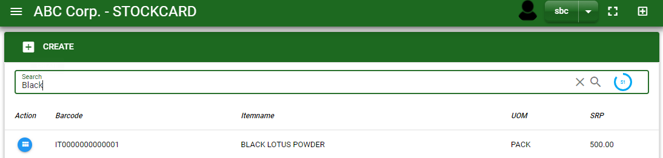
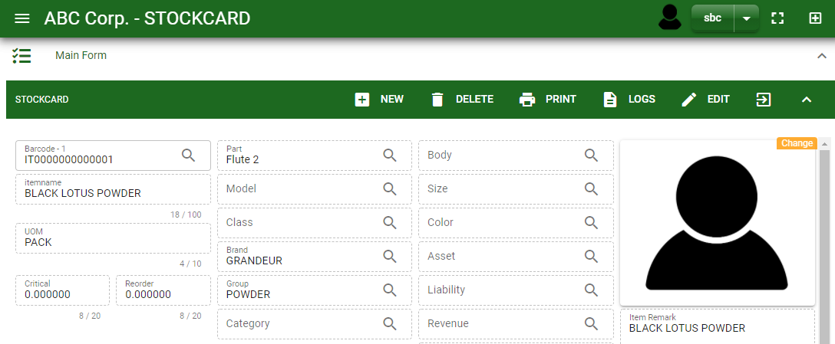
Masterfile / Stockcard Ledger - Module
How To Edit Item Details?
1.1. In the stockcard ledger – main window, search the item you wish to edit its information in the search bar. Or,
1.2. In stockcard ledger – main form, click the lookup button and select the item you wish to edit its information by typing its item name in the search bar.
1.1.
Stockcard Ledger – Main Window
2. After you select the item, click edit button in the upper right side of stockcard ledger – main form.
2.
1.2.
How to search item?
Type the item name or code in the search bar.
Click ‘enter’ in the keyboard to search.
Click the button before the item code to select the item.
Stockcard Ledger – Main Form
4

Slide 5
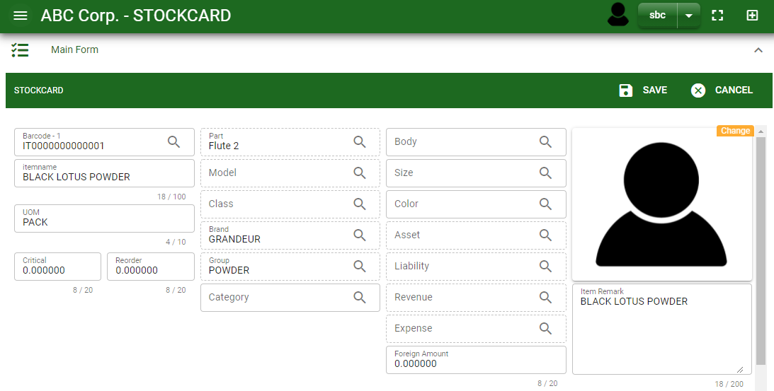
Masterfile / Stockcard Ledger - Module
How To Edit Item Details?
4
3
3. Edit the information you want to edit.
4. If done, click save button.
Stockcard Ledger – Main Form
5

Slide 6
Masterfile / Stockcard Ledger - Module
How To Delete an Item?
1.1 In the stockcard ledger – main window, search the customer you want to delete.
1.2 In stockcard ledger – main form, click the lookup button and select the customer you want to delete.
1.1.
Stockcard Ledger – Main Window
2. Click delete button.
2.
1.2.
How to search item?
Type the item name or code in the search bar.
Click ‘enter’ in the keyboard to search.
Click the button before the item code to select the item.
Stockcard Ledger – Main Form
6

Slide 7
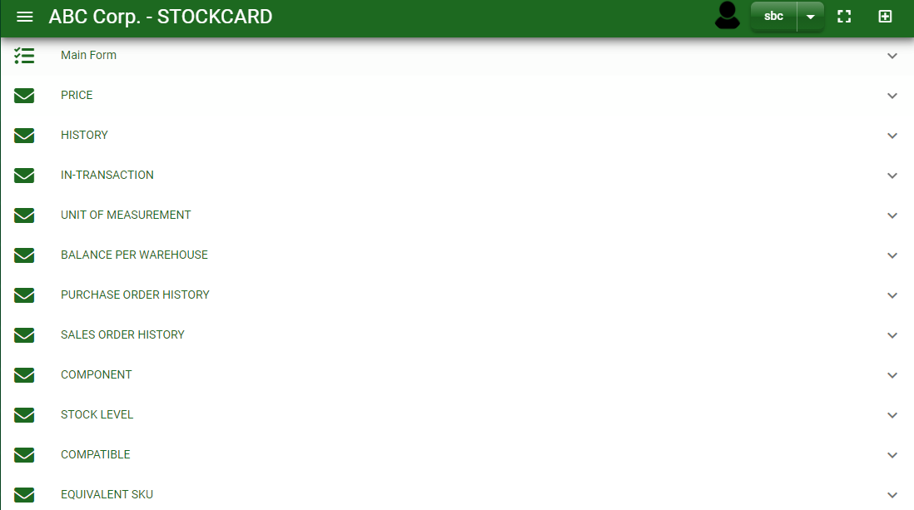
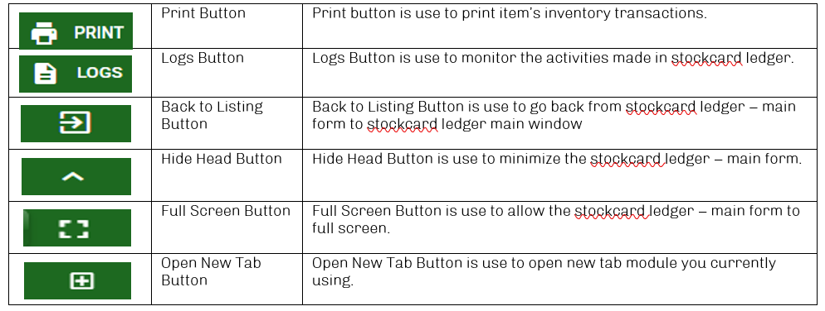
Masterfile / Stockcard Ledger - Module
Other Information
When you click the arrow parallel to the main form on the upper right, the stockcard ledger – main form will minimize and the other information will be displayed as shown in the photo below.
Click the arrow parallel to what information you want to open and provide the necessary filter to generate the data you want to display.
Supplier Ledger – Main form
Other Buttons
7

