Slide 1
Warehouse Ledger
Warehouse is a list of warehouse in a company.

Slide 2
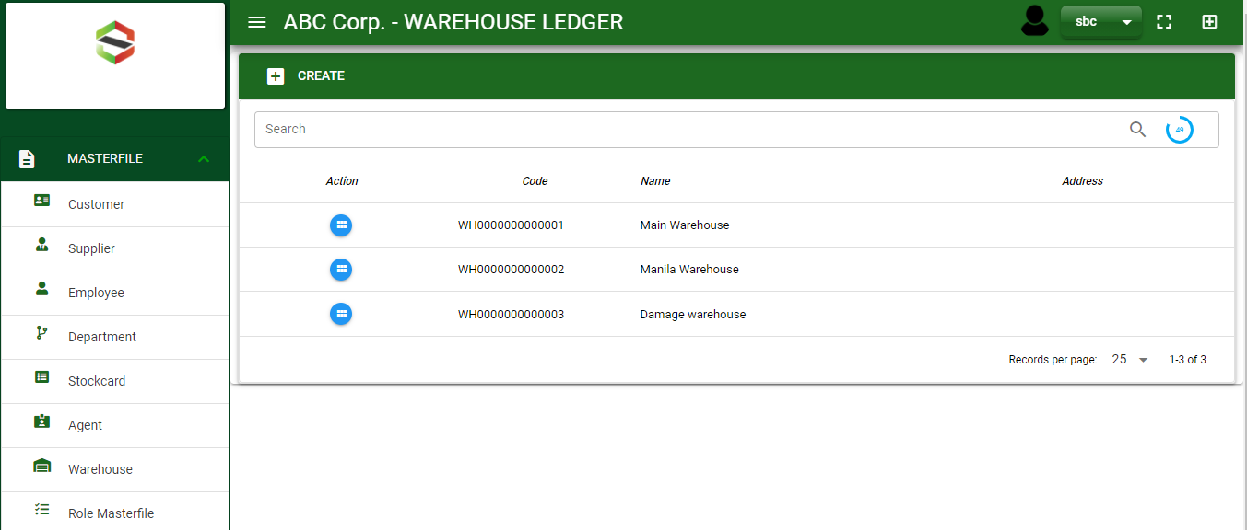

Masterfile / Warehouse Ledger - Module
Main Window
When you click the Warehouse module under Masterfile, warehouse list will display in the warehouse ledger main window.
Warehouse Ledger – Main Window
2

Slide 3
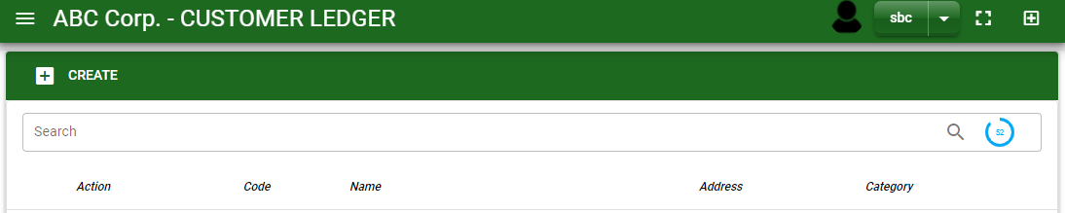
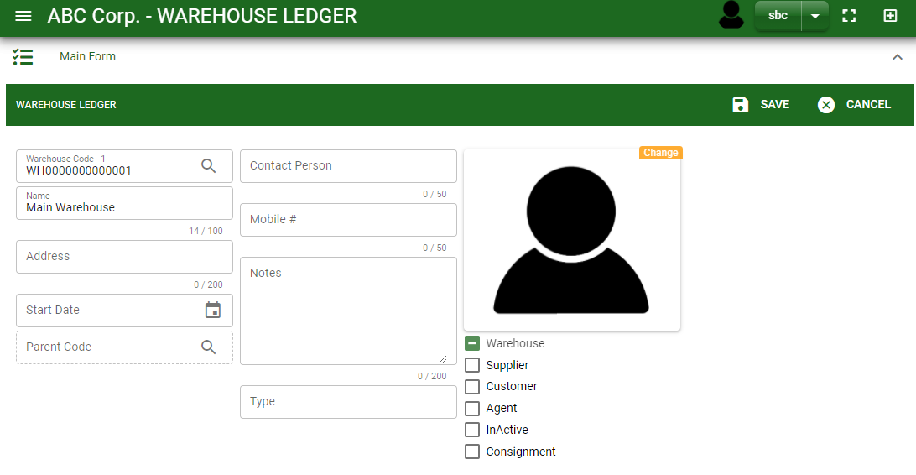
Masterfile / Warehouse Ledger - Module
1
How To Create New Warehouse?
1. In Warehouse Ledger – Main Window, you will notice a create button in the upper left of the window. Click the create button and you will be redirect in warehouse ledger – main form.
2. After you click the create button in the warehouse ledger – main window, you will be redirected in warehouse ledger – main form where you will encode the warehouse other information.
3. In the above photo, fill in all the necessary details in the provided field.
4. If done, click save button.
Warehouse Ledger – Main Window
4
3
Warehouse Ledger – Main Form
3

Slide 4
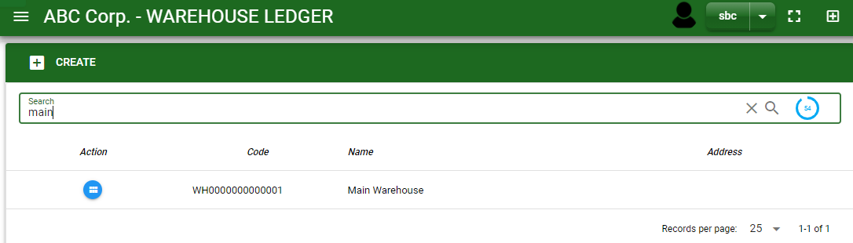
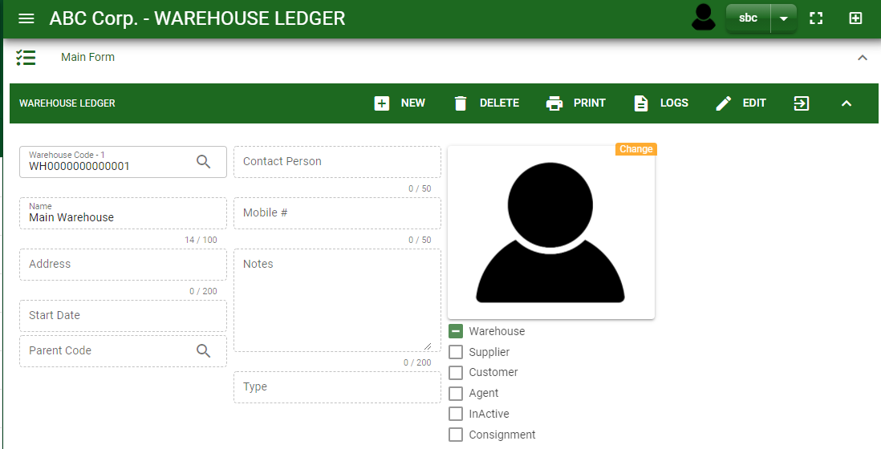

Masterfile / Warehouse Ledger - Module
How To Edit Warehouse Details?
1.1. In the warehouse ledger – main window, search the warehouse name you wish to edit its information in the search bar. Or,
1.2. In warehouse ledger – main form, click the lookup button and select the warehouse you wish to edit its information by typing its agent name in the search bar.
1.1.
Warehouse Ledger – Main Window
2.
1.2.
2. After you select the warehouse, click edit button in the upper right side of warehouse ledger – main form.
How to search warehouse?
Type the warehouse name in the search bar.
Click ‘enter’ in the keyboard to search.
Click the button before the warehouse code to select the warehouse.
Warehouse Ledger – Main Form
4

Slide 5
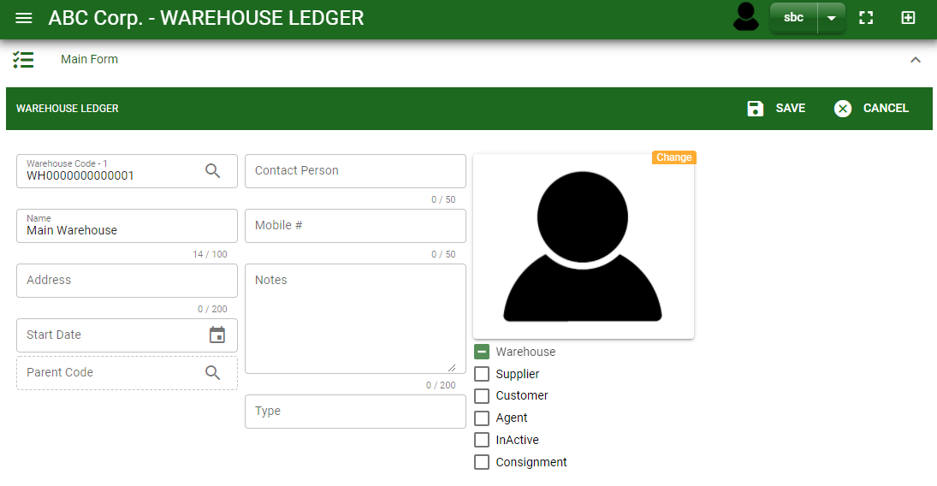
Masterfile / Warehouse Ledger - Module
How To Edit Warehouse Details?
4
3
3. Edit the information you want to edit.
4. If done, click save button.
Warehouse Ledger – Main Form
5

Slide 6
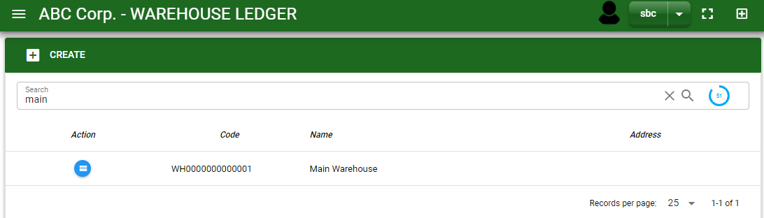
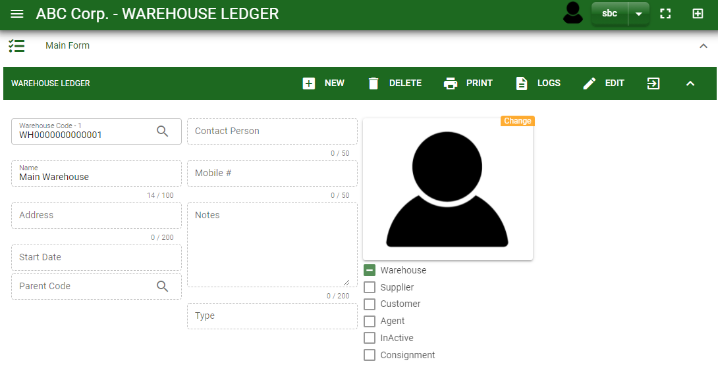
Masterfile / Warehouse Ledger - Module
How To Delete a Warehouse ledger?
1.1 In the warehouse ledger – main window, search the warehouse you want to delete.
1.2 In warehouse ledger – main form, click the lookup button and select the warehouse you want to delete.
1.1.
Warehouse Ledger – Main Window
2. Click delete button.
2.
1.2.
How to search warehouse?
Type the warehouse name in the search bar.
Click ‘enter’ in the keyboard to search.
Click the button before the warehouse code to select the warehouse.
Warehouse Ledger – Main Form
6

Slide 7
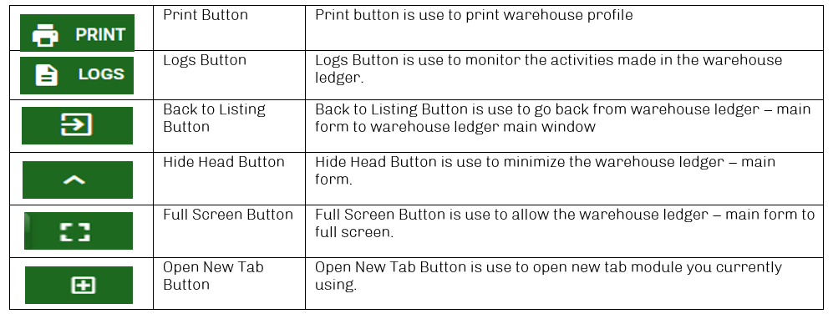
Masterfile / Warehouse Ledger - Module
Other Buttons
7

