Slide 1
Linux总线、设备、驱动模型
Barry Song <21cnbao@gmail.com>

Slide 2


麦当劳喜欢您来，喜欢您再来

Slide 3
一个想象的Ethernet控制器/一块板
#define ABC_BASE 0x100000
#define ABC_IRQ 10
int abc_send(...)
{
writel(ABC_BASE + REG_X, 1);
writel(ABC_BASE + REG_Y, 0x3);
...
}
int abc_init(...)
{
request_irq(ABC_IRQ,...);
}

Slide 4
一个想象的Ethernet控制器/N块板
可以这样写代码吗？
#ifdef BOARD_A
#define ABC_BASE 0x100000
#define ABC_IRQ 10
#elif defined(BOARD_B)
#define ABC_BASE 0x110000
#define ABC_IRQ 20
#elif defined(BOARD_C)
#define ABC_BASE 0x120000
#define ABC_IRQ 10
...
#endif

Slide 5
一个想象的Ethernet控制器/1板N卡
可以这样写代码吗？
#ifdef BOARD_A
#define ABC1_BASE 0x100000
#define ABC1_IRQ 10
#define ABC2_BASE 0x101000
#define ABC2_IRQ 11
#elif defined(BOARD_B)
#define ABC1_BASE 0x110000
#define ABC1_IRQ 20
...
#endif
int abc1_send(...)
{
writel(ABC1_BASE + REG_X, 1);
writel(ABC1_BASE + REG_Y, 0x3);
...
}
int abc1_init(...)
{
request_irq(ABC1_IRQ,...);
}
int abc2_send(...)
{
writel(ABC2_BASE + REG_X, 1);
writel(ABC2_BASE + REG_Y, 0x3);
...
}
int abc2_init(...)
{
request_irq(ABC2_IRQ,...);
}
…
还是这样？
int abc_send(int id, ...)
{
if (id == 0) {
writel(ABC1_BASE + REG_X, 1);
writel(ABC1_BASE + REG_Y, 0x3);
} else if (id == 1) {
writel(ABC2_BASE + REG_X, 1);
writel(ABC2_BASE + REG_Y, 0x3);
}
...
}

Slide 6
去耦合

Slide 7
统一纽带

Slide 8
总线、设备、驱动
实体 | 功能 | 代码
设备 | 描述基地址、中断号、时钟、DMA、复位等信息 | arch/arm arch/blackfin arch/xxx 等目录
驱动 | 完成外设的功能，如网卡收发包，声卡录放，SD卡读写… | drivers/net sound drivers/mmc 等目录
总线 | 完成设备和驱动的关联 | drivers/base/platform.c drivers/pci/pci-driver.c …

Slide 9
匹配

Slide 10

驱动、设备注册demo：globalfifo
DEMO

Slide 11
设备是设备，驱动是驱动

Slide 12
设备端代码: arch/xxx/
static struct resource dm9000_resource1[] = {
{
.start = 0x20100000,
.end = 0x20100000 + 1,
.flags = IORESOURCE_MEM
…
.start = IRQ_PF15,
.end = IRQ_PF15,
.flags = IORESOURCE_IRQ | IORESOURCE_IRQ_HIGHEDGE
}
};
static struct platform_device dm9000_device1 = {
.name = "dm9000",
.id = 0,
.num_resources = ARRAY_SIZE(dm9000_resource1),
.resource = dm9000_resource1,
};
static struct platform_device *ip0x_devices[] __initdata = {
&dm9000_device1,
&dm9000_device2,
};
static int __init ip0x_init(void)
{
platform_add_devices(ip0x_devices, ARRAY_SIZE(ip0x_devices));
}

Slide 13
驱动端代码: drivers/xxx/
static int dm9000_probe(struct platform_device *pdev)
{
…
db->addr_res = platform_get_resource(pdev, IORESOURCE_MEM, 0);
db->data_res = platform_get_resource(pdev, IORESOURCE_MEM, 1);
db->irq_res = platform_get_resource(pdev, IORESOURCE_IRQ, 0);
…
}
static struct platform_driver dm9000_driver = {
.driver = {
.name = "dm9000",
.pm = &dm9000_drv_pm_ops,
.of_match_table = of_match_ptr(dm9000_of_matches),
},
.probe = dm9000_probe,
.remove = dm9000_drv_remove,
};

Slide 14
总线match函数
static int platform_match(struct device *dev, struct device_driver *drv)
{
struct platform_device *pdev = to_platform_device(dev);
struct platform_driver *pdrv = to_platform_driver(drv);
/* When driver_override is set, only bind to the matching driver */
if (pdev->driver_override)
return !strcmp(pdev->driver_override, drv->name);
/* Attempt an OF style match first */
if (of_driver_match_device(dev, drv))
return 1;
/* Then try ACPI style match */
if (acpi_driver_match_device(dev, drv))
return 1;
/* Then try to match against the id table */
if (pdrv->id_table)
return platform_match_id(pdrv->id_table, pdev) != NULL;
/* fall-back to driver name match */
return (strcmp(pdev->name, drv->name) == 0);
}

Slide 15
1个驱动多个设备
Linux习惯使用alloc
Linux习惯使用私有数据
static int dm9000_probe(struct platform_device *pdev)
{
struct board_info *db; /* Point a board information structure */
...
ndev = alloc_etherdev(sizeof(struct board_info));
if (!ndev)
return -ENOMEM;
...
/* setup board info structure */
db = netdev_priv(ndev);
...
db->addr_res = platform_get_resource(pdev, IORESOURCE_MEM, 0);
db->data_res = platform_get_resource(pdev, IORESOURCE_MEM, 1);
db->irq_res = platform_get_resource(pdev, IORESOURCE_IRQ, 0);
...
ret = register_netdev(ndev);
...
return ret;
}
static int dm9000_start_xmit(struct sk_buff *skb, struct net_device *dev)
{
struct board_info *db = netdev_priv(dev);
...
return NETDEV_TX_OK;
}

Slide 16
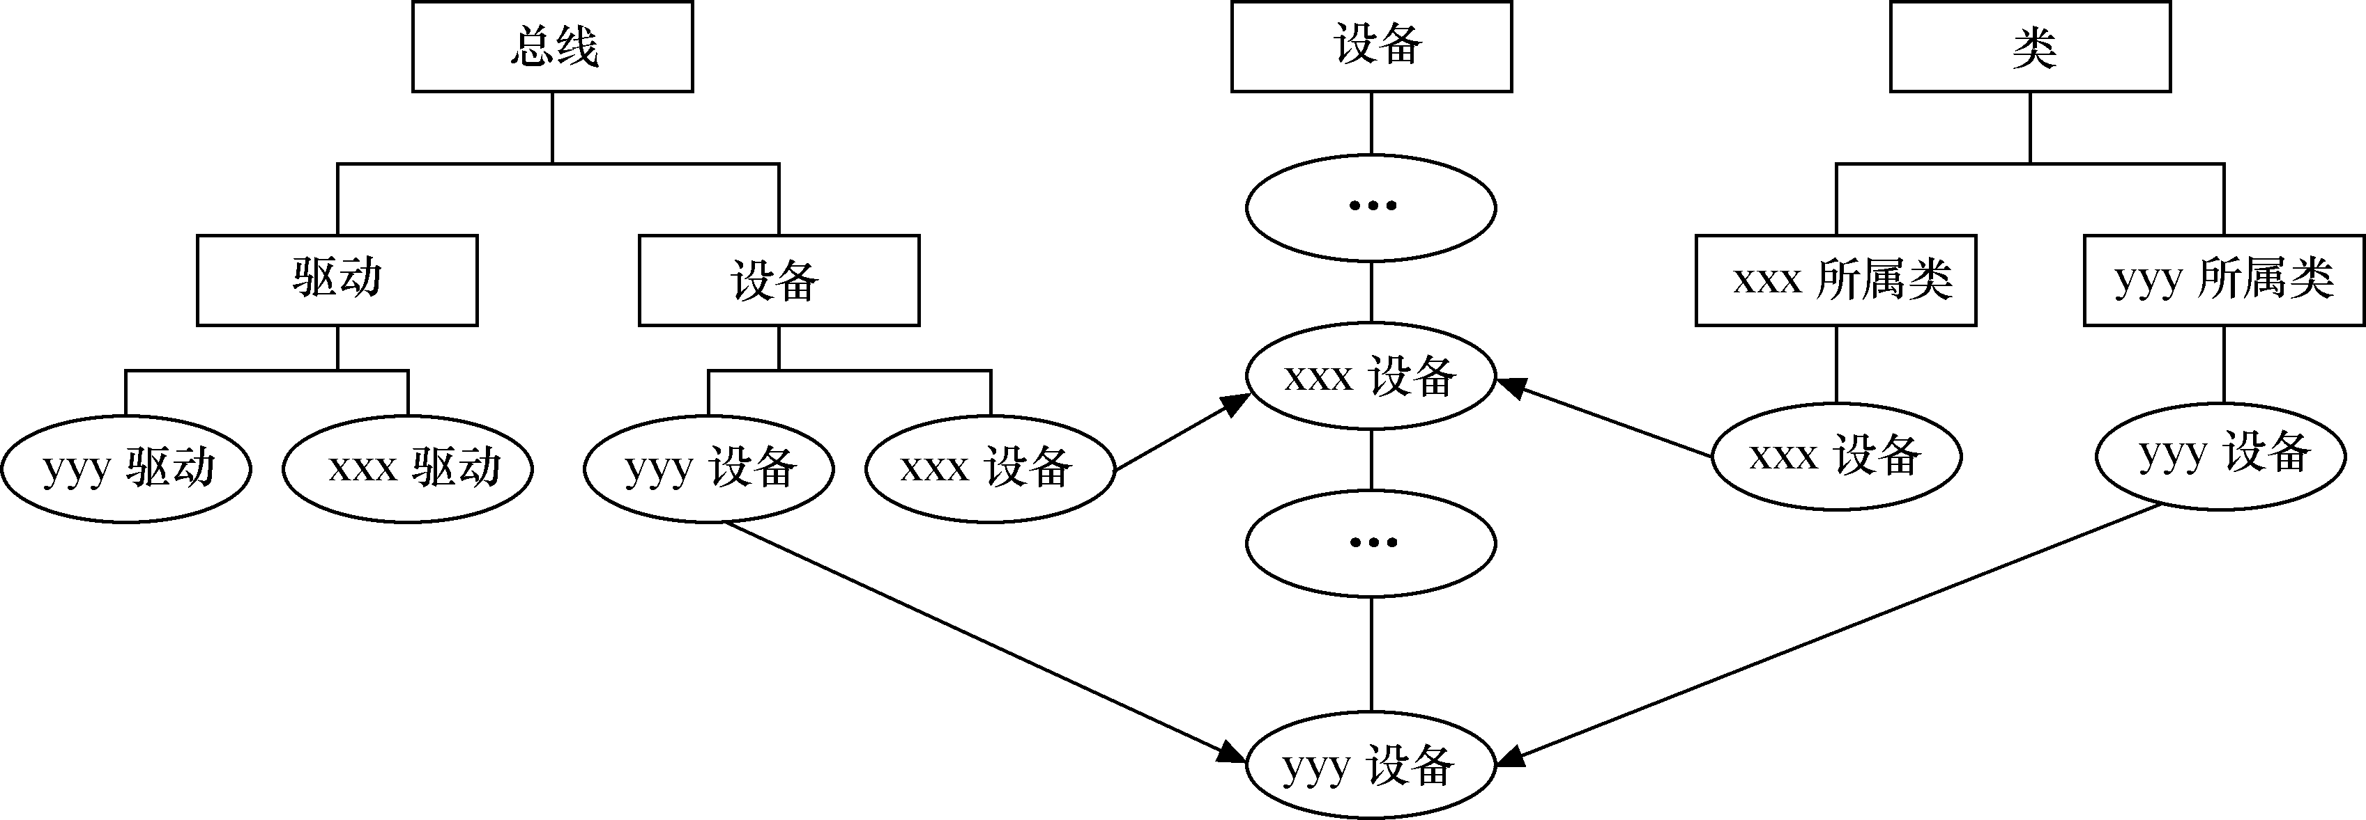
/sys
/sys/bus
/sys/devices
/sys/class

Slide 17
class的视角

Slide 18
一个LED在/sys/devices和/sys/class
/sys/class/leds/v2m:green:user1 简洁直观的路径
/sys/devices/platform/smb/smb:motherboard/smb:motherboard:leds/leds/vm:green:user1
等级化的硬件互连

Slide 19
总线级联 – 单片机编码思维
可以这样写代码吗？
cpu_x_i2c_reg...
cpu_x_i2c_reg...
tp_y_reg...
tp_y_reg...
cpu_x_i2c_reg...
cpu_x_i2c_reg...
tp_y_reg...
tp_y_reg...
这是M*N强耦合

Slide 20
总线级联 – 适配器单独驱动
每一级透过自己挂的总线枚举进来；
尽管它自己可能是总线适配器
可以这样写代码吗？
cpu_x_i2c_reg...
cpu_x_i2c_reg...
tp_y_reg...
tp_y_reg...
cpu_x_i2c_reg...
cpu_x_i2c_reg...
tp_y_reg...
tp_y_reg...

Slide 21
总线级联与电源管理

Slide 22
设备在脚本，驱动在C里

Slide 23
DTS
开机过程中执行的类似语句会帮忙从dts节点生成platform_device：
of_platform_populate(NULL, of_default_bus_match_table,
NULL, NULL);
eth: eth@4,c00000 {
compatible = "davicom,dm9000";
reg = <
4 0x00c00000 0x2
4 0x00c00002 0x2
>;
interrupt-parent = <&gpio2>;
interrupts = <14 IRQ_TYPE_LEVEL_LOW>;
…
};

Slide 24
dts和driver的匹配
eth: eth@4,c00000 {
compatible = "davicom,dm9000";
…
};
#ifdef CONFIG_OF
static const struct of_device_id dm9000_of_matches[] = {
{ .compatible = "davicom,dm9000", },
{ /* sentinel */ }
};
MODULE_DEVICE_TABLE(of, dm9000_of_matches);
#endif
static struct platform_driver dm9000_driver = {
.driver = {
.name = "dm9000",
.pm = &dm9000_drv_pm_ops,
.of_match_table = of_match_ptr(dm9000_of_matches),
},
.probe = dm9000_probe,
.remove = dm9000_drv_remove,
};

Slide 25
Of populate展开device
of_platform_populate函数会最终生成和展开platform_device
struct platform_device *of_device_alloc(struct device_node *np,
const char *bus_id,
struct device *parent)
{
struct platform_device *dev;
int rc, i, num_reg = 0, num_irq;
struct resource *res, temp_res;
dev = platform_device_alloc("", -1);
if (!dev)
return NULL;
/* count the io and irq resources */
while (of_address_to_resource(np, num_reg, &temp_res) == 0)
num_reg++;
num_irq = of_irq_count(np);
/* Populate the resource table */
if (num_irq || num_reg) {
res = kzalloc(sizeof(*res) * (num_irq + num_reg), GFP_KERNEL);
...
dev->num_resources = num_reg + num_irq;
dev->resource = res;
for (i = 0; i < num_reg; i++, res++) {
rc = of_address_to_resource(np, i, res);
WARN_ON(rc);
}
if (of_irq_to_resource_table(np, res, num_irq) != num_irq)
...
}
...
}
设备驱动模型连本质都没有变!

Slide 26
谢谢!

