Slide 1
INTRO TO PYTHON
Final project
Yicheng Jerry Si

Slide 2
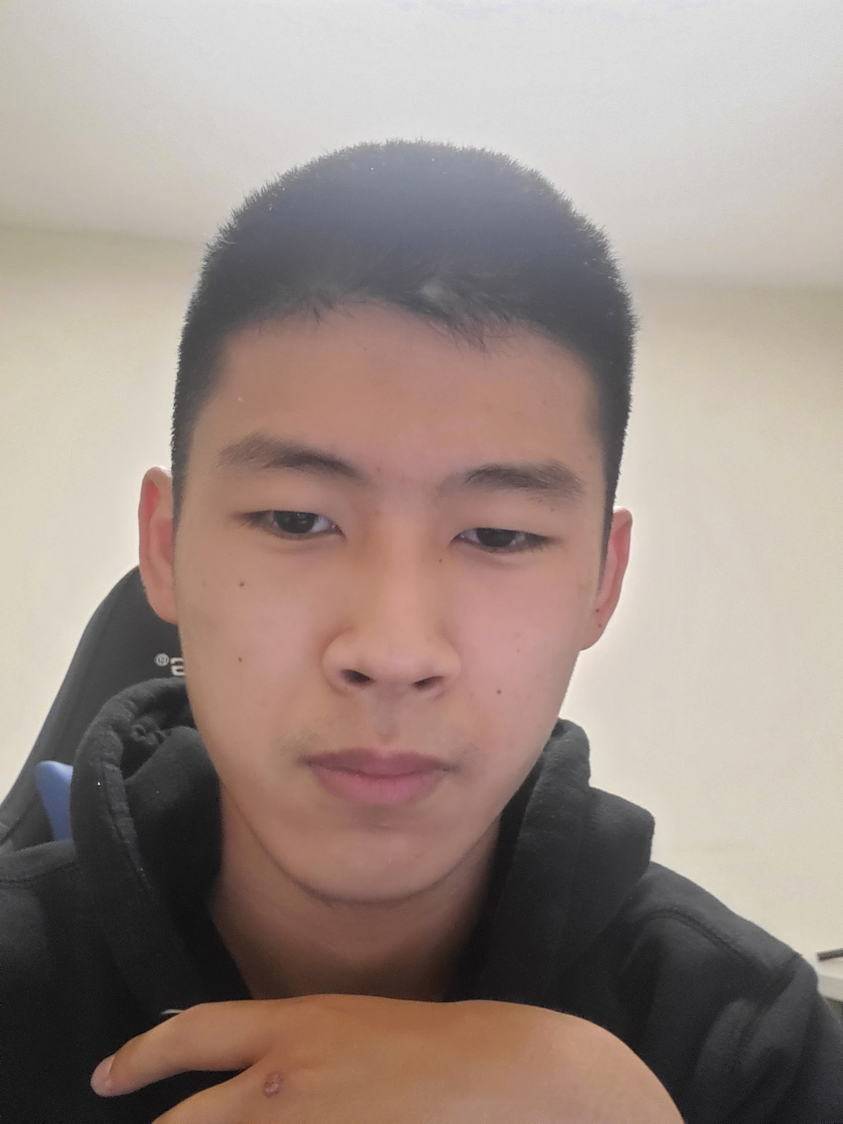
Introduce myself
My name is Yicheng （Jerry) Si, I am going to be a high school senior
I like play piano and guitar

Slide 3
# set up #
yes_no = ["yes", "no"]
directions = ["left", "right", "forward", "backward"]
Honest_choice = ["Gold hammer", "Silver hammer", "Iron hammer"]
# Introduction
name = input("What is your name, Traveller?")
print("Hello, " + name + ". Let us start our journey!")
print("You find a map, there have a lot of treasure.")
print("Now, let's start our journey?")
print("There is a bridge in front you, you drop your only tool hammer in to the river, even those that iron hammer is really hard too use, but it is very important too have a tool in journey")
print("There is a god living under the river.")
1

Slide 4
# Honest game
response = ""
while response not in Honest_choice:
response = input("Hi, young man, the hammer you drop is this Gold hammer, or this Silver hammer, or this really bad Iron hammer ?")
if response == "Gold hammer":
print("'You are a liar',because you are lying, you have been kill by the God.")
quit()
elif response == "Silver hammer":
print("Ok, you can take that Silver hammer")
elif response == "Iron hammer":
print("'Thank you for your honest', Because of your honest, God give all the hammer to you and take you to the destination of your Jorney. Game over!!!")
quit()
else:
print("I didn't understand that.")
2

Slide 5
# Start of game
response = ""
while response not in yes_no:
response = input("Would you like to step into the forest?yes/no")
if response == "yes":
print("You head into the forest. You hear crows cawwing in the distance.")
elif response == "no":
print("You are not ready for this quest. Goodbye, " + name + ".")
quit()
else:
print("I didn't understand that.")
3

Slide 6
# Next part of game
response = ""
while response not in directions:
print("To your left, you see a dragon.")
print("To your right, there is more forest.")
print("There is a rock wall directly in front of you.")
print("Behind you is the forest exit.")
response = input("What direction do you move?left/right/forward/backward")
if response == "left":
print("The dragon eats you. Farewell, " + name + ".")
quit()
elif response == "right":
print("You head deeper into the forest, and finaly, find the treasure.")
elif response == "forward":
print("You cannot scale the wall.")
response = ""
elif response == "backward":
print("You leave the forest. Goodbye, " + name + ".")
quit()
else:
print("I didn't understand that.")
4

Slide 7
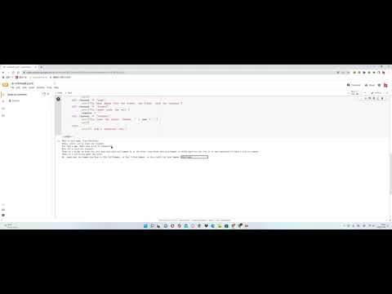
Recording of the adventure game

Slide 8
Set up I learned set up, set up is much eaiser to use in our program, because I don’t have type each words out, I just need to tyoe the tag out.
+name+ this thing can help me to remember the character name.
“While, If, elif” Those words can give the program a basic frame.
What I learned in this summer session is basic frame, because I never learned computer sci before, so the most thing I learned is the frame, like how to use def, if , elif, return print or hello format.

