Slide 1

Are these different?

Slide 2

Sampling and Reproducibility
When we collect data we are taking a snapshot of a fragment of a larger continuously existing system.
Every sample we take is going to be a little different.
Did the system change?

Slide 3
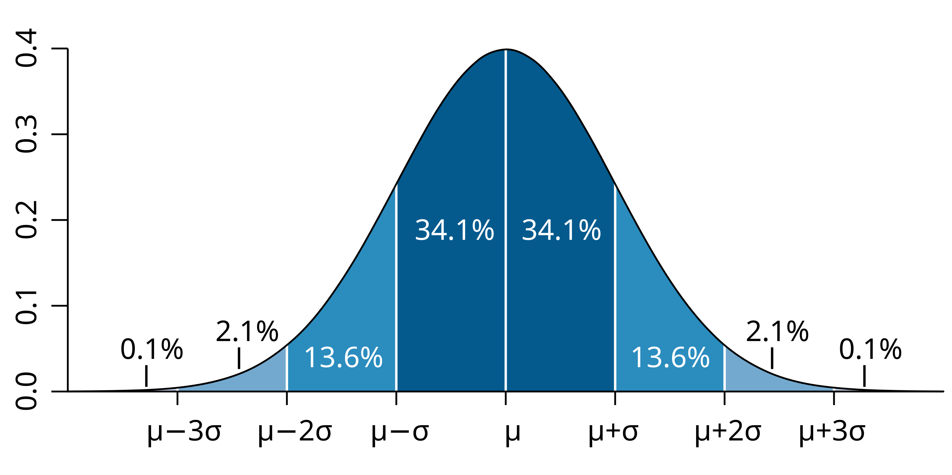
Normal (Gaussian) Distribution
When you sample from a stable system your results will generally be represented by a normal distribution.
Normal distributions are balanced around the mean (mean = median)
Standard deviation describes how much noise or churn there is between samples.

Slide 4
Sampling from a normal distribution

Slide 5

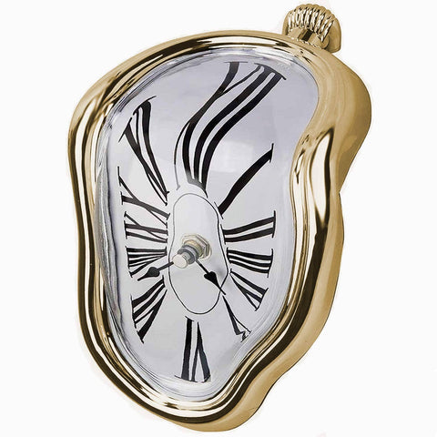
You don’t get infinite money or time

Slide 6
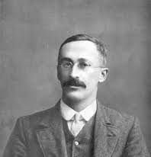
One-Sample (“Student’s”) T-test
Looks at one sample set.
Asks does the sample set have the same mean as a specific expected value.
Provides a p-value for support of the hypothesis.
THE HYPOTHESIS: The mean of the sample set is equal to the expected value.
In general we reject the hypothesis if p<0.05 although in some cases other thresholds may be used.
Notes:
William Sealey Gosset = Student

Slide 7

Why rejection test???
With a finite sample size you cannot prove that the data follows a certain distribution or has an exact mean.
The mean could be 0, or 0.001 or 0.00345 - you’d really never know.
What you can do is make a hypothesis that the data is true and ask if that hypothesis is rejected.
You can reject the improbable.

Slide 8
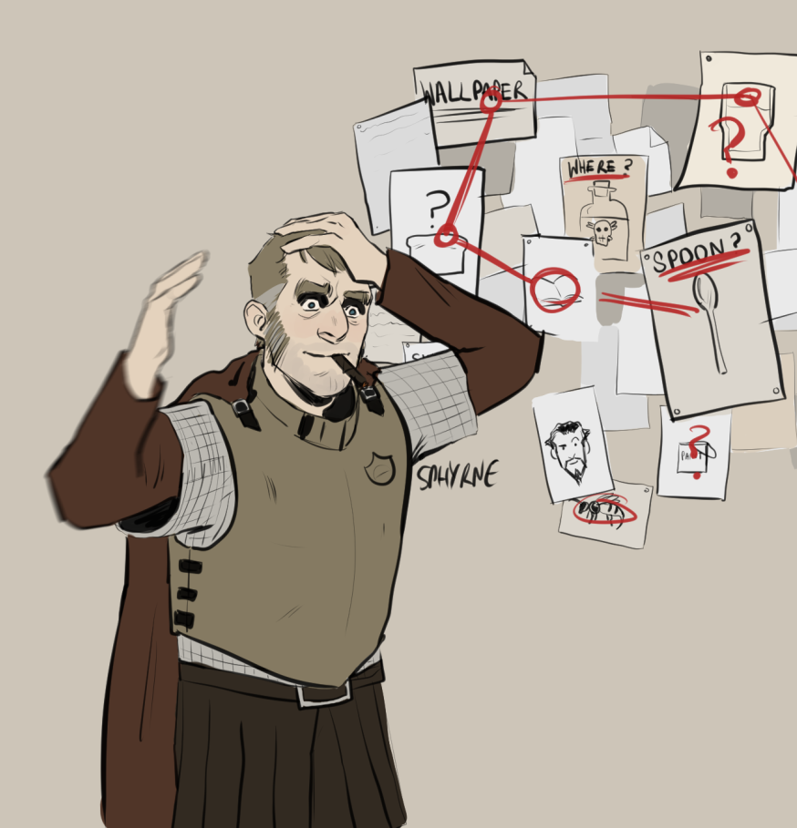
Don’t forget what you’ve actually learned
“[H]e distrusted the kind of person who’d take one look at another man and say in a lordly voice to his companion, “Ah, my dear sir, I can tell you nothing except that he is a left-handed stonemason who has spent some years in the merchant navy and has recently fallen on hard times,” and then unroll a lot of supercilious commentary about calluses and stance and the state of a man’s boots, when exactly the same comments could apply to a man who was wearing his old clothes because he’d been doing a spot of home bricklaying for a new barbecue pit, and had been tattooed once when he was drunk and seventeen and in fact got seasick on a wet pavement. What arrogance! What an insult to the rich and chaotic variety of the human experience!”
― Terry Pratchett, Feet of Clay

Slide 9
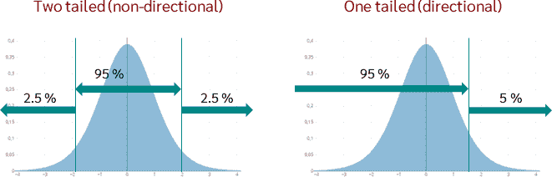
One or Two tails?

Slide 10
Recapping p-values
A p-value measures how consistent the data is with the hypothesis.
eg. Normal distribution with mean = 0
NOT probability that the hypothesis is true!!!
p=1 does NOT mean the hypothesis is true. it means that your samples could be produced under the hypothesis.
There are LOTS of other hypotheses that could potentially also do this.

Slide 11
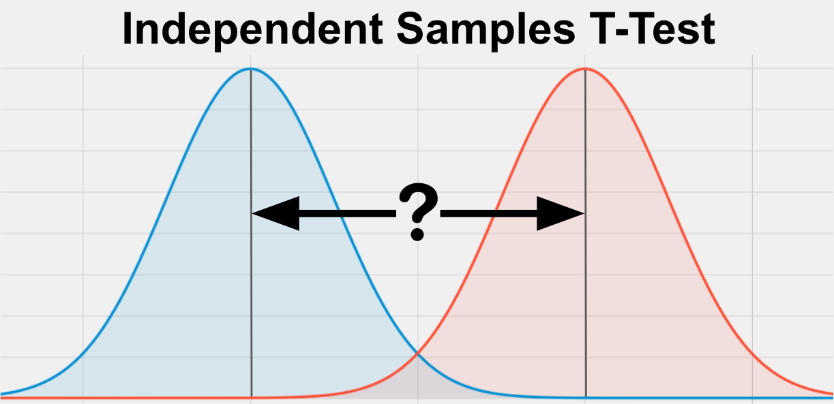
Two sample T-test
Are two sets of samples the same?
Sometimes instead of comparing to an abstract value you want to know if two sets of tests are demonstrably different.
Very common for experiments, is my test group different than my control group.

Slide 12
Assumptions of the 2 sample t-test
The two samples are independent of one another
The two populations have equal variance or spread
The two populations are normally distributed

Slide 13
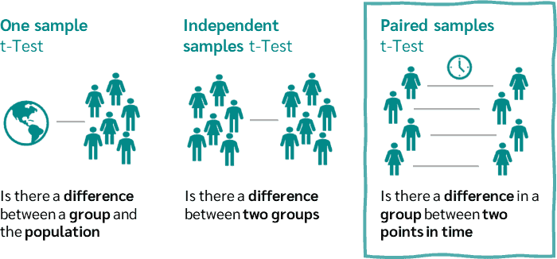
Independent vs Paired samples

Slide 14
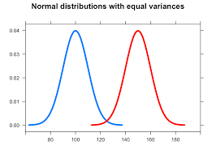
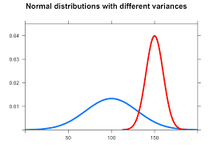
Equal vs Unequal Variance
Standard t-test
Welch’s t-test

Slide 15
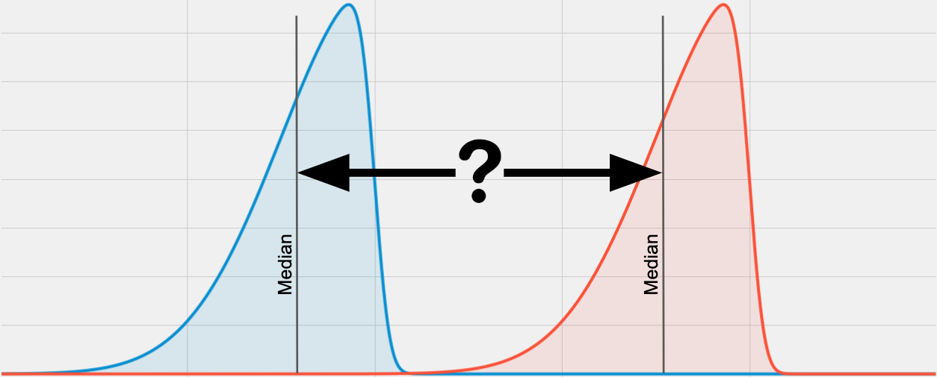
Non-normal distributions – Wilcoxan Rank sum test / Mann-Whitney U test

Slide 16
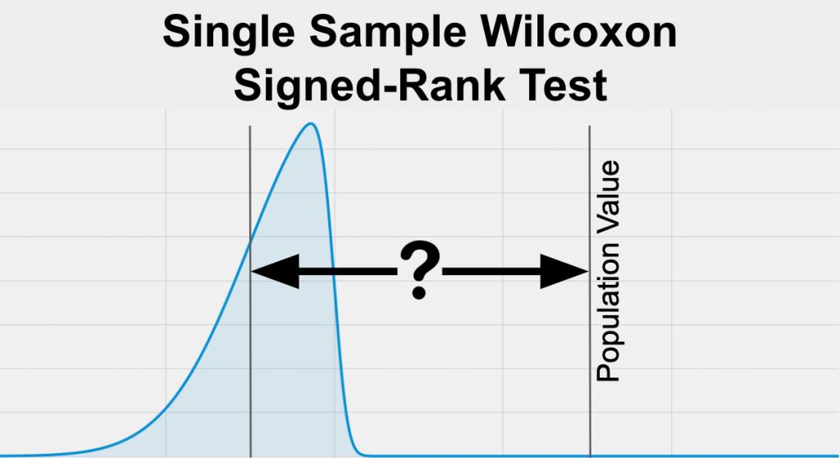
Wilcoxan Signed Rank test

Slide 17
One
Number of samples
Two
Normally distributed?
Normally distributed?
Yes
No
Yes
No
Single sample T-test
Wilcoxan Signed rank test - single
Equal Variance?
Independent or paired samples
Yes
No
Ind.
Pair
Independent or paired samples
Welch’s t-test
Mann Whitney U test
Independent
Paired
Two sample independent T-test
Two sample related T-test
Wilcoxan Signed rank test – paired

