Slide 1



Science Before Statistics
Section 1 — Introduction to Biostatistics
Jose Andres Calvache MD MSc PhD

Slide 2
Science Before Statistics
Research questions
Brief overview of study designs

Slide 3
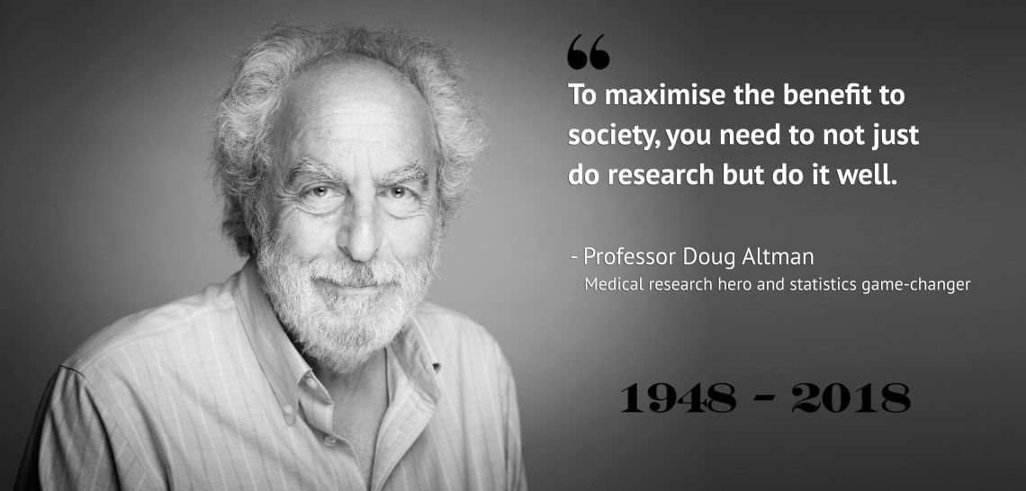
On research quality

Slide 4
Why methodology matters
Training in statistics and methodology should discuss how studies are designed and how research questions are translated into study procedures, data collection processes, and analysis tools.

Slide 5
Research incentives — the problem
Research incentives focus on quantity, rather than methodological quality
Funders and journals prioritize novelty over incremental and replication research
Researchers’ agendas are dictated by short-term deadlines
Peer review remains unacknowledged
Methodological illiteracy is still accepted
Transparent and complete reporting remains rare

Slide 6
Practices resulting from prioritizing publication appearance over quality (1/2)
Poor study preparation and design
Data or analysis tweaking (e.g. p-hacking)
Incomplete reporting
Selective reporting

Slide 7
Practices resulting from prioritizing publication appearance over quality (2/2)
To use exaggerated claims when disseminating research results (over or wrong interpretation)
Publication bias
HARKing (hypothesizing after the results are known)
Reluctance to take corrective action post hoc

Slide 8
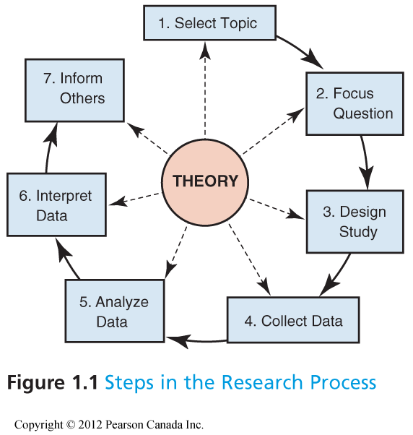
The research process

Slide 9
What is Science?
Oxford Dictionary definition: A branch of knowledge conducted on objective principles involving the systematized observation of and experiments with phenomena, especially concerned with the material and functions of the physical universe.
More simply: Science is the acquisition of reliable but not infallible knowledge of the real world, including explanations of phenomena.

Slide 10
What Science is not! (popular myths)
The practice of Science leads to the truth
Science can prove things
Science can only be done whenever experimental manipulation can be carried out
The essence of science is the testability of hypotheses and the reproducibility of findings

Slide 11
Knowledge comes in many forms
Science is one approach to gaining knowledge through research
Science includes anything observable in the universe
  Must be measurable
  Empirical — relies on observation and experience

Slide 12
Areas of Science
Physical Sciences
  Chemistry
  Physics
Biological Sciences
  Ecology
  Evolution
  Molecular Biology
Behavioural Sciences
  Animal behaviour
  Human behaviour
Earth Sciences
Can rely heavily on observation outside the laboratory

Slide 13
Why understand science?
To be informed
To make decisions
Pseudoscience
  Silly to dangerous
  Need to separate sense from nonsense

Slide 14
Why we need to understand
Link between MMR vaccine & Autism, 1998 — study in The Lancet
Sample size of 12 children
Parents of 8 noted symptoms of Autism after vaccination
Study recommended further investigation to examine possible link

Slide 15
Why we need to understand — the aftermath
Press conference with lead author who suggested a link
Major health scare
Children getting MMR vaccine dropped considerably

Slide 16
Major flaws with this study
Small sample size
Patients were not chosen randomly
No control group to compare
Most importantly, despite these flaws the study did not observe a link. Importance of communication of findings.

Slide 17
Major flaws with this study — what happened next
Lead author received large amounts of money from lawyers
Applied for patent for a vaccine to rival MMR
As a result, 10 of the 12 authors published a retraction
Since then… all following studies have been definitive on the conclusion that there is no link between MMR vaccine and autism.

Slide 18
Philosophy of Science
Philosophy: How we understand the world
Science: A method for understanding
  Developing a theory
  Formulation of hypotheses
  Explanations and predictions
  Design and analyses

Slide 19
Four terms: four meanings
Fact
Law
Hypothesis
Theory

Slide 20
A fact
(National Academy of Sciences)
In science, an observation that has been repeatedly confirmed and for all practical purposes is accepted as “true”.
Truth in science, however, is never final, and what is accepted as a fact today may be modified or even discarded tomorrow.

Slide 21
A law
(National Academy of Sciences)
In science, a descriptive generalization about how some aspect of the natural world behaves under specified circumstances.
e.g. the second law of thermodynamics

Slide 22
A scientific hypothesis
(National Academy of Sciences)
A tentative statement about the natural world leading to deductions or predictions that can be tested. If the deductions are verified, it becomes more probable that the hypothesis is correct.
If the deductions are incorrect, the original hypothesis is abandoned or modified.

Slide 23
A scientific hypothesis — testability
Research hypotheses must refer to concepts that can be studied scientifically (can be observed). “Living organisms are purposely designed by a maker”: no way to test for this hypothesis.

Slide 24
A theory
(National Academy of Sciences)
The goal of science.
In science, a well substantiated explanation of some aspect of the natural world that incorporates facts, laws, and tested hypotheses.
A key element of scientific theories is that they must be FALSIFIABLE (refutability).
Notes:
If you examine 1 million swans and observe them all to be white, this does not prove the hypothesis that all swans are white — if you see one black swan, the hypothesis is falsified (falsification).

Slide 25
Evidence
Hypotheses are usually tested through experimentation
Two types of evidence accepted by scientists
  Confirmation of hypotheses by data strengthens their validity
  Repeated inconsistency of data with a hypothesis leads to rejection

Slide 26
Evidence — when a hypothesis is not verified
When a hypothesis is not verified, ask: is it because the hypothesis is incorrect, or because of problems in the statement of the hypothesis, or problems in the experiment? Repeat testing in many different ways.

Slide 27
Hypothetico-deductive reasoning
Karl Popper (1902–1994) proposed a reasoning cycle:
Conception — a Problem, an Idea, a Previous observation, or an Existing theory leads to an Insight, which generates a General Hypothesis and then a Specific Hypothesis
Assessment — the Specific Hypothesis is compared with new observations or experimental results
The comparison leads to either Confirmation or Falsification of the hypothesis, which feeds back into the cycle

Slide 28

Example: Echinacea and the common cold
1. Observation
Individuals taking Echinacea say that it reduces the intensity and duration of a cold.
2. Hypothesis
Echinacea reduces the severity and duration of a cold (how is it defined).
Null: Echinacea has no effect on the duration or severity of the common cold.

Slide 29
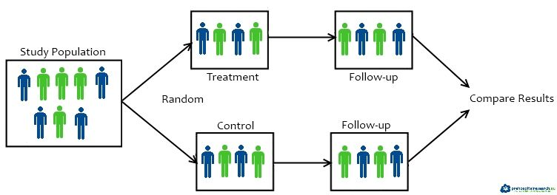
Example: testable predictions
3. Testable predictions, clear outcomes
If Echinacea reduces the duration & severity, then individuals taking Echinacea should get sick less frequently and should recover more quickly.
4. Conduct an experiment

Slide 30
Example: conclusions
5. Draw conclusions
Cold symptoms lasted for the same amount of time in experimental and placebo groups
Echinacea had no effect on the duration or severity of the cold
Causally related
What next? Repeat the experiment using different variant cold viruses, use larger dose, other populations.

Slide 31
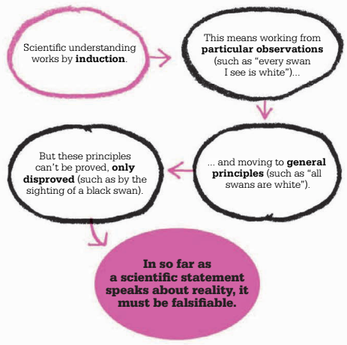
Popper on induction

Slide 32
Failure of falsification
Null models not unique
Science versus no science based on falsification — it is a criteria of demarcation, not about the method
Should falsify the explanatory model, not the null
To build some amount of theory at some point, no statistical procedure is sufficient
It is called “confirmation” — models should be consistent with observed data

Slide 33
Against selection-of-test thinking
Test and (selection of test) are specialized procedures
Most developed in early 20th century — fragile, initial, and eclipsed by more recent tools
Users are using models (usually linear models)
Falsifying null model not sufficient
Against dichotomization of choices
P-values: wrong interpretations
Inference is not decision

Slide 34
Against selection-of-test thinking — credits
Credits: Statistical Rethinking — Richard McElreath @rlmcelreath

Slide 35
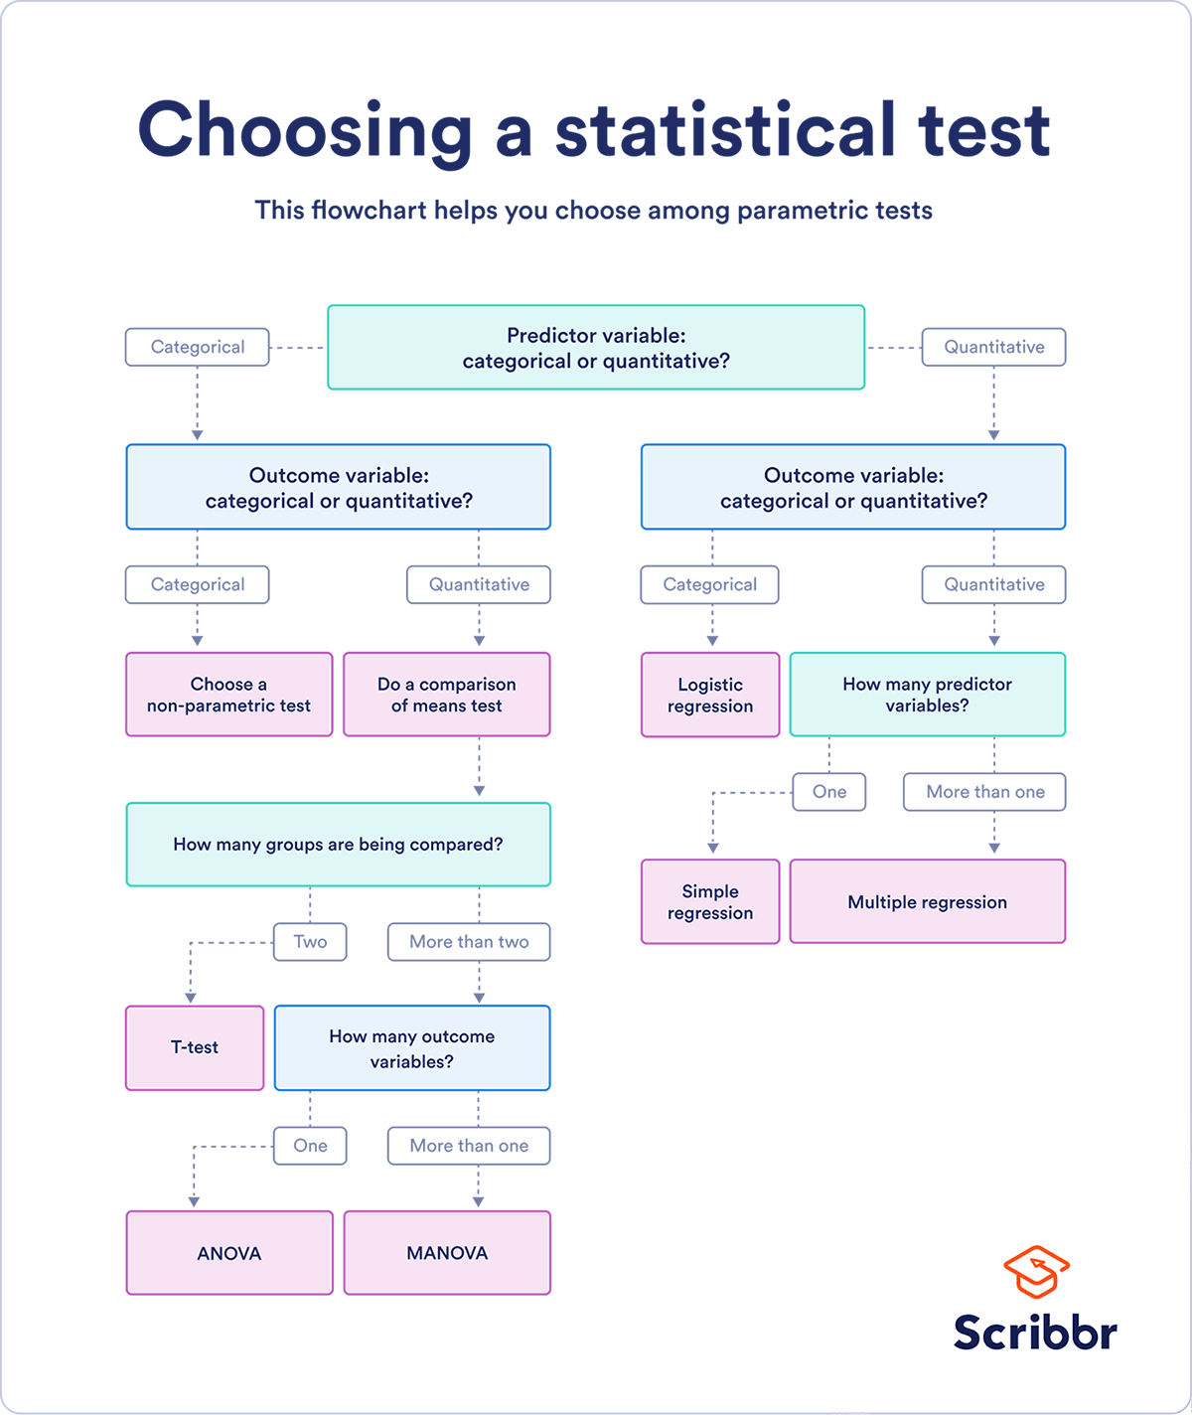
Choosing a statistical test

Slide 36
Philosophy of Science — Inductivism
Inductivism: Empirism, concept developed by Hume (1777)
Causes of events can be determined by observation
Generalization from observations
Unlike deduction, the conclusions of inductive reasoning are probable given the evidence, in contrast to being certain

Slide 37
Philosophy of Science — Inductivism (cont.)
When events not following the rule occur, the theory becomes a probability rather than a certainty — this is where Bayesian statistics can play a huge role
Principle of the Uniformity of Nature: “The future will resemble the past”
Extend the ordinary logic (true/false) to continuous plausibility

Slide 38
Some forms of inductivism
Positivism (19th Century)
Science can rise above superstition by specializing in the description and analysis of observable phenomena, leading to discovery of natural laws.
Logical positivism
Science progresses toward truth by observation, formulation of hypotheses, empirical verification, leading to additional hypotheses. Scientific questions are referred to as “positive” while unscientific ones are “normative”.

Slide 39
Problems with inductivism
The theory chosen is not necessarily the right one
The observed data can be biased (quite common) — measurement error
Difficult to come up with an experiment without an underlying theory
In other words, we are born Bayesian…

Slide 40
Hypothetico-deductive and falsification
Background
Fisher with p-values (nil-null hypothesis testing)
Pearson with hypothesis testing (alternative hypothesis)
Neyman with 95% CI

Slide 41
Hypothetico-deductive and falsification — Fisher’s framing
Applies Popper’s theory to statistics:
“The null hypothesis is never proved or established, but is possibly disproved, in the course of experimentation. Every experiment may be said to exist only in order to give the facts a chance of disproving the null hypothesis.” (Fisher, 1947)

Slide 42
Issues with this theory
The hypothesis is true or false, there is no probability…
“Scientific hypotheses can be rejected (i.e. falsified), but never established or accepted the same way.”

Slide 43
The Bayesian approach
Refutation and hypothetico-deductive approaches were developed to avoid the concept that theories in sciences can be appraised in terms of their “probabilities”.
Theories usually lie between being certainly right or certainly wrong, we cannot tell…

Slide 44
The Bayesian approach — Poincaré
“It is often stated that one should experiment without preconceived ideas. This is simply impossible; not only would it make every experiment sterile, but even if we were ready to do so, we could not implement this principle. Everyone stands by his own conception of the world, which he cannot get rid of so easily.” (Poincaré, 1905)

Slide 45
The Bayesian approach — reasoning
Bayesian statistics have an inductive approach:
Start with a prior distribution (prior knowledge, multitude of observations)
Get data (observe under different conditions)
Obtain a posterior distribution (update prior knowledge)

Slide 46
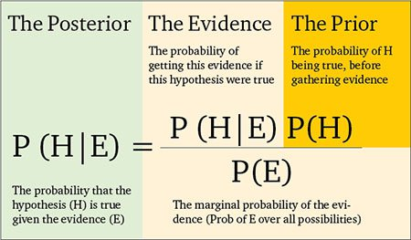
The Bayesian approach — Bayes’ theorem

Slide 47
Frequentist vs Bayesian (1/3)
 | Frequentist | Bayesian
Data | A repeatable random sample — there is a frequency | Fixed, probably a few samples
Belief | No expression of belief (formally not present) → objective view on probability | Approach deals with belief (formally present) → subjective view on probability; updates beliefs in the evidence of new data (posterior distribution)

Slide 48
Frequentist vs Bayesian (2/3)
 | Frequentist | Bayesian
Estimate | Point estimate using MLE and Least Squares Estimate | Posterior distribution with high density interval (mean, mode, median)
Parameters | Fixed and unknown | Unknown, random, described probabilistically

Slide 49
Frequentist vs Bayesian (3/3)
 | Frequentist | Bayesian
Interval | Confidence interval: over an infinite sample size taken from population, 95% of these contain the true population value | Credible interval: a 95% probability that the population value is within the limits of the interval
Hypothesis testing | Statistical hypothesis testing with p-value and significance level | Bayes factor — direct test of null and alternate hypothesis, measure of strength of evidence
Computation | Less computationally intensive | Computationally intensive

Slide 50
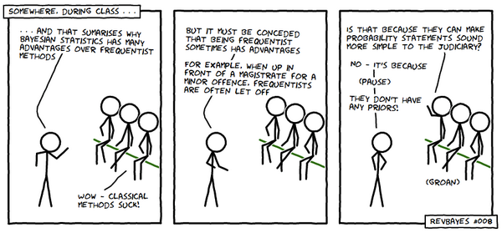
A lighter look at Bayesian vs frequentist

Slide 51
A few words on: Pseudoscience
Ideas often put forward as scientific when they are not.
Examples
Astrology
Creation Science / Intelligent Design Theory
Paranormal phenomena

Slide 52
A few words on: Pseudoscience (cont.)
Examples (cont.)
UFOs
Cryptozoology: e.g. Bigfoot, the Ogopogo and Loch Ness Monster
And many, many more — some in health care!
Can be dangerous.

Slide 53
How to recognize Pseudoscience
Driven by cultural, ideological or commercial goals
Changed very little since first established
Challenge to dogma is considered heresy
Observations not consistent with beliefs are ignored
Vague and ambiguous

Slide 54
The Research Question and Study Designs

Slide 55
Right problem and right question
“An approximate answer to the right problem is worth a good deal more than an exact answer to an approximate problem.” ~ John Tukey

Slide 56
Research question
A good research question should be:
Feasible
Interesting
Novel
Ethical
Relevant

Slide 57
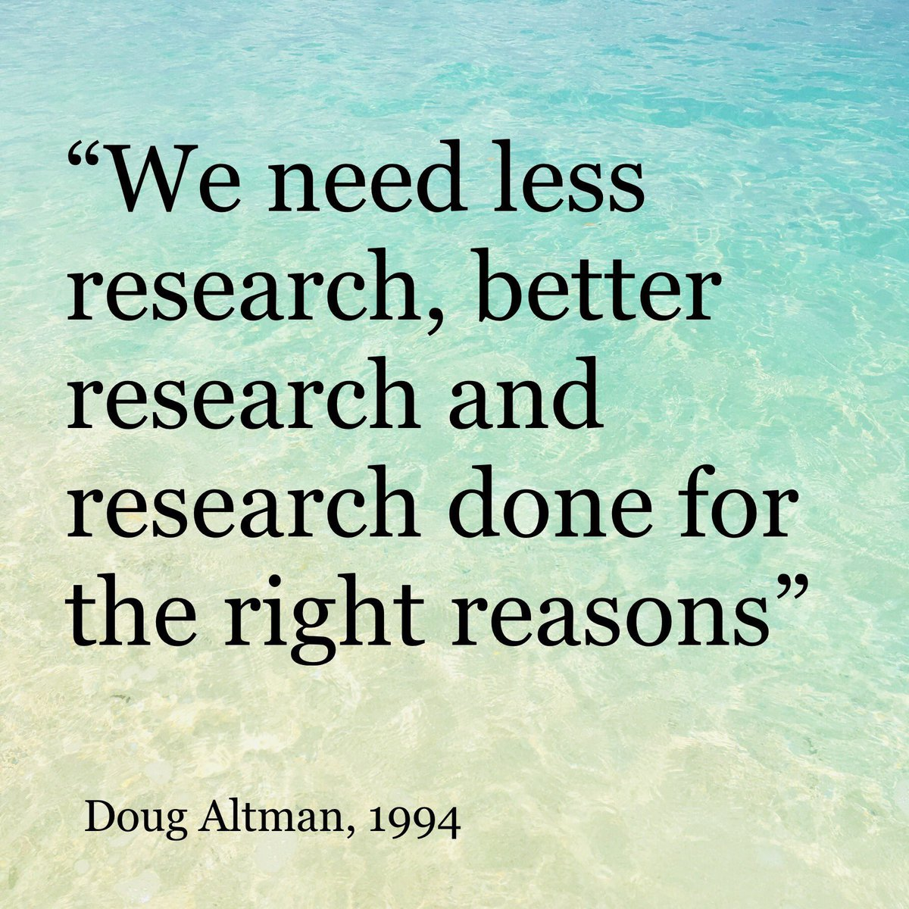
On the right reasons to do research

Slide 58
What is the research question?
Step 1. Determine the components of the research question and the type of question under study
PO: Population and Outcomes
PICOt
Step 2. Classify the type of research question

Slide 59
Question types
Prevention
Screening
Diagnosis
Prognosis
Incidence
Prevalence
Etiology / Treatment
Harm

Slide 60
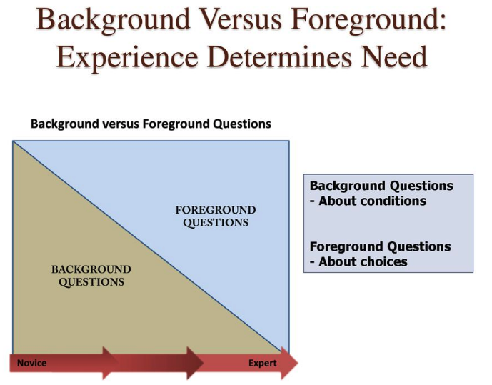
Background vs Foreground questions

Slide 61
Background vs Foreground — components
Background — general knowledge
General questions like who, what, when, where…
Range reduction
PO components
Foreground — more specific, PICO(t)
Structured to facilitate its use and/or search
P - Population / Problem, I - Intervention / Exposure, C - Comparison / Control, O - Outcome, (t) - timeframe

Slide 62
Background vs Foreground — examples
What is the incidence of postoperative nausea and vomiting after abdominal surgery? (Background)
Who has the most postoperative pain experience after surgery? (Background)
What is the incidence of early postoperative cognitive decline in patients older than 60 years under general anesthesia compared to regional anesthesia? (Foreground / PICOt)

Slide 63
Question and study design
Research question → Study design
The research question determines the appropriate study design — not the other way around.

Slide 64
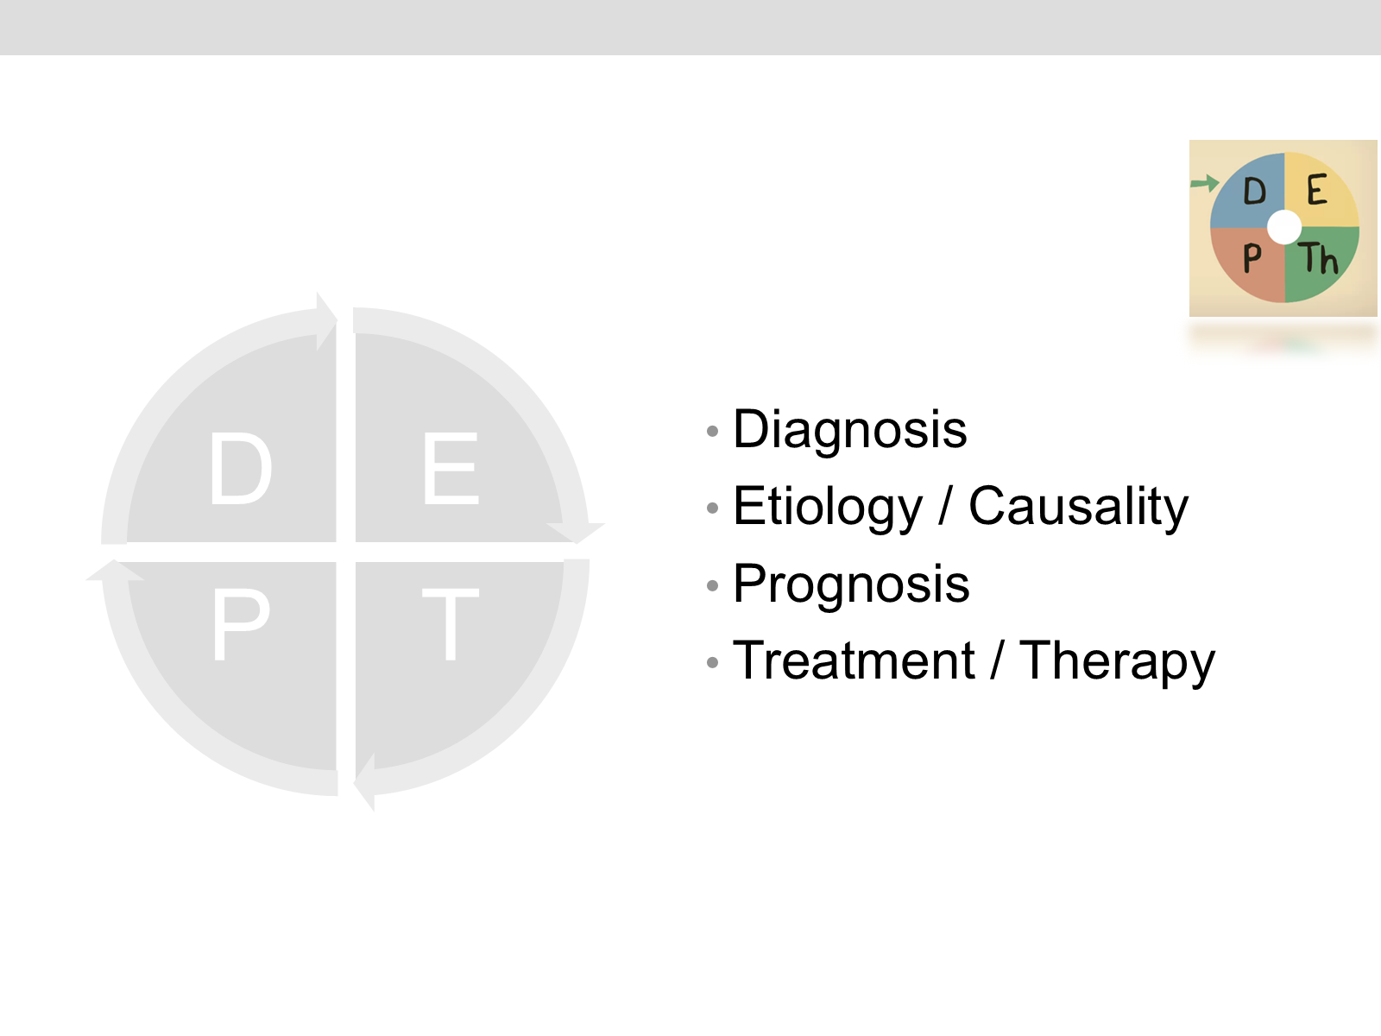
Types of clinical questions

Slide 65
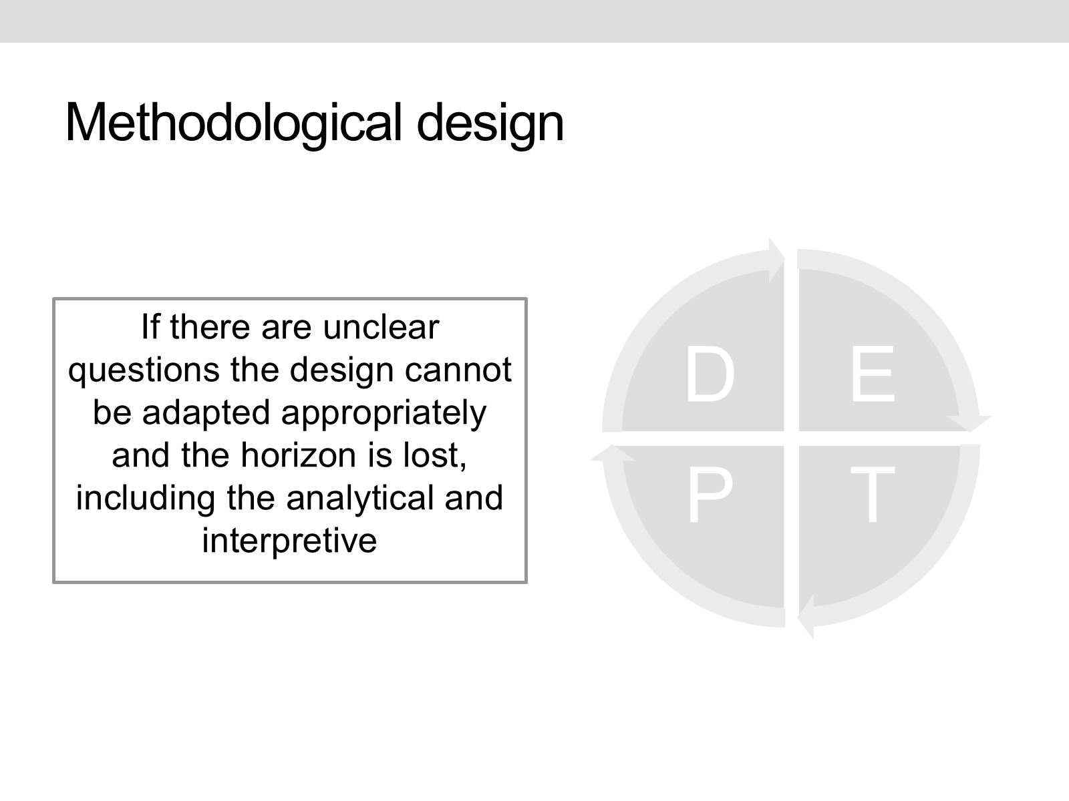
Methodological design
If there are unclear questions the design cannot be adapted appropriately and the horizon is lost, including the analytical and interpretive.

Slide 66
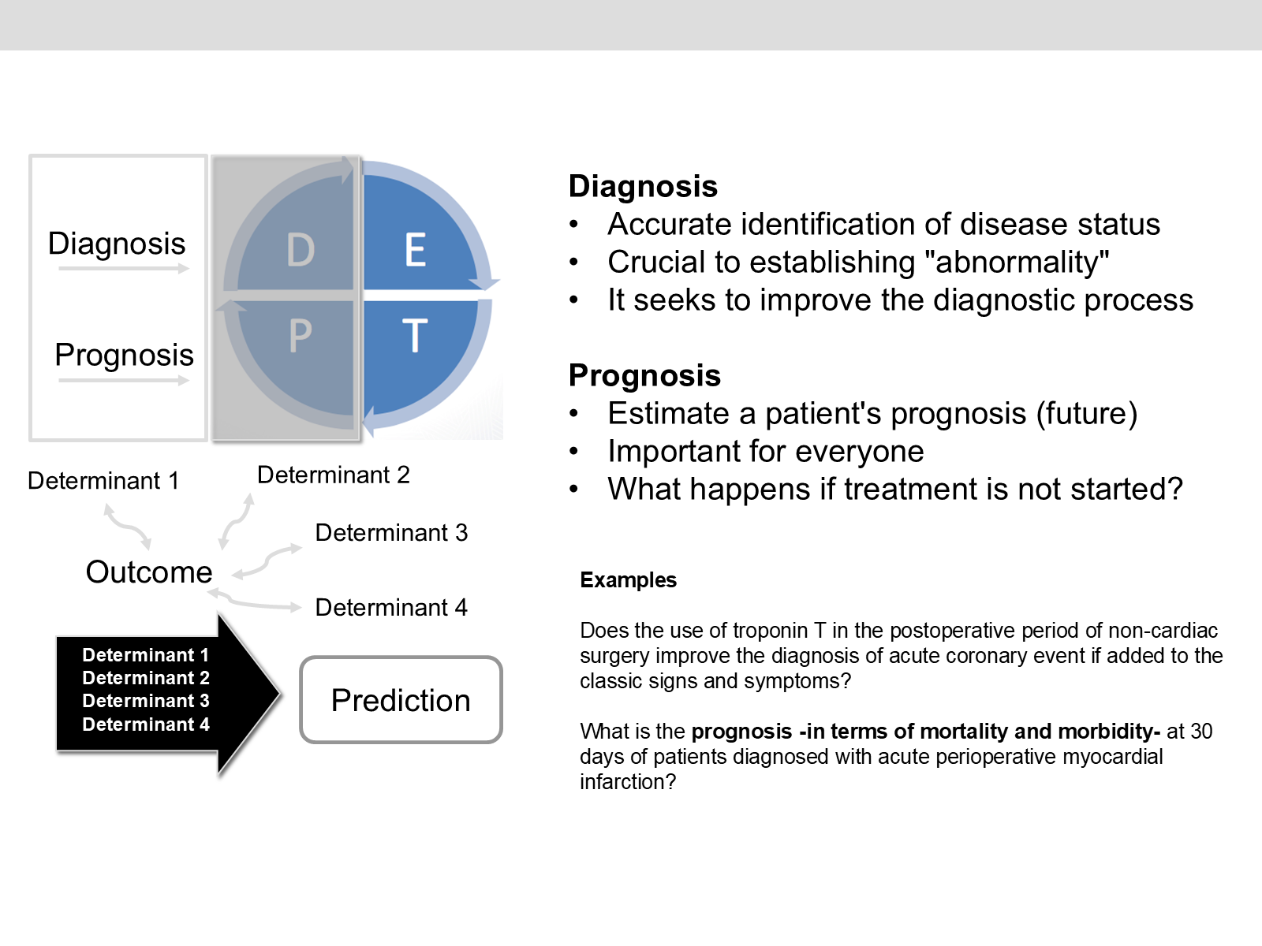
Diagnosis and Prognosis

Slide 67
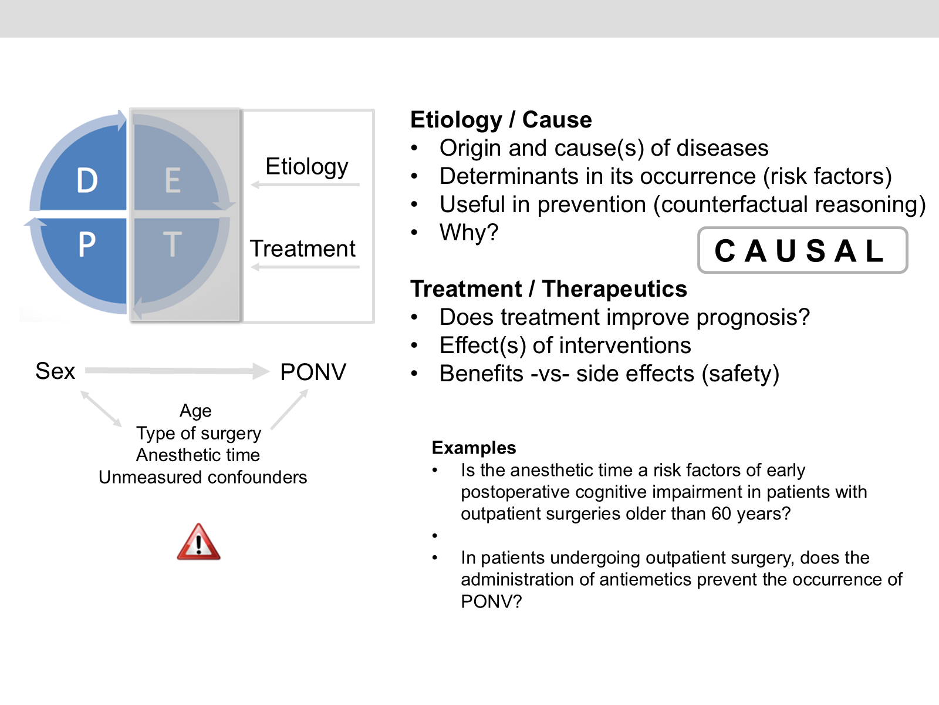
Etiology and Treatment

Slide 68
Matching the question type to study designs
Question type | Research designs
Effectiveness of an intervention | RCT > Experimental > RDD > CE
Diagnosis | Diagnostic test (Cross sectional*) > Cohort > RCT
Etiology / Cause | Cohort > Case-control > Cross sectional
Prognosis | Cohort > RCT
Safety / Harm | RCT > Case-control > Cohort > Case Series > Case Report
Values and preferences | Qualitative research > Surveys (Cross sectional*)
Prevalence | Cross sectional > Cohort
Incidence | Cohort > RCT

Slide 69
The research process — elements
Element | Purpose
Research question(s) | Direct research — the main objective of the process; PICOt structured or unstructured
Background | Importance of the topic under study; existing knowledge and justification
Design | Strategy to find the answer; epidemiological methodology
Subjects under study | Selection of study participants — who they are and how they will be selected
Variables | What information will be collected — predictors, confounders, outcome(s)

Slide 70
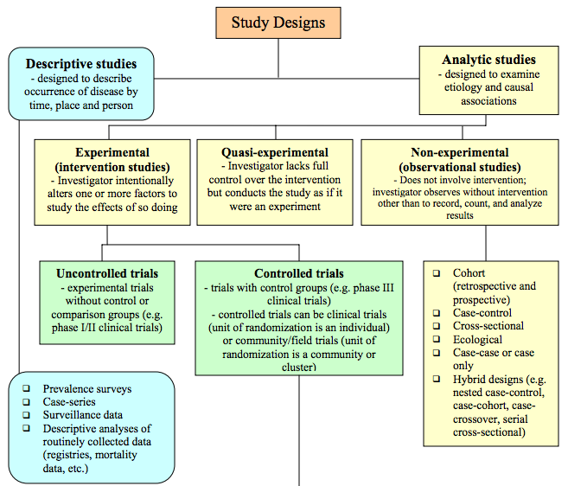
Study designs
Koepsell & Weiss. Epidemiologic Methods. Oxford University Press, 2003

Slide 71
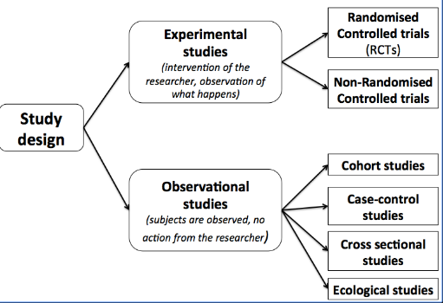
Study designs — overview
Grimes et al. Lancet 2002;359:57-61

Slide 72
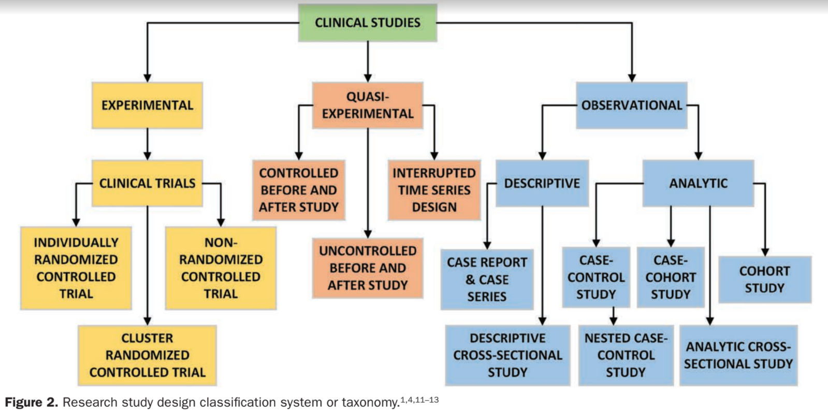
Study designs — illustrated

Slide 73
Prospective vs retrospective studies
It is not a good classification — we must separate the direction of exposure/outcome versus how the subjects were recruited
Longitudinal or follow-up
It’s also not very informative
RCTs and Cohort studies are longitudinal
Two designs without follow-up: CS, DTA

Slide 74
Key questions for choosing a design
Is there follow-up of participants from exposure(s) to outcome(s)?
Was there follow-up (in the past)?
Is there an active intervention of the researcher, or does it only observe what is happening?
Notes:
Slide 20 original note: key questions to classify a study design.

Slide 75
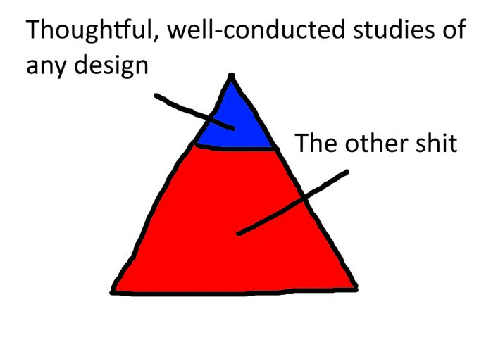
Pyramids? Not very accurate!

Slide 76
Pyramids — the takeaway
Traditional “evidence pyramids” oversimplify how study designs relate to each other and to evidence quality.

Slide 77
Cohort studies
Population is an aggregate of subjects (share a condition).
Closed cohorts
Group of subjects that are followed from a defined starting point to the occurrence of an outcome of interest
Cohort members do not change over time (except for mortality or loss of follow-up)
Individuals do not switch between exposure categories
Useful for short-term studies with high frequency of outcome
Open cohorts or Dynamic Population Study (DPS)
Simulate real populations
Participants can enter or leave the study without compromising study integrity
Subjects under study contribute with person-time of exposure

Slide 78
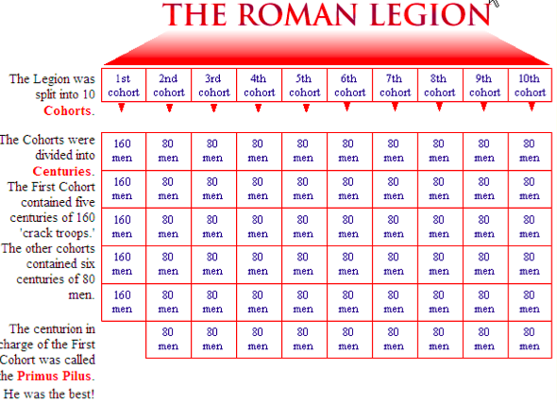
“Cohort” — the word’s origin

Slide 79
“Cohort” — what it means today
A Roman “cohort” (cohors) was one of ten divisions of a legion — the origin of the epidemiological term for a defined group followed over time.

Slide 80
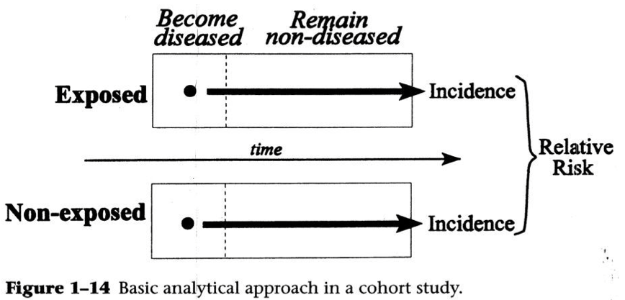
Cohort studies — basic analytical approach

Slide 81
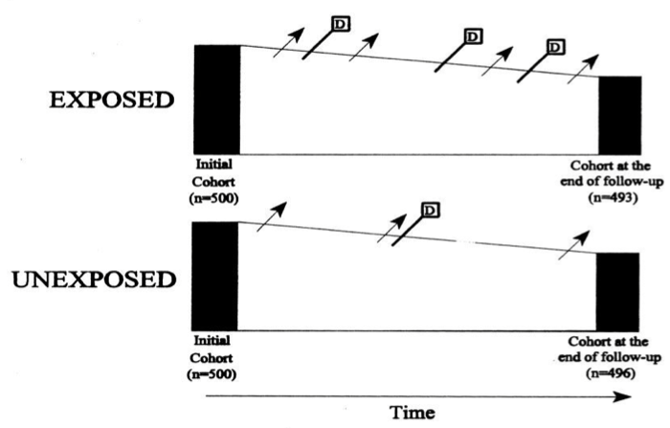
Cohort studies — closed cohort example

Slide 82
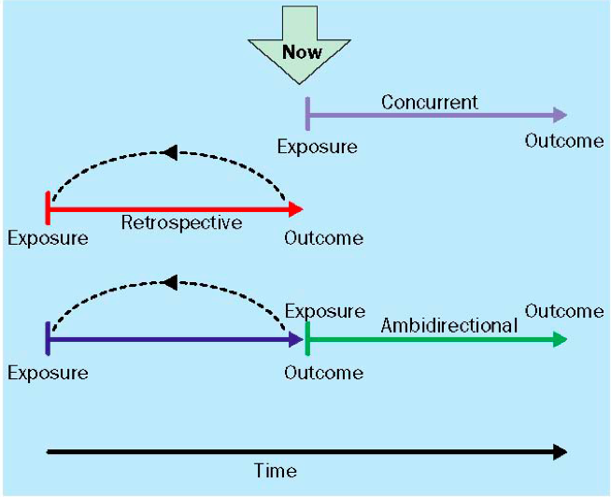
Variations of cohort studies
Concurrent, retrospective, and ambidirectional cohorts differ in when exposure and outcome are measured relative to “now”.

Slide 83
Cohort studies — characteristics
Advantages
Allow to quantify absolute risk and RR
They follow the logic of the clinical question
Assess exposure effects on several outcomes
Useful in frequent outcomes
Disadvantages
Economic costs
Logistics costs
Extended time
May require large numbers of patients
Losses during follow-up

Slide 84
Example. Rotterdam Study
The Rotterdam Study is a prospective, population-based cohort study. The aim of the Rotterdam Study is to investigate factors that determine the occurrence of cardiovascular, neurological, ophthalmological, endocrinological, and psychiatric diseases in elderly people.
The study was established in 1990 by Prof. Albert Hofman of the department of Epidemiology & Biostatistics at the Erasmus Medical Center in Rotterdam, the Netherlands
Inhabitants of Ommoord, a suburb of Rotterdam, were invited to participate on a regular basis
The findings of the Rotterdam Study have been presented in close to 1,000 research articles and reports

Slide 85
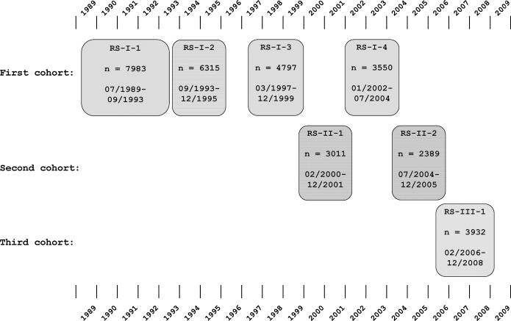
Rotterdam Study — examination cycles
Diagram of examination cycles of the Rotterdam Study

Slide 86
Rotterdam Study — research questions
The initial cohort (RS-I) started out in 1990 with 7,983 men and women aged 55 years and over. Follow-up visits were held in 1994-1995, 1997-1999, 2002-2004, and 2009-2011.
Cardiovascular diseases: What are the determinants of presence and progression of atherosclerotic vessel wall abnormalities and of occurrence of cardiovascular disease, and what is the role of disturbances in hemostatic function?
Neurologic diseases: What is the prevalence and incidence of various types of dementia and of Parkinson’s disease, and which are the determinants?

Slide 87
Rotterdam Study — research questions (cont.)
Locomotor diseases: What is the prevalence and incidence of vertebral and hip fractures and its determinants? What are the determinants of bone mineral density?
Ophthalmic diseases: What is the prevalence and incidence of age-related macular degeneration and of glaucoma, and which are the determinants?
http://www.erasmus-epidemiology.nl/research/ergo.htm

Slide 88
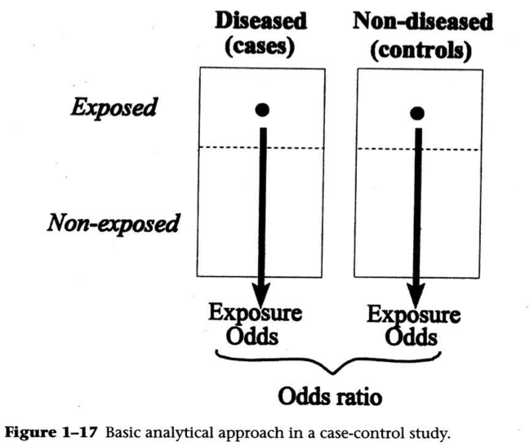
Case-control study

Slide 89
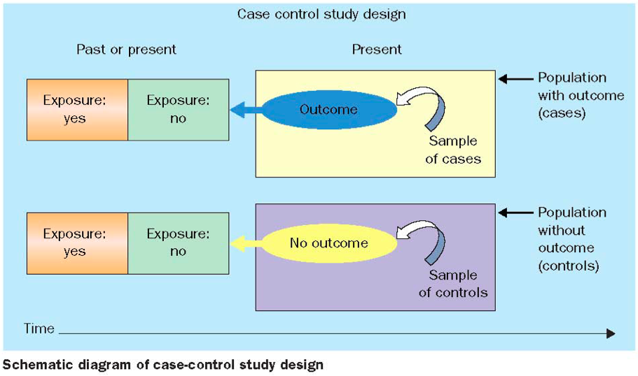
Case-control study — schematic design

Slide 90
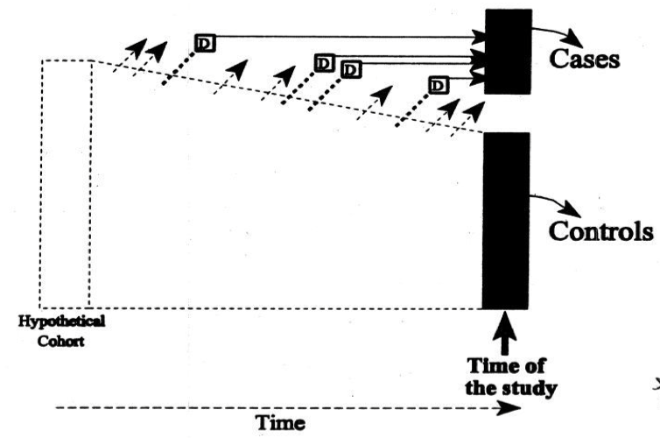
Case-control study — hypothetical cohort view

Slide 91
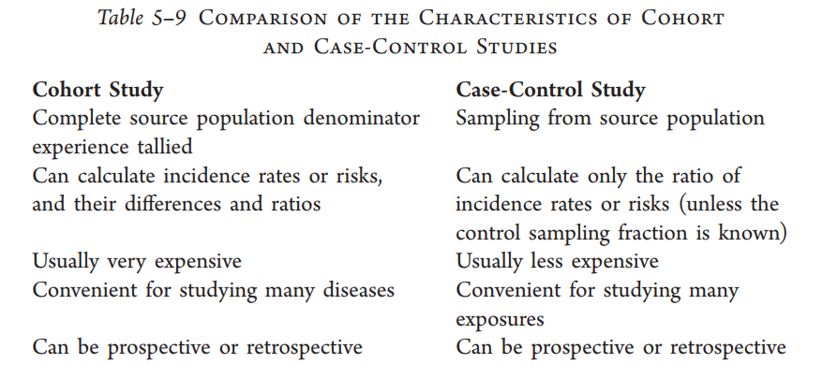
Cohort vs Case-control — comparison

Slide 92
Sampling strategies
Controls should represent the distribution of exposure in the study
Must be selected regardless of exposure

Slide 93
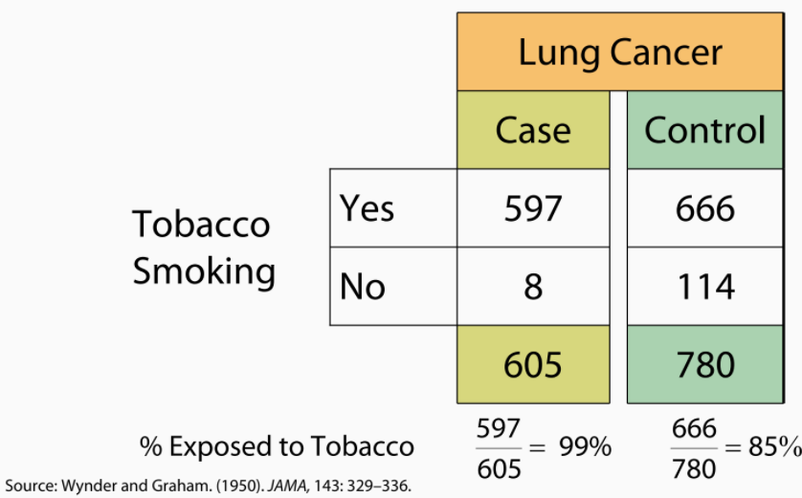
Case-control — example: tobacco and lung cancer

Slide 94
Case-control — characteristics
Advantages
Efficiency in studying diseases (outcomes) or rare events
Short time
They have no follow-up
Economic
Relatively easy case identification
Disadvantages
Biases in exposure measurement (misclassification)
Difficulties in establishing controls
They do not determine absolute risk, incidence, or prevalence — they make an indirect estimate through odds

Slide 95
Cross sectional studies
Prevalence studies
A study that examines the relationship between a state of health-disease (exposure), other variables of interest that already exist, and one or more outcomes, in a population in a given time.
The exposure-outcome relationship is measured in terms of prevalence
Or according to the presence or absence of exposure in those who have or do not have the outcome

Slide 96
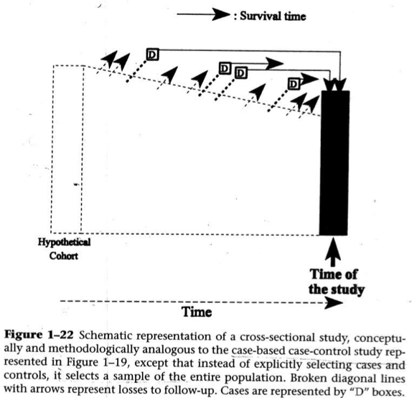
Cross sectional studies — schematic representation

Slide 97
Cross sectional studies — characteristics
Advantages
High control in subjects’ selection and measurements
There are no losses to follow-up
Absence of waiting time
Economic, fast studies
First step for further studies
Disadvantages
There is not a sequence of causality
Not useful in rare diseases
They do not determine incidence or absolute risk
Potential bias

Slide 98
Cross sectional — example
As part of a population-based screening program, researchers evaluated the prevalence of microalbuminuria in relatives of patients with chronic kidney disease (CKD) compared with the general population. The prevalence of microalbuminuria was significantly greater in those with a family history of CKD than in the age- and sex-matched control group.
Prevalence was 9.5% in those with a family history of CKD, versus 1.4% in the age- and sex-matched control group with no family history of CKD

Slide 99
Cross sectional — example (reference)
Bello AK, Peters J, Wight J, de Zeeuw D, El Nahas M; European Kidney Institute. A population-based screening for microalbuminuria among relatives of CKD patients: the Kidney Evaluation and Awareness Program in Sheffield (KEAPS). Am J Kidney Dis. 2008 Sep;52(3):434-43.

Slide 100
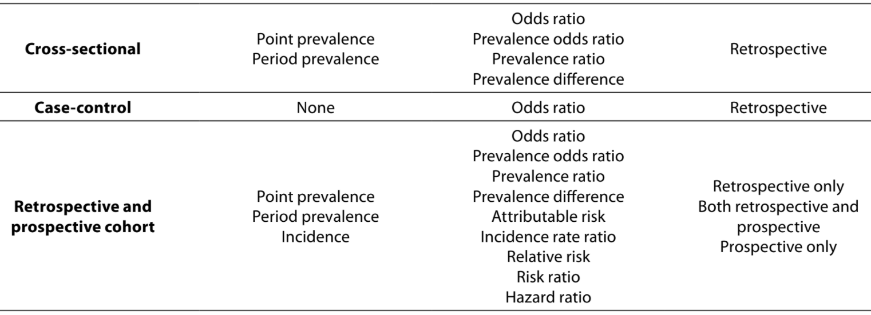
Observational designs — measures summary
Observational study design measures of disease, measures of risk, and temporality.

Slide 101
Activity
Researchers investigated whether pioglitazone was associated with an increased risk of bladder cancer in people with type 2 diabetes. Use of pioglitazone, an oral antidiabetic agent in the thiazolidinedione class, is controversial.
A cohort of 115,727 patients with type 2 diabetes was established, with patients entering the cohort if they had been newly treated with oral hypoglycaemic agents. Patients were considered exposed to pioglitazone if they had ever taken it, with duration and cumulative dosage recorded.

Slide 102
Activity — results
In the cohort, 376 cases of bladder cancer were diagnosed (at least one year after cohort entry, to account for latency). Each case was matched to as many as 20 controls on year of birth, year of cohort entry, sex, and duration of follow-up. A total of 6,699 controls were identified.
The researchers reported that the use of pioglitazone was associated with an increased risk of bladder cancer among people with type 2 diabetes.
Which one of the following study designs best describes that used above?
Case-control study
Cohort study
Cross sectional study
Nested case-control study

Slide 103
Diagnostic test assessment (DTA)
Useful to know the value of a new diagnostic method
Value is measured in sensitivity and specificity
The value of the test in the patient is measured in positive and negative predictive values
A “gold standard” is indispensable

Slide 104
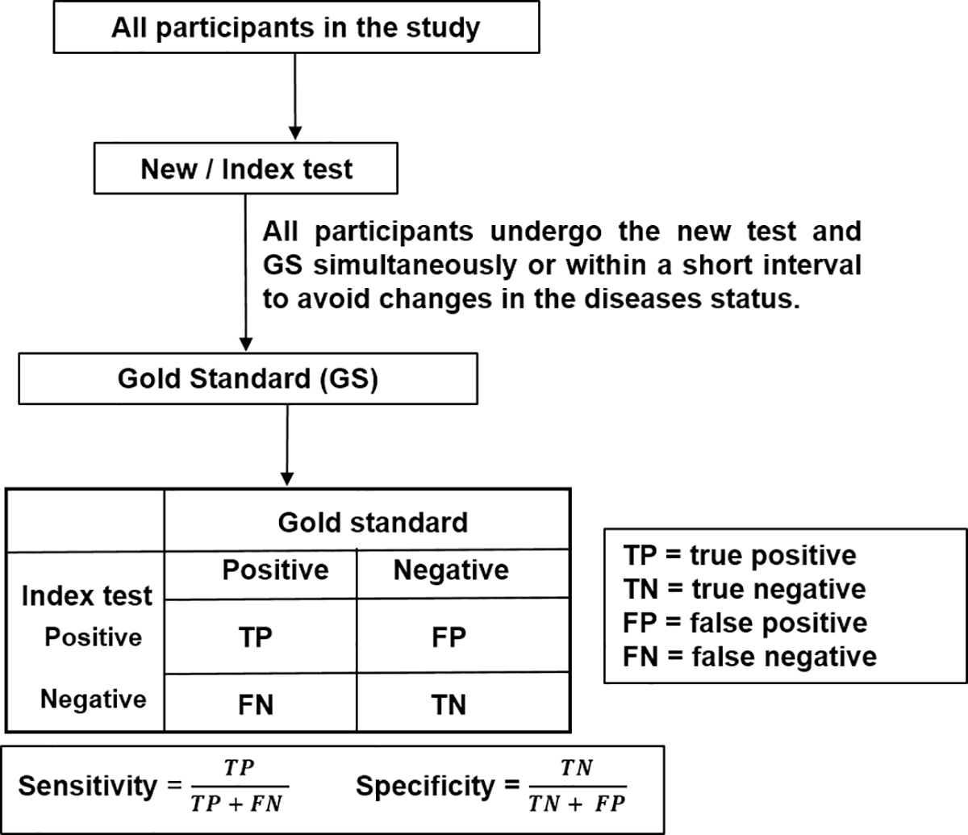
DTA — basic design

Slide 105
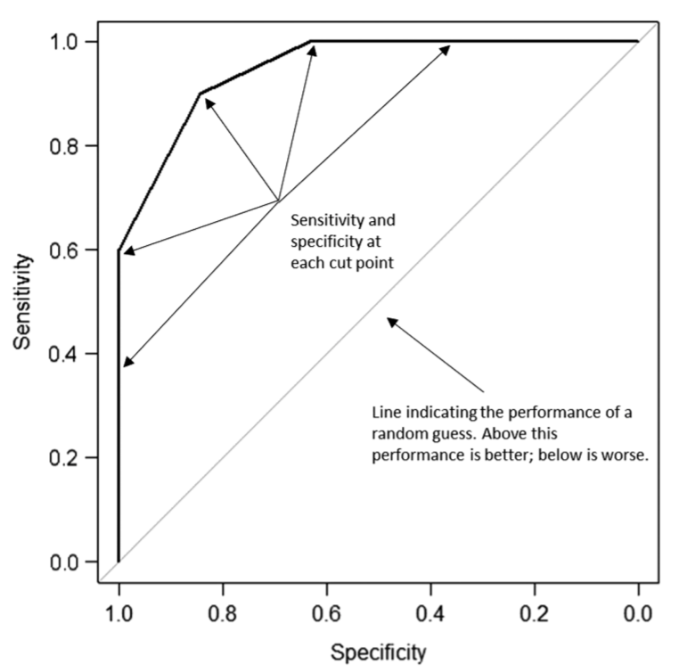
Diagnostic performance — ROC curve

Slide 106
Case report / Case series
Describes the characteristics of a patient or a group of patients with similar characteristics
Generally describe a new finding
Represent nearly a third of publications
Allow the generation of hypotheses
Are the interface between clinical practice and epidemiology

Slide 107
Case series or cohort study?
Understanding outcome as “occurrence of a disease or a state associated with disease” (e.g. death, metastasis in breast cancer).
What is the inception point of the study?
Exposure: patients “free” or “without” the outcome and followed over time. Exposure(s) are varied characteristics, fixed or not. Exposure may be binary (smoke/non-smoking) or continuous (blood pressure)
Outcome: sampling people with a certain condition or disease

Slide 108
Case series or cohort study? — the cohort view
 | Yes | No | Total
Exposed | a | b | a+b
Non exposed | c | d | c+d
Total | a+c | b+d | a+b+c+d
The cohort study allows to directly estimate the absolute risk of occurrence of the outcome. The absolute risk ratio is the relative risk (RR).

Slide 109
Case series or cohort study? — relative risk formula
$$\text{Relative risk (RR)}=\frac{CI_{exp}}{CI_{non exp}}=\frac{\frac{a}{a+b}}{\frac{c}{c+d}}$$

Slide 110
Case series or cohort study? — case series structure
Having a control group is not a requirement of cohort design since its objective may be:
Describe the course of the disease or the “prognosis”
It is important to clarify whether it pursues etiology (causality) or prognosis
The comparison group can be internal (Male/Female)

Slide 111
Case series structure
By definition, it should sample subjects based on outcome or disease-associated status
Patients with specific exposure and specific outcome, or patients with exposure-independent outcome (case-control)
Notes:
A case series is a prevalence survey of a group of individuals with a particular disease, performed at a single point in time — particularly common for delineating the clinical picture of rare diseases. For example, sampling an outcome and describing its potential risk factors: this would be the case group of a case-control study.

Slide 112
Case series — the sampling view
 | Yes | No | Total
Exposed | a | b | a+b
Non exposed | c | d | c+d
Total | a+c | b+d | a+b+c+d
In none of the cases can the absolute risk of occurrence of the outcome be calculated directly.

Slide 113
Difference between the two designs
Cohort study: sampling is exposure-based, has a follow-up period, and the absolute risk of outcome can be directly calculated
Case series: only patients with the outcome are selected and do not allow the calculation of absolute risk — these may have an exposure, or this may not be taken into account
Dekkers O, Egger M, Altman DG, Vandenbroucke JP. Distinguishing Case Series From Cohort Studies. Ann Intern Med. 2012;156:37-40.

Slide 114
Key points
The number under study loses importance
  A study of 5 patients with prosthetic reconstruction of the radial head is followed for 5 years and all remain with full functionality
  Functionality estimation? Is it accurate? What confidence?
Selection biases or loss to follow-up may affect risk estimation
To investigate causality (etiology) or therapy almost always requires a control group (counterfactual thinking)

Slide 115
Randomized clinical trial
The clinical trial is a prospective human study that compares the effect of an intervention in a group with a control, in a disease or in a given condition.

Slide 116
Characteristics of clinical trials
They are experiments in humans
Studies in which the researcher establishes the population, assigns the intervention, and decides who and how to evaluate the outcomes
If well conducted, they provide high-quality causal evidence, making them the substrate of systematic reviews of the literature and Evidence-Based Medicine
They are not the only source of causal evidence, as they are not always feasible

Slide 117
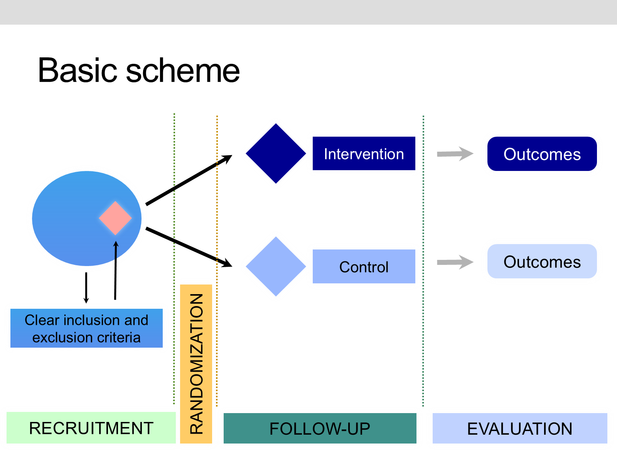
Basic scheme

Slide 118
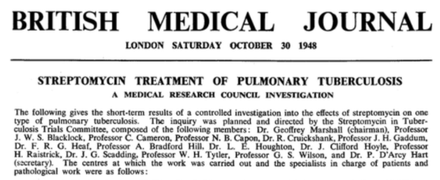
A bit of history
In 1948, Sir Austin Bradford Hill published the first RCT with strict concealed randomization of patients to treatment or control, and blinding of researchers to avoid bias.

Slide 119
A bit of history — reference
Medical Research Council (1948b). Streptomycin treatment of pulmonary tuberculosis: a Medical Research Council investigation. BMJ 2:769-782.

Slide 120
The streptomycin trial — results
 | Alive | Dead | Total
Streptomycin | 51 | 4 | 55
Placebo | 38 | 14 | 52

Slide 121
The streptomycin trial — mortality
Mortality: 7% with streptomycin vs 27% with placebo.

Slide 122
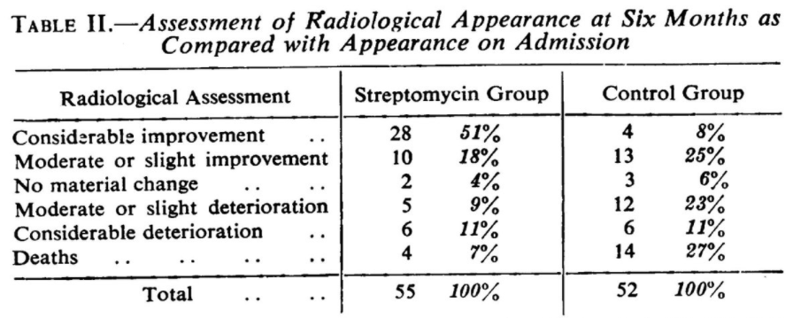
The streptomycin trial — radiological assessment

Slide 123

Systematic reviews
Balmoral Castle in Scotland

Slide 124

Systematic reviews — built brick by brick
A systematic review is built from many individual studies, the same way a castle is built from many bricks.

Slide 125
Why do we need systematic reviews
Efficient way to access the body of research
  Saves time required for search, critical appraisal, and interpretation of results
They explore differences across studies and assess their validity (risk of bias)
Reliable source for decision making, if well conducted
  Unbiased selection of relevant information
  Useful for decision-making in health care, policy development, and future research

Slide 126
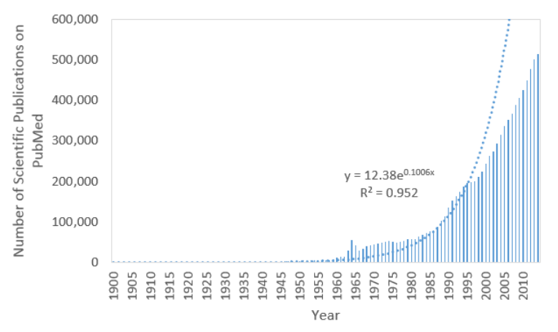
The exponential growth of the literature

Slide 127
Systematic reviews — the process
Defining the review question(s) and developing criteria for including studies
Searching for studies
Selecting studies and collecting data
Assessing risk of bias in included studies
Analyzing data and undertaking meta-analyses
Addressing reporting biases
Presenting results and “summary of findings” tables
Interpreting results and drawing conclusions

Slide 128
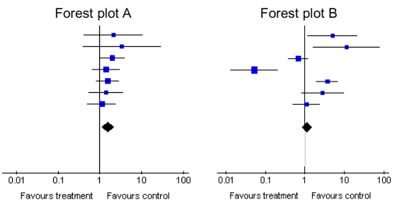
Forest plots — reading the summary of evidence

Slide 129
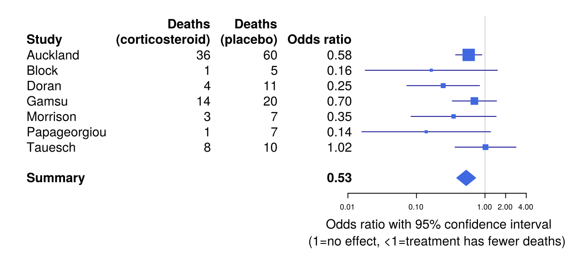
Forest plot — worked example

Slide 130

Forrest plot

Slide 131
Forrest plot — the connection
The Cochrane Collaboration logo is itself a forest plot — summarizing the evidence for corticosteroids given to women expected to deliver prematurely, showing a reduction in the odds of death among premature babies.

Slide 132
General Aims of Data Analysis

Slide 133
Steps in the research process
Figure 1.1 Steps in the Research Process

Slide 134
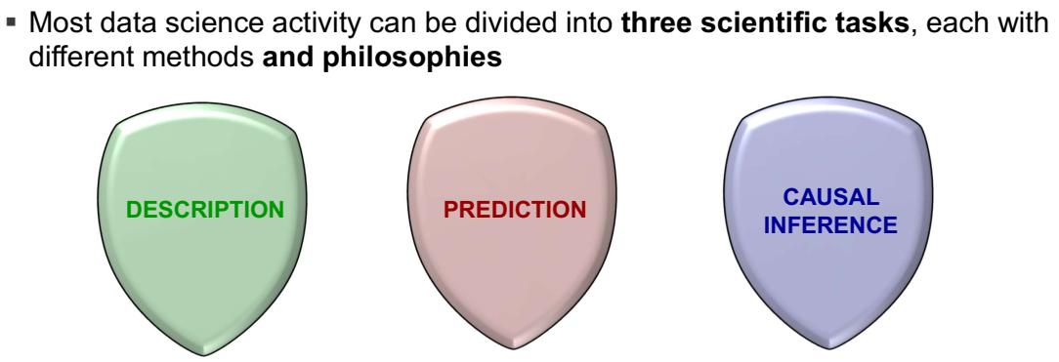
Three scientific tasks of data science
Hernán et al. A Second Chance to Get Causal Inference Right. CHANCE 2019;32(1):42-49. Credits to @PWGTennant

Slide 135
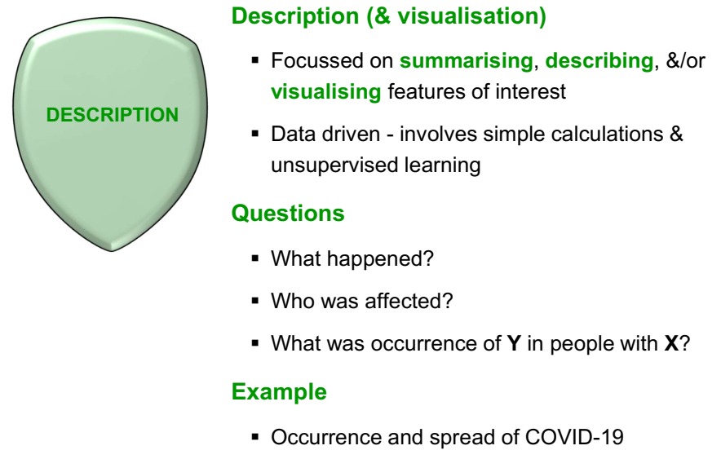
Description
Credits to @PWGTennant

Slide 136
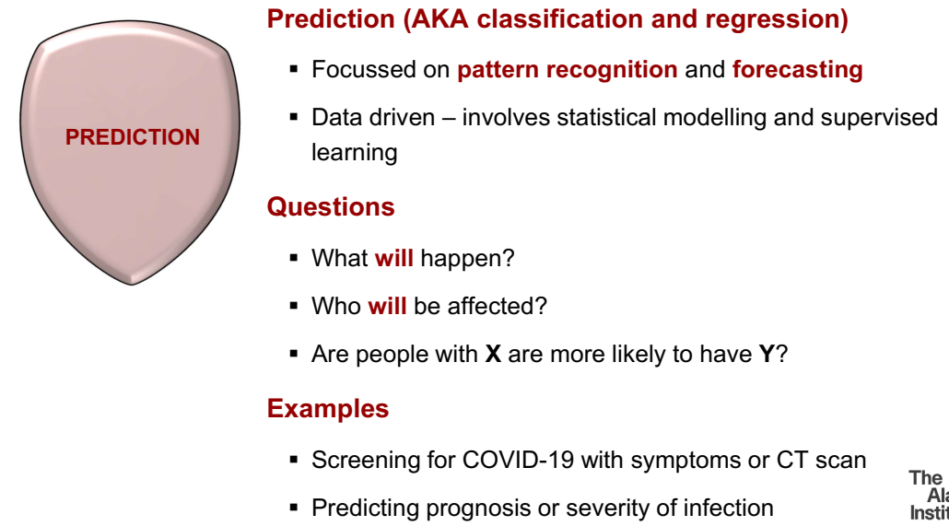
Prediction
Credits to @PWGTennant

Slide 137
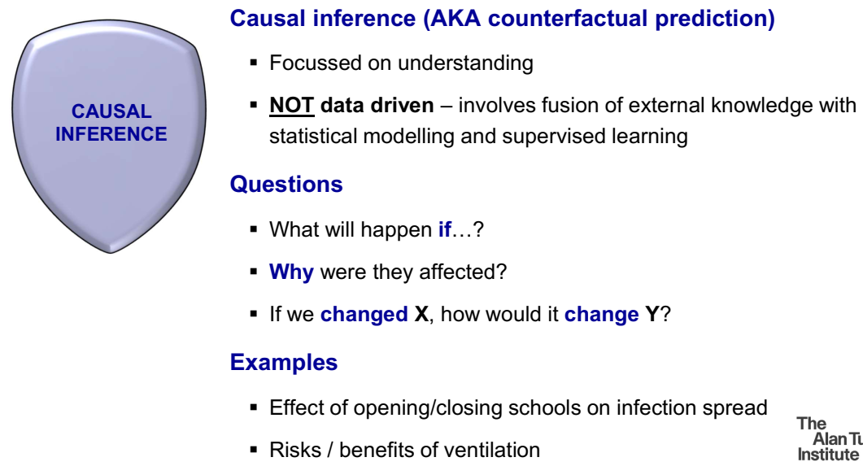
Causal inference
Credits to @PWGTennant

Slide 138
The research objectives
Be focused on basic elements of the problem and research question
Be measurable, achievable, observable
Be clear and precise
Follow a logical order (if they are more than one)
Use infinitive verbs (English)

Slide 139

Objectives as a route map
Appropriate objectives are the route map of statistical analysis.

Slide 140
On invention and method
“The greatest invention of the nineteenth century was the invention of the method of invention.”
— A. N. Whitehead

Slide 141
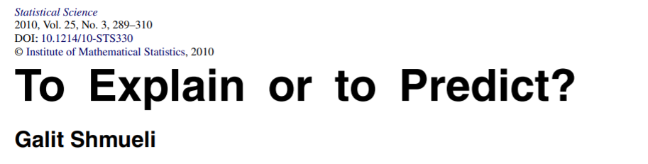
To Explain or to Predict? — Shmueli 2010
Galit Shmueli. “To Explain or to Predict?” Statistical Science, 2010, Vol. 25, No. 3, 289-310. DOI: 10.1214/10-STS330

Slide 142
Why modeling frameworks matter
Statistical modeling is a powerful tool for developing and testing theories by way of causal explanation, prediction, and description
In many disciplines there is near-exclusive use of statistical modeling for causal explanation and the assumption that models with high explanatory power are inherently of high predictive power

Slide 143
To Explain or to Predict?
Prediction
  What will happen next?
Explanation
  Why did it happen?

Slide 144
Explanatory modeling
A set of underlying (causal) factors measured by variables X are hypothesised to cause an underlying effect measured by variable Y
Focus: statistically testing the causal hypotheses
Data come from well designed experiments or observational studies

Slide 145
Predictive modeling
Goal: predict Y from new observations of given input variables X
This includes temporal forecasting: observations until time t (the input) are used to forecast future values at time t+k, k>0 (the output)
A predictive model is any model that produces predictions, regardless of its underlying modelling approach: Bayesian or Frequentist, Parametric or Non-Parametric, Data Mining Algorithm or Statistical Model, etc.

Slide 146
Two modeling paths
In each step, there are differences in the choice of methods, criteria, data, and information to consider when the goal is predictive vs explanatory
Conceptual / practical differences invariably lead to a difference between a final explanatory model and a predictive model
A priori determination of the main study goal is essential to conduct adequate modelling

Slide 147
Descriptive Modeling
Aimed at summarizing or representing the data structure in a compact manner
Unlike explanatory modeling, in descriptive modeling the reliance on an underlying causal theory is absent or incorporated in a less formal way
Unlike predictive modeling, descriptive modeling is not aimed at prediction

Slide 148
Descriptive Modeling (cont.)
Fitting a regression model can be descriptive if it is used for capturing the association between the dependent and independent variables rather than for causal inference or for prediction

Slide 149
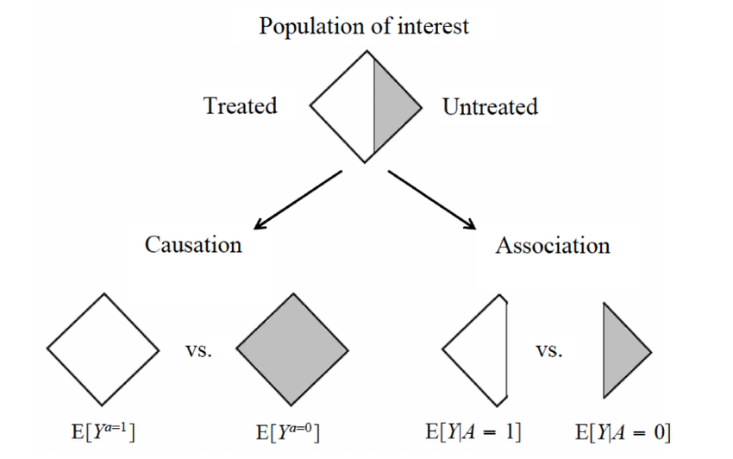
Association versus Causation
Hernán MA, Robins JM (2020). Causal Inference: What If. Boca Raton: Chapman & Hall/CRC.

Slide 150
Association versus Causation — types
Association — definition: the concurrence of two variables more often than would be expected by chance.
Types of association:
Spurious association
Indirect association
Direct (causal) association
  One to one causal association
  Multi-factorial association

Slide 151
Association — a clinical example
A researcher in an observational study found that the average serum homocysteine among male patients with ischemic heart disease was 15 mcg/dl (normal = 10-12 mcg/dl)
What can we say about that?

Slide 152
Association — advancing the reasoning
Hyperhomocysteinemia causes IHD?
Hypothesize that,
  Hyperhomocysteinemia may have a role in the etiology of IHD
  Hyperhomocysteinemia is associated with IHD
For advancing in the understanding there has to be a “comparison”
  Comparison would generate another summary measure which shows the extent of this “Association” or “Effect” or “risk” (RR, OR, AR)

Slide 153
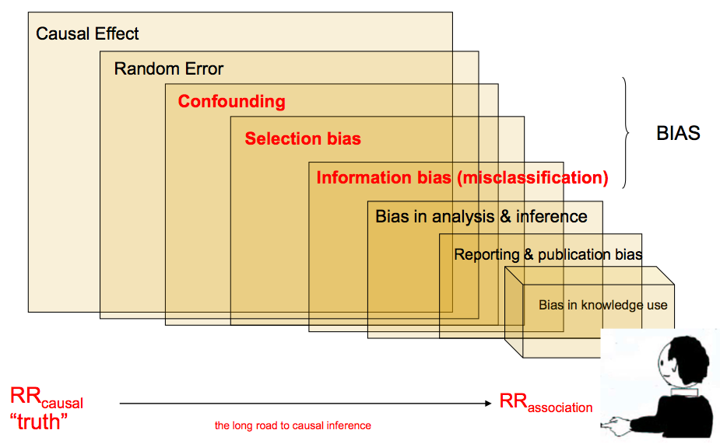
From association to causation in epidemiology
The long road to causal inference: from RR causal “truth” to RR association, through random error and multiple sources of bias.

Slide 154

Open your mind,

Slide 155

Open your mind, (cont.)

Slide 156
Open your mind — the question
What exactly does your mind need to consider something causal?

Slide 157
Assumptions of causality (1/2)
Exchangeability (No Unmeasured Confounding). Conditional on the measured baseline covariates, the potential outcomes are independent of exposure assignment. That is, there are no unmeasured common causes of the exposure and outcome that would induce confounding.
Positivity. For every covariate pattern with positive probability in the target population, each exposure level has a non-zero probability of being observed. Thus, all relevant covariate strata contain individuals receiving each exposure level being compared.

Slide 158
Assumptions of causality (2/2)
Consistency. The exposure is sufficiently well defined such that the observed outcome under the exposure actually received corresponds to the corresponding potential outcome: this assumes that different versions of the same exposure do not produce different outcomes and that the exposure is measured without ambiguity.

Slide 159
Association versus Causation (conceptually speaking)
Association
Correlation
Regression
Odds / relative risk
Dependence
Likelihood
Conditional
Causation
Influence
Effect
Confounding
Explanation
Intervention
Randomization
Attribution

Slide 160
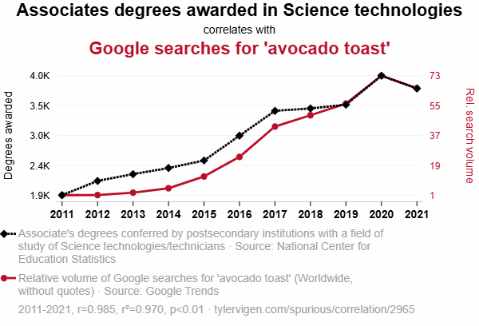
Correlation is not causation
Associates degrees awarded in Science technologies correlates with Google searches for “avocado toast” (2011–2021).

Slide 161
Dark Causal Inference (1/2)
Causal reasoning is often implicit rather than explicitly stated, inferred from conclusions and recommendations rather than from clearly defined causal questions and assumptions.
Researchers may use ambiguous terms such as association, linked to, or risk factor despite drawing causal interpretations.

Slide 162
Dark Causal Inference (2/2)
This creates plausible deniability while retaining causal implications.
Approximately two-thirds of studies in major epidemiological and psychological journals address seemingly causal questions without clearly specifying the causal target or required assumptions.

Slide 163
“Effect” Without an Intervention — Electric Blankets and Childhood Cancer
An observational study described its objective and findings using explicit causal language, including “effect” and “effect estimate.”
However, no intervention was performed and the causal assumptions required for identification were not articulated.
Key lesson: Repeated use of causal terminology can transform an observational association into an apparently causal finding, creating “dark” causal inference.

Slide 164
The “Risk Factor” Label — Perinatal Exposures and Maternal Morbidity
Observational studies may describe exposures as “risk factors” or report “adjusted associations,” while drawing etiological or preventive implications.
This terminology can obscure the underlying causal estimand and identification assumptions, including exchangeability, positivity, and consistency.
Key lesson: A statistical predictor is not necessarily a causal determinant or an actionable intervention target.

Slide 165
The Convenience Disclaimer — Income and Happiness
Studies may frame the research question and interpretation in explicitly causal terms, while describing the analysis formally as cross-sectional associations.
A methodological disclaimer may state that causal-sounding terms are used merely for convenience, despite causal interpretations dominating the narrative.
Key lesson: A disclaimer cannot substitute for a clearly defined causal estimand and explicit identification strategy.

Slide 166
Hydroxychloroquine and COVID-19 mortality (1/2)
Early observational studies of hydroxychloroquine were interpreted as evidence of a therapeutic effect, despite substantial potential for confounding by disease severity and treatment selection.
  In a large observational study, hydroxychloroquine use was associated with intubation or death (HR 1.04; 95% CI, 0.82–1.32), although the investigators appropriately emphasized the possibility of residual confounding.

Slide 167
Hydroxychloroquine and COVID-19 mortality (2/2)
Subsequent randomized evidence showed no mortality benefit, illustrating how an observational association can be misleading when interpreted as a causal effect.
Key lesson: Adjustment and propensity scores do not transform an observational association into a causal effect without credible identification assumptions.

Slide 168
COVID-19 severity: Smoking as a “Risk Factor” (1/2)
Observational studies identified smoking as a risk factor for COVID-19 severity, reporting elevated adjusted risks after multivariable regression.
  The label risk factor can easily shift from describing a predictive association to implying that modifying the exposure would reduce disease risk.

Slide 169
COVID-19 severity: Smoking as a “Risk Factor” (2/2)
However, an adjusted association does not establish that smoking is a causal intervention target; this requires explicit causal assumptions and a well-defined intervention.
It was described as a modifiable factor.
Key lesson: A “risk factor” is not necessarily a causal factor—and statistical adjustment does not by itself establish intervention effects.

Slide 170
Research Questions: The Fundamental Triad
Research questions should be explicitly classified as:
Descriptive: Characterize distributions, patterns, or differences in health outcomes.
Predictive: Predict or classify outcomes using observed covariates.
Causal: Estimate how an exposure or intervention would change an outcome.

Slide 171
Research Questions: The Fundamental Triad — key principle
Key principle: The research objective should determine the estimand, methods, and variable selection—not the other way around.

Slide 172
The Problem with “Association”
Association is inherently ambiguous: different adjustment sets define different statistical associations.
If the adjustment set is selected during analysis, the research question becomes analysis-driven rather than prespecified.
Defining the target as an “association adjusted for X” does not allow meaningful assessment of unmeasured confounding.
For causal questions, use explicit causal language and prespecify the causal estimand.

Slide 173
The Problem with “risk factors to…” (1/2)
Terms such as risk factor, associated with, and linked to often conceal causal questions behind non-causal language, allowing causal interpretations without explicitly stating or defending the required assumptions.
  The label risk factor does not define a specific estimand: the reported relationship may be crude, adjusted, or conditioned on different sets of covariates.

Slide 174
The Problem with “risk factors to…” (2/2)
Association does not imply interventionability: e.g., caviar consumption may be associated with wealth through socioeconomic status, but making people eat caviar would not make them wealthy.
Key message: A predictor or statistical “risk factor” should not automatically be interpreted as an appropriate target for intervention.

Slide 175
The “Plague” of Risk Factor Epidemiology & False Positives (1/2)
The Core Problem: Traditional risk factor epidemiology often focuses solely on estimating statistical associations without defining causal mechanisms, leading to a “plague” of false-positive research findings across nutrition, cancer, and environmental epidemiology.
Overconfidence in Statistical Models: Researchers frequently treat any statistical correlation as a causal “effect,” blurring the critical distinction between well-defined exposures (e.g., smoking) and vague, unmanipulable states (e.g., “unhappiness” or general BMI).

Slide 176
The “Plague” of Risk Factor Epidemiology & False Positives (2/2)
Public Health Disconnect: Uncritical tolerance for vague causal effects generates misleading conclusions that confuse the public and fail to inform actionable public health policies.

Slide 177
The “Risk Factor” Trap: Methodological Pitfalls (1/2)
Blind multivariable adjustment may lead researchers to interpret statistically significant coefficients as causal risk factors without a prespecified causal question.
Without a causal diagram (DAG), adjustment may:
  block causal pathways by conditioning on mediators;
  introduce spurious associations by conditioning on colliders.

Slide 178
The “Risk Factor” Trap: Methodological Pitfalls (2/2)
A variable associated with an outcome is not necessarily a causal determinant; modifying it may have no effect on disease occurrence.
Key message: Identifying actionable determinants requires a formal causal inference framework, not simply multivariable regression.

Slide 179
Transparent Use of Scientific Language
Section | Preferred terminology
Introduction / Methods | Causal effect — define the causal question and target estimand
Results | Association — describe the observed statistical relationship
Discussion | Estimated causal effect — interpret the association under stated causal assumptions

Slide 180
Transparent Use of Scientific Language — assumptions
Causal inference requires explicit consideration of exchangeability, positivity, and consistency, supported where appropriate by DAGs, target trial emulation, and sensitivity analyses.

Slide 181
Research Objectives and Interpretation
Objective | Recommended language | Example interpretation
Descriptive | Describe, characterize, document, compare | “The age-adjusted risk of dementia differed by 5% between the two educational groups.”
Predictive | Predict, classify, forecast, risk stratification | “The model predicted 5-year dementia risk with an AUC of 0.82.”
Causal | Causal effect, intervention, impact, affect | “Under the stated causal assumptions, vitamin B supplementation reduced 5-year dementia risk by 5 percentage points.”

Slide 182
Research Objectives and Interpretation — core principle
Core principle: The language of the paper should reflect the scientific question and the estimand—not merely the statistical model used.

Slide 183
The importance of language
Avoiding “causal” language with observational study designs is common publication practice, often justified as being a more cautious approach to interpretation
There is a substantial disconnect between causal implications used to link an exposure to an outcome and the action implications made
This undercuts common assumptions about what words are often considered non-causal and that policing them eliminates causal implications

Slide 184
The importance of language — reference
Haber NA, et al. Causal and Associational Linking Language From Observational Research and Health Evaluation Literature in Practice: A systematic language evaluation. medRxiv 2021.08.25.21262631; doi: https://doi.org/10.1101/2021.08.25.21262631

Slide 185
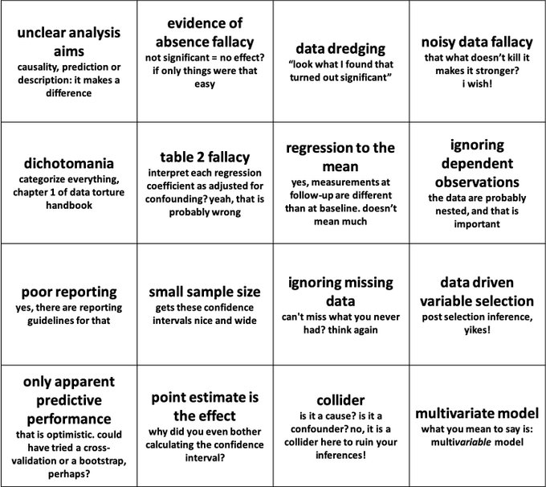
A statistical “bingo card” of common pitfalls

Slide 186

The CHAMP statement
Mansournia MA, et al. Br J Sports Med 2021;0:1-9. doi:10.1136/bjsports-2020-103652

Slide 187
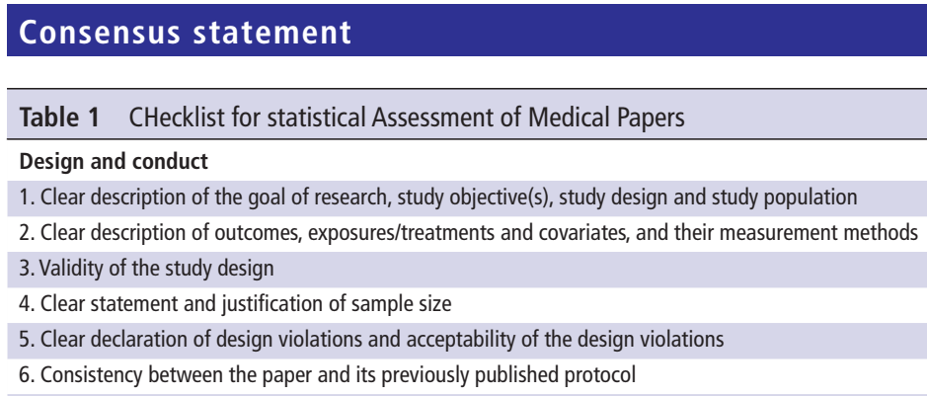
CHAMP — design and conduct

Slide 188
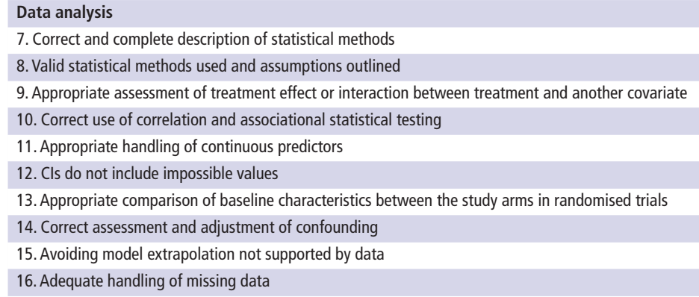
CHAMP — data analysis

Slide 189
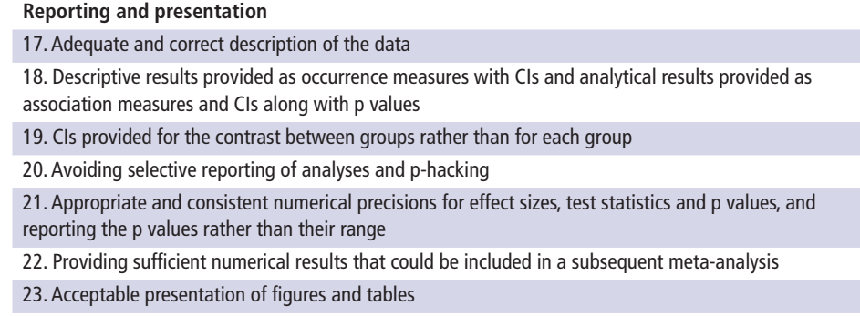
CHAMP — reporting and presentation

Slide 190
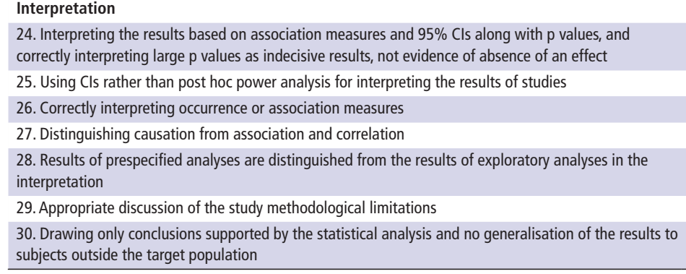
CHAMP — interpretation

Slide 191
What is Biostatistics

Slide 192

I need a scientific question
Comic by @RosanaFerrero (in Spanish)

Slide 193
I need a scientific question — translation
Researcher: I need a statistical analysis. — Statistician: Perfect. What is your research question?
R: I want to know if there are statistically significant differences. — S: Differences in what?
R: I don’t know… in the groups. — S: Which groups?
R: The ones we have. — S: And what exactly do you want to know?
R: Well… if there are differences.
S: I need you to bring me a scientific question.

Slide 194
What is Biostatistics
Statistics applied to biomedical problems
Decision making in the face of uncertainty or variability
Design and analysis of experiments; detective work in observational studies (in epidemiology, outcomes research, etc.)
Attempt to remove bias or find alternative explanations to those posited by researchers with vested interests

Slide 195
What is Biostatistics (cont.)
Experimental design, measurement, description, statistical graphics, data analysis, inference, prediction
To optimize its value, biostatistics needs to be fully integrated into biomedical research and we must recognize that experimental design and execution are all important.

Slide 196
Statistical scientific method
Statistics is not a bag of tools and math formulas but an evidence-based way of thinking.
It is all important to:
Understand the problem
Properly frame the question to address it
Understand and optimize the measurements
Understand sources of variability
…and much more

Slide 197

Putting it all together
Problem → Plan → Data → Analysis → Conclusion (adapted from F. Harrell, Biostatistics for Biomedical Research)

