Slide 1



Types of Data, Data Description and Measures of Association
Section 2 — Introduction to Biostatistics
Jose Andres Calvache MD MSc PhD

Slide 2
Types of Data

Slide 3
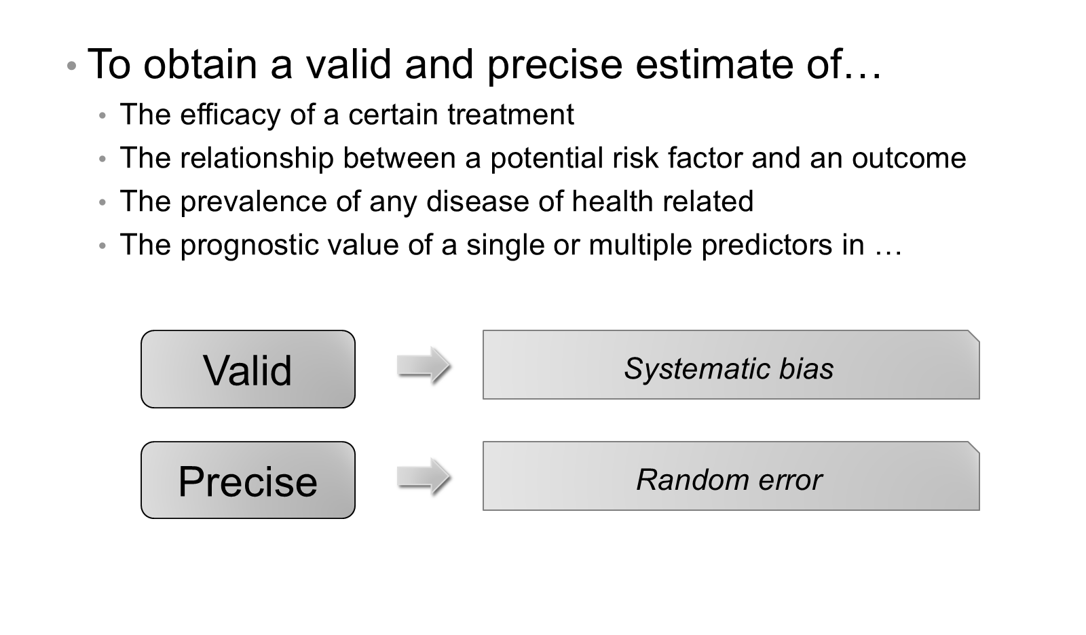
Basic principles of research

Slide 4
Basic principles in data analysis
Do a lot of graphs
Use the common sense
“Critical thinking”
This is the only beginning
Look for appropriate advice and support from the start

Slide 5
Basic definitions
Population → Sample → Variable → Data

Slide 6
Population
Group of subjects that share at least one characteristic — N = size of the population
Students of the university
Health care workers in Popayán
Public hospitals in Colombia
Patients with histologically confirmed diagnosis of gastric cancer
Older patients under abdominal surgery (certain age)

Slide 7
Population — definition and unit of analysis
The population should be very clearly defined
Unit of analysis: member of the population

Slide 8
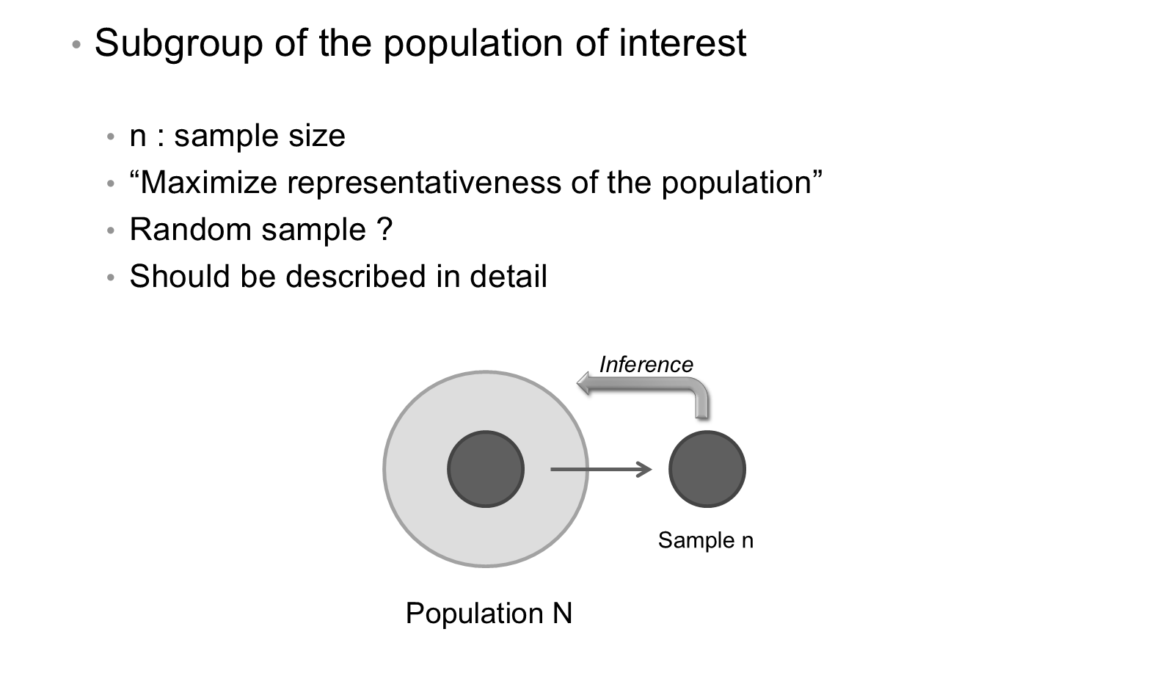
Sample

Slide 9
Variable
Characteristic of the population in which we are interested
X_{n}: univariable; X₁, X₂, X₃, … X_{p}: p multivariable
Name; gender, socioeconomic status; age, weight, BMI
Outcomes (fail/success), (death/alive); length of hospital stay
Should be clearly defined in the protocol (age groups, what is a “fail”?)

Slide 10
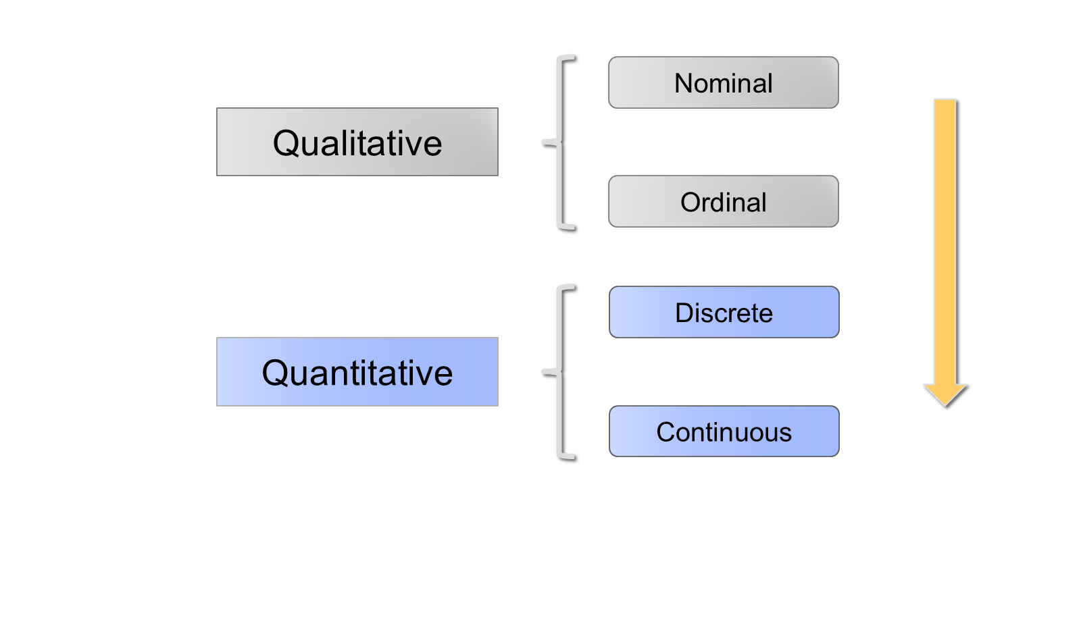
Types of variables

Slide 11
Nominal variables
To express a quality
By using k categories — mutually exclusive — (C₁, C₂, … C_{n}), also called categorical variables
Racial group: African, Caucasian, Hispanic, Asian (k = 4)
Blood group: A, B, AB, O (k = 4)
Gender: Male, Female (k = 2)

Slide 12
Nominal variables (cont.)
The number of categories should be clearly defined in advance
Binary categorical variables (k = 2)
It is possible to transform the variable into (k − 1) indicators against a reference category
Order is meaningless
How to summarize: frequency table (n, %)

Slide 13
Ordinal variables
To express an ordered quality (C₁ < C₂ < C_{n})
Pain level: (none, slight, moderate, severe)
Cancer stage: (I, II, III, IV)
Social stratum: 1, 2, 3, 4 (numbers as categories)
Categories could be numbered (1, 2, 3, n). How to summarize: frequency table (n, %)

Slide 14
How to summarize: frequency table (n, %)
Pain level after surgery | Freq (n) | %
None | 10 | 20
Slight | 15 | 30
Moderate | 15 | 30
Severe | 10 | 20

Slide 15
Qualitative variables
Mutually exclusive? A variable could take one or more categories (C₁, C₂, … C_{k})
Affected systems: (cardiovascular, renal, nervous) (k = 3)
Risk factors: (smoking, sedentary, hypertension) (k = 3)
Reordering: could be transformed into a binary variable for each category
X₁ = 1 if C₁ is present, otherwise 0; X₂ = 1 if C₂ is present, otherwise 0; … X_{n}

Slide 16
Discrete (quantitative) variables
To express a numerical quantity
Usually calculated by counting or measurement
Discrete variables (counting)
They take a finite number of values (k) without decimals
Number of children at school
Number of medical consultations

Slide 17
Continuous (quantitative) variables
All possible real values in an interval or continuum — usually associated with a unit of measurement
Weight (kg); BMI (kg/m²)
Cholesterol level (mmol/L)
Survival time in a certain cancer (years, months)
Systolic blood pressure (mmHg)
How to summarize these variables?

Slide 18
Data
A single observation of a variable in the population
Data will be analyzed
  Single value for BMI
  Single value for weight
  Single value for age

Slide 19
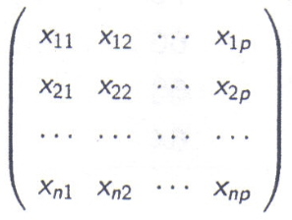
Data sample
n observations in n subjects (rows versus columns)

Slide 20
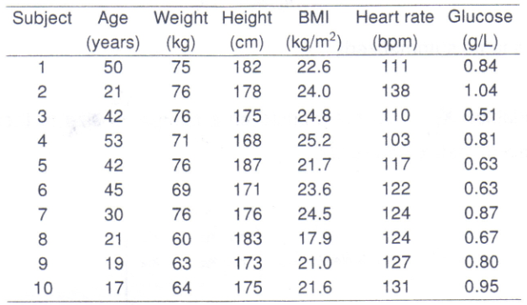
Data sample — example

Slide 21
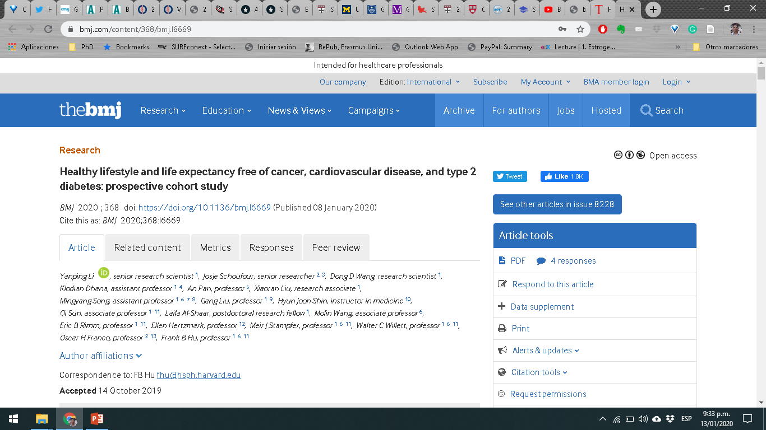
Example: healthy lifestyle and life expectancy

Slide 22
Example — abstract (1/4)
Objective: To examine how a healthy lifestyle is related to life expectancy that is free from major chronic diseases.
Design: Prospective cohort study.
Setting and participants: The Nurses’ Health Study (1980-2014; n = 73,196) and the Health Professionals Follow-Up Study (1986-2014; n = 38,366).

Slide 23
Example — abstract (2/4)
Main exposures: Five low risk lifestyle factors: never smoking, body mass index 18.5-24.9, moderate to vigorous physical activity (≥30 minutes/day), moderate alcohol intake (women: 5-15 g/day; men 5-30 g/day), and a higher diet quality score (upper 40%).
Main outcome: Life expectancy free of diabetes, cardiovascular diseases, and cancer.

Slide 24
Example — abstract (3/4)
Results: The life expectancy free of diabetes, cardiovascular diseases, and cancer at age 50 was 23.7 years (95% confidence interval 22.6 to 24.7) for women who adopted no low risk lifestyle factors, in contrast to 34.4 years (33.1 to 35.5) for women who adopted four or five low risk factors.

Slide 25
Example — abstract (4/4)
At age 50, the life expectancy free of any of these chronic diseases was 23.5 (22.3 to 24.7) years among men who adopted no low risk lifestyle factors and 31.1 (29.5 to 32.5) years in men who adopted four or five low risk lifestyle factors. For current male smokers who smoked heavily (≥15 cigarettes/day) or obese men and women (body mass index ≥30), their disease-free life expectancies accounted for the lowest proportion (≤75%) of total life expectancy at age 50.

Slide 26
Example — conclusion
Conclusion: Adherence to a healthy lifestyle at mid-life is associated with a longer life expectancy free of major chronic diseases.

Slide 27
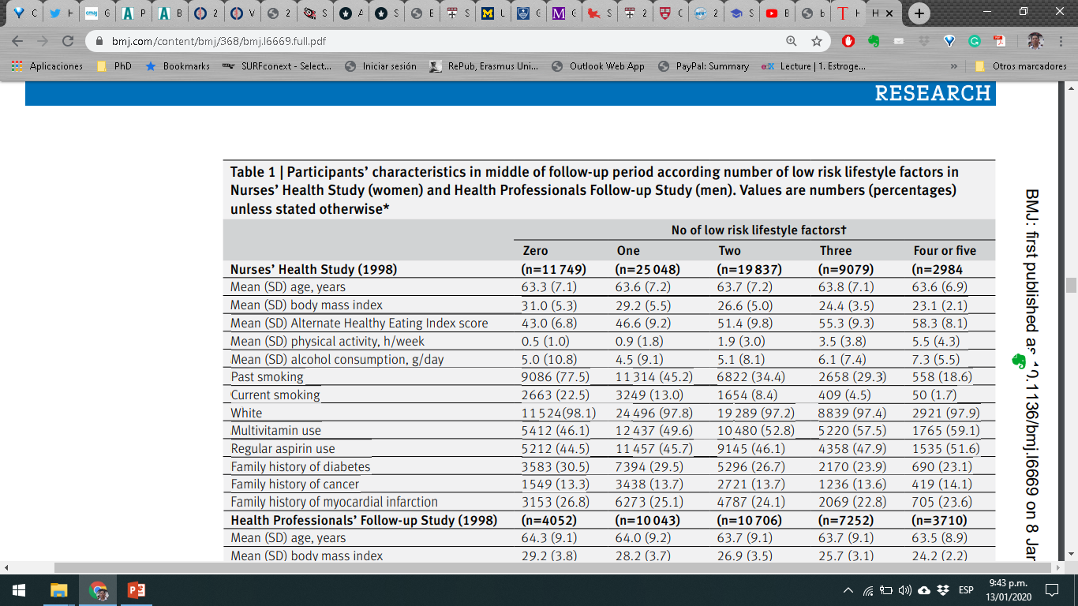
Example — Table 1

Slide 28
Graphs and Data Description

Slide 29
Qualitative variables (n, %)
Absolute frequencies (n) and proportions (%)
Sample (X₁, X₂, … X_{n}); each category j (1, 2, … k)
$$p_{j}=\frac{n_{j}×100\%}{n} (j=1,…,k)$$
For example: $\frac{10×100\%}{50}=20\%$

Slide 30
Qualitative variables — example
Pain level | Frequency (n) | %
None | 10 | 20
Mild | 15 | 30
Moderate | 15 | 30
Severe | 10 | 20

Slide 31
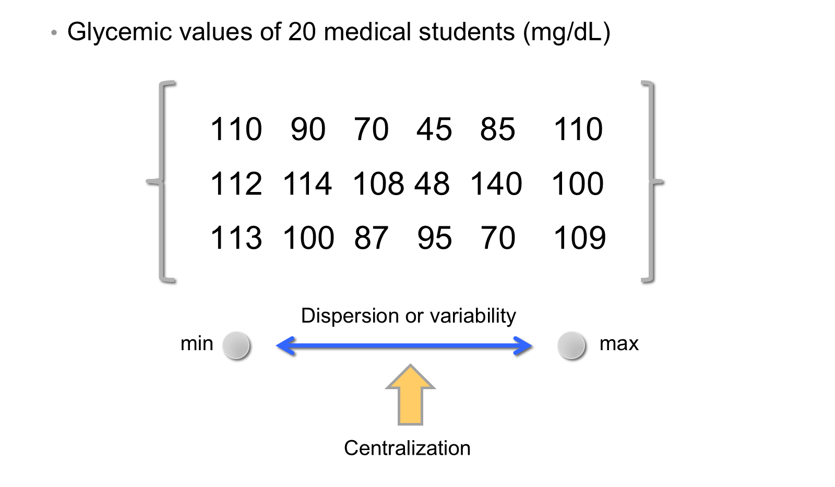
Quantitative variables

Slide 32
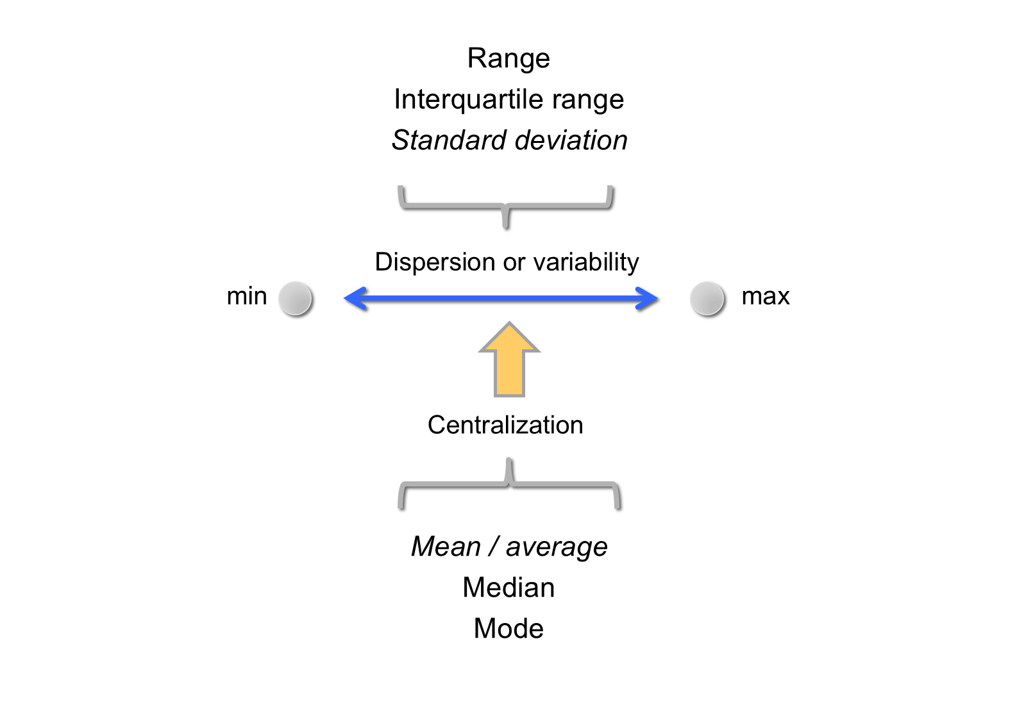
Centralization and dispersion

Slide 33
Mean ($\overset{‾}{x}$)
Arithmetic mean or average of a sample (X₁, X₂, … X_{n})
$$\overset{‾}{x}=\frac{x_{1}+x_{2}+…+x_{n}}{n}=\frac{\sum_{i=1}^{n}{x_{i}}}{n}$$
Centralization statistic
Sensitive to extreme values of data
Gravity center of the data

Slide 34
Standard deviation (SD)
Let us consider a sample (X₁, X₂, … X_{n}) with mean $\overset{‾}{x}$
$$SD=\sqrt{\frac{(x_{1}−\overset{‾}{x})^{2}+…+(x_{n}−\overset{‾}{x})^{2}}{n−1}}=\sqrt{\frac{∑(x−\overset{‾}{x})^{2}}{n−1}}=s$$
Measure of variability: s ≥ 0; sensitive to extreme values
Numerator: sum of squares $∑(x−\overset{‾}{x})^{2}$; s²: variance

Slide 35
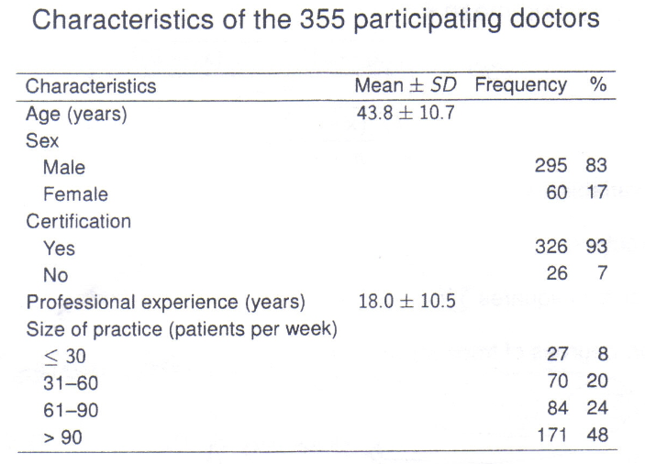
Mean and SD — example

Slide 36
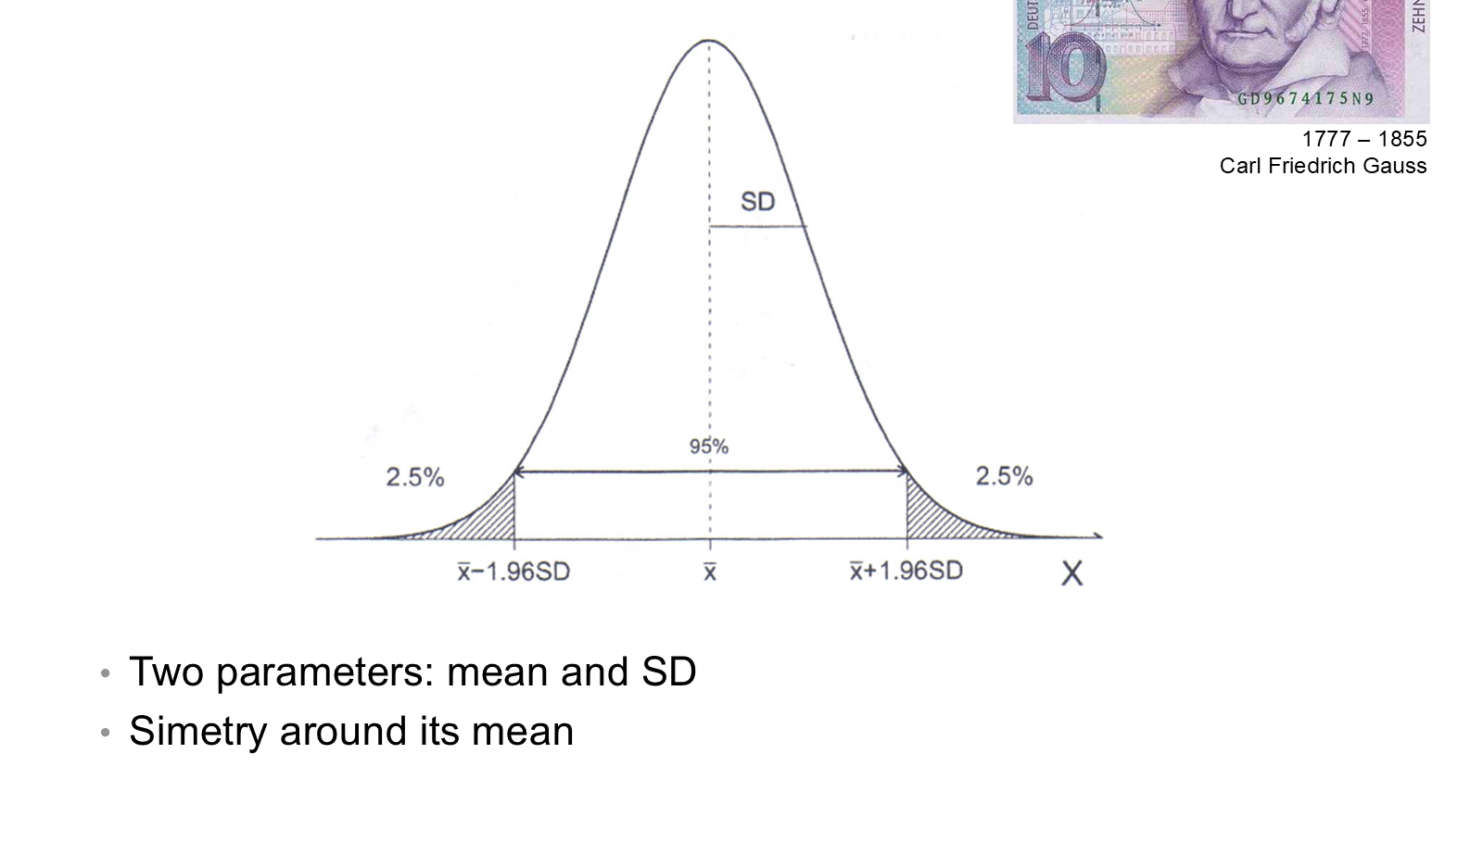
Normal distribution

Slide 37
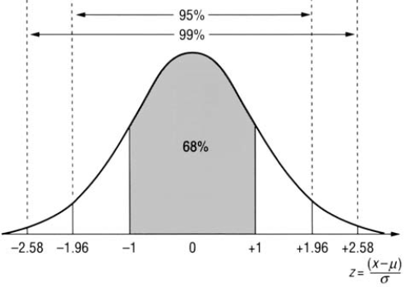
Normal distribution — standard normal

Slide 38
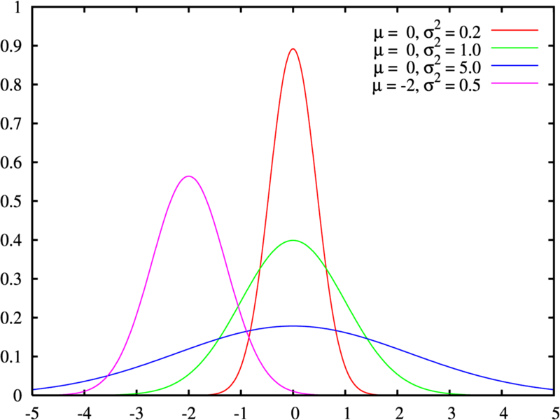
Normal distribution — different means and variances

Slide 39
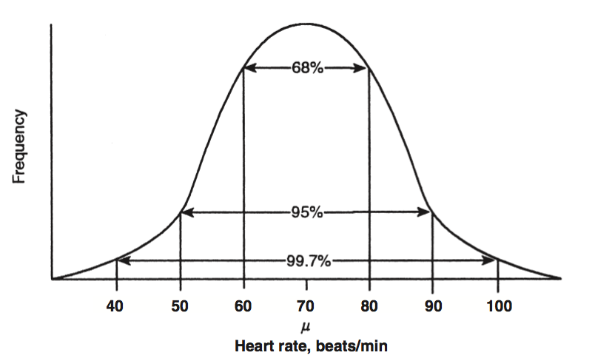
Normal distribution — heart rate example

Slide 40
SD and normal distribution
Mean ± 1 SD contains 68% of the data
Mean ± 2 SD contains 95% of the data
Mean ± 3 SD contains 99.7% of the data

Slide 41
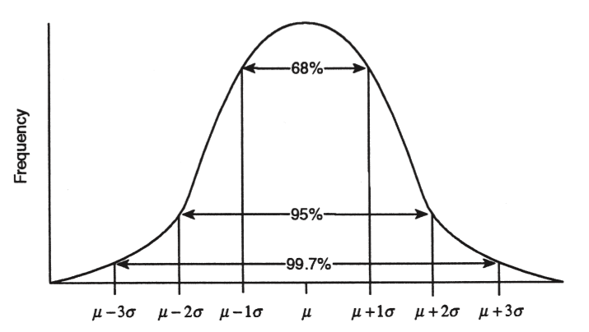
SD and normal distribution — μ ± σ

Slide 42
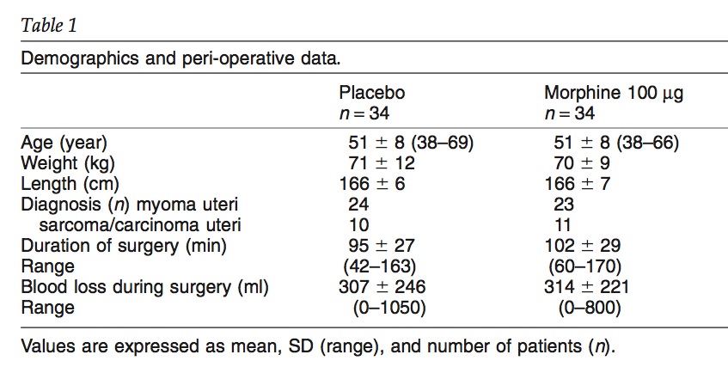
Reporting mean ± SD

Slide 43
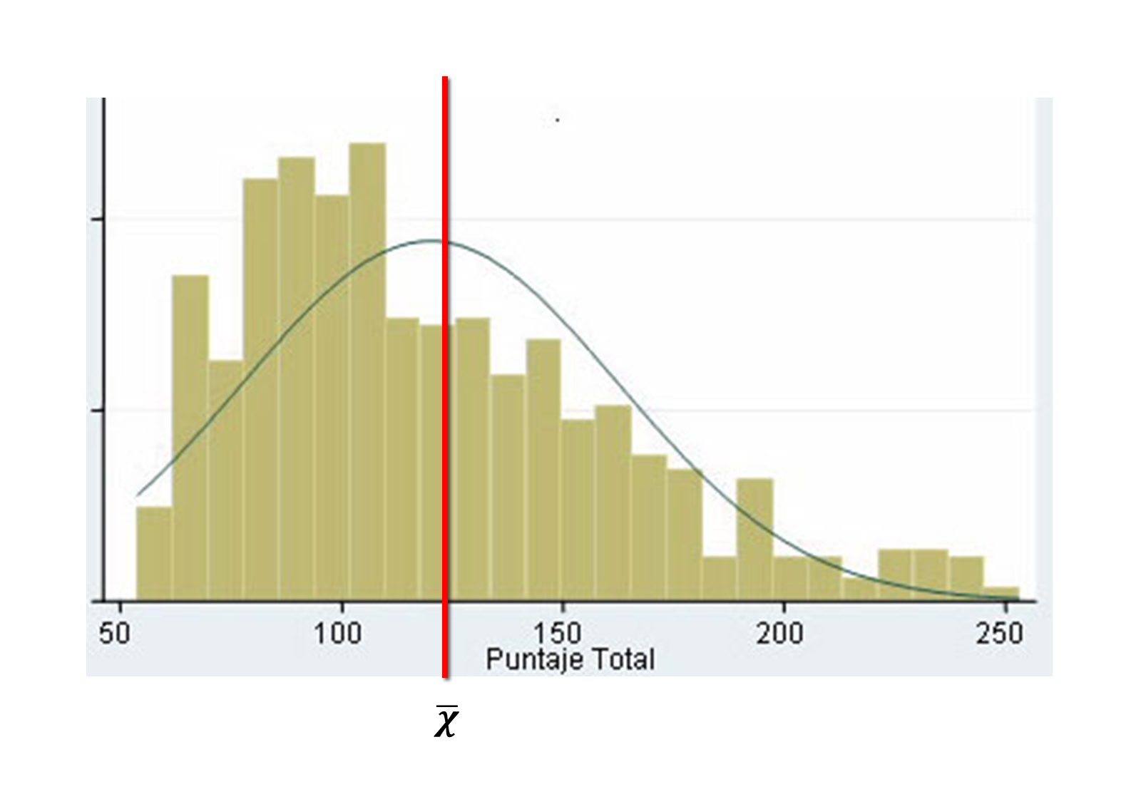
Mean in a skewed distribution

Slide 44
Median and quartiles
Asymmetric distribution; non-parametric distribution
Median: centralization
Quartiles: variability; interquartile range (IQR): variability
10th percentile, P₁₀: 10% of the data lie below this boundary and 90% above

Slide 45
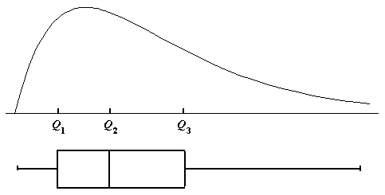
Quartiles and the boxplot

Slide 46
Median
Sample (X₁, X₂, … X_{n}): reorder the data from lowest to highest
$$x_{(1)}≤x_{(2)}≤…≤x_{(n)}$$
X₍₁₎: minimum; X_{(n)}: maximum — between them, the “range”

Slide 47
Median — calculation
$n$ odd:
$$\text{Median}=x_{\left(\frac{n+1}{2}\right)}$$
$n$ even:
$$\text{Median}=\frac{x_{\left(\frac{n}{2}\right)}+x_{\left(\frac{n}{2}+1\right)}}{2}$$

Slide 48
Median — properties
It is not affected by extreme data: robust
Useful in asymmetric distributions
P₍₅₀₎ = Median = Quartile 2 (Q2)

Slide 49
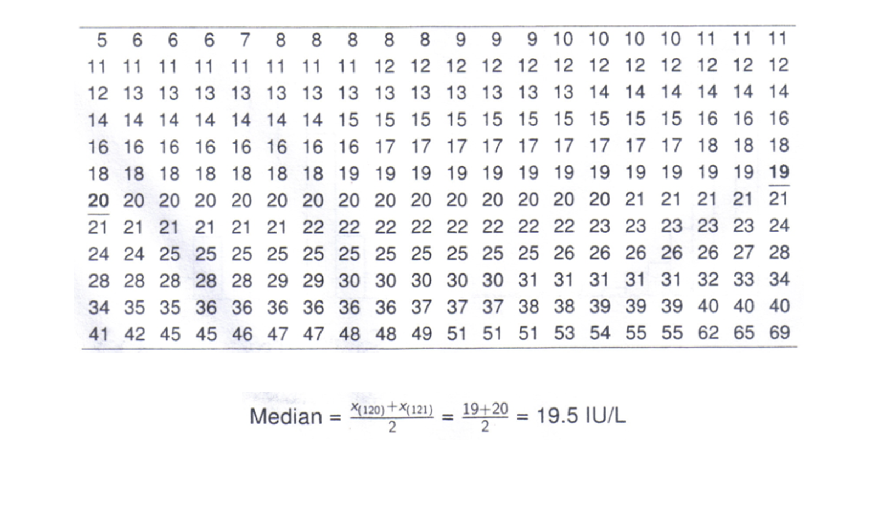
Data from 240 medical students (ALT)

Slide 50
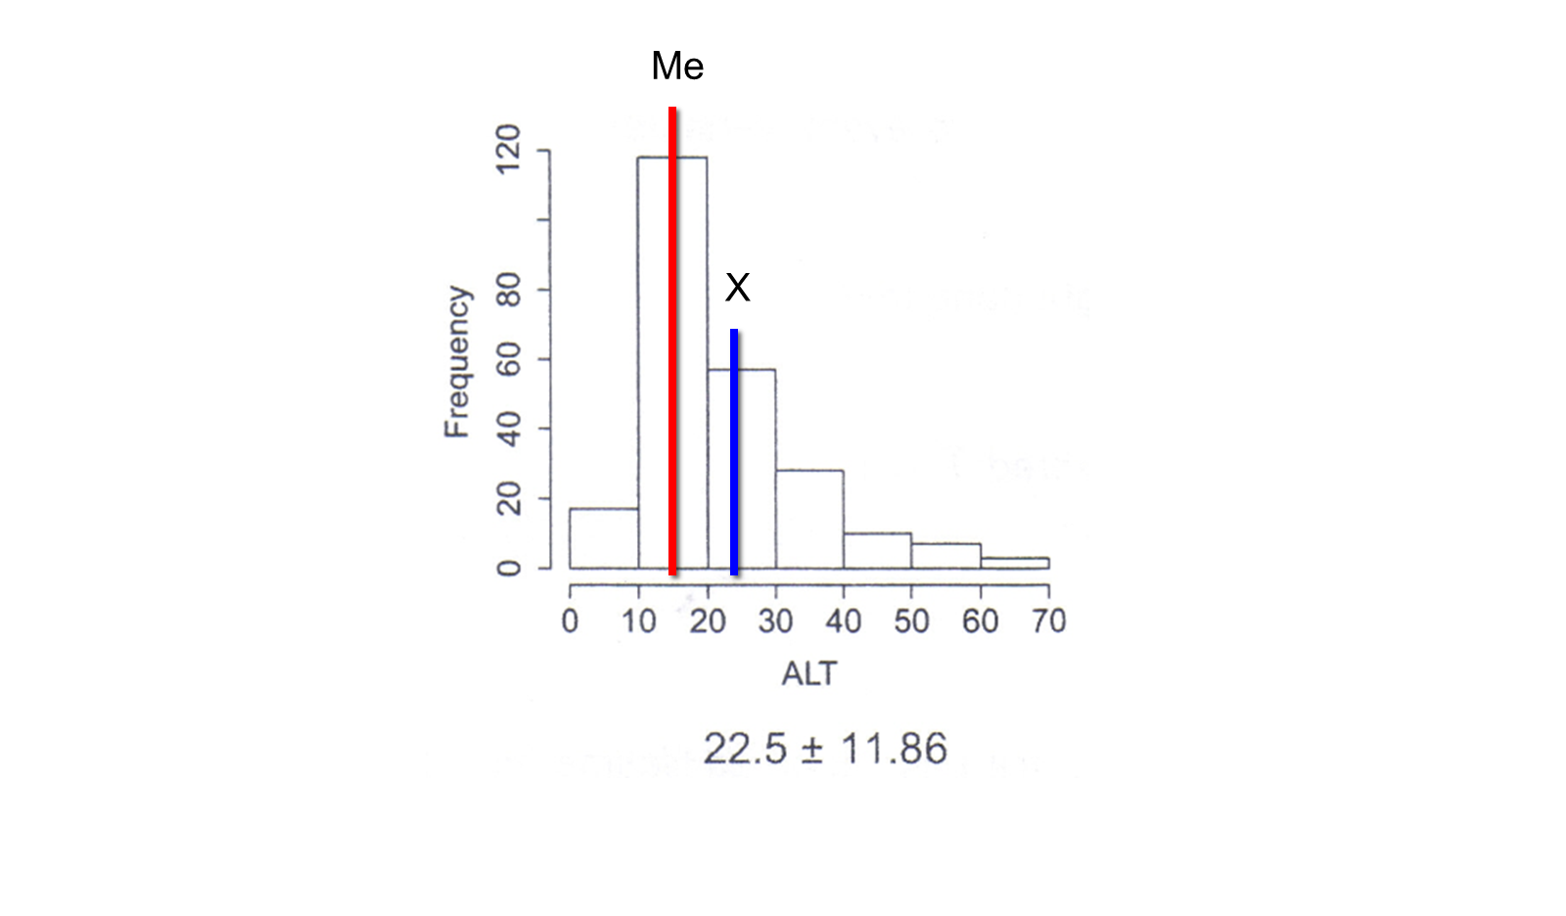
Data from 240 medical students (ALT) — histogram

Slide 51
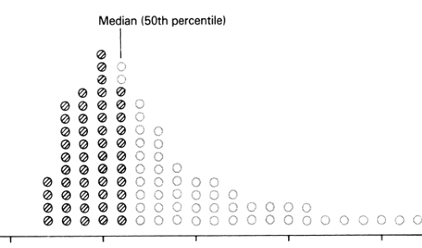
Median (50th percentile)

Slide 52
Median and IQR
Useful in asymmetric distributions
Robust parameters
The IQR contains 50% of the data
Components of the boxplot

Slide 53
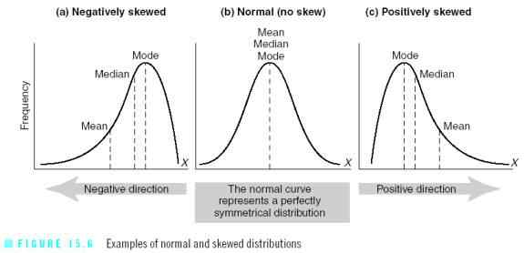
Distribution of the data
Mean > Median: right-skewed distribution · Mean < Median: left-skewed distribution

Slide 54
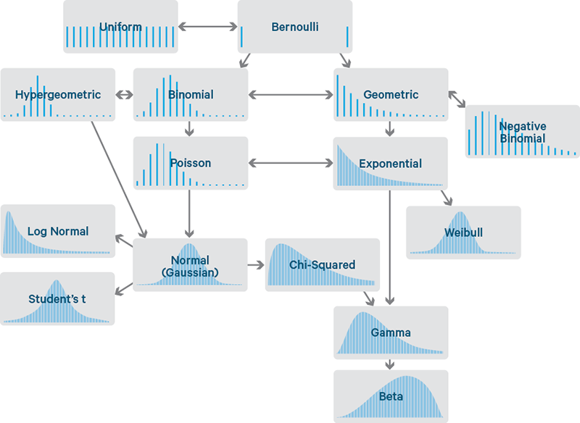
Families of distributions

Slide 55
Graphs in statistics
Fisher (1890-1962)
The type of graph depends on the type of data to summarize
Very useful to check and present the data — first step during analysis

Slide 56
Graphs by type of variable
Variable | Graphs
Qualitative | Bar graph, pie graph
Ordinal | Bar graph (ordered)
Discrete | Bar graph
Continuous | Histogram, density plot, frequency plot, box plot, scatter plot

Slide 57
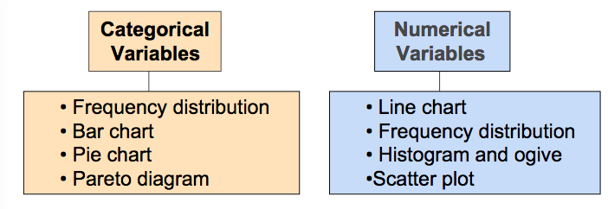
Graphs in statistics — overview

Slide 58
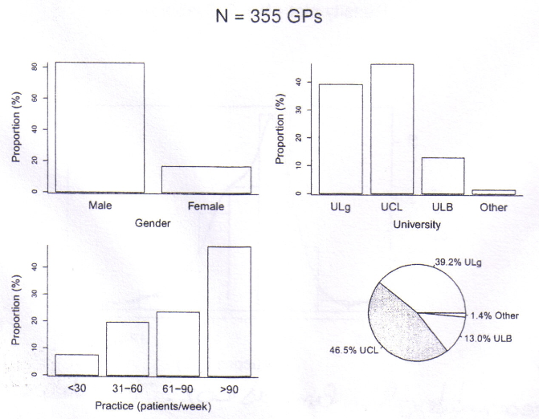
Qualitative data

Slide 59
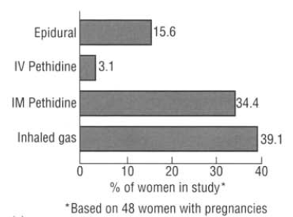
Qualitative data — bar chart

Slide 60
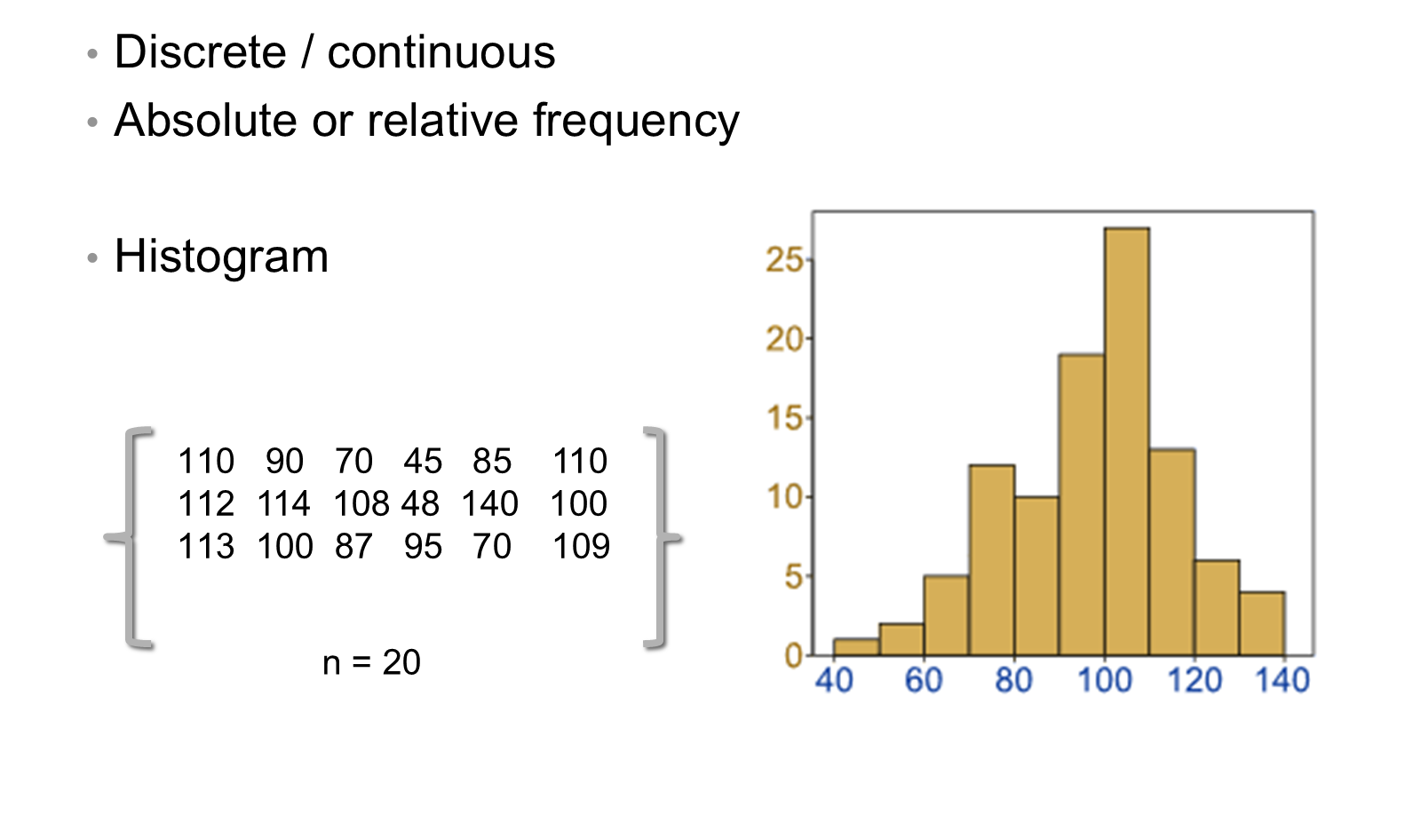
Quantitative data

Slide 61
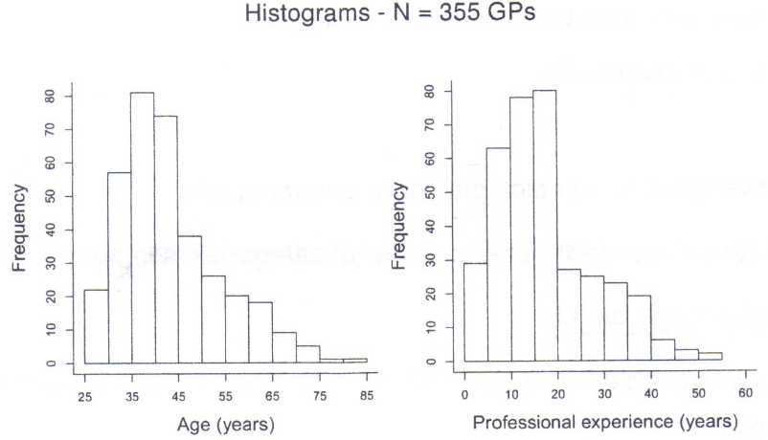
Histograms

Slide 62
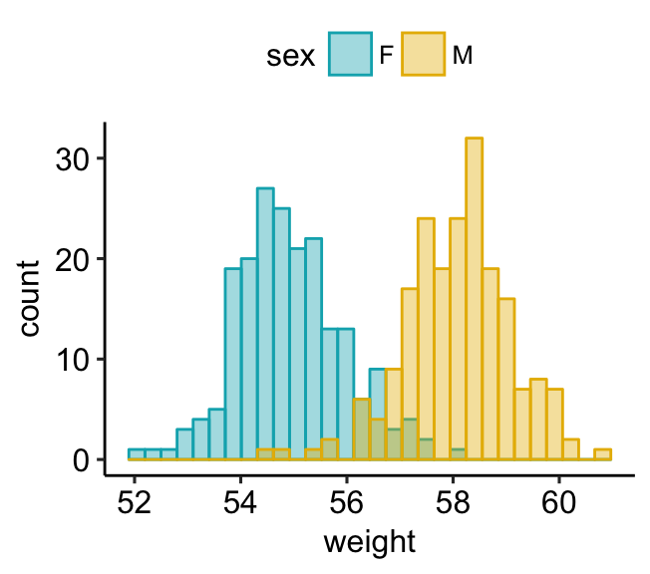
Histograms by group

Slide 63
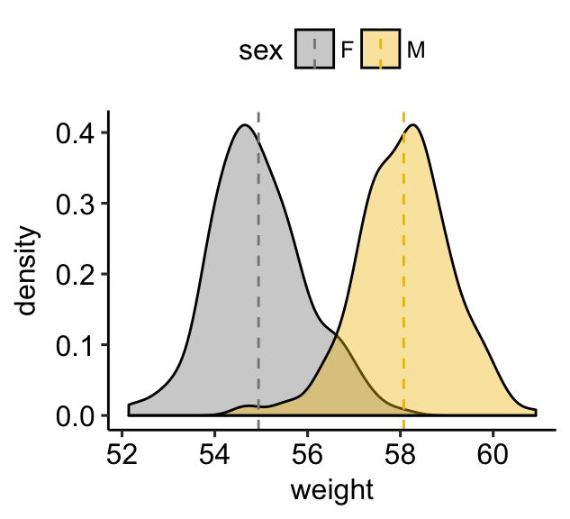
Density plots by group

Slide 64
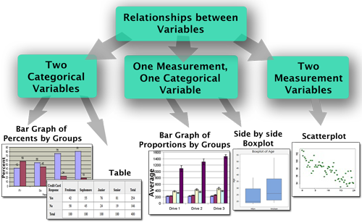
Relationships between variables

Slide 65
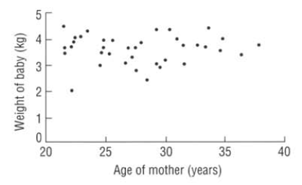
Scatter plot — outliers

Slide 66
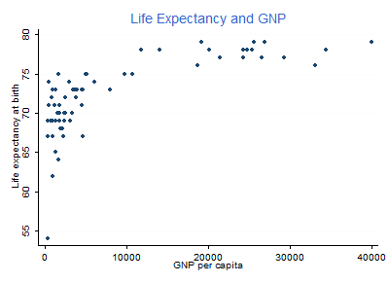
Scatter plot — life expectancy and GNP

Slide 67
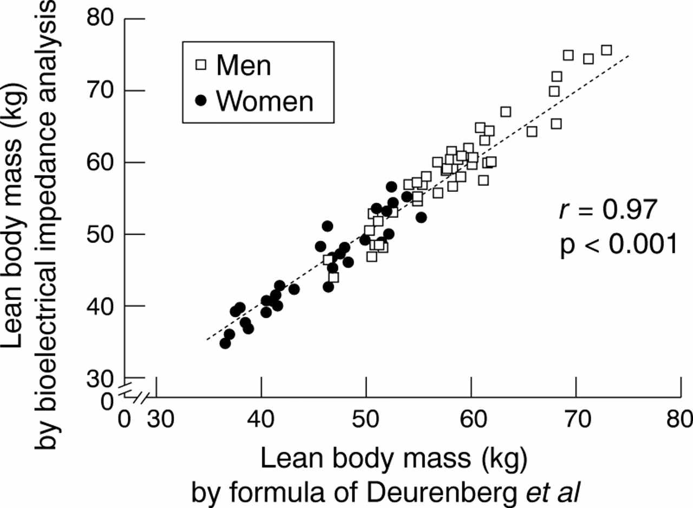
Scatter plot — agreement between methods

Slide 68
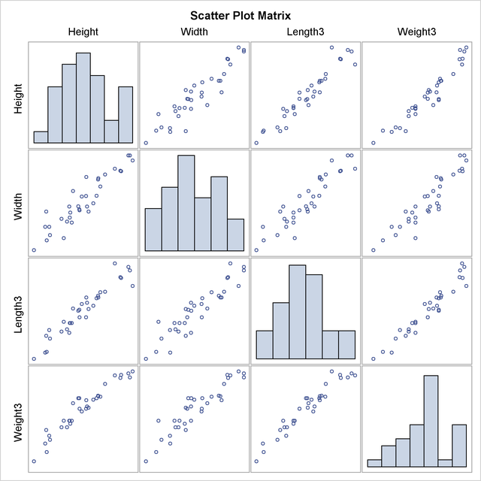
Scatter plot matrix

Slide 69
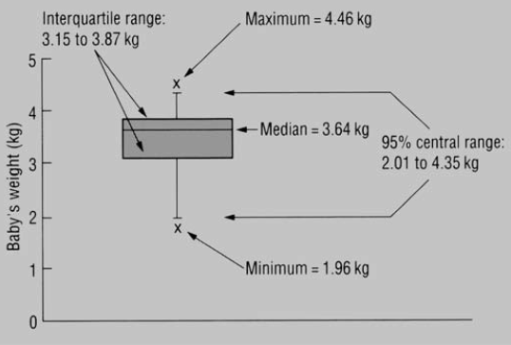
Boxplot

Slide 70
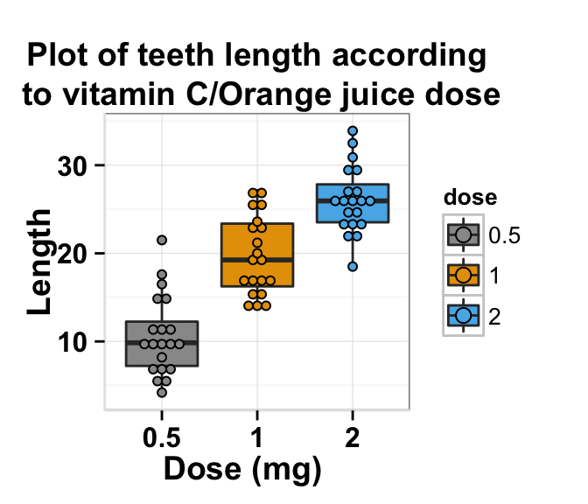
Boxplot with data points

Slide 71
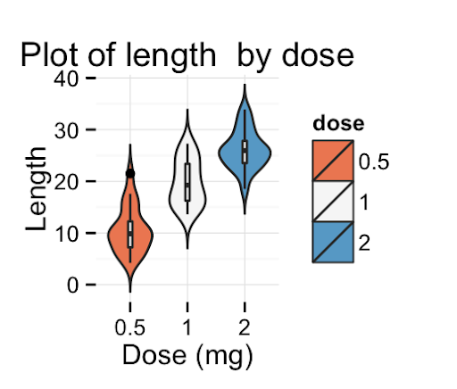
Violin plot 1

Slide 72
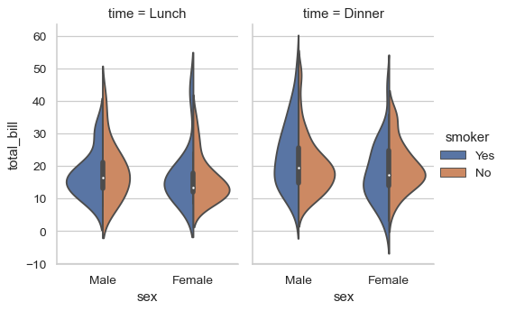
Violin plot 2

Slide 73
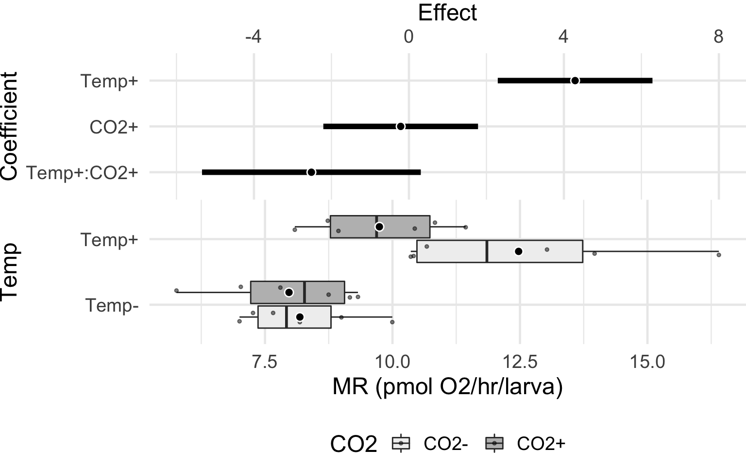
Harrell plot
Harrell, Frank E. 2014. “Principles of Graph Construction.”
Notes:
The plot has two parts. The lower part is a superimposed dot plot and box plot. The large circle for each treatment combination is the conditional mean. The upper part shows the effects and effect uncertainty. Here the effects are parameter estimates (coefficients) of the model and 95% confidence intervals of these estimates. Key: Temp- = 13°C, Temp+ = 18°C, CO2- = 400 µATM, CO2+ = 1100 µATM.

Slide 74
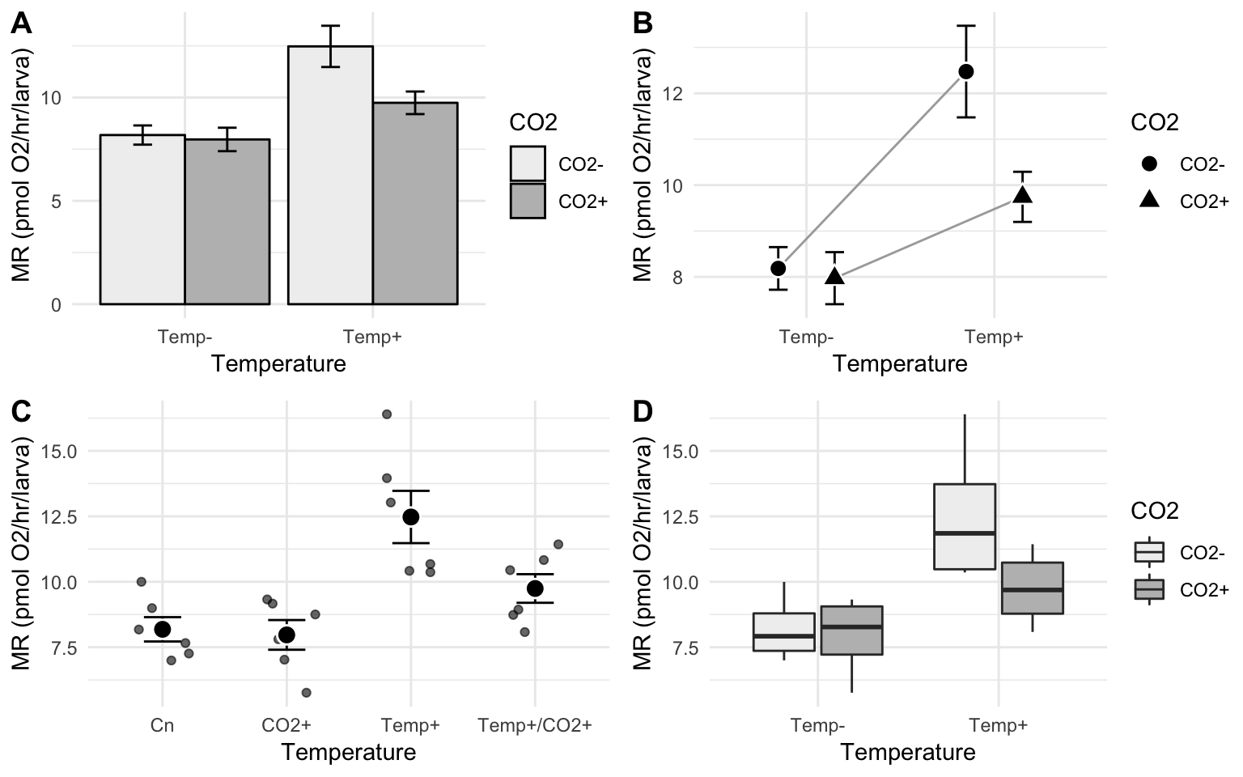
Harrell plots vs. common alternatives
https://www.middleprofessor.com/files/quasipubs/harrell_plot_intro.html
Notes:
bar plot, (B) interaction plot, (C) dot plot, (D) box plot. In all four plot types, the treatment effects are inferred by mentally computing the distance between treatment means (or median in case of the box plot). The interaction effect is inferred in (C) by comparing obliqueness of the lines. The uncertainty in treatment effects and especially the interaction effect cannot be inferred from any of the plots A-D.

Slide 75
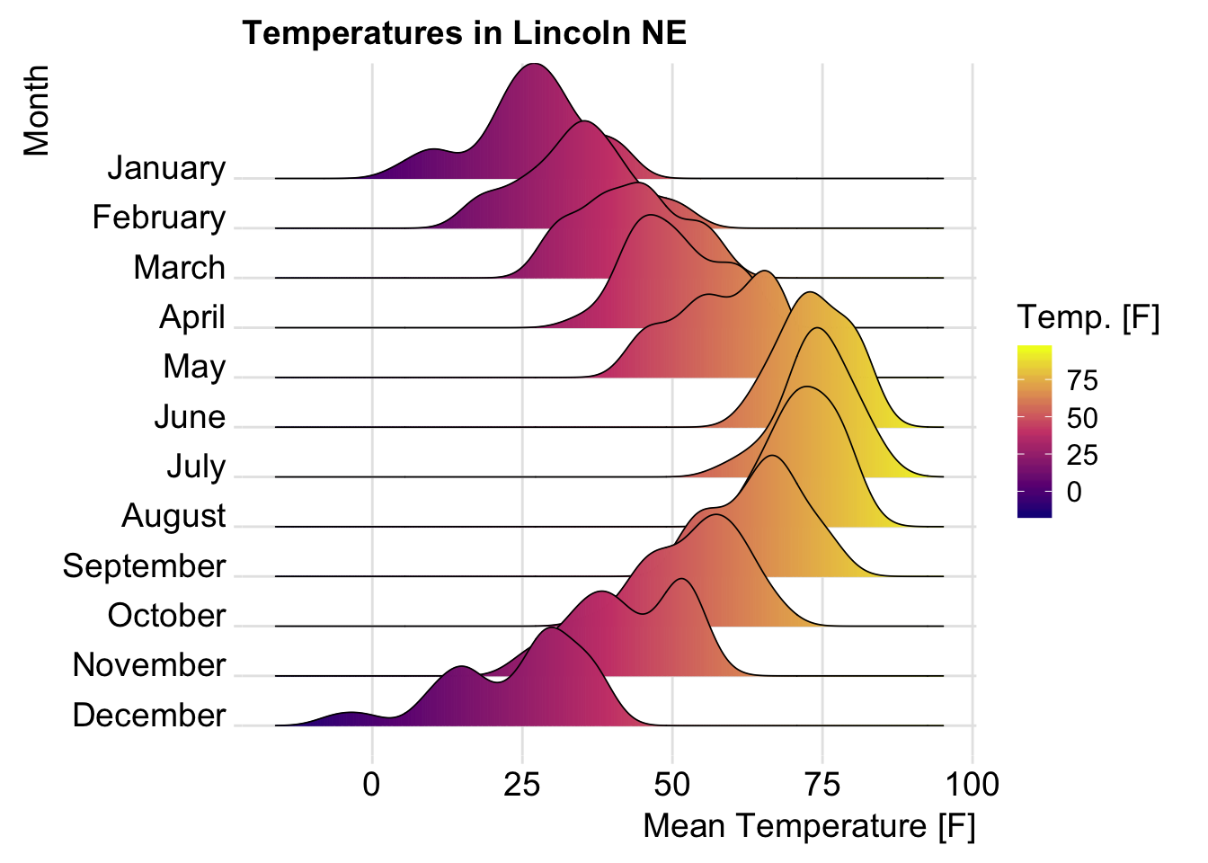
Ridgeline plot

Slide 76
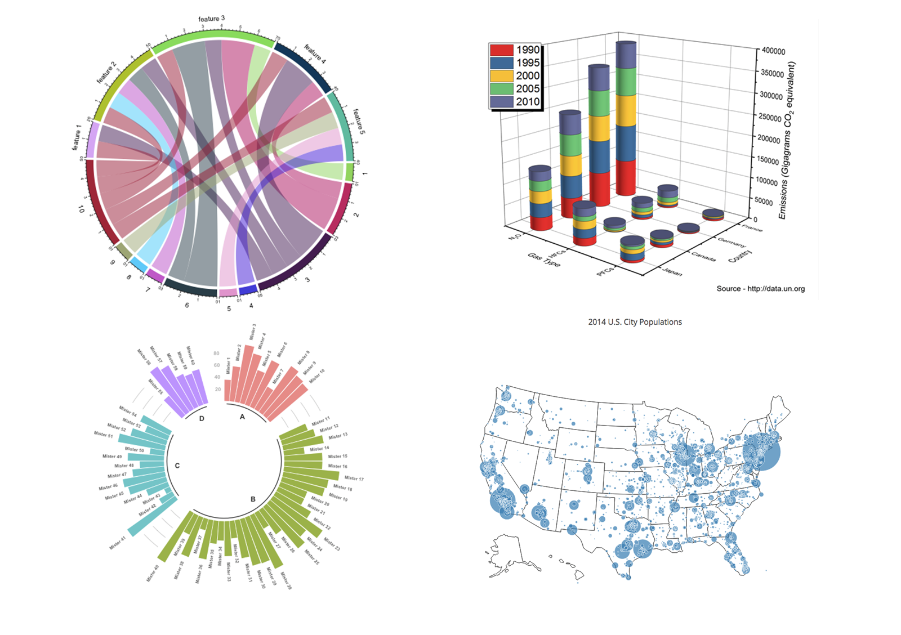
More complex graphs

Slide 77
Tufte’s views on graphical excellence
“Excellence in statistical graphics consists of complex ideas communicated with clarity, precision, and efficiency.”

Slide 78
Tufte — graphical displays should (1/2)
Show the data
Induce the viewer to think about the substance rather than about methodology, graphic design, the technology of graphic production, or something else
Avoid distorting what the data have to say
Present many numbers in a small space
Make large data sets coherent

Slide 79
Tufte — graphical displays should (2/2)
Encourage the eye to compare different pieces of data
Reveal the data at several levels of detail, from a broad overview to the fine structure
Serve a reasonably clear purpose: description, exploration, tabulation, or decoration
Be closely integrated with the statistical and verbal descriptions of a data set

Slide 80
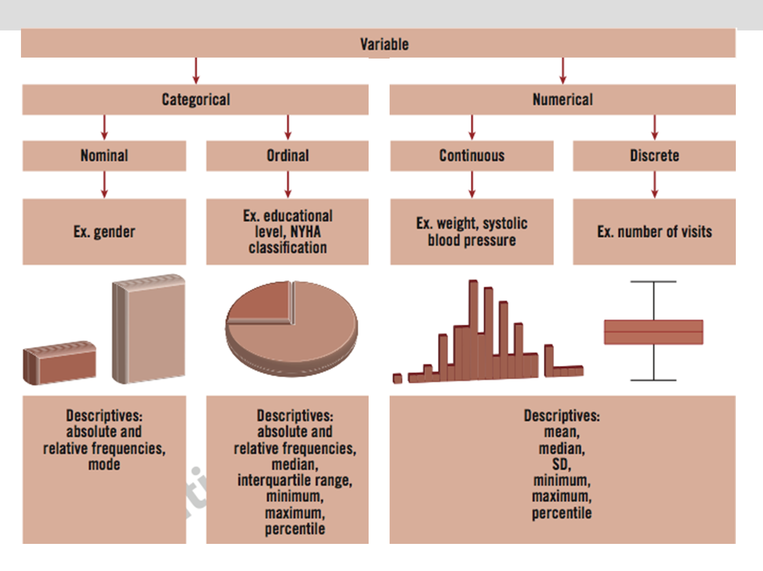
Summary: variables, descriptives and graphs

Slide 81
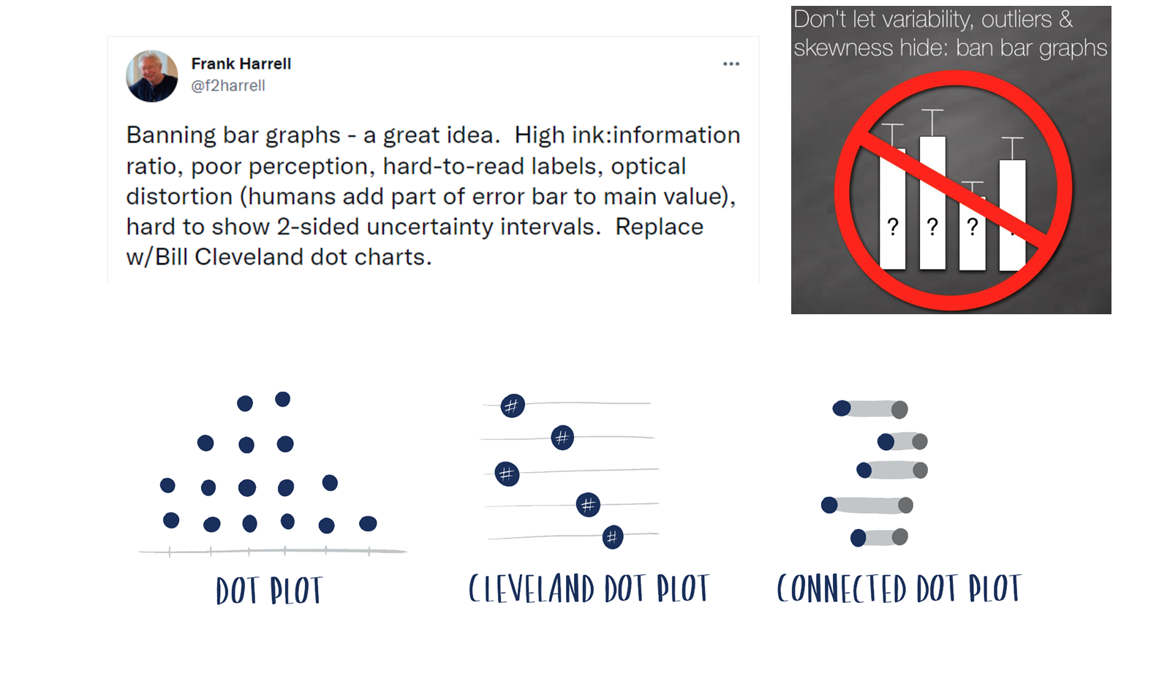
Banning bar graphs

Slide 82
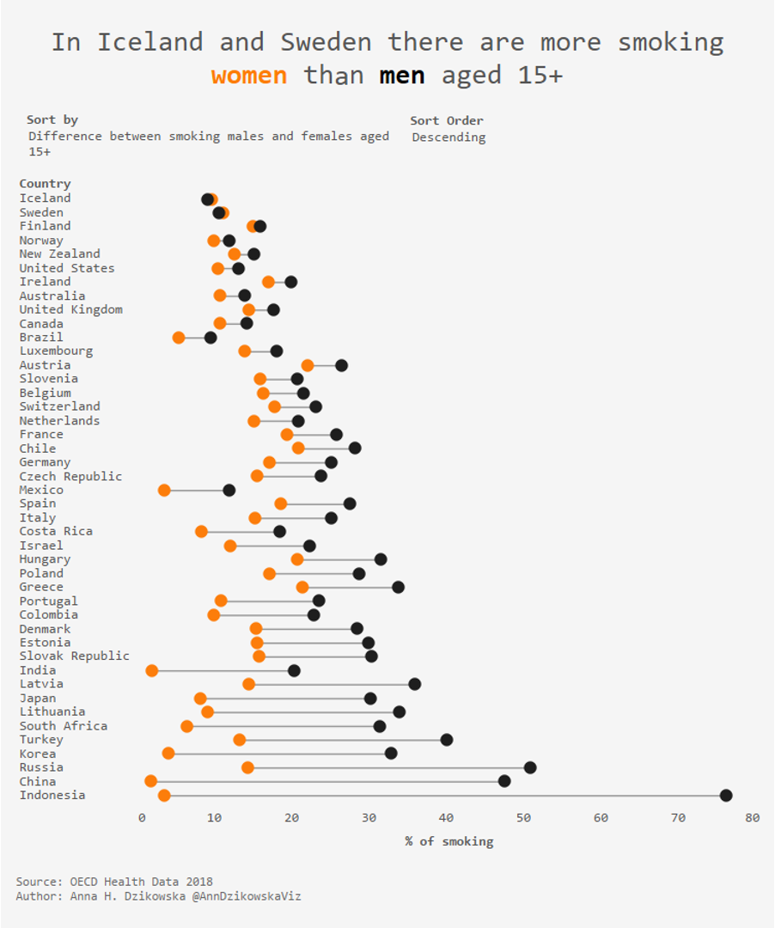
Dot plot example

Slide 83
Descriptive statistics / Describing data
To look slowly at the data
To discover trends
To show relationships
To what end?
To find the best approach to show it
To increase the comprehension of the data
To give utility to the data

Slide 84
Measures of Occurrence, Association and Effect

Slide 85
Measures of occurrence, association and effect
To describe the occurrence of an event of interest (X)
When we have two variables (X, Y) there is an interest in their degree of “association”
Measures of occurrence: risks, rates, incidence, prevalence
Measures of association:
Absolute: absolute risk and absolute risk reduction (ARR)
Relative: odds, relative risk, odds ratio, hazard ratio
Pearson linear “correlation” coefficient

Slide 86
Risk and basic measures of frequency
Risk: probability of an event occurring (illness, death…) — a measure of frequency and a measure of association
Basic measures of frequency
Incidence (incident or new cases): proportion or rate
Prevalence (prevalent or existing cases): point or period prevalence

Slide 87
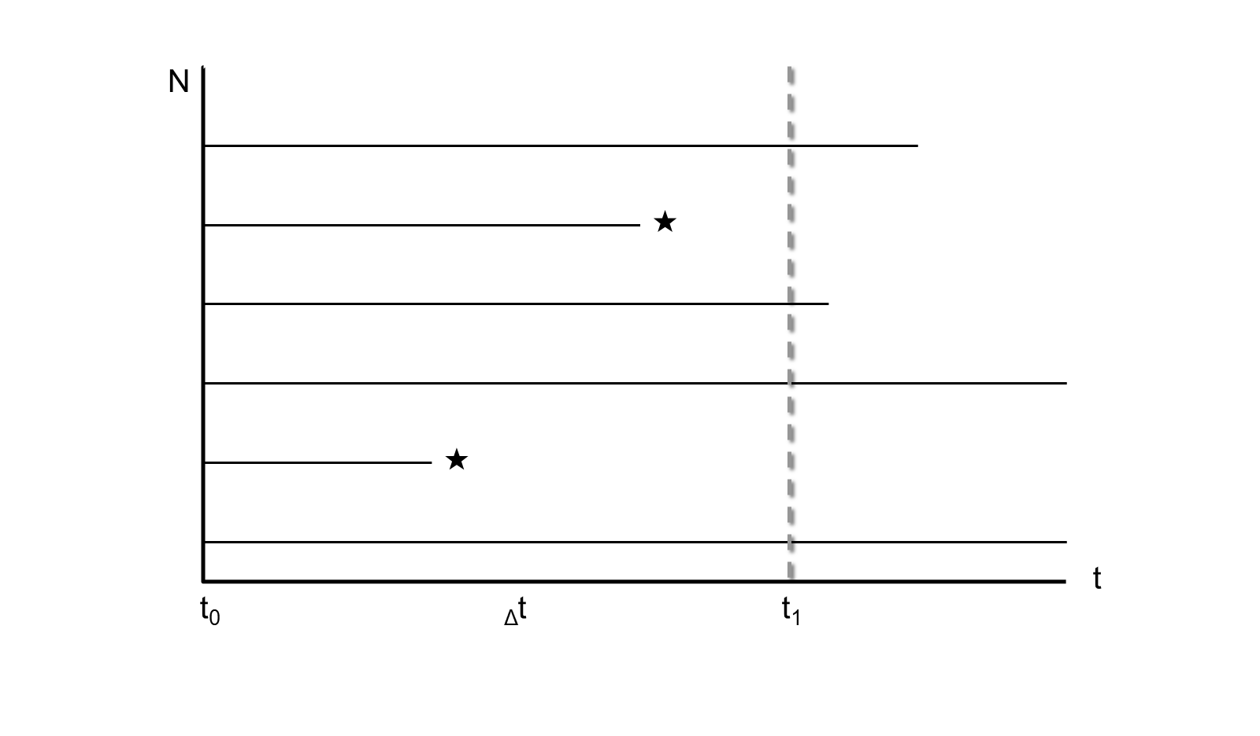
Risk — Incidence

Slide 88
Risk — Cumulative incidence (CI)
$$CI=\frac{\text{Number of new events}}{\text{Total population at risk}}$$
It is a proportion (cases / total) — a fraction (%)
Represents risk (from 0 to 1)
Requires a time specification
It requires defining the “population at risk”
Absence of losses (complete follow-up)

Slide 89
Risk — Cumulative incidence: examples and uses
Examples
5-year mortality of patients diagnosed with lung cancer
Mortality within 30 days of ICU admission
10-year incidence of gastric cancer in general practitioners
Uses in health sciences: (absolute) risk — fatality, lethality, mortality, 5-year survival…

Slide 90

Risk — “Rate”
It is a measure of “how fast something happens”: 1 hour, 60 km → average rate = 60 km/h

Slide 91
Risk — Incidence rate (IR)
Incidence rate (velocity), event rate
It is a density — NOT a ratio or proportion
Allows risk estimation only indirectly
$$IR=\frac{\text{Number of new events}}{\text{Person−time free of the event}}$$
Definition: number of subjects presenting the event per unit of subject-follow-up time at risk of the particular event

Slide 92
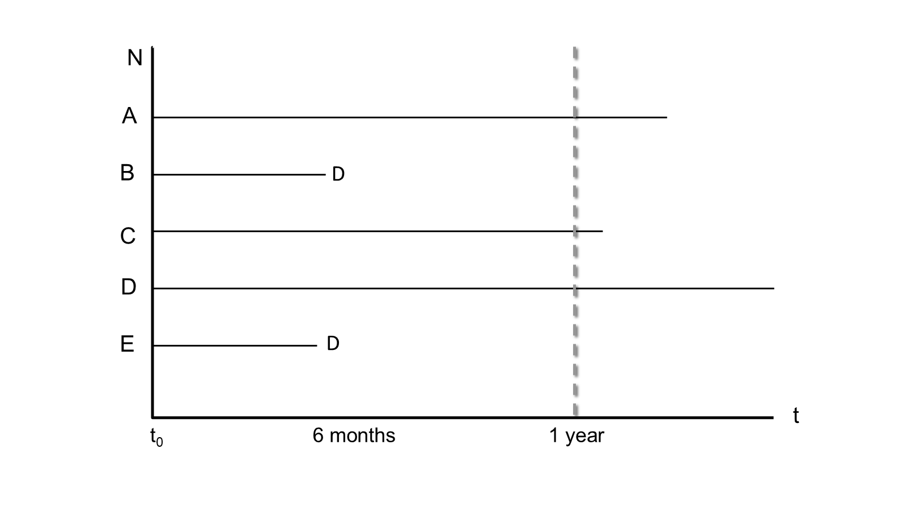
CI versus IR

Slide 93
CI versus IR — calculation
Cumulative incidence (CI) | Incidence rate (IR)
CI = 2 / 5 = 0.4 | IR = 2 / (3 + 0.5 + 0.5) = 2 / 4
Cumulative incidence of AMI at 1 year is 40% | Incidence rate of 0.5 per person-year (5 per 10 person-years)

Slide 94
IR (incidence rate) — example
5 new cases per 10 person-years
Interpretation:
On average, 5 new cases occur for every 10 years of observation in a cohort of disease-free subjects
Its interpretation is not easy to use for the prediction of risk at the individual level
It becomes useful at the population level or in research

Slide 95
Risk vs Rate
Cumulative incidence | Incidence rate
Proportion (0 – 1) | Describes how quickly new events occur in a population
Probability that an individual will develop the disease in a certain time | Useful in etiological comparisons (causality)
Used for individual prognosis | Low use at the individual level
Does not take into account situations such as loss to follow-up or competing risks | Can handle situations such as loss to follow-up or competing risks
Easy to quantify in small populations without major losses | Can be calculated in large populations or with losses during follow-up

Slide 96
Mortality
It can be expressed as cumulative incidence (proportion) or as a rate
Classification as a rate is used in vital statistics
$$MR=\frac{\text{All−cause deaths}}{{\text{Population at risk}}^{∗}}×100,000$$
MR: mortality rate, with deaths and population at risk measured over the same period
*Population at risk at the middle of the period (year)

Slide 97
Risk — Prevalence
Existing cases / total population
Cases that are present
Proportion (%), ranges from 0 to 1
Point or period

Slide 98
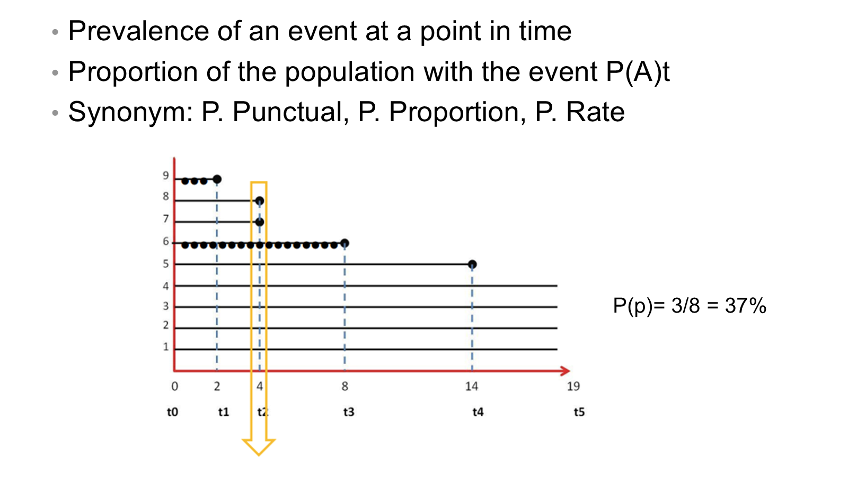
Point prevalence

Slide 99
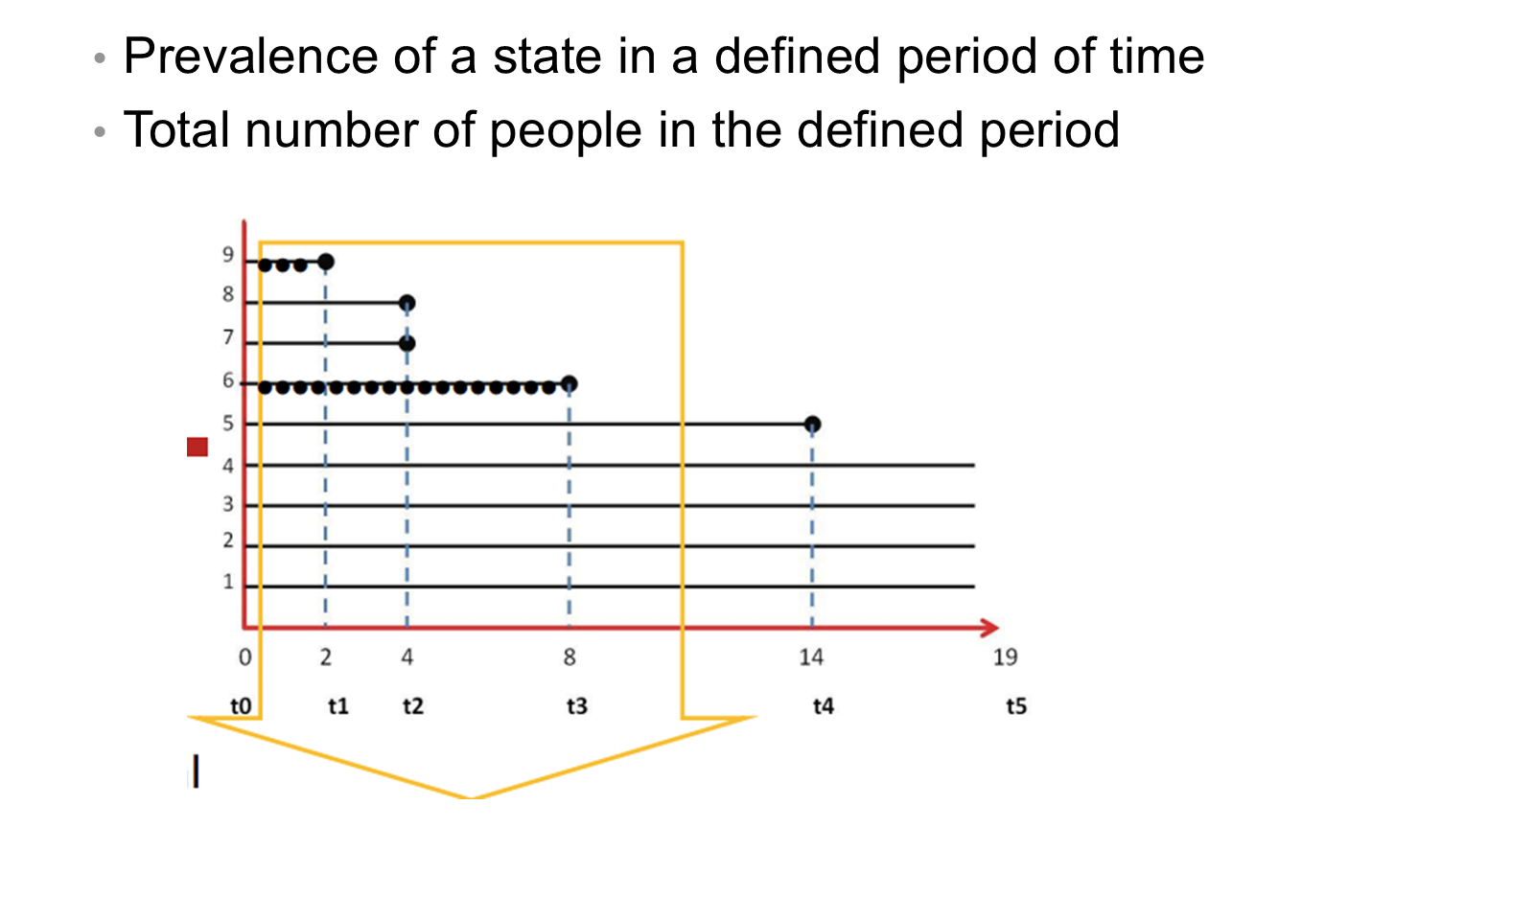
Period prevalence
Period prevalence (years 1 to 4): P(per) = 4/9 = 44%

Slide 100
Point / Period
Point prevalence: proportion of people experiencing the clinical event (case) at a given point in time. It is a cut at a given moment, in which the CASES are counted.
Period prevalence: proportion of cases. It includes those who fell ill in previous periods and who are still CASES (existing and new). Each person represented in the numerator had the disease at some point during the specified period.

Slide 101
Prevalence and incidence relationship
$$\text{Prevalence}=IR×\text{duration of the disease}$$
*Only useful in cases of low IR
Prevalence depends on INCIDENCE
A high incidence produces a high prevalence if the duration of cases does not change
Prevalence depends on the DURATION of the disease (recovered, dead, migrated)

Slide 102

Incidence, prevalence and outflow
Gordis. Epidemiology, 4th Edition. Relationship between incidence and prevalence.

Slide 103
2 × 2 table
 | Outcome: Yes | Outcome: No | Total
Exposed | a | b | a+b
Non exposed | c | d | c+d
Total | a+c | b+d | a+b+c+d

Slide 104
2 × 2 table — frequency measures
Frequency measurements can be extracted:
CI (exp) = a / (a+b)
CI (non exp) = c / (c+d)
CI = (a+c) / (a+b+c+d)
Prevalence = (a+c) / (a+b+c+d)

Slide 105

Absolute association measures

Slide 106
Relative association measures: relative risk / CIR
 | Outcome: Yes | Outcome: No | Total
Exposed | a | b | a+b
Non exposed | c | d | c+d
Total | a+c | b+d | a+b+c+d

Slide 107
Relative risk / CIR — formula
The relative risk is a ratio of cumulative incidences — the cumulative incidence ratio (CIR):
$$CIR=\frac{CI_{\text{exposed}}}{CI_{\text{non exposed}}}=\frac{\frac{a}{a+b}}{\frac{c}{c+d}}$$
RR = 1: no association between categories and outcome
RR > 1: positive association or risk
RR < 1: negative association or less risk (protective)

Slide 108
Relative risk — example (Honolulu Heart Programme, Abbot, 1980)
Cohort | Yes | No | Total
Smokers | 171 | 3264 | 3435
Non-smokers | 117 | 4320 | 4437
Total | 228 | 7584 | 7872

Slide 109
Relative risk — example calculation
Cerebral thrombosis after 12-year follow-up:
CI (smokers) = 171 / 3435 = 0.049 in 12 years of follow-up
CI (non-smokers) = 117 / 4437 = 0.026 in 12 years of follow-up
$$RR (CIR)=\frac{CI_{\text{exposed}}}{CI_{\text{non exposed}}}=\frac{0.049}{0.026}=1.89$$

Slide 110

Odds

Slide 111
Odds — risk vs odds
Risk (CI) = 10 / 100 = 0.1 = 10%
Odds = 10 / 90 = 0.11 = 11%
Odds: the relationship between the probability of occurrence of an event and the non-occurrence of the same event

Slide 112
Odds ratio
Useful association measure when the entire exposed population is not available
Useful in case-control studies but applicable to any study data
Flexible mathematical properties (0 – infinite); the numerator is not included in the denominator

Slide 113
Odds ratio — 2 × 2 table
 | Cases | Controls
Exposed | a | b
Non exposed | c | d
Total | a+c | b+d

Slide 114
Odds ratio — formula
Odds (exp) = a / b; Odds (non exp) = c / d
$$\text{Odds Ratio}=\frac{a/b}{c/d}=\frac{a×d}{c×b}$$

Slide 115

Odds ratio — example (MacMahon et al., NEJM, 1981)

Slide 116
RR and OR interpretation (1/2)
Both indicate magnitudes of association
The RR is the ratio of two cumulative incidences (risks). As a direct risk assessment, it is appropriate to refer to the RR as “risk”
  RR = 1.8: compared to the control group, the intervention group had a 1.8-fold increased risk of developing side effects
When interpreting the OR, it is preferable to speak of “times more likely” and avoid the term “risk”
  OR = 1.8: compared to the control group, the intervention group was 1.8 times more likely to develop side effects

Slide 117
RR and OR interpretation (2/2)
When the outcome event is infrequent (< 10%), the OR and RR approach each other
When interpreting the clinical significance of an outcome expressed as an OR, it should be treated as an RR (most of the time)

Slide 118

Risk “vs” Odds
Effective Clinical Practice, May/June 2000, Volume 3, Number 3

Slide 119
Clarifying some concepts
What (exactly) is a risk factor?*
*Think in prediction versus explanation

Slide 120

Is caviar a risk factor for being a millionaire?
BMJ 2016;355:i6536 doi: 10.1136/bmj.i6536

Slide 121
The risk factor approach
The risk factor approach to epidemiology was introduced by the Framingham Heart Study investigators, who first alluded to the idea in 1951 and introduced it in 1961
The semantic confusion has hindered precise communication about study design and data analysis
You have a secretive friend, and among other questions, you are interested in knowing whether he is a millionaire. You are aware that there are some attributes, or risk factors, that are thought to be linked to being a millionaire

Slide 122
Four broad objectives of clinical research
Clinical research can generally be divided into four broad objectives based on the intended use of the information obtained by the study:
Diagnosis
Prognosis
Treatment effects
Aetiology

Slide 123

Objectives and definitions of risk factor

Slide 124
Therefore…
When conducting observational studies, data analysis needs to be designed to match the particular definition that is being considered
The definition of “risk factor” will vary depending on whether a research question is exploring diagnosis, prognosis, treatment effects, or aetiology
Unless a definition is specified, it is not possible for readers of research papers to understand what the investigators attempted to learn, or to evaluate whether they succeeded in their objectives

