Slide 1



Statistical Inference, Hypothesis Testing and Analysis of Continuous Outcomes
Section 3 — Introduction to Biostatistics
Jose Andres Calvache MD MSc PhD

Slide 2
Statistical Inference and Estimation

Slide 3
Population and sample
Population — PARAMETERS | Sample — ESTIMATES (“estimands”)
Mean (μ) | Mean (x̄)
Standard deviation (σ) | Standard deviation (s)
Proportion (P) | Proportion (p)
Incidence | Incidence
Prevalence | Prevalence
RR | RR
OR… | OR…
Notes:
An estimator is a numerical quantity calculated on a sample that we expect to be a good approximation of a quantity with the same meaning in the population (the parameter).
For the mean of a population, “the best” estimator is the sample mean.
For the relative frequency of a category of a variable, “the best” estimator is the relative frequency in the sample.
An estimator, in contrast to an estimand, is a formula or algorithm used to estimate the target quantity from the clinical trial data, such as the difference in sample means between 2 treatment groups, or the Kaplan-Meier estimator of a survival curve. Statistical inference for an estimand requires a choice of the estimator and a measure of its precision. Typical methods of statistical inference are hypothesis tests, confidence intervals, and posterior credibility intervals in a Bayesian analysis. The estimate is the numeric value obtained when the estimator is applied to the actual data from the trial.

Slide 4
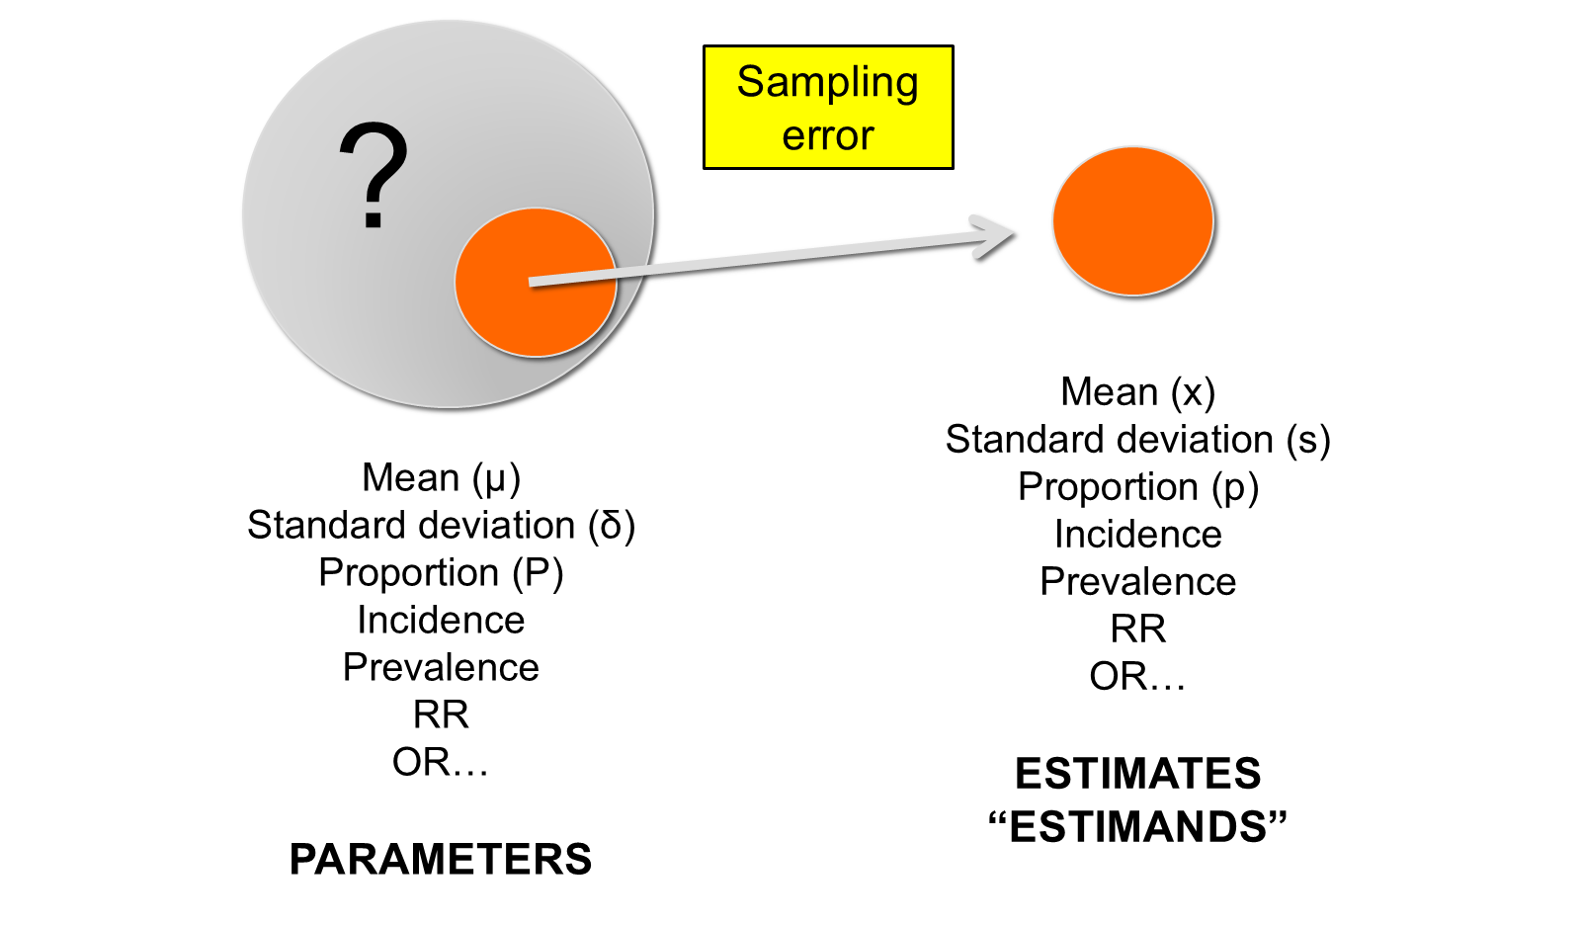
Population and sample — sampling error
From the population (parameters, unknown “?”) to the sample (estimates): the difference is the sampling error

Slide 5
Random sample
It is a random selection of subjects from a population
Technically “it is representative” of the population regardless of its size
In this sampling technique, each individual in the population is equally likely to be selected in the sample
Notes:
Sampling variability.
The most complex part of the statistical process.
Fisher: the study of variability.
Variability due to sampling introduces a crucial concept: the standard error (SE).
This area of statistics opens the door to inference.

Slide 6
Simple sampling
Extracting a sample n from a population P is no easy task
Simple sampling (3 conditions):
  n must be fixed
  Subjects are randomly selected (all have the same probability of being selected) and this is independent
  Subjects are extracted from an unchanged population
There are various sampling schemes: stratified, systematic, sequential

Slide 7
Simple sampling — human intervention
Always avoid human intervention in the selection of subjects, which would affect the inference process

Slide 8
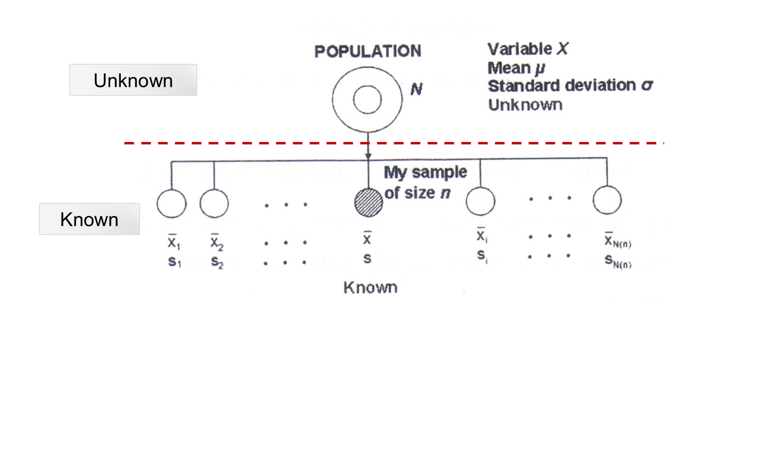
Sampling theory

Slide 9
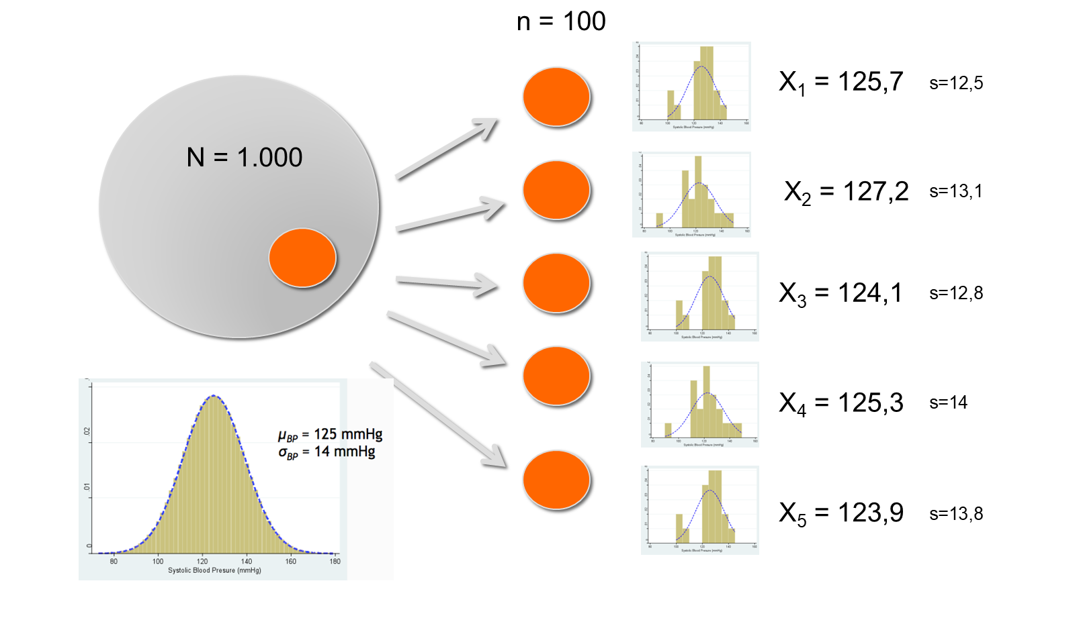
Consider this situation,
Population N = 1,000 (μ = 125 mmHg, SD = 13.5) and five random samples of n = 100

Slide 10
Five random samples (n = 100) from N = 1,000
Sample (n = 100) | Mean | SD (s)
1 | 125.7 | 12.5
2 | 127.2 | 13.1
3 | 124.1 | 12.8
4 | 125.3 | 14.0
5 | 123.9 | 13.8

Slide 11
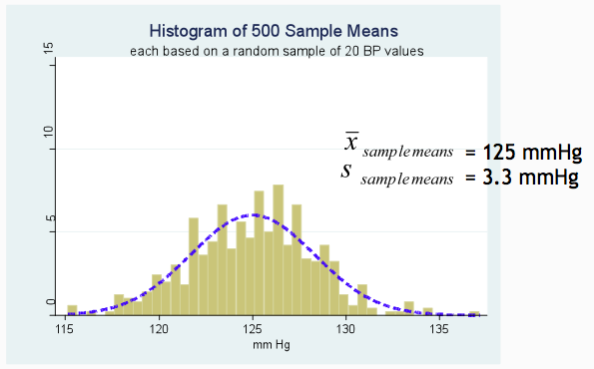
“The mean” of the sampling means
The standard deviation of the sample means is the Standard Error of the Mean (SEM)

Slide 12
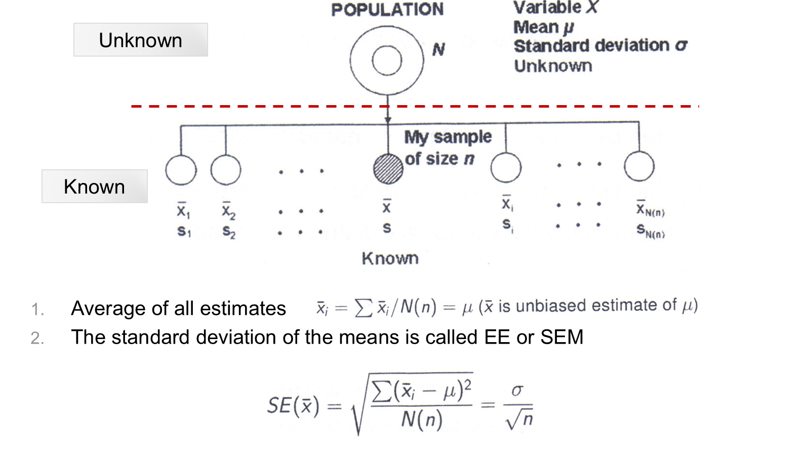
Sampling theory — SEM

Slide 13
Standard error of the mean (SEM)
$$SE(\overset{‾}{x})=\sqrt{\frac{∑({\overset{‾}{x}}_{i}−μ)^{2}}{N(n)}}=\frac{σ}{\sqrt{n}}$$
Very important concept in statistics
The greater the $σ$, the larger the SEM
The higher the $n$, the smaller the SEM
Precision depends on variability and $n$

Slide 14

The normal distribution — Gauss
Carl Friedrich Gauss on the 10 Deutsche Mark banknote, with the normal (Gaussian) curve

Slide 15
The normal distribution
Organization of naturally appearing “population” data
  Systolic blood pressure, body temperature, size, weight
It is characterized by two parameters: the mean ($μ$) and the standard deviation ($σ$)
$N(μ,σ)$ (centralization and variability)

Slide 16
The normal distribution — properties
Symmetrical; mean and median match
At a distance from the mean:
  $μ±1 σ$ = 68% of the data
  $μ±1.96 σ$ = 95% of the data
  $μ±2.5 σ$ = 99% of the data

Slide 17
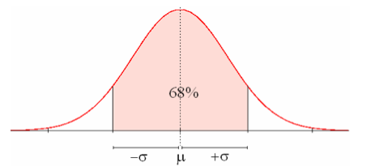
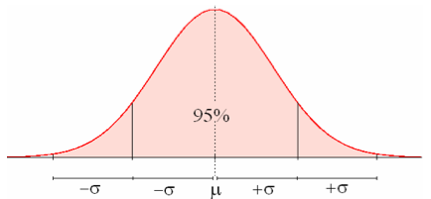
The normal distribution — 68% and 95%

Slide 18
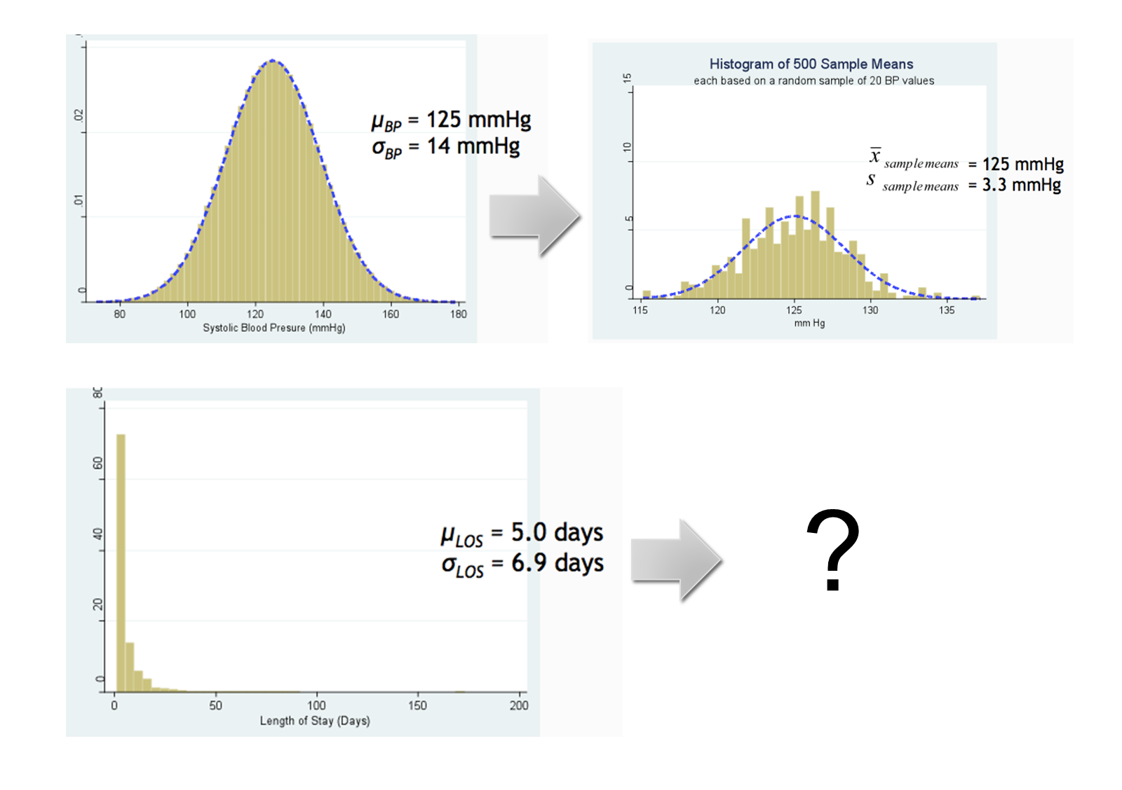
Sampling distribution — blood pressure
Systolic blood pressure (normal) → 500 sample means; and a skewed variable (length of stay)?

Slide 19
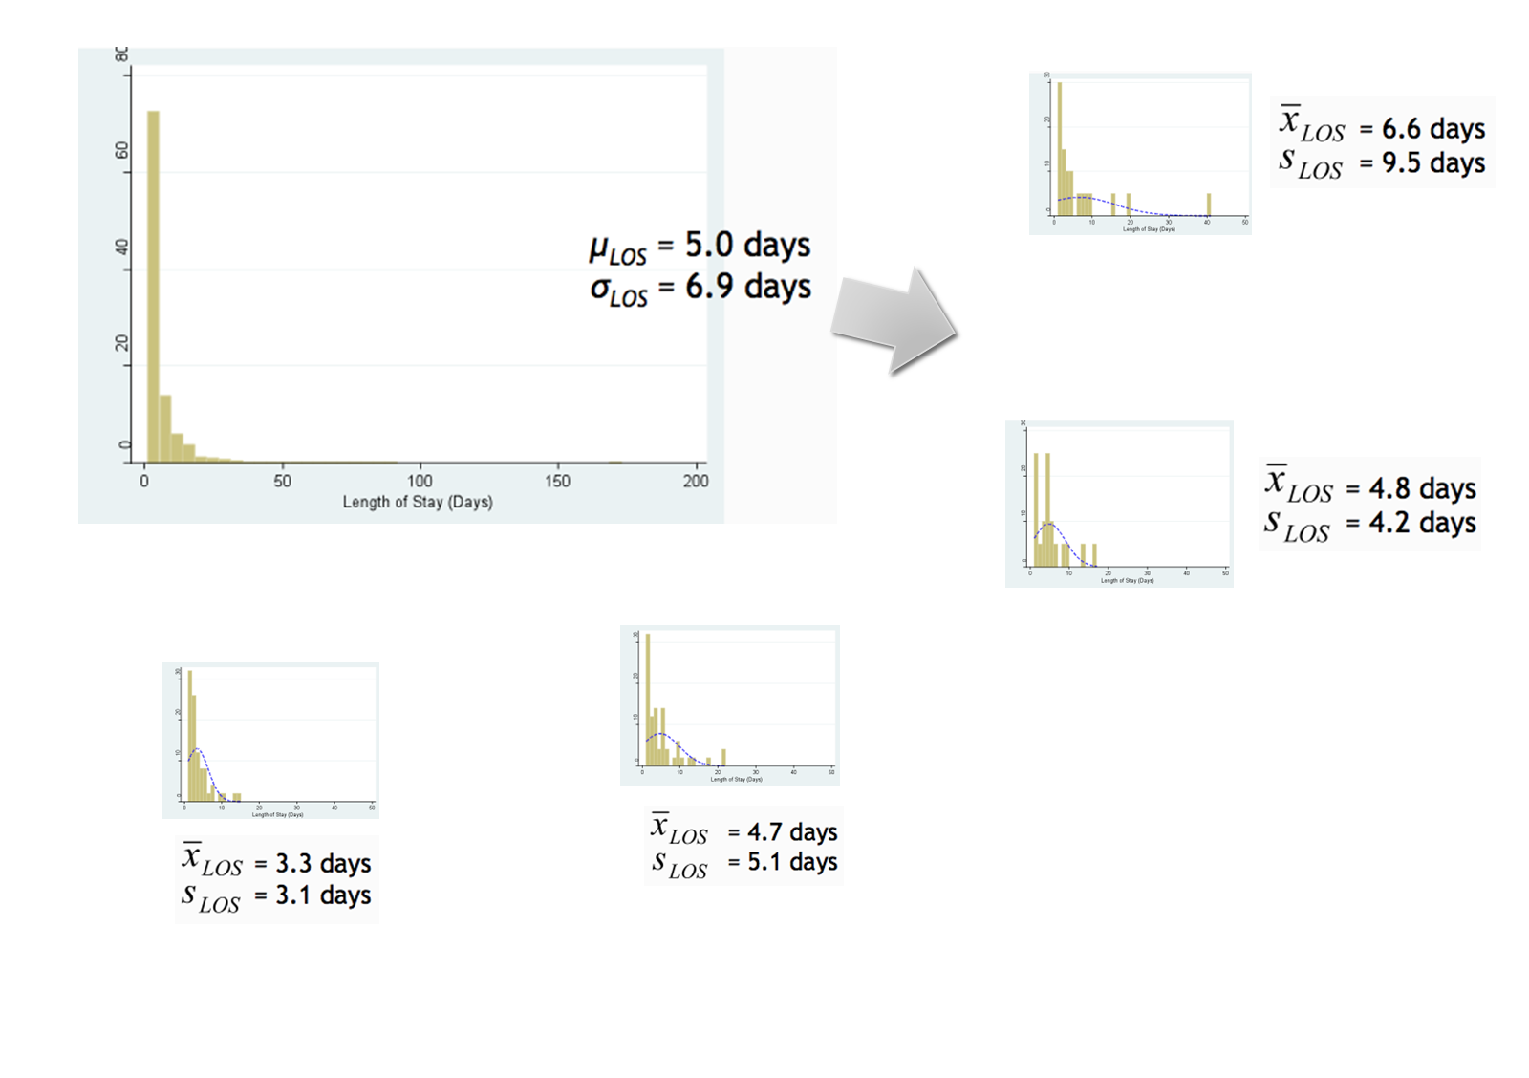
Sampling distribution — length of stay
Length of stay (LOS) is highly skewed: μ = 5.0 days, σ = 6.9 days; individual samples are also skewed

Slide 20
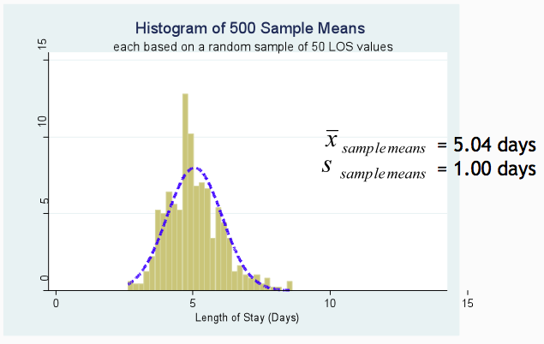
500 sample means — length of stay

Slide 21
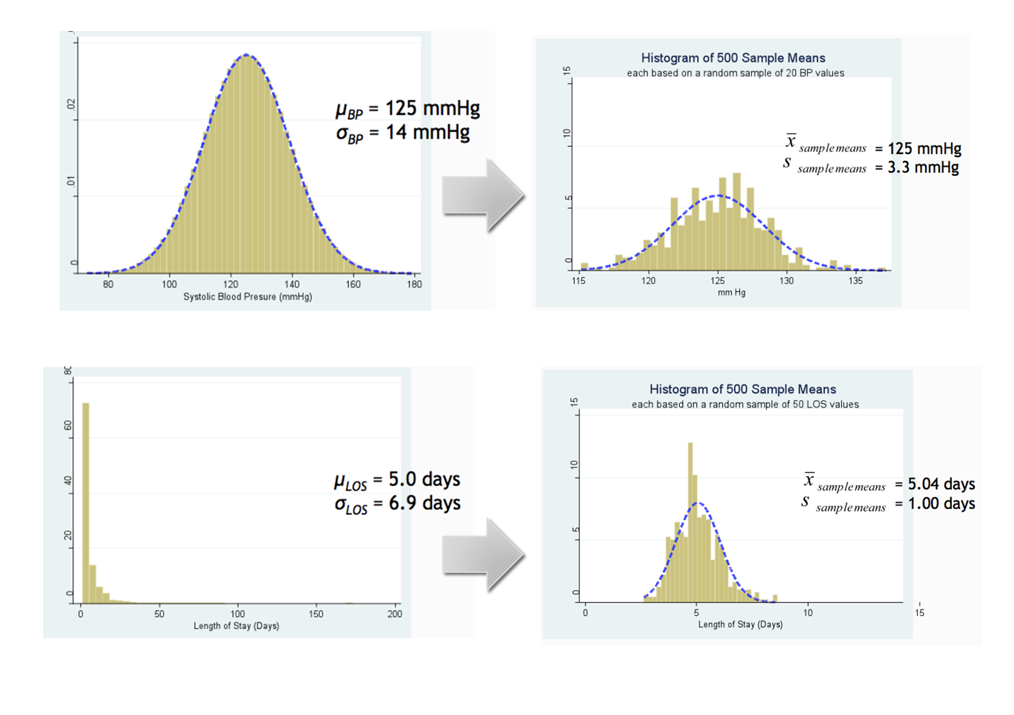
Sampling distributions — both variables

Slide 22
Why is the normal distribution important?
Although a random variable does not have a “normal” population distribution, the distribution of certain data extracted from random samples DOES have it!
Distributions of the sampling mean tend to be normally distributed even though the population data are not.
Distribution of the sample mean is the best estimator of the population mean

Slide 23
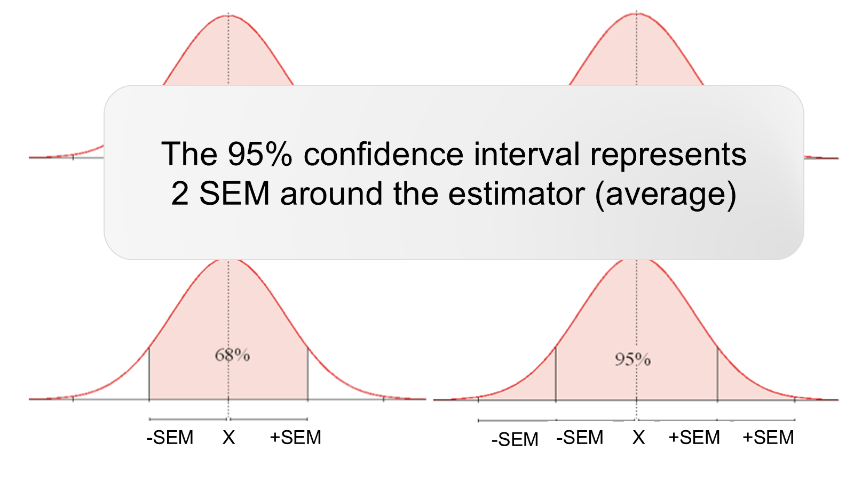
SEM and the 95% CI
The 95% confidence interval represents 2 SEM around the estimator (average)

Slide 24
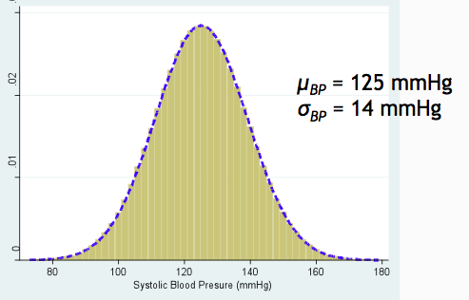
95% confidence interval — example
Notes:
If 100 random samples are drawn, in 95 of them the confidence interval will contain the parameter. In 5 it will not!

Slide 25
95% confidence interval — calculation
Lower limit $=\overset{‾}{X}−1.96 (SEM)=125−6.4=118.6$ mmHg
Upper limit $=\overset{‾}{X}+1.96 (SEM)=125+6.4=131.4$ mmHg
Mean 125 mmHg, 95% CI (118 – 131)

Slide 26
95% confidence interval
It is a measure of the dispersion of the estimate under study
Represents a range in which the actual population parameter is found 95% of the time (frequentist)
It is obtained from the standard error and can be calculated for any estimand: mean, proportions, OR, RR, r², etc.
More useful than the estimator alone because it evaluates “uncertainty”

Slide 27
95% confidence interval (cont.)
Provides a range of possible values for the parameter
The researcher will never be able to observe the real parameter
$\overset{‾}{X}$ is the best estimate you can have from your sample
The 95% CI starts with this estimate and also provides the degree of uncertainty in this amount.

Slide 28
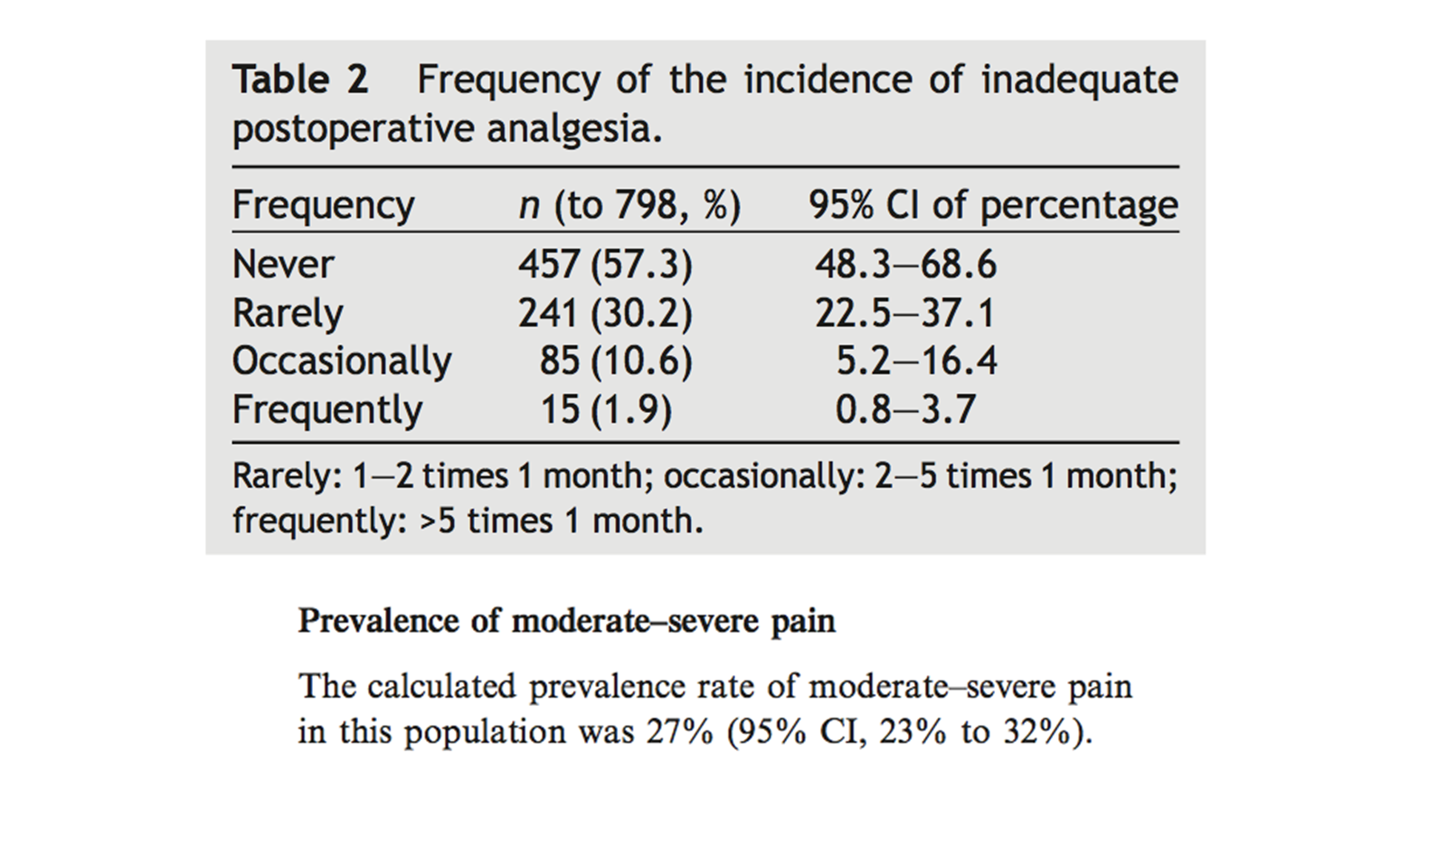
For example, (p)

Slide 29
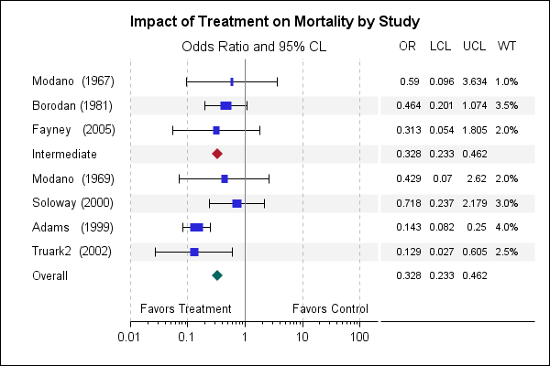
For example, odds ratio

Slide 30
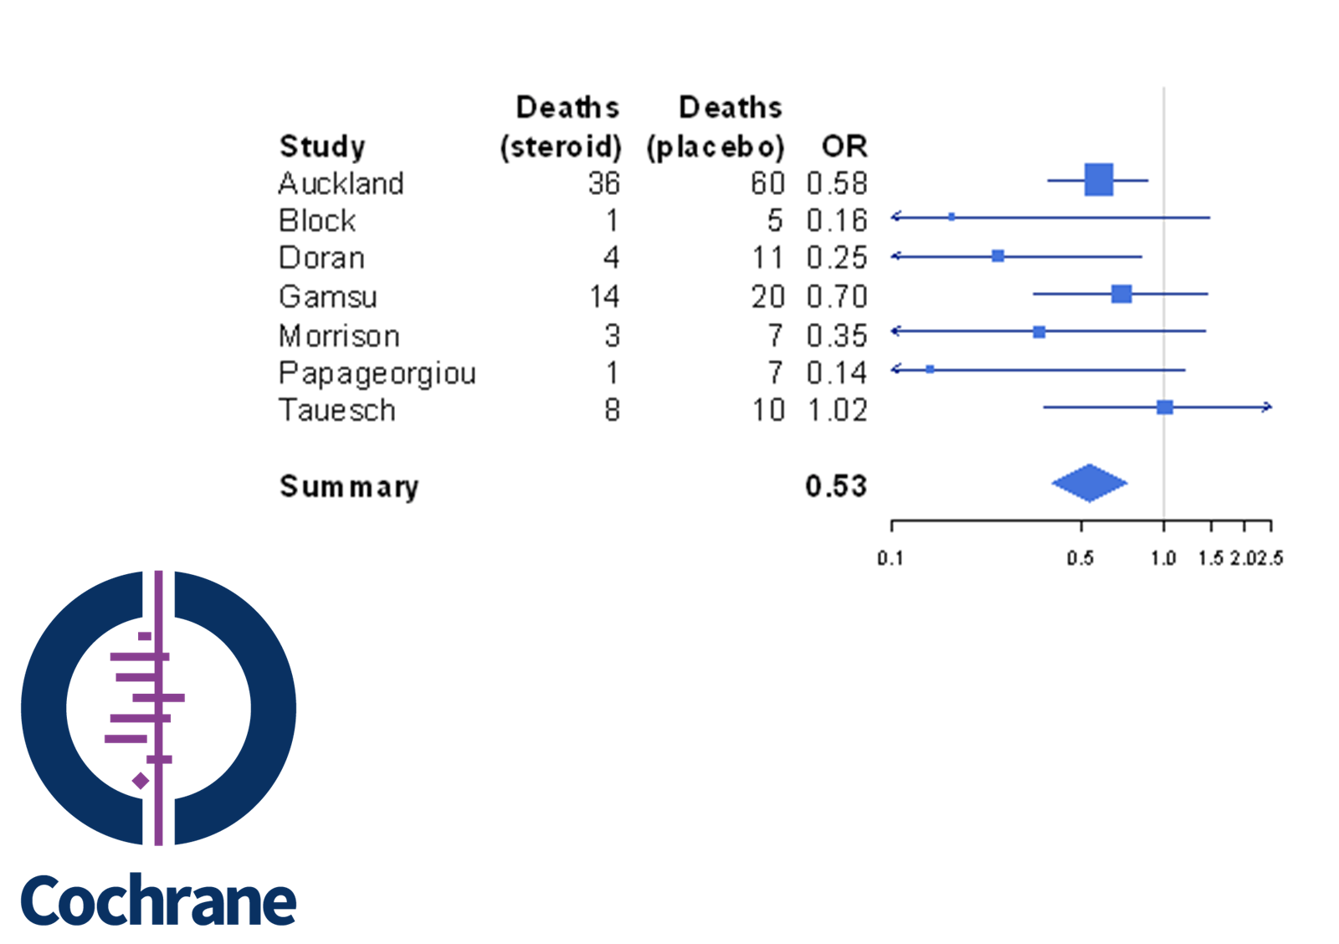
For example, meta-analysis

Slide 31
Finally: Standard deviation “versus” standard error
The term “standard deviation” refers to the variability of observations in a population or sample (reference ranges).
The “standard error” is also a measure of variability, but it applies to the distribution of multiple sample means taken from a population (the basis of the 95% CI).

Slide 32
Hypothesis Testing

Slide 33
Test or hypothesis contrasts
A statistical hypothesis is a statement regarding some characteristic of a population. This hypothesis has not yet been tested.
  The average age of patients in the emergency room is 30 years
  The proportion of hospitalized male patients is 40%
  Gender is associated with having type 2 diabetes

Slide 34
Test or hypothesis contrasts (cont.)
To contrast a hypothesis is to compare the statements with the reality we observe –in a sample–.
According to such a comparison, we will “accept or reject” our hypotheses.
**Too much binary, too much black/white

Slide 35
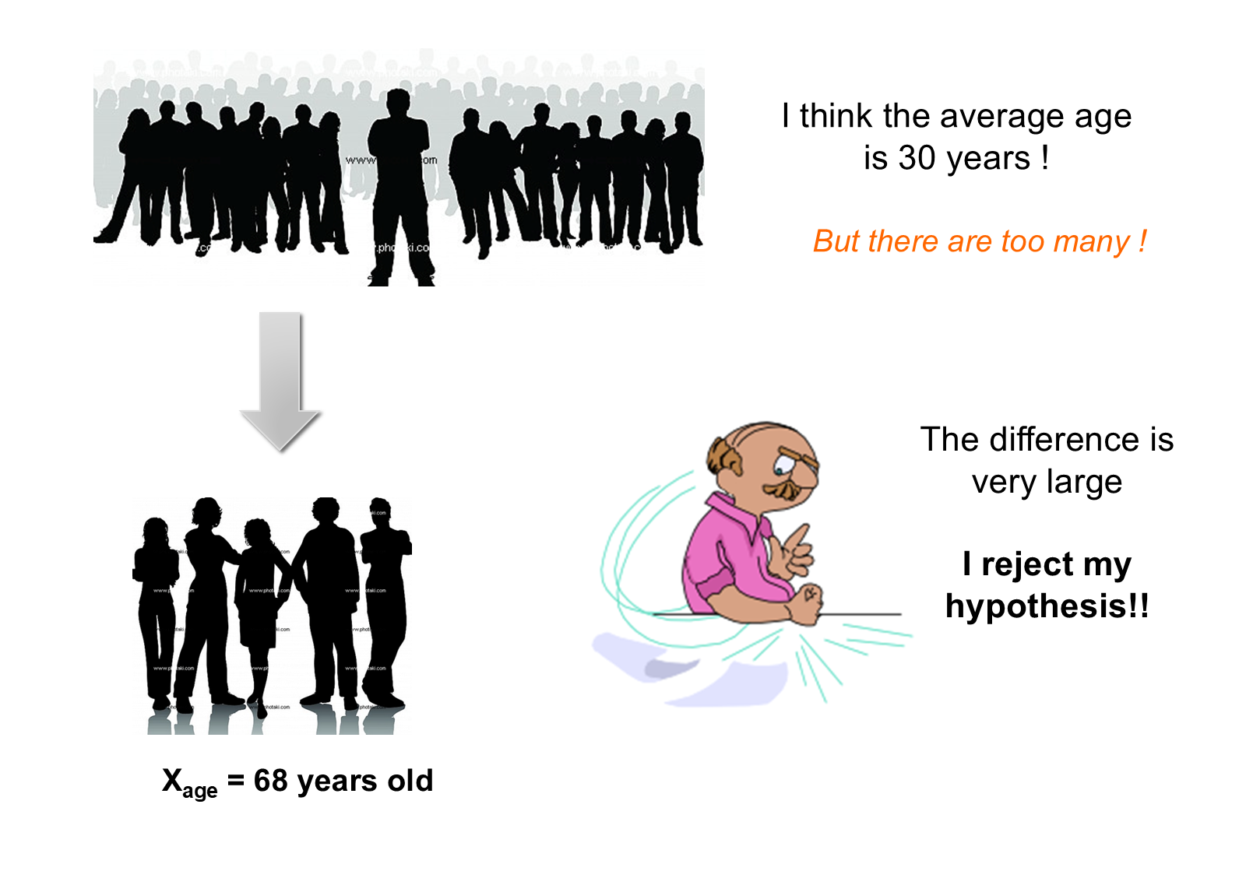
Contrasting a hypothesis — example

Slide 36
Hypothesis
It is a statement about parameters of a population
  Means
  Proportions
  Standard deviation
  Association, correlation, etc.
If we want to contrast it, you must set it up BEFORE the analysis
Notes:
Examples:
Compare the proportion of smokers between men and women.
Compare the mean age between those alive and those who died.
Is there a correlation between weight and height?
Assess whether there is an association between gender and cardiovascular disease.
Does blood group depend on race?

Slide 37
Contrasts of hypotheses – Steps,
Identify and construct the hypothesis
Collect our data (sample)
Define a level of significance
Make a decision regarding contrast

Slide 38
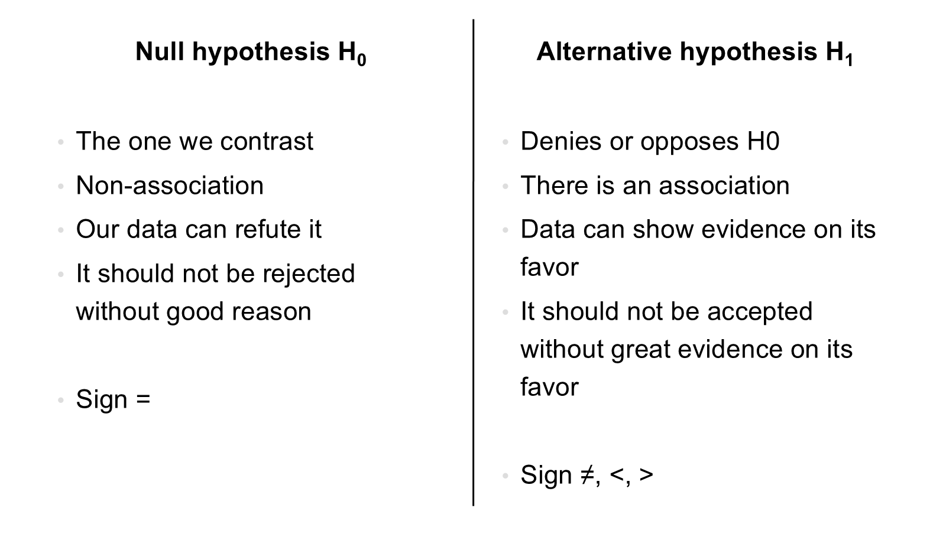
1. Identify and construct the hypothesis

Slide 39
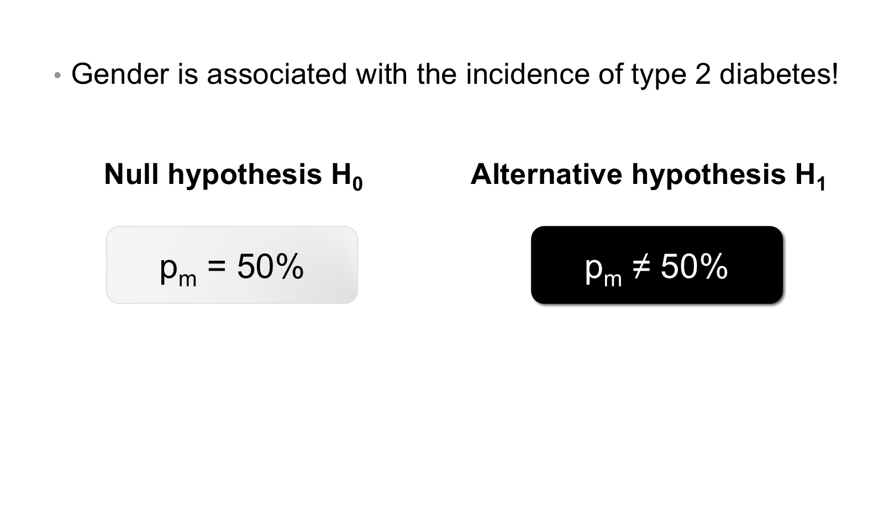
The null and alternative hypothesis (H0 – H1)

Slide 40
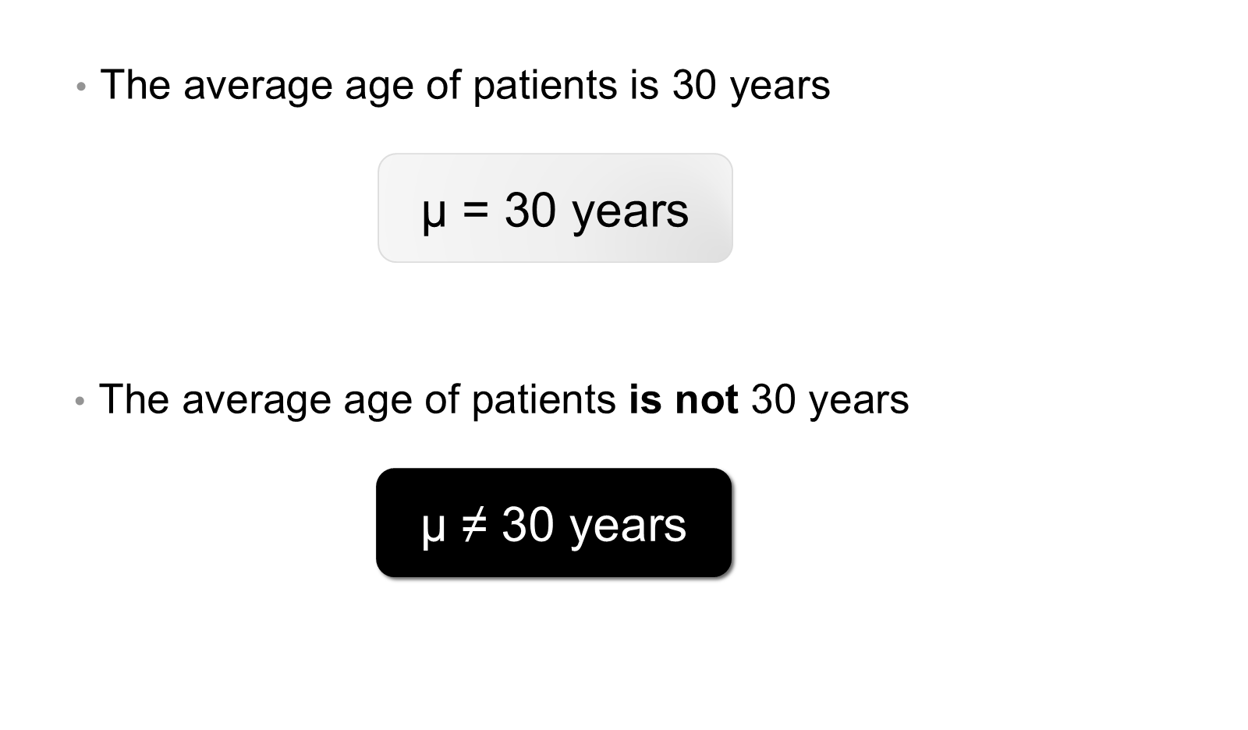
H0 and H1 — example

Slide 41
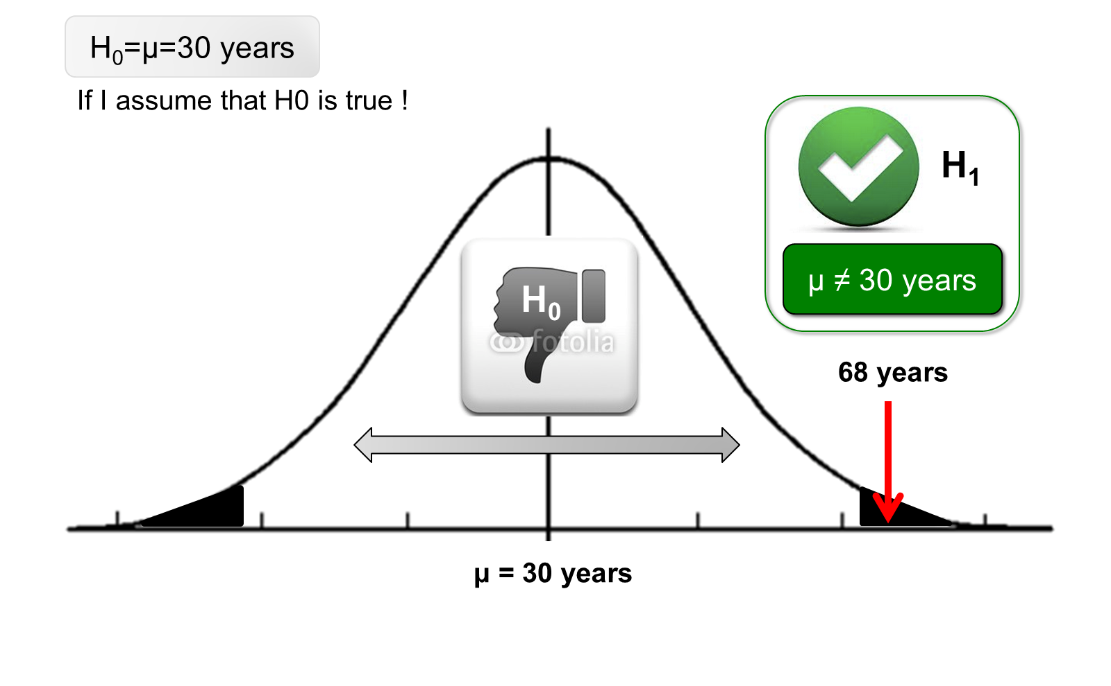
Reasoning of the hypothesis contrast,

Slide 42
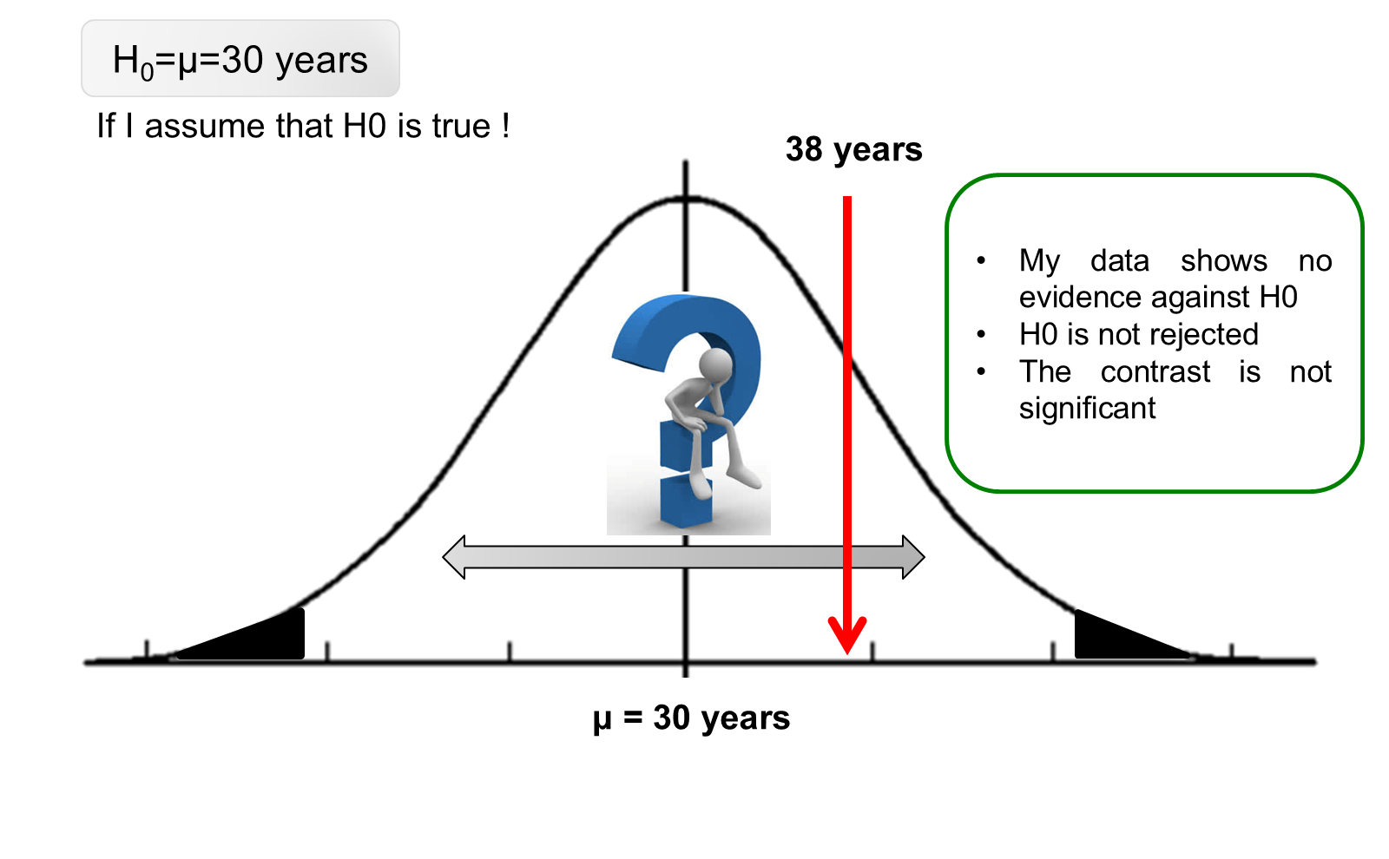
Reasoning of the contrast — no evidence

Slide 43
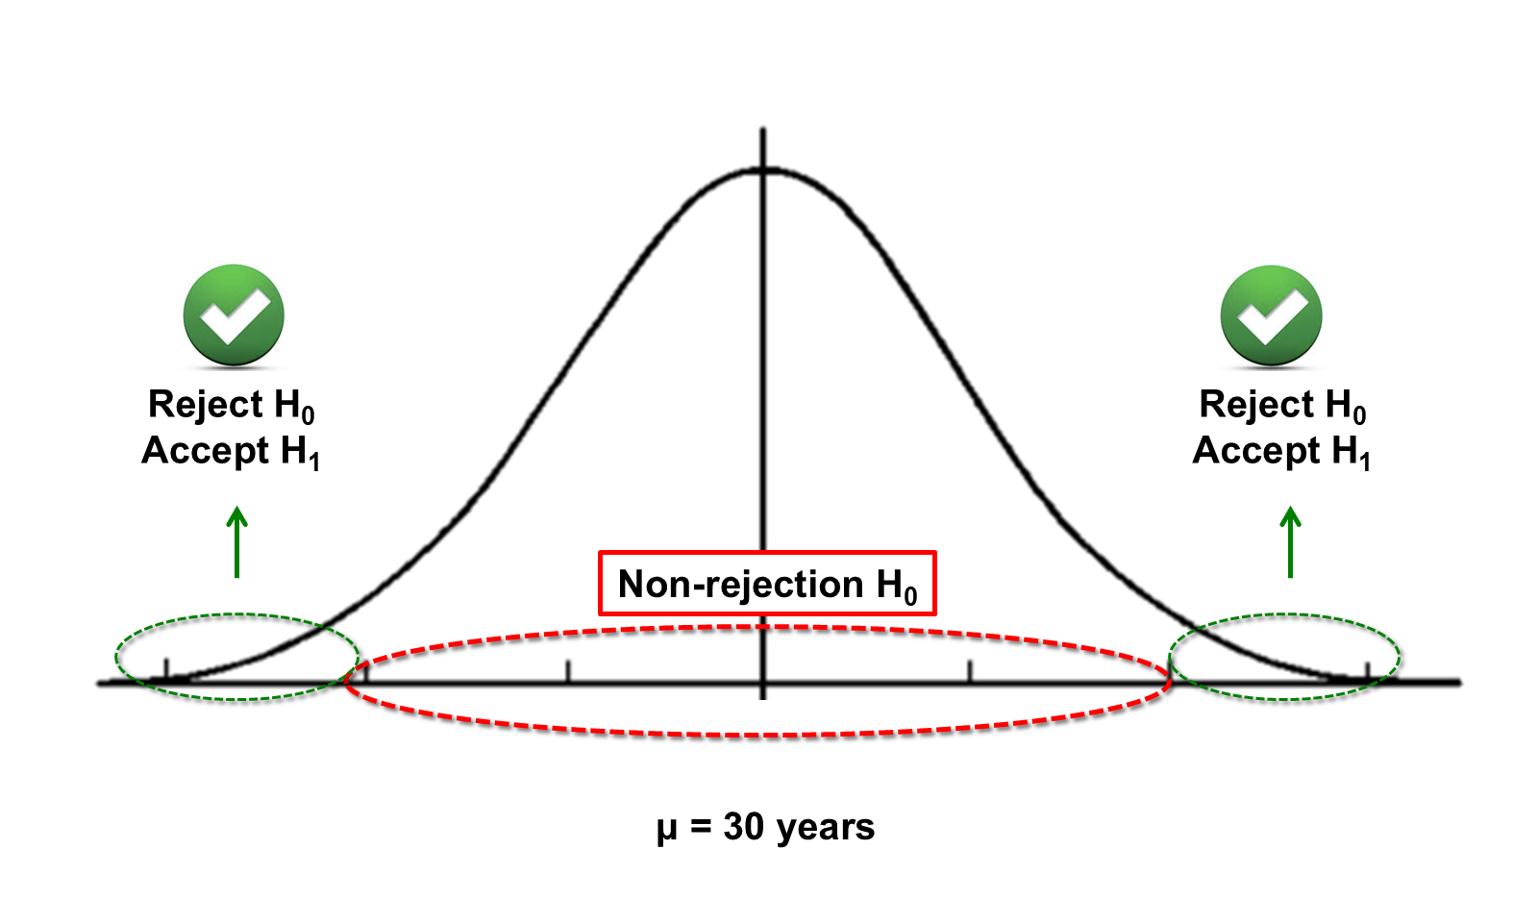
Level of significance

Slide 44
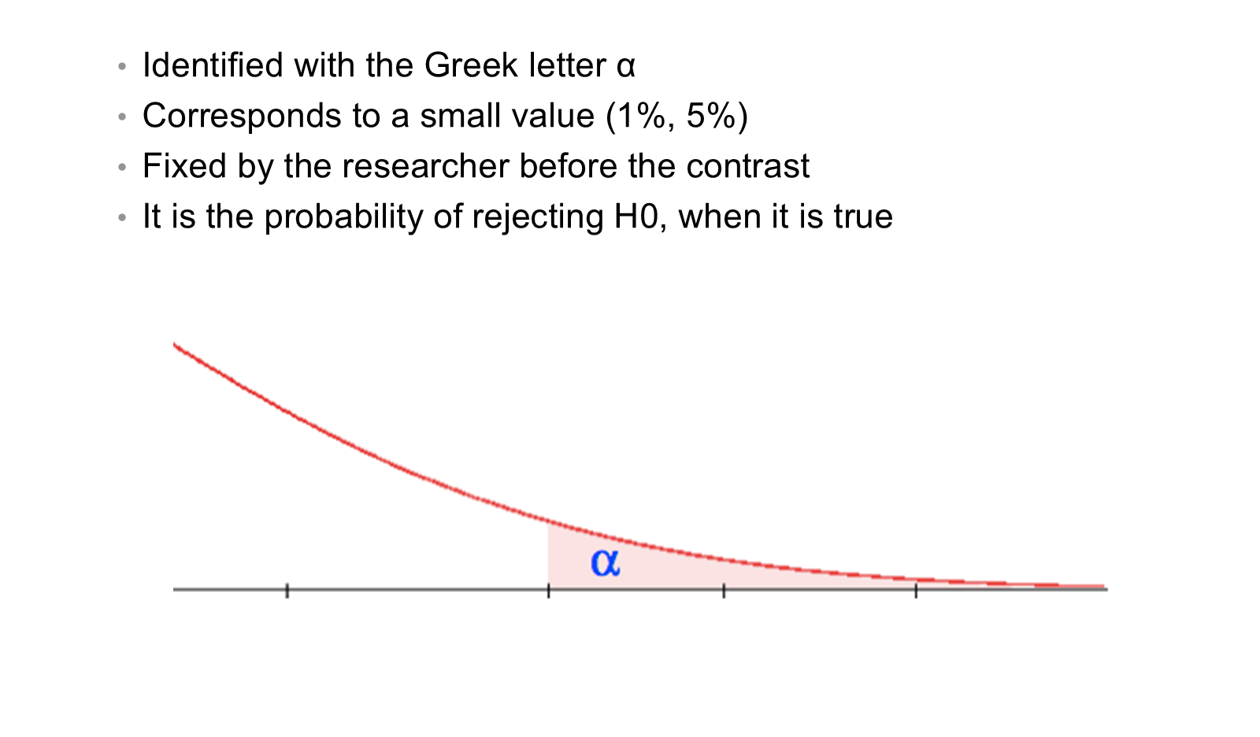
Level of significance (α)

Slide 45
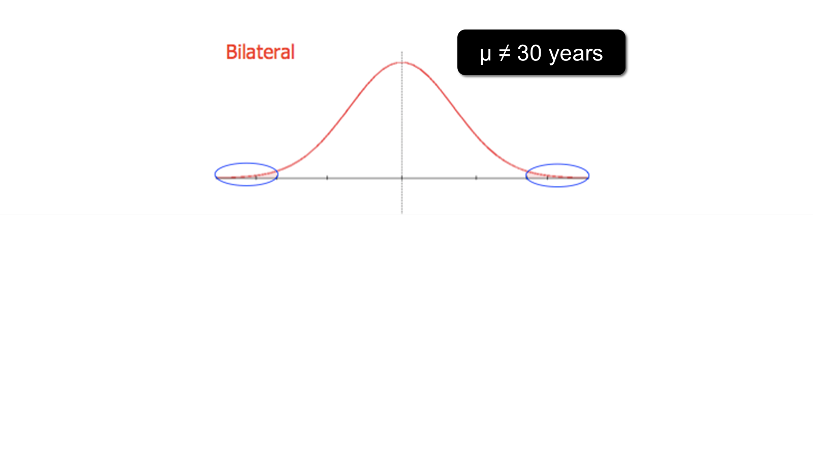
Unilateral or bilateral contrast (H1)
Bilateral: μ ≠ 30 years; unilateral: μ < 30 years or μ > 30 years

Slide 46
Signification (p value)
It is the probability of the area that starts right at the value of the statistic obtained from the sample.
It is the probability of having a sample that disagrees even more than ours with H0
It is the probability that –by pure chance– we obtain a sample stranger than the one obtained, being H0 true
Contrast is significant when $p$ is less than $α$ (0.05)

Slide 47
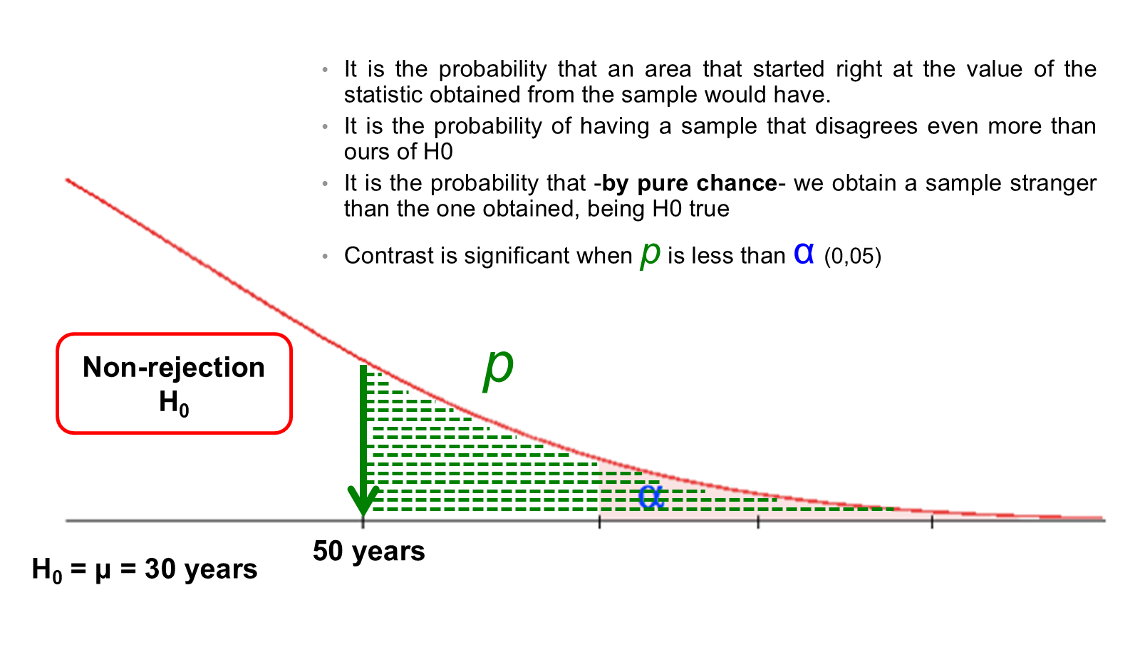
Signification (p value) — graphical view
H0: μ = 30 years; observed sample mean 50 years

Slide 48
Signification (p value) — significant result
The area of $p$ is lower than that of $α$ ($p<0.05$)
The result obtained in my study disagrees more than tolerated a priori
I have enough evidence in my sample to reject H0 and accept H1
If I can’t refuse H0, it does NOT mean that this is true!
The contrast is statistically significant

Slide 49
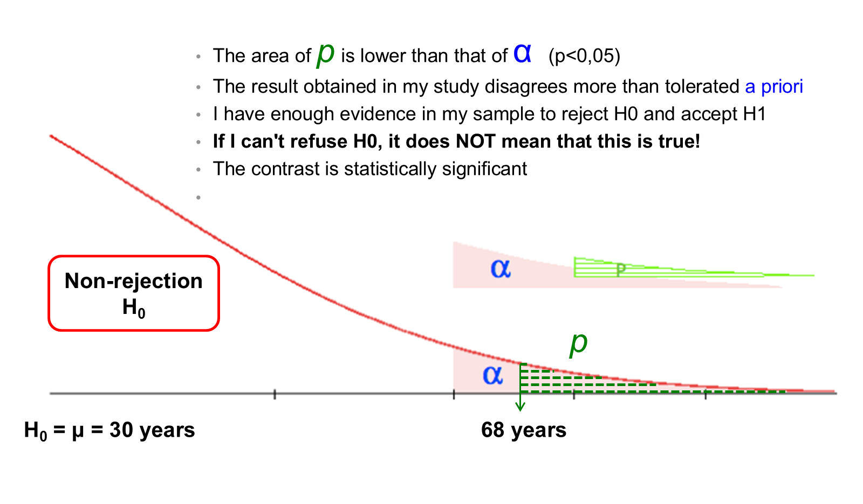
Significant result — graphical view
H0: μ = 30 years; observed sample mean 68 years

Slide 50
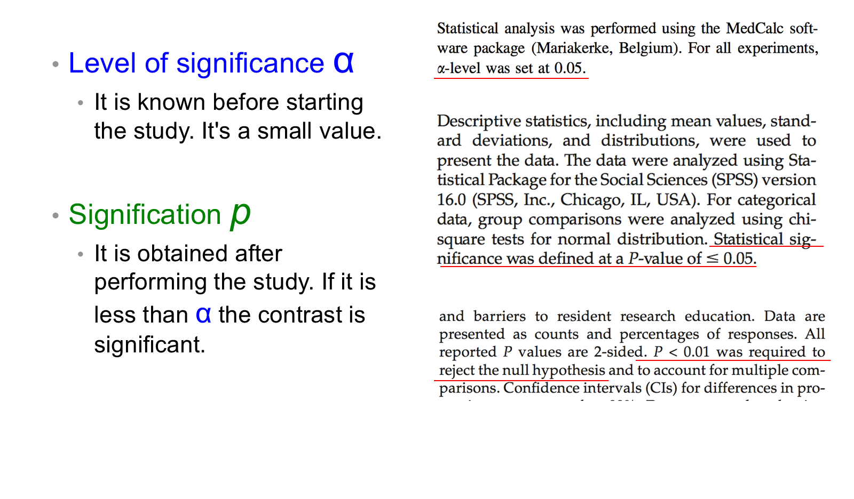
In short, α and p

Slide 51
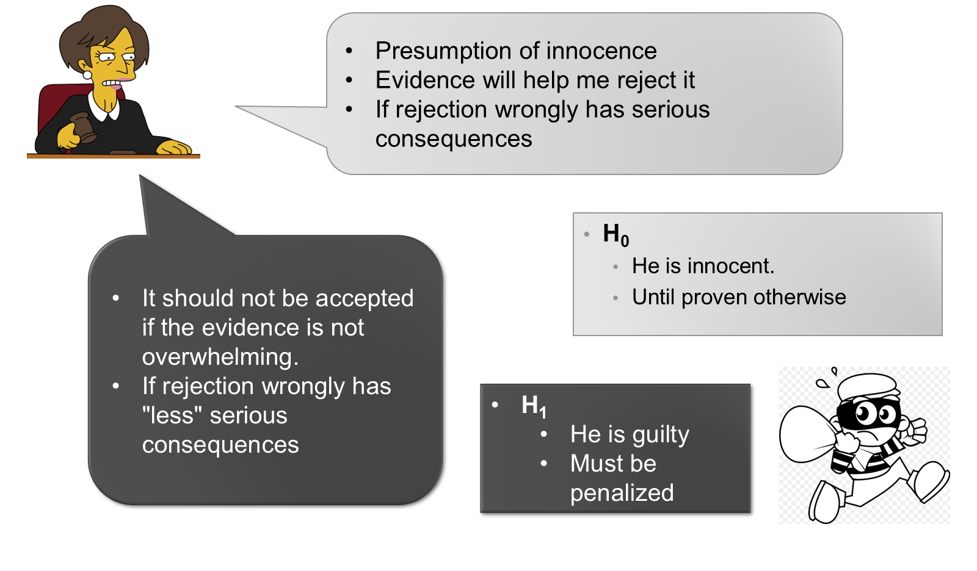
Risks in the contrast of hypotheses

Slide 52
Judicial legal process
 |  | In reality: Innocent | In reality: Guilty
Judge’s verdict | Innocent | OK | Error — less serious
 | Guilty | Error — “very serious” | OK
Notes:
Since our data (sample) is the only thing we have for the judgment, two types of errors can occur.

Slide 53
Other examples,
Imagine a clinical trial testing a new antibiotic treatment for the management of severe central nervous system infections – very expensive
H0: Treatment in clinical trial has no effect in reality
H1: The treatment has a real effect

Slide 54
Other examples — types of error
Result of the study | Reality: H0 true | Reality: H0 false
No rejection of H0 | Correct — the treatment has no effect and so it is decided. | Type II error — the treatment does have an effect but we do not perceive it. Probability β
Reject H0 / Accept H1 | Type I error — the treatment has no effect but it is decided that it does. Probability α | Correct — the treatment has an effect and the study confirms it.

Slide 55
Types I and II errors
Type I ($α$): $P(\text{reject }H_{0}∣H_{0}\text{ is true})$
  Level of significance = 0.05 (5%)
Type II ($β$): $P(\text{accept }H_{0}∣H_{0}\text{ is false})$ (less bad)
  $1−β$: $P(\text{reject }H_{0}∣H_{0}\text{ is false})$ – STATISTICAL POWER
Notes:
For a given n, H1 and H0, if the value of α decreases the value of β increases, and vice versa.

Slide 56
Balance between α and β
For a fixed sample size, the two types of error cannot be reduced at the same time
To reduce β (or increase statistical power) you have to increase the sample size

Slide 57
Final summary,
Hypothesis contrast
  Strategy for creating a decision (about a parameter)
  Evaluates the probability of finding samples that differ even more than the one obtained
  Provides a p value to be able to discriminate
  Too much binary and recently very criticized

Slide 58
Final summary (cont.)
Confidence intervals
  Quantifies the effect of interest (parameter) and the uncertainty of the estimate
  Provides a range in which the parameter could be located
  Allows to evaluate the clinical interest of the estimate
  It should always be used –when possible–

Slide 59
Analysis of Continuous Outcomes

Slide 60
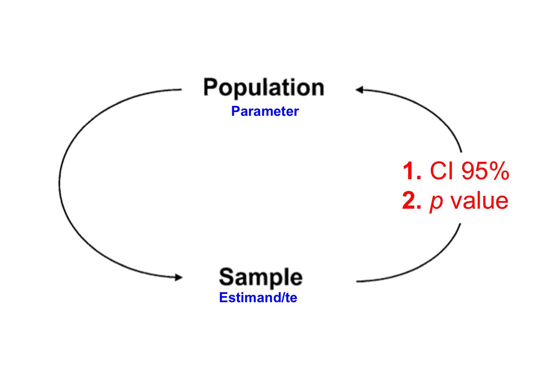
From sample to population
Parameter (population) ← estimand/estimate (sample): 1. 95% CI, 2. p value

Slide 61
Test for a single group
N = [General population living in Popayán]
  What is the average systolic blood pressure in the population?
  I develop my study and select a sample (n)
$H_{0}:μ=μ_{0}$ ; $H_{1}:μ≠μ_{0}$
I’m going to contrast the average of my sample against a certain value (population $μ_{0}$)
This will allow me to reject or not reject $H_{0}$
Notes:
We have to start at some (reasonable) point = μ0.

Slide 62
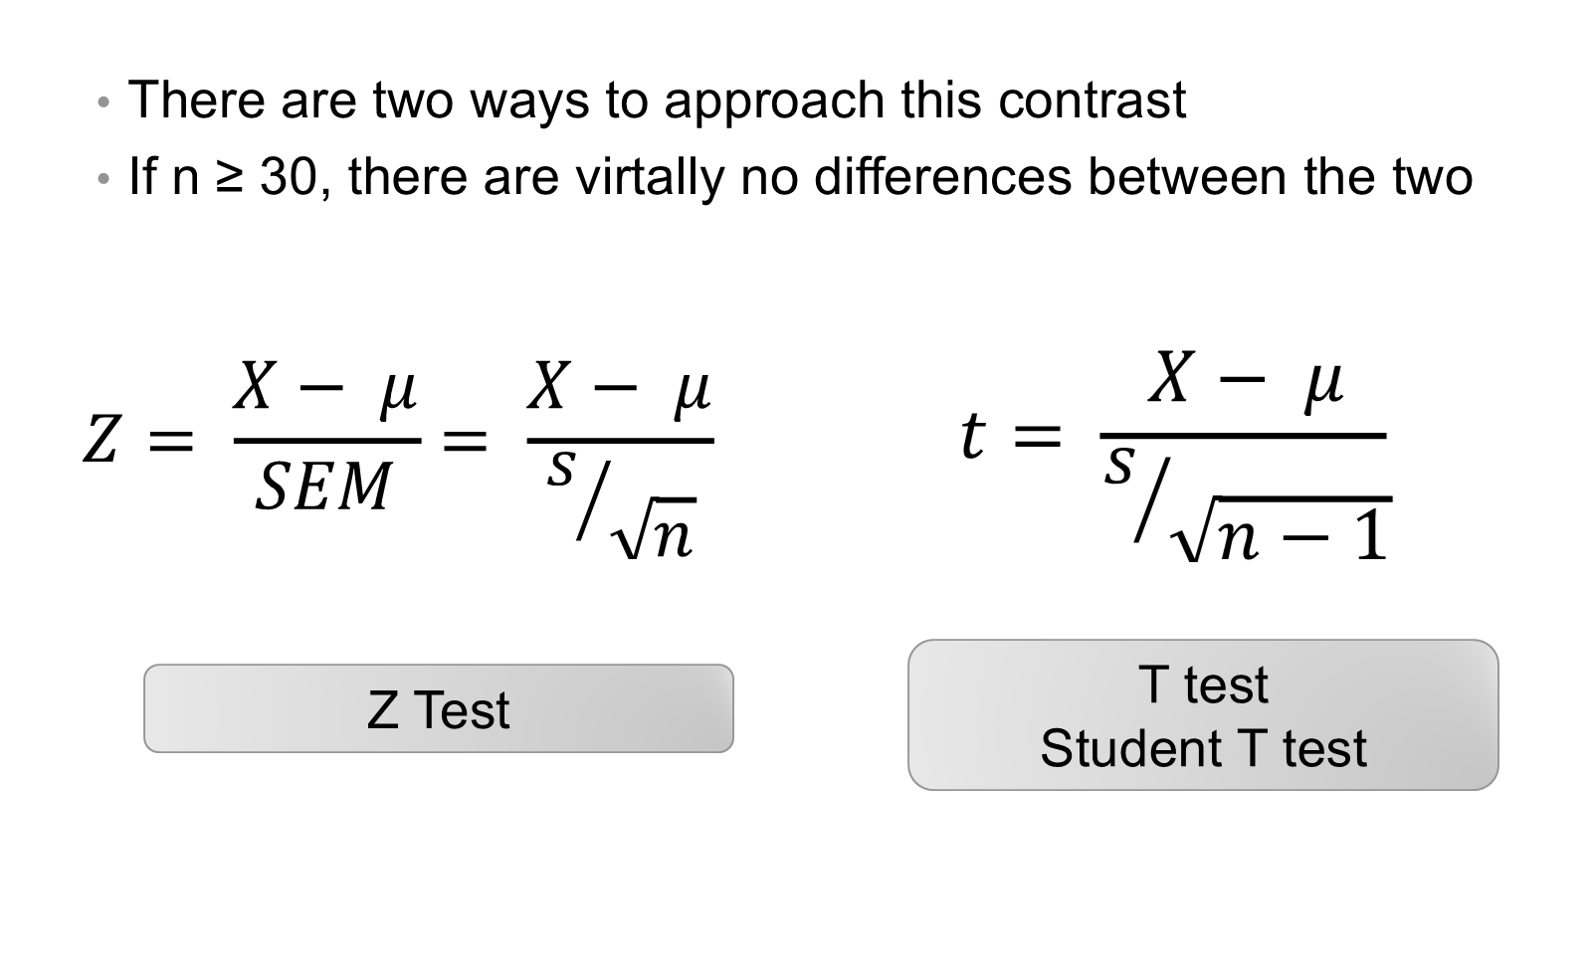
Test for a single group — Z and t tests

Slide 63
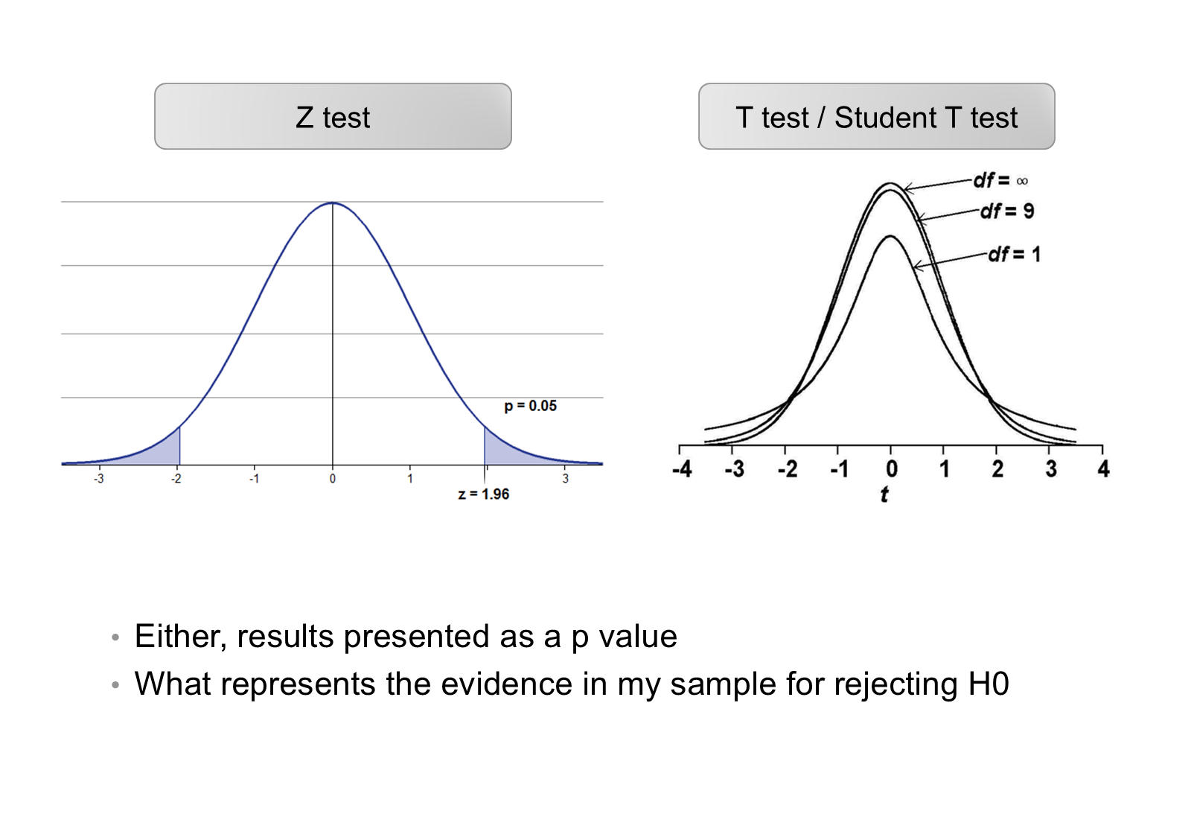
Z test and t test
Either way, results are presented as a p value: what represents the evidence in my sample for rejecting H0

Slide 64
Example,
I think the SBP of the population is 120 mmHg! I select my sample,
$H_{0}:μ=120$ ; $H_{1}:μ≠120$
$\overset{‾}{X}=130$ mmHg
I apply one of the tests described (Z, t-test)
P-value = 0.01
There is enough evidence in my sample to reject H0

Slide 65
Example — confidence interval
$\overset{‾}{X}=130$ mmHg versus 120 mmHg
95% CI $=\overset{‾}{X}±1.96 (SEM)$
95% CI = [126 – 135]
Notes:
The 95% confidence interval provides a range of values in which we are 95% certain that the true population mean lies. If the 95% confidence interval does not include the hypothesized value for the mean, μ0, we reject the null hypothesis at the 5% level.

Slide 66
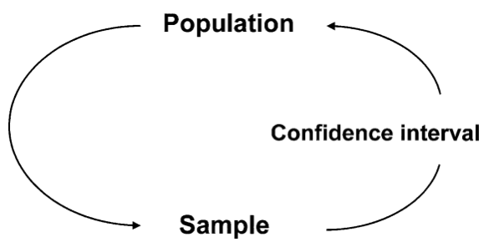
Example — from sample to population

Slide 67
Test to compare independent means
I have samples that come from two groups independent of each other
Cohort study, to study cardiovascular risk at a given site
I am interested to know if the BMI of men and women in my study is different (differs significantly)
  Group of men in follow-up
  Group of women in follow-up

Slide 68
Test to compare independent means — data
 | BMI | SD | n | SEM
Men | 25.53 | 2.44 | 74 | 0.28
Women | 27.18 | 5.08 | 95 | 0.52

Slide 69
Independent means — hypotheses
$H_{0}:μ_{H}=μ_{M} ⇒ H_{0}:μ_{H}−μ_{M}=0$
$H_{1}:μ_{H}≠μ_{M} ⇒ H_{1}:μ_{H}−μ_{M}≠0$
${\overset{‾}{X}}_{H}−{\overset{‾}{X}}_{M}=25.53−27.18=−1.65$
$p=0.005$

Slide 70
Test to compare independent means — 95% CI
$$SEM_{{\overset{‾}{X}}_{1}−{\overset{‾}{X}}_{2}}=\sqrt{(SEM_{1})^{2}+(SEM_{2})^{2}}$$
$$SEM_{{\overset{‾}{X}}_{H}−{\overset{‾}{X}}_{M}}=\sqrt{({0.28}_{H})^{2}+({0.52}_{M})^{2}}=0.59$$
$$\text{95\%CI}=−1.65±1.96 (SEM_{diff})=−1.65±1.16=[−2.81\text{ to }−0.49]$$

Slide 71
Conclusion
There is a statistically significant difference in the BMI of men and women
Such a difference is: –1.65 kg/m², 95% CI [–2.81 to –0.49] (p = 0.005)
On average men have a BMI 1.65 kg/m² lower than women, but such a difference can be between –2.81 and –0.49
This CI does not contain zero, so it suggests a real difference at the population level in the BMI of men and women.
Notes:
Analogous example: those on the low-carb diet lost more on average by 3.9 kg; after accounting for sampling variability this excess average loss over the low-fat diet group could be as small as 1.6 kg or as large as 6.2 kg.
This confidence interval does not include 0, suggesting a real population-level association between type of diet (low-carb or low-fat) and weight loss.

Slide 72
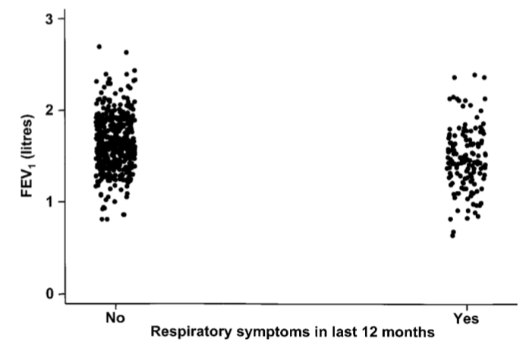
FEV1 and respiratory symptoms
Scatter plot showing the relationship between FEV1 and respiratory symptoms in 636 children living in a deprived suburb of Lima, Peru.

Slide 73
Assumptions of the t test
Single group
  The distribution of the variable at the population level is normal with an unknown variance
Two independent groups
  The distribution of variables in the population is normal
  The variances of the variables are equal (Levene test)

Slide 74
Test to compare related means
In this case, the two samples to be compared are paired.
  Assess blood pressure before and after treatment in a group of subjects (the same before and after)
  A group of students are evaluated at the beginning and end of the academic semester
  A numerical variable is measured in a group of subjects several times over time (e.g., hemoglobin)
Applying the concept of the t-test for independent samples here is incorrect

Slide 75
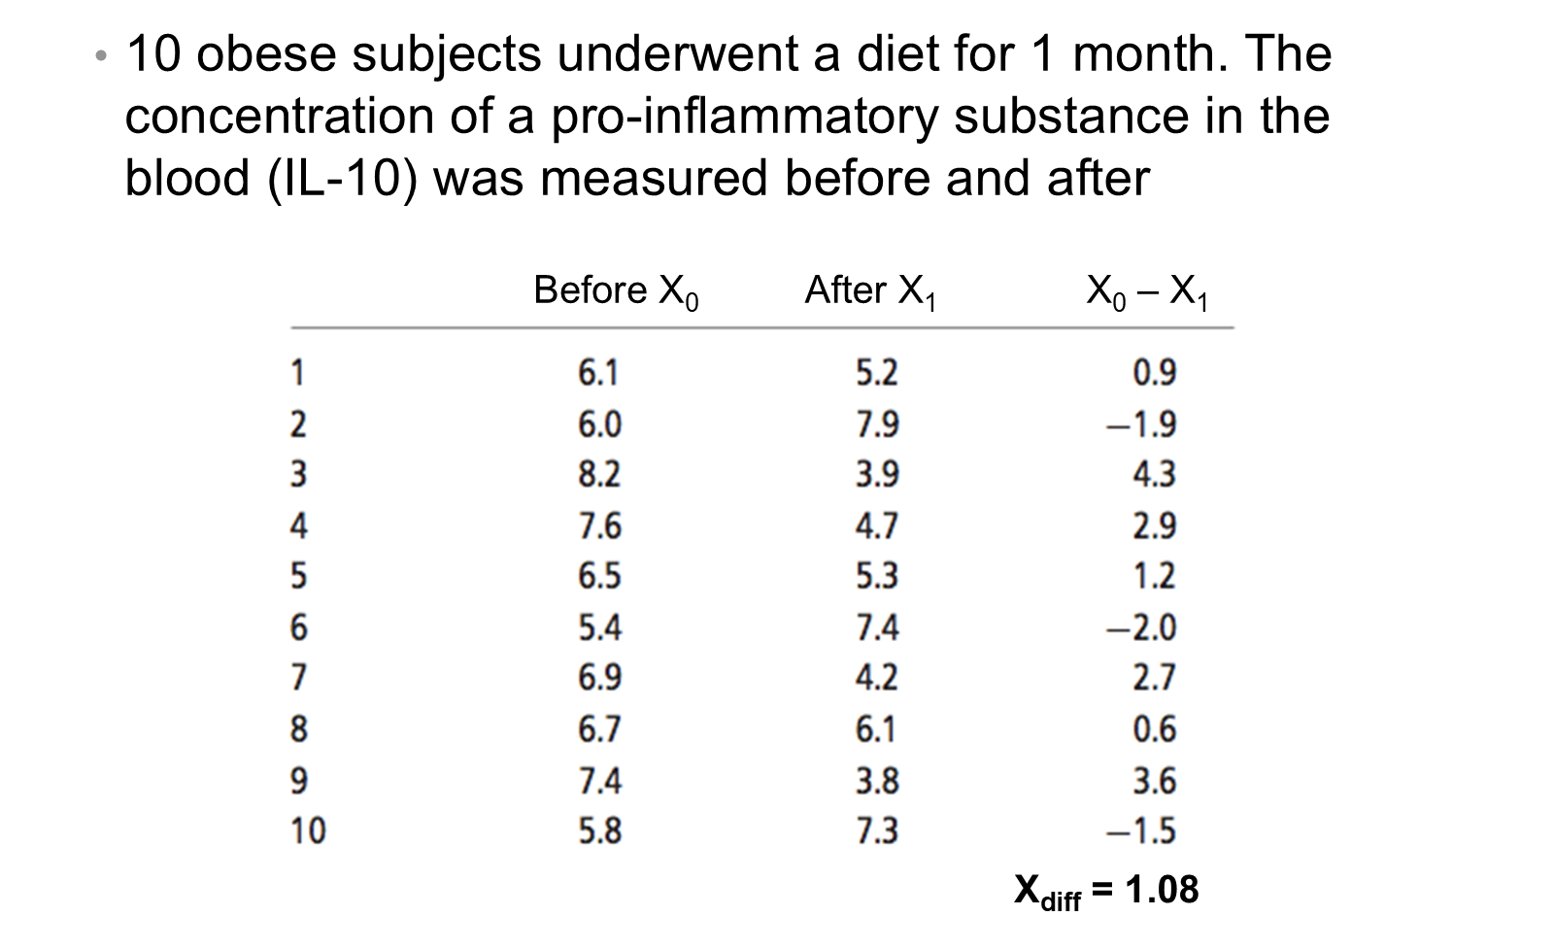
Test to compare related means — example

Slide 76
Test to compare related means — results
$H_{0}:μ_{diff}=0$ ; $H_{1}:μ_{diff}≠0$
${\overset{‾}{X}}_{diff}=1.08$ ; $SEM_{diff}=0.73$
Paired t test: P-value = 0.168
1.08, 95% CI [–0.57 to 2.73]
We do not have enough evidence to reject H0
In other words, there is no evidence that the intervention significantly reduces the value of IL-10
The CI contains 0

Slide 77
Smoking and lung function
To investigate whether smoking reduces lung function, forced vital capacity (FVC, a test of lung function) was measured in 100 men aged 25–29, of whom 36 were smokers and 64 non-smokers.
$${\overset{‾}{X}}_{smok}−{\overset{‾}{X}}_{non\text{−}smok}=4.7−5.0=−0.3\text{ litres}$$

Slide 78
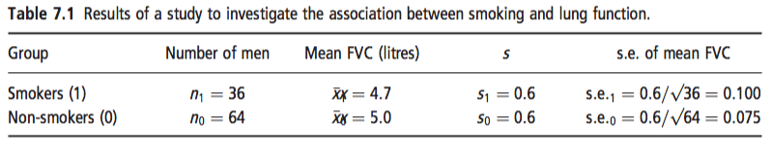
Smoking and lung function — data

Slide 79
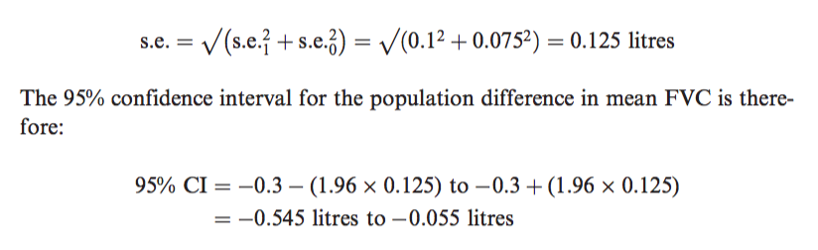
Smoking and lung function — 95% CI

Slide 80
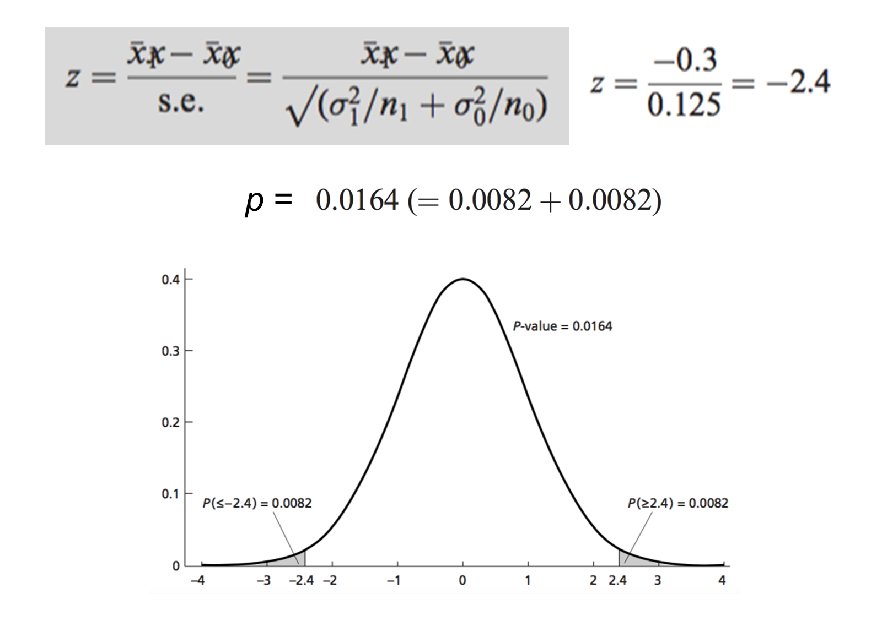
Smoking and lung function — z test

Slide 81
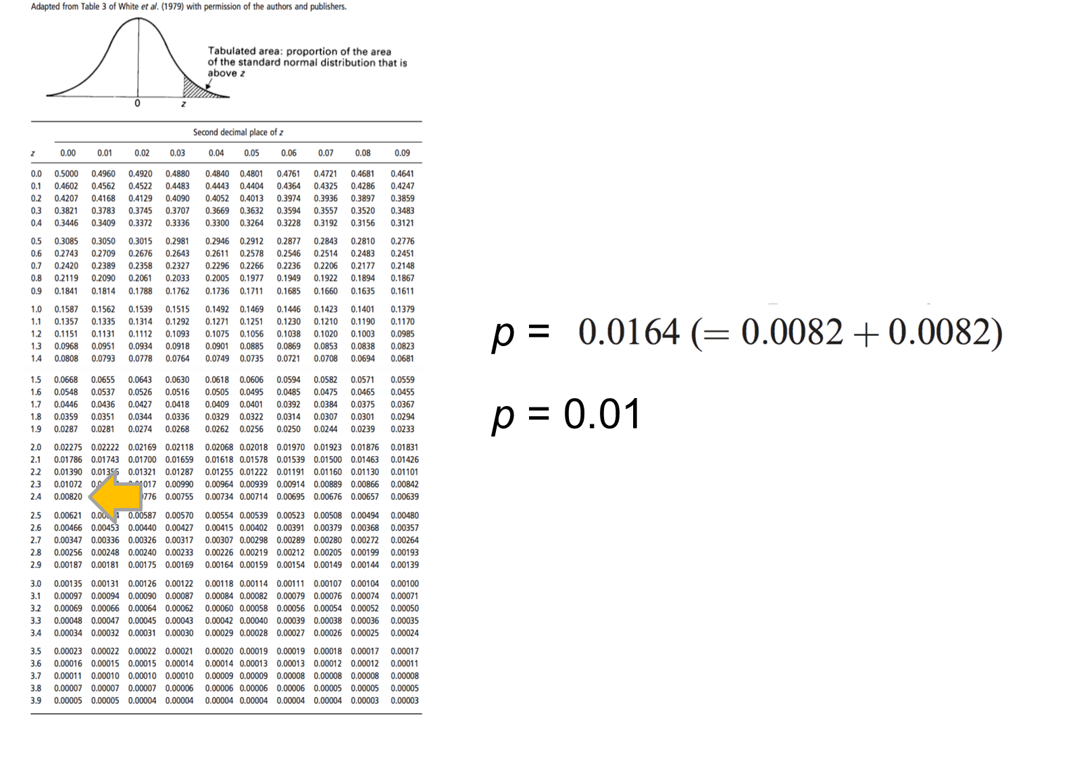
Smoking and lung function — p value
p = 0.0164 (= 0.0082 + 0.0082) ≈ p = 0.01

Slide 82
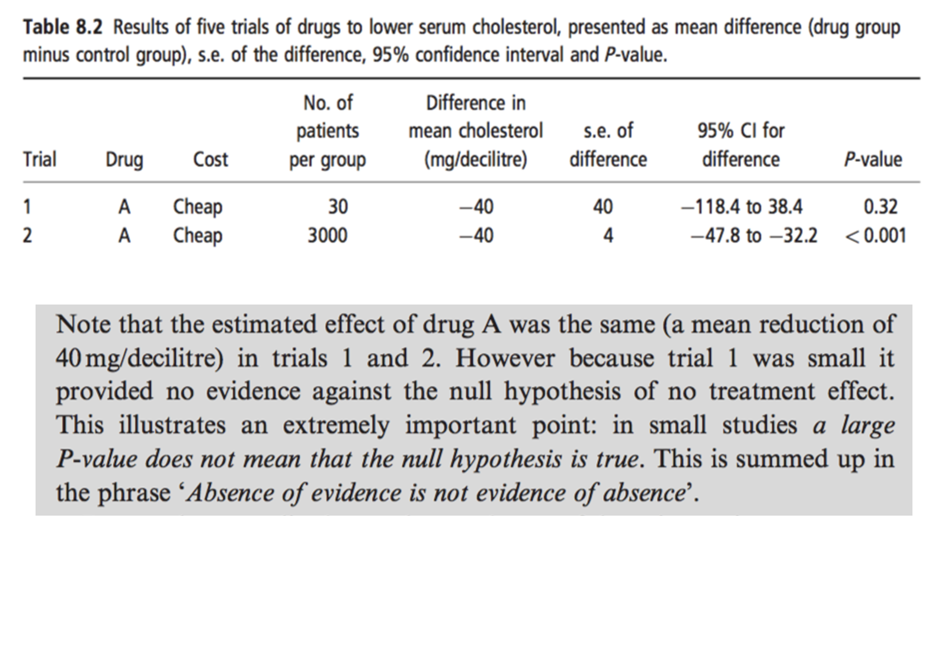
P values and CIs (1/2)

Slide 83
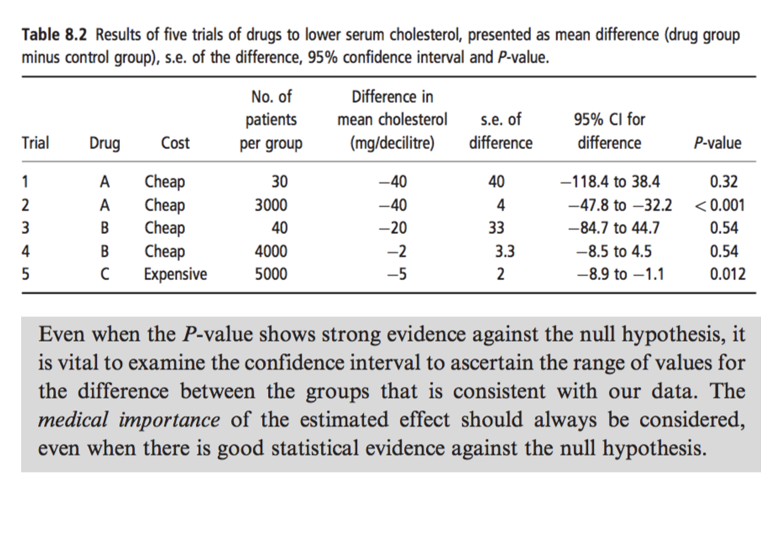
P values and CIs (2/2)

Slide 84
Non-parametric tests for means
Non-parametric statistics do not follow theoretical distributions of random variables
They do not require the conditions that parametric tests require.
They are based solely on the distribution of the data in the sample
They are also called distribution-free tests
Non-parametric tests have “less statistical power”

Slide 85
Mann-Whitney U test // Wilcoxon test
Wilcoxon rank sum test
Mann-Whitney-Wilcoxon rank sum test
It is based on the median and ranks of the data
Not affected by extreme values
Requires access to the total data (dataset)
Its result is only in terms of p value

Slide 86
Mann-Whitney U test
A group of ten students were randomized to receive a new pedagogical scheme. At the end, an evaluation exam was carried out on each group. The results are the difference between the post-pre test.

Slide 87
Mann-Whitney U test — data
Group (post − pre score) | 1 | 2 | 3 | 4 | 5
Intervention (I) | 5 | 0 | 7 | 2 | 19
Control (C) | 6 | –5 | –6 | 1 | 4

Slide 88
Mann-Whitney U test — why?
Only 10 subjects under study
It is possible that in 10 subjects the results of the post-pre test are not normally distributed

Slide 89
Mann-Whitney U test — 1. reorganize data (ranks)
Value | –6 | –5 | 0 | 1 | 2 | 4 | 5 | 6 | 7 | 19
Rank | 1 | 2 | 3 | 4 | 5 | 6 | 7 | 8 | 9 | 10
Group | C | C | I | C | I | C | I | C | I | I

Slide 90
Mann-Whitney U test — result
Compare the ranks of each group using statistical techniques and provide a p-value as a result
P-value = 0.17
There is no statistically significant difference in the assessment of improvement between the control and intervention group

Slide 91
When t-test and when Mann-Whitney U test?
If your sample is small (e.g. less than 30)
If there are suspicions that the distributions of the variables do not follow a normal trend
Non-parametric tests are more “conservative”
There is no consensus

