Slide 1



Analysis of categorical outcomes
Section 4 — Introduction to Biostatistics
Jose Andres Calvache MD MSc PhD

Slide 2
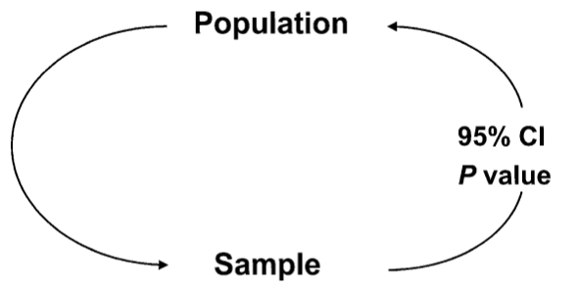
Population and sample

Slide 3
Key terms
Parameter · Estimand/te · 95% CI · P value

Slide 4
CI95% for a proportion
A binary variable X of two categories: 1 / 0
For the sample the proportion is p
Useful if n is large

Slide 5
CI95% for a proportion — formulas
$$σ_{(p)}=\sqrt{π(1−π)}$$
$$SD_{(p)}=\sqrt{p(1−p)}$$
$$se_{(p)}=\sqrt{\frac{p(1−p)}{n}}$$
$$CI95\%=p±1.96\sqrt{\frac{p(1−p)}{n}}$$

Slide 6
Example
To estimate the prevalence of obesity in faculty students
n = 200
p = 30% = 0.3

Slide 7
Example — CI95% calculation
$$SD_{(p)}=\sqrt{p(1−p)}=\sqrt{0.3(1−0.3)}=0.458$$
$$SE_{(p)}=\sqrt{\frac{p(1−p)}{n}}=\sqrt{\frac{0.3(0.7)}{200}}=0.032$$
$$CI95\%=p±1.96 (SE_{(p)})=0.3±1.96(0.032)$$
$$CI95\%=0.3 [0.237−0.362]=[23.7\%−36.2\%]$$

Slide 8
Comparing proportions
Pediatric AIDS Clinical Trial Group (ACTG)
“We conducted a randomized, double-blinded, placebo-controlled trial of the efficacy and safety of zidovudine (AZT) in reducing the risk of maternal-infant HIV transmission”
363 pregnant women with HIV were randomized to AZT or placebo (18 postnatal months)

Slide 9
Comparing proportions — study data
180 AZT HIV+ 13 children
183 Placebo HIV+ 40 children
Conner, E., et al. (1994). Reduction of maternal-infant transmission of human immunodeficiency virus type 1 with zidovudine treatment, New England Journal of Medicine 331: 18.

Slide 10
Risk of transmission (CI 18 months)
 | HIV + | HIV - | Total
AZT | 13 | 167 | 180
Placebo | 40 | 143 | 183
Total | 53 | 310 | 363

Slide 11
Risk of transmission — CI calculation
CI_{AZT} = 13/180 = 7%
CI_{PLAC} = 40/183 = 22%

Slide 12
Cumulative incidence and CI 95%
CI_{AZT} = 13/180 = 7% CI95% [ 3.9 - 12 ]
CI_{PLAC} = 40/183 = 22% CI95% [ 16 - 28 ]
95% confidence intervals are calculated following the binomial distribution (if n is large it approaches normal)
The question is: Is this difference significant or can it be explained by chance (random error)?

Slide 13
Chi2 test
Test that can be extended to two or more proportions
It is based on,
  “Expected” values and “observed” values
  Expected: If H0 were true
Is there a relationship between columns and rows?
What would they be then? the “expected” values if the H0 were true?

Slide 14
Chi2 test — observed table
 | HIV + | HIV - | Total
AZT | 13 | 167 | 180
Placebo | 40 | 143 | 183
Total | 53 | 310 | 363

Slide 15
Chi2 test — formula
$$χ^{2}=\sum_{4 cells}^{​}{\frac{(O−E)^{2}}{E}}$$

Slide 16
“Observed” vs “expected” if H0 were true
 | HIV + | HIV - | Total
AZT | 13 | 167 | 180
Placebo | 40 | 143 | 183
Total | 53 | 310 | 363

Slide 17
“Expected” if the H0 were true
 | HIV + | HIV - | Total
AZT | 26 | 154 | 180
Placebo | 27 | 156 | 183
Total | 53 | 310 | 363

Slide 18
Chi2 test — formula
$$χ^{2}=\sum_{4 cells}^{​}{\frac{(O−E)^{2}}{E}}$$

Slide 19
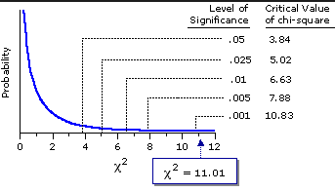
P value for Chi2 test

Slide 20
Chi2 test — conclusion
CI_{AZT} = 13/180 = 7% CI95% [ 3.9 - 12 ]
CI_{PLAC} = 40/183 = 22% CI95% [ 16 - 28 ]
P value for Chi2 test = 0.0001
There is sufficient evidence to reject H0 (equality). I accept H1: There are “statistically significant” differences between AZT and Placebo

Slide 21
Example 2
Food poisoning occurred at a certain site. Some believe that the origin was chicken sandwiches

Slide 22
Example 2 — 2×2 table
 | Yes (Food poisoning) | No (Food poisoning) | Total
Sandwich (Exposure) | a | b | a+b
Other food | c | d | c+d
Total | a+c | b+d | a+b+c+d

Slide 23
Example 2 — results
 | Yes | No | Total
Sandwich | 109 | 116 | 225
Other food | 4 | 34 | 38
Total | 113 | 150 | 263

Slide 24
Example 2 — proportions
p_{sand} = 109/225 = 48%
p_{other} = 4/38 = 10%

Slide 25
Example 2 — hypothesis test
P value for Chi2 test = 0.001
H0: p_{sand} = p_{other}
H1: p_{sand} ≠ p_{other}

Slide 26
Fisher’s exact test
The chi2 test is based on a normal approximation
  Works well if the samples are large
Solution,
Fisher’s exact test
  Difficult manual calculation
  It has no approximations and delivers an “exact” p-value
  Useful in small samples

Slide 27
Fisher’s exact test — example
65 pregnant patients — classified as high risk for hypertension in pregnancy — are randomized in the third trimester to Aspirin 100 mg/day versus placebo to assess the effect on the occurrence of hypertension

Slide 28
Fisher’s exact test — data
 | HT + | Non HT | Total
ASA 100 | 4 | 30 | 34
Placebo | 11 | 20 | 31
Total | 15 | 50 | 65

Slide 29
Fisher’s exact test — reference
Schiff, E. et al. The use of aspirin to prevent pregnancy-induced hypertension and lower the ratio of thromboxane A2 to prostacyclin in relatively high risk pregnancies. New England Journal of Medicine, 321, 6.

Slide 30
Fisher’s exact test — results
CI_{ASA} = 4/34 = 12%
CI_{PLAC} = 11/31 = 35%
Fisher p value = 0.0378
Chi2 p value = 0.0234
Both tests reject H0

Slide 31
Test for variables with more than two categories
The Chi2 test can be extended to variables with more than two categories
H0: Variables are independent
H1: Variables are related (or depend in some category on one another)

Slide 32
Test for variables with more than two categories — table
 | Stratum 1 | Stratum 2 | Stratum 3 | Total
Male | 51 | 95 | 38 | 184
Female | 17 | 101 | 75 | 193
Total | 68 | 196 | 113 | 377

Slide 33
Test for variables with more than two categories — result
 | Stratum 1 | Stratum 2 | Stratum 3 | Total
Male | 51 | 95 | 38 | 184
Female | 17 | 101 | 75 | 193
Total | 68 | 196 | 113 | 377

Slide 34
Test for variables with more than two categories — conclusion
Chi2 p value = 0.000
I have enough evidence to reject the H0 of independence. They are significantly related

