Slide 1



Introduction to Multivariable Analysis
Section 5 — Introduction to Biostatistics
Jose Andres Calvache MD MSc PhD

Slide 2
Section objectives
General introduction to multivariable analysis

Slide 3
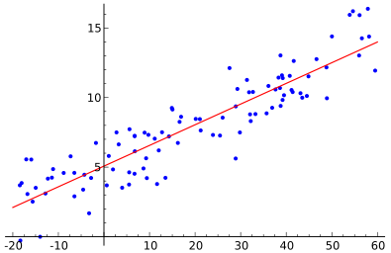
Multivariable analysis

Slide 4
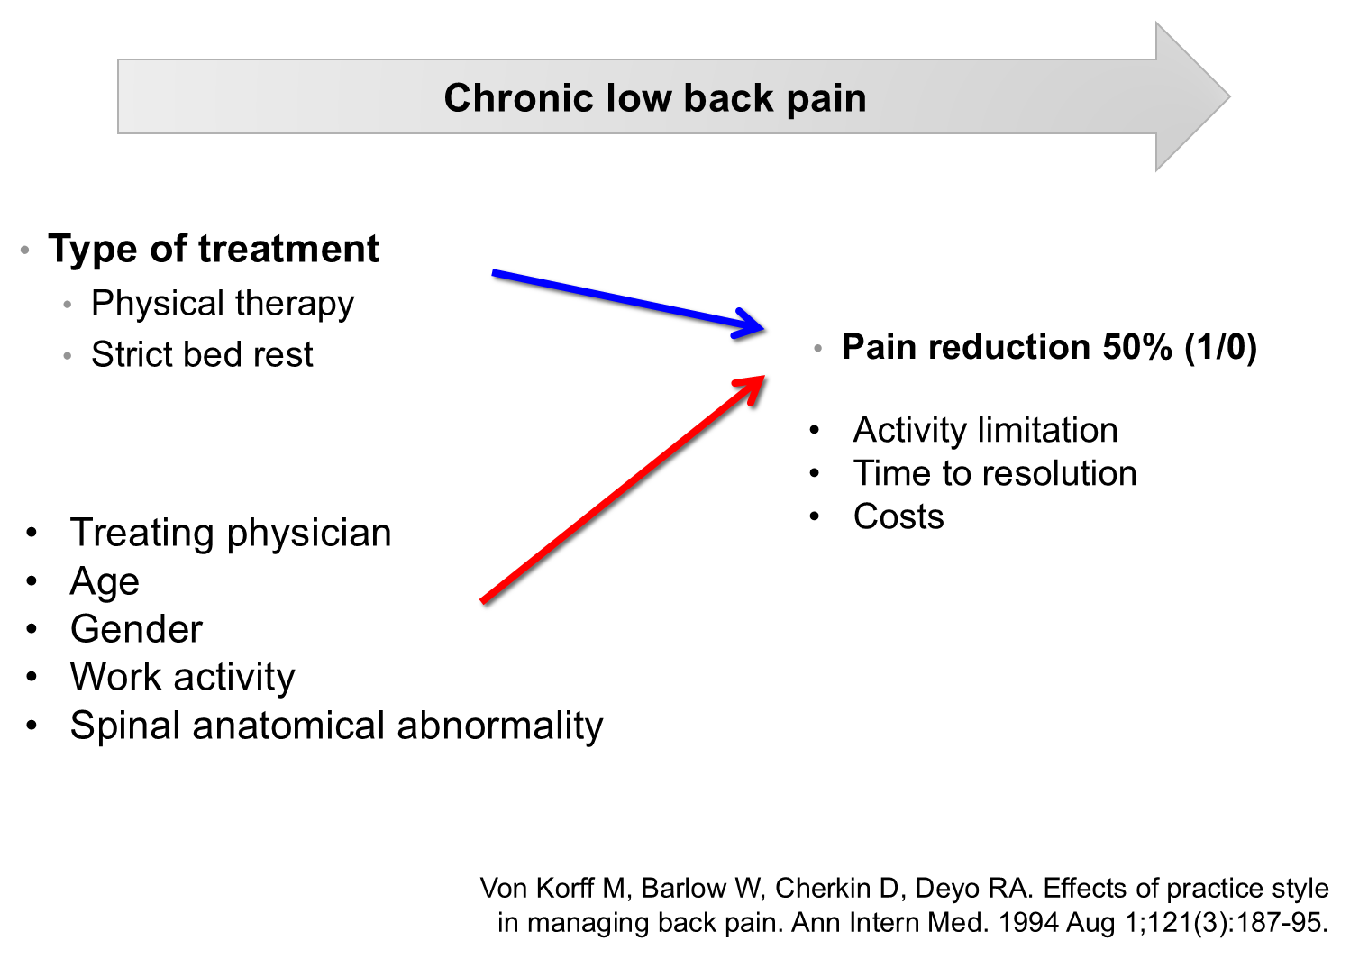
Example: chronic low back pain
1071 patients (44 physicians). Von Korff M, et al. Ann Intern Med. 1994;121(3):187-95.

Slide 5
What is multivariable analysis?
Statistical techniques to establish the unique (independent) contribution of a variable or a group of variables to an outcome.
It allows us to examine the effect of the treatment (bed rest vs physical therapy) while holding the other factors constant or fixed.
Many statistical techniques focus on the analysis of one or two variables.

Slide 6
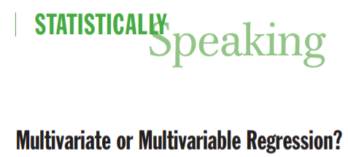
Multivariate or multivariable regression?

Slide 7
Multivariate or multivariable regression? (cont.)
Statistically speaking, multivariate analysis refers to statistical models that have 2 or more dependent or outcome variables
Multivariable analysis refers to statistical models in which there are multiple independent or response variables.

Slide 8
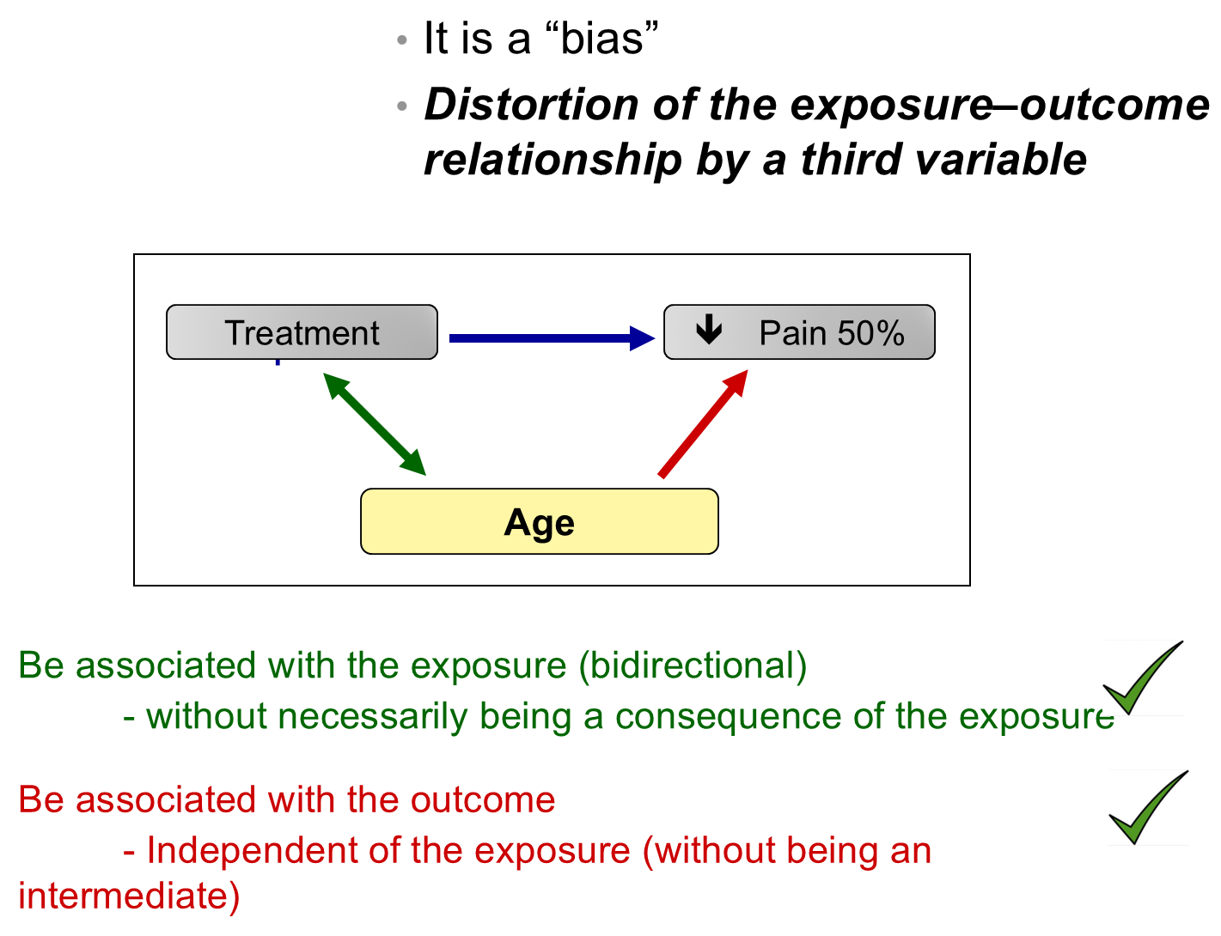
Confounding

Slide 9
Multivariable analysis and confounding
Multivariable analysis is a method to control for confounding
(it is not the only method)

Slide 10
For example,
With the use of multivariable analysis it was possible to show that tobacco exposure has an independent relationship with the risk of cardiovascular disease, after adjusting for factors such as sedentary lifestyle, obesity, gender, age and arterial hypertension.

Slide 11
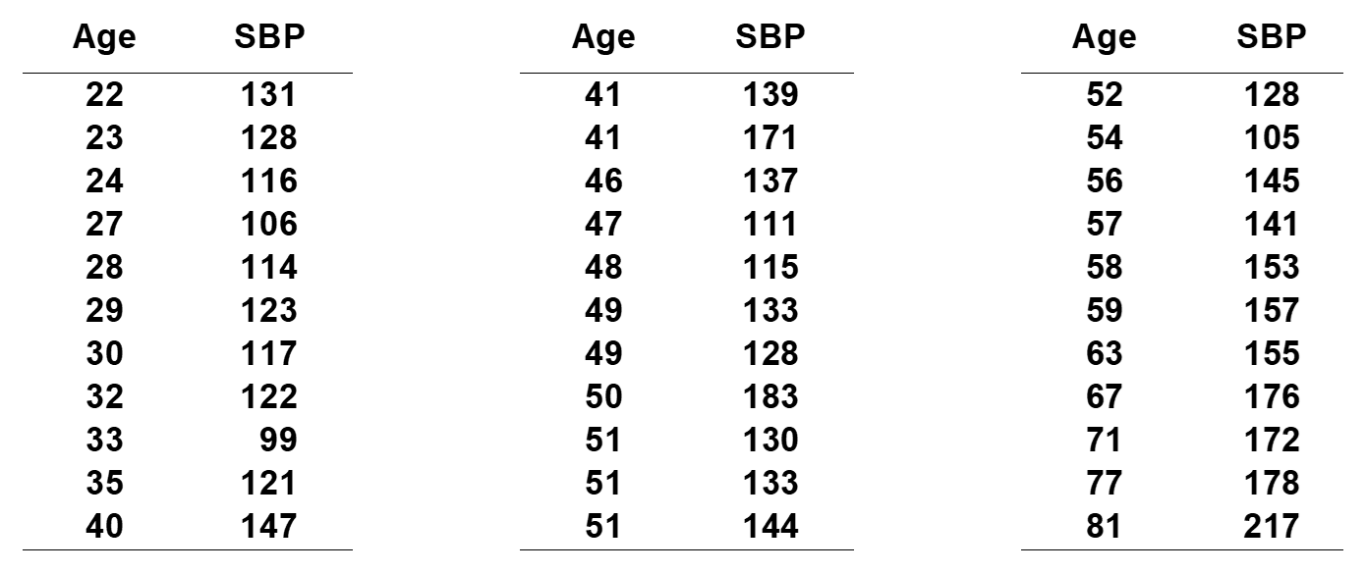
Age and systolic blood pressure

Slide 12
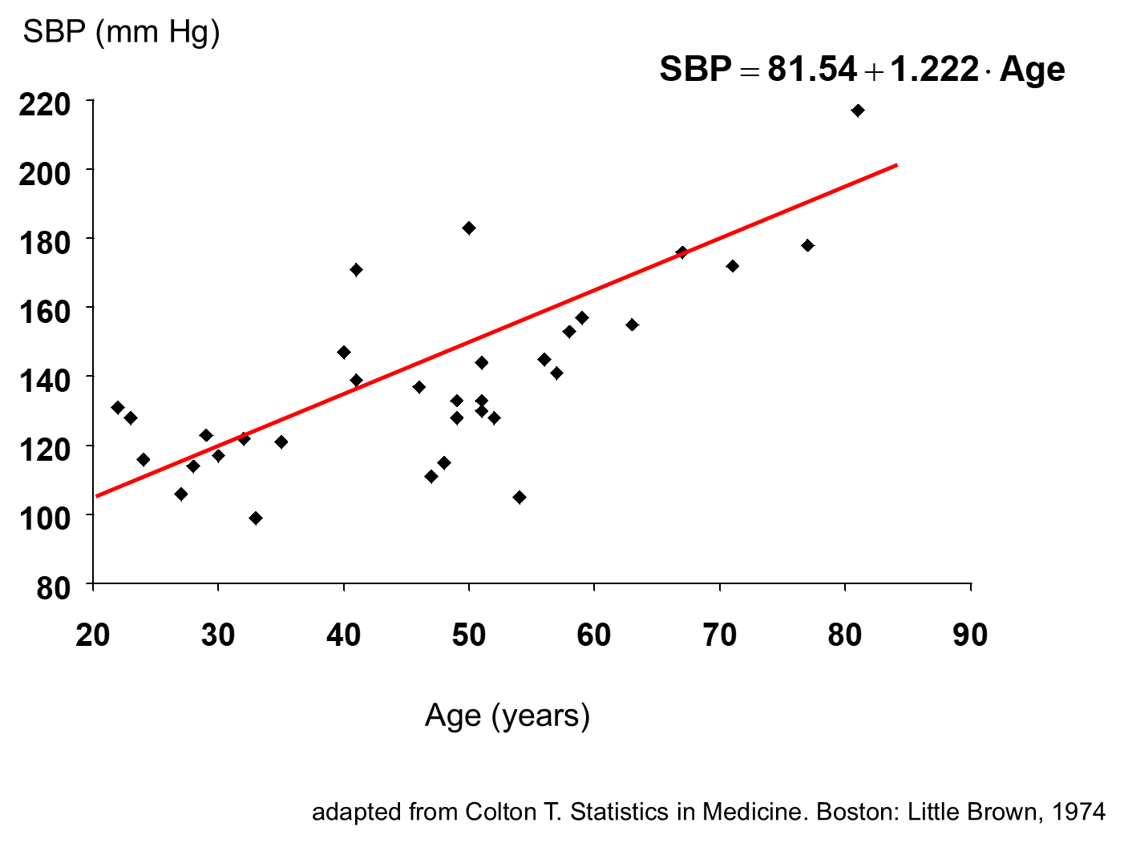
Age and systolic blood pressure — scatter plot

Slide 13
Simple linear regression
Relationship between two continuous variables (SBP (y) – age (x))
Regression coefficient $β_{1}$
  Measure of association between y and x
  How much y changes on average when x changes by one unit
  Least squares method

Slide 14
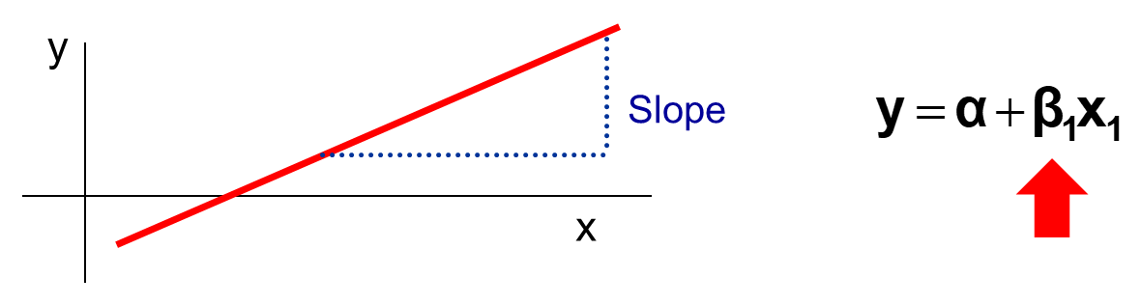
Simple linear regression — the slope

Slide 15
Multiple linear regression
Relationship between a continuous variable and a group of continuous or categorical variables
$$y=α+β_{1}x_{1}+β_{2}x_{2}+…+β_{i}x_{i}$$

Slide 16
Multiple linear regression — coefficients
(Partial) regression coefficients $β_{i}$
  Amount by which y changes on average when $x_{i}$ changes by one unit while all the other $x_{i}$ variables remain constant
  Measure of association between $x_{i}$ and y adjusted for the effect of all the $x_{i}$ variables
Example,
  SBP versus age, weight, height, gender, etc.

Slide 17
Regression equation
$$y=α+β_{1}x_{1}+β_{2}x_{2}+…+β_{i}x_{i}$$

Slide 18
Regression equation — terminology
y | α + β₁x₁ + β₂x₂ + … + βᵢxᵢ
Dependent | Independent variables
Predicted | Predictor variables
Response variable | Explanatory variable
Outcome variable | Covariates

Slide 19
Types of multivariable analysis
Type of outcome (y) | Examples of variables | Type of multivariable analysis (* extensions of the models)
Continuous | Blood pressure, weight, blood glucose | Simple linear regression; multiple linear regression
Binary (qualitative) | Death, remission, presence of infarction | Logistic regression
Time to event | ICU length of stay, time to infarction, time to cancer remission | Proportional hazards model or Cox regression

Slide 20
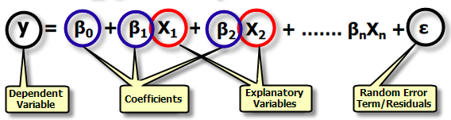
Outcome: continuous

Slide 21
Outcome: continuous — example
We studied the relationship between systolic blood pressure (SBP) and height in 100 children. It is known that height and weight are positively correlated. We therefore performed a multiple linear regression analysis to investigate the effects of height (cm), weight (kg) and sex (0 = boy, 1 = girl) on SBP (mmHg) in these children.

Slide 22
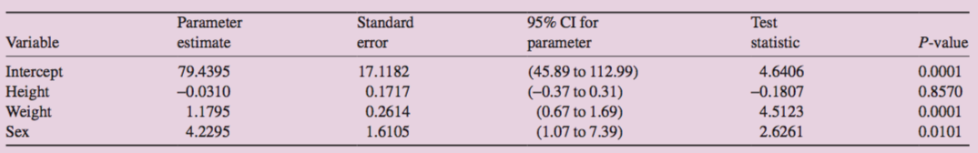
Outcome: continuous — results

Slide 23
Outcome: continuous — fitted equation
$$SBP=79.44−(0.03×height)+(1.18×weight)+(4.23×sex)$$

Slide 24
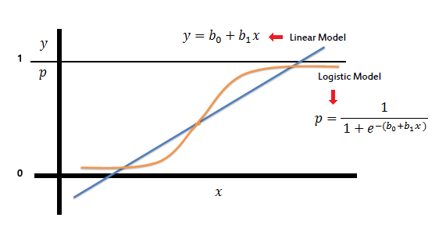
Outcome: binary
Linear model vs logistic model

Slide 25
Outcome: binary — logistic model
$$log\left(\frac{π}{1−π}\right)=β_{0}+β_{1}x_{1}+β_{2}x_{2}+…+β_{m}x_{m}$$
$$P=\frac{1}{1+e^{−(β_{0}+β_{1}x_{1}+β_{2}x_{2}+…+β_{k}x_{k})}}$$

Slide 26
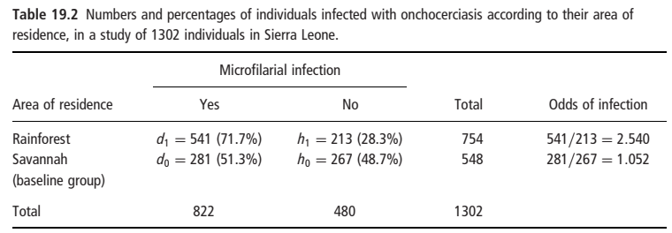
Outcome: binary — example (1/4)

Slide 27
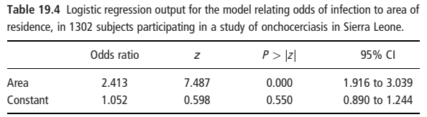
Outcome: binary — example (2/4)

Slide 28
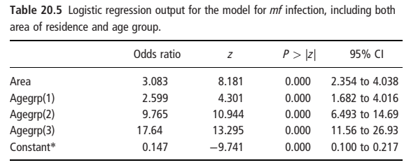
Outcome: binary — example (3/4)

Slide 29
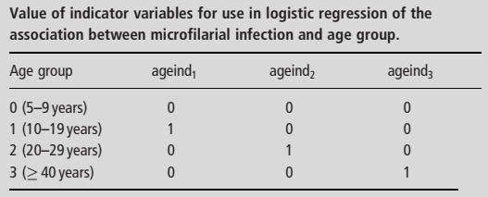
Outcome: binary — example (4/4)

Slide 30
Outcome: time to event
Cox proportional-hazards model
$$h(t)=h_{0}(t) e^{B_{1}x_{1}+B_{2}x_{2}+…+B_{k}x_{k}}$$
where
$h(t)$ = the hazard at time t
$h_{0}(t)$ = the hazard for a person with the value of 0 for all independent variables
$B$ = the regression coefficient for the independent variable x
$x$ = an independent variable

Slide 31
Uses of multivariable techniques
Causal models
  Isolate the effect of a single predictor on an outcome.
  Confounding is crucial and important
Prognostic models
  Predict the occurrence of an outcome based on several predictors.
  Confounding is not relevant, but other phenomena such as collinearity are

Slide 32
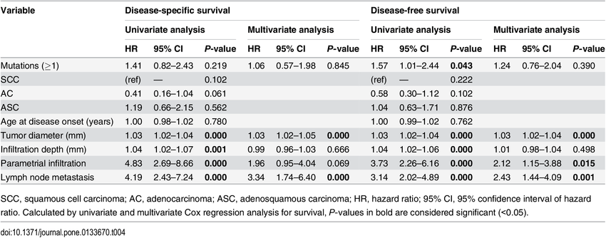
Example: Cox regression in a published study
doi:10.1371/journal.pone.0133670.t004

Slide 33
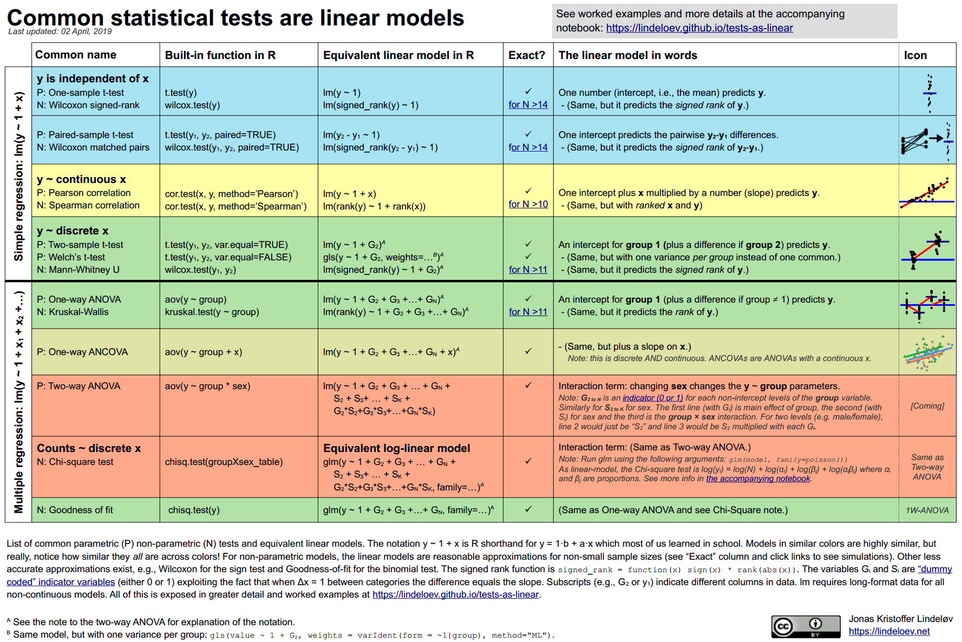
Common statistical tests are linear models
Lindeløv JK. Common statistical tests are linear models. https://lindeloev.github.io/tests-as-linear/

Slide 34
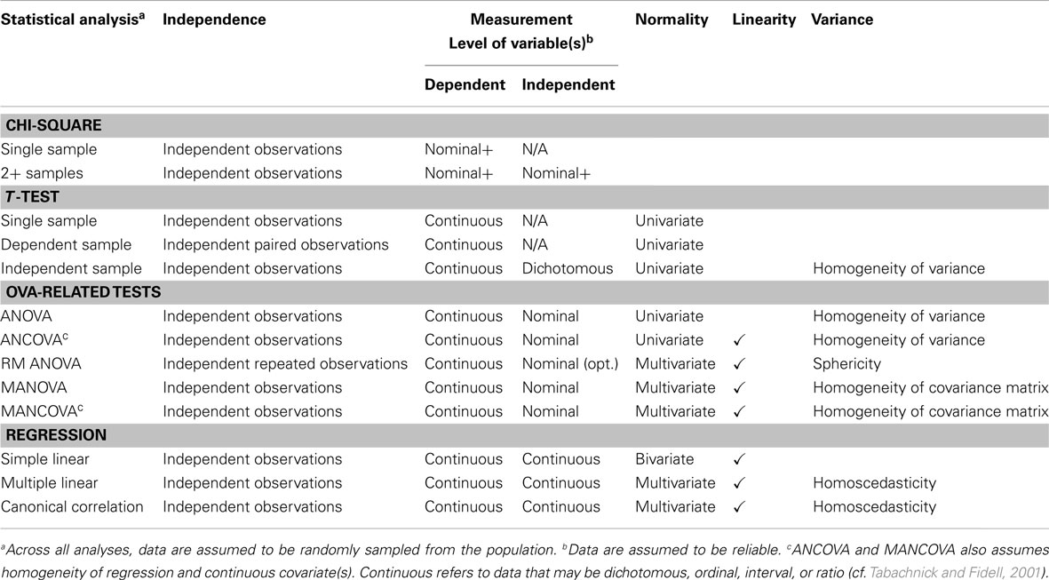
Choosing a statistical analysis

Slide 35
Final critical points (1/2)
Seek expert advice: Contact a biostatistician or professor; they will help you validate the study design, choose the right tests and interpret the results.
Plan and define your variables: Before starting, clarify what type of data each variable is (nominal, continuous, etc.) and how you will code it in the software.
Clean and validate your database: Review and handle missing data and outliers, and check the distribution (normality) of your variables.

Slide 36
Final critical points (2/2)
Do descriptive statistics first: Summarize your data with means, medians and graphs; this lets you understand the sample and identify initial errors.
Understand the fundamentals of the tests: Learn what the null hypothesis (H₀) and the p value mean; do not just report the number without understanding it.

Slide 37
Contact
Recommendations, comments and more
@jacalvache
jacalvache@unicauca.edu.co

Slide 38

Scan the QR code

