Slide 1



Introduction to Survival Analysis
Section 6 — Introduction to Biostatistics
Jose Andres Calvache MD MSc PhD

Slide 2
Section objectives
Introduction to survival analysis
  Life tables – Kaplan-Meier curves
  Analysis of time-to-event outcomes

Slide 3
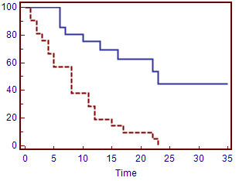
Survival curves

Slide 4
Longitudinal studies
During the follow-up of research subjects, several problems can occur that make their characterization and description difficult.
Loss to follow-up
  Dropping out of the study
  Difficulties contacting the subjects under observation
  Occurrence of multiple events

Slide 5
Longitudinal studies — cumulative incidence
Sometimes, the calculation of the cumulative incidence is insufficient to describe more complex situations appropriately.

Slide 6
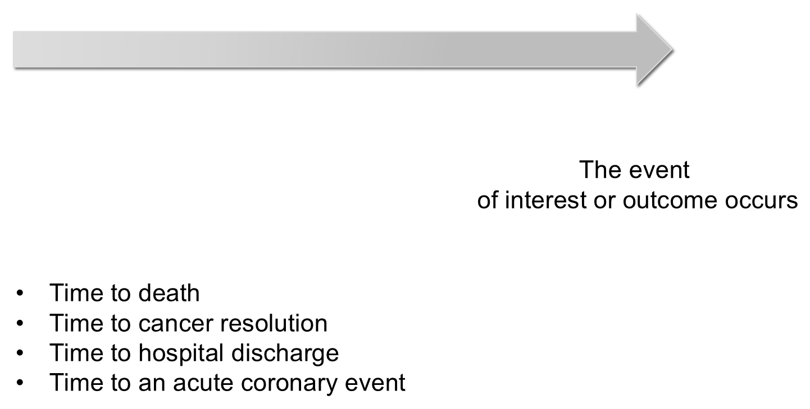
Time to …
Time until the event of interest or outcome occurs

Slide 7
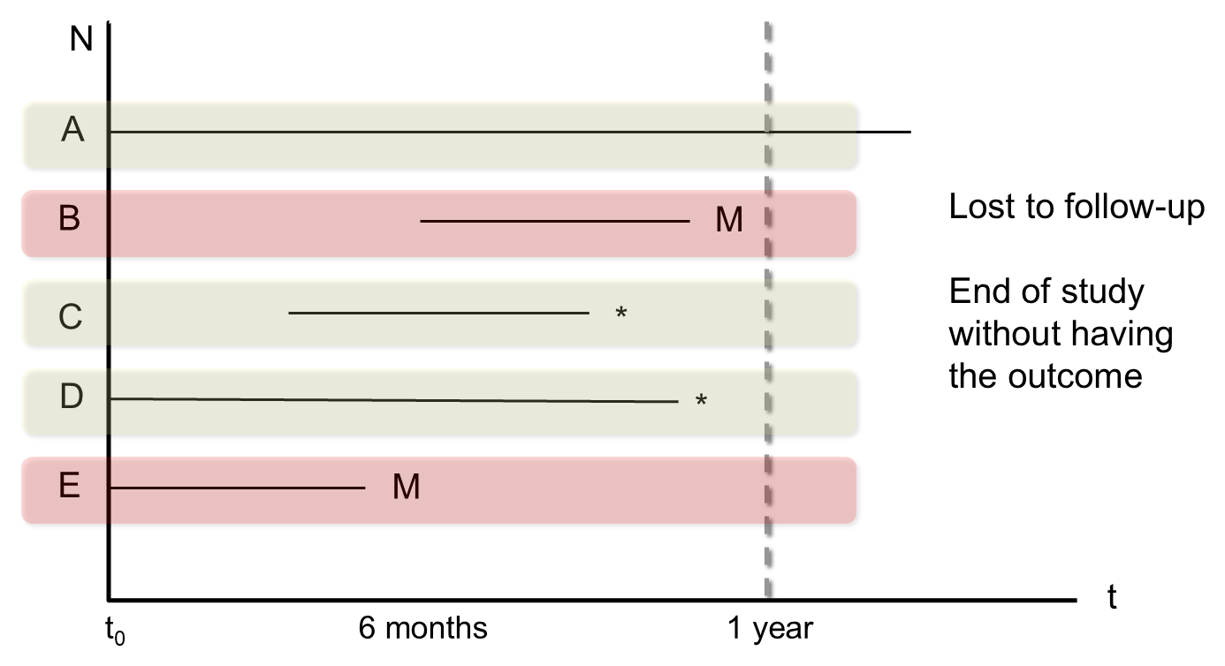
Main feature of survival analysis: censoring
M = lost to follow-up; * = end of study without having had the outcome

Slide 8
Survival analysis?
It is a group of statistical techniques in which the times until the occurrence of an event are analyzed, rather than the simple occurrence of the event.
Appropriate for analyzing longitudinal time-to-event data in the presence of censoring.
In these situations other statistical methods are insufficient or provide invalid results.

Slide 9
Summarizing survival data
T = survival time (or time to an event)
Usually right-skewed distributions
Data are summarized using,
  Life tables
  Survival curves calculated with the Kaplan-Meier method
  Median survival and quartiles

Slide 10
Strategies for analyzing survival data
Estimate a function that gives the probability of the outcome as a function of time
Identify risk factors for a better or worse survival prognosis
Compare the survival of different groups

Slide 11
Survival curve
T = time to the event (T > 0)
$$S(t)=P(T>t), t≥0$$
Proportion of subjects “alive” after time t
Decreasing function

Slide 12
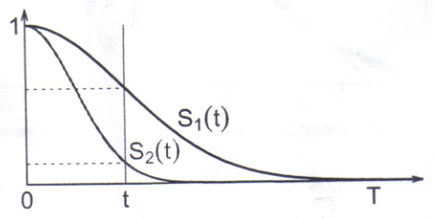
Survival curve — two groups

Slide 13
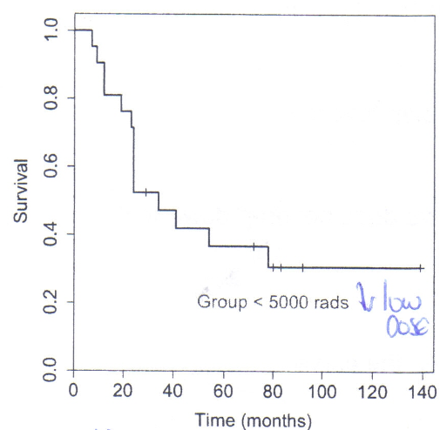
Kaplan-Meier survival curve

Slide 14
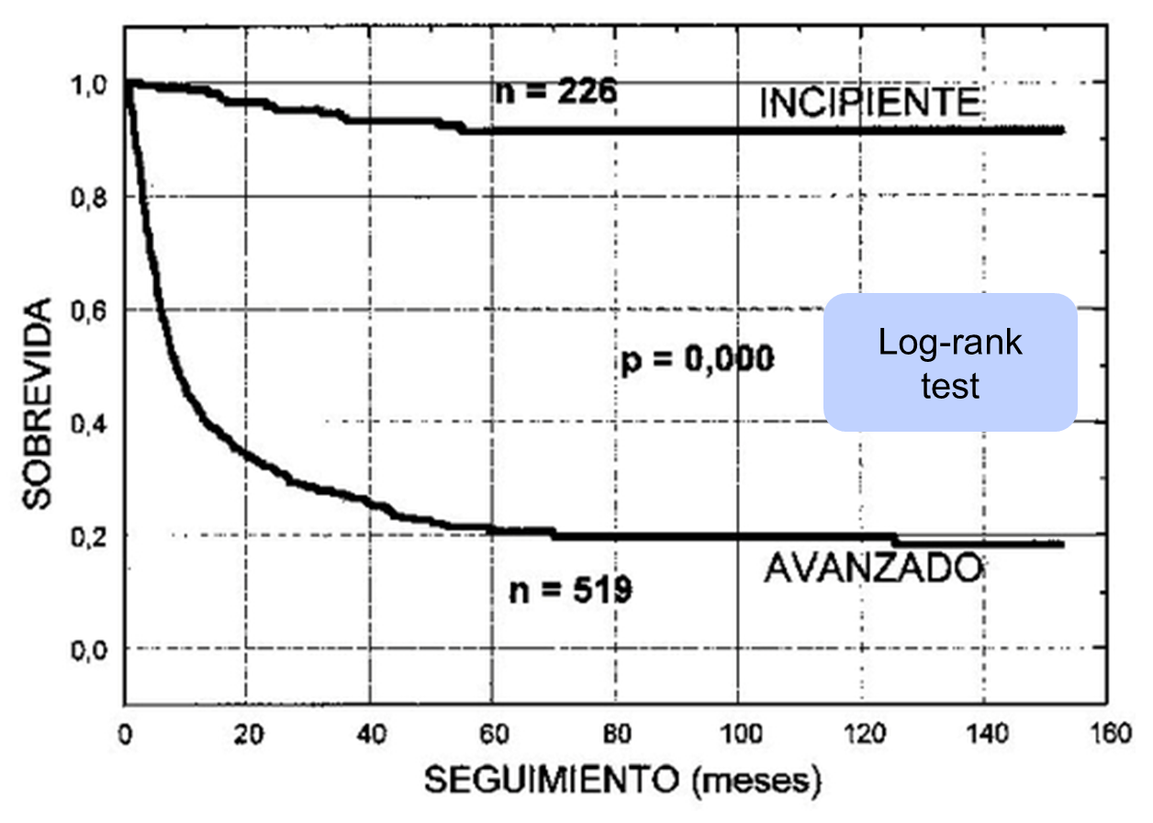
Comparing two survival curves
Log-rank test: survival by follow-up (months), early (n = 226) vs advanced (n = 519) stage

Slide 15
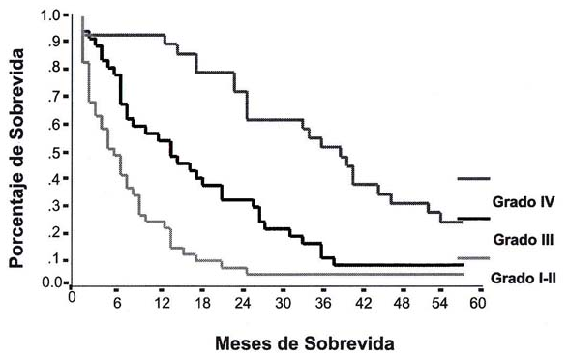
Comparing several survival curves
Percentage survival (y-axis) by months of survival (x-axis) for tumour grade I–II, III and IV

Slide 16
Contact
Recommendations, comments and more
@jacalvache
jacalvache@unicauca.edu.co

