Slide 1
Practical Session
Programming Multiagent Systems
WESAAC 2013
Olivier Boissier
Rafael H. Bordini
Jomi F. Hübner
Alessandro Ricci
(EMSE, France)
(PUC-RS,Brazil)
(UFSC, Brazil)
(Bologna University, Italy)

Slide 2
Scenario (1)
Giacomo wants to build a house
We consider two main phases:
Contracting specialised companies Giacomo hires various companies specialised in different aspects of construction
Building the house Contractors execute the main workflow for building the house under Giacomo’s supervision

Slide 3
Scenario (2)
Phase 1: Contracting specialised companies
The objective here is to hire one company for each of these tasks:
Site preparation
Lay floors
Build walls
Build roof
Fit windows
Fit doors
Install the plumbing
Install the electrical system
Paint the exterior of the house
Paint the interior of the house
NB: The same company can be hired for more than 1 task

Slide 4
Scenario (3)
Site preparation
Lay floors
Build walls
Build roof
Fit windows
Fit doors
Install the plumbing
Install the electrical system
Paint the exterior of the house
Paint the interior of the house
Phase 2: Building the house
After the companies have been hired, they have to execute their tasks on time and in coordination with each other
Some tasks depend on others and some tasks can be done in parallel, as represented by the workflow (";" for sequence and "|" for parallel)
a ; b ; c ; (d | e | f) ; (g | h | i) ; j

Slide 5
An MAS for House Building
To make the scenario suitable for a course like this, we introduced some simplifications in the system design
We summarise the solution using our approach, commenting on:
Agents
Contracting Phase (using Environment)
Building Phase (using Organisation)

Slide 6
Agents
Two types of agents:
House owner (Giacomo): provides the requirements for the house, with budget limitations
Companies: they will offer their service and, if hired, will execute the house building tasks; they are characterised by their competences in house building

Slide 7
Agents Implementation
The house owner is programmed in Jason
Companies are programmed in Jason (or 2APL, Jadex, ...)
A heterogeneous agent system

Slide 8
Contracting Phase
Electronic auctions will be used to hire the required companies
One auction for each task
Each auction is started with:
the task description
the maximum value the owner can pay for it
By the end of an auction, the company to be hired for that task is determined

Slide 9
Environment Implementation
An auction artifact encapsulates the auction mechanism
Giacomo creates instances of such artifacts for creating/managing the various auctions; one such auction is used for hiring companies for each of the house building tasks
Companies can perceive those artifacts and bid according to their competence and following their own strategies
After some time Giacomo decides to finish the auction, observing the current best bid shown on the artifact

Slide 10
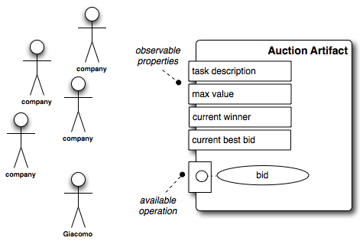

Slide 11
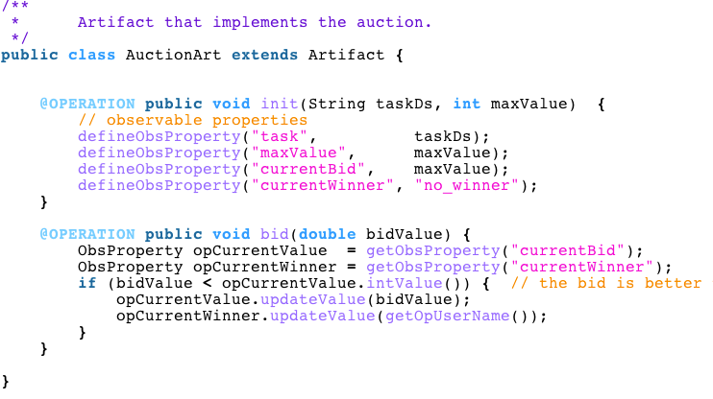
src/env/tools/AuctionArt.java

Slide 12
Contracting: Agent Side
Giacomo has plans to launch all auctions by creating the corresponding artifacts
Company agents have plans to look for the auction artifacts of their interest and plans defining their own bidding strategy
After some time Giacomo looks at the best bid in each auction artifact and awards a contract for the winning company

Slide 13
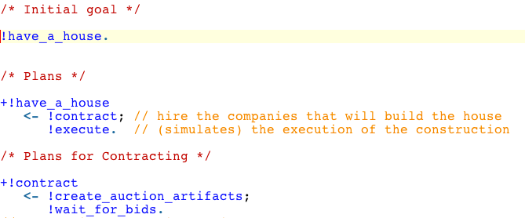
src/agt/giacomo.asl

Slide 14
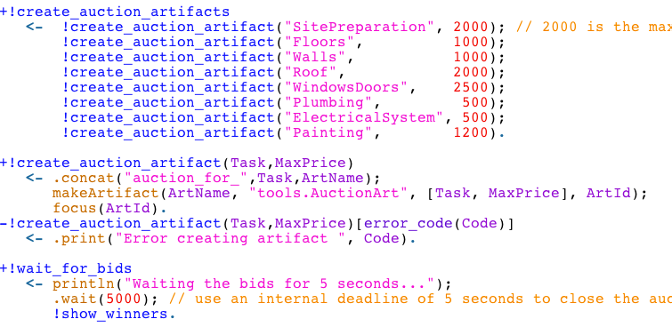
src/agt/giacomo.asl

Slide 15
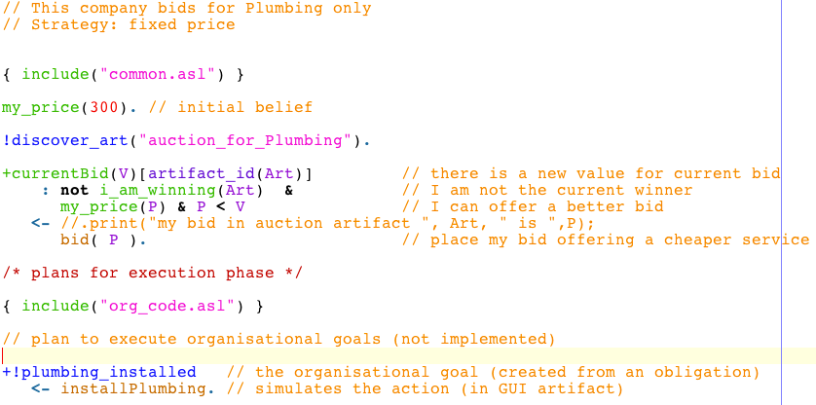
src/agt/companyA.asl

Slide 16
Eclipse Project

Slide 17
Requirements
JaCaMo >= 0.4 (link), that includes
The code of the application used in this tutorial
Documentation
More examples
Eclipse >= Luna
JaCaMo Eclipse plugin (link)

Slide 18
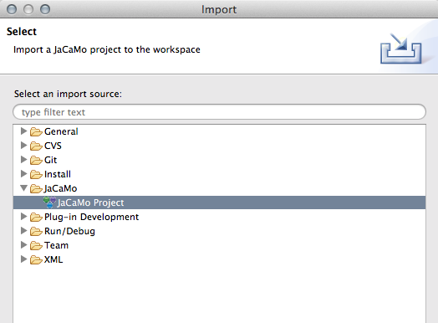

Slide 19
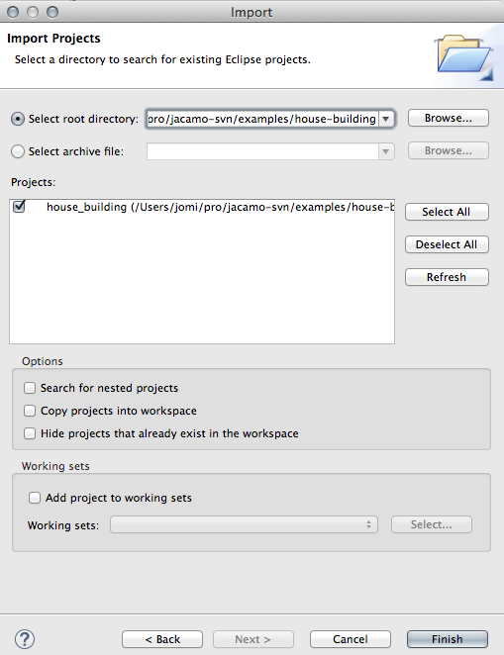

Slide 20
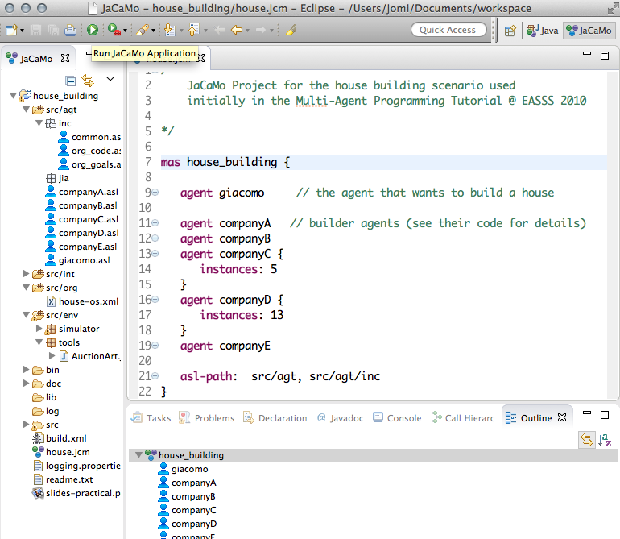

Slide 21
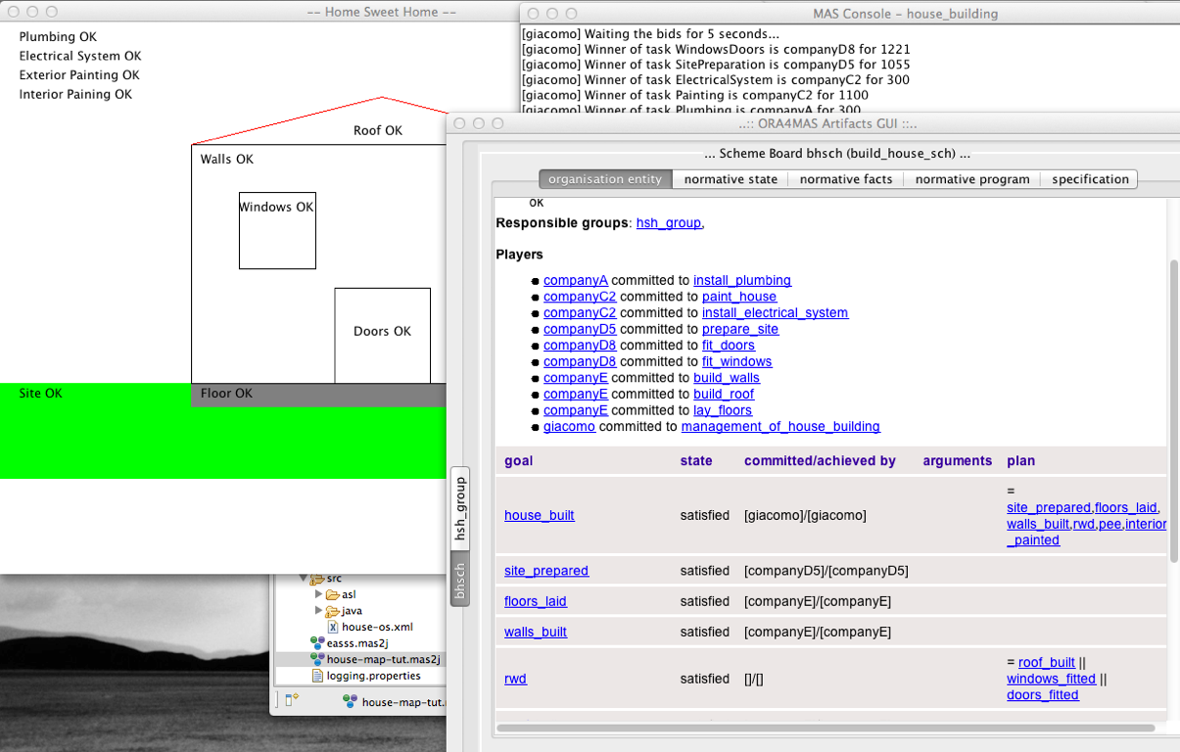

Slide 22
Exercises
Change the code of the auction artifact to:
create a new observable property that shows the state of the auction (open or closed)
add a new operation clearAuction (after clearAuction, the state of the auction becomes closed and attempts to use the bid operation will fail)
Change the house owner program so that the agent uses the new clearAuction operation

Slide 23
Homework
Change the auction artifact so that it shows and manages the bidding deadline and has a new operation for starting the auction; the clearAuction operation is no longer needed
Create a new company for one of the tasks and give it any bidding strategy you like

Slide 24
Homework
Choose a new auction mechanism and implement a new auction artifact that implements that mechanism; you should not change the agents for this exercise
Now choose another mechanism that will require different strategies in the agents and implement them

Slide 25
Moise Specification

Slide 26
Building Phase
After all auctions are over, Giacomo sends messages for the hired companies to enter into the execution phase
A virtual organisation is created to assist with coordination and cooperation in the execution of the global workflow
Implementation choice:
The organisation is specified using the Moise organisation modelling language

Slide 27
Building: Organisation Side
Moise functional specification is used to define the workflow
Moise structural specification is used to define the role and group structures
Moise normative specification is used to distribute the tasks of the workflow to the roles

Slide 28
Functional Specification
Site preparation
Lay floors
Build walls
Build roof
Fit windows
Fit doors
Install the plumbing
Install the electrical system
Paint the exterior of the house
Paint the interior of the house
The functional specification simply defines a social scheme for the global workflow
a ; b ; c ; (d | e | f) ; (g | h | i) ; j
One mission for each task except for the painting of the exterior and of the interior of the house that are grouped into the same mission
A task for the management of the execution of the workflow is also added

Slide 29
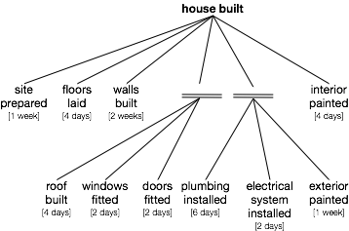

Slide 30
Structural Specification (1)
Role hierarchy
house_owner
building_company
abstract role, specialised into: site_prep_contractor, bricklayer, roofer, window_fitter, door_fitter, plumber, electrician, painter

Slide 31
Structural Specification (2)
The roles are used in a group called ‘house_group’ where:
house_owner has cardinality (1,1)
site_prep_contractor has cardinality (1,1)
bricklayer has cardinality (1,2)
roofer has cardinality (1,1)
window_fitter has cardinality (1,1)
door_fitter has cardinality (1,1)
plumber has cardinality (1,1)
electrician has cardinality (1,1)
painter has cardinality (1,1)

Slide 32
Structural Specification (3)
Notes:
the role building_company is compatible with building_company so that the same agent can play more subroles
role house_owner has authority over the building_company role
a communication link connects the role build_company to house_owner

Slide 33
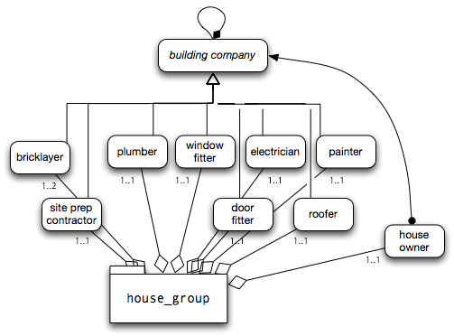

Slide 34
Normative Specification (1)
Given the definition of the missions, the following norms are defined:
any agent playing the role houseOwner is obliged to commit to mission ‘mManagement’
role site_prep_contractor to the mission concerning the site preparation goal
role bricklayer to the mission of laying the floors
bricklayer is also obliged to commit to the mission of building the walls
roofer is obliged to the mission of building the roof

Slide 35
Normative Specification (2)
role window_fitter to the mission related to fitting the windows
door_fitter is obliged to commit to the mission of fitting the doors
plumber to installing the plumbing
electrician to installing the electrical system
painter to the mission concerning the painting of the house

Slide 36
Building: Agent Side
Owner agent is equipped with the plans to construct the virtual organisation based on the result of contracting phase
Company agents have plans to enter the organisation, adopt the role corresponding to their contract and to catch the different events generate by the OMI
Companies have plans to execute autonomously the various actions related to the goals related to the missions they are committed to in the organisation scheme
NB: agents are benevolent with respect to the organisation, i.e. they don't violate the norms

Slide 37
Building: Environment Side
Artifacts that model the state of the environment (e.g., model the state of the construction of a wall)

Slide 38
Exercises
Do the following changes in the organisation specification:
tasks site_preparation and lay_floors can be done in parallel
all tasks have to be done in sequence

Slide 39
Homework
Develop an agent that tries to adopt roles related to tasks he is not supposed to (malevolent agent!)
(e.g. Giacomo trying to play some company role)
Develop an agent that does not fulfill the tasks

Slide 40
Homework
Change the Giacomo agent so that it reacts to the norm violation
Giacomo should create a new auction for that task and forbid the violating company from taking part in the new auction
Change the system to build two houses in parallel

Slide 41
Homework
Change the Giacomo agent so that it reads the Moise specification and creates the necessary auction artifacts based on the specified tasks
Change Giacomo so that it is able to monitor the building of the house and check whether the tasks are being done appropriately

Slide 42
Conclusions
Separation of concerns
agent, environment, organisation, interaction
MAP = AOP + EOP + OOP + IOP
Design == Implementation
In our code, (almost) no (direct) communication in the MAS!

Slide 43
TMP
TEMPORARY SLIDES: CHECK IF NEEDED

Slide 44

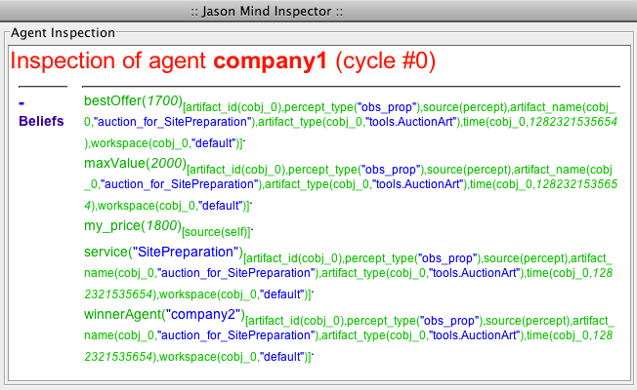
Belief Base with Observable Properties

Slide 45

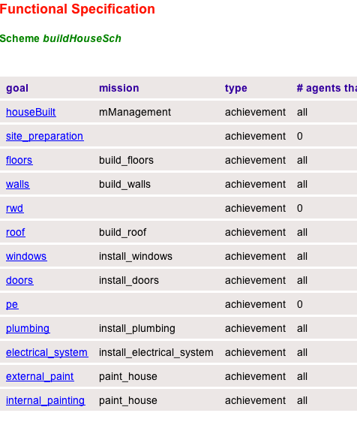
Organisation Simulator

Slide 46

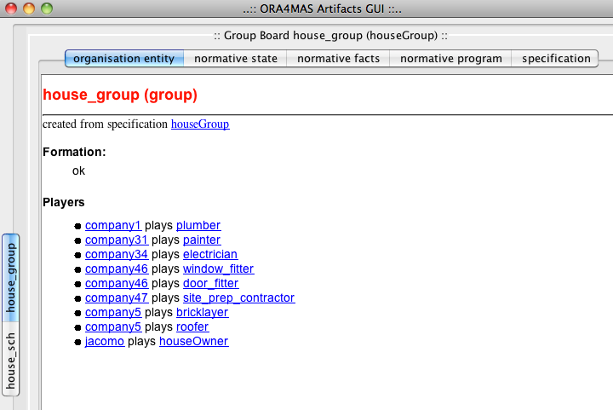
Organisation Entity

