Slide 1






Correspondence between typing methods results:
A web-based quantitative analysis tool
Correspondence between typing methods results:
A web-based quantitative analysis tool
Carriço, J.A.; F. R. Pinto; J. Melo-Cristino; H. de Lencastre ; J. S. Almeida ; M.Ramirez
17th ECCMID/25thICC, Munich, April 2007

Slide 2
Comparing typing methods
Microbial Typing methods provide powerful tools for epidemiological studies
How to compare typing methods?
  Typeability
  Reproducibility/Stability
  Discriminatory power
  etc...
    Struelens et al, 1996, Clin Microbiol Infect 2:2-11.

Slide 3
Comparing Typing methods results
How to compare Typing methods results?
  set of results or type assigments for a method -> a Partition of the dataset
  Examples:
    for MLST a partition could be the ST assignments or clonal complex assignment by eBURST;
    for PFGE the partitions are the types defined by strains clustered together at a certain similarity threshold;
    for Serotyping , the partition is the serotype assignment
        So for comparing results we need to ways to compare partitions

Slide 4
Need for quantitative Biology
When you can measure what you are talking about and express it in numbers you know something about it. When you cannot measure it, when you cannot express it, your knowledge is of a meagre and unsatisfactory kind.
- Lord Kelvin 1861

Slide 5
For each pair of isolates:
Method
Method
Method
Sequence Type
PFGE Cluster
s1
Same PFGE cluster?
Y N
s2
a
a
b
Y
N
s3
Same Sequence Type?
s4
c
d
s5
s6
s7

Slide 6
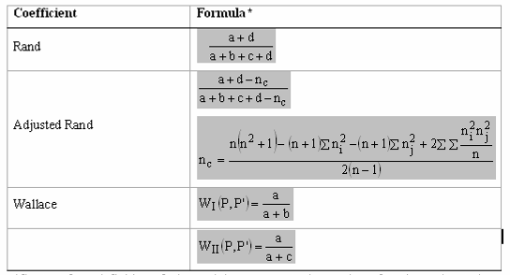
Partition congruence coefficients
WP10b – Data Analysis
Proportion of agreement
Proportion of agreement
corrected for presence of chance agreement
Probability that a pair of points which are in the same cluster under P are also in the same cluster under P’ and vice-versa.
Same partition under 2?
Y N
Translating…:
Y
N
a
a
b
Same partition under 1?
Probability that a pair of strains which have the same MLST also have the same PFGE type (for example)
c
d

Slide 7
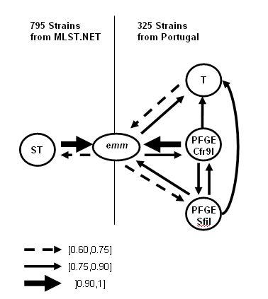
Framework aplication to
S pyogenes
WP10b – Data Analysis
Data
325 strains macrolide-resistant S pyogenes
Results
emm is not sufficient to define clones
SmaI/Cfr9I preferred to SfiI for PFGE typing
PFGE and MLST are the methods of choice
Wallace coefficient
Carriço et al, JCM, 2006, 44,77, p2524 - 2532

Slide 8
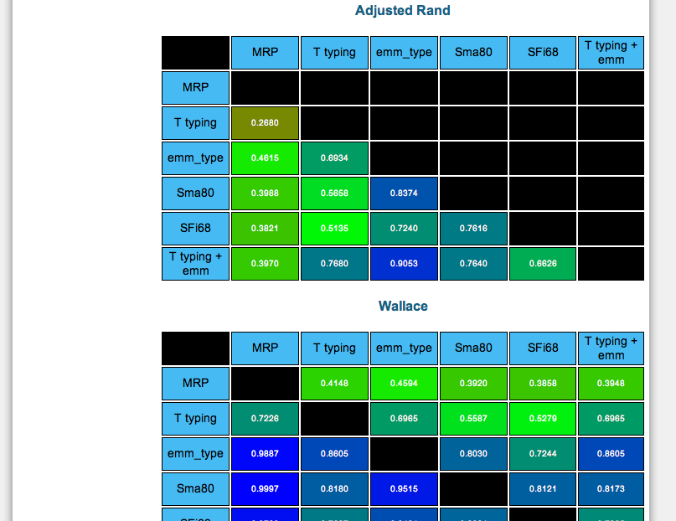
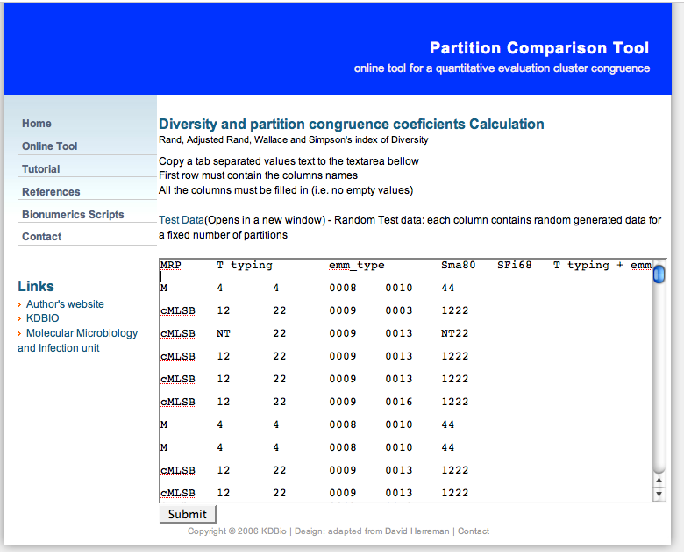
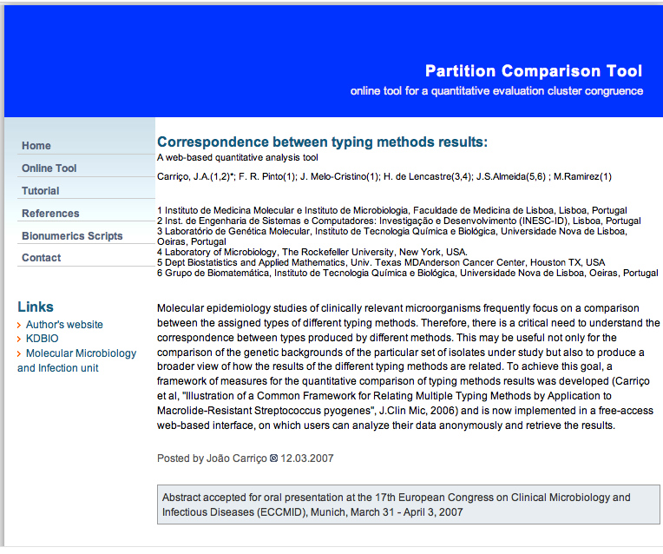
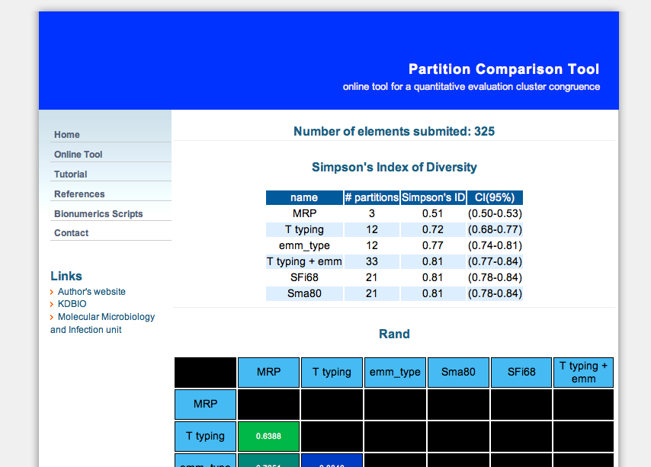
www.comparingpartitions.info

Slide 9
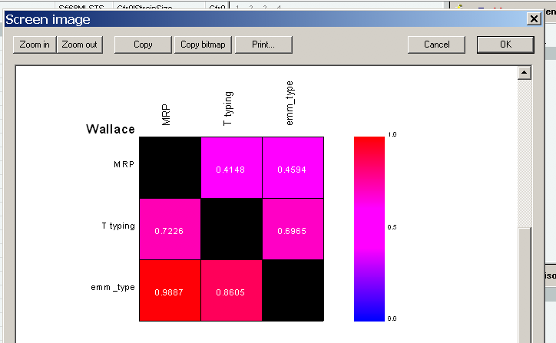
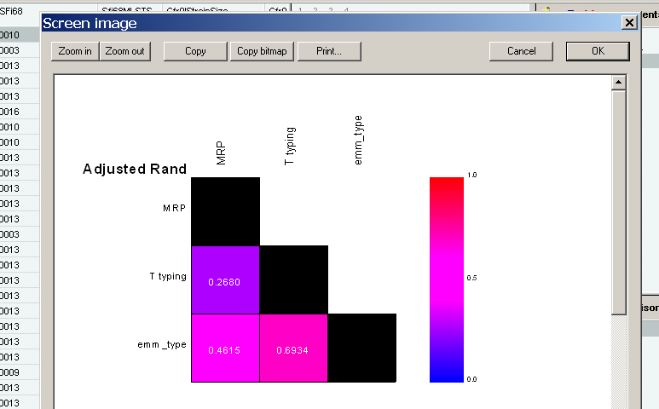
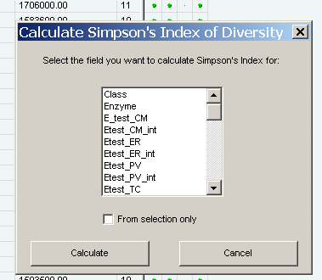
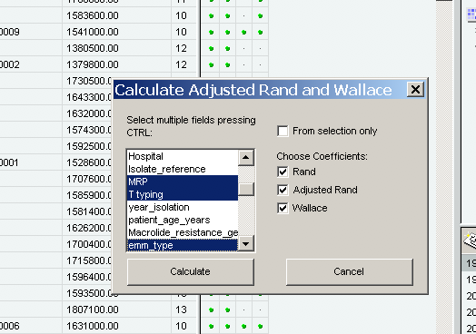
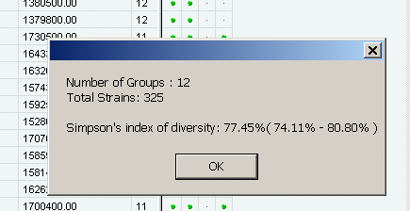
Bionumerics Scripts

Slide 10
Conclusions
The proposed framework is useful for a global evaluation of typing methods results congruence:
quantifying relations between results in established typing methods
- evaluating new typing methods
www.comparingpartitions.info:
a free easy-to-use web interface where anyone can use the proposed framework on their own data

Slide 11
Conclusions
Other applications
The defined framework can be used for comparison of any classifications
e.g. expression and functional classifications of microarray
Congruence of methods can help to clarify evolutionary timeframes
e.g. genetic background evolve slowly whereas proteins under immune selection may evolve faster

Slide 12
Acknowledgments
Catarina Silva-Costa for the S. pyogenes data
ECCMID/ICC and Wyeth for the travel grant

