Slide 1
Computer Assisted Analysis
of
Pulsed-field Gel Electrophoresis gels
João André Carriço
jcarrico@algos.inesc-id.pt
40th ESCMID Postgraduate Education Course:
Bacterial Molecular Typing – A Practical and Theoretical Course

Slide 2

Why “Computer assisted”
Analysing 2 gels to detect outbreak situation
  worst case scenario: ((2*27⁽¹⁾)*(2*27-1))/2=1431 comparisons
Analysing 20 gels from an 1 year longitudinal study
  worst case scenario: ((20*27⁽¹⁾)*(20*27-1))/2=145530 comparisons!
“Please have a computer do that for me!”
.... But the computers won’t replace the eyes...hence the “assisted”
⁽¹⁾30 lanes gels with 3 markers =27 isolates

Slide 3
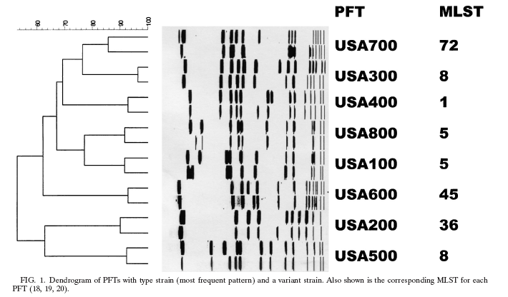
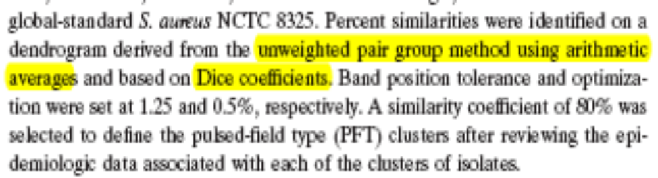
Dendrograms for PFGE Type assignment
What is behind the dendrogram?
Band position tolerance: 1.25%
Optimization: 0.5%
UPGMA
Dice coefficients
Cut-off 80%
Image Analysis settings:
Dendrogram construction:
Cluster Cut-off:/Type definition:
McDougal, L. K., et all. 2003. J Clin Microbiol 41:5113-20.

Slide 4
Image Analysis : Normalization
Molecular size markers:
Lambda
Reference Strains

Slide 5
Image Analysis :
Band matching
a b c d e f
Typical settings:
Band position tolerance
Optimization

Slide 6
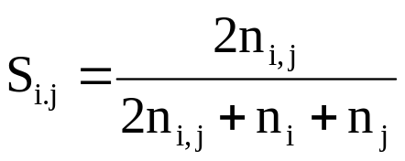
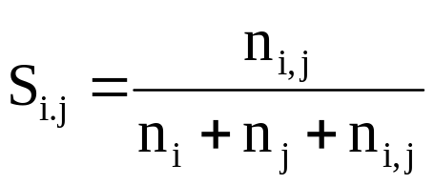
Cluster Analysis:
Distance metrics
a b c d e f
Dice
Jaccard
n_{i,j}=
10
n_{i}=
3
n_{j}=
1
# bands
11
12
14
13
11
11
By calculating
all possible pairs
you build a Similarity Matrix
# bands
difference
1
4
4
Dice = 83,3% 81.8%
Jaccard = 71,4% 69.2%

Slide 7
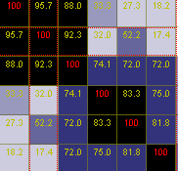
Building the Dendrogram
a b c d e f
a
b
c
d
e
f
ab c d e f
a
ab
c
d
e
f
90.15
39.75
17.8
b
32.6
c
90.15
32.6
39.75
17.8
UPGMA:
Unweighted Pair Group Method with Arithmetic mean
Sim (c, (a,b))= (88.0+92.3)/2 =90.15
And you procede until you have everything in one group...

Slide 8
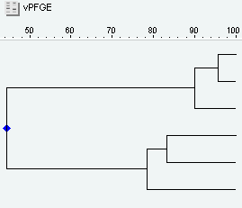
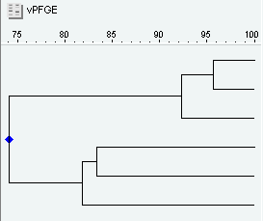
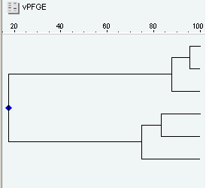
Building the Dendrogram
UPGMA
Single Linkage
a
b
c
d
e
f
a
b
c
d
e
f
a
b
c
d
e
f
Complete
Linkage

Slide 9
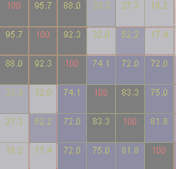
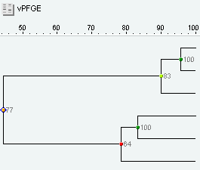
Validating the Dendrogram:
Cophenetic Correlation
a b c d e f
a b c d e f
a
b
c
d
e
f
a
b
c
d
e
f
Pearson´s R
a
b
c
d
e
f

Slide 10
Assigning strain to types
Tenover’s Criteria:
if two strains’ band patterns differ up to 6 bands, counted on both lanes, they are considered to be from the same type
Cluster Cut-off:
Normally tries to emulate the Tenover’s criteria
The dendrogram should be looked upon and analysed taking in consideration other relevant epidemiological data
Tenover, F, et all. 1995. J Clin Microbiol 43(11):5483-90.

Slide 11
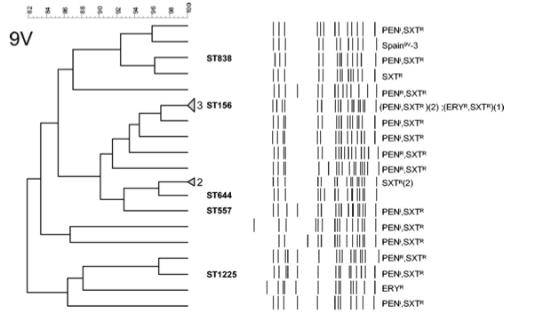
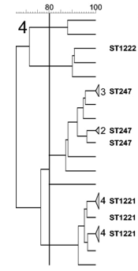
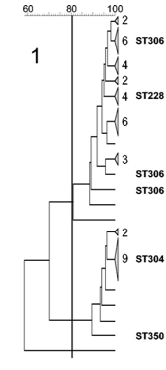
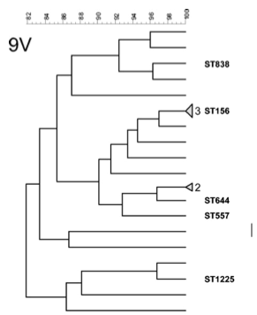
Assigning strain to types
S.pneumoniae
Serrano, I, et al. 2005. J Clin Microbiol 43(4): 1706-1715.

Slide 12
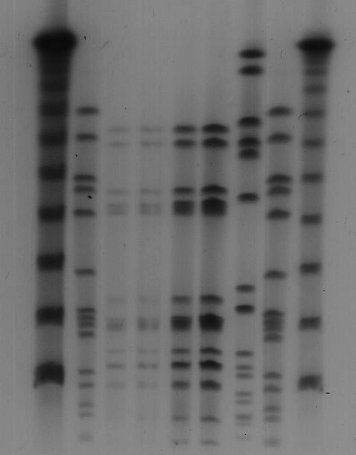
Problems in PGFE
λ
λ
λ
R6
R6
λ
R6
R6
N315
N315
T4
T4
1:10
1:5
1:2
1:1
1:10
1:5
1:2
1:1
???
???
???
???
???
???
???
???
???
???

Slide 13

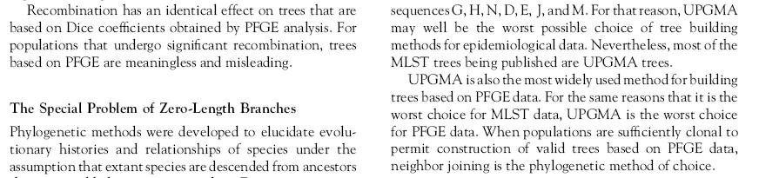
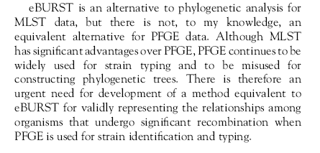
Problems in data analysis
An.Epidemiol.16, (3) 2006: 157–169

Slide 14
Conclusions
PFGE is still the “gold standard” typing method of choice for several microorganisms
The PFGE Image Analysis should always be carefully done and the program settings and parameters need to be carefully selected...but other epidemilogically relevant data should always be considered!
Dendrograms aren’t the best method for analysing PFGE data, but they are “easily” understandable and provide a way to summarize data .... New methods are needed.
As all gel based methods the inter-laboratory reproducibility involves a big concerted effort... Sequence-based methods are much more appealing for data exchange
Computers help you in the analysis...they don’t do the analysis for you ;-)

Slide 15
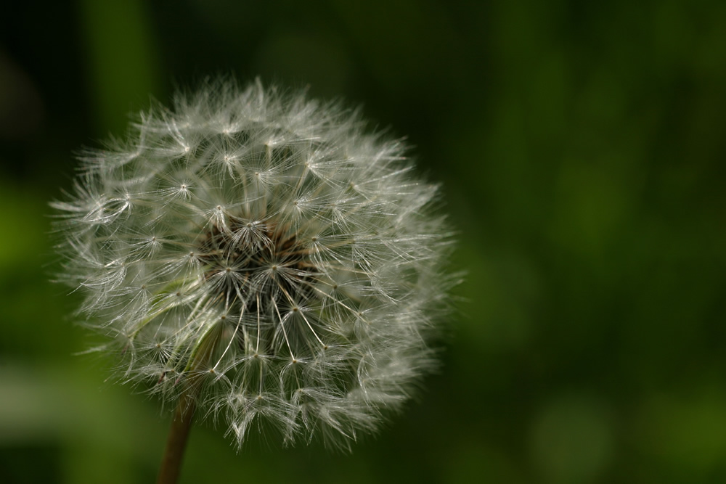

technology
from seed

