Slide 1
Searching Waves
Techniques for Finding Transients
In Gravitational Wave Astronomy
J. Andrew Casey-Clyde
San Jose State University

Slide 2
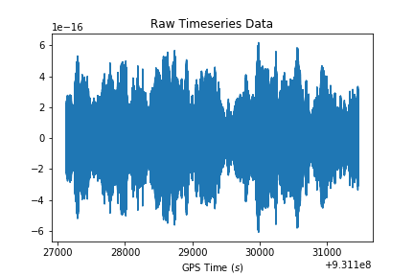
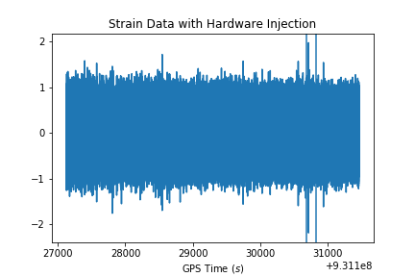
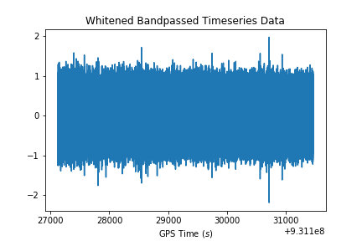
Problems
Noisy data
Lots of data
  2 weeks ~ 50GB
Machine Learning

Slide 3
Kleine Welle Algorithm
Searches for energy overdensities in timeseries data
  Decompose into component wavelets
  Cluster wavelet coefficients
  Significance thresholding

Slide 4
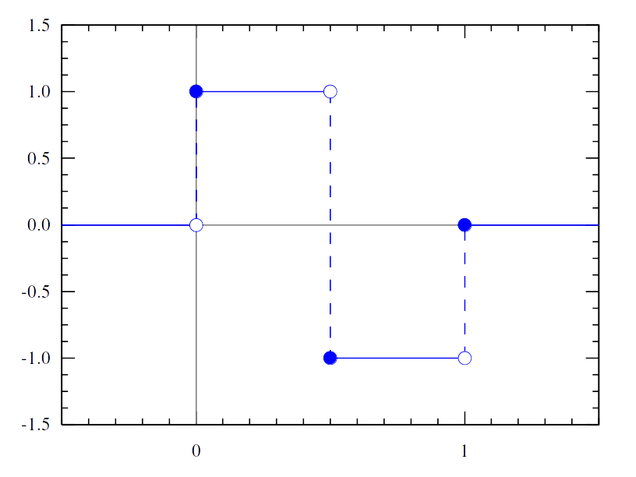
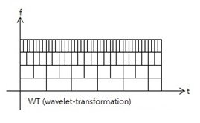
Decomposition
Decompose timeseries into wavelets/coefficient
Wavelet transformation
  Characterizes “strength” of component wavelets
Dyadic wavelet decomposition
  Scales 2^{j}

Slide 5
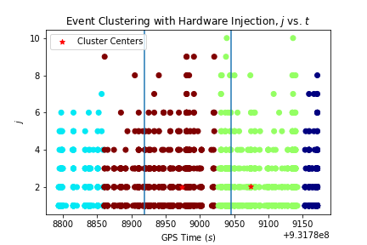
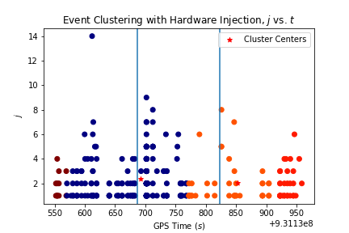
Clustering
Select significant points (>4σ_{j})
Cluster in time/scale
MeanShift clustering
  No prior cluster knowledge

Slide 6
Thresholding
Cluster energy
Significance

Slide 7
Results
Compare to injections
  H1
    7 CBC, 1 Burst
  L1
    3 CBC, 2 Burst
Found
  H1: 10 CBC, 1 Burst
  L1: 2 CBC, 2 Burst

Slide 8
References
Stéphane Mallat. A Wavelet Tour of Signal Processing. Academic Press, 2nd edition, 1999
S Chatterji, L Blackburn, G Martin, and E Katsavounidis., Class. Quantum Gravity, 2004
Lindy Blackburn. KleineWelle Technical Document, 2007

